Slide 1

MECHANICAL AND METALLURGICAL CHARACTERIZATION OF WIRE ARC ADDITIVE MANUFACTURED SS316L
SCHOOL OF MECHANICAL ENGINEERING
MAJOR-PROJECT REVIEW - I
Guide:
Dr. Maheswaran C B
Assistant Professor - II
School of Mechanical Engineering
Batch Members:
Charudharshana R (126009021)
Mahashree T (126009055)
Reshma P (126009088)

Slide 2
ABSTRACT
Wire Arc Additive Manufacturing (WAAM) is a Direct Energy Deposition process capable of producing large-scale metallic components with high deposition rates and reduced material wastage. SS316L stainless steel is widely used in structural and industrial applications due to its excellent strength, corrosion resistance, and weldability. However, the repeated thermal cycles involved in the WAAM process significantly influence microstructure evolution and mechanical properties.
In this study, SS316L was fabricated using a MIG-based WAAM system. Initial welding trials were conducted by varying current, voltage, and welding speed to identify optimal parameters that ensured stable arc conditions, maximum deposition efficiency, minimum spatter, and defect-free layer formation.A multi-layer wall was successfully fabricated using the selected parameters.
Mechanical testing including tensile, impact, and hardness tests is currently in progress to evaluate material performance. Metallurgical characterization using EBSD will be carried out to analyze grain structure and crystallographic orientation. The study aims to establish a correlation between process parameters, microstructure, and mechanical properties to assess the suitability of WAAM-fabricated SS316L for structural applications.

Slide 3
OBJECTIVE
To fabricate SS316L using a MIG-based Wire Arc Additive Manufacturing (WAAM) process.
To optimize welding parameters (current, voltage, and welding speed) through initial trial runs for stable deposition and minimum spatter.
To build a multi-layer SS316L wall using the optimized parameters.
To evaluate the mechanical properties through tensile, impact, and hardness testing.
To perform metallurgical characterization using EBSD to analyze grain structure and crystallographic orientation.
To establish a correlation between process parameters, microstructure, and mechanical properties.

Slide 4
ABOUT WAAM
Wire Arc Additive Manufacturing (WAAM) is a metal additive manufacturing technique that employs an electric arc as the heat source and a metal wire as the material to additively manufactured components layer by layer. WAAM is a cost-effective technique that has been developed from conventional arc welding processes like GTAW and GMAW. WAAM has a high deposition rate, improved material efficiency, and lower waste generation compared to conventional machining and powder-based additive manufacturing techniques. SS316L is particularly well-suited for WAAM due to its excellent weldability, low carbon content, and high corrosion resistance. In this research project, SS316L components are manufactured by WAAM and tested for their mechanical properties (tensile strength, impact resistance, hardness)

Slide 5
ABOUT SS316L
SS316L is an austenitic stainless steel alloy that has low carbon content, denoted by “L” in “SS316L.” It is resistant to corrosion, particularly in a marine and chemical environment, and has good strength, ductility, and weldability. SS316L was selected for the study because it is commonly used in industrial applications, has good compatibility with welding-based processes such as WAAM, and has low chances of carbide precipitation and cracking due to its low carbon content. SS316L has a stable microstructure that is ideal for analyzing the mechanical properties of tensile strength, impact toughness, hardness, and detailed analysis of the grain structure using EBSD.

Slide 6
Mechanical Properties Of SS316L
PROPERTY | UNITS | SS316L Value
Density | kg/m^3 | 8000
Elastic Modulus | GPa | 193
Thermal Conductivity | W/m.k | 16.3 (100 °C); 21.5 (500 °C)
Specific Heat (0–100 °C) | J/kg.k | 500
Electrical Resistivity | nΩ·m | 740
Tensile Strength | MPa | 485
Yield Strength | MPa | 170
Hardness | Rockwell | 95

Slide 7
BASE PAPER
The base paper titled “Effect of Build Orientation on the Microstructure and Mechanical Properties of Wire Arc Additive Manufactured Grade 91 Steel/Monel 400 Bimetallic Components” investigates the microstructural and mechanical characterization of Wire Arc Additive Manufactured (WAAM) Grade 91 steel, Monel-400, and their bimetallic interface.
The study emphasizes controlled layer-by-layer deposition, careful selection of process parameters such as wire feed rate, travel speed, and arc current, and their influence on microstructural evolution and mechanical performance. Advanced characterization techniques including SEM, EDS, XPS, tensile testing, and microhardness evaluation were used to analyze the as-built structures.
From this work, we have adopted the WAAM fabrication methodology, parameter control strategy, and systematic approach to layer deposition to ensure structural integrity and consistent build quality in our project.

Slide 8
Literature Review
S.NO | TITLE | YEAR | AUTHOR | INFERENCE
3 | Tailoring Microstructure for Enhanced Mechanical and Wear Performance of Wire Arc Additively Manufactured SS 316L: Role of Interlayer Cooling Time | 2025 | Pushkal Badoniya, Manu Srivastava, Prashant K. Jain | This paper studies how changing interlayer cooling time (1–4 min) affects WAAM 316L stainless steel. Increasing cooling time made the grains finer, improved hardness and strength, and reduced wear. The study shows that proper cooling time improves overall mechanical and wear performance.
4 | Mechanical properties and corrosion resistance of a component manufactured by Wire Arc Additive Manufacturing | 2025 | Lucas Lauriano da Silva, Demostenes Ferreira Filho | The study concludes that WAAM-manufactured smooth tubes meet ASTM Grade B mechanical standards and show better corrosion resistance than conventional steel in chlorine environments. However, misalignment during fabrication causes porosity, reducing tensile strength. Therefore, WAAM is a viable method for chlorine pipeline components with proper process control.

Slide 9
Literature Review
S.NO | TITLE | YEAR | AUTHOR | INFERENCE
1 | A Comparative Study on the Microstructure, Mechanical Properties, Wear and Corrosion Behaviors of SS 316 Austenitic Stainless Steels Manufactured by Casting and WAAM Technologies | 2023 | Ugur Gürol, Engin Kocaman, Savaş Dilibal, Mustafa Koçak | This paper compares stainless steel made by casting and WAAM. WAAM parts were stronger and had better corrosion resistance, while heat-treated cast parts showed good wear resistance. The study concludes that WAAM can replace casting for making SS316 components.
2 | Impact Toughness at Room and Cryogenic Temperatures of 316L Stainless Steel Processed by Wire Arc Additive Manufacturing | 2025 | Edouard de Sonis, Sylvain Dépinoy, Pierre-François Giroux, Hicham Maskrot, Pierre Wident, Flore Villaret, Anne-Françoise Gourgues-Lorenzon | This paper studies how WAAM 316L stainless steel behaves under impact at room and very low temperatures. The material becomes brittle at −193°C, but after recrystallization heat treatment, its toughness improves significantly. The study shows that heat treatment plays a key role in improving low-temperature performance.

Slide 10
Literature Review
S.NO | TITLE | YEAR | AUTHOR | INFERENCE
5 | Research on microstructure and mechanical properties of 316L stainless steel fabricated by coaxial electron beam wire feeding additive manufacturing | 2025 | Hongwei Ding, Ming Chuan Li, Hongyuan Wen, Yihua Shao | The study shows that 316L stainless steel fabricated by CAEBWAM exhibits a duplex microstructure (γ-austenite + δ-ferrite) with excellent ductility (>80% elongation). Higher heat input increases cellular spacing, reducing strength but improving elongation. The process demonstrates strong potential for producing high-ductility stainless steel components with controllable mechanical properties.
6 | Wire arc additive manufacturing of dissimilar alloys: Processing strategies and interfacial phenomena | 2025 | Fei Yang, Canhui Wu, Ruifeng Li, Feng Fang, Liming Dong, | This review analyzes processing strategies in WAAM for dissimilar alloys, focusing on interfacial microstructure control and suppression of brittle intermetallic compounds (IMCs). It concludes that optimized deposition architectures—such as gradient structures, intermediate layers, and interwoven strategies—significantly improve mechanical performance and interface reliability of multi-material components

Slide 11
Literature Review
S.No | TITLE | YEAR | AUTHOR | INFERENCE
7 | Experimental investigations on the multi-layered SS316L wall fabricated by CMT-based WAAM: Mechanical and microstructural studies | 2023 | T.S. Senthila, S. Ramesh Babub M. Puviyarasana V. Sai Balachandara | This paper studies a multi-layer SS316L wall made using CMT-based WAAM. The wall had good bonding between layers and no major defects. It showed good strength and ductile behavior. The study concludes that CMT-WAAM is suitable for making strong SS316L components.
8 | Influence of process parameters on microstructure and mechanical behavior of WAAM stainless steel | 2024 | A. Singh et al. | This paper studies the effect of heat input and deposition strategy on microstructure and hardness. It found that higher heat input increased grain size and slightly reduced hardness. The study concludes that controlling process parameters is critical for improving mechanical strength and quality of WAAM stainless steel parts.

Slide 12
Literature Review
S.No | TITLE | YEAR | AUTHOR | INFERENCE
9 | Microstructural and mechanical properties examination of SS316L–Cu functionally graded material fabricated by wire arc additive manufacturing | 2024 | Bunty Tomar S. Shiva | This paper investigates SS316L–Cu functionally graded material made using CMT-WAAM. The interface was defect-free with smooth compositional transition and good bonding strength. The fabricated material showed high tensile strength and ductile behavior. The study concludes that WAAM is effective for producing strong and reliable graded materials.
10 | Mechanical properties and microstructure of SS 316L created by WAAM based on GMAW | 2024 | Chandramohan Sasikumar R. Oyyaravelu | This paper studies SS316L fabricated using GMAW-based WAAM. The fabricated wall showed good bonding between layers with no major defects. The material exhibited good tensile strength, impact strength, hardness, and wear resistance with ductile fracture behavior. The study concludes that WAAM is a reliable method to produce SS316L components suitable for industrial applications.

Slide 13
RESEARCH GAP
Several studies have investigated WAAM fabrication of SS316L, focusing mainly on general mechanical properties and process feasibility.
Limited research has been reported on systematic parameter optimization using MIG-based WAAM systems.
Insufficient studies correlate:
Process parameters (current, voltage, welding speed)
Microstructural evolution (grain orientation, phase distribution using EBSD)
Mechanical performance (tensile, impact, hardness)
The influence of optimized deposition parameters on the combined mechanical and metallurgical behavior of WAAM-fabricated SS316L requires further investigation.

Slide 14
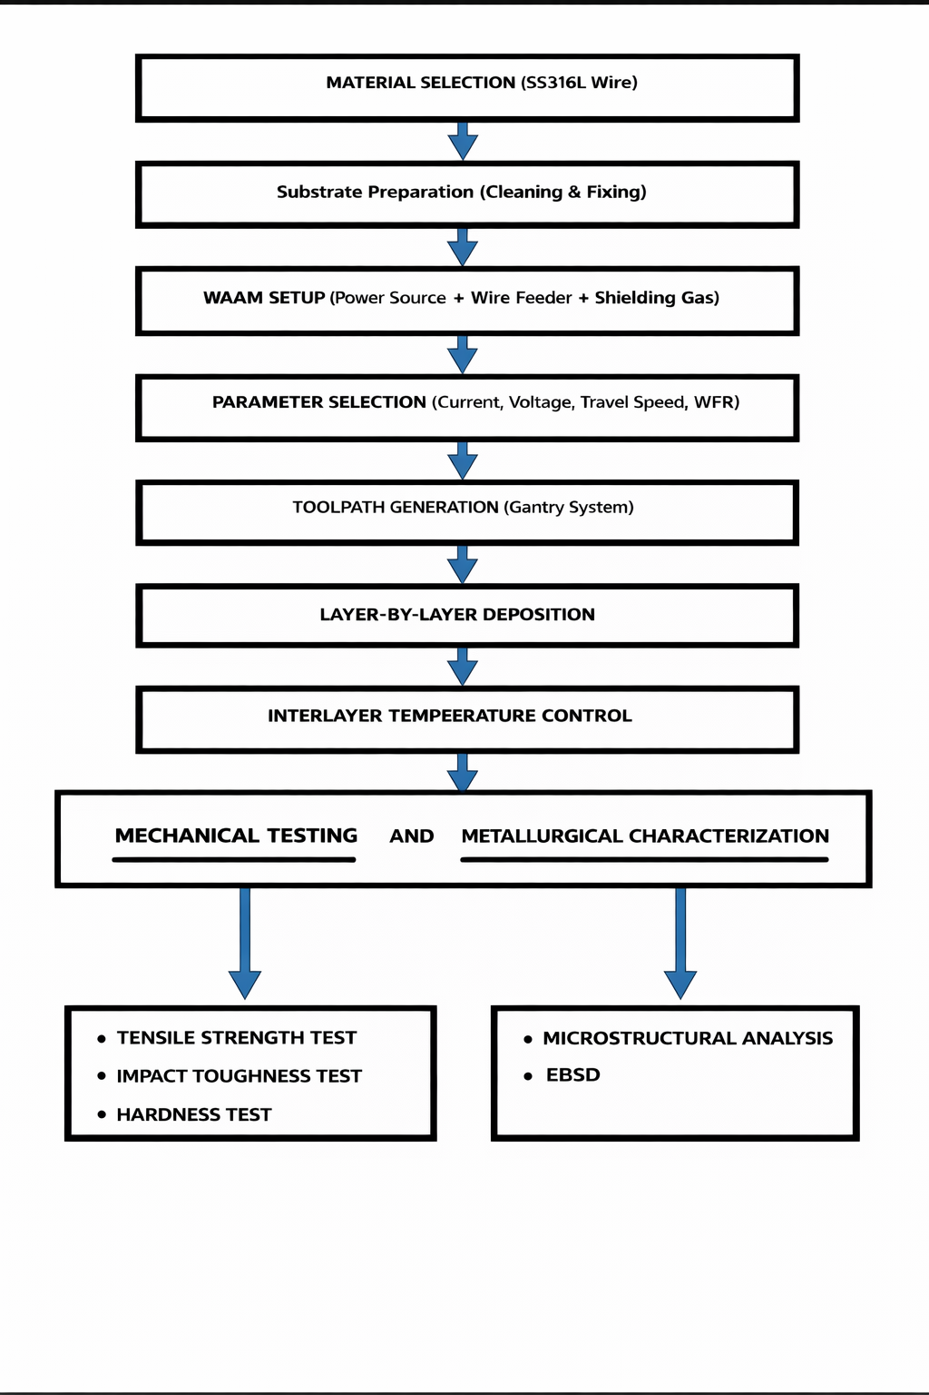
WORK METHODOLOGY

Slide 15
Process Parameters – MIG Based WAAM
Base Material :
Material: Mild Steel (MS) Plate
Thickness: 18mm
Filler Material:
Material: Stainless Steel 316L (SS316L)
Wire Diameter: 1.2 mm
Deposition Layer: 40-41 layers
Welding Parameters:
Parameter | Value
Current | 170 A
Voltage | 27 V
Wire Feed Rate | 11.5 m/min
Travel Speed | 300 mm/min
Shielding Gas | 100% Argon
Gas Flow Rate | 10 L/min

Slide 16
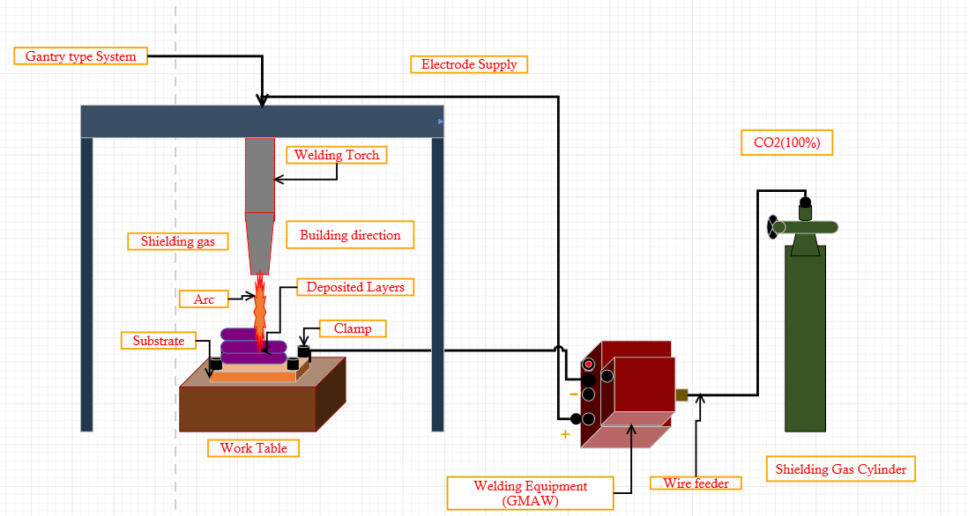
Schematic Representation of WAAM

Slide 17
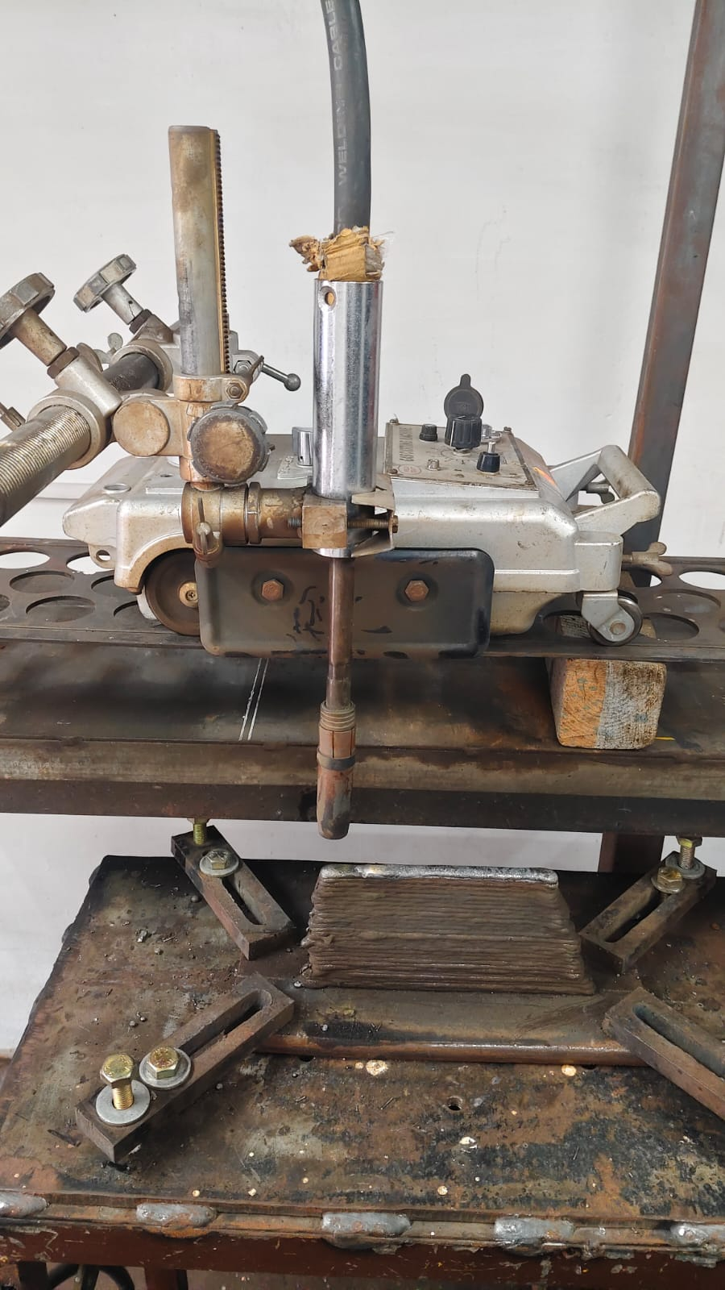
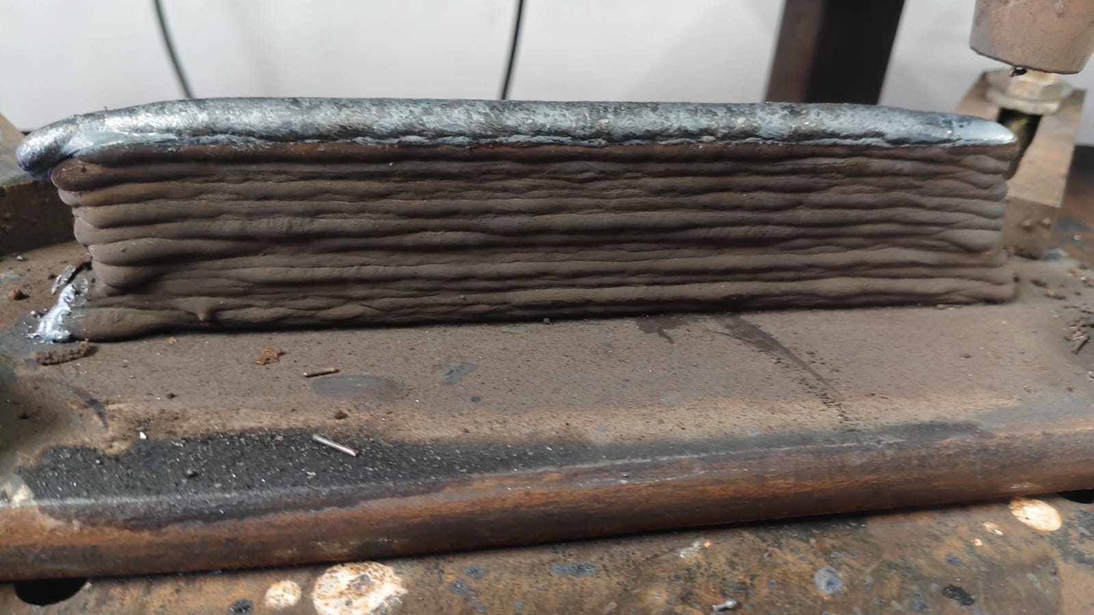
Sample preparation

Slide 18
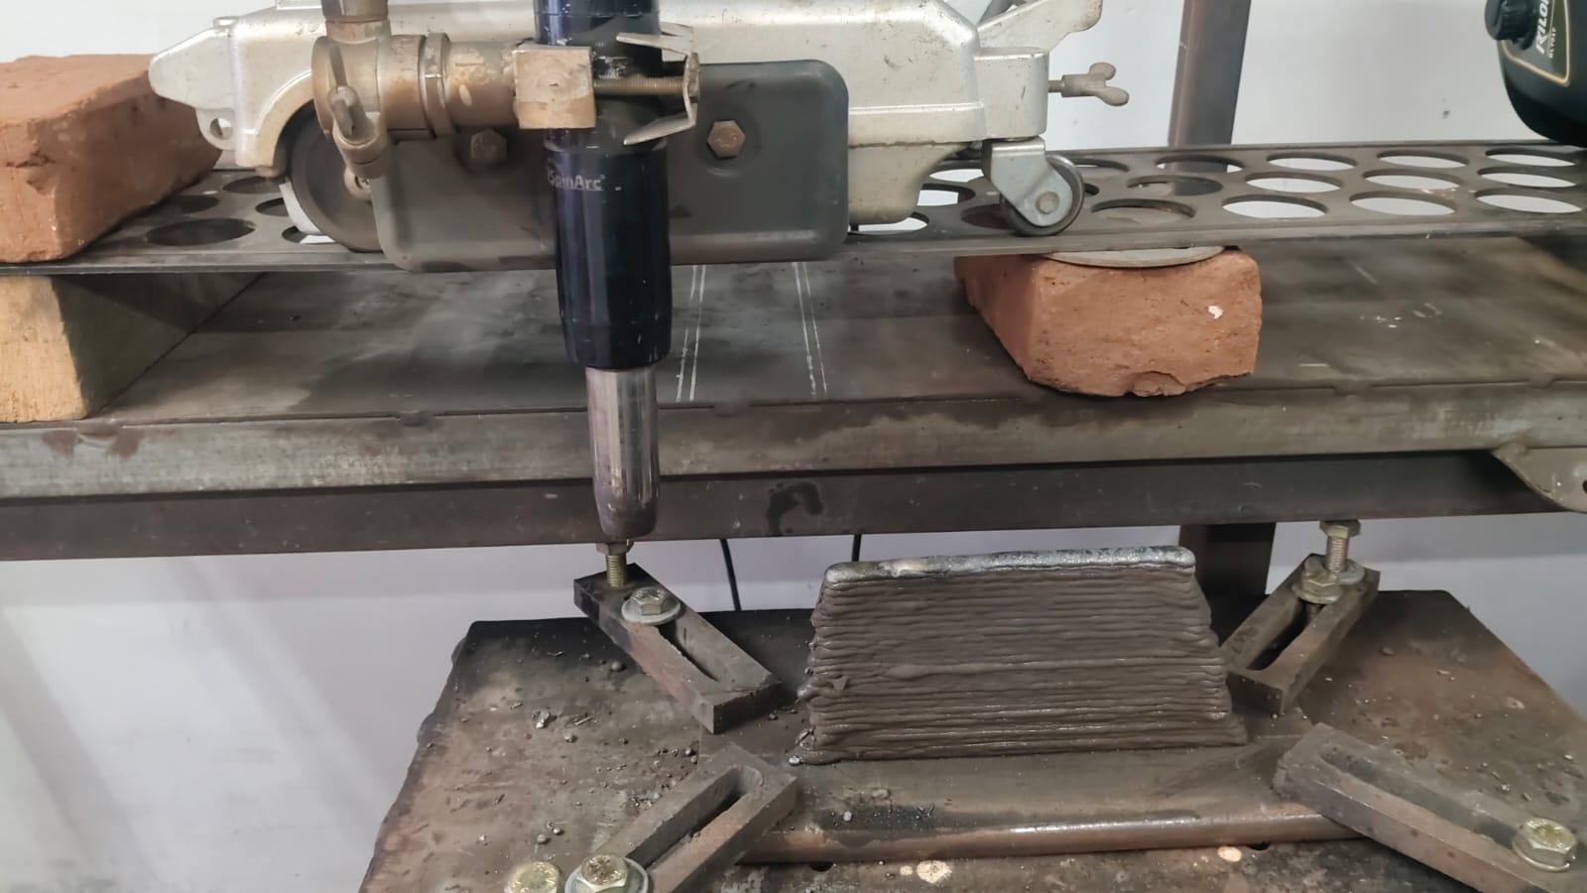
Sample preparation

Slide 19
Works to be carried out
Mechanical Testing
Tensile strength test
Impact toughness test
Hardness test
Metallurgical Characterization
Microstructure analysis
EBSD

Slide 20
REFERENCES
Ugur Gürol, Engin Kocaman, Savaş Dilibal, Mustafa Koçak. A comparative study on the microstructure, mechanical properties, wear and corrosion behaviors of SS 316 austenitic stainless steels manufactured by casting and WAAM technologies. Journal of Manufacturing Processes, 2023.
Edouard de Sonis, Sylvain Dépinoy, Pierre-François Giroux, Hicham Maskrot, Pierre Wident, Flore Villaret, Anne-Françoise Gourgues-Lorenzon. Impact toughness at room and cryogenic temperatures of 316L stainless steel processed by wire arc additive manufacturing. Materials Science and Engineering A, 2025.
Pushkal Badoniya, Manu Srivastava, Prashant K. Jain. Tailoring microstructure for enhanced mechanical and wear performance of wire arc additively manufactured SS 316L: Role of interlayer cooling time. Materials Today Communications, Volume 46, 112612, 2025.
Hongwei Ding,Ming chuan Li, Hongyuan Wen, Yihua Shao, Jinhan Chen,Jianlong Feng, Shuai Chang, Liqun Li (2025).Research on microstructure and mechanical properties of 316L stainless steel fabricated by coaxial electron beam wire feeding additive manufacturing.Materials Letters, Volume 399, Article 138945.Published by Elsevier.

Slide 21
Lucas Lauriano da Silva, Demostenes Ferreira Filho (2025).Mechanical properties and corrosion resistance of a component manufactured by Wire Arc Additive Manufacturing.Procedia Computer Science, Volume 253,Published by Elsevier.
Fei Yang, Canhui Wu, Ruifeng Li, Feng Fang, Liming Dong, Wei Xiong,Hyoung Seop Kim, Wenyi Huo (2025).Wire arc additive manufacturing of dissimilar alloys: Processing strategies and interfacial phenomena.Journal of Manufacturing Processes, Volume 156, Published by The Society of Manufacturing Engineers (Elsevier).
T.S. Senthil,S. Ramesh Babu,M. Puviyarasan, V. Sai Balachandar. Experimental investigations on the multi-layered SS316L wall fabricated by CMT-based WAAM: Mechanical and microstructural studies. Journal of Alloys and Metallurgical Systems, 2023.
A. Singh, X., Y., Z. et al. Influence of process parameters on microstructure and mechanical behavior of WAAM stainless steel. Defect and Diffusion Forum, 2025
Bunty Tomar, S. Shiva. Microstructural and mechanical properties examination of SS316L–Cu functionally graded material fabricated by wire arc additive manufacturing. CIRP Journal of Manufacturing Science and Technology, 2024.
Sasikumar C and R. Oyyaravelu. Mechanical properties and microstructure of SS 316L created by WAAM based on GMAW. Materials Today Communications, vol. 38, Article 107807,2024.

Slide 22


