Slide 1

DEEP LEARNING + NLP PROJECT
Detection of Manipulative
Behavior in Text-Based
Conversations
RESHMA S NATH
Notes:
1

Slide 2
01
Introduction
🌐 Context
⚠️ Problem
Psychological manipulation in digital conversations is rising rapidly with social media, messaging apps, and online relationships.
Manual detection of manipulative language is subjective and unscalable. Automated NLP-based solutions are urgently needed.
🤖 Solution
🎯 Objective
A deep learning model using LSTM with dual outputs — binary detection + technique classification — trained on real conversation data.
Build an end-to-end pipeline from raw text conversations to live prediction via a Gradio UI interface.
Notes:
2

Slide 3
02
Relevance in Today's World
4.9B
60%+
$10B+
Social media users globally
exposed to online manipulation
of domestic abuse cases
involve psychological manipulation
Lost to online scams using
manipulative language annually
💬
Online grooming, scams, and emotional abuse increasingly use subtle text-based manipulation that's hard to detect manually.
🛡️
Mental health platforms and content moderators need AI tools to flag manipulative conversations in real time.
🔍
NLP advances now allow fine-grained classification of manipulation types — enabling more targeted interventions.
📱
With billions of daily messages, automated detection is essential for digital safety at scale.
Notes:
3

Slide 4
03
Dataset Overview
Dataset Columns
10,000
Conversations
Column | Description
conversation_id | Unique ID for each conversation
manipulation_type | Type of manipulation technique used
is_manipulation | Binary label — TRUE / FALSE
context_type | Relationship context (friend/family/etc.)
conversation_length | Number of messages in conversation
manipulation_intensity | Float score 0–1 indicating intensity
messages | JSON array of speaker turns with sentiment
question_count | Number of questions asked in chat
7
Manipulation Types
4
Context Types
80/20
Train/Test Split
Notes:
4

Slide 5
04
Manipulation Techniques in Dataset
😔 Guilt Tripping
🌀 Gaslighting
✨ Charm & Flattery
Making someone feel responsible for the manipulator's emotions to force compliance.
Causing the victim to question their own perception, memory, or sanity.
Excessive praise or compliments to lower defenses and gain compliance.
💣 Love Bombing
⚡ Direct Coercion
🎭 Passive Aggression
Overwhelming someone with affection to create dependency and control.
Explicit threats or demands to force behavior through fear or pressure.
Indirect hostility — sarcasm, silent treatment, veiled insults.
✅ Neutral (Control)
Non-manipulative conversations used as the negative class baseline.
Notes:
5

Slide 6
05
Project Pipeline — Data to Model
01
Load Dataset
02
EDA
03
Label Encoding
pandas read_csv
10,000 rows, 8 columns
Distribution plots, class
balance check, histograms
LabelEncoder on
manipulation_type column
04
Train-Test Split
05
Tokenization
06
Class Weighting
80/20 stratified split
random_state=42
Keras Tokenizer
num_words=5000, maxlen=100
compute_class_weight
to handle class imbalance
Notes:
6

Slide 7
06
LSTM Model Architecture
INPUT LAYER
EMBEDDING
LSTM LAYER
shape: (100,)
5000 vocab / 64-dim
64 units
TYPE OUTPUT
BINARY OUTPUT
Dense(7, softmax)
Manipulation Type Class
Dense(1, sigmoid)
Manipulation: YES / NO
Optimizer: Adam | Loss: binary_crossentropy + sparse_categorical_crossentropy | Metrics: Accuracy | Epochs: 3 | Batch: 32
Notes:
7

Slide 8
07
Model Training & Evaluation
Training Configuration
Model Outputs
Train Size
8,000 (80%)
BINARY
DETECTION
Sigmoid output → Probability
Threshold 0.5 → YES / NO
Test Size
2,000 (20%)
Stratified
Yes (by is_manipulation)
Class Weighting
compute_class_weight balanced
TYPE
CLASSIFICATION
Softmax over 6 classes
Argmax → Technique Label
Validation Split
20% of training set
Epochs
3
DUAL-HEAD
SHARED LSTM
Single model, two tasks
Joint loss optimization
Batch Size
32
Max Sequence Length
100 tokens
Notes:
8

Slide 9
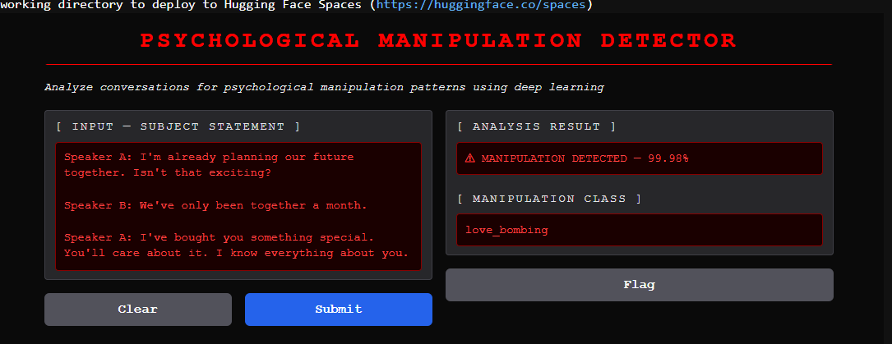
08
Gradio — Live Detection Interface
Notes:
9

Slide 10
09
Conclusion
🧠 DEEP LEARNING FOR NLP
LSTM-based architecture successfully handles sequential text data for psychological manipulation detection.
🎯 DUAL-OUTPUT DESIGN
The multi-head model simultaneously performs binary detection and 6-class technique classification from shared features.
📊 REAL-WORLD DATASET
10,000 labelled conversations spanning 4 context types and 6 manipulation techniques provide a robust training base.
💻 LIVE DEPLOYMENT
Gradio interface makes the model accessible without any coding knowledge — ready for real-time conversation analysis.
🚀 FUTURE SCOPE
Using larger datasets, multi-lingual support, and real-time API integration.
Notes:
10

Slide 11
10
References
[1] Hochreiter, S. & Schmidhuber, J. (1997). Long Short-Term Memory. Neural Computation, 9(8), 1735–1780.
[2] Abreu, A. (2023). Psychological Manipulation Detection Dataset. Kaggle. https://www.kaggle.com
[3] Chollet, F. (2015). Keras: Deep Learning for humans. https://keras.io
[4] Gradio Team (2023). Gradio: Build & Share Delightful Machine Learning Apps. https://gradio.app
Reshma S Nath | Deep Learning + NLP Project | Detection of Manipulative Behavior in Text-Based Conversations
Notes:
11

Slide 12
Thank You.
Reshma S Nath | Deep Learning + NLP Project | Detection of Manipulative Behavior in Text-Based Conversations
Notes:
1

