Slide 1
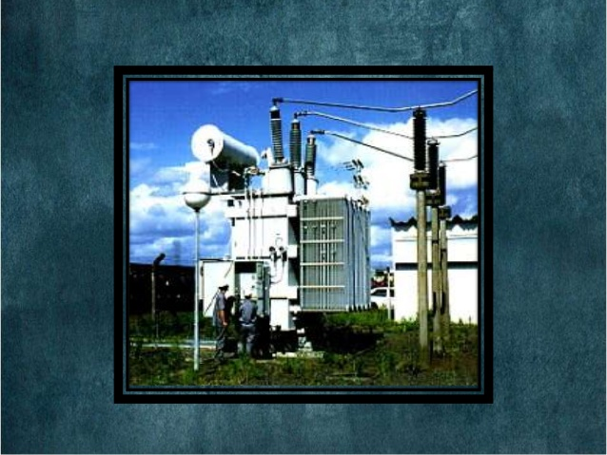
COMPUTER AIDED DESIGN OF TRANSFORMER
Guided by

Slide 2
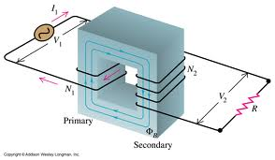
TEAM MEMBERS
Reshma Subramaniam
Rajkamal Rajan
Rashid C.S
Akif Javad

Slide 3
INTRODUCTION
Our goal is to design the transformer that would suit to specification as well as would be economical
Manual design is time consuming, needs more man power & accuracy level may be lower
Hence we introduce a user friendly C++ program to design transformer with given specifications and provide the most accurate output.

Slide 4
DESIGN PROCEDURE
CORE DESIGN
WINDOW DIAMENSION DESIGN
YOKE DESIGN
OVERALL DESIGN
LOW VOLTAGE WINDING DESIGN
HIGH VOLTAGE WINDING DESIGN
RESISTANCE CALCULATION
LEAKAGE REACTANCE CALCULATION
LOSS CALCULATION
EFFICIENCY CALCULATION

Slide 5
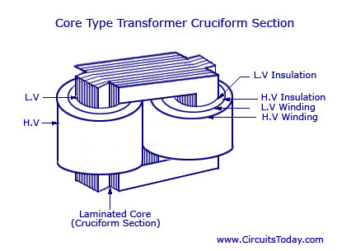
CORE DESIGN
Enter kVA rating of transformer & value of K. From this, voltage per turn is calculated.
Enter frequency & no: of phases. Flux in core is estimated.
Further user is asked to enter the value of flux density from which Net iron area is calculated.
Then, gross iron area is calculated from entered value of stacking factor.
Now according to the type of core, the dimension of core is calculated.

Slide 6
WINDOW DIMENSION OF TRASNSFORMER
Enter primary winding voltage, Flux density, Current density.
According to kVA rating, window space factor is decided. Then user is asked to enter modified window space factor.
Window area is calculated. Enter ratio of height to width of window. From this, width and height of window is calculated.
Enter modified height and width of window.
Distance between adjacent cores is further calculated.

Slide 7
YOKE DESIGN
Area of yoke is 15-25% larger than the core.
Enter ratio – area of yoke to limbs
Flux density, area and gross area of yoke is calculated.
Enter depth of yoke
Height of yoke is calculated.

Slide 8
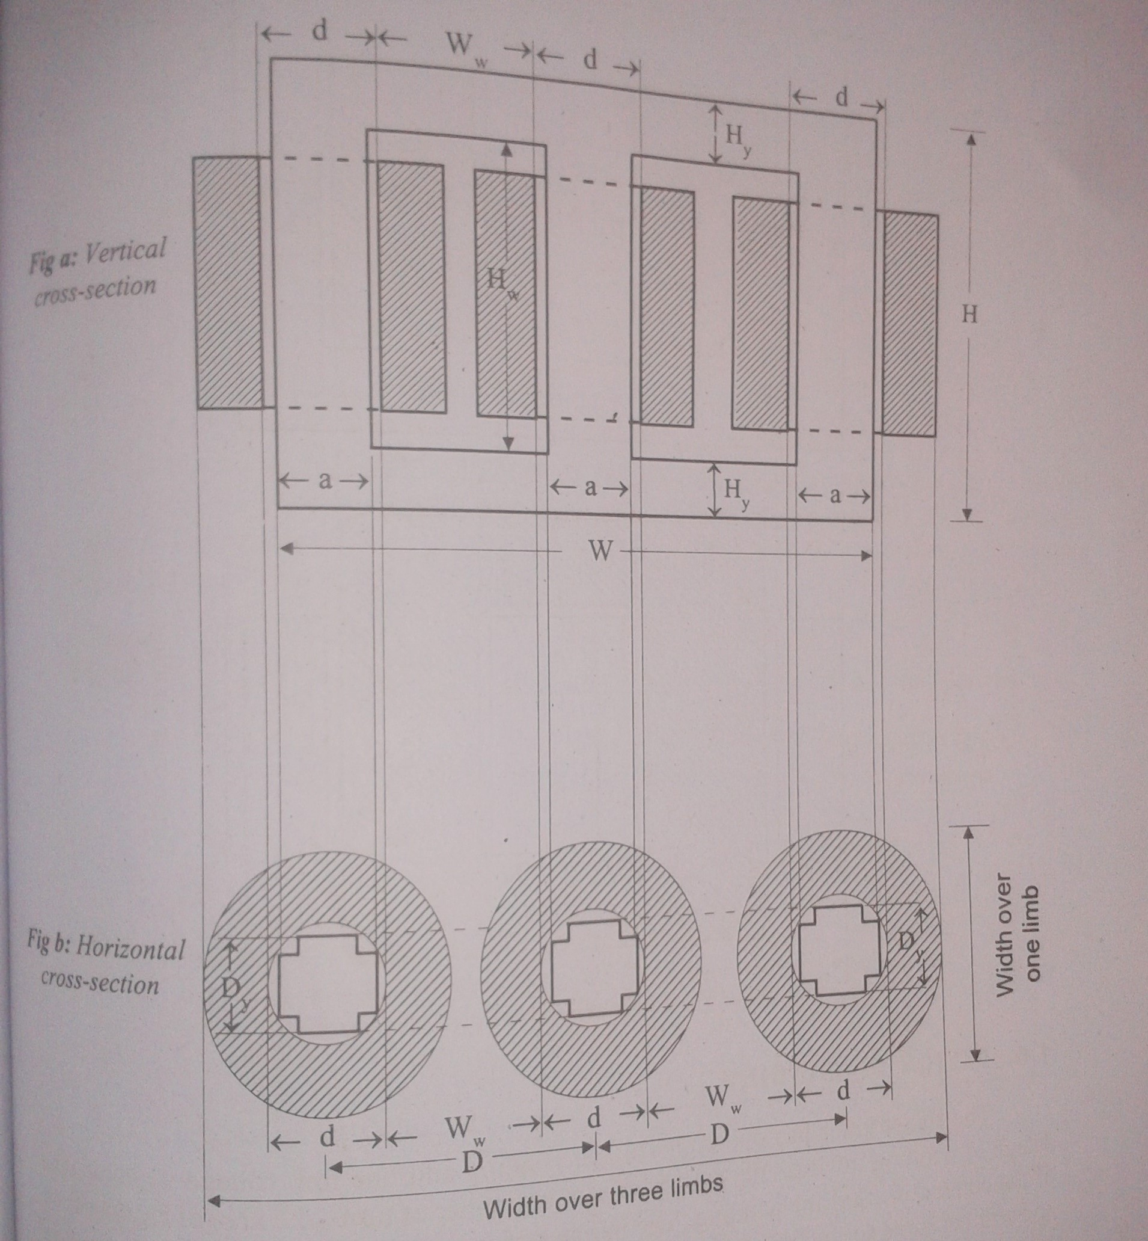
OVERALL DIAMENSION

Slide 9
Distance b/w adjacent core centers D= d+Ww
Height of frame H=Hw+2*Hy
Width of frame W=2*D+Dy
Depth of frame Df=Dy

Slide 10
LOW VOLTAGE WINDING DESIGN
Enter secondary line voltage and mention the connection type – star or delta according to which phase voltage is calculated.
Turns per phase and secondary phase current is calculated
Enter current density of secondary phase. Area of secondary conductor is estimated.
Area of each conductor is calculated from number of strips

Slide 11
Enter the dimension of proper conductor according to IS:1897-1962
Modify area and current density in conductor
Enter proper value of covering from which dimension with covering is found
Enter number of layers to be used
Turns along axial depth and axial depth of LV winding is calculated
Clearance is calculated and if it is > 6, proceed. Else, recalculate

Slide 12
Enter thickness of press board cylinder & radial depth of LV winding is calculated.
Enter insulation for circumscribing circle & insulation b/w LV winding and core
Diameter of circumscribing circle is calculated
Inside diameter is estimated
Outside diameter is estimated.

Slide 13
HIGH VOLTAGE WINDING DESIGN
Enter primary line voltage along with connection type star or delta. Calculate phase voltage and primary turn per phase
Decide whether there is any tapping or not
Enter voltage per coil. Number of coils is found. Enter new value of no of cores > calculated value. From this modified value of voltage per coil is calculated
Turns per coil is also found out.
Enter number & turns of normal coil
Total custom turns is calculated
From number of layers, turns per layer is calculated.

Slide 14
Primary current per phase is calculated
Enter current density in primary conductor
Area of primary conductor is calculated
Enter type of conductor- round / rectangular form which modified area of primary conductor is calculated
Modified current density of primary conductor is estimated
Axial depth, axial length, clearance is calculated
From the thickness of insulation b/w layers, radial depth, thickness if insulation b/w LV & HV, inside & outside diameter of HV is calculated

Slide 15
RESISTANCE DESIGN
Enter resistivity of material of HV and LV winding(0.021 is default)
Resistance of LV and HV side is calculated
Resistance referred to primary side is also found out
Finally, per unit resistance is evaluated

Slide 16
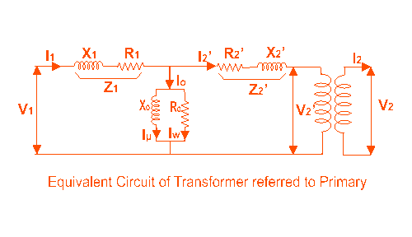
LEAKAGE REACTANCE DESIGN
Mean diameter and length of mean turn of winding is evaluated
Leakage reactance referred to primary side is calculated
Per unit leakage reactance is calculated
Per unit impedance
is calculated

Slide 17
CALCULATION OF LOSSES
Copper loss=I²R is calculated first
Enter % of stray loss
Enter density of lamination and no of limbs
Weight of limb is calculated
Enter specific core loss according to flux density in limbs as well as in yokes
Core loss in limbs & yokes are calculated
Total loss is evaluated

Slide 18
EFFICIENCY OF TRANSFORMER
Total loss is calculated
Efficiency=output/(output+loss)
Also condition for maximum efficiency is calculated.

Slide 19


Slide 20
INPUT
kVA rating: 100 kVA
Frequency: 50Hz
Connection: Delta/Star
Line voltage: HV: 11 kV
LV: 433 kV
Line current: HV: 25 A
LV: 133.33 A
Phase: 3

Slide 21
Type: core
Phase voltage HV: 11 kV
LV: 250 kV
Phase current HV: 3.03 A
LV: 133.33 A
Bm 1.2 Wb/m^2

Slide 22
OUTPUT
Output constant K: .45
Per turn voltage Et: 4.5 V
Diameter of circ- dia: 0.167m
umscrbing circle
Dimensions: al: .15m
bl: .07m
Net iron area: Ai: .0167 m²

Slide 23
Flux Fm .02 wb
Weight 143.6 Kg
Total iron loss .5459 w
Window no 2
Window space factor .195
Height of window .124 m
Width of window .164 m
Window area .0165 m²

Slide 24
Height of frame: .6252 m
Width of frame: .812 m
Distance b/w 2 core centre .331 m
Area of conductor 60.6mm ²
Turns per phase 56
No of layers 2
Radial depth of HV winding: 1.06cm
Axial length of HV winding: 36.25 cm
Insulation b/w layers: 1 mm

Slide 25
Coil inside diameter: 17cm
Coil outside diameter: 19.06 cm
Length of mean turn: 56.7 m
Resistance 30.776 Ω
P.U resistance .0413 Ω
P.U reactance .05196 Ω
P.U impedance .0539 Ω
Insulation b/w LV winding to core: 1 mm
“ “ “ HV: 5 mm

Slide 26
Total core loss 262.29 W
Total copper loss 1577.4 W
Total full load loss 1839.69 W
Efficiency 98%

Slide 27


