Slide 1

Predicting Loan Default
A story in four parts: the problem, the clues, the solution, and putting it to work
Presented by Reshma
NTUC Associate Data Analyst Capstone · Finance track (PKDD bank data, 8 linked tables)
Notes:
SAY (about 30 seconds):
Good morning everyone. My name is Reshma, and my capstone project is about predicting loan default, which means predicting whether a borrower will fail to repay a loan.
I used real data from a Czech bank, given to us as eight linked files.
In the next 15 minutes I will cover the problem, how I cleaned and joined the data, the model I built, how well it works, and how a bank could use it.
TIP: Speak slowly. Smile. You know this project better than anyone in the room.

Slide 2





The story in four parts
PART 1 · THE PROBLEM
PART 1
PART 2
PART 3
PART 4
The problem
The clues
The solution
Putting it to work
Some borrowers don't repay. Can we spot them before saying yes?
8 files of the bank's own data: accounts, transactions, people, districts
A model that gives every application a risk score
An app the bank can use, kept healthy with monthly checks
Our main character: a credit officer with a 100,000 CZK loan application on the desk. Approve or decline?
Notes:
SAY (about 30 seconds):
I'll tell this project as a story in four parts.
Part 1, the problem: some borrowers don't repay, and the bank wants to spot them before saying yes.
Part 2, the clues: the bank's own data, eight files about accounts, transactions, people and districts.
Part 3, the solution: a model that gives every loan application a risk score.
Part 4, putting it to work: an app the bank can actually use, and how to keep it working.
Our main character is a credit officer with a 100,000 CZK loan application on the desk. By the end, we'll help them decide.

Slide 3


Every loan is a bet
PART 1 · THE PROBLEM
The problem
The goal
Why this project
Banks lose money when borrowers don't repay their loans.
Predict, before a loan is approved, whether the borrower is likely to default.
To predict credit risk is one of the most common uses of Predictive data analytics in banking, with clear business value.
1 in 9
682
Full journey
loans in this bank defaulted
past loans, 8 data tables
data → model → live app
Notes:
STORY: Imagine our credit officer. A customer wants 100,000 CZK. Say yes to a good customer and the bank earns interest; say yes to the wrong one and the bank loses money.
SAY (about 45 seconds):
Banks lend money every day, and some borrowers do not pay it back. In this bank, about one in nine loans went bad.
My goal: look at a loan application and the customer's bank account history, and predict before approval whether the loan is likely to default.
I chose this project because predicting credit risk is one of the most common uses of predictive analytics in banking, and it let me do the full journey: data, model, and a working app.
IF ASKED "What does default mean here?": a loan with status B (finished but not fully paid) or D (still running but the customer is in debt).

Slide 4
Research objectives
PART 1 · THE PROBLEM
1
Clean and join the data
2
Account behaviour
Clean the 8 tables and combine them into one table, one row per loan.
Is how customers run their account before the loan (balances, income, overdrafts) linked to default?
How: Cleaning log, key checks, row counts
How: Charts and statistical tests
3
Loan terms
4
Customer and region
Are loan amount, length and monthly payment linked to default?
Do age, card ownership and district (salary, unemployment, crime) matter?
How: Default rate by group, tests
How: Chi-square and Mann-Whitney tests
5
Prediction model
6
Drivers and actions
Build and compare 5 models; reach an F1 score of at least 0.50 on unseen loans.
Find the main risk drivers and turn them into recommendations for the bank.
How: Confusion matrix, cross-validation
How: Feature importance, scorecard
Notes:
SAY (about 1 minute):
To solve the problem, I set six research objectives.
One: clean the eight files and join them into one reliable table, with one row per loan.
Two: find out whether account behaviour before the loan, like balances, income and overdrafts, is linked to default.
Three: check whether the loan terms, meaning amount, length and monthly payment, matter.
Four: check whether customer and regional factors, like age, card and district, matter.
Five: build and compare five prediction models, with a target F1 score of at least 0.50 on loans the model has never seen.
Six: find the main risk drivers and turn them into recommendations for the bank.
I'll come back to these at the end and show what I found for each one.
IF ASKED "Why these objectives?": they follow the process in the capstone brief: understand and prepare the data, explore it, build and test a model, then interpret the results and recommend actions.

Slide 5

Why this story matters to me
PART 1 · THE PROBLEM
Moving up the data analytics ladder
Where I'm heading
This project
Analyst roles that use machine learning, e.g. credit risk, fraud or customer analytics in banking and fintech.
Prescriptive
What should we do?
Predictive
What will happen?
Skills this project proves
Diagnostic
Why did it happen?
Python
Data cleaning
Descriptive
What happened?
Machine learning
Model testing
Excel, Power BI dashboards
SQL, statistics
Python, machine learning
Next step
Deployment
Monitoring
Notes:
SAY (about 45 seconds):
Why this kind of project? Data analytics is often shown as a ladder.
Descriptive: what happened. That is the Excel and Power BI dashboards from the course.
Diagnostic: why it happened, using SQL and statistics.
Predictive: what will happen. That is this project, using Python and machine learning.
[PERSONALISE: one sentence about your own background, e.g. "In my previous role I worked with ... and I want to move into ..."]
This project shows the skills employers look for in analyst roles in banking: cleaning data, building and testing a model, and putting it to use.

Slide 6
The evidence: 8 files from one bank
PART 2 · THE CLUES IN THE DATA
File | Rows | One row is… | Used for
Loan.csv | 682 | a loan (status = the target) | Target, loan terms
Account.csv | 4,500 | a bank account | Account age, statement frequency
Transaction.csv | 1,056,320 | an account transaction | Balances, income, overdrafts
Disp.csv | 5,369 | a client's role on an account | Owner, number of users
Client.csv | 5,369 | a customer | Age
Card.csv | 892 | a payment card | Card held before the loan
District.csv | 77 | a region | Salary, unemployment, crime
Order.csv | 6,471 | a standing payment order | Description only (no dates)
8
linked tables
1.06 M
transactions
1993–98
bank history
Notes:
TRANSITION: So that's the problem. Now, where do we find clues? In the bank's own data.
SAY (about 40 seconds):
These are the eight files from the capstone. The Loan file has 682 loans and a status column; that status is what I predict.
The other files describe each loan's bank account, more than one million transactions, the people on the account, their cards, and their district.
The Order file has no dates, so I did not use it in the model. I will explain why on the next slides.
IF ASKED "Why only 682 loans when there are 4,500 accounts?": only 682 accounts took a loan. The other accounts help describe the bank but have no loan outcome to learn from.

Slide 7
Where the 682 loans come from
PART 2 · THE CLUES IN THE DATA
4,500
How all 682 were kept
bank accounts (Account.csv)
Start from the loans: every join adds other files to Loan.csv
Left joins: a loan stays even with no match (no card = 'none')
Check every join: the table stays at 682 rows from start to end
Clean, don't delete: fixes changed values, no loan was removed
682
took a loan, one each (Loan.csv rows)
606
76
good (status A or C)
defaulted (B or D), 11%
The other 3,818 accounts never took a loan, so there is no outcome to learn from.
Split for modelling: 545 loans to learn from (80%) + 137 hidden for the final exam (20%), both 11% defaulters.
Notes:
SAY (about 45 seconds):
Where does the number 682 come from? It is simply the number of rows in the Loan file: every loan the bank gave between 1993 and 1998.
The bank has 4,500 accounts, but only 682 of them ever took a loan, and each took exactly one. Only those loans have a known outcome, so only they can teach the model.
Of the 682, 606 were good, status A or C, and 76 defaulted, status B or D. That is 11 percent.
For modelling I split them: 545 loans to learn from and 137 hidden for the final exam, both keeping the same 11 percent default rate.
And I kept all 682 the whole way: I started every join from the loans, used left joins, checked the row count after every join, and the cleaning fixed values without deleting any loans.
IF ASKED "What about the other 3,818 accounts?": they never took a loan, so there is no answer to learn from. They are still part of the bank's data but not part of the model.

Slide 8
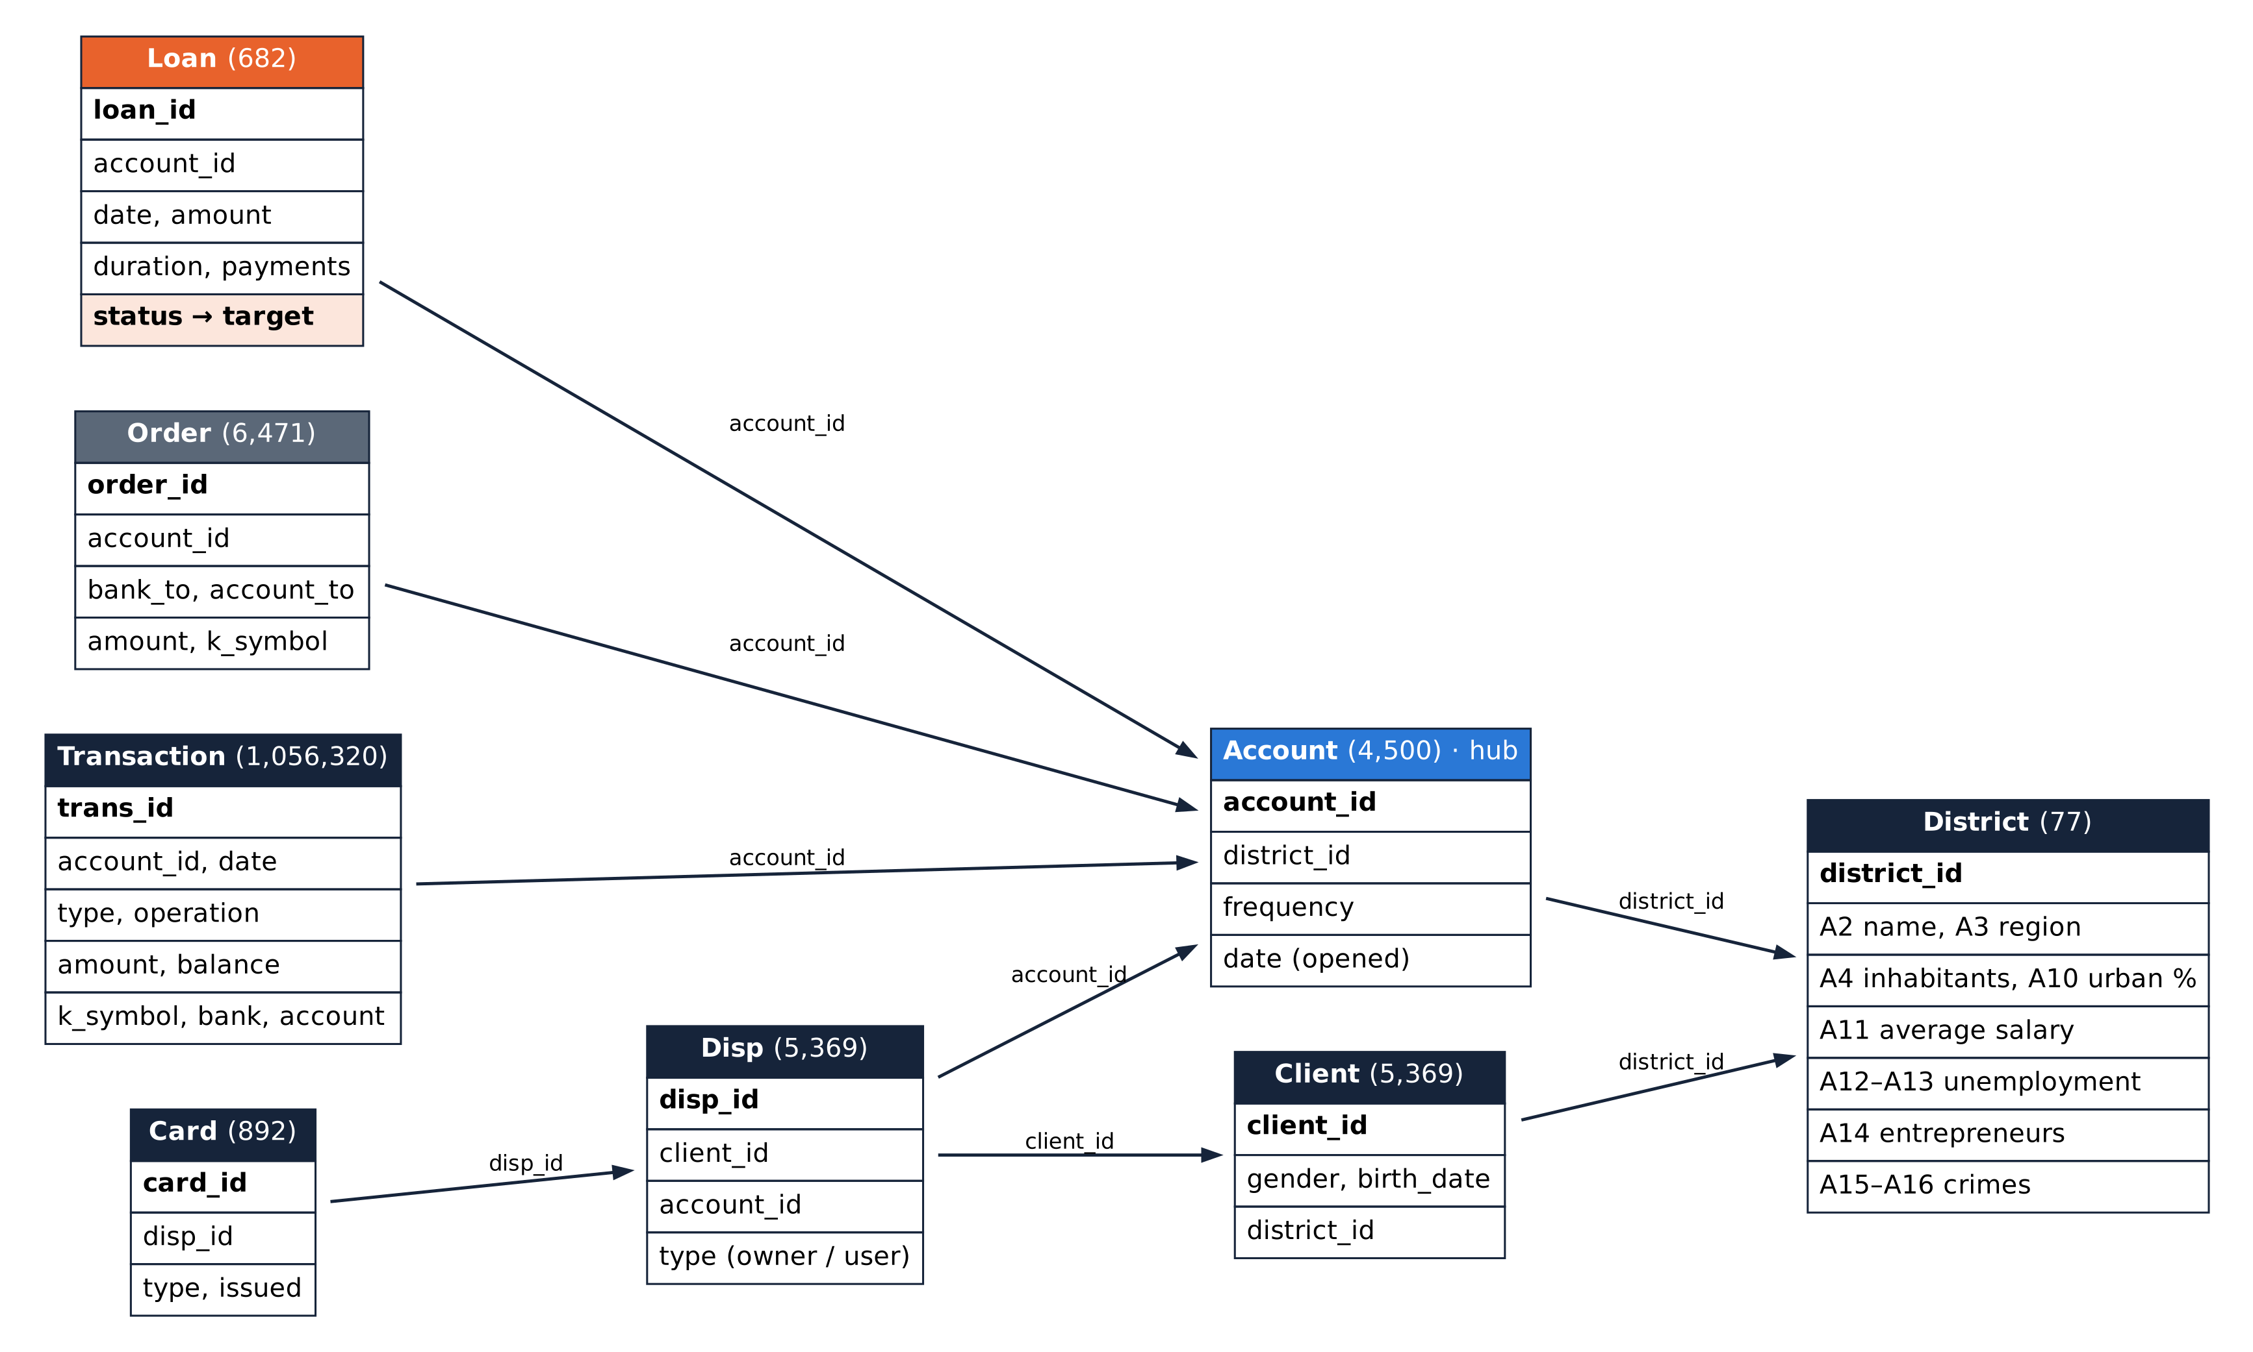
How the 8 files connect
PART 2 · THE CLUES IN THE DATA
How I joined them
Hub: Account (4,500)
Start: the 682 loans, then add the other files one by one
Match on: shared ID columns (account_id, client_id …)
Check: 682 rows in = 682 rows out
Left out: Order (no dates)
Rule: every loan has exactly one account, and every account one owner.
Relationship diagram: 8 files, row counts and join keys (redrawn from the provided diagram)
Notes:
SAY (about 40 seconds):
This diagram shows how the files link together. Account, in blue, is the centre.
Each loan belongs to one account. Each account sits in a district and has transactions and orders.
The Disp file links accounts to people, and says who is the owner and who is an extra user. Cards belong to a person on an account.
Before joining, I checked that every loan has exactly one account and every account has exactly one owner.
IF ASKED "What is a key?": an ID column that appears in two files, like account_id, so we can match the rows up.
IF ASKED "What is Disp?": short for disposition. It says which client can use which account, as owner or user.

Slide 9
Why we join the tables: each file adds a clue
PART 2 · THE CLUES IN THE DATA
The answer is only in Loan.csv. The clues about the customer are in the other files. A model learns from ONE table (one row per loan), so we join every file onto the loan using shared ID columns, like VLOOKUP in Excel.
Loan.csv
Account.csv
Transaction.csv
Disp.csv
start here
Joined on: account_id
Joined on: account_id
Joined on: account_id
The loans and the answer (default or not)
Each bank account
Every money movement (1 million)
Who owns or uses the account
Clue: Amount, length, monthly payment
Clue: Account age, statement frequency
Clue: Balances, income, overdrafts
Clue: Shared or single account
Client.csv
Card.csv
District.csv
Order.csv
Joined on: client_id
Joined on: disp_id
Joined on: district_id
Joined on: account_id
The customer
Cards issued to the customer
Where the account is held
Standing payment orders
Clue: Age on the loan date
Clue: Card held before the loan
Clue: Salary, unemployment, crime
Left out: no dates (leakage risk)
Notes:
SAY (about 1 minute):
Why do we need to join the tables? The answer, whether a loan defaulted, is only in the Loan file. But the Loan file knows very little about the customer: just the amount, the length and the monthly payment.
Everything that tells us what kind of customer this is sits in the other files. Transactions show how they manage their money. Disp shows if the account is shared. Client gives their age. Card shows if they had a card. District describes where they live.
A model can only learn from one table, with one row per loan and all the facts in its columns. So we join each file onto the loan using the shared ID columns, like a VLOOKUP in Excel.
The Order file was left out because it has no dates.
IF ASKED "Why not just use the Loan file?": the model would only see amount and length, and could not tell a careful saver from someone who keeps going overdrawn. The strongest clues came from the joined files.

Slide 10




Tidying the evidence: issues and fixes
PART 2 · THE CLUES IN THE DATA
Codes in Czech
Blank and missing codes
e.g. PRIJEM, VYDAJ, SIPO, POPLATEK MESICNE
Purpose codes were a mix of blanks and empty values (535k rows)
Action: Translated to English: credit, debit, household, monthly
Action: Unified as 'unknown'
Missing district figures
Amounts without a sign
1995 unemployment and crime missing for one district (Jesenik)
Transaction amounts were always positive
Action: Filled with that district's 1996 values
Action: Added + for money in, − for money out
Notes:
SAY (about 40 seconds):
The data had no duplicates and no broken links, but it needed tidying.
Codes were in Czech, so I translated them to English.
Some codes were blank, so I labelled them 'unknown'.
One district was missing its 1995 figures, so I used its 1996 figures.
Transaction amounts were all positive, so I added a minus sign for money going out.
Every change is recorded in a cleaning log in the notebook.

Slide 11
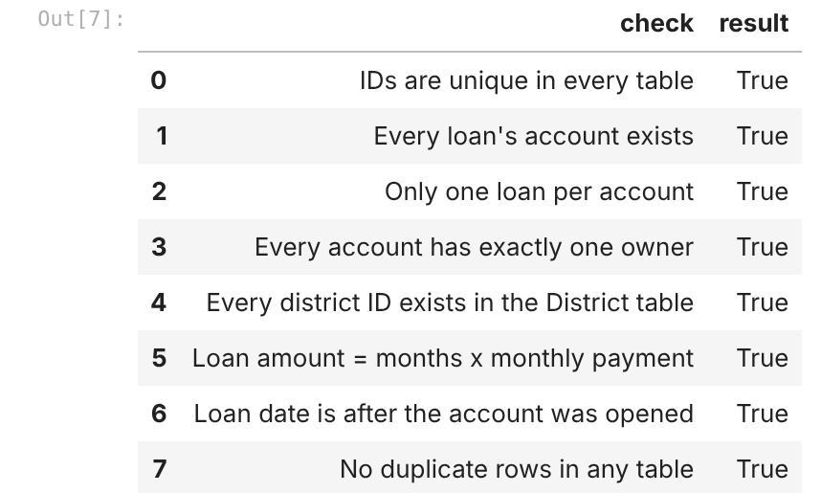
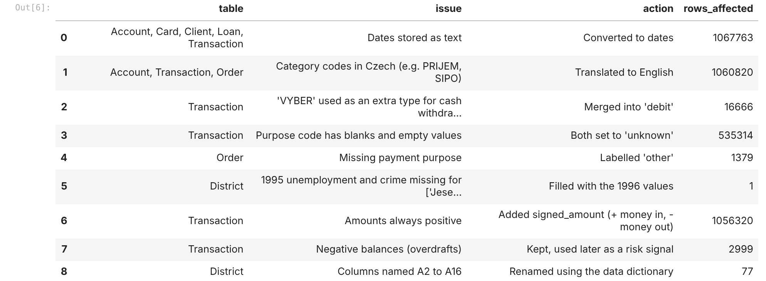
Data cleaning: checks performed
PART 2 · THE CLUES IN THE DATA
Check | How (Python) | Result
Missing values | df.isna().sum() | District, Order, Transaction: fixed
Duplicate rows | df.duplicated() | OK: 0 in all 8 tables
Unique IDs | is_unique | OK: all primary keys
Links between tables | isin() | OK: no orphan records
Data types | df.info() | Dates as text: converted
Loan maths | amount = months × payment | OK: every loan
Date logic | loan after account opened | OK: every loan
Overdrafts | balance < 0 | Kept: real behaviour
Notebook: key and consistency checks
Notebook: cleaning log
Notes:
SAY (about 30 seconds):
These are the checks I ran on every file, each just one or two lines of Python.
No duplicates, every ID unique, no records pointing to something that does not exist, and the loan maths adds up: amount equals months times monthly payment.
I kept negative balances, because overdrafts are real customer behaviour, and they turned out to be the strongest warning sign.
IF ASKED "Why not remove negative balances as outliers?": they are not errors; the bank allows overdrafts, and they carry important information about risk.

Slide 12
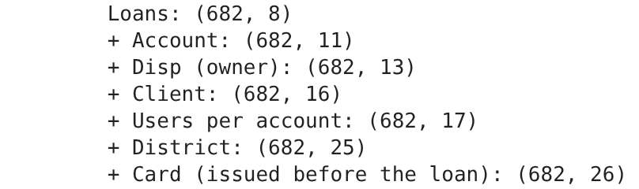

Joining the evidence: 8 tables into one
PART 2 · THE CLUES IN THE DATA
Loan
+ Account
+ Owner (Disp)
+ Client
+ District
+ Card
+ Transactions
682 rows
682 rows
682 rows
682 rows
682 rows
682 rows
682 rows
Only use what the bank knew on the loan date
Transactions: only those before the loan (54,694 of 191,556)
Cards: only those issued before the loan
Orders: left out of the model (no dates)
Notebook: row count checked after every join
Notes:
SAY (about 50 seconds):
To get one table, I started with the 682 loans and added the other files one at a time, checking the row count after each step: always 682.
The transaction file is huge, so for each account I summarised it into a few numbers, such as the average and lowest balance.
The most important rule: only use what the bank knew on the loan date. Using later information is called data leakage; it makes a model look great in testing but fail in real life.
So I kept only the 54,694 transactions made before each loan, only cards issued before the loan, and left the Order file out.

Slide 13
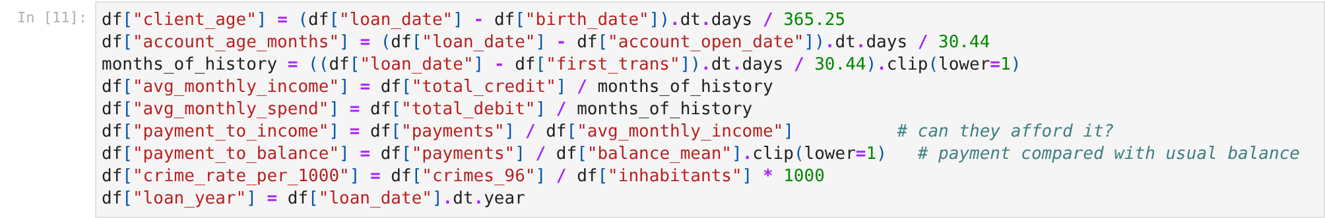
Turning raw data into clues (feature engineering)
PART 2 · THE CLUES IN THE DATA
New column | What it means
balance_mean / min / last | Average, lowest and latest balance before the loan
balance_std | How much the balance jumps around
n_negative_balance | Times the account was overdrawn
n_penalty_interest | Times the bank charged penalty interest
avg_monthly_income | Money coming in per month
payment_to_balance | Monthly loan payment ÷ average balance
client_age | Age of the borrower on the loan date
n_account_users | 1 = sole owner, 2 = shared account
crime_rate, unemployment | District conditions
Notebook: creating the new columns
24 inputs in total. Gender, IDs and the Order table were left out on purpose (fairness and leakage).
Notes:
SAY (about 40 seconds):
Feature engineering means creating useful inputs from raw data.
From each customer's transactions before the loan, I calculated their average, lowest and latest balance, how much the balance jumps around, how many times they went overdrawn, and how often the bank charged penalty interest.
I also created an affordability measure: the monthly payment divided by the average balance.
In total the model uses 24 inputs. I left out gender on purpose for fairness.

Slide 14
The first twist: only 1 in 9 loans defaulted
PART 2 · THE CLUES IN THE DATA
What this shows: every loan has a status code. A and C are good loans; B and D are loans that went bad ("default"). Bars = number of loans.
Why this is a trap
Imagine a lazy model that says "will repay" to all 682 loans.
It is right 606 times: 89% accurate!
But it catches 0 of the 76 bad loans, so it is useless.
So accuracy alone can't be trusted here. I judge the model on:
Recall: how many bad loans it catches
Precision: how many of its warnings are right
F1: the balance of the two (main score)
606 good (A + C), 89%
76 went bad (B + D), 11%
Notes:
SAY (about 40 seconds):
Only 76 of the 682 loans defaulted, about 11 percent.
This creates a trap. A lazy model that always says 'this person will repay' would be 89 percent accurate, but it would catch zero defaulters.
So accuracy alone is misleading here. Instead I use the confusion matrix and the scores we learned in the course: recall, precision and the F1 score.

Slide 15
The big clue: how customers run their account
PART 2 · THE CLUES IN THE DATA
The question: does the way a customer runs their bank account before the loan predict who will default? How to read: each bar = % of loans in that group that went bad. Overall: 11% (1 in 9).
Balance went below zero before the loan: all 27 of these loans went bad.
Bank charged a penalty before the loan: 26 of 29 went bad.
Payment too big for the balance: 23% went bad vs 3% when it was small (8× more).
Shared account (2 people): none of 145 went bad. Single owner: 14%.
So: customers who struggle to keep money in their account struggle to repay a loan. These are the clues the model learns from.
Notes:
SAY (about 50 seconds):
This is my most important finding from exploring the data.
All 27 accounts that went overdrawn before the loan later defaulted, compared with 7.5 percent of the others. The group is small, but the signal is very clear.
Penalty interest tells the same story.
When the monthly payment was large compared with the usual balance, 23 percent defaulted, against 3 percent for the most comfortable customers.
And accounts shared by two people never defaulted.
Statistical tests confirmed 11 inputs are clearly linked to default; region and card type are not.

Slide 16





Building the solution in 6 steps
PART 3 · THE SOLUTION
Split
Prepare
5 models
Practise
Tune
Final exam
Hide 137 loans (20%) for the final exam; learn from the other 545
Turn text into numbers and put all numbers on a similar scale
From a simple guess up to a forest of decision trees
5 practice rounds (cross-validation); a missed defaulter counts extra
Try 12 settings for the best model, keep the one with the best score
Score the 137 hidden loans once, at the very end
Inputs: 24 facts about each loan and its account. Fair test: the hidden loans are never used for learning or tuning.
Notes:
SAY (about 45 seconds):
Here is how I built and tested the models, in six steps.
First I hid 20 percent of the loans, 137 of them, as the final exam.
Then I prepared the data: turning text like card type into numbers.
I compared five models, from a simple guess up to a forest of trees.
Each one did five practice rounds on the training loans, and I told the models that missing a defaulter is worse than a false alarm.
I tried 12 settings for the best model and kept the one with the best F1 score.
Finally, I scored the hidden loans once, at the very end.
IF ASKED "What is stratified?": both parts keep the same 11 percent default rate.
IF ASKED "What are class weights?": a way of telling the model that defaulters are rare and important, so mistakes on them count more.

Slide 17

How the model decides, in plain words
PART 3 · THE SOLUTION
One decision tree (simplified example)
A forest = 250 trees
Overdrawn before the loan?
Each tree learns from a random sample of loans and facts
Each tree votes: repay or default
Share of votes = the risk score
e.g. 200 of 250 trees say default → 80% risk
Yes
No
High risk
Payment large vs balance?
Yes
No
Medium risk
Low risk
Like asking 250 credit officers and going with the majority.
The real trees ask many more questions, learned from the 545 training loans.
Notes:
SAY (about 40 seconds):
How does the chosen model, the Random Forest, actually decide?
On the left is one decision tree, simplified. It asks yes or no questions: was the account overdrawn before the loan? If yes, high risk. If no, is the payment large compared with the balance? And so on.
A Random Forest builds 250 such trees, each from a slightly different sample of loans. Each tree votes, and the share of votes becomes the risk score. If 200 of 250 trees say default, the risk is 80 percent.
It is like asking 250 credit officers and going with the majority.
IF ASKED "Why many trees instead of one?": one tree can be fooled by a few unusual loans; averaging many trees is more stable and more accurate.

Slide 18
Comparing the 5 models: two pass the F1 mark
PART 3 · THE SOLUTION
Model | Accuracy | Precision | Recall
Baseline | 89% | 0% | 0%
Logistic Reg. | 81% | 35% | 72%
Decision Tree | 77% | 28% | 59%
Random Forest | 91% | 61% | 51%
Gradient Boost. | 92% | 77% | 41%
Random Forest has the best F1. Logistic Regression catches more defaulters but raises many false alarms. After tuning, the Random Forest was tested on the hidden loans.
F1 = 2 × Precision × Recall ÷ (Precision + Recall)
Accuracy says the lazy model is 89% good. F1 says it's useless, because F1 only looks at what happens with the bad loans.
Notes:
SAY (about 40 seconds):
This compares the five models on the five practice rounds, using the F1 score.
The baseline, which always guesses 'repay', scores 0 because it never catches anyone.
The decision tree reaches 0.36 and Logistic Regression 0.46. Gradient Boosting reaches 0.53 and Random Forest 0.54: these two pass my 0.50 mark.
The table shows why: Logistic Regression catches the most defaulters, 72 percent, but only 35 percent of its flags are right, so it raises many false alarms.
I tuned the Random Forest and took it to the final exam.
IF ASKED "Why not Logistic Regression, since it catches more defaulters?": it flags too many good customers. The forest is the better balance, and I keep Logistic Regression as the easy-to-explain scorecard.

Slide 19
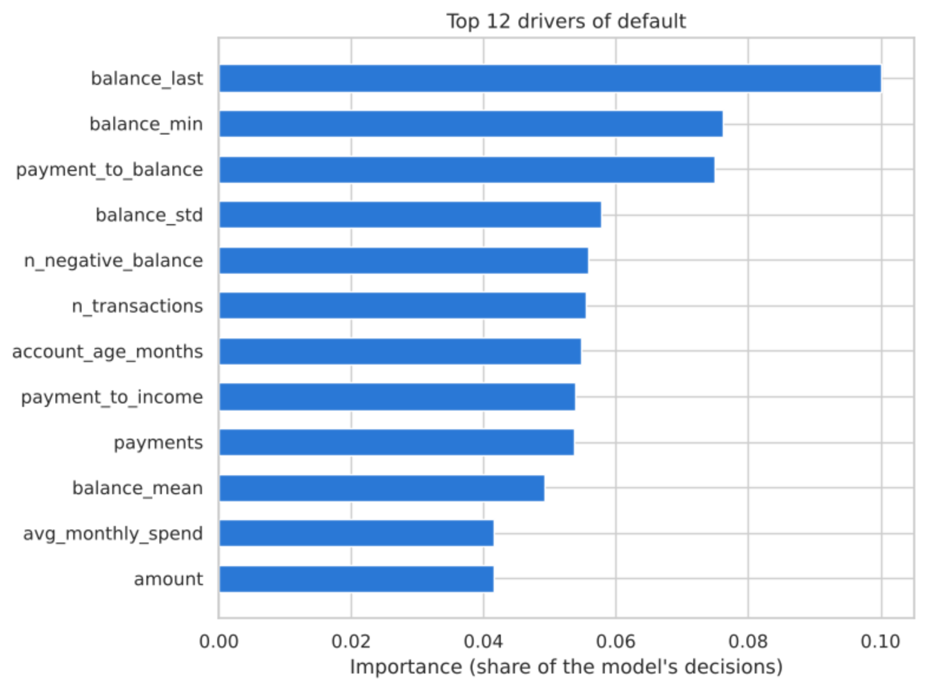
What drives default: account behaviour
PART 3 · THE SOLUTION
Top risk signals
Low latest balance before the loan
Low lowest balance
Payment large versus balance
Balance that jumps around
Times overdrawn
Region, salary and age matter far less.
How much each input helps the model's decisions (feature importance)
Notes:
SAY (about 35 seconds):
Which inputs matter most to the forest? The Random Forest reports how much each input helped its trees tell defaulters from good borrowers. That is called feature importance.
The top inputs are all about account behaviour: the latest and lowest balance before the loan, the payment compared with the balance, how much the balance jumps around, and overdrafts.
District, salary and age matter much less. This matches what I found when exploring the data, which gives me confidence.

Slide 20





From notebook to bank tool: deployment
PART 4 · PUTTING IT TO WORK
Trained model
Saved file
Scoring function
Batch report
Web app + API
tuned forest
1.9 MB
applicant in, risk out
CSV for Excel / Power BI
for staff and other systems
Risk bands on the test loans
Ready for a pilot
Band | Loans | Defaulted
Low | 112 | 1%
Medium | 16 | 31%
High | 9 | 100%
Pass mark F1 0.50; the model scores 0.77. Start with a credit officer reviewing every High and Medium flag.
Notes:
TRANSITION: We have a solution that works. But a model in a notebook doesn't help anyone. Part 4: putting it to work.
SAY (about 45 seconds):
Deployment means turning the model into something people can use.
I saved the trained model as a small file and wrapped it in a function: put in an applicant's details, get back their risk.
It can be used in three ways: a batch report that Excel or Power BI can open, a web app for staff, and an API so other bank systems can ask for a score.
The risk bands work well: on the test loans, all 9 High-risk loans defaulted, against 1 percent of Low-risk loans.
My quality bar was an F1 of 0.50; the model scores 0.77, so I recommend a pilot, with a credit officer reviewing every High and Medium flag.
IF ASKED "What is an API?": a way for one computer system to ask another for an answer automatically, without a person typing anything.

Slide 21
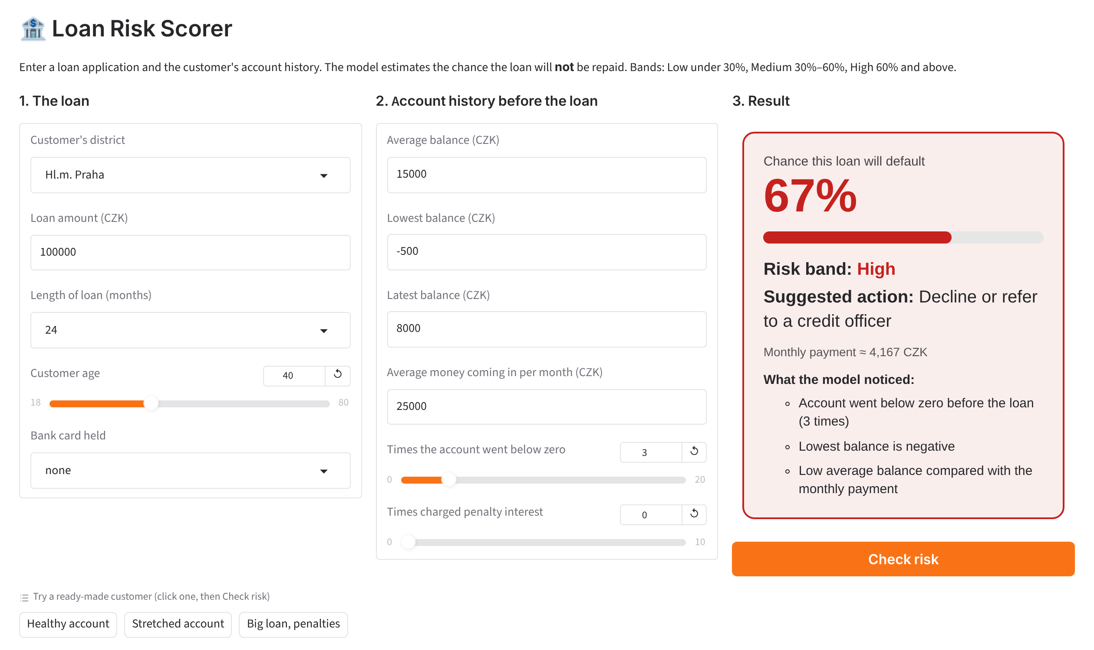

Back to our credit officer: live demo
PART 4 · PUTTING IT TO WORK
What I'll show
Open the app (Loan_Risk_Demo notebook)
Click Healthy account, then Check risk: 2%, Approve
Click Stretched account: 67%, High
Read out 'What the model noticed'
Stretched account: 67%, High. The healthy account scores 2%, Low, Approve.
Backup: this screenshot, or the app in section 12 of the notebook.
Notes:
STORY: Remember our credit officer with the 100,000 CZK application? Let's help them decide.
DO (about 2 minutes):
1. Switch to the browser tab with the app (opened earlier from Loan_Risk_Demo.ipynb; click the gradio.live link).
2. SAY: "This is a simple app built on my model. On the left is the loan, in the middle the account history."
3. Click "Healthy account", then "Check risk". SAY: "A 100,000 CZK loan, steady balance, never overdrawn. About 2 percent: Low risk, approve."
4. Click "Stretched account", then "Check risk". SAY: "Same loan, but lower balances and three overdrafts. Risk jumps to about 67 percent: High, refer to a credit officer."
5. Point to "What the model noticed". SAY: "The app also shows the warning signs, so staff can see why."
6. Optional: change one number live, e.g. set overdrafts back to 0, and click Check risk again.
BEFORE THE TALK: open the app 10 minutes early and keep the tab open. The gradio.live link expires after about 72 hours.
IF THE APP FAILS: stay calm, say "Here is the same result from my earlier run", and point at this screenshot.

Slide 22
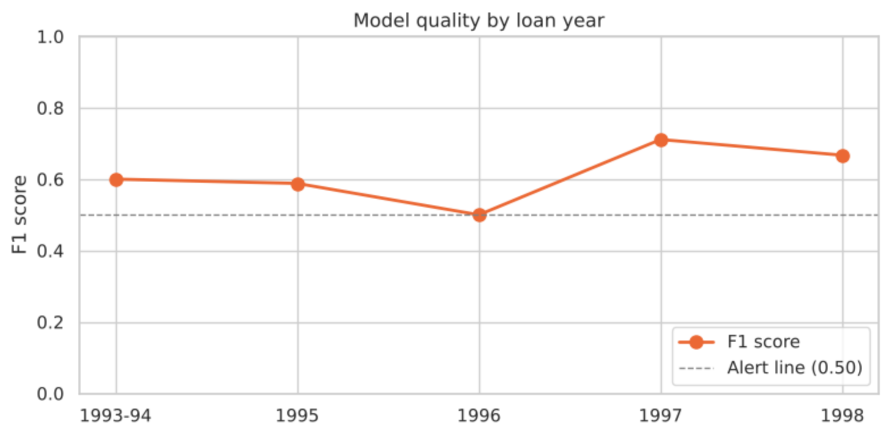
Keeping it working: scale and monitoring
PART 4 · PUTTING IT TO WORK
~140,000
loans scored per second
1 M+
transactions summarised in under a second
0.65
F1 on later years (retrained 1993–96, tested 1997–98)
F1 score by loan year stays at or above the 0.50 alert line
Monthly check | Now | Alert if
Change in applicants (PSI) | 0.13 watch | > 0.25
Model quality (F1 score) | 0.50–0.71 | < 0.50
Default-rate shift | −5.5 pts * | > ±5 pts
Growth: same model file runs in parallel batch jobs
Change: one function retrains it on new data
* 1998 loans are too new to have defaulted yet: compare loans of the same age.
Notes:
SAY (about 45 seconds):
Two points on running this for real.
Scalability: it scores about 140,000 loans per second, so it can easily handle a whole bank's loan book.
Adaptability: one function retrains it on new data. Trained on 1993 to 1996 and tested on 1997 to 1998, it still scored an F1 of 0.65.
Monitoring: every month I would check three things. Are applicants changing? That is the PSI number. Is the F1 score still at or above 0.50? And is the default rate shifting?
The default-rate alert you see is expected: 1998 loans are too new to have defaulted yet. The lesson is to compare loans of the same age.
IF ASKED "What is PSI?": Population Stability Index. It measures how different new applicants are from the ones the model learned on. Under 0.10 is stable, 0.10 to 0.25 watch, above 0.25 retrain.

Slide 23
Research objectives: what I found
THE ENDING
1
Clean and combine the 8 tables
2
Does account behaviour matter?
Found: One reliable table: 682 loans, no rows lost in 8 joins
Found: Strongly: low, unstable balances and overdrafts signal risk
3
Do loan terms matter?
4
Do customer and regional factors matter?
Found: Yes: a payment that is large versus the balance raises risk
Found: Less: shared accounts are safer; region has little effect
5
Build and compare prediction models
6
Recommend next steps
Found: Best model: F1 0.77 on unseen loans (pass mark 0.50)
Found: Pilot the model with a credit officer; monitor monthly
Notes:
TRANSITION: Before I finish, let's go back to the six research objectives from the start.
SAY (about 1 minute):
One: I cleaned and joined the eight files into one table, and no loan was lost.
Two: account behaviour matters most. Low or unstable balances and overdrafts before the loan were the strongest warning signs.
Three: loan terms matter: when the monthly payment is large compared with the usual balance, risk goes up.
Four: customer and regional factors matter much less, although accounts shared by two people were safer.
Five: my best model scored an F1 of 0.77 on loans it had never seen, well above the 0.50 pass mark.
Six: my recommendation is a pilot with a credit officer, with monthly monitoring. I'll go through the details on the next slides.

Slide 24


The ending: the problem, solved
THE ENDING
How well it works: 137 loans it had never seen
What matters
Model said
0.77
F1 score
pass mark 0.50
Behaviour
balances, overdrafts, payment vs balance
Good
Bad
Really good
121
1
Less so
region, salary, age
91%
warnings right
10 of 11
approved
false alarm
Really bad
5
10
67%
bad loans caught
10 of 15
What it means
missed
caught
Reliable
scrambled answers: F1 drops to 0.02; later years: F1 0.65
96%
accuracy
lazy guess: 89%
Pilot-ready
with a credit officer checking its warnings
F1 = 2 × precision × recall ÷ (precision + recall) · 0 = useless, 1 = perfect
Answer for our credit officer: yes, the bank can spot most risky borrowers before saying yes, using data it already has.
Notes:
STORY: So, back to where we started: can the bank spot risky borrowers before saying yes? Yes.
SAY (about 1 minute):
Here is the final result, on the 137 loans the model had never seen.
The grid shows what the model said against what really happened. It approved 121 good customers correctly and caught 10 of the 15 bad loans. It raised only 1 false alarm, and missed 5.
That gives an F1 score of 0.77, well above my 0.50 pass mark. When it warns, it is right 10 times out of 11, 91 percent. It catches two thirds of the bad loans, and overall accuracy is 96 percent.
What matters most is account behaviour before the loan: balances, overdrafts, and how big the payment is compared with the balance. Region, salary and age matter much less.
And it is reliable: when I scrambled the answers its F1 dropped to almost zero, and trained only on older loans it still scored 0.65 on 1997 and 1998. So it is ready for a pilot, with a credit officer checking its warnings.
IF ASKED "Why does it miss 5 of 15?": at a 50 percent cut-off it is careful. If the bank also reviews the Medium band, above 30 percent, 14 of the 15 bad loans are flagged.

Slide 25




What the bank should do next
THE ENDING
Pilot the model
Watch account behaviour
Score every application; a credit officer reviews High-risk flags.
Overdrafts and low balances before a loan are early warning signs.
Add dates to standing orders
Monitor monthly
So they can be used safely in future models.
PSI, F1 score and default rate; retrain when an alert fires.
Build in fairness
Explain decisions
Keep gender out of credit decisions and check results are fair.
Use the simple scorecard to explain outcomes to customers.
Notes:
SAY (about 45 seconds, then stop):
My recommendations.
One: pilot the model, scoring every application, with a credit officer reviewing High-risk flags.
Two: treat overdrafts and low balances before a loan as early warning signs, even without a model.
Three: add dates to standing orders so that data can be used safely in future.
Four: monitor monthly, using PSI, the F1 score and the default rate, and retrain when an alert fires.
Five: keep gender out of credit decisions and check that outcomes are fair.
Six: use the simple scorecard to explain decisions to customers.
Thank you. I am happy to take questions.
TIP: for questions, the backup slides have simple answers to the most likely ones.

Slide 26
Questions I may be asked (1 of 2)
APPENDIX
Question | Simple answer
Why Random Forest, not the simpler model? | The scorecard catches a few more defaulters but raises many more false alarms (F1 0.52 vs 0.77). I keep it to explain decisions.
Only 15 defaulters in the test: is 0.77 reliable? | It is a small test, so I also report F1 0.56 from the 5 practice rounds and 0.65 on later years. All pass 0.50.
Why not just use accuracy? | Saying 'nobody defaults' is already 89% accurate and catches nobody. Recall and F1 are not fooled by that.
What is data leakage and how did you avoid it? | Using information the bank did not have on the loan date. I used only transactions and cards from before each loan, and left out Order.
Only 11% defaulted. How did you handle that? | Both parts of the split keep 11% defaulters, and the model is told a missed defaulter counts more (class weights).
Why did you leave out gender? | Fairness: credit decisions should not depend on gender, and the model works well without it.
Why does it miss 5 of 15 defaulters? | At a 50% cut-off it is careful (10 of 11 flags right). Reviewing everything above 30% (Medium and High) flags 14 of 15 defaulters.
Notes:
Backup slide for questions. Do not present it; jump here only if someone asks.

Slide 27
Questions I may be asked (2 of 2)
APPENDIX
Question | Simple answer
Why was the Order table left out? | It has no dates, so the orders may have been set up after the loan. That would be leakage.
How did you choose the 30% and 60% cut-offs? | They are a business choice the bank can change. On the test loans, all 9 High-risk loans defaulted versus 1% of Low.
How do you know it is not overfitting? | Practice rounds, one final exam on hidden loans, the scrambled-answer check (F1 0.02) and the later-years test (F1 0.65).
How would a bank actually use it? | Score each application in the app, or score all loans in a nightly file for Excel / Power BI. A credit officer checks High flags.
What is PSI? | A number for how much new applicants differ from the training data. Above 0.25 means retrain.
What are the limitations? | Small (682 loans) and old (1990s) data from one bank. Next: newer data, fairness checks, dates on orders.
Notes:
Backup slide for questions. Do not present it; jump here only if someone asks.

Slide 28
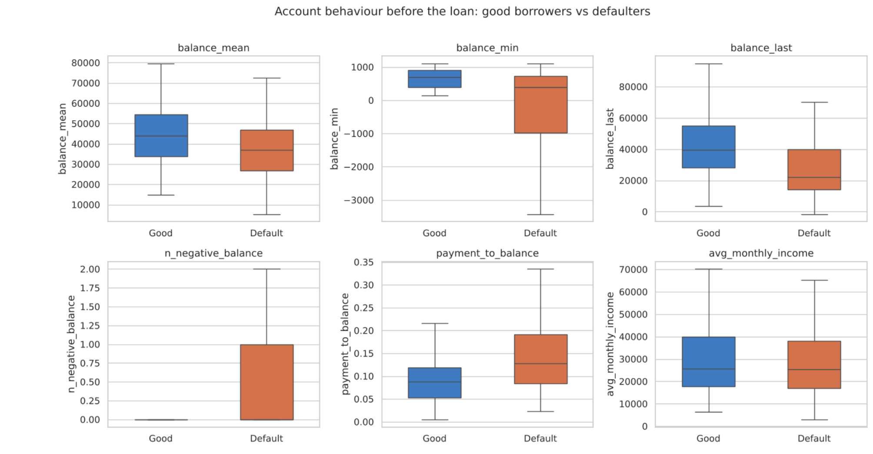
Account behaviour: defaulters vs good borrowers
APPENDIX
Box plots
Each box shows the middle half of customers. Defaulters (orange) had lower balances and a higher payment-to-balance ratio. Median latest balance: 21,959 vs 39,416 CZK.
Notes:
Backup slide. Each box shows the middle half of customers; the line inside is the median (middle value). Orange = defaulters. They had clearly lower balances, especially the latest balance before the loan (median 21,959 vs 39,416 CZK), and a larger payment compared with their balance.

Slide 29
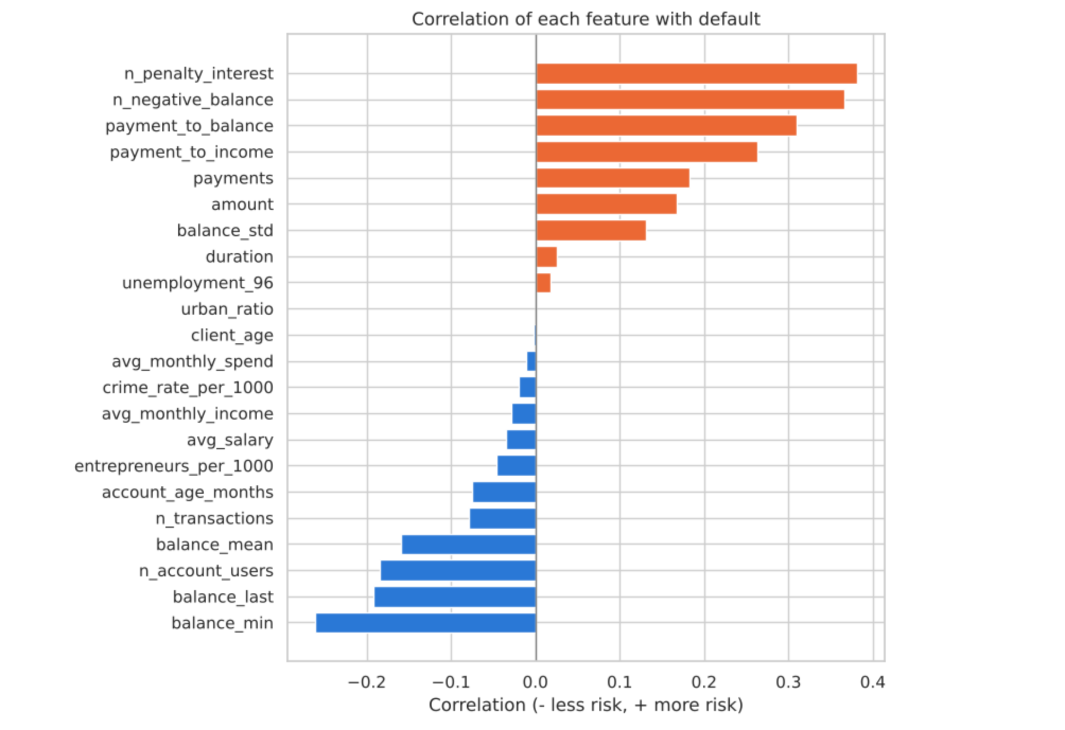
Correlation and default rate by year
APPENDIX
Overdrafts and an unstable balance correlate most with default; shared accounts least. 1998 looks safe only because those loans are too new to have defaulted.
Notes:
Backup slide. Correlation shows which inputs move together with default (closer to +1 or -1 = stronger link). Overdrafts and an unstable balance link most strongly to default.
The default rate is steady at 13 to 15 percent each year until 1998. 1998 looks safe only because those loans are too new to have gone bad yet.

Slide 30
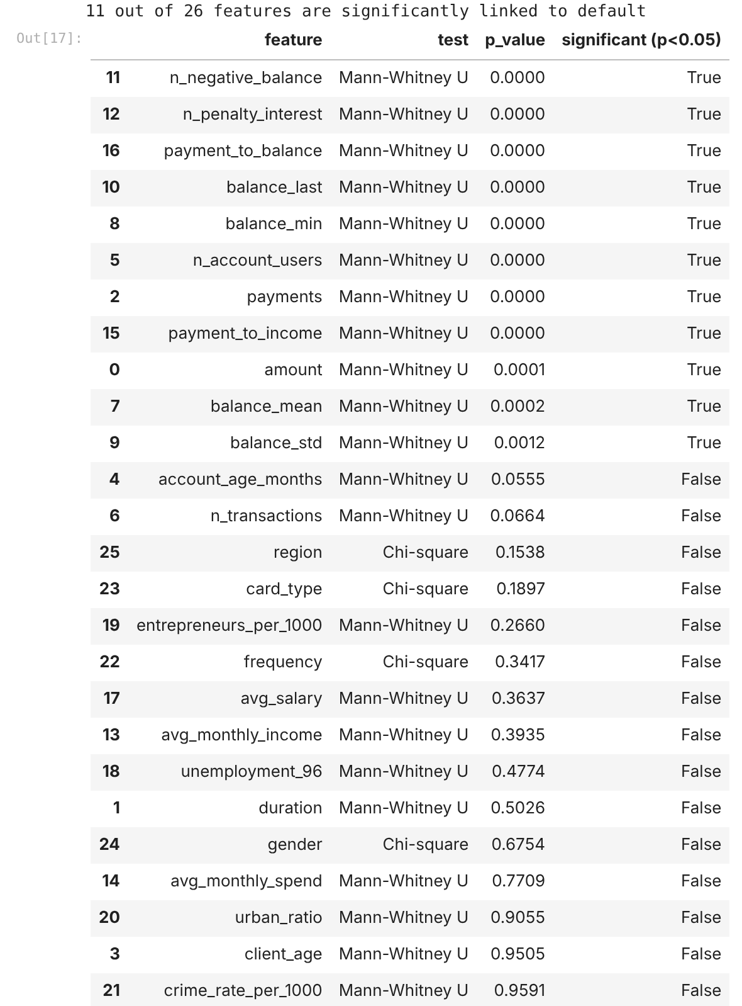
Statistical tests: 11 of 26 inputs significant
APPENDIX
Input | Test | Significant?
Times overdrawn | Mann-Whitney U | Yes (p < 0.001)
Penalty interest | Mann-Whitney U | Yes (p < 0.001)
Payment vs balance | Mann-Whitney U | Yes (p < 0.001)
Latest / lowest balance | Mann-Whitney U | Yes (p < 0.001)
Account users | Mann-Whitney U | Yes (p < 0.001)
Loan amount / payment | Mann-Whitney U | Yes (p < 0.001)
Region | Chi-square | No (p = 0.15)
Card type | Chi-square | No (p = 0.19)
Average salary | Mann-Whitney U | No (p = 0.36)
Notes:
Backup slide. Tests used:
Mann-Whitney U for number inputs: checks whether defaulters and good customers have different values.
Chi-square for category inputs: checks whether the default rate differs between groups.
p below 0.05 means the difference is very unlikely to be chance. Account behaviour and loan size are significant; region, card type and salary are not.

Slide 31
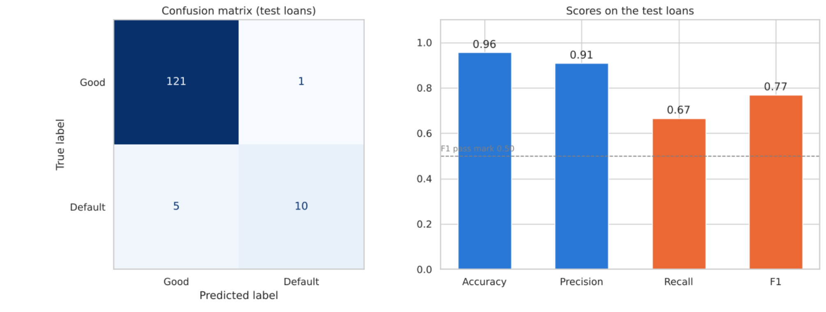
Confusion matrix and scores (test set)
APPENDIX
Notes:
Backup slide. Left: the confusion matrix for the 137 test loans: 121 correct approvals, 10 defaulters caught, 5 missed, 1 false alarm. Right: the four scores. Accuracy 96 percent, precision 91 percent, recall 67 percent, F1 0.77 (pass mark 0.50, dashed line).

Slide 32
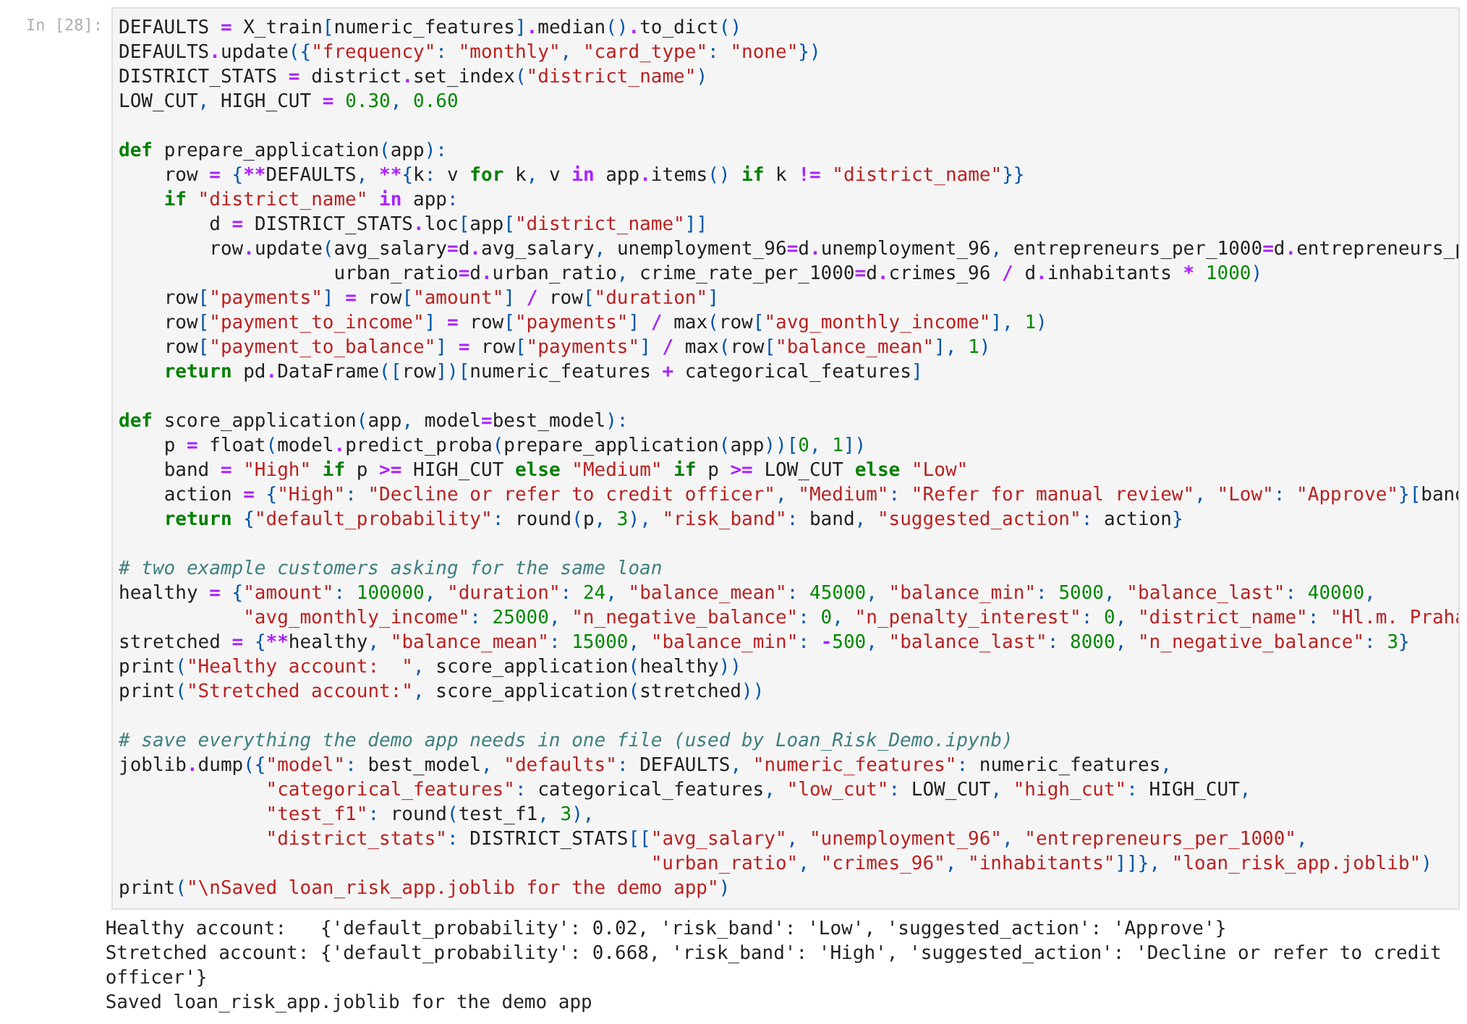
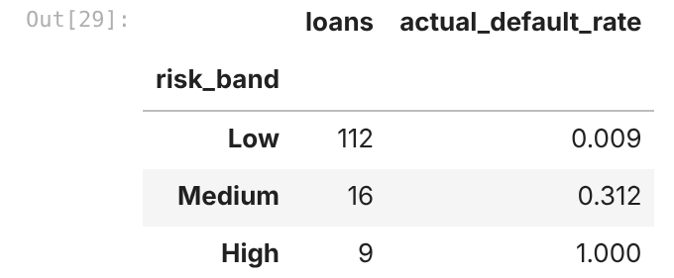
Scoring code and batch results
APPENDIX
Risk bands vs actual defaults
High band: all 9 loans defaulted. Low band: 1%. The bands separate risky and safe borrowers clearly.
Notes:
Backup slide. The scoring function takes a new applicant's details, fills anything missing with typical values, calculates the monthly payment and affordability, asks the model for a probability, and turns it into a band: Low under 30 percent, Medium 30 to 60, High 60 and above. The batch report scores many loans at once and saves a CSV for Excel or Power BI. On the test loans: Low 112 loans, 1 percent defaulted; Medium 16 loans, 31 percent; High 9 loans, 100 percent.

Slide 33
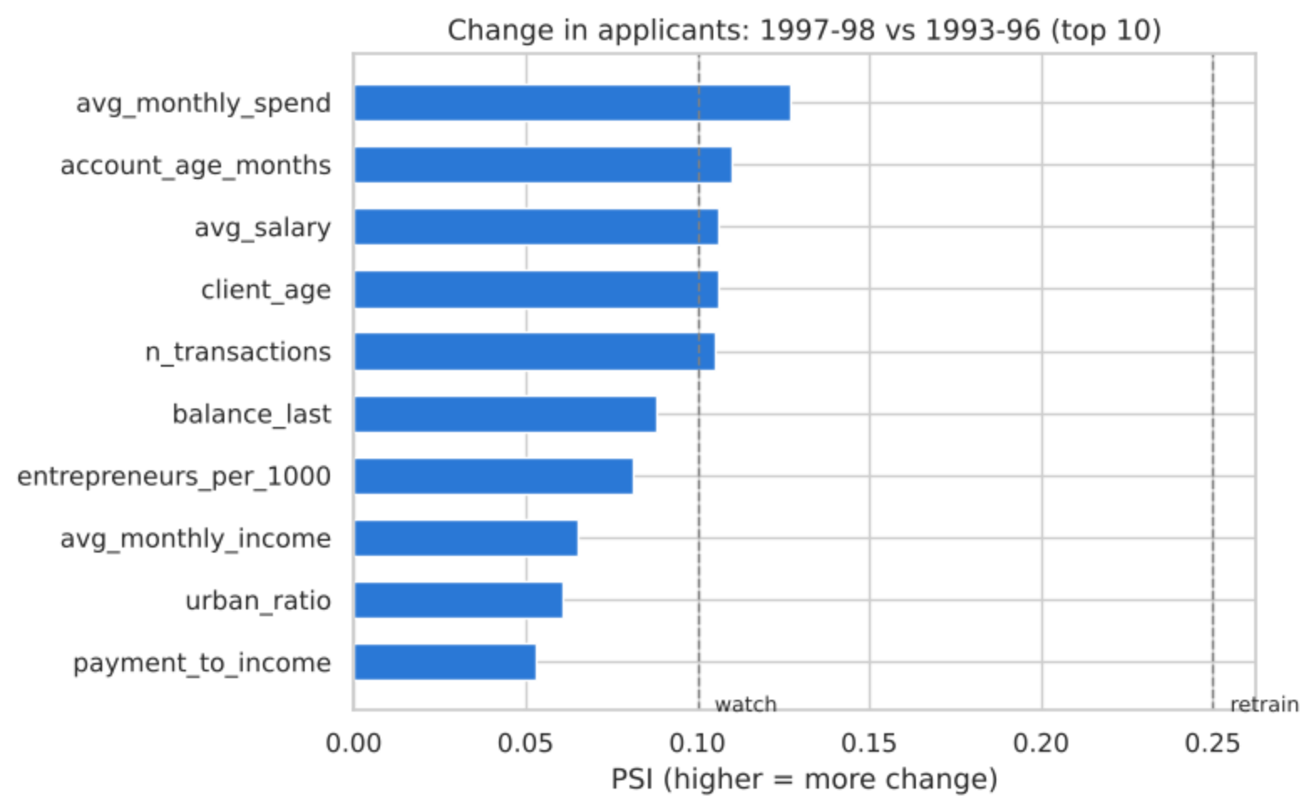
Monitoring detail: change in applicants (PSI)
APPENDIX
How to read PSI
Below 0.10: stable
0.10–0.25: watch
Above 0.25: retrain
A few inputs (spending, account age, salary) are in the watch zone: customers change slowly over time, a reason for scheduled retraining.
Notes:
Backup slide. PSI compares each input for older and newer applicants. Below 0.10 stable, 0.10 to 0.25 watch, above 0.25 retrain. A few inputs, such as spending, are in the watch zone, which is normal over several years and a reason for scheduled retraining.

Slide 34





Tools and techniques used
APPENDIX
Google Colab / Jupyter
pandas & NumPy
Matplotlib & Seaborn
SciPy
Notebook environment for every step (.ipynb deliverable)
Loading, cleaning, integration, feature engineering
Bar, box, line, heatmap and drift charts
Chi-square and Mann-Whitney U hypothesis tests
scikit-learn
joblib
Gradio
PowerPoint
Pipelines, 5 models, cross-validation, tuning, metrics
Saving the trained pipeline for deployment
Web app for the live scoring demo
Communicating the process and findings
Notes:
Backup slide. Everything was done in a Jupyter notebook on Google Colab: pandas and NumPy for data work, Matplotlib and Seaborn for charts, SciPy for statistical tests, scikit-learn for the machine learning and the confusion-matrix scores, joblib to save the model, and Gradio to turn it into a web app.

