Slide 1


Single Sign On Service
Reshmi Krishna

Slide 2
Agenda
Pivotal Single Sign On Services
Architecture
Service Plan
Role Based Access
Demo :
Setting up Service and Identity provider
Deploying apps to access it

Slide 3
SAML
XML-based, open-standard data format
Dates back to 2001
SOAP based standard
Addresses web browser single sign on
Notes:
SAML is an XML-based, open-standard data format for exchanging authentication and authorization data between parties.
SAML dates from 2001; the most recent major update of SAML was published in 2005, been there for awhile so lot of tooling associated with it
SOAP based standard and is known for being fairly complex to work with despite the libraries and tooling available to support it.
The single most important requirement that SAML addresses is web browser single sign-on (SSO).

Slide 4
SAML 2.0 flow
Client
(Web Browser)
1. Client Request
Server
Auth Server
Notes:
Resource Server- this is the web-server you are trying to access information on.
Client - this is how the user is interacting with the Resource Server, like a web app being served through a web browser.
Authorization Server - this is the server that owns the user identities and credentials. It's who the user actually authenticates with.
1) User accesses URL in app : for example account.citi.com which stores all of their bank info. But account.citi.com doesn’t handle authentication itself

Slide 5
SAML 2.0 flow
Client
(Web Browser)
1. Client Request
Server
2. Auth Request
Auth Server
Notes:
to authenticate the user, resource server (account.citi.com) constructs a SAML Authnrequest and send it to the auth server. This request is encrypted. After the Auth server receives the request it decrypts it and verifies the signature.

Slide 6
SAML 2.0 flow
Client
(Web Browser)
1. Client Request
Server
2. Auth Request
Auth Server
3. User Redirect
Notes:
3) With a valid Authnrequest the auth server will present the user with a login form in which they can enter their username and password.

Slide 7
SAML 2.0 flow
2. Auth Request
Client
(Web Browser)
1. Client Request
Server
Auth Server
4.Redirect to App
3. User Redirect
Notes:
4) Once the user has logged in, The Auth Server takes the SAML token and redirects the user back to the account.citi.com. The SAML token that includes identity information about the user (such as their username, email, etc)

Slide 8
SAML 2.0 flow
Client
(Web Browser)
1. Client Request
Server
2. Auth Request
Auth Server
5.User Logged In
4.Redirect to App
3. User Redirect
Notes:
5) Resource server (account.citi.com) verifies the SAML token, decrypts it if necessary, and extracts out identity information about the user, such as who they are and what their permissions might be.
account.citi.com now logs the user into its system, presumably with some kind of cookie and session.

Slide 9
Oauth
OAuth is an open standard for authorization
Focuses on client developer simplicity
OpenID Connect is an implementation of Oauth
Enables the client to use the authorization server to authenticate the user
Uses simpler REST calls, improved ease of use
Enables a single set of user credentials to access multiple sites
Notes:
OAuth provides to clients a 'secure delegated access' to server resources on behalf of a resource owner. It specifies a process for resource owners to authorize third-party access to their server resources without sharing their credentials.
OAuth 2.0 focuses on client developer simplicity while providing specific authorization flows for web applications, desktop applications, mobile phones, and living room devices.
OpenID Connect is a standard that has emerged as a specific implementation of Oauth 2.0 based on the way Google and others handle SSO. Enables the client to use the authorization server to authenticate the user
It uses simpler REST calls, gaining more and more traction for simpler ease of use.
• Provides the client basic profile information about the user
• Enables a single set of user credentials to access multiple sites
• Standard means of obtaining and verifying identity (ID) tokens
The UAA issues OAuth 2.0 or OpenID Connect ID tokens

Slide 10
OAuth 2.0 flow
1. Obtain Auth Grant
Client
Server
Auth Server
Notes:
Resource Server (Service Provider) - this is the web-server you are trying to access information on.
Client - this is how the user is interacting with the Resource Server. This could be a browser-based web app, a native mobile app, a desktop app, a server-side app.
Authorization Server (Identity Provider) - this is the server that owns the user identities and credentials. It's who the user actually authenticates and authorizes with.
Oauth has 4 grant types (Authorization Code, Client Credentials, Password & Implicit)
1) A user opens account.citi.com on their web browser. The user is presented with a login form and asked if they want to approve Resource Server to act on their behalf. The user logs in and they are redirected to account.citi.com. The client receives an auth grant code as part of the redirect and then passes this along to the client.

Slide 11
OAuth 2.0 flow
1. Obtain Auth Grant
Client
Server
Auth Server
2. Access token exchange
Notes:
The Client then uses that authorization grant code to request an access token from the Authorization Server.
if the authorization grant code is valid, then the Authorization Server grants an access token.

Slide 12
OAuth 2.0 flow
1. Obtain Auth Grant
Client
Server
Auth Server
3. Request resource
2. Access token exchange
Notes:
3) The access token is then used by the client to request resources from the Resource Server (test.citi.com).

Slide 13
OAuth 2.0 flow
1. Obtain Auth Grant
Client
Server
Auth Server
3. Request resource
4.Validating token
2. Access token exchange
Notes:
4) test.citi.com receives the request for a resource and it receives the access token. In order to make sure it's a valid access token it sends the token directly to the Authorization Server to validate. If valid, the Authorization Server sends back information about the user.

Slide 14
OAuth 2.0 flow
5. Resource granted
1. Obtain Auth Grant
5.Token Validated
Client
Server
Auth Server
3. Request resource
4.Validating token
2. Access token exchange
Notes:
4) test.citi.com receives the request for a resource and it receives the access token. In order to make sure it's a valid access token it sends the token directly to the Authorization Server to validate. If valid, the Authorization Server sends back information about the user.

Slide 15
User Authentication and Authorization (UAA) Server
Multi-tenant component of the Elastic Runtime
Secures Elastic Runtime components and apps/APIs
Authenticates users
Acts as an authorization server
Notes:
Multi-tenant component of the Elastic Runtime
• Secures Elastic Runtime components, applications and APIs (e.g. Apps Manager and Cloud Controller API)
• Can also secure access to other applications/APIs using the Pivotal Single Sign-On (SSO) Service
• source component based on industry standards such as SAML, OAuth 2.0 and OpenID Connect
It can authenticate and authorize users by issuing tokens to the client applications on behalf of the users

Slide 16
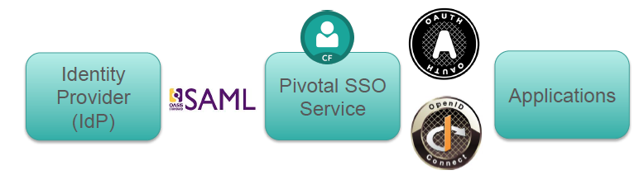
Pivotal Single Sign-On Service for Applications
Notes:
1)SSO server acts as an identity bridge/proxy – translating between standard SAML 2.0 identity providers and lighter weight Oauth 2.0 based applications, which is more widely used.
The reason we do this is OAUTH 2.0 is becoming very widely used. It’s light weight and support different applications types out of the box like web app, mobile, javascript, service to service. It does all this by using different grant types like : Authorization Code, Client Credentials, Password & Implicit. It’s very easy to write with Spring boot including the sso connectors
2) This is Implemented as a managed service (available in the marketplace)
3) Certified with Industry Standard SAML Identity Providers : CA SiteMinder, Forge Rock Open AM, Ping Identity, Okta, VMware Workspace
OpenID Connect 1.0 is a simple identity layer on top of the OAuth 2.0 protocol. It allows Clients to verify the identity of the End-User based on the authentication performed by an Authorization Server, as well as to obtain basic profile information about the End-User in an interoperable and REST-like manner.
The Pivotal Single Sign-On service supports all four types of OAuth grant types (Authorization Code, Client Credentials, Password & Implicit). Each of these grant types apply based on the type of the Application in question (Web/Mobile/Service/JavaScript only Apps). Spring Security provides a very Simple & Light Weigh approach for enabling OAuth (simple annotation structures). We have provided samples for all four grant types using Spring. These sample apps can be found here : https://github.com/pivotal-cf/identity-sample-apps
Basically converting SAML assertion tokens from Identity Provider into Oauth Token, which is received and validated by the application.
The tokens issued conform to the the JWT token format. The tokens are self validating. A protected token introspection end point is also provided for checking the validity of the token.
The big advantage with OAuth2 flows are that the communication from the Authorization Server back to the Client and Resource Server is done over HTTP Redirects with the token information provided as query parameters. OAuth2 also doesn't assume the Client is a web-browser whereas the default SAML Web Browser SSO Profile does.
Native mobile applications will just work out of the box. No workarounds necessary.
The Integration between the Application/API’s on the platform and the Pivotal Single Sign-On Service is via OAuth 2.0.
The Single Sign-On server (UAA) acts as an Identity Bridge/ Proxy. It converts the SAML Assertions tokens from the On-Premise Identity Provider into an OAuth Token which is received and validated by the Application. The tokens issued conform to the the JWT token format. The tokens are self validating. A protected token introspection end point is also provided for checking the validity of the token.
The Pivotal Single Sign-On service supports all four types of OAuth grant types (Authorization Code, Client Credentials, Password & Implicit). Each of these grant types apply based on the type of the Application in question (Web/Mobile/Service/JavaScript only Apps). Spring Security provides a very Simple & Light Weigh approach for enabling OAuth (simple annotation structures). We have provided samples for all four grant types using Spring. These sample apps can be found here : https://github.com/pivotal-cf/identity-sample-apps
OpenID Connect 1.0 is a simple identity layer on top of the OAuth 2.0 protocol. It allows Clients to verify the identity of the End-User based on the authentication performed by an Authorization Server, as well as to obtain basic profile information about the End-User in an interoperable and REST-like manner.
Provides SSO security and convenience to applications hosted on or external to the Cloud Foundry platform
• Uses an internal user store (the UAA database) or an
external SAML 2.0 compliant federated identity provider
• Certified with Ping Identity, CA SSO, Azure ADFS,
ForgeRock Open AM, VMWare Identity Management, Okta
• Implemented as a managed service (available in the
marketplace)
Make enabling security for applications simple for Application Developers
Application Single Sign-On via integration with external user stores
Support for all application types : Web, Native & Service Apps
Self Service interface for managing applications and configuring security policy
Multitenant Service enabling identity and policy segregation based on business needs
Certified with Industry Standard SAML Identity Providers : CA SiteMinder, Forge Rock Open AM, Ping Identity, Okta, VMware Workspace
- Pivotal SSO service is a multitenant service for enabling identity and policy segregation based on business needs
- It is certified with industry standard SAML identity providers like Okta, Ping Identity, CA Siteminder, Forge Rock Open AM, Vmware Workspace. Basically it can use the UAA database or an external SAML 2.0 compliant federated identity provider
- It can support different types of apps like Web, Native & Service apps
- It is implemented as a managed service (available in the
marketplace)

Slide 17

Single Sign On Flow
Access URL via browser
SAML Auth
Request
User
Service Provider
Identity Provider
(OKTA)
User logs into Identity Provider
1
2
4
3
Login with Oauth token generated by SSO Server on PCF
SAML Assertion Token
Notes:
1) I have an web app in pcf, lets call it app1. When I log in to app1, it requests authorization from Resource Server (Service Provider) in our case.
2) The Service Provider then makes a SAML Auth Request to the identity provider which includes the authorization grant provided by the Service Provider. The identity provider then presents the user with the login screen, where the uset logs in.
3) After the user is validated, the SAML Assertion Token is passed back to the Service Provider, which then decryptes it and converts it into Oauth tokens
4) The user then logs into the application using the Oauth token, which conforms to JWT token format.
The tokens are self validating. A protected token introspection end point is also provided for checking the validity of the token.

Slide 18
Pivotal Single Sign-On – Architecture
Pivotal Cloud Foundry – Elastic Runtime
UAA (Multi-tenant)
Default Tenant
SAML SP
Apps Manager
[OAuth Client]
Oauth AuthZ Server
SAML IDP for App Developers
SAML(HTTPS POST
CF CLI
[OAuth Client]
Tenant A (Service Plan)
SAML IDP for Employees
SAML(HTTPS POST
SAML SP
App A
[OAuth Client]
Oauth AuthZ Server
App B
[OAuth Client]
Notes:
Notes :
Single high availability multi-tenant UAA for securing platform and hosted applications
UAA is HA and can be installed a part of elastic runtime.
When UAA is installed it creates a default tenant, which is accessible at UAA.system domain. The default tenant secures interfaces to the platform like CLI, Apps manager cloud controller API. With the new UAA u can have logical multi tenancy not physical, where u create multiple domains to secure 1 or more apps.
3) Each tenant gets its own virtual authorization server
4) Multiple SAML 2.0 external identity providers are supported
5) Each application has an associated OAuth client in the UAA
6) All applications must be OAuth 2.0-aware
Most of the enterprises today manage their Users (Employees/Partners) etc. in an LDAP Based directory which in most cases is Active Directory.
The Active Directory is usually front-ended by a Federation Gateway (Usually CA SiteMinder/Ping Federation/ ADFS) which expose this directory users as Federated Identities for Single Sign-On purposes.
Pivotal Single Sign-On service supports the configuration of Multiple SAML Identity Providers. These can be associated with the relevant Applications.
Multiple Identity Providers allows for specifying Simple to Advanced Authorization Filters for each Identity Provider and then tying it with the application which needs to be secured.
A typical authorization scenario could be : Only Users in New York should be allowed to access Application “Foo”
This could be accomplished in the following way:
1> Set up a SAML Identity Provider configuration with the Authorization Filter allowing users in the New York Location
2> Configure this Identity Provider and the Single Sign-On service for SAML trust (Exchange of SAML Service Provider and Identity Provider Metadata)
a. Pivotal Single Sign-On Service provides a user interface for setting up the SAML Identity Provider
3> Register an OAuth Client with Application Foo and associate it with the Identity Provider registered above (Via the Pivotal Single Sign-On service User Interface)

Slide 19
How to store platform user credentials
Internal store
LDAP
Enterprise Identity Provider
Notes:
There are three ways to store platform user credentials: All these options are available when you download elastic runtime
1. Internal store- user information is stored in the UAA database
2. LDAP- user information is stored in an LDAP server
• Configured on the Elastic Runtime’s LDAP Config tab
3. Enterprise Identity Provider- user information is stored in an
external service like CA SSO or ADFS
• Configured on the Elastic Runtime’s SSO Config tab
• This is the recommended approach for external platform usersit
is more secure than LDAP

Slide 20





Current State of Application Security
Operational Overhead
Customer Applications
Proprietary Agent/SDK
Enterprise/Internal Applications
Vendor Specific Service Brokers
Maintenance Overhead
Mobile Applications
Notes:
Most used ones are siteminder.
Traditionally you will have Agents that intercept traffic and redirect them to policy server, which can present authentication page. Then the user taken to the page that can be accessed.

Slide 21
Pivotal Single Sign-On Service 1.0.0
Make enabling security for applications simple for Application Developers
Application Single Sign-On via integration with external user stores
Support for all application types : Web, Native & Service Apps
Self Service interface for managing applications and configuring security policy
Multitenant Service enabling identity and policy segregation based on business needs
Certified with Industry Standard SAML Identity Providers : CA SiteMinder, Forge Rock Open AM, Ping Identity, Okta, VMware Workspace
Notes:
We support web apps, native apps and all.
The service is multi tenant : if u have different identity needs and u want to separate identity providers and plans u can do that. Example is consumer and enterprise apps. Also if u have dev, stage env, u can have different plans.

Slide 22
User Authentication and Authorization (UAA) Server
Multi-tenant component of the Elastic Runtime
Secures Elastic Runtime components, applications and
APIs (e.g. Apps Manager and Cloud Controller API)
Can also secure access to other applications/APIs using
the Pivotal Single Sign-On (SSO) Service
Open source component based on industry standards
such as SAML, OAuth 2.0 and OpenID Connect
Notes:
Secures Elastic Runtime components, applications and
APIs (e.g. Apps Manager and Cloud Controller API)
Can also secure access to other applications/APIs using
the Pivotal Single Sign-On (SSO) Service

Slide 23
UAA contd
Authenticates users
Can store user credentials internally or using an external
identity provider (Ping Identity, CA SSO, Azure ADFS,
Okta ...)
Acts as an authorization server
Issues tokens to client applications on behalf of users
Enables the convenience and security of single sign-on
(SSO) for platform applications (e.g. Apps Manager) and
other applications (using the Pivotal SSO Service)

Slide 24
Service Plan Visibility
Single Sign-On Service Plan (UAA Tenant)
ORG
(Service Plan Visible)
ORG
(Service Plan Visible)
Space (Service Instance)
Space (Service Instance)
Space (Service Instance)
Space (Service Instance)
App
App
App
App
App
App
App
App
Notes:
Enable service access command in CLI
U can enable service plan across orgs
Service instance links app to plan
Service Plan is a UAA tenant so 1 or more apps across diff spaces may want to use same service plan because its app end user identity.
Q)We are not using LDAP rather using SAML to connect to external userstore?
SAML is more secure way. LDAP just collects lowest layer that doesn’t enforce security policy but when u deal with federated identity provider enforce security policy like session policy or password policy. LDAP just collects username and password and cant do policies.
Q)Does support clustered mysql in elastic runtime? If the customer has configured mysql as uaa db and cc db
Will work with external connection for example rds on aws
Q) Integrate Ops Manager and UAA?
Work underway to integrate ops manager with UAA. UAA will just secure ops manager and UAA in elastic runtime will just secure ert and the apps in that.
Bosh UAA will be different. So there might be 3 UAAs
Q) Are there are plans to support AD as identity provider via SAML?
AD is already supported through AD federation services which is ADFS. If a customer has ping or site minder and AD can be enabled via federation services. This current service is notthAD but through Azure ADFS

Slide 25
Role Based Access
PCF Admin
Manage Service Plans
Space Developer
Create Service Instance
Bind Applications with SSO Service
Enable Service Plans in Orgs
On-Board Identity Providers
Associate Apps with Identity Providers
Limited to App SSO Configuration within Space boundary
Notes:
As PCF admin, you are also a service admin

Slide 26
Use cases
Description | How to
As an Application Developer I want to enable Single Sign-On for my Application by connecting it to the existing enterprise user store for authentication | Administrator on-boards Enterprise Identity Provider Enable Application for OAuth Bind Application with SSO Service Instance Associate Application with Identity Provider
As an Application Developer I want to limit access to my Application to a certain user group | Administrator configures Identity Provider with Proper Authorization Filters One or more Identity Providers configured under the given SSO Plan Enable Application for OAuth Bind Application with SSO Service Instance Associate Application with the right Identity Provider
As an Application Developer I want to enable SSO for any kind of App : Web, Native or Service | Enable Application for OAuth Set Grant Type Environment Variable to right type Bind Application with SSO Service Instance
Notes:
Use cases
You build app and now your end users can access that app lets say through okta
Oauth is lightweight everything over rest
You can provide authorization filters on the identity providers

Slide 27
SSO Service HA Considerations
Dependent on HA of Database (UAADB)
External Clustered DB’s supported
Or new install of 1.6 support HA MySQL
SSO Service Instance is Blue-Green
Postgres to MySQL HA Migration planned between PCF 1.6 and 1.7
Notes:
The availability of the service is contrained by availability of db u r using.
Roadmap -> post gres to mysql ha.
Depending on org policies, onboarding users to identity provider and its handled by ip. How user gets sso service, its part of authentication service. We on the fly create a record on uaa and which is used later.
If the app needs to assign roles, we don’t have the ability yet to sign roles on ip. Via api, u can set up users to the role.
Q) If u don’t have roles, what metadata we get? Ans) we only get userid from ip. Roadmap is we will support claims like user attributes, user roles.
We don’t support SAML claims today, will be added in the next version.

Slide 28
Demo
SSO Ops Manager Config – SSO tile
Identity Provider Configuration
SSO service in marketplace
Application :
Push OAuth 2.0 aware app
Bind to SSO service
Notes:
Pivotal SSO tile that can be downloaded from network.pivotal.io. It’s really straight forward, you should have already set up the user store in elastic runtime.
Then when you login in as admin in pcf apps manager, go to system org, identity service space-> u see broker, this is the application that’s used to configure service plans.
I can configure as many plans as we want and that will show up in the marketplace. Check the concept of org visibility
Also check the manage user store, by default the user store is internal user store. The purpose of SSO is connect to external identity provider, we will be using okta for this demo.
Service Provider Metadata will be used to create trust between this app and the identity provider.
Login into okta preview, click on app 1. SAML settings get populated with information with the service plan I created. Single sign on URL is the auth URL that I configured on the service plan. Take the service metadata link from the ops manager and configure it.
Then lets deploy the app, click marketplace, and bind and show apps
Pivotal SSO service is found in the marketplace
SSO tile that can be downloaded from network.pivotal.io
The Pivotal Single Sign-On service is implemented as a
managed service
• Available in the marketplace as service plans
• Installing the SSO service creates a System > identityservice-
space containing an identity-service-broker app
• Can access SSO logs from Apps Manager or the cf CLI
• Enable SSO for an application in one of two ways:
– Bind the application to the service instance
– Register the application with the Pivotal Single Sign-On
service dashboard
• The application must be OAuth 2.0 aware

Slide 29
Summary
Used for one or more identity providers
Access Control is handled by service plans and roles
It leverages existing UAA in PCF

Slide 30
Notes:
!) different grant types

Slide 31
Service & App Flow
Application
Identity Provider (IdP)
SAML Service Provider (per service plan)
Configure SAML 2.0 IdP for SSO
Configure SSO Service Plan as SAML Service Provider
Install SSO Tile
Create service plan (per tenant)
For Java Apps
Bind & Restart App
For other Apps
Bind the App
Enable & Configure OAuth for App
Create SAML User Store Connection under SSO Management Dashboard
Enable SSO Service Plan for one or more Orgs

Slide 32
Request-Response Flow
User
Access URL via browser
Service Provider
SAML Auth Request
Identity Provider
User logs into Identity Provider
Login with Oauth token generated by SSO Server on PCF
SAML Assertion Token

Slide 33
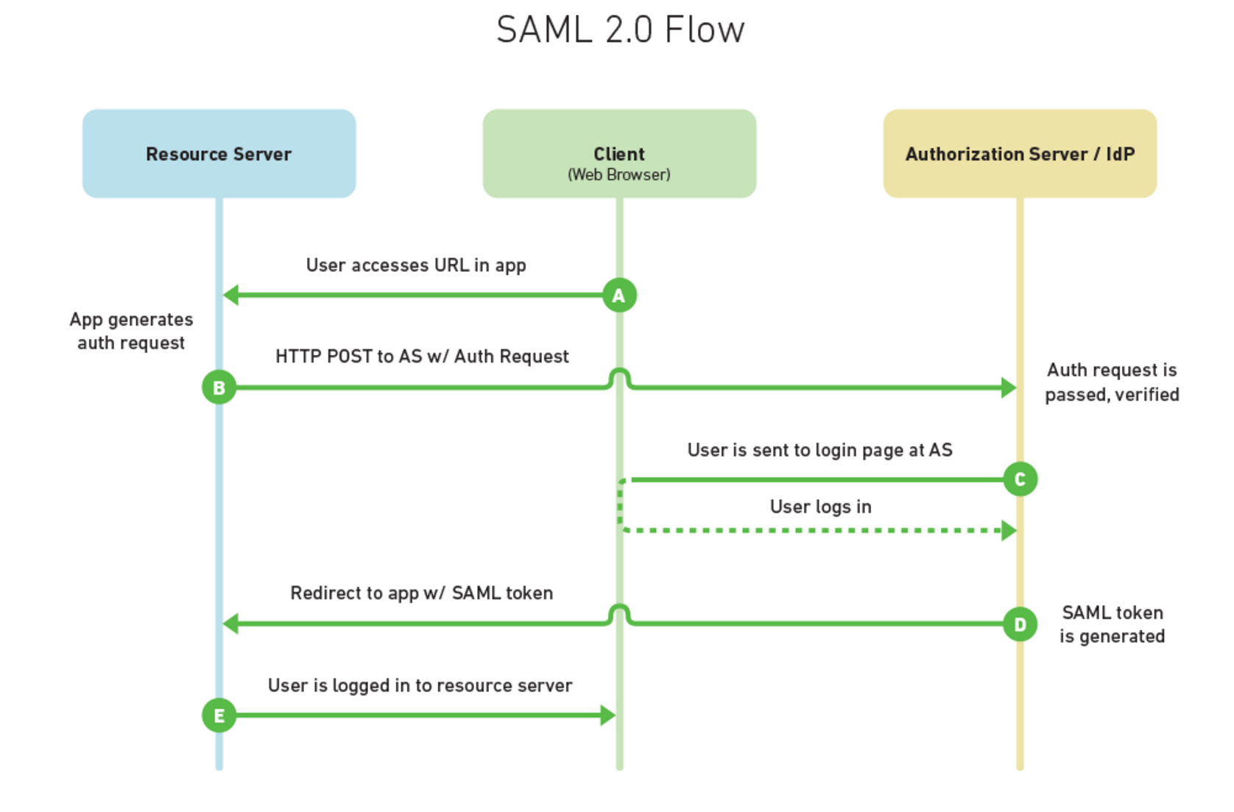
SAML 2.0 flow
Notes:
A - a user opens their web-browser and goes to MyPhotos.com which stores all of their photos. MyPhotos.com doesn't handle authentication itself.
B - to authenticate the user MyPhotos.com constructs a SAML Authnrequest, signs it, optionally encrypts it, and encodes it. After which, it redirects the user's web browser to the Identidy Provider (IdP) in order to authenticate. The IdP receives the request, decodes it, decrypts it if necessary, and verifies the signature.
C - With a valid Authnrequest the IdP will present the user with a login form in which they can enter their username and password.
D- Once the user has logged in, the IdP generates a SAML token that includes identity information about the user (such as their username, email, etc). The Id takes the SAML token and redirects the user back to the Service Provider (MyPhotos.com).
E - MyPhotos.com verifies the SAML token, decrypts it if necessary, and extracts out identity information about the user, such as who they are and what their permissions might be. MyPhotos.com now logs the user into its system, presumably with some kind of cookie and session.
At the end of the process the user can interact with MyPhotos.com as a logged in user. The user's credentials never passed through MyPhotos.com, only through the Identity Provider.

Slide 34
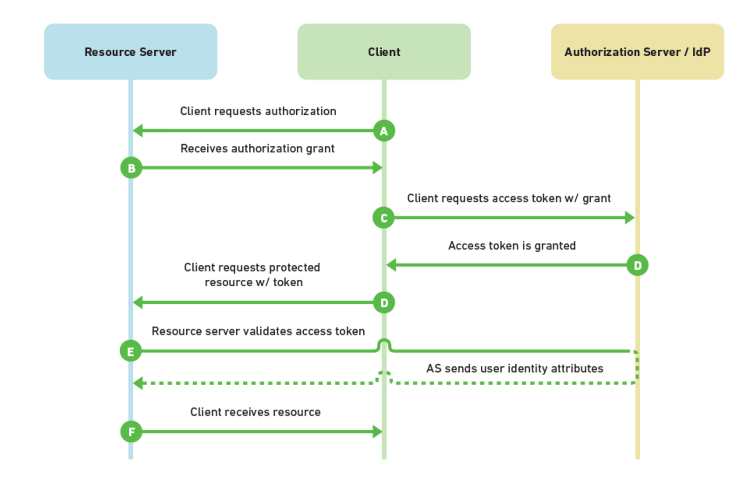
Oauth 2.0 flow
Notes:
A - a user opens their web-browser and goes to MyPhotos.com which stores all of their photos. MyPhotos.com doesn't handle authentication itself, so the user is redirected to the Authorization Server with a request for authorization. The user is presented with a login form and is asked if they want to approve the Resource Server (MyPhotos.com) to act on their behalf. The user logs in and they are redirected back to MyPhotos.com.
B - the client receives an authorization grant code as a part of the redirect and then passes this along to the client.
C - the Client then uses that authorization grant code to request an access token from the Authorization Server.
D - if the authorization grant code is valid, then the Authorization Server grants an access token. The access token is then used by the client to request resources from the Resource Server (MyPhotos.com).
E - MyPhotos.com receives the request for a resource and it receives the access token. In order to make sure it's a valid access token it sends the token directly to the Authorization Server to validate. If valid, the Authorization Server sends back information about the user.
F - having validated the user's request MyPhotos.com sends the requested resource back to the user.
This is the most common OAuth2 flow: the authorization code flow. OAuth2 provides three other flows (or what they call authorization grants) which work for slightly different scenarios, such as single page javascript apps, native mobile apps, native desktop apps, traditional web apps, and server-side applications where a user isn't directly involved but they've granted you permission to do something on their behalf.

