Slide 1


Zipkin
Distributed Tracing

Slide 2
Topic
Distributed Tracing
Zipkin
Spring Cloud Sleuth
Roadmap

Slide 3
Challenges Of MicroServices
Configuration Management
Service Registration & Discovery
Routing & Load Balancing
Fault Tolerance
Monitoring
Tracing
Notes:
We talk about all the wonderful things that can be achieved from Microservices architecture.
Monolith-> SOA -> Microservices is a continuum and most orgs and somewhere in the middle. When we moved from monolith -> micro services, the challenges got transferred to the microservices ecosystem.
[Talk about challenges]
Monitoring and Logging is all good but sometimes you have request say x which took over 1 sec, who get that info through your logs. Lets say you have 4 microservices
Well back in 2008, Google was facing a similar challenge with complex, large-scale distributed systems. Their applications were collections of software modules that may be developed by different teams, perhaps in different programming languages, and could span many thousands of machines across multiple physical facilities…. Understanding system behavior in this context requires observing related activities across many different programs and machines

Slide 4
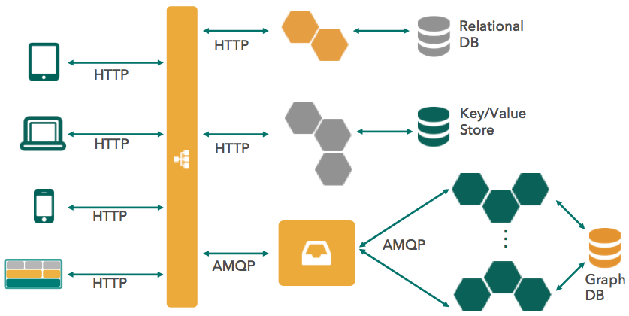
Distributed Tracing
Distributed tracing systems collect end-to-end latency graphs (traces)
in near real-time
Notes:
Microservice and data pipeline architectures are a often a graph of components distributed across a network.
A call graph or data flow can become delayed or fail due to the nature of the operation, components, or edges between them.
We want to understand our current architecture and troubleshoot latency problems, in production. Most importantly answer questions like 1) When was the event and how long did it take? 2) Where did this happen? 3) Which event was it? 4) Is it abnormal?
Polyglot microservice and data flow architectures are increasingly easy to write and deploy. You don’t need a wizard to deploy them nowadays and you shouldn’t need one to troubleshoot them, With this in mind Distributed Systems were created.
Since the adoption of SOA/microservice architectures (with REST services taking a central place in them), systems become more and more distributed. The importance of having the visibility of how each request travels from the client to the service and from service to service till the eventual response is being constructed is hard to overestimate. Distributed tracing systems are designed to solve that.
Collect graphs of info about your call maybe even real time.

Slide 5
Dapper
Google’s production distributed systems tracing infrastructure
Design Goals :
Low overhead
Application-level transparency
Scalability
Based on :
Traces and Spans
Notes:
Dapper is a Large-Scale Distributed Systems Tracing Infrastructure. Googlge designed and started using it in 2008 and finally wrote a paper about it in 2010.
• Low overhead: the tracing system should have negligible
performance impact on running services. In
some highly optimized services even small monitoring
overheads are easily noticeable, and might compel
the deployment teams to turn the tracing system
off.
• Application-level transparency: programmers
should not need to be aware of the tracing system.
A tracing infrastructure that relies on active collaboration
from application-level developers in order
to function becomes extremely fragile, and is often
broken due to instrumentation bugs or omissions,
therefore violating the ubiquity requirement. This
is especially important in a fast-paced development
environment such as ours.
• Scalability: it needs to handle the size of Google’s
services and clusters for at least the next few years.

Slide 6
A Trace is a graph of spans in context
Time
Frontend Request (Trace id: 1, Span id : 1)
Trace id : 1
Parent id : 1
Span id : 2
Trace id : 1
Parent id : 1
Span id : 3
Trace id : 1
Parent id : 3
Span id : 4
Trace id : 1
Parent id : 3
Span id : 5
Notes:
The trace give u the structure through which you can identify your calls. You can you can think about trace as a tree and the tree nodes as spans.
The edges indicate a casual relationship between a span and its parent span. Independent of its place in a larger trace tree, though, a span is also a simple log of timestamped records which
encode the span’s start and end time, any RPC timing data, and zero or more application-specific annotations

Slide 7


Span – An individual operation
Operation
Events
Server Received
Server Sent
Tags
Notes:
A span is an individual operation that took place. It contains time stamped events and tags.
Tags : When you troubleshooting, u can search by these tags. Can be uri’s or anything.
Span: The basic unit of work. For example, sending an RPC is a new span, as is sending a response to an RPC. Span’s are identified by a unique 64-bit ID for the span and another 64-bit ID for the trace the span is a part of. Spans also have other data, such as descriptions, timestamped events, key-value annotations (tags), the ID of the span that caused them, and process ID’s (normally IP address).
Spans are started and stopped, and they keep track of their timing information. Once you create a span, you must stop it at some point in the future.

Slide 8
Tracers create Spans
Tracers execute in your production apps! They are written to not log too much, and to have
propagate structural data in-band, and the rest out-of-band
have instrumentation or sampling policy to manage volume
often include opinionated instrumentation of layers such as HTTPnot cause applications to crash.

Slide 9
Tracing Systems
Tracing systems collect, process and present data reported by tracers.
aggregate spans into trace trees
provide query and visualization for latency analysis
have retention policy (usually days)

Slide 10
Zipkin
Open Sourced Distributed Systems Tracing from Twitter
Implementation based on Dapper Paper by Google
Adrian Cole (Spring Cloud) is the main contributor
Goals :
Aggregate spans into trace trees
Provide query and visualization for latency analysis
Have retention policy
Notes:
Zipkin is a tracing system. Zipkin started out as a project during our first Hack Week. During that week we implemented a basic version of the Google Dapper paper for Thrift. Today it has grown to include support for tracing Http, Thrift, Memcache, SQL and Redis requests. These are mainly done via our Finagle library in Scala and Java, but we also have a gem for Ruby that includes basic tracing support. It should be reasonably straightforward to add tracing support for other protocols and in other libraries.
Find a core library which the devs already use and sneak that code in for free. That library inside tweeter is called Finagle
Finagle is an extensible RPC system for the JVM, used to construct high-concurrency servers. Finagle implements uniform client and server APIs for several protocols, and is designed for high performance and concurrency. Most of Finagle’s code is protocol agnostic, simplifying the implementation of new protocols.
It does it’s a wrapper written in scala wraps different protocol like thrift, http, memcache servers deals with load balancing, retries. Most services within Twitter uses

Slide 11
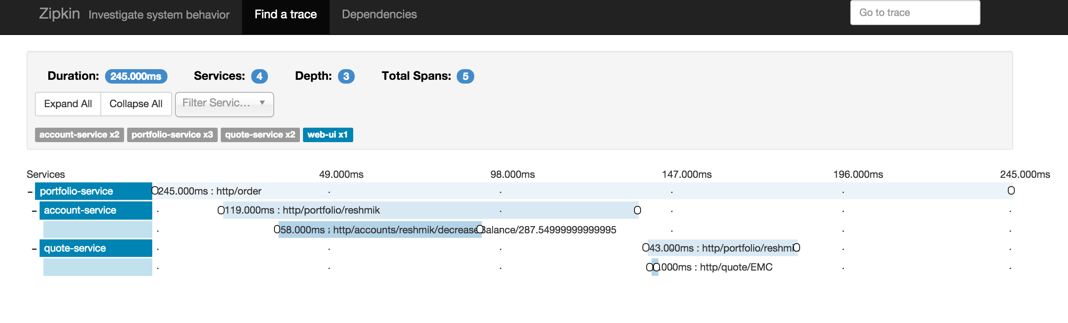
Zipkin

Slide 12
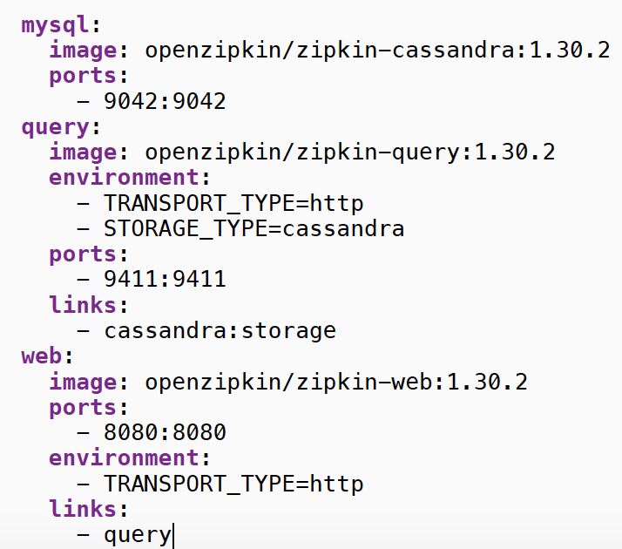
Zipkin Architecture
Tracers collect timing data and
transport it over HTTP or Kafka.
Collectors store spans in MySQL or
Cassandra.
Users query for traces via Zipkin’s
Web UI or Api.
Notes:
The architecture is pluggable.

Slide 13
Zipkin
Zipkin was created by Twitter in 2012. In 2015, OpenZipkin became the primary fork.
OpenZipkin is an org on GitHub. It contains tracers, OpenApi spec,
service components and docker images.
https://github.com/openzipkin https://gitter.im/openzipkin/zipkin

Slide 14
Spring Cloud Sleuth
It includes instrumentation for Spring Boot, and a streaming collector.
Report to zipkin via HTTP by depending on spring-cloudsleuth-zipkin https://github.com/spring-cloud/spring-cloud-sleuth
Notes:
Spring Cloud Stream is also available, providing a more flexible and scalable pipeline.

Slide 15
Architectural Diagram
Transport
Mq/Http/Log
App
Sleuth
Collector
App
Sleuth
App
Sleuth
Query Server
Span Store

Slide 16
Spring Cloud Sleuth
Distributed Tracing Solution for Spring Cloud
Transparent to application developer
Include starter BOM on app build system
<dependency>
<groupId>org.springframework.cloud</groupId>
<artifactId>spring-cloud-starter-zipkin</artifactId>
</dependency>
Specify “sampler” @Bean public AlwaysSampler defaultSampler() { return new AlwaysSampler(); }

Slide 17
Road Map (Distributed Tracing + PCF)
Envision SCS marketplace service
Beta Q2, Commercial Q3
Future versions might merge with Metrix

Slide 18
Demo

