Slide 1


Spring Cloud
Config Server
Reshmi Krishna
Notes:
In this presentation we’re going to cover cloud native architecture

Slide 2
Configuration Management
Config
Server
Service
Registry
Circuit Breaker Dashboard
Tracing Dashboard
Client
UI
(JavaScript)
UI Server
Proxy
Edge
Service
Backend Service
Circuit Breaker
Load Balancing
Backend Service
Backend Service
Notes:
We know from 12 factor that we want to extract configuration that will be different between dev, test, and prod, but where do we put it and how do we manage updates across a distributed web of applications?

Slide 3
AGENDA
Review Config Magement
Config Server
Config Client
Spring Cloud Services

Slide 4
AGENDA
Review Config Magement
Config Server
Config Client
Spring Cloud Services

Slide 5
Config in a Spring Context
Spring has provided several approaches to setting config
Still, gaps exist:
Changes to config require restarts
No audit trail
Config is de-centralized
Notes:
Configuration in a Spring context can usually be described as values that wire up Spring beans.
Spring has provided several approaches to setting config, including externalizing (via Command Line argumments, Env Variables, etc.)
Still, gaps exist:
Changes to config require restarts
No audit trail
Config is de-centralized
No support for sensitive information (no encryption capabilities)

Slide 6
Config in a 12 Factor Context
12 Factor application design states that configuration should be kept in OS environment variables.
In Pivotal Cloud Foundry, this is accomplished in the following ways:
Using the cf set-env command
Using a manifest with env: sections
Notes:
12 Factor application design states that configuration should be kept in OS environment variables.
In Pivotal Cloud Foundry, this is accomplished in the following ways:
Using the cf set-env command
Using a manifest with env: sections
This works well for applications with less demanding configuration needs.

Slide 7
Challenges When Using Env. Variables
Managing many env variables can be a challenge
Pivotal Cloud Foundry uses immutable containers
Any configuration change requires restarting the app
If you want zero downtime then do blue/green deployments
Notes:
Often times we want more capabilities because of the following:
Managing many env variables can be a challenge
Pivotal Cloud Foundry uses immutable containers.
Any configuration change requires restarting the app.
If you want zero downtime then blue/green deployments are necessary. This may be too much overhead.

Slide 8
More Demanding Config Use Cases
Debugging a production issue
Report all configuration changes made to a production system to support regulatory audits
Toggle features on/off in a running application
Notes:
Changing logging levels of a running application in order to debug a production issue
Change the number of threads receiving messages from a message broker
Report all configuration changes made to a production system to support regulatory audits
Toggle features on/off in a running application
Protect secrets (such as passwords) embedded in configuration

Slide 9
Externalized Configuration
Configuration Mgmt approach should support:
Versioning
Auditability
Refresh without restart
Notes:
Q: How can these new use-cases be handled?
A: Externalize configuration to a service.
Configuration Mgmt approach should support:
Versioning
Auditability
Encryption
Refresh without restart

Slide 10
AGENDA
Review Config Magement
Config Server
Config Client
Spring Cloud Services

Slide 11
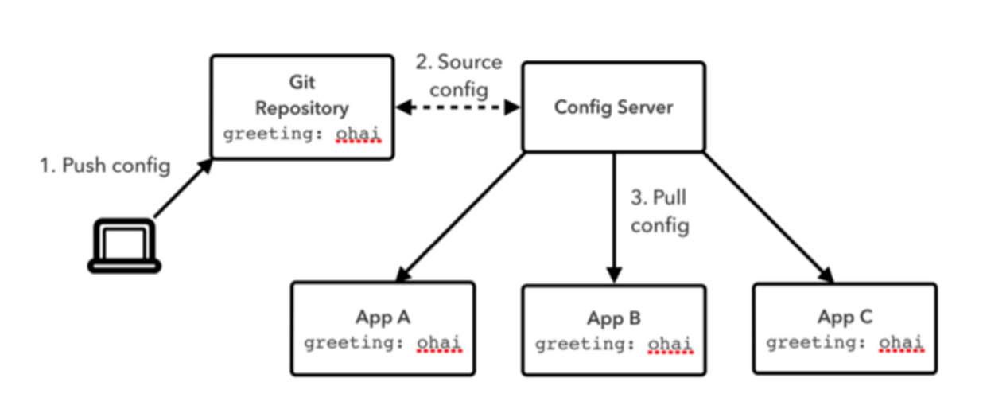
Configuration Flow

Slide 12
Spring Cloud Config Server
The Server provides an HTTP, resource-based API for external configuration
Bind to the Config Server and initialize Spring Environment
Embeddable using @EnableConfigServer
Include spring-cloud-config-server dependency
Notes:
The Server provides an HTTP, resource-based API for external configuration (name-value pairs, or equivalent YAML content).
Bind to the Config Server and initialize Spring Environment with remote property sources
Embeddable easily in a Spring Boot application using @EnableConfigServer
Encrypt and decrypt property values (symmetric or asymmetric) -> JCE extension
If the remote property sources contain encrypted content (values starting with {cipher}) they will be decrypted before sending to clients over HTTP. The main advantage of this set up is that the property values don’t have to be in plain text when they are "at rest" (e.g. in a git repository).
To use the encryption and decryption features you need the full-strength JCE installed in your JVM (it’s not there by default). You can download the "Java Cryptography Extension (JCE) Unlimited Strength Jurisdiction Policy Files" from Oracle, and follow instructions for installation (essentially replace the 2 policy files in the JRE lib/security directory with the ones that you downloaded).

Slide 13
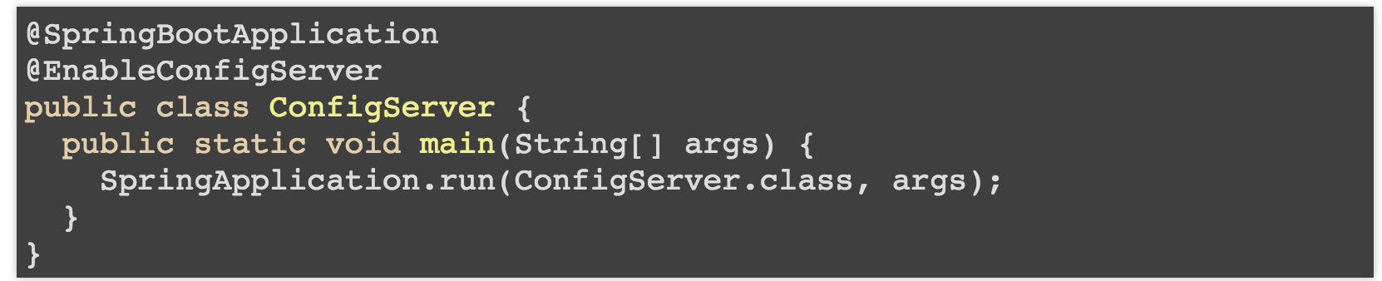
Embedded Server
The server is easily embeddable in a Spring Boot application using the @EnableConfigServer annotation.
Notes:
This app is a config server:

Slide 14
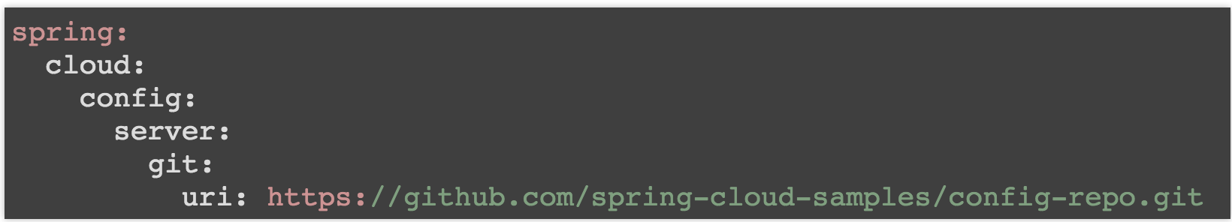
Server Config
Application configuration data is stored in a backend
Git, Subversion and File System backends are supported
Notes:
Application configuration data is stored in a backend
Git, Subversion and File System backends are supported
Git is the default backend. It's great for auditing changes and managing upgrades
Setting the git backend is done via the spring.cloud.config.server.git.uri configuration property

Slide 15
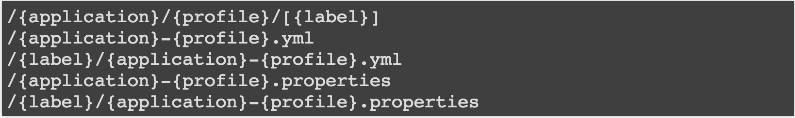
Server Endpoints
Config server exposes config on the following endpoints:
Notes:
{application} maps to "spring.application.name" on the client side;
{profile} maps to "spring.active.profiles" on the client (comma separated list); and
{label} which is a server side feature labelling a "versioned" set of config files.

Slide 16
Configuration Files
spring.application.name=foo
spring.active.profiles=dev
Repo Files :
application.yml - shared between all clients
application-dev.yml – shared and profile specific
foo.yml - app specific
foo-dev.yml - app and profile specific
Notes:
Config files are stored in the git repository.
Example Input:
spring.application.name=foo
spring.active.profiles=dev
Union of all sources with overriding behavior.
Repo Files:
application.yml - shared between all clients
application-dev.yml - shared between all clients but profile specific (takes precedence over application.yml)
foo.yml - app specific (takes precedence over application.yml files)
foo-dev.yml - app and profile specific (takes precedence over foo.yml)

Slide 17
AGENDA
Review Config Magement
Config Server
Config Client
Spring Cloud Services

Slide 18
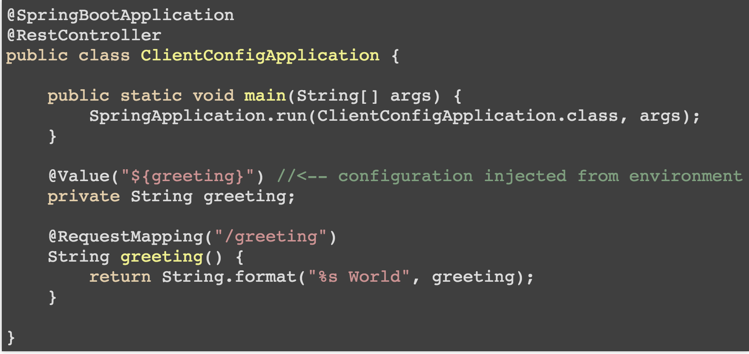
Client Application
Notes:
Typical Spring Configuration without Spring Cloud Config:

Slide 19
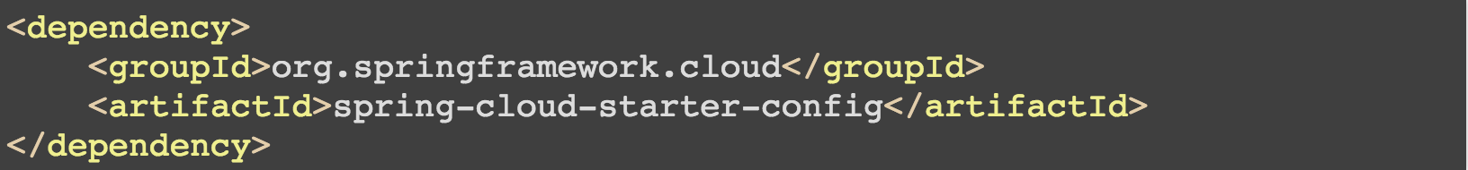
Include Dependency

Slide 20
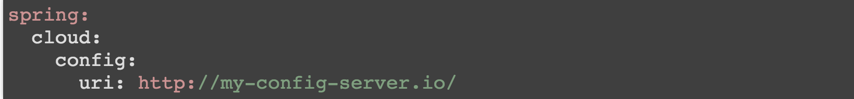
Client Config
Sample bootstrap.yml
spring.cloud.config.uri defaults to http://localhost:8888
Notes:
For Spring clients to use the configuration server, specify the spring.cloud.config.uri configuration property:
Sample bootstrap.yml

Slide 21
Refreshable Application Components
What can be refreshed in a Spring Application?
Loggers logging.level.*
@ConfigurationProperties beans
Beans with @RefreshScope annotation

Slide 22
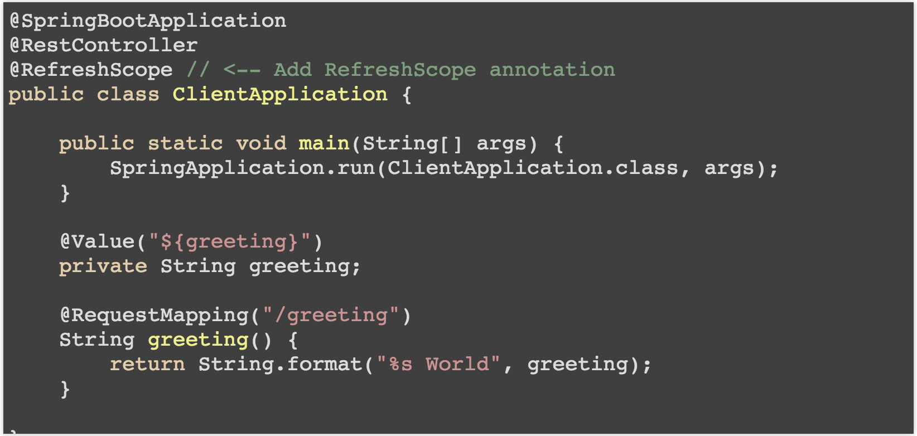
@RefreshScope

Slide 23
Refreshing Configuration
Two step process
1) Update Repository
2) Send a request to the application(s)
Send a POST request to the refresh endpoint in the client app to fetch updated config values:
http://127.0.0.1:8080/refresh
Requires the Actuator dependency on the classpath (pom.xml).
Notes:
<dependency>
<groupId>org.springframework.boot</groupId>
<artifactId>spring-boot-starter-actuator</artifactId>
</dependency>

Slide 24
Spring Cloud Bus
Leverage Spring Cloud Bus pub/sub notification with RabbitMQ
Send a POST request to the refresh endpoint to fetch updated config values:
http://127.0.0.1:8080/bus/refresh
Requires the Cloud Bus AMQP dependency on the classpath (pom.xml)
Notes:
When running many applications, refreshing each one can be cumbersome.
<dependency>
<groupId>org.springframework.cloud</groupId>
<artifactId>spring-cloud-starter-bus-amqp</artifactId>
</dependency>

Slide 25
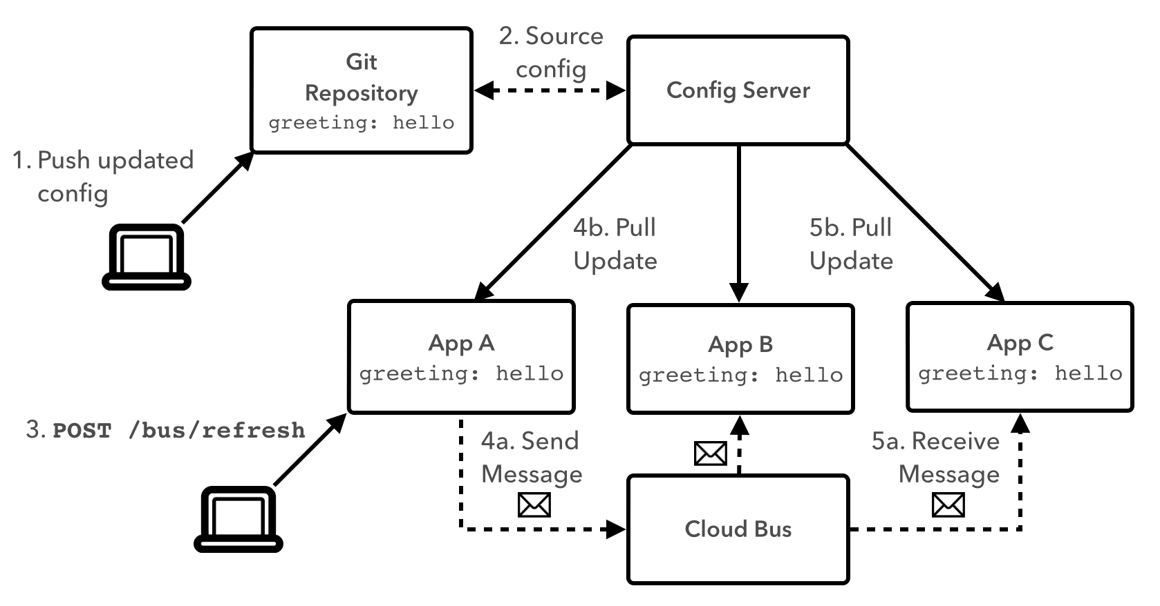
Cloud Bus Diagram
Notes:
We can use a configuration server accessible to all applications to manage configuration.
Using a version control system, like git or subversion, as a backing for the config server provides additional benefits: we can maintain an auditable history of values over time, we can correlate the values the were used at any point in time, and we can direct different versions of the app to use different versions of configuration values.
Using a cloud bus allows us to propagate changes across the distributed system. We can use a REST endpoint to trigger an application to refresh its configuration, and that app would take care of publishing the change to the shared bus.

Slide 26
Spring Cloud Services
Brings Spring Cloud to Pivotal Cloud Foundry
Includes: Config Server, Service Registry & Circuit Breaker Dashboard services

Slide 27
Spring Cloud Services: Config Server
Include dependency:
<groupId>io.pivotal.spring.cloud</groupId>
<artifactId>spring-cloud-services-starter-config-client</artifactId>
2) Create a Config Server service instance
3) Configure the service instance with a Git Repository
4) Bind the service to the app

Slide 28
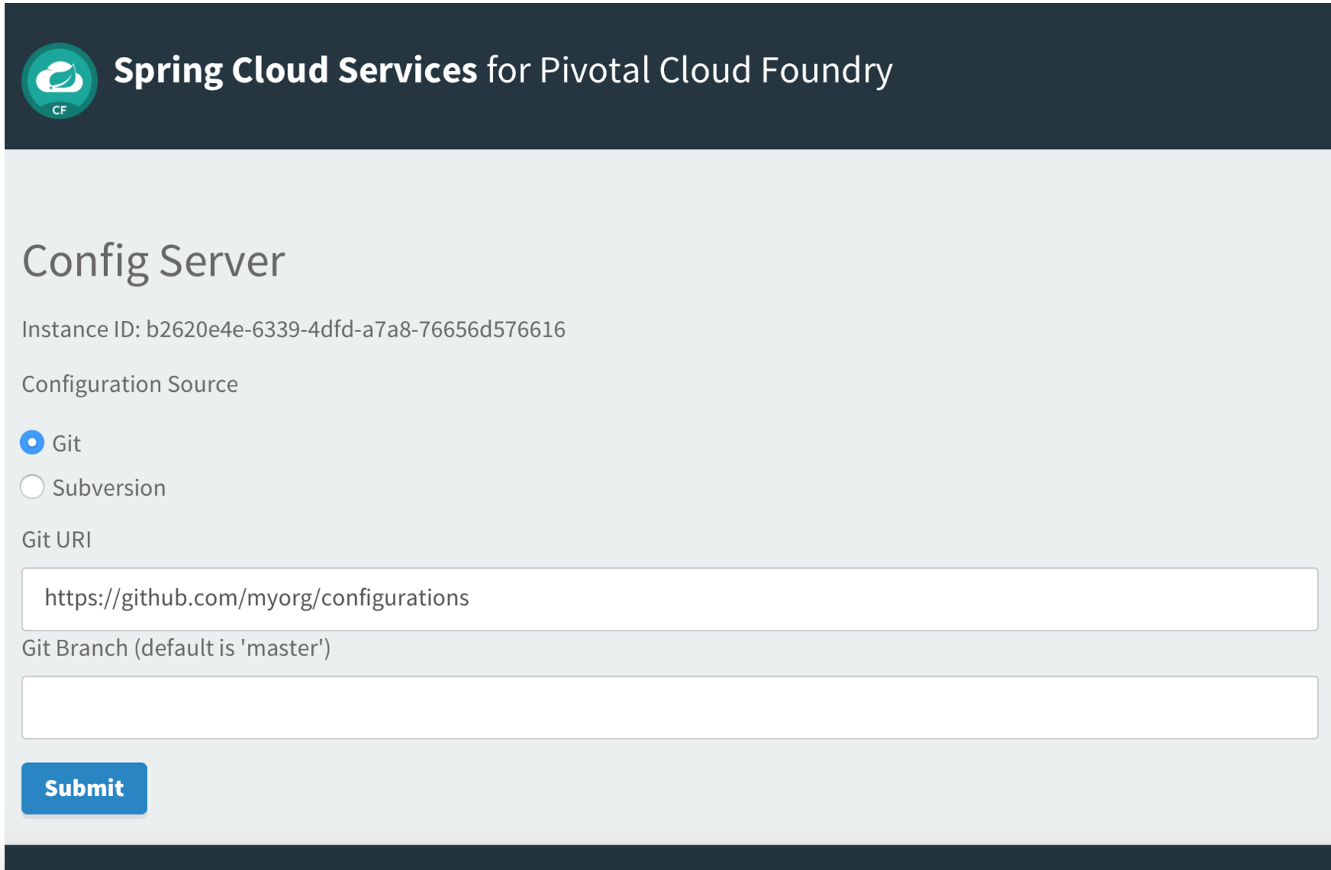
Spring Cloud Services: Config Server

Slide 29
Cloud Bus in Pivotal Cloud Foundry
Include dependency:
<dependency>
<groupId>org.springframework.cloud</groupId>
<artifactId>spring-cloud-starter-bus-amqp</artifactId>
</dependency>
2) Create a RabbitMQ service instance
3) Bind the service to the app

Slide 30
Spring Cloud Netflix:
Service Discovery
Notes:
In this presentation we’re going to cover cloud native architecture

Slide 31
Agenda
Review Service Discovery
Eureka Server
Eureka Client
Spring Cloud Services

Slide 32
Challenges
Service Discovery is one of the key tenets of a microservice based architecture.
In distributed systems, application dependencies cease to be a method call away
Trying to hand configure each client or use some form of convention can be very difficult to do and can be very brittle.
Notes:
Service Discovery is one of the key tenets of a microservice based architecture.
In distributed systems, application dependencies cease to be a method call away.
Trying to hand configure each client or use some form of convention can be very difficult to do and can be very brittle.

Slide 33
Where have we been?
How have we discovered services in the past?
Service Locators
Dependency Injection
Service Registries

Slide 34
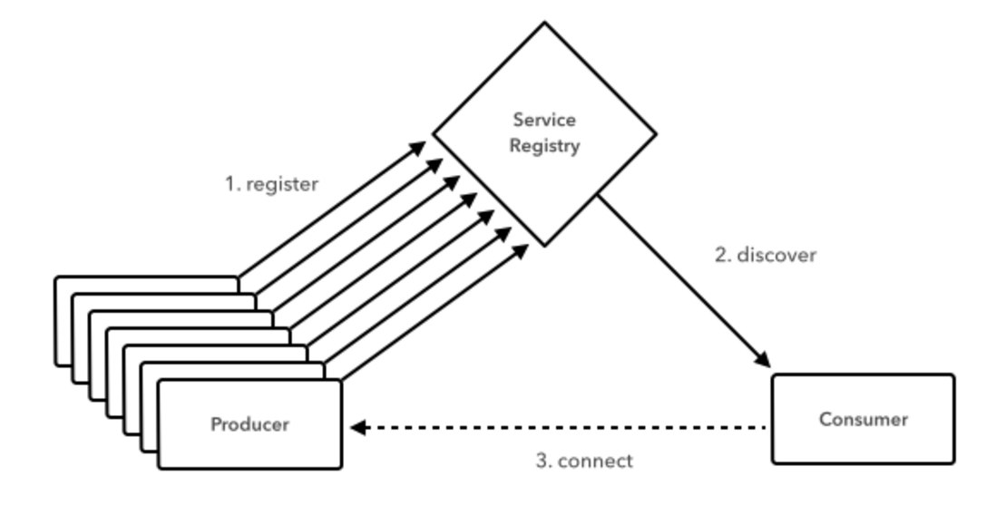
Service Discovery with Spring Cloud
Notes:
Service instances in the registry all have to send heartbeats to keep their registrations up to date
Clients also have an in-memory cache of eureka registrations (so they don’t have to go to the registry for every single request to a service)

Slide 35
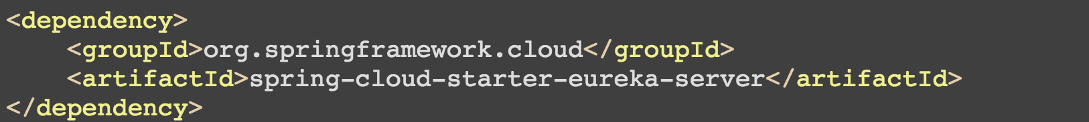
Include Dependency

Slide 36
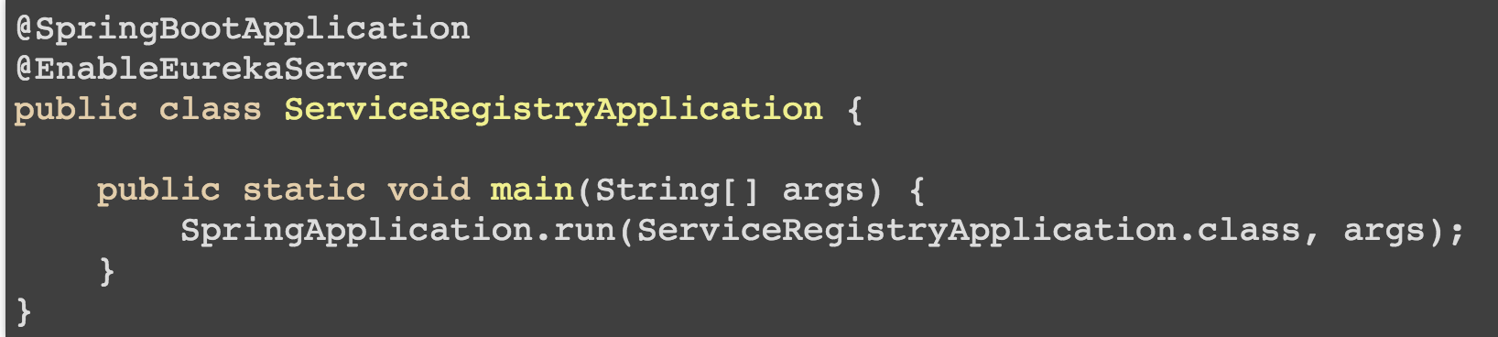
Eureka Server
Notes:
An example Eureka server. @EnableEurekaServer annotation.

Slide 37
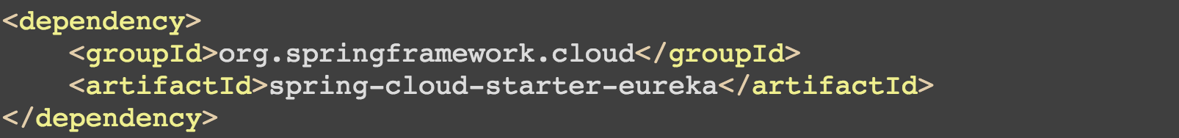
Eureka Client : Include Dependency

Slide 38
Client Application
@SpringBootApplication
@EnableDiscoveryClient
public class GreetingServiceApplication {
public static void main(String[] args) {
SpringApplication.run(GreetingServiceApplication.class, args);
}
}
Notes:
An example client application. @EnableDiscoveryClient annotation.

Slide 39
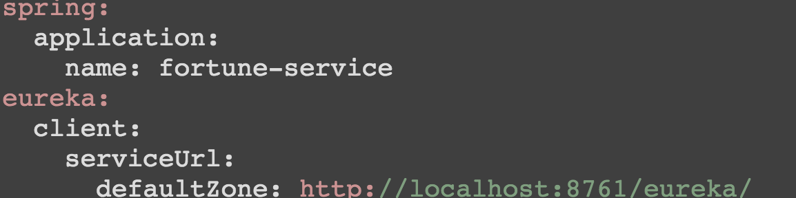
Configuration required to locate the Eureka.
application.yml
Notes:
defaultZone - the default serviceUrl to reach Eureka
spring.application.name is the name the application will use to register its service

Slide 40
Registering With Eureka
When a client registers with Eureka, it provides meta-data about itself
Eureka receives heartbeat messages from each instance belonging to a service.
If the heartbeat fails over a configurable timetable, the instance is normally removed from the registry.
Notes:
When a client registers with Eureka, it provides meta-data about itself such as host and port, health indicator URL, home page etc.
Eureka receives heartbeat messages from each instance belonging to a service. If the heartbeat fails over a configurable timetable, the instance is normally removed from the registry.

Slide 41
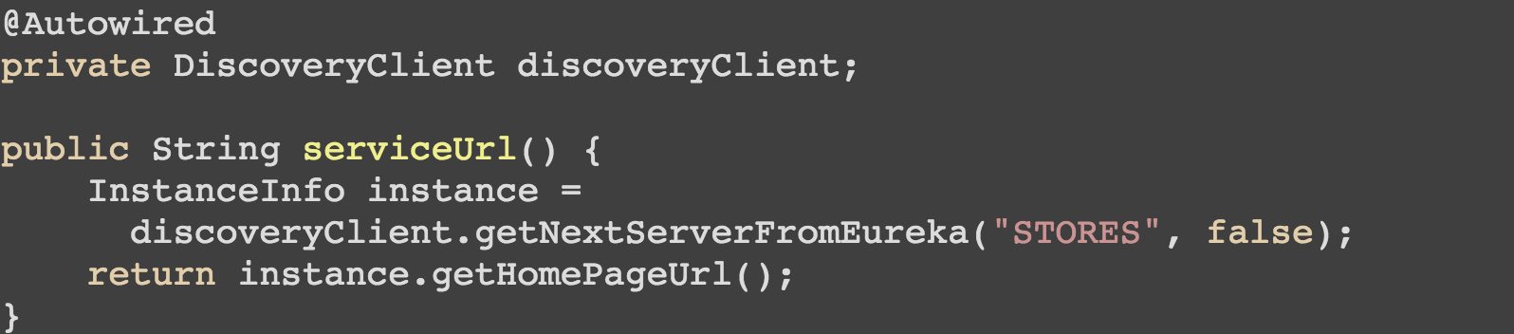
Discovery Client
Notes:
The DiscoveryClient is used to locate the stores service.

Slide 42
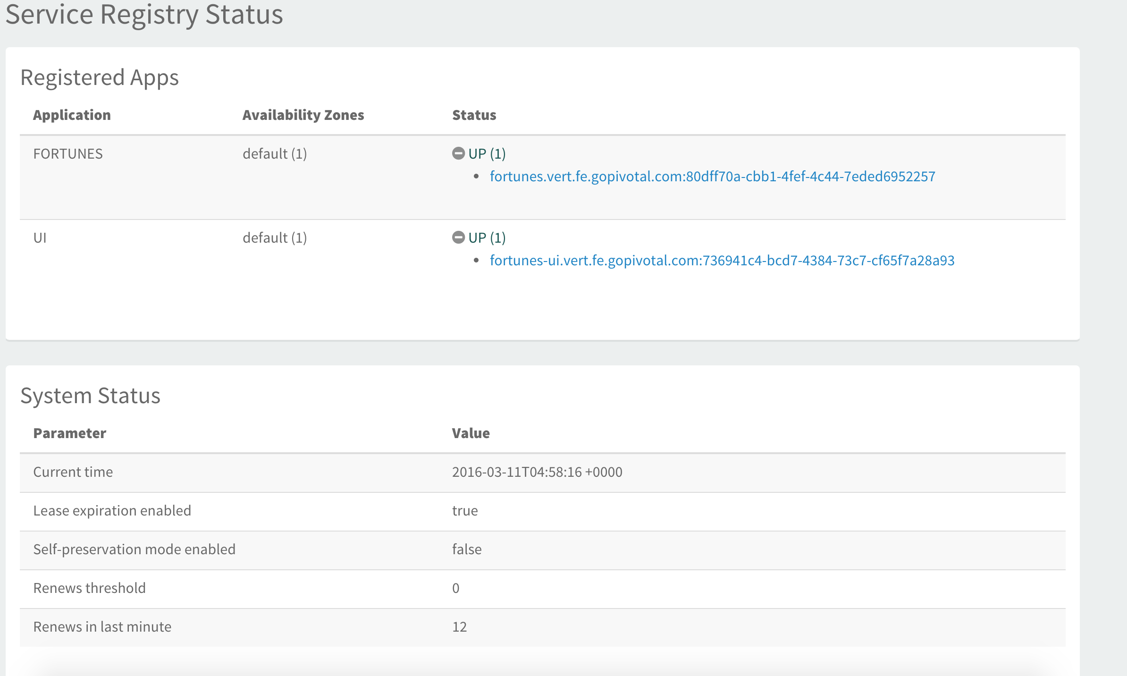
Spring Cloud Services: Service Registry

Slide 43
Spring Cloud Services: Service Registry
1) Add dependency
<dependency>
<groupId>io.pivotal.spring.cloud</groupId>
<artifactId>spring-cloud-services-starter-service-registry</artifactId>
</dependency>
2) Create a Service Registry service instance
3) Bind the service to the app

