Slide 1
Case: Predicting Net Promoter Scores
-Reshmika Reddy

Slide 2
Objectives
What are the primary factors that lead to patient becoming a "promoter" or a "detractor"? How do these factors impact the NPS status?
If the hospital chooses a 3-way classification of NPS status, what are the key factors that are associated with a patient becoming a promoter / detractor / passive? How do the factors impact the NPS status?

Slide 3
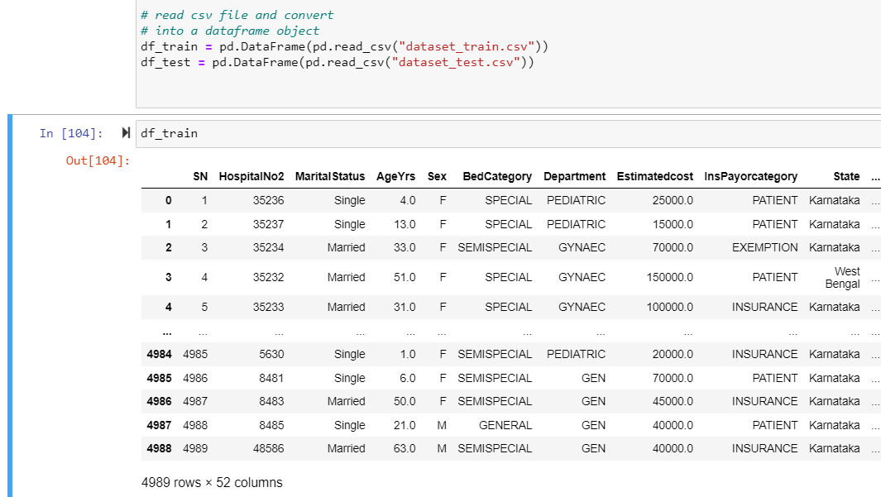
Introduction
The goal of our study is to increase the proportion of promoters and reduce the detractors.
Our target variable is ‘NPS_Status ’
Data before cleaning

Slide 4
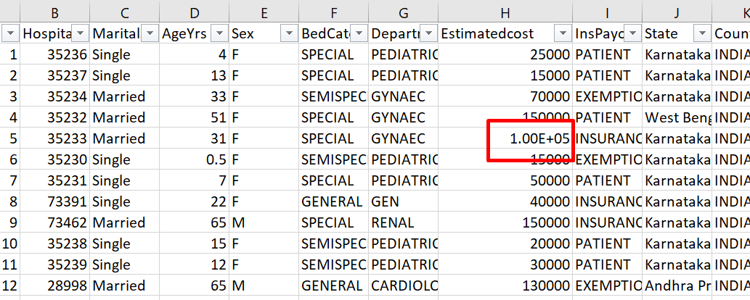
Data Cleaning
Estimated cost is normalized first and is then transformed into bins to convert the categorical to continuous variable.

Slide 5
Dropping Columns
Dropped unnecessary columns like Sn as it is not the good explanatory variable.
We drop Admission Date, Discharge Date as we already have Length of Stay.
We see significant rows as similar for State, Country and Statezone as significant data is from Karnataka, India, South so we drop the columns.

Slide 6
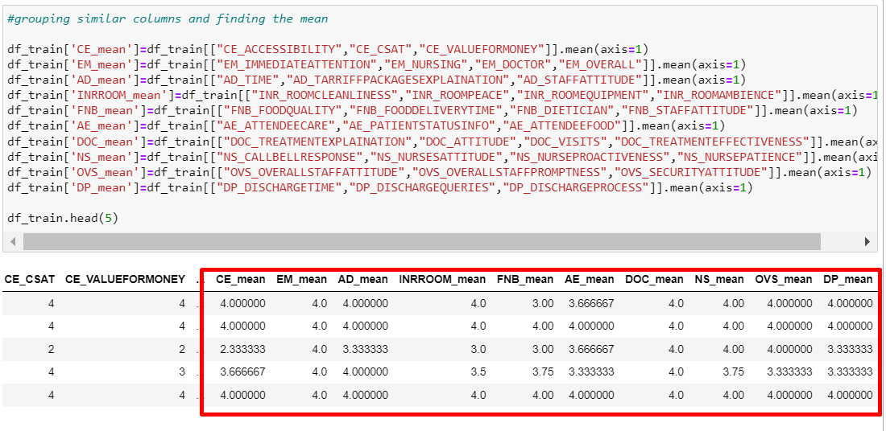
Create new features by Grouping Similar Columns
Calculating the mean by combining related columns

Slide 7
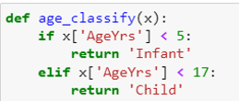
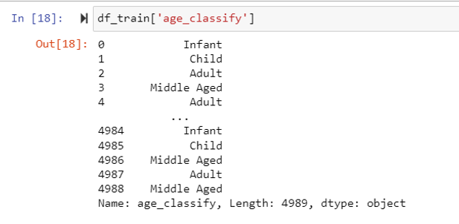
Convert AgeYrs to Bins
Since we are doing a chi square test on the feature, we decided to create bins mostly between Infant, Child, Adult, Middle Aged and Senior Citizen to analyze and see which has more impact. Since we have a new variable age_classify we drop AgeYrs.

Slide 8
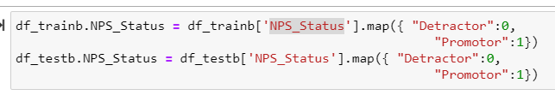
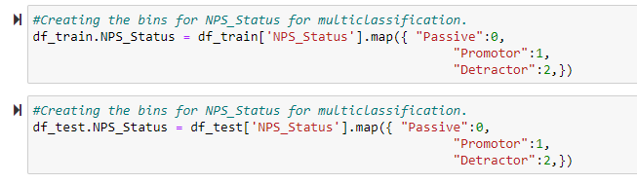
Map NPS_Status to Dummies
We have decided to create dummies of NPS_Status (Detractor = 0, Promotor = 1) for binary class analysis.
We have decided to create dummies of NPS_Status (Passive = 0, Promotor = 1, Detractor = 2) for multi class analysis.

Slide 9
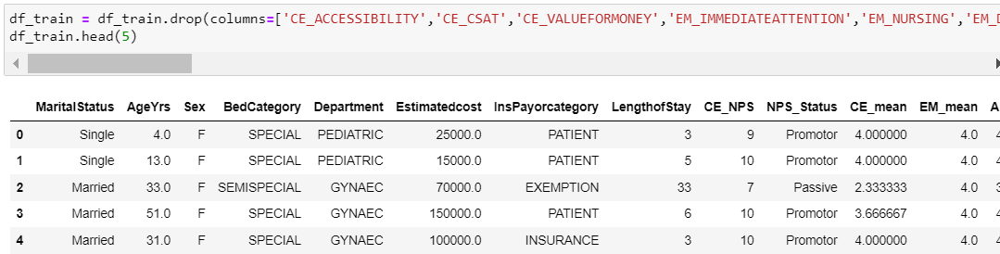
Dropping columns
Since we have created new columns by taking mean of related columns, we are dropping the related columns and keeping everything else.

Slide 10
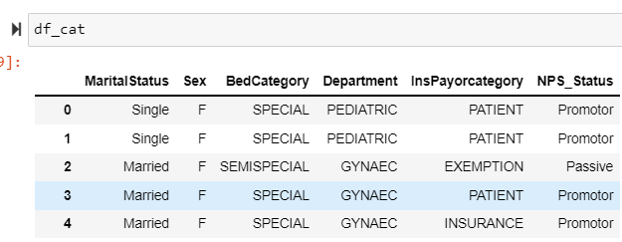
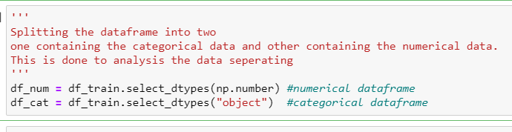
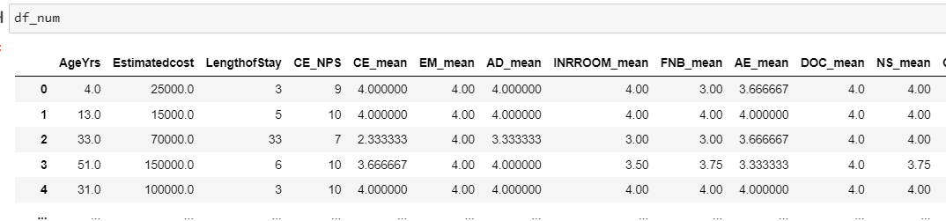
Splitting the data frame to categorical and numerical frame for further Data Exploration

Slide 11
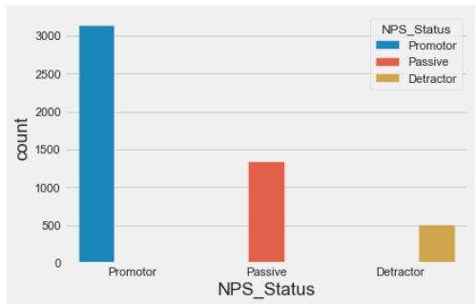
Promoter, Passive and Detractor count in the dataset

Slide 12
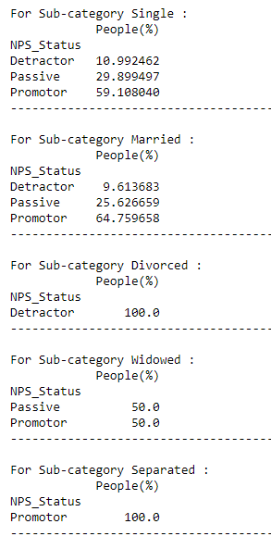
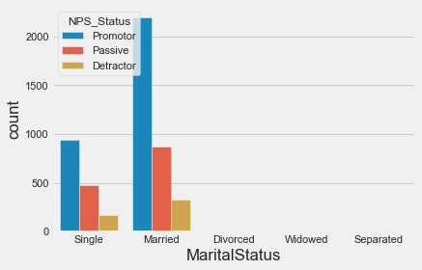
Visualizations: Multi class Features
Single and married have almost the same amount of promoters
Divorced and Separated have only detractors/promoters with very few records
Widowed have only 2 categories with 50-50 split.

Slide 13
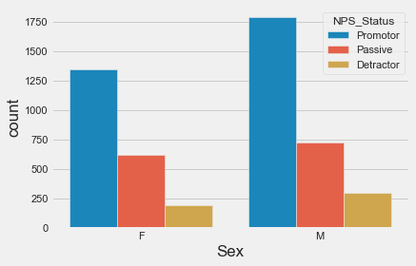
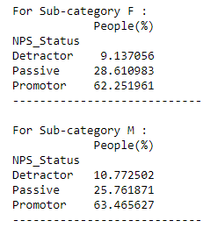
Visualizations: Multi class Features
Both male and female have
similar % of Promoters

Slide 14
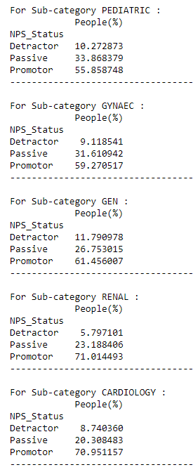
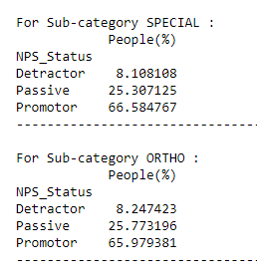
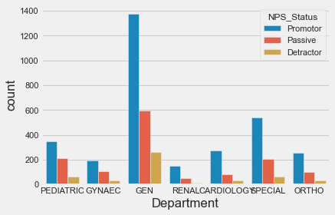
Visualizations: Multi class Features
No of promoters are the
highest in all the
departments

Slide 15
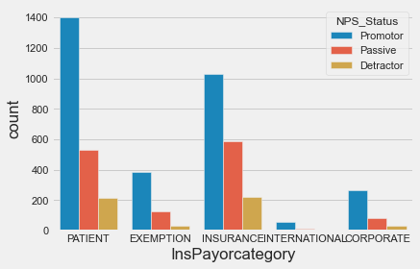
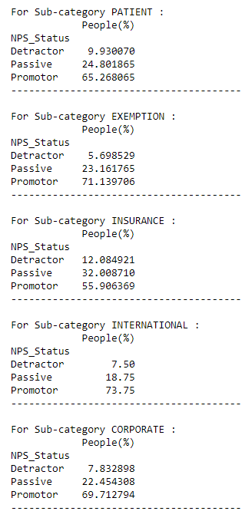
Visualizations: Multi class Features
No of promoters are the
highest in all the
InsPayorcategory

Slide 16
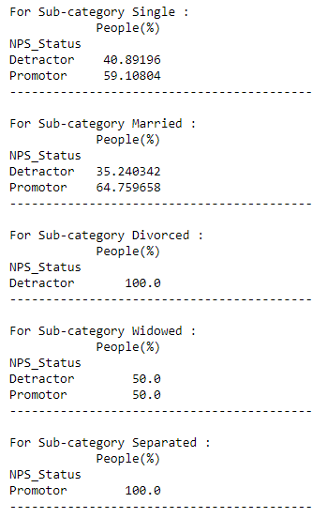
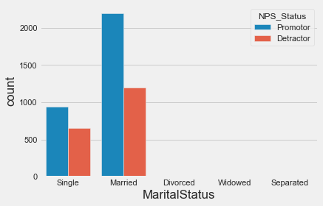
Visualizations: Binary class Features
Single and married have almost the same amount of promoters
Divorced and Separated have only detractors/promoters with very few records
Widowed have only 2 categories with 50-50 split.

Slide 17
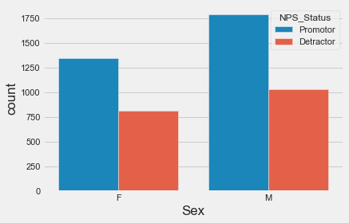
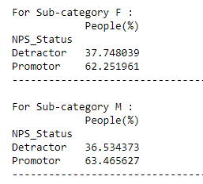
Visualizations: Binary class Features
Both male and female have
similar % of Promoters

Slide 18
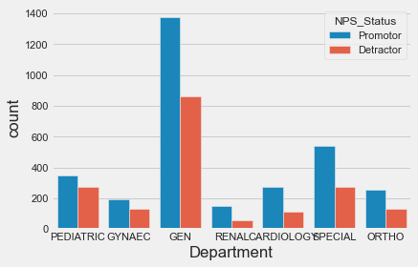
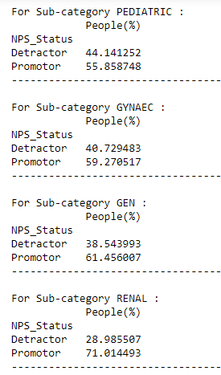
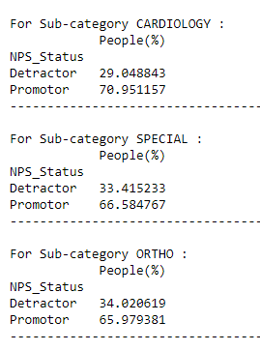
Visualizations: Binary class Features
No of promoters are the
highest in all the
departments with similar ratios between the promoters and detractors

Slide 19
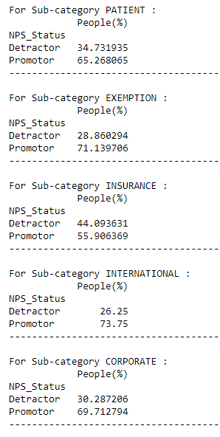
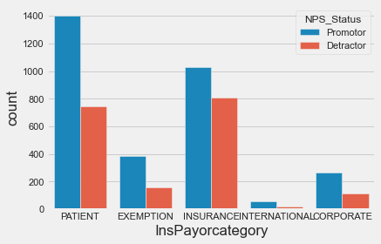
Visualizations: Binary class Features

Slide 20
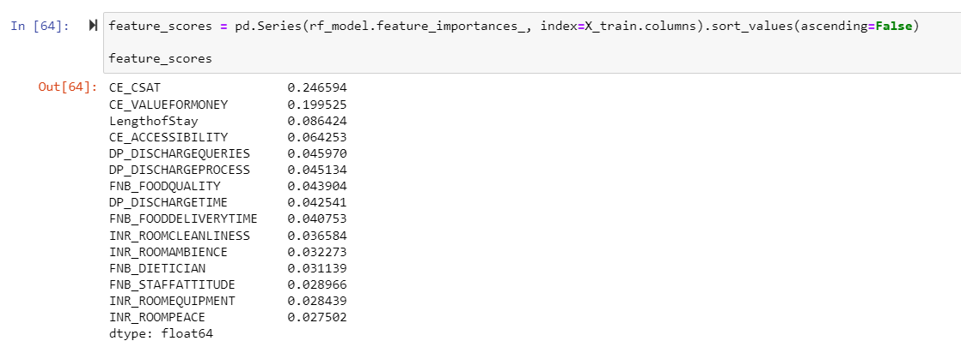
Important Features Scores for Multi Class

Slide 21
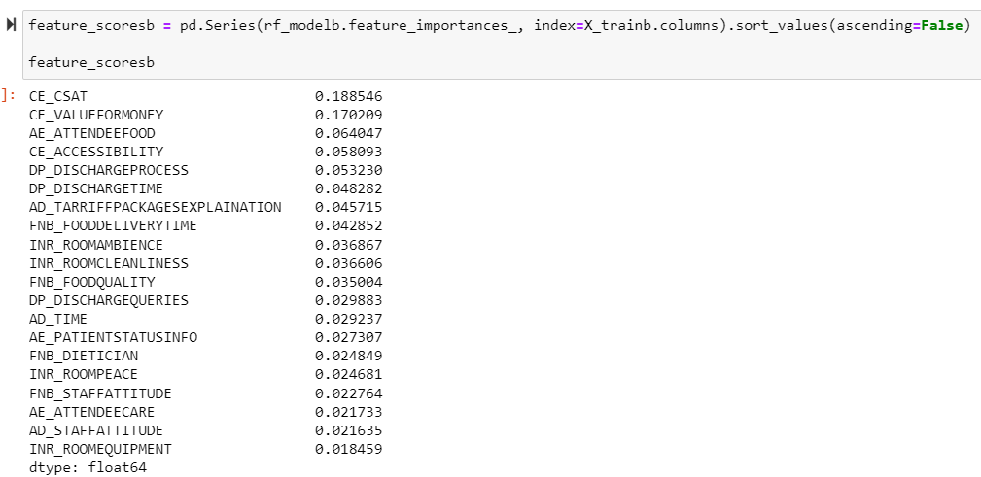
Important Features Scores for Binary Class

Slide 22
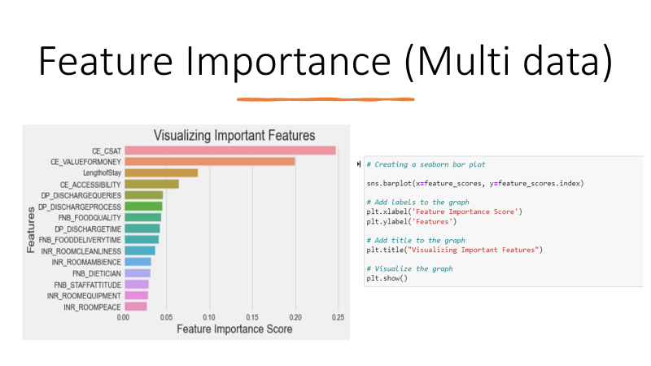

Slide 23
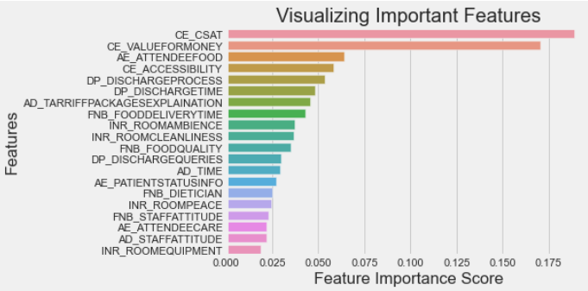
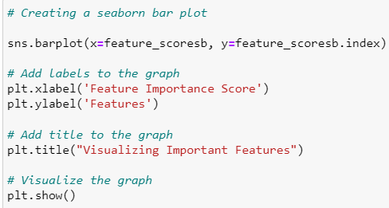
Feature Importance (Binary class)

Slide 24
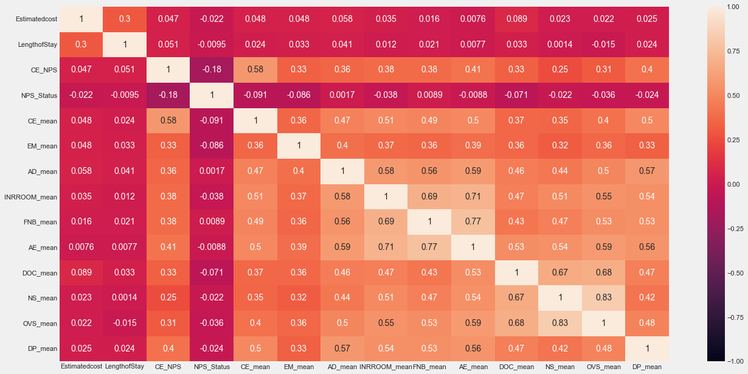
Correlation
We create a heat map and see few features are highly correlated so decide to drop them to avoid multicollinearity. We also did this to determine the type of model we need to execute.
The heat map shows that most of the columns are correlated to each other

Slide 25
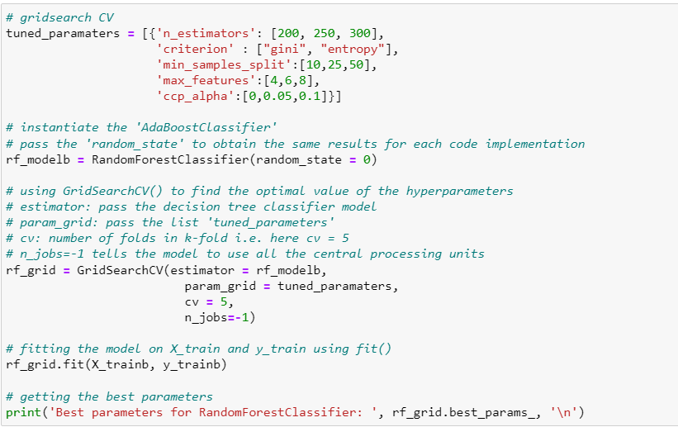
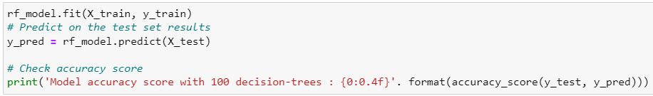
Modeling: Random Forest
We divide the training data into training and test set and then check the accuracy. We used random forest. We get the accuracy 72% binary data and 66% for multi data. Performed parameter tuning using GridSearchCV
rf_model = RandomForestClassifier(random_state = 0, n_estimators= 250 , criterion='entropy' ,max_features= 8, min_samples_split= 50)

Slide 26
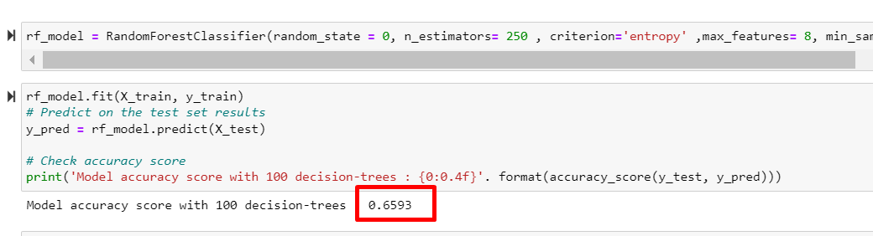
Checking Accuracy with Test Data (Multi class)
We factorised all columns in test data and then checked the accuracy using Random Forest Model. We get the accuracy 66%.

Slide 27
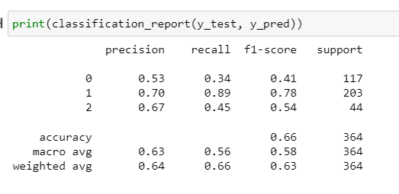
Classification Report (Multi class)
We factorised all columns in test data and then checked the accuracy using Random Forest Model. We get the accuracy 66%.

Slide 28
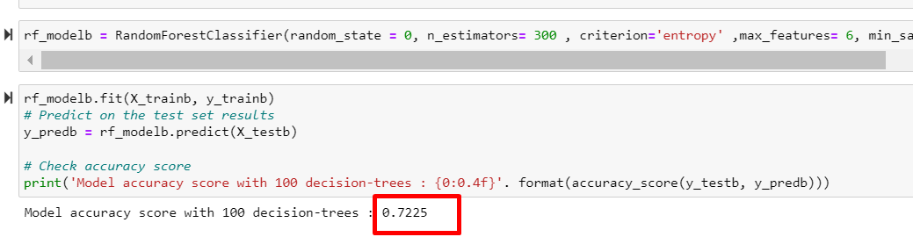
Checking Accuracy with Test Data (Binary class)
We factorised all columns in test data and then checked the accuracy using Random Forest Model. We get the accuracy 72%.

Slide 29
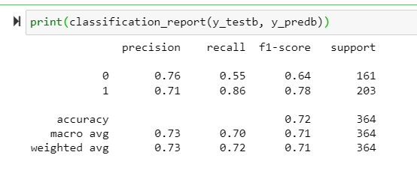
Classification Report (Binary class)
We factorised all columns in test data and then checked the accuracy using Random Forest Model. We get the accuracy 66%.

Slide 30
Things we could have done differently
We could have conducted a t-test between every numerical feature and the target feature (NPS Status, a categorical feature), and then used the p value to decide which characteristics to keep during the feature engineering stage.
We could have play around with the variables and narrowed them down such as CE_CSAT.

