Slide 1
ECODISTRICTS

Slide 2
Problem Statement
Cities currently account for 80% of greenhouse gas emissions and 75% of energy consumption.
This will have a huge impact on people life expectancy.
“How will the cities respond?”

Slide 3
Proposed Solution
Cities fail to respond due to lack of systematic framework.
By working at a scale of districts or neighborhoods, the challenge becomes more manageable and practices can be extended to impact the cities.
“ECODISTRICTS” is a powerful collaboration platform, a cutting edge of sustainability solution that use a district scale to achieve greater impact.
This protocol develops an online processes, where departments in the district gather and analyze data on the energy consumption and emissions and alert the communities whose consumption exceeds the set threshold

Slide 4
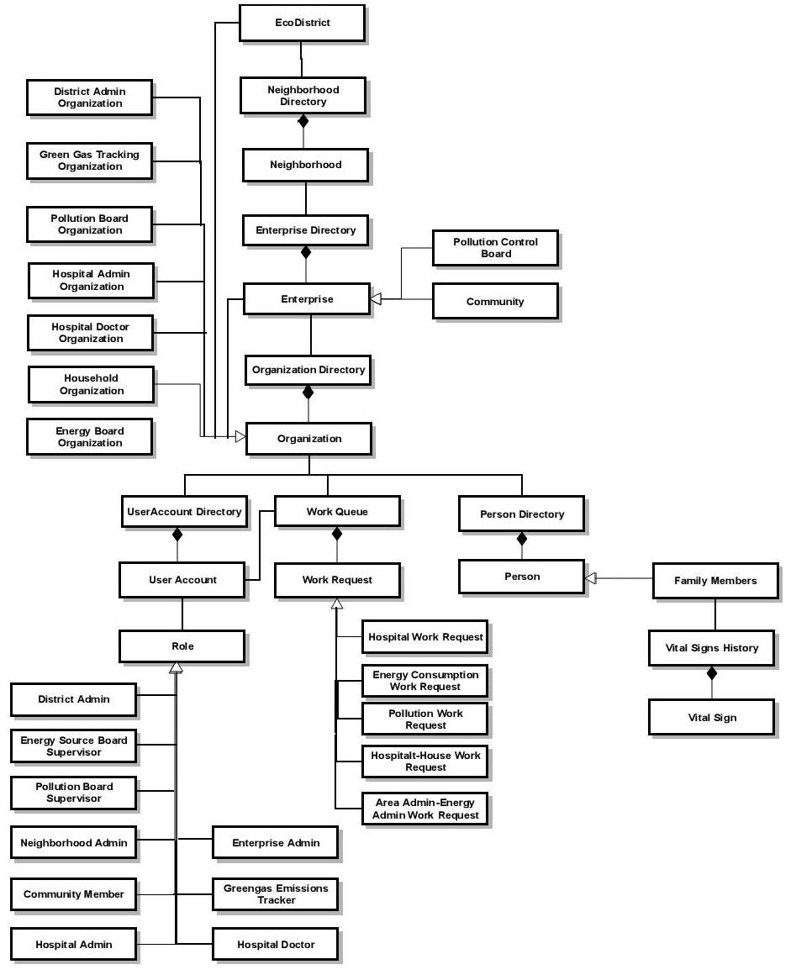

Slide 5
ROLES
District Admin
Neighborhood Admin
Enterprise Admin
Hospital Admin
Hospital Doctors
Community Member
Energy Source Board Supervisor
Green Gas Emission Tracker
Pollution Control Board Supervisor

Slide 6
Project Features
Through sensors, the vital signs and energy consumptions of the appliances are recorded.
These reading are sent to the respective organizations.
The data is analyzed and alerts are sent to the house hold admin in case of any abnormality or inefficiency
Through this application a house admin can fix an online appointment.

Slide 7
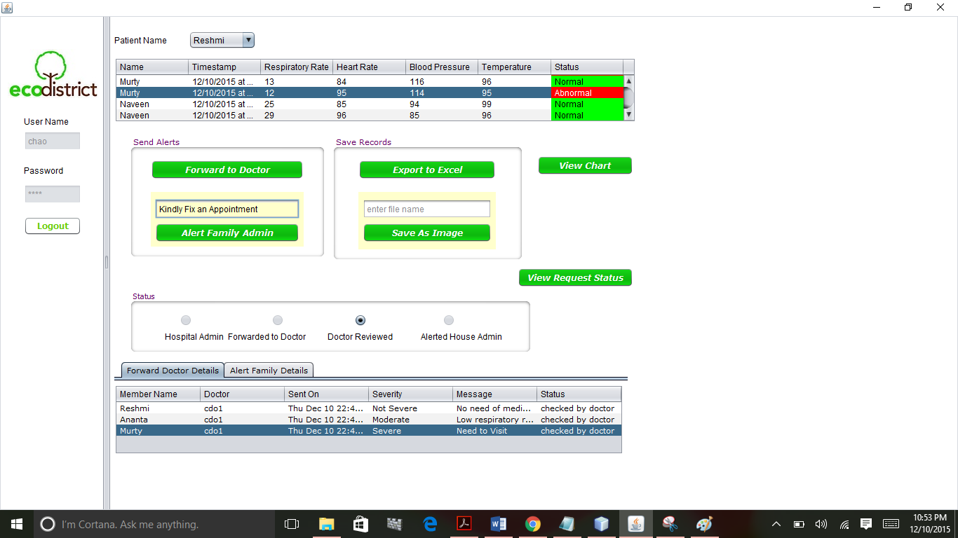
Managing Patient Vital Signs:

Slide 8
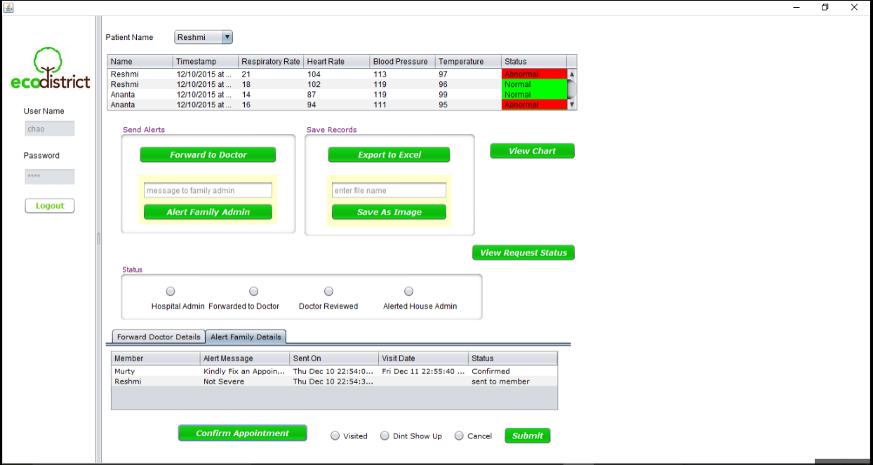
Managing Vital Signs:

Slide 9
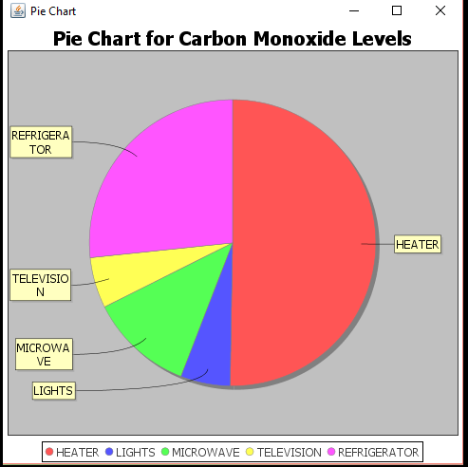
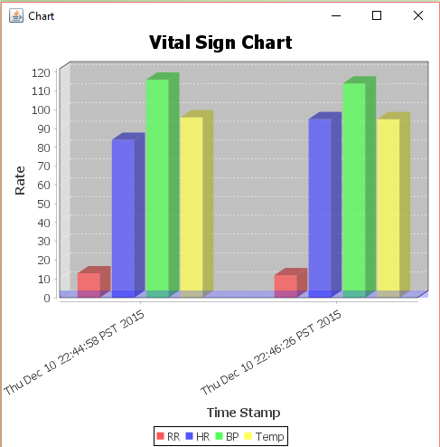
Data Analytics

Slide 10


