Slide 1

Beacon World
Reshmi Padavala
Ruchi Goyal

Slide 2
Project Overview
Using the concept of Bluetooth Low Energy in small devices called beacons that brings retailers and customers together
Beacon technology can be used for various purposes such as indoor navigations, offers and discounts, efficient service and quick payments, delivery tracking and as a marketing opportunity.

Slide 3
Roles And Responsibilities
Reshmi Padavala
UX Research Methods
Storyboarding
Style Guide Documentation
Prototype for Retailer
Ruchi Goyal
Sensory design
Selenium testing
Prototype for Customer

Slide 4
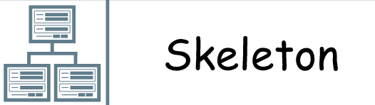
Skeleton Plane
Identify specific aspects of interface, navigation, and information design that will make the intangible structure concrete

Slide 5
Interface design
Proper Placement of interface elements as and when required
Easy access and use of interface element
Navigation Design
Global navigation: Navigation bars linked to the main section which provides broad sweep to the entire application
Local navigation: Access to nearby architecture of the application
Supplementary navigation: Provided proper shortcuts for ease of use

Slide 6
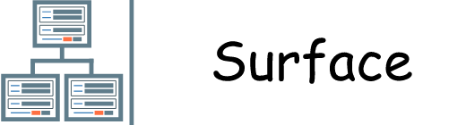
Surface Plane
Arrangement of various elements of interface design, navigation design and information design. Deal with aspects of sensory design, which appeal the most the use

Slide 7
Sensory Design
Important features and buttons are highlighted for easy access
Color combination: Conducted survey with various options for the color scheme.
Maintained internal and external consistency

Slide 8
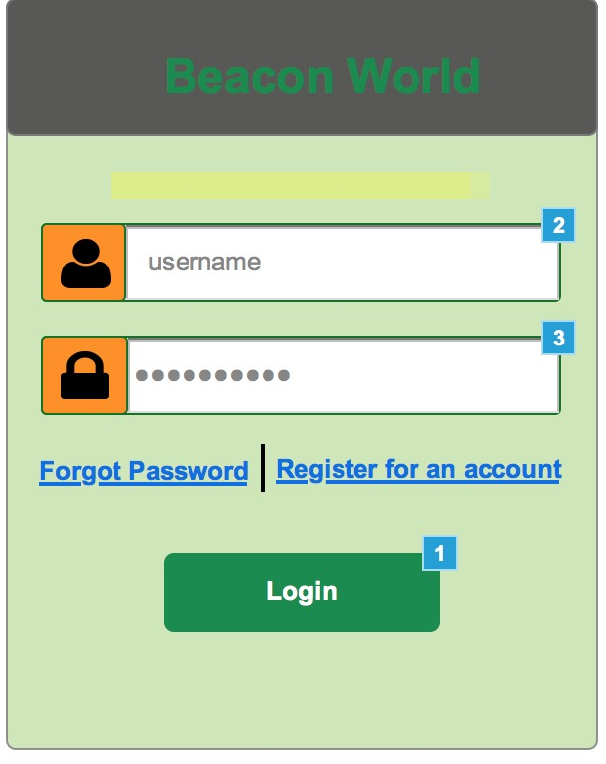
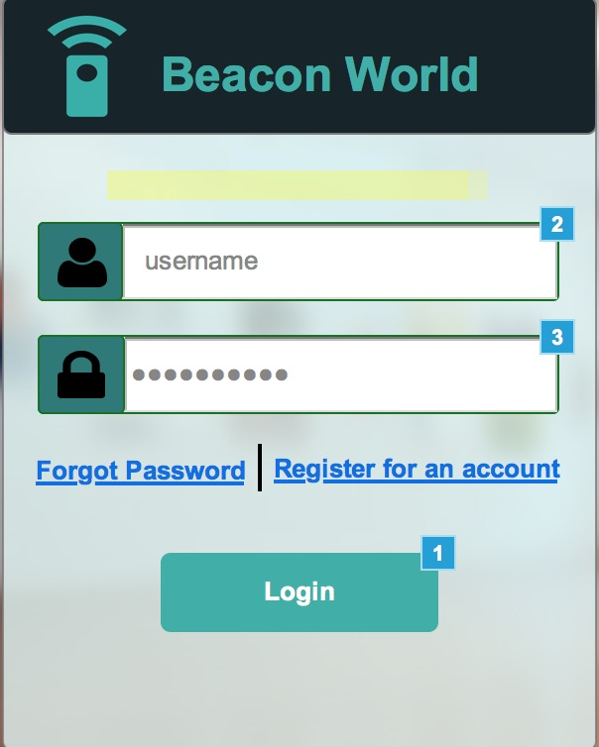
Color scheme options
Option 1
Option 2

Slide 9
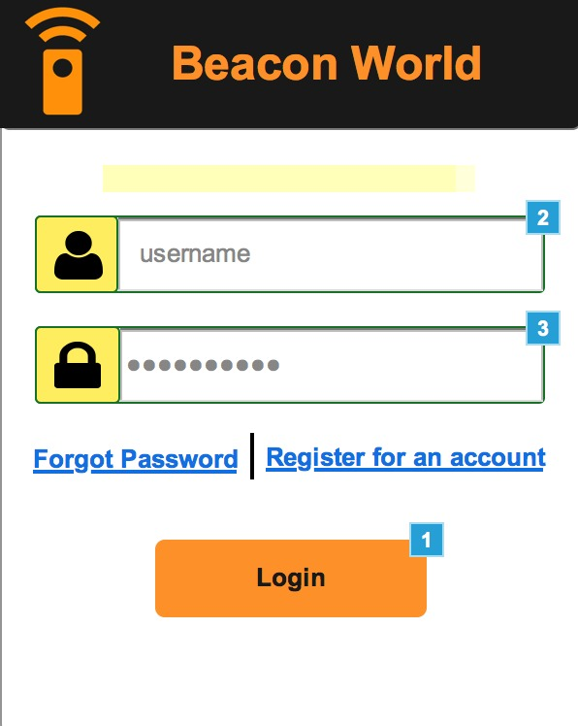
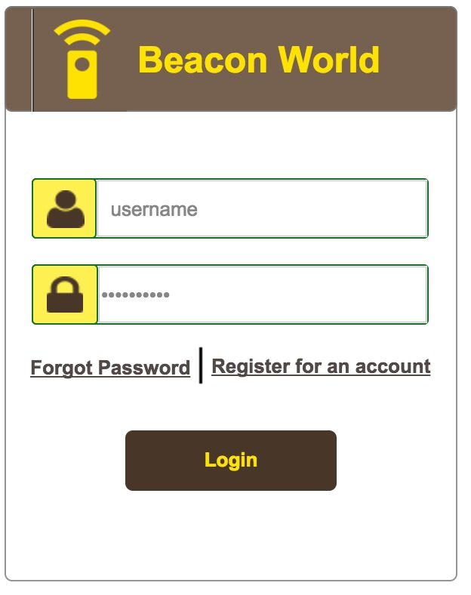
Color scheme options
Option 3
Option 4

Slide 10
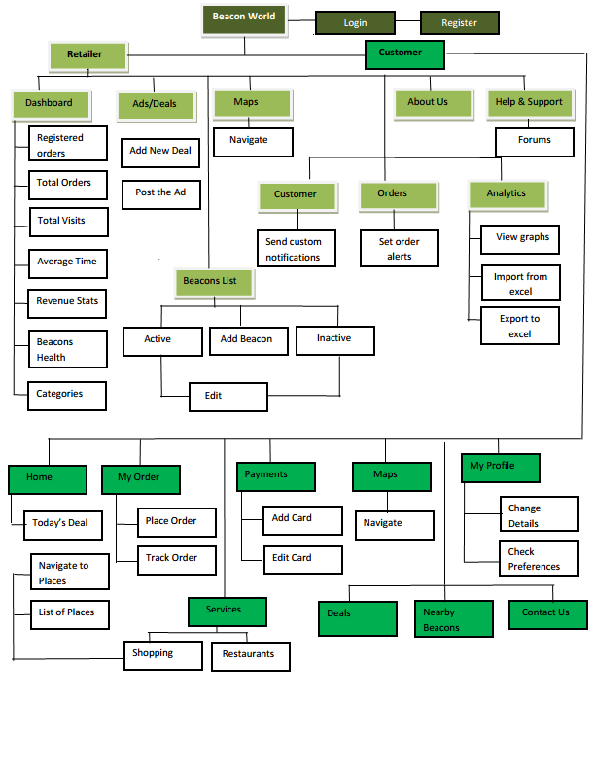
Open Card Sorting

Slide 11
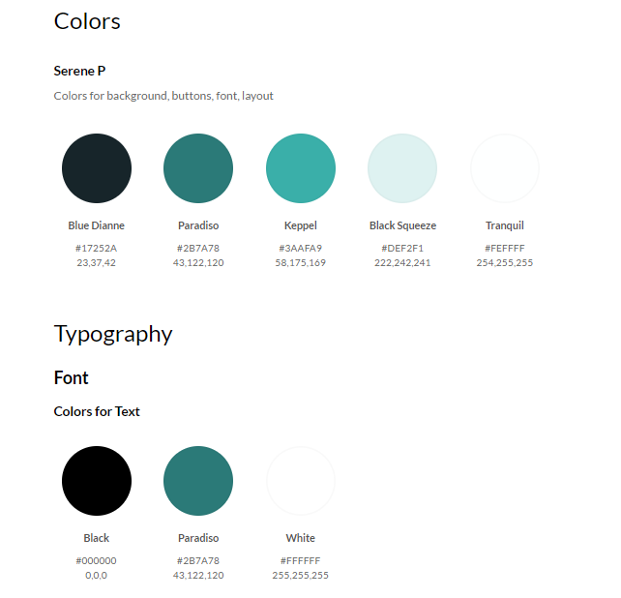
Style Guide

Slide 12
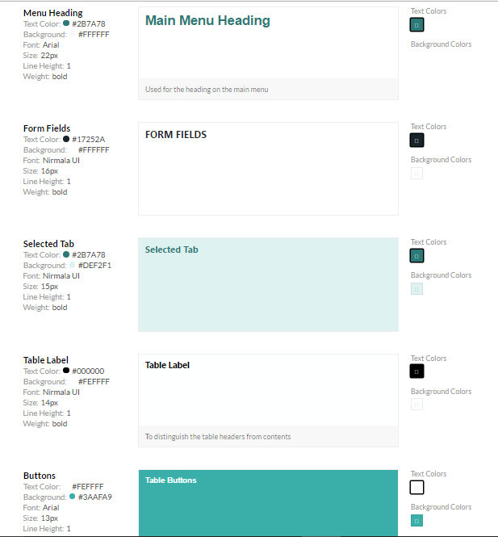

Slide 13
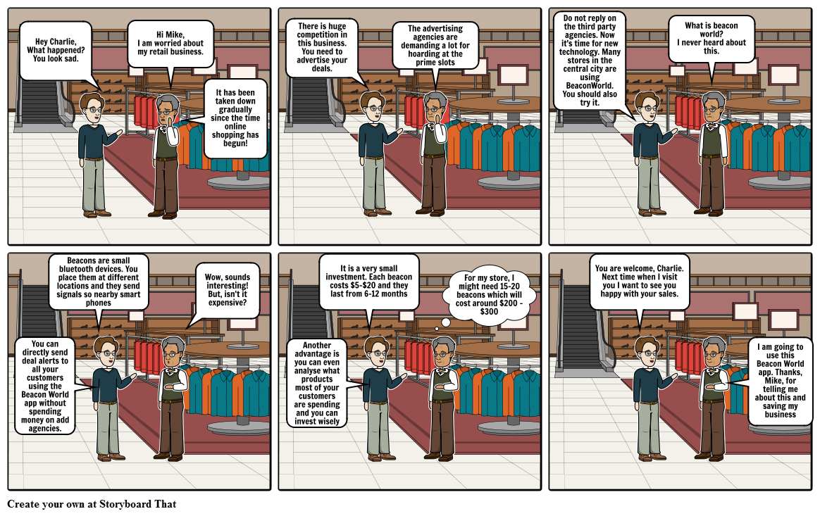
The retailer is worried about his sales and a friend of him suggests about the use of beacon technology that will help him get high sales

Slide 14
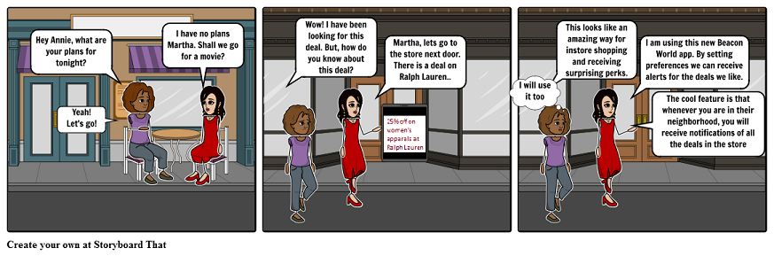
Martha and Annie plan to go for a movie and on the way Annie talks about a deal in the store next by. Martha is surprised how Anna knows about this. Anna suggests Martha about the new app Beacon World

Slide 15
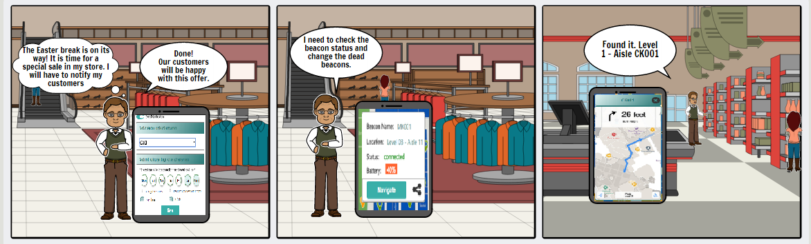
The retailer presents how the Beacon World App can be used

Slide 16
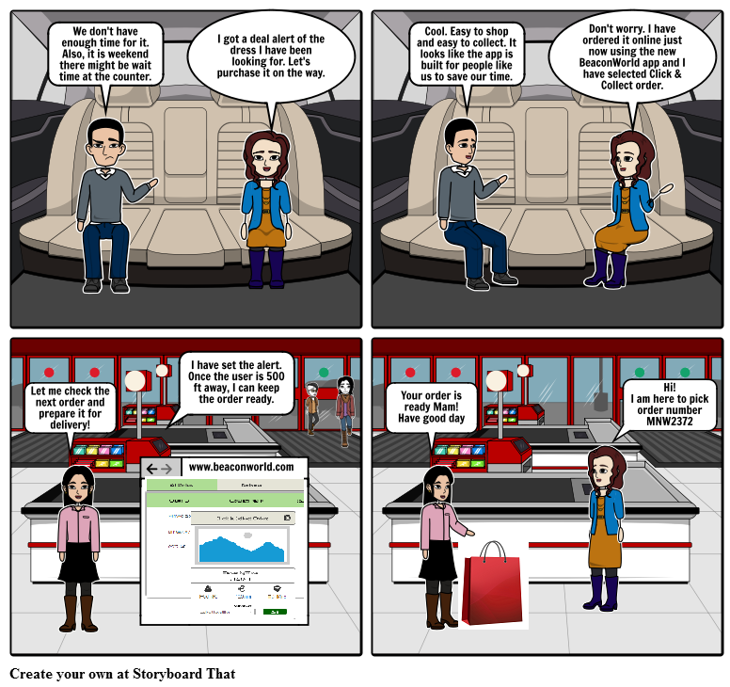
The scenario describes about the quick shopping feature provided

Slide 17
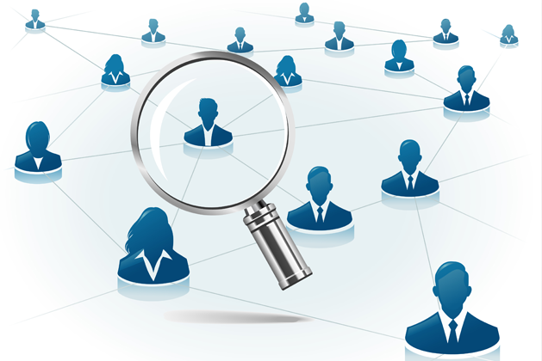
UX Research
Beacon World
Beacons
Customers
Ads/Deals

Slide 18
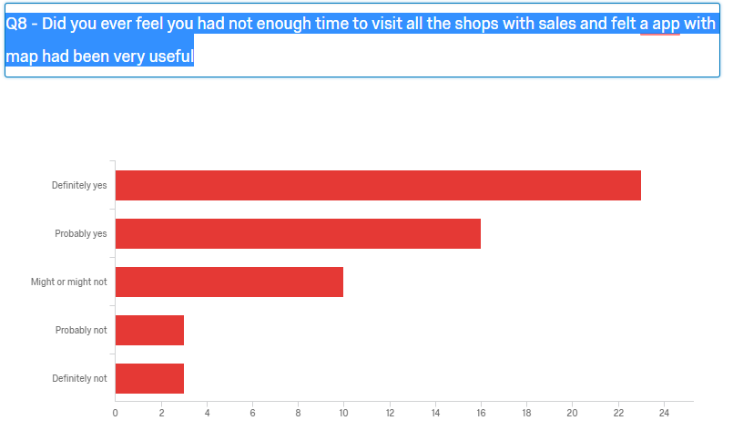
Customers Survey on Shopping Experiences

Slide 19
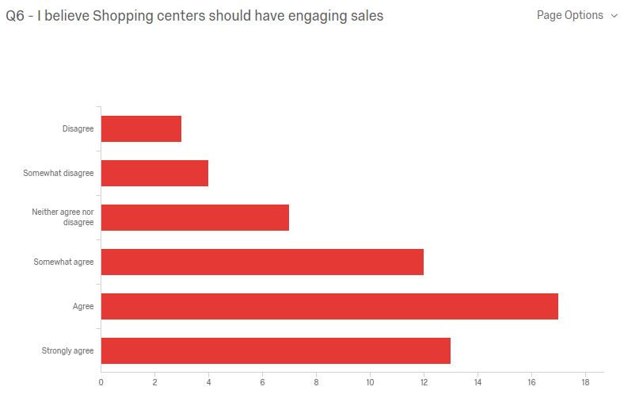
Customers Survey on Shopping Experiences

Slide 20
UX Research:
Survey during strategy phase
Card sorting – on IA while implementing the project
Usability Benchmarking, Lab Studies – to access
Interviews – for feedback

Slide 21
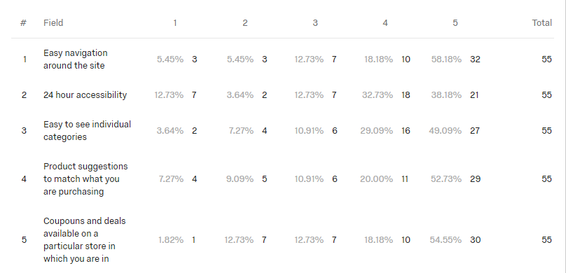
Customers Survey on Shopping Experiences

Slide 22
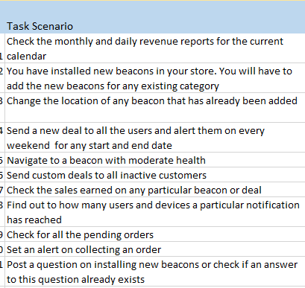
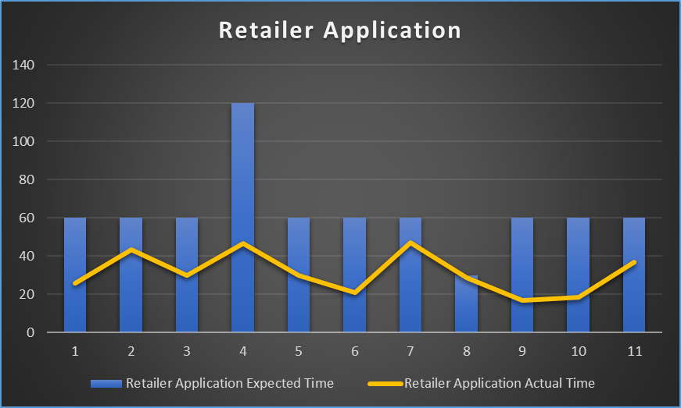
Benchmarking Usability

Slide 23
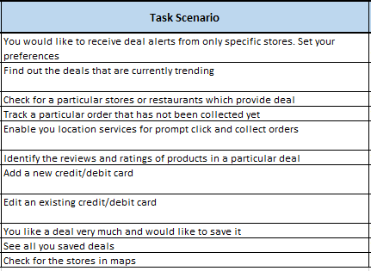
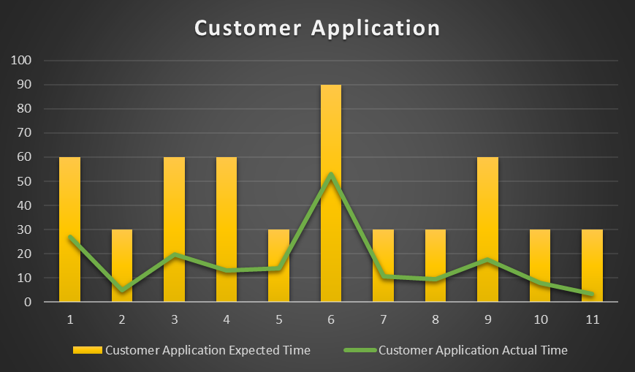
Benchmarking Usability

Slide 24
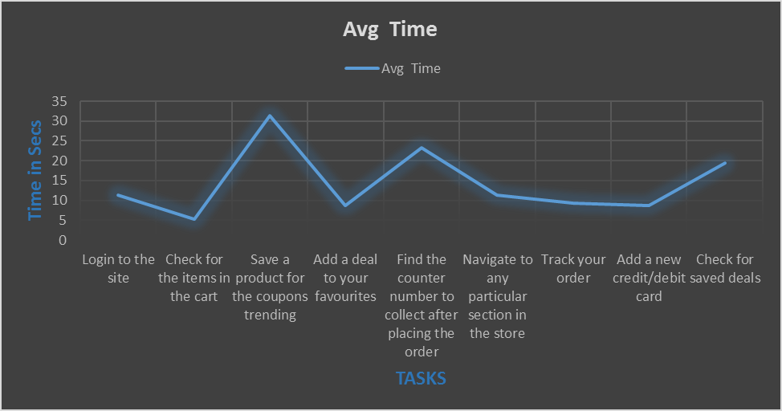
Moderated Lab Studies

Slide 25
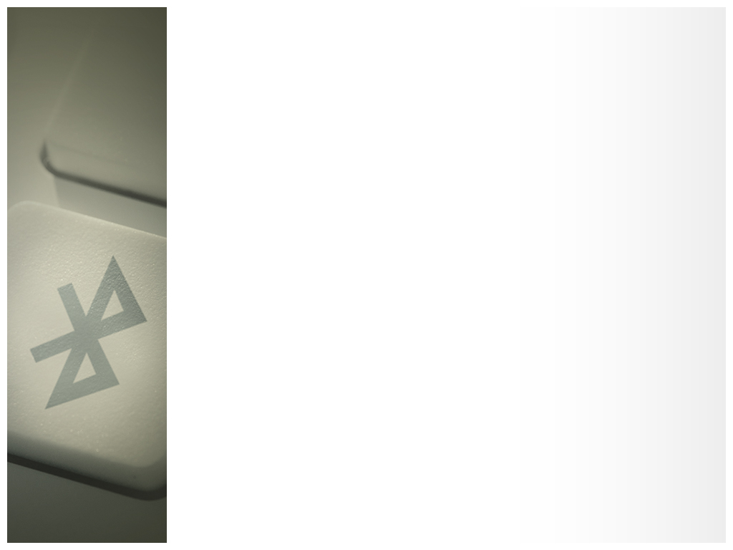
Concept Testing-Feedback
Performed for testing Retailer Web Application on a group of 6 people :
Metrics and Key performances with visualization on dashboard – Implemented
Option to add new deal or advertisement – Implemented
No integration between beacons and map in the beacons list – Since there is a designated menu for maps, it will be redundant to add the same feature at different location. Also, the beacons in the maps have markers will have colors that match the beacon health. This feature will give a top view of the beacon health without looking at the details.
List of active and inactive users – To send custom notifications for selective customers – Implemented
See the analytics for the deals which helps to maximize the sales by studying the deals or products which users preferred most – Implemented
No instructions on adding new beacons or installing them – In help and support page, support will be provided for all type of questions through FAQs, Forums, Installation guides
Selecting beacons of a particular health in Dashboard should navigate to the maps containing beacons of selected health – Implemented after the feedback

Slide 26
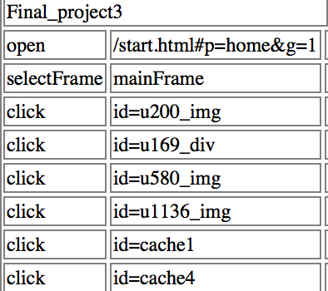
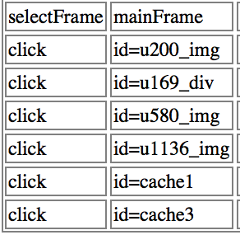
Selenium Testing
Tested For Both the prototypes
For Customer

Slide 27
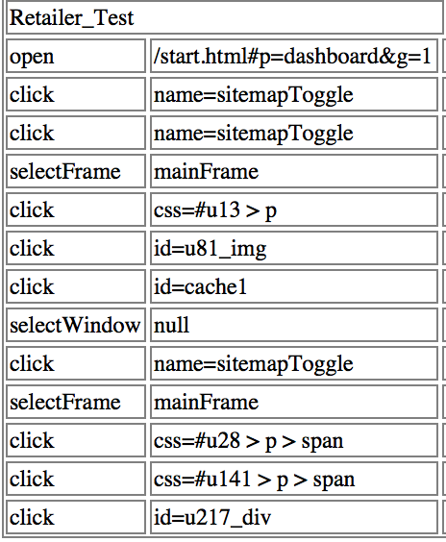
Selenium Testing
Tested For Both the prototypes
For Retailer

Slide 28


Any Questions…

