Slide 1

iCare Medical Service on Cloud
Team : RedHat
Team Size : 5
Project : Sample 2

Slide 2

Team Members
Bhavna Menghrajani
Gokul Ramakrishnan
Priyanka Singh
Reshmi Padavala
Sreenivas Vattikundala

Slide 3
Patient Portal
Login – to authenticate users
User – to retrieve the records from systems
Database consists of user credentials and health related information stored in relational database

Slide 4

Objective
Develop, deploy and test a scalable web application with high availability on the amazon EC2 cloud
Design a business model that provides the business justification for the cost and performance
Auto scale the resources to accommodate the load on the application, network and data storage
Monitoring the system and triggering alerts using CloudWatch alarms
Develop a disaster recovery procedure

Slide 5
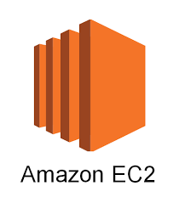
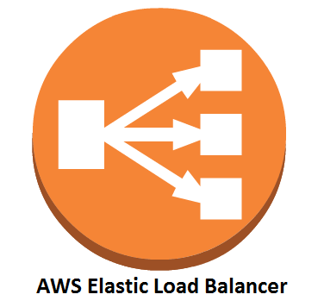

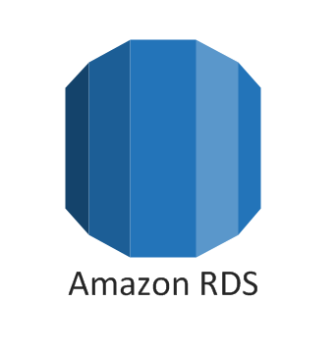

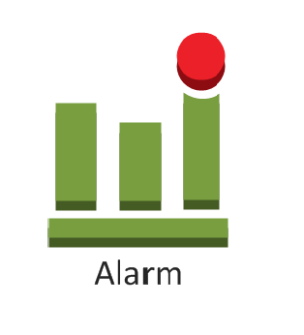

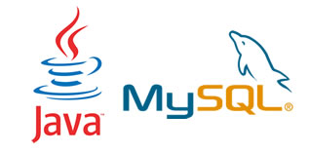
Technology Stack

Slide 6
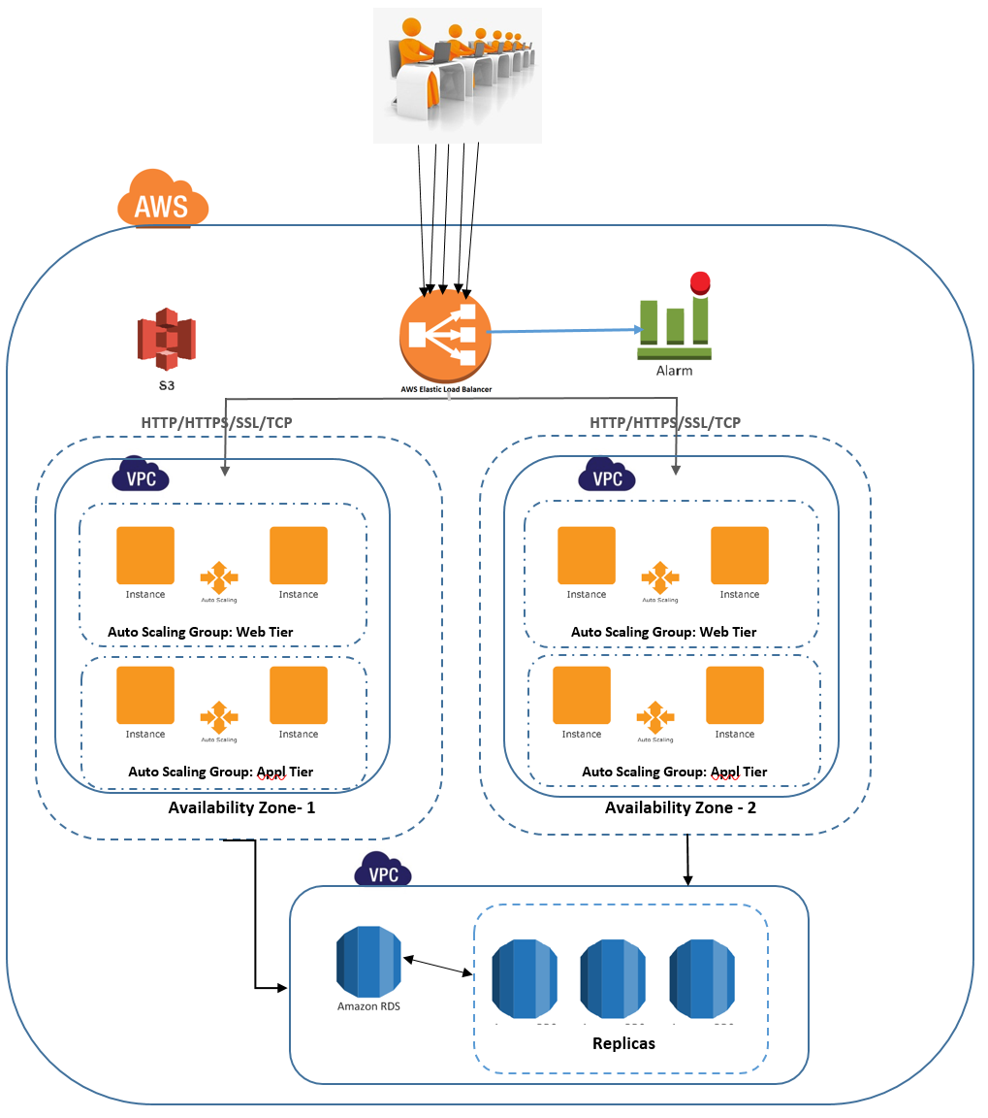
Architecture

Slide 7
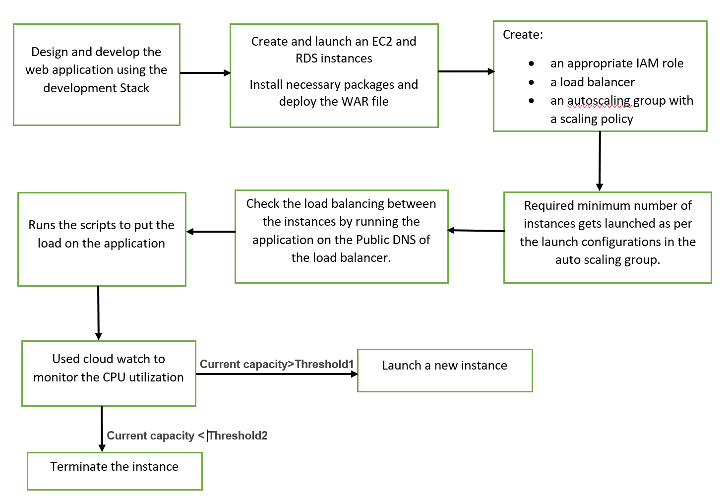
Cloud Architecture Formation

Slide 8

Load Balancer
Distribute traffic across multiple EC2 instances on multiple zones
Availability zones : us-west 2a, us-west-2b
Check connections from clients through listeners
HTTP : 80
TCP : 8080
Monitor health checks of the registered instances
Handle traffic evenly across in each availability zone
Create even number of instances on each zone
Classic load balancer over application load balancer
Support for TCP and SSL listeners

Slide 9

Auto Scaling Groups
Create a collection of instances to handle the application load
Specify desired, minimum and maximum capacity of instances to be launched
Scale based on demand:
Better Fault Tolerance
Better Availability
Better Cost Management
Scaling policies:
Scale out(Launch instances)
Scale in(Terminate instances)
Factors that triggers the launch of instance:
Current capacity
Scaling policy
Instance warm up
Cooldowns

Slide 10
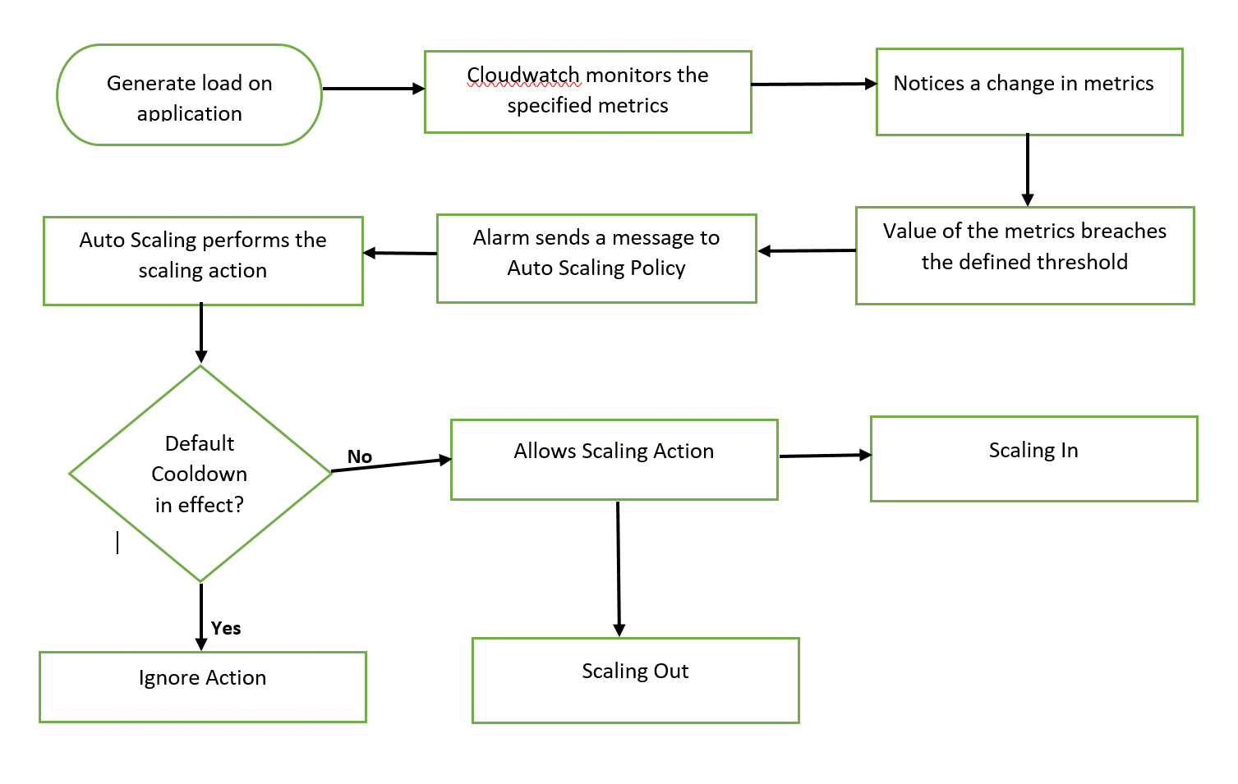
Dynamic Scaling Flow

Slide 11
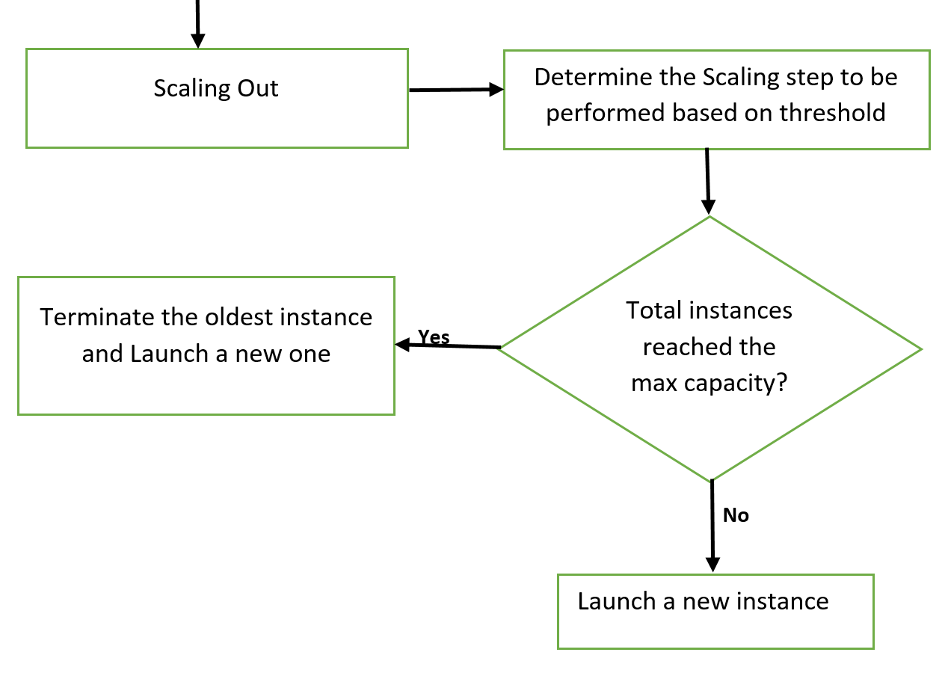
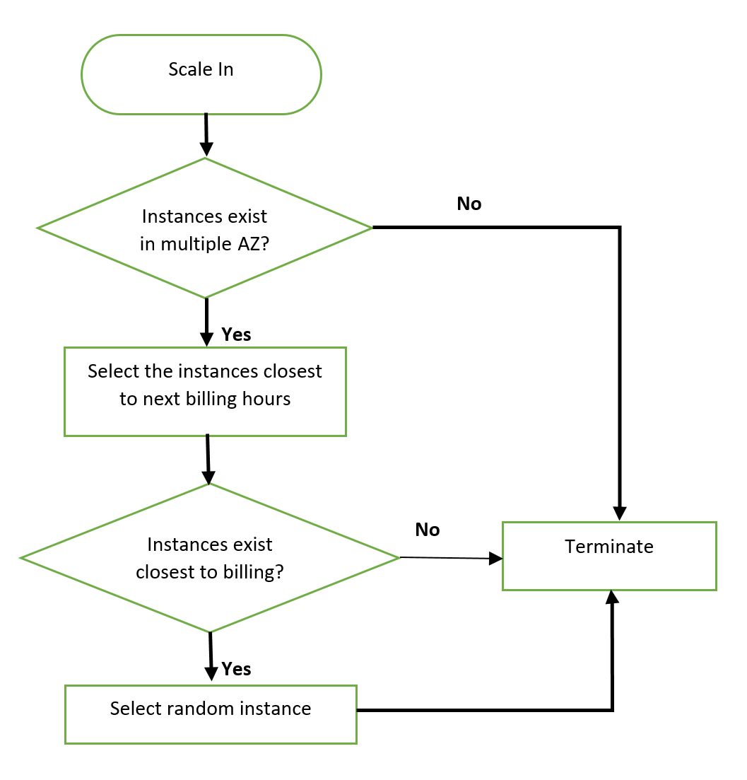

Slide 12

CloudWatch Alarm
Monitors AWS resources: EC2 and RDS instances
Set alarm metrics and associate with auto scaling group for dynamic scaling
Choose CPU Utilization metric
Enter the threshold
Monitor the graphs of CPU Utilization on the instances
Graph varies:
As per the load
In between the specified time intervals
Identify the state of the alarm:
OK
ALARM
INSUFFICENT_DATA

Slide 13
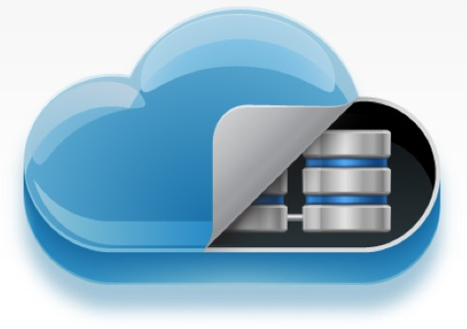
RDS
Manage Relational Database on cloud
Connect MySQL Engine
Storage - SSD provisioned to the DB instance
Multi-AZ Deployment – High Availability
Backup Retention Period – 7 Days (every day 12.00am)
Security Groups
Enable enhanced monitoring
Cloudwatch Alarm- monitor the performance and health of DB instance

Slide 14

Disaster Recovery
Multi-AZ for RDS
EC2 instances across multiple Availability Zones
Creating replicas
Storing the resources and WAR file in S3 bucket

Slide 15
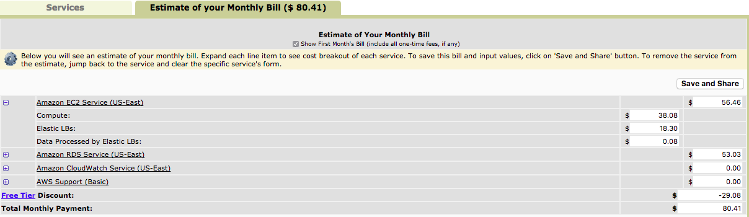
Cost vs Performance
Application estimated cost per months : $80.41
Application cost for 6 months : $482.46

Slide 16

Insights
Challenges
Configuring the python environment on cloud
SSL – after adding the ssl, the application was not accessible
https – application failed to work on https port
Future Scope
Configuring SSL on the application
Integrating S3 for backups
Auto deploying the war from S3

Slide 17


Slide 18


