Slide 1
E-MEDICARE
PROJECT MEMBERS :-
1. Kammakattu Bharath Reddy
2. Narikimilli Sai Sandeep
3. Deeksha Thakur
4. Reshmitha R
5. Monika B V
6. Prabhanjan R
7. Poonam Kumari
8. Mowsika X
9. Kunal Balkrishna Raskar
10. Hanumolu Om Sesank

Slide 2
ABSTRACT
The purpose of E-Medicare System is to automate the existing manual system by the help of computerized equipment's and full-fledged computer software, fulfilling their requirements, so that their valuable data can be stored for a longer period with easy accessing and manipulation of the same.
E-Medicare System, as described above, can lead to error free, secure, reliable and fast management system.
The aim is to replace the existing manual system by E-Medicare , By Eliminating the middle man thus leading to the Profit of the company.

Slide 3
INTRODUCTION
The “Online E-Medicare Store” has been developed to override the problems prevailing in the practicing manual system. This software is supposed to eliminate and reduce the hardships faced by the existing system. Online Medical Store can lead to error free, secure, reliable and fast management system.
"Online E-Medicare Store" - web application ,where users can register, login, purchase medicines e.g. Antibiotics, Antipyretics. and manage their orders in the system.

Slide 4
OBJECTIVES
The Medical Store Management System Also Has Following Objectives:
To manage the user details for analyzing sales and expenses.
To show the description and information of the stocks and others and to monitor the information regarding the transaction of the sales.
To enhance the efficiency of management in medical store.
To improve the function of edit, add and update the records for the proper resource management.

Slide 5
SCOPE
The Scope For Developing The Medical Store Management System Are As Follows:
The medical store management system also helps in keeping track of the available stock of medicine and also update them on a regular manner.
This project also enables to store the detail of suppliers and the stocks supplied by them and the database for the customers and employees can also be managed by using this project.
The designing of medical store management system saves the time which one spent in keeping records and managing payments of the stocks.
The process of sailing medicine is very crucial as the medical stores must keep eye on the expiry date of every stock and medicine. This project helps the medical stores to keep track on the expiry date of every medicine they have in the store.

Slide 6
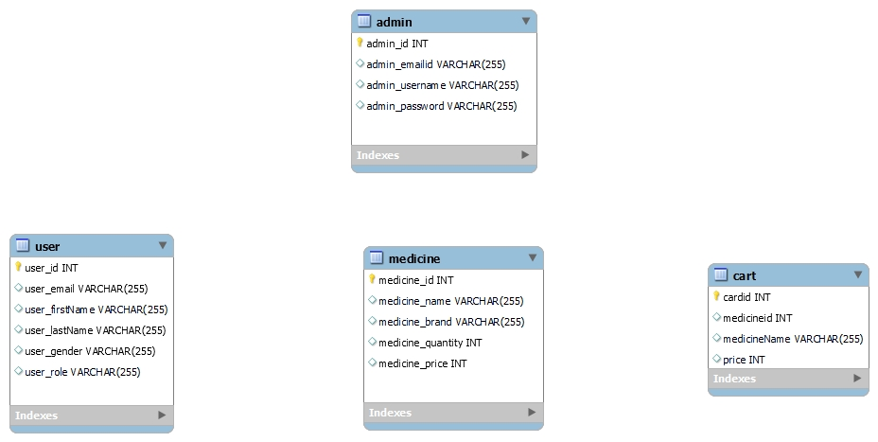
ER-DIAGRAM

Slide 7



TECHNOLOGY USED
Server-side: Spring Boot, Spring Cloud, Spring Data JPA
Database: MySQL
Server: EmbeddedTomcat
DevOps: Docker, Git Hub

Slide 8
MODULES OF E-MEDICARE SYSTEM
Admin Module: Used for managing medicine details.
Users Module: Used for managing the users of the system.
Medicine Module: Used for managing the Medicine details.
Cart Module: Used for managing the details of Cart.

Slide 9
Class Diagram
Admin
admin_id INT
admin_emailId VARCHAR(225)
Admin_username VARCHAR(225)
Admin_password VARCHAR(225)
save()
findByEmail()
findByEmainIdAndPassword()
User
user_id INT
user_email VARCHAR(225)
user_password VARCHAR(225)
user_firstName VARCHAR(225)
user_lastName VARCHAR(225)
user-gender VARCHAR(225)
user_role VARCHAR(225)
findByEmail()
save()
deleteById()
Medicine
medicine_id INT
medicine_name VARCHAR(225)
medicine_brand VARCHAR(225)
medicine_quantity INT
medicine_price INT
updateMedicines()
getMedicinesById()
deletemedicinesById()
Cart
cartid INT
Medicine_id INT
medicineName VARCHAR(225)
price INT
getCart()
addToCart()
deleteItemById()

Slide 10
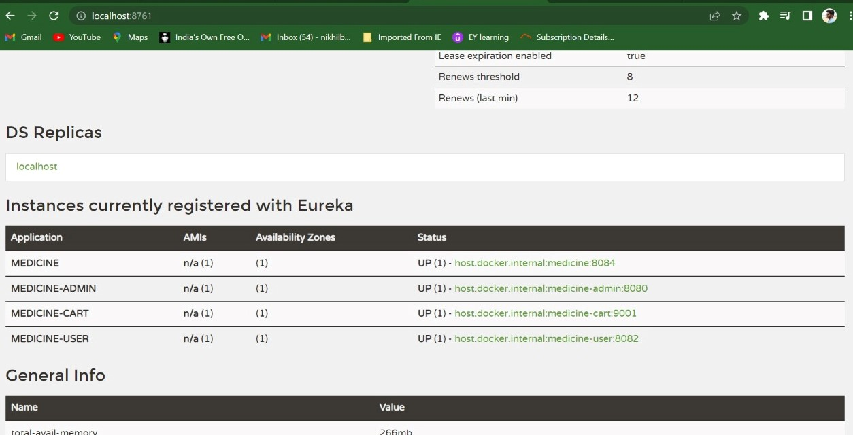
INSTANCES REGISTERED WITH EUREKA

Slide 11
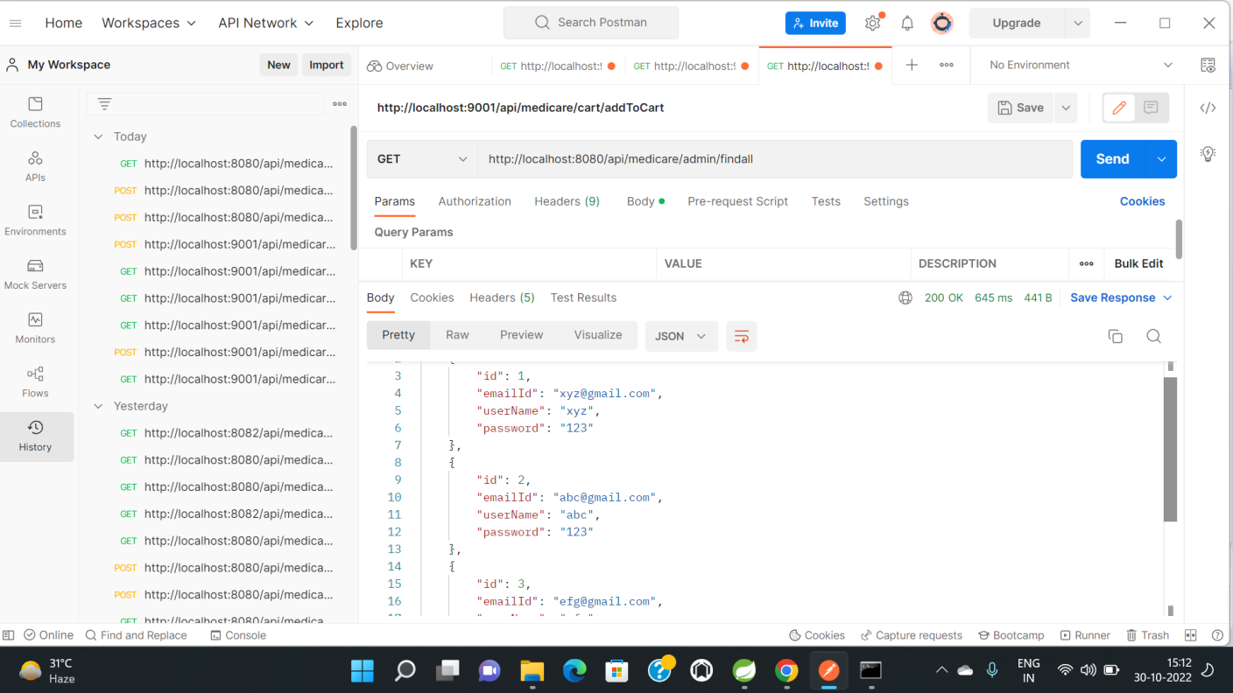
Functional Testing using POSTMAN tool Admin module:

Slide 12
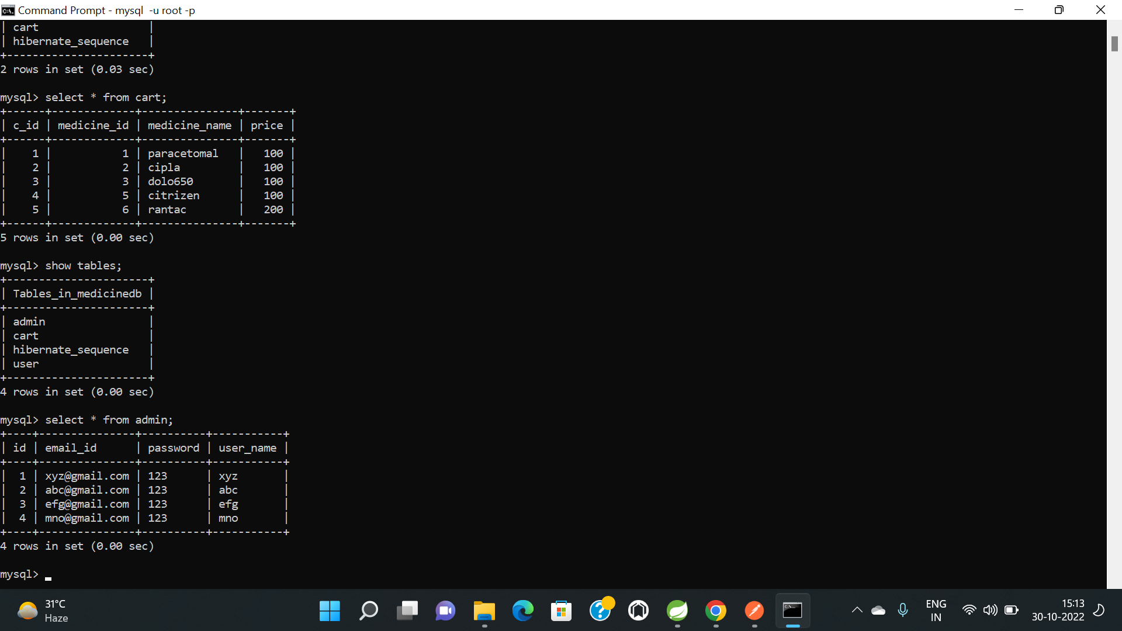
ADMIN DATABASE

Slide 13
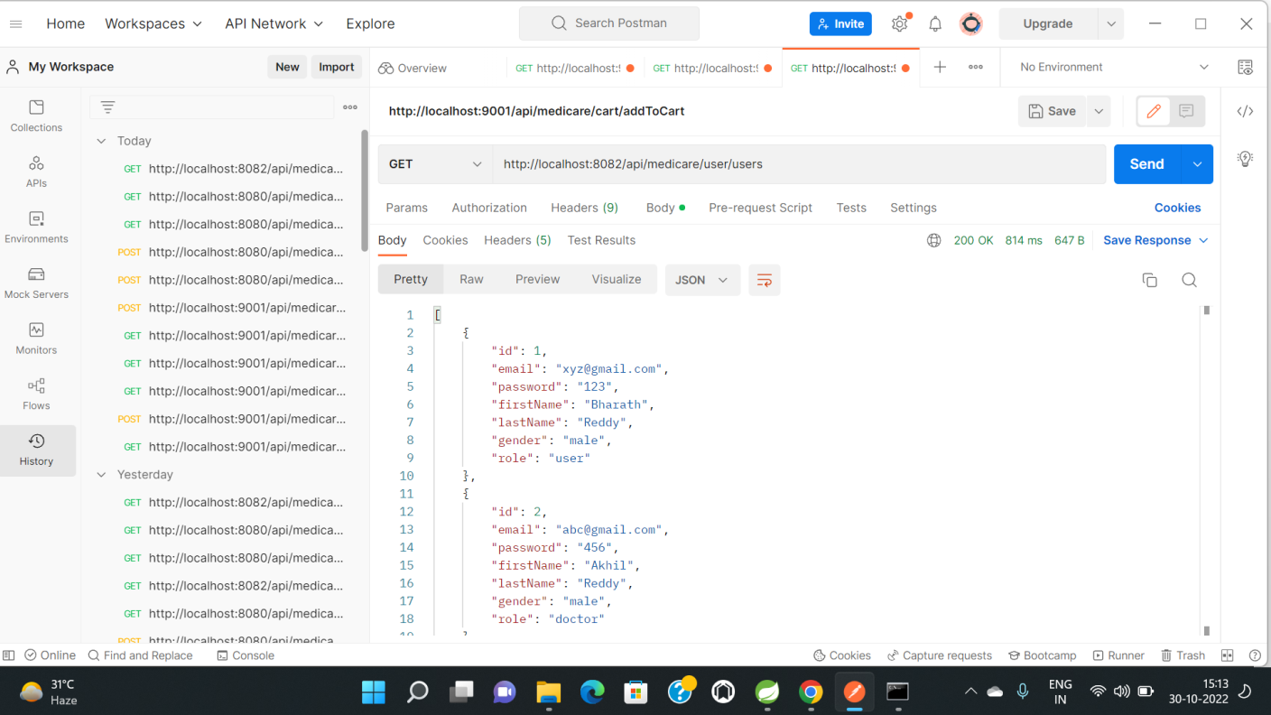
User module:

Slide 14
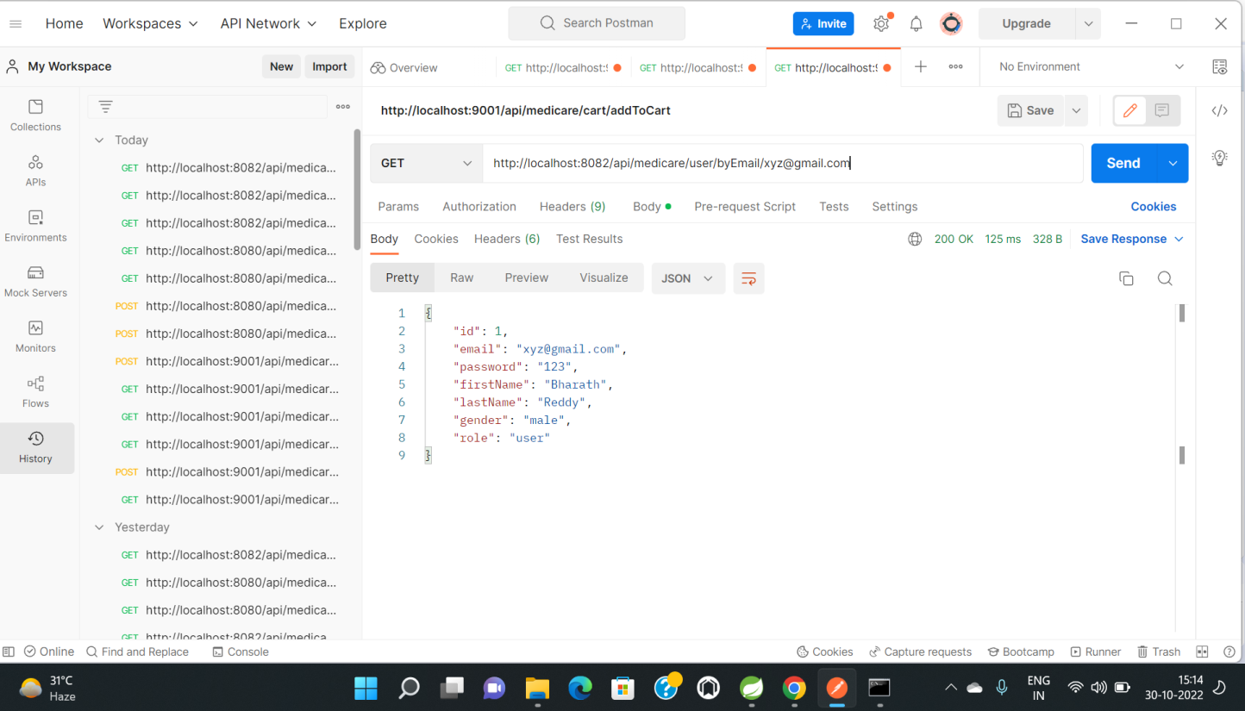

Slide 15
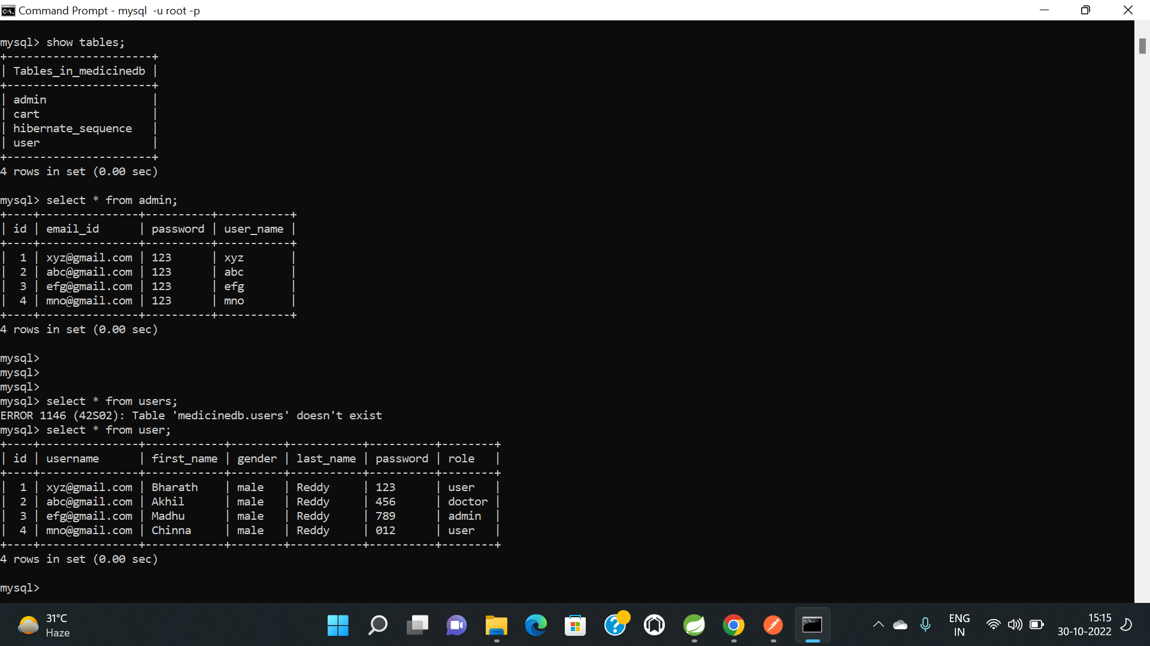
USER DATABASE

Slide 16
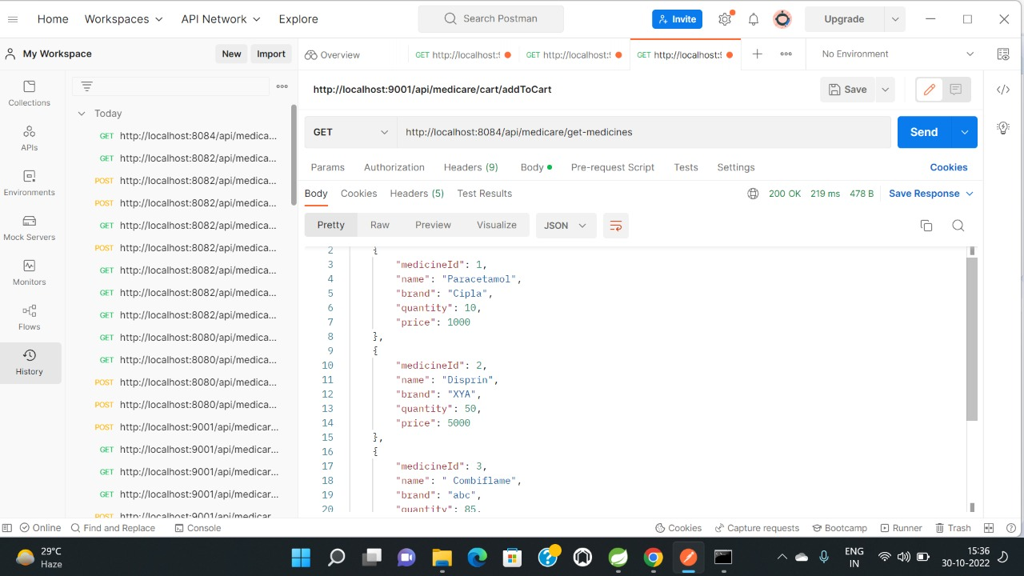
MEDICINE MODULE:

Slide 17
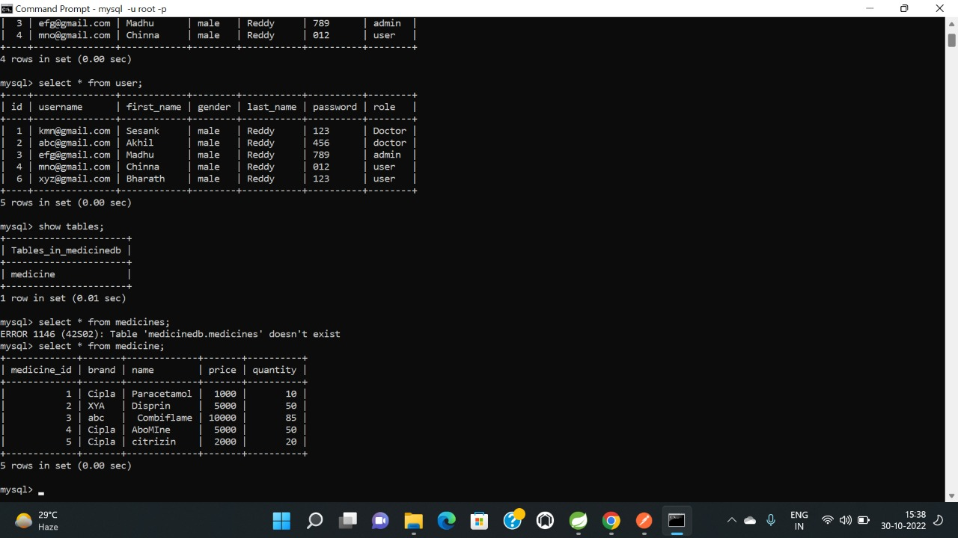
MEDICINE DATABASE:

Slide 18
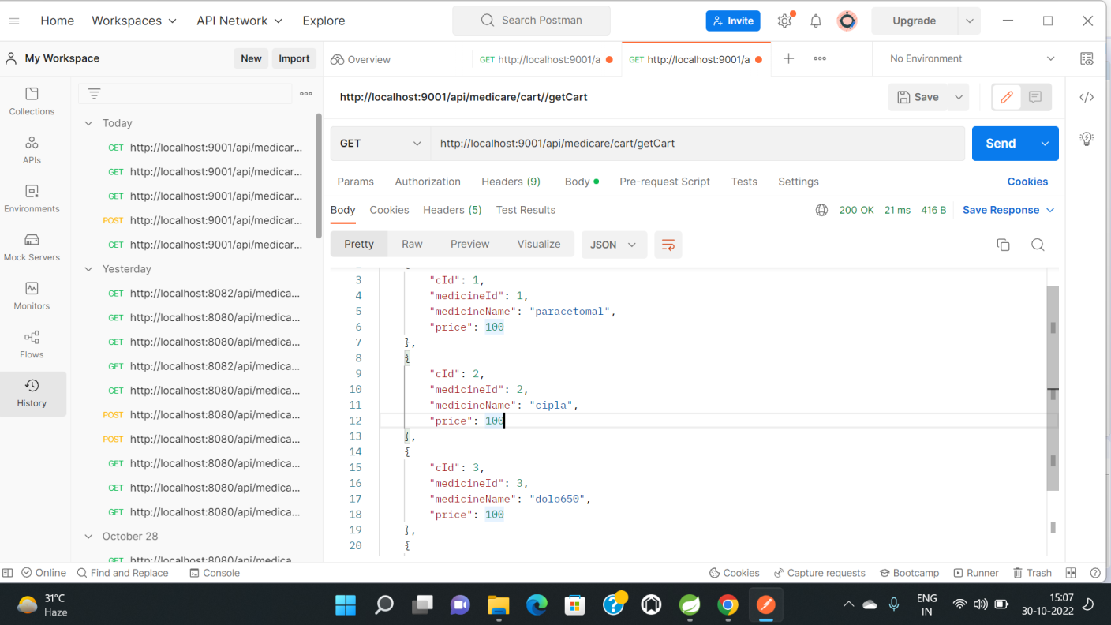
CART MODULE:

Slide 19
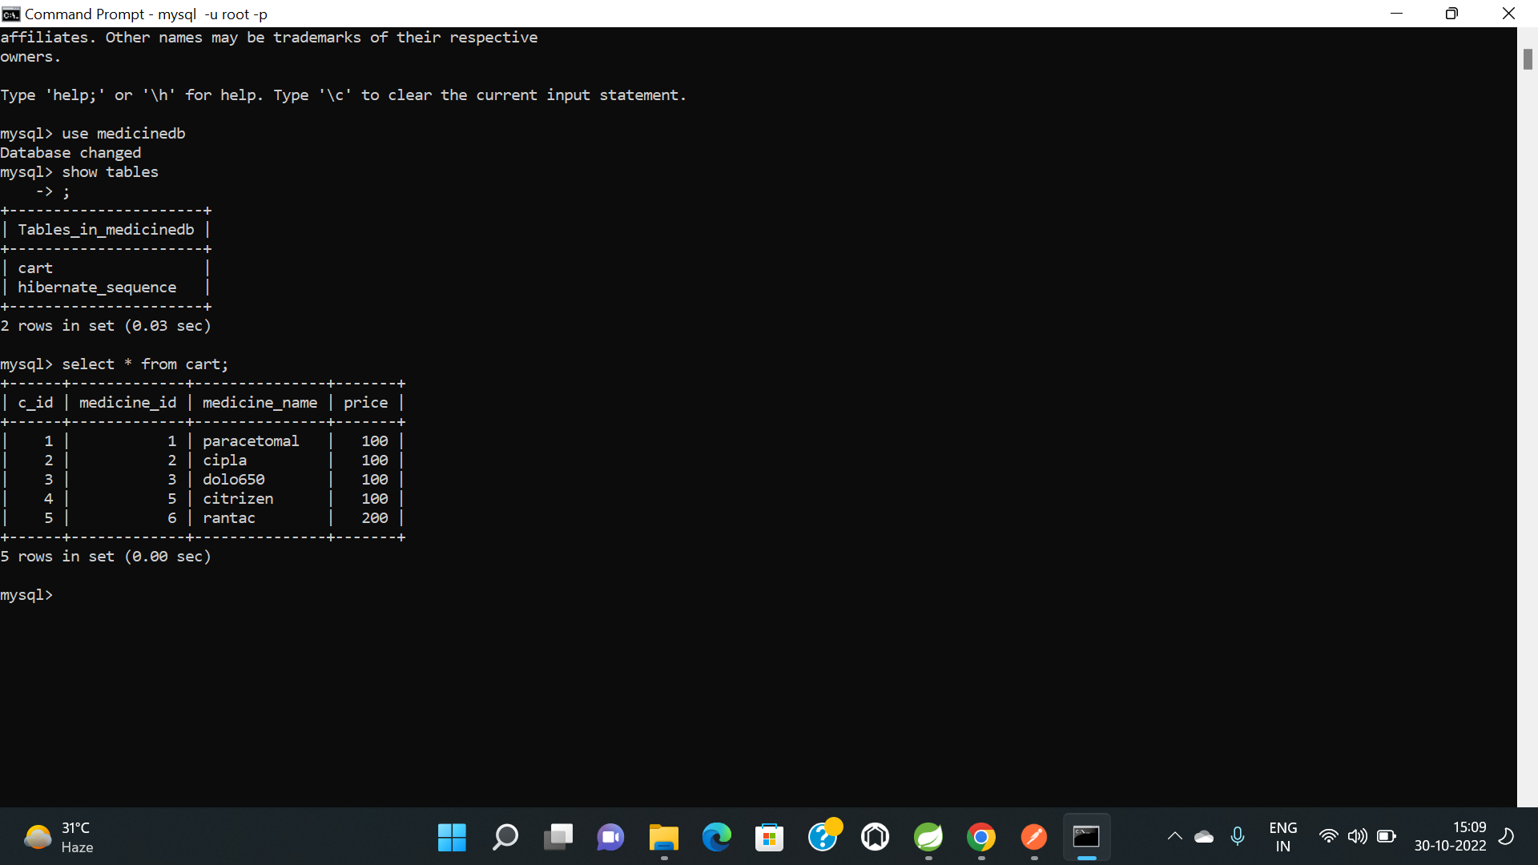
CART DATABASE

Slide 20
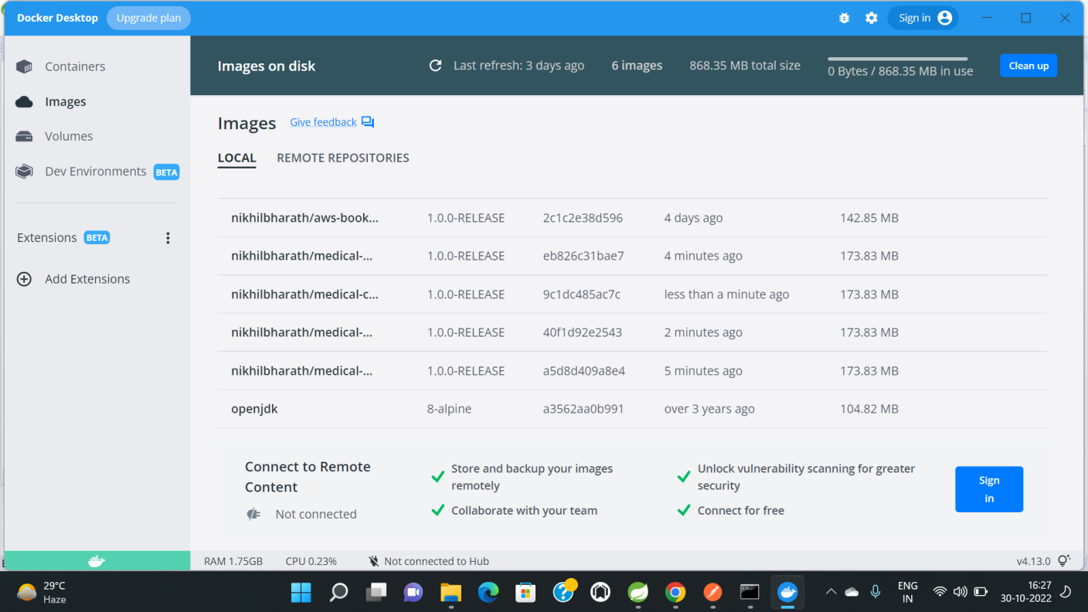
DOCKER IMAGES:

Slide 21
ADVANTAGES
User can view details of the medicines Online.
It is convenient for users as this system provides accurate cost and description of the product.
The website is flexible to be used and for e-medicare.
User can view different categories of product of different pharma company at a single place.

Slide 22
DISADVANTAGES
Concerns about the quality of available health information.
Not easily understandable information and difficulty to evaluate if information is adequate for the user.
Lack of applicable software.
The unavailability or lack of basic infrastructure, such as internet connection in remote areas.

Slide 23
CONCLUSION
This E Medicare system is a web-based application that assists in management of medicine in easy, comfortable and effective service.
The proposed application aims to create a friendly working environment for any Medicare centers and to overcome the drawbacks in existing system of Medicare management.
We understand the problem domain and produce a model of the system, which describes operations that can be performed on the system.
We included features and operations in detail, including screen layouts.
We designed user interface and security issues related to system.
Finally, the system is implemented and tested according to test cases.

Slide 24

Thank You

