Slide 1
Online Artwork Sale and Auction System
ARTOMART
GUIDE
Miss Kukku Thomas
Assistant Professor
Department of computer Application
Reshna Ravi
Roll no : 44
S3 MCA
Date of Review : 11/7/2025

Slide 2
Introduction
ArtoMart is an online art marketplace designed to connect artists and buyers through a secure platform for art sales and live auctions. It enables artists to showcase their work digitally and allows buyers to explore, bid, and purchase artworks in real time. With features like role-based dashboards, live bidding updates, payment integration, and admin moderation, ArtoMart ensures a seamless and transparent art trading experience. The platform promotes digital accessibility, enhances user engagement, and supports the modern transformation of the art market.

Slide 3
Abstract
Artomart is an online platform for showcasing, selling, and auctioning artwork.
It connects artists and buyers through fixed-price sales and timed auctions.
Users can create profiles, upload art, and manage sales or bids.
Admins manage users, artwork approvals, auctions, and policies.
Key modules include user, artwork, gallery, auction, admin dashboard, and notifications.
Built with HTML, CSS, JavaScript, Python (Django), and MySQL.

Slide 4
Scope and Objectives
Scope of the Project
The Artomart system aims to provide an efficient web-based platform for buying, selling, and auctioning artworks. It allows users to browse artworks, place bids in live or time-bound auctions, and purchase artworks directly through the platform. The system includes role-based access for buyers, artists, and administrators, ensuring smooth management of auctions, sales, user interactions, and notifications. The scope also extends to enhancing transparency in transactions, providing real-time updates on auctions, supporting digital and physical art sales, and creating a seamless bridge between artists and art collectors globally.
Objectives
To develop an easy-to-use web application for browsing, bidding, and purchasing artworks.
To implement real-time auction updates and notifications for buyers and artists.
To provide role-based dashboards for buyers, artists, and administrators.
To enhance the overall experience, transparency, and reliability of art sales and auctions on the platform.

Slide 5
Feasibility study
Technical Feasibility
Development: The platform can be built using existing technologies .
Scalability: The system can be designed to handle increasing traffic and user growth.
Security: Implementing proper security measures (e.G., Encryption, authentication) can protect user data and transactions.

Slide 6
Financial Feasibility
Revenue Streams: The platform can generate revenue through commission-based sales, premium features, and advertising.
Initial Investment: Development costs, marketing expenses, and infrastructure setup will require initial investment.
Potential Returns: The platform's potential returns depend on user adoption, sales volume, and market competition.

Slide 7
Market Feasibility
Target audience: Artists, art enthusiasts, and collectors form a potential target audience.
Market size: The global art market is significant, with a growing online presence.
Competition: Existing art marketplaces and platforms will require artomart to differentiate itself through unique features and user experience.

Slide 8
Operational Feasibility
User management: the platform's user management system can handle artist registrations, artwork uploads, and buyer interactions.
Content moderation: a moderation team or ai-powered tools can ensure content quality and adherence to platform policies.
Customer support: providing responsive customer support will be crucial for user satisfaction and retention.

Slide 9
Problem Definition
Artists struggle to reach a global audience, buyers face challenges in verifying authenticity, and auction participation is constrained by location. Existing platforms lack real-time updates, secure transactions, and integrated management of physical and digital artworks, including NFTs. ArtoMart addresses these issues by offering a web-based platform that connects artists, buyers, and administrators, enabling seamless auctions, secure payments, real-time notifications, and comprehensive dashboards, thereby improving efficiency, transparency, and accessibility in the art market.

Slide 10
Existing System
Pros
Cons
Artists can use platforms like Instagram, Facebook, or WhatsApp.
Keeps track of all uploaded artworks, sales, offering a complete record for artists and admin.
Artists can reach a wider audience beyond local exhibitions or galleries.
Users must be online to access or participate.
Platform are general, not focused on art and auction.
Users cannot bid or sell through timed auctions.
User are not notified about auction and new art.
Everyone has the same permissions (no separation between artist/admin).

Slide 11
Proposed System
Pros
Cons
Made for Artists only – Dedicated platform to showcase and sell artworks.
Auction Features – artists can sell special artwork through bidding.
Admin Control – admin approve artworks and manages auction timings.
Notification – Users are notified when auction start.
Auction needs admin approval.
The platform needs regular updates and security checks.

Slide 12
Literature review

Slide 13
Author | Year | Source | Title | Work
Peize Dong | 2021 | ICEMCI | Bidding Strategies in Online Art Auctions with Buyout Prices | Conference Proceedings Paper / Research Article
Jason Milionis, Dean Hirsch, Andy Arditi, Pranav Garimidi | 2022 | arXiv preprint | A Framework for Single‑Item NFT Auction Mechanism Design | Blockchain‑based auction mechanism design for digital art
Chidi Ukamaka Betrand, Oluchukwu Uzoamaka Ekwealor, Chinazo Juliet Onyema | 2022 | International Journal on Data Science and Technology | Online Art Gallery Exhibition and Auction System for Indigenous Art Works | Solve high exhibition costs lack of support by using a web system built with React.js, Node.js, and MongoDB.

Slide 14
Author | Year | Source | Title | Work
M Senthemil, kadar S Mohideen, S Saran, R Reshma | 2022 | IEEE | A State-of-the-Art Approach for Securing Online Auction System | improved blockchain framework to solve security issues in traditional e-auctions
Jaehyuk Choi, Lan Ju, Jian Li, Zhiyong Tu | 2023 | arXiv preprint, arXiv:2302.08167 | Information Extraction and Artwork Pricing | Research Article / Preprint
Christine Bourron | 2023 | Arts journal, MDPI, Vol. 12, Issue 5, Article 212 | Comprehensive Analysis of the Trade of NFTs at Major Auction Houses: From Hype to Reality | Peer-reviewed Journal Article

Slide 15
System Specifications
Front End:
HTML, CSS, JavaScript
Back End:
Python, Django
Database:
MSQL

Slide 16
Modules of Proposed System
User Module
- User registration and login
- Request artwork for auction
- Upload artwork for fixed price sale.
- Create profile, add bid, buy artworks.

Slide 17
Modules of Proposed System
Admin Module
- Approve Auction request and create auction
- Set time period for auction.
- View users, artwork details.
- Notify users about active auctions
.

Slide 18
Modules of Proposed System
Auction Module
- Select highest bidder after auction ends.
Notification Module
- Send alerts to users about new auctions and notify seller and buyer of auction result

Slide 19
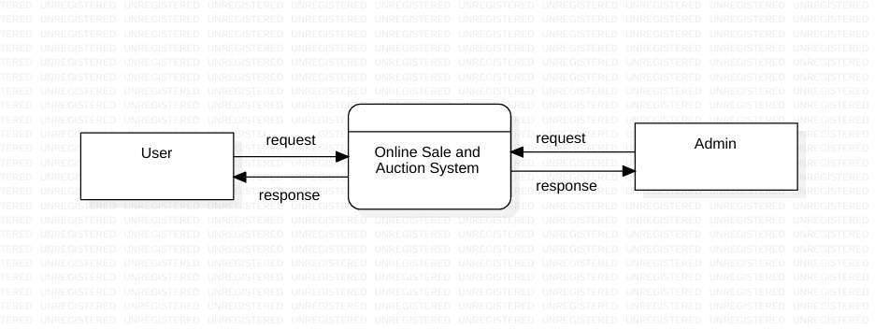
Data flow diagram
Level 0

Slide 20
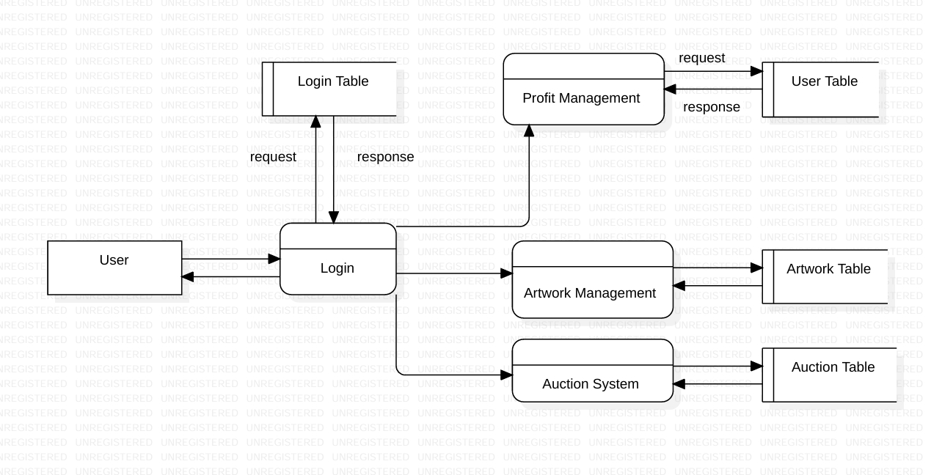
LEVEL 1 USER

Slide 21
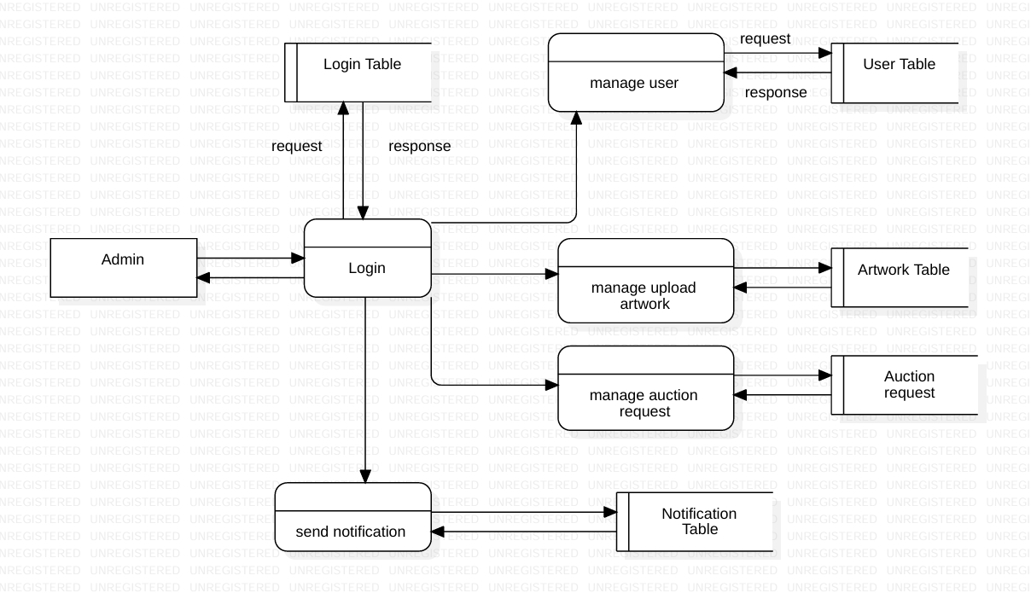
LEVEL 1 ADMIN

Slide 22
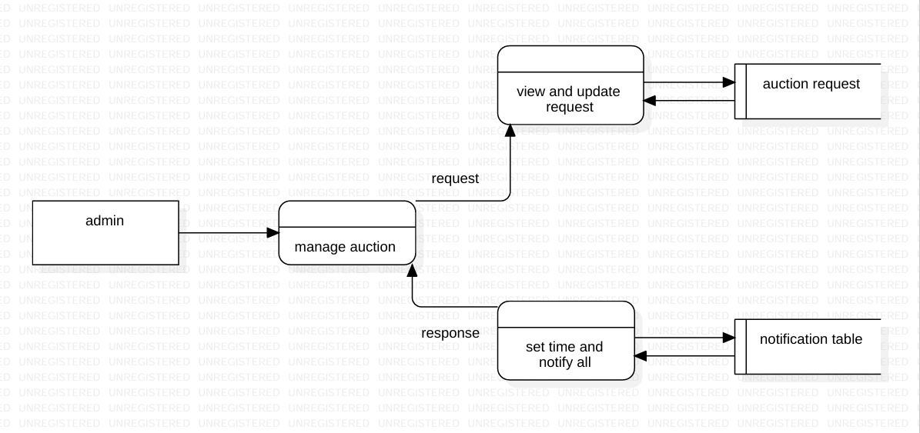
LEVEL 2 ADMIN

Slide 23
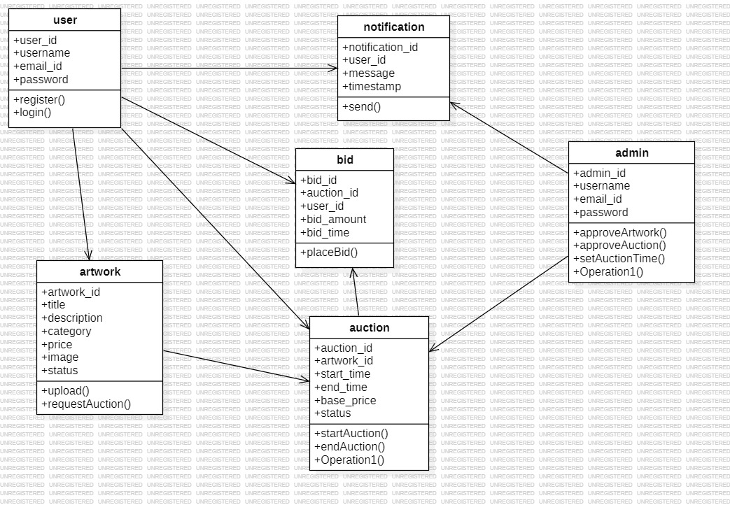
Class Diagram

Slide 24
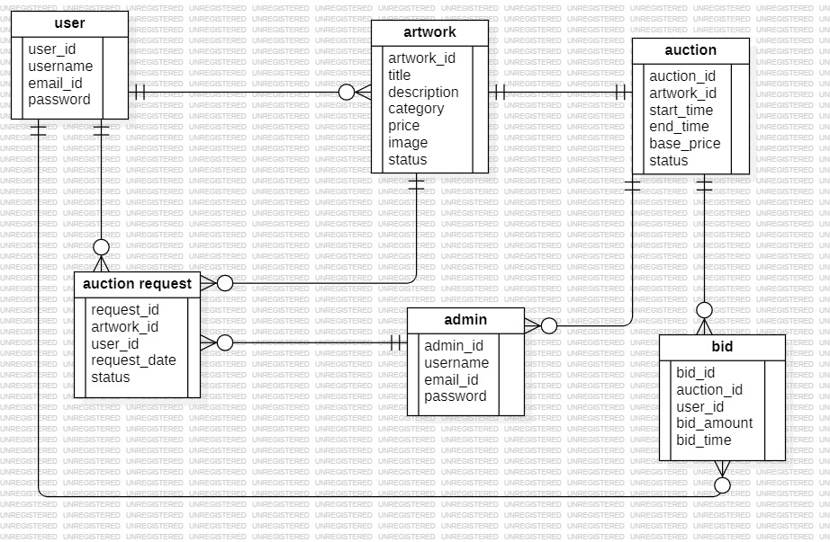
Entity Relationship Diagram

Slide 25
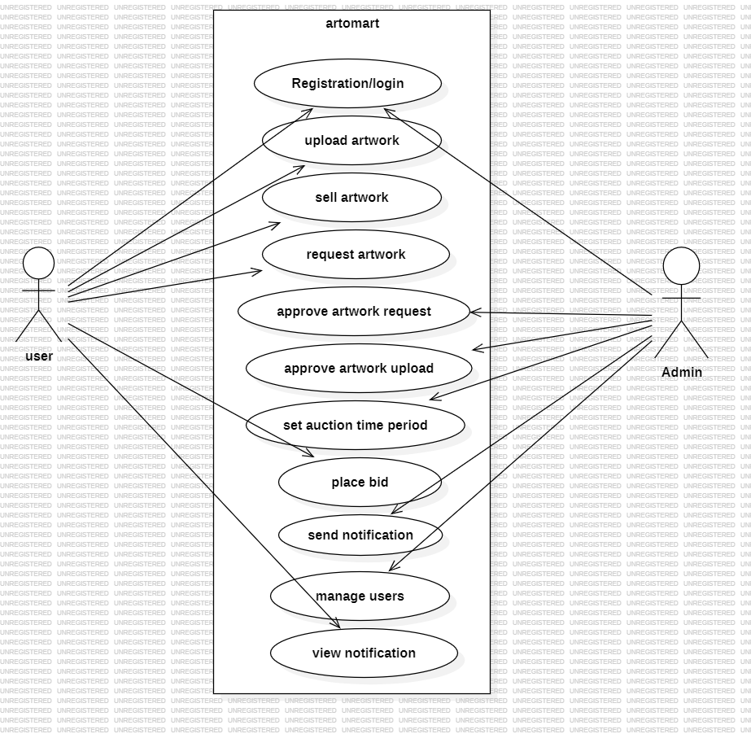
Use case diagram

Slide 26
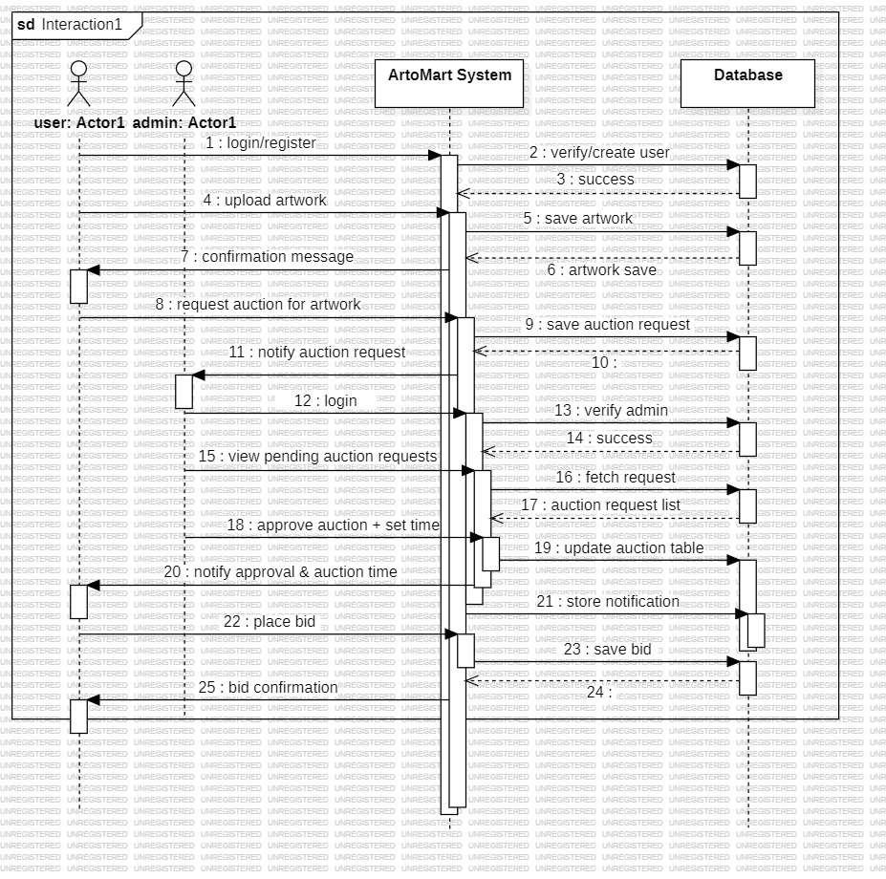
Sequence Diagram
Announce
Auction bid list

Slide 27
RESULT
User Registration & Login: Secure registration and role-based access for artists, buyers, and admins.
Artwork Management: Artists can upload, edit, or delete artworks; choose fixed-price or auction sales.
Auction System: Real-time bidding with automatic winner selection; notifications for bid updates.
Notifications & Alerts: Timely updates for artists, buyers, and admins; improves engagement and transparency.
Security & Data Integrity: Encrypted data storage, role-based access, and input validation.
System Performance: Seamless user experience, real-time updates, and smooth operation for multiple users.
Scalability & Future Enhancements: Modular design supports AI recommendations, analytics, virtual exhibitions, and mobile integration.

Slide 28
Future Scope
Integrate AI-based artwork recommendation to suggest personalized art to buyers.
Implement augmented reality (AR) preview, allowing users to visualize artwork on their wall before buying.
Introduce global multi-currency and crypto payment support for international buyers.
Add AI-based price prediction and bidding strategy assistance for auctions.
Launch mobile application for real-time auction notifications and seamless artwork browsing.
Provide artist analytics dashboard to track views, sales, and bidding trends.
Integrate virtual gallery/exhibition feature for artists to showcase collections in a 3D environment.
Enable community interaction features like reviews, live chat between artist and buyer, and art forums.

Slide 29
Overall conclusion
Based on this feasibility study, Artomart appears to be a viable project, offering a unique solution for artists and art enthusiasts. With careful planning, execution, and ongoing evaluation, the platform can achieve its goals and establish a strong presence in the online art market.

Slide 30
REFERENCE
[1] R. Reshma, “ArtoMart – Online Art Sales and Auction Management System,” International Journal of Research in Computer Applications and Web Technologies, vol. 7, no. 2, pp. 150–156, 2025.
[2] A. Thomas and S. Ravi, “Digital Art Marketplace with Live Auction Features,” International Journal of Innovative Computing and Digital Transformation, 2024.
[3] P. Kumar and L. Mehta, “Blockchain-Based Authentication for Online Art Auctions,” International Journal of Secure E-Commerce Systems, 2024.
[4] S. Verma and M. Joseph, “AI-Driven Auction Recommendation Systems for Digital Art Platforms,” International Journal of Artificial Intelligence and Smart Systems, 2023.
[5] K. Arjun and F. Ali, “Design and Development of Web-Based Art Trading Systems,” International Journal of Web Engineering and Technology Innovations, 2023.
[6] D. Mathew and J. Roy, “NFT Integration and Online Art Sales Platforms,” Journal of Digital Assets and Blockchain Technology, 2024.

Slide 31
THANK YOU!

