Slide 1
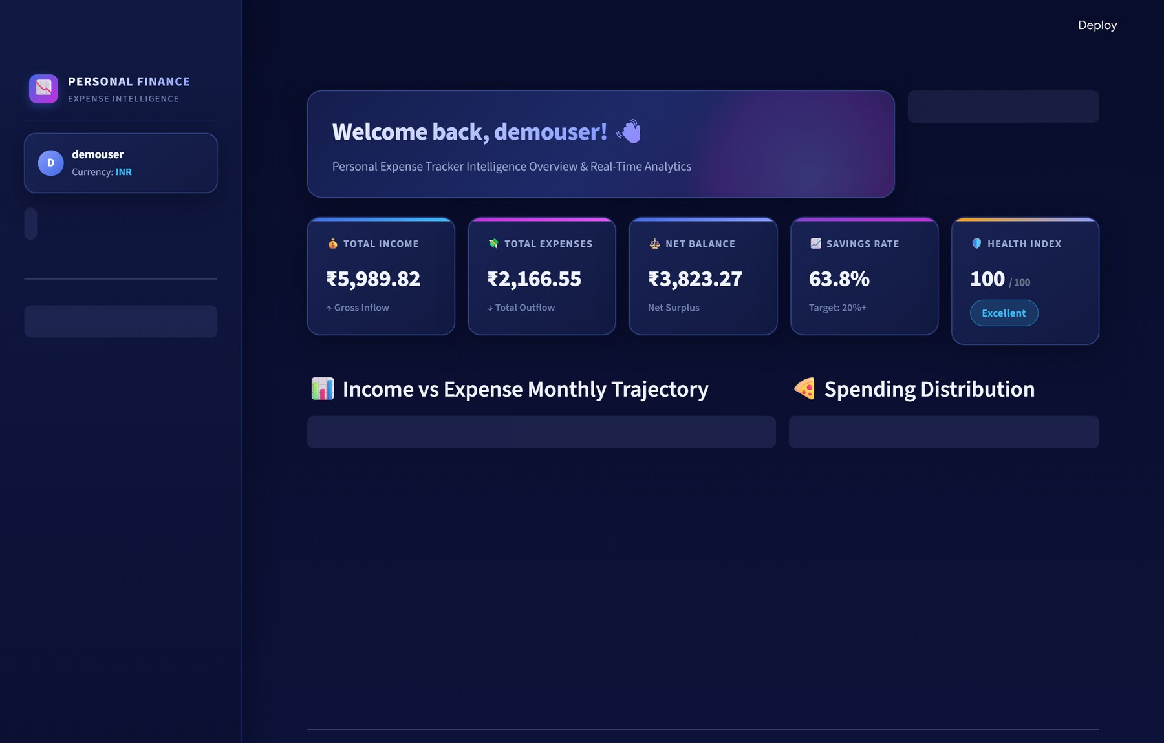
FINANCE & INTELLIGENCE PLATFORM
Personal Expense
Tracker
Production-grade personal financial intelligence & ML forecasting
Executive dashboard + Health Index
ML next-month forecasting
Active budget guardrails
7 interactive chart types
PDF and Excel export
Python
Streamlit
Plotly
10
9
7
6/6
Scikit-Learn
Supabase
FPDF2
Modules
Pages
Chart types
Tests passing
Personal Expense Tracker | Finance & Intelligence Platform
Notes:
Start with the gap this project fills. Most expense trackers are ledgers: they tell you where money went after it is gone. This platform adds a forecasting engine, live budget guardrails and a health score on top of the ledger. The screenshot on the right is the real dashboard running with the demo account, so everything you see in this deck comes from the live app, not mockups.

Slide 2



The Problem: Financial Fragmentation
2
Cash Flow Blindness
Subscription Creep
Tool Fragmentation
Tools report spending after it happens
No view of next month's outflow
Balances surprise users at month end
Recurring charges pile up unnoticed
Discretionary surges go undetected
Savings rate erodes silently
3+ disconnected apps and sheets
High manual upkeep, high drop-off
No unified intelligence layer
TODAY
WITH THIS PLATFORM
Banking portal
Static spreadsheet
Calculator app
One cockpit: KPIs, forecast, budgets, export
Personal Expense Tracker | Finance & Intelligence Platform
Notes:
Ask the audience when they last knew their next month's spending before the month started. Most people check a bank balance at the end of the month and work backwards. The three pain points here are really one problem seen from different angles: no foresight, no early warning on creeping costs, and no single place where the data lives. The bottom strip is the before and after we will build toward.

Slide 3




The Solution: An Intelligence-First Cockpit
3
Real-Time Executive KPIs
5 KPI cards plus a 0-100 Health Index
Predictive ML Forecasting
Next-month spend with a 95% range
Active Budget Guardrails
Green, amber and red category caps
Enterprise Data Portability
LIVE DEMO VALUES
CSV/XLSX import, PDF and Excel export
Income ₹5,989.82 | Expenses ₹2,166.55 | Savings rate 63.8% | Health 100/100
Personal Expense Tracker | Finance & Intelligence Platform
Notes:
Each pillar answers one of the problems from the last slide. The Health Index is a single number that blends savings rate, expense-to-income ratio and budget adherence, so you can read the state of your finances in a glance. Forecasting is what separates this from a ledger: it looks forward. The numbers in the strip under the screenshot come from the demo account.

Slide 4
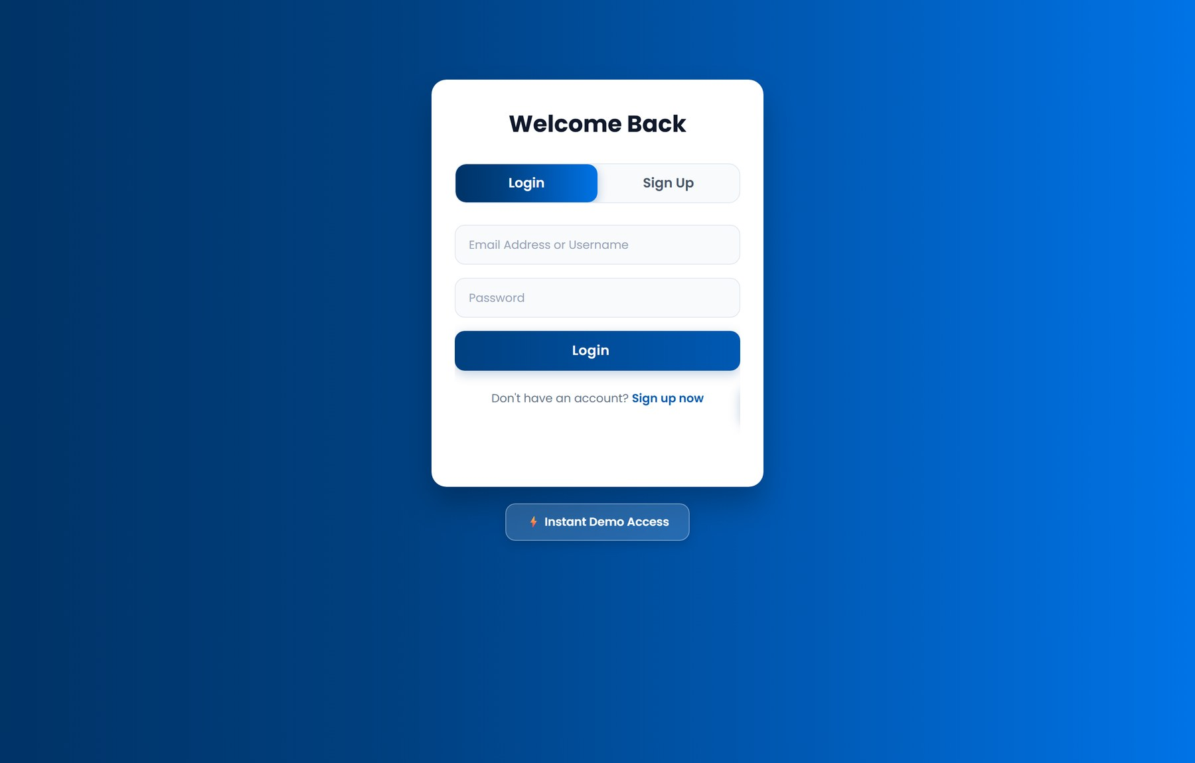



From Onboarding to Wealth: A 5-Stage Journey
4
1 ONBOARD
2 CAPTURE
3 MONITOR
4 FORECAST
5 OPTIMIZE
1-click Instant Demo
PBKDF2 secure sign-up
Session persists across pages
Quick Add entry
CSV/XLSX drag-and-drop
Recurring expense flags
Monthly category caps
Under 75% green, 75-99% amber
100%+ red alert
Scikit-learn regression
Next-month projection
95% confidence range
50/30/20 rule audit
Anomaly spike alerts
Goals and PDF export
Instant Demo seeds 6 months of data (3,721 transactions) with no sign-up.
Registration: name, email, username, password. Unique email enforced.
Passwords hashed with PBKDF2-HMAC-SHA256 and a random per-user salt.
Personal Expense Tracker | Finance & Intelligence Platform
Notes:
Walk the five stages left to right. The onboarding screenshot is worth pausing on: the Instant Demo Access button under the login card is how any evaluator can get inside with six months of realistic data and no setup. After that the flow is capture, monitor, forecast, optimize, and each stage maps to a module you will see later in the deck.

Slide 5
3-Tier Architecture with Dual-Engine Persistence
5
PRESENTATION
Modern web browser
Glassmorphic CSS (utils/css.py)
Plotly interactive charts
Google Fonts
Browser client
APPLICATION & LOGIC
app.py: central router (session init, auth gating, theme, navigation)
Streamlit + Python, 10 domain modules
auth
dashboard
transactions
budgets
analytics
ml_engine
insights
savings
import_export
settings
DATA ACCESS
get_connection()
init_db()
seed_demo_data()
PgCursorWrapper
PgConnectionWrapper
database/db.py
STORAGE
Supabase PostgreSQL 15+
SQLite 3 (WAL mode)
Primary and fallback engines
auto-failover
Cloud primary, pooler on port 6543
Local fallback, zero config
Personal Expense Tracker | Finance & Intelligence Platform
Notes:
The architectural highlight is the bottom layer. db.py hands back either a wrapped PostgreSQL connection or a native SQLite one, and the cursor wrapper translates SQL dialects on the fly, for example swapping the question-mark placeholders for percent-s and adding RETURNING id to inserts. That means the ten modules above it never know which engine they are talking to. If the cloud database cannot be reached, the app logs a warning and carries on locally.

Slide 6
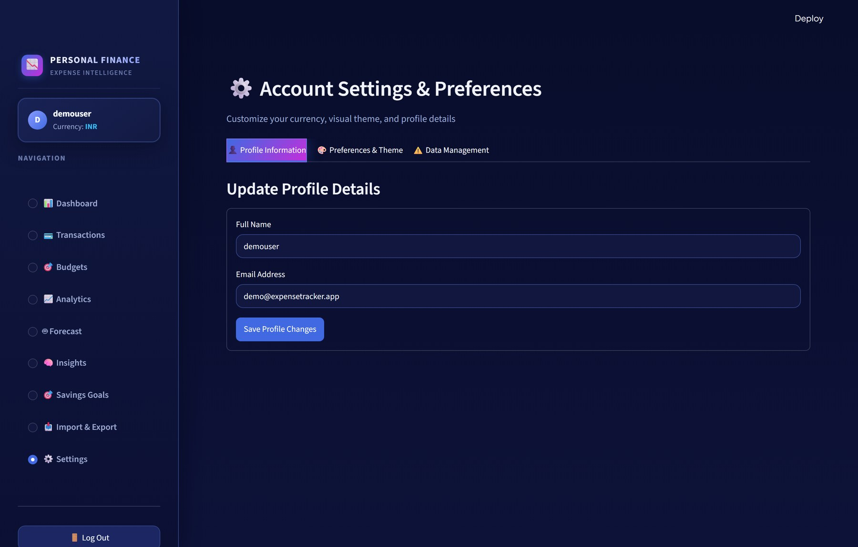






Verified Technology Stack
6
Streamlit
Pandas + NumPy
v1.63.0
v3.0.5 / v2.5.3
App framework, UI, routing
Resampling and aggregation
Plotly
Scikit-Learn
v7.0.0
v1.9.1
7 interactive chart types
Regression and ML forecasting
SETTINGS & PERSONALIZATION
7 currencies: USD EUR GBP INR JPY CAD AUD
Dark Fintech and Light Modern themes
Profile editing, demo re-seed, data reset
PostgreSQL + SQLite
FPDF2 + OpenPyXL
Supabase 15+ / SQLite 3
v2.8.8 / v3.1.5
Cloud and offline persistence
Branded PDF, multi-sheet Excel
Personal Expense Tracker | Finance & Intelligence Platform
Notes:
Every library has one clear job. Pandas and NumPy handle the time-series work, Plotly draws the charts, scikit-learn does the forecasting, and FPDF2 plus OpenPyXL produce the exports. The database is deliberately two engines behind one interface. The settings screenshot on the right shows the account area; currency and theme live under the Preferences tab.

Slide 7
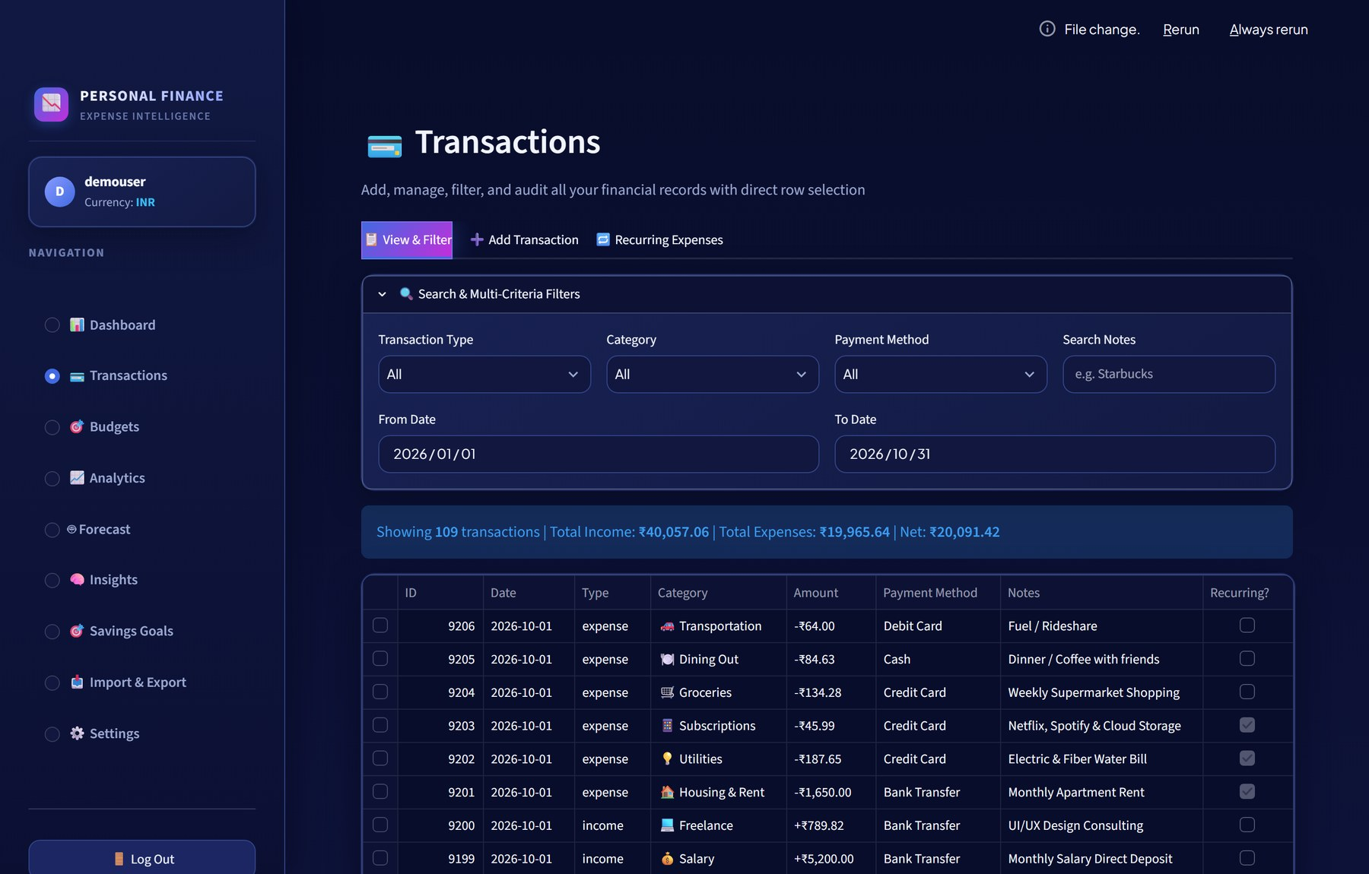
Transactions, Budgets & Data Flow
7
3-TIER BUDGET ALERTS
Healthy <75%
Warning 75-99%
Critical 100%+
Filter by type, category, payment, dates, notes
Row click opens edit or confirmed delete
Add with recurring flag and frequency
Parameterized SQL, injection resistant
Live: 109 transactions shown | Income ₹40,057.06 | Expenses ₹19,965.64 | Net ₹20,091.42
DATA FLOW
Entry, CSV/XLSX, demo seed
Schema validation
Database
Pandas
Plotly charts
Personal Expense Tracker | Finance & Intelligence Platform
Notes:
The transactions hub is where auditability lives. The filter panel narrows the ledger by type, category, payment method, date range and a text search on notes, and the summary bar recalculates as you filter. Clicking a row opens the edit or delete card below the table. The budget bars use three states so that a category turns amber before it turns red. The strip at the bottom is the data pipeline from any input source through validation into the database and out to charts.

Slide 8
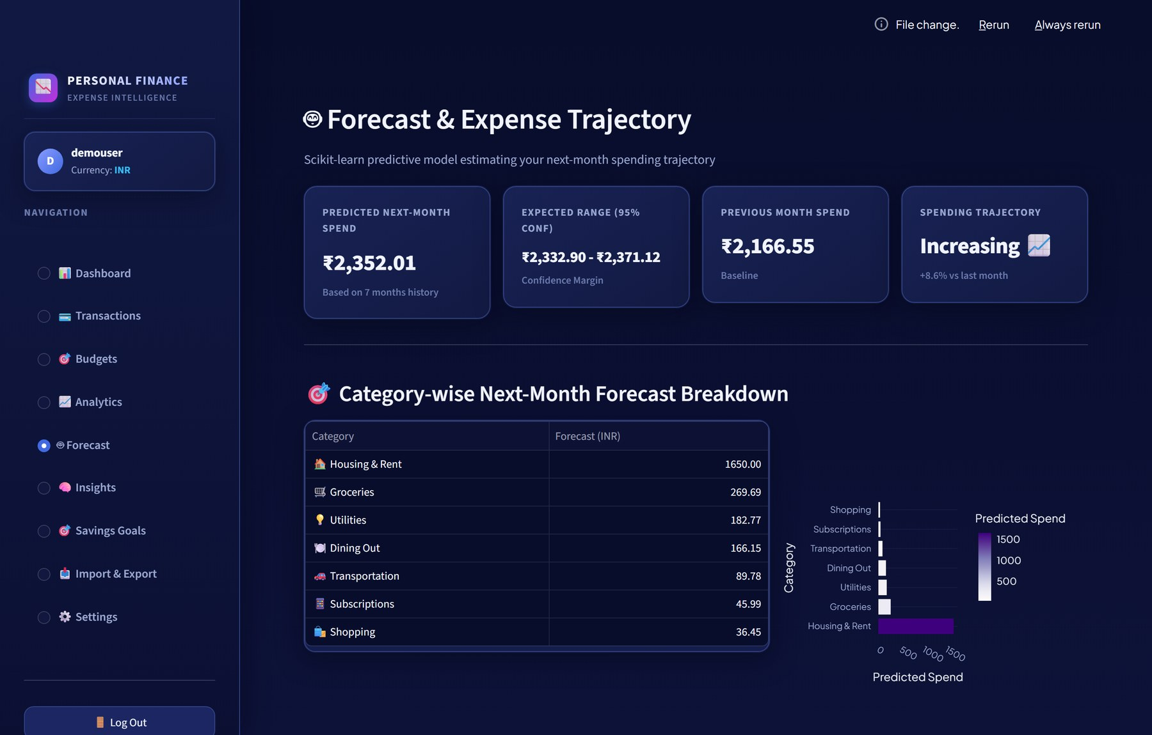
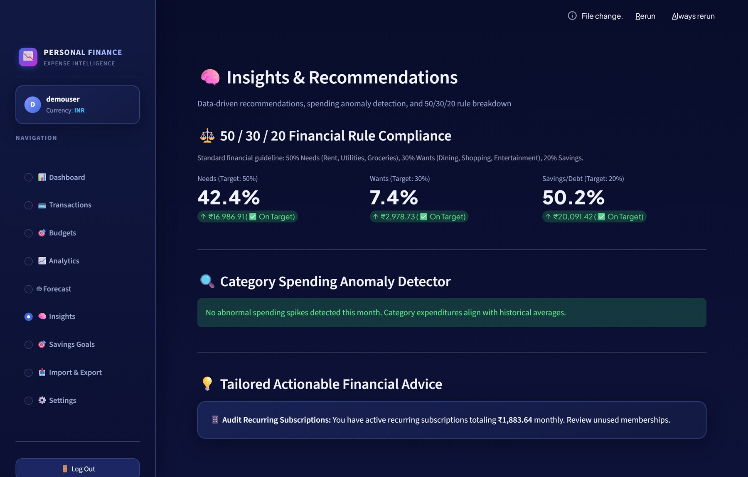
ML Forecasting & Financial Intelligence
8
FORECAST PIPELINE
1
Validate input: 5+ expenses over 2+ months
2
Aggregate monthly totals
3
Features: month_index, lag_1, rolling_avg_3
4
Fit LinearRegression (RandomForest fallback)
Forecast page
Insights page
5
Predict next-month total, floored at 0
₹2,352.01
₹2,333 - ₹2,371
+8.6%
42 / 7 / 50
6
Confidence bounds from residual std dev
Predicted next month
95% expected range
Increasing vs last month
Needs/Wants/Savings
7
Category split: 0.6 last month + 0.4 mean
Anomaly detector flags a category above 1.25x its 3-month average (50+ units); none flagged this month
Recurring subscriptions audit: ₹1,883.64 committed per month
8
Classify trend with a +/-5% threshold
Personal Expense Tracker | Finance & Intelligence Platform
Notes:
This is a real scikit-learn regression, not a rule of thumb. It trains on three features, the time step, last month's spend and a three-month rolling average, then reports a point estimate with a range based on the residual spread. In the demo account the model projects about 2,352 rupees, up 8.6 percent on last month, so the trajectory reads Increasing. The Insights page runs a 50/30/20 check and an anomaly detector; for this account neither found a problem, which is itself a good demo of the empty state.

Slide 9
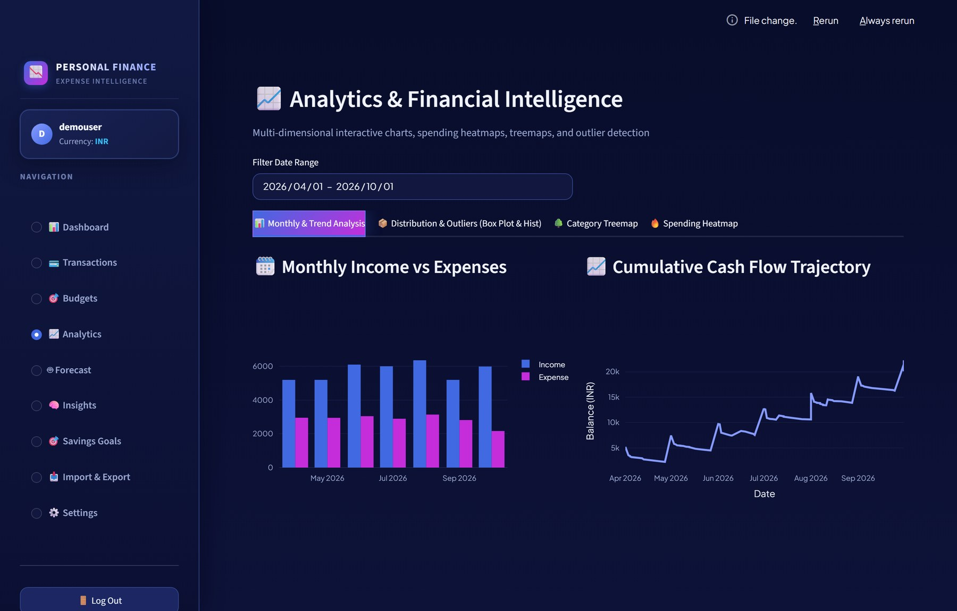
Interactive Visual Analytics: 7 Chart Types
9
THE SEVEN CHART TYPES
1
Grouped monthly bar
Analytics: Monthly & Trend
2
Spending donut
Dashboard
3
Cumulative cash flow line
Analytics: Monthly & Trend
4
Amount histogram
Analytics: Distribution
5
Box plot (outliers)
Analytics: Distribution
6
Category treemap
Analytics: Treemap tab
7
Day-of-week heatmap
Analytics page: monthly income vs expenses and cumulative cash flow (Apr to Oct 2026)
Analytics: Heatmap tab
Personal Expense Tracker | Finance & Intelligence Platform
Notes:
Two of the seven charts are visible in this screenshot; the other analytics charts sit behind the sub-tabs along the top, and the donut lives on the dashboard. The heatmap is the one to demo live: it shows spending by day of week across the weeks of a month, so weekend overspending jumps out. The box plot does a similar job for outliers within a category. A date range filter at the top of the page applies to all of them.

Slide 10




Cloud Deployment & Graceful Fallback
10
Developer
GitHub
Streamlit Cloud
Supabase Postgres
git push to main
Source repository
Python 3.10+ container, auto-deploy
Pooler on port 6543
if unreachable
Graceful fallback
SQLite 3 (WAL)
A failed PostgreSQL connection logs a warning and activates SQLite, so the app keeps running instead of crashing.
Local fallback
SECRETS
CONFIG
BUILD
DATABASE_URL via st.secrets or env; .env and *.db are git-ignored
.streamlit/config.toml: headless on, usage stats off
requirements.txt dependencies; no Dockerfile yet (planned)
Personal Expense Tracker | Finance & Intelligence Platform
Notes:
Deployment is deliberately simple: push to GitHub and Streamlit Community Cloud rebuilds the container from requirements.txt. The database connection string is injected as a secret and never committed. The fallback is the reliability story, but be precise about it: it keeps the app available if the cloud database is unreachable, though local SQLite data is separate from the cloud data. Two honest gaps to mention if asked: there is no Dockerfile in the repository yet, and remote database latency was not benchmarked.

Slide 11

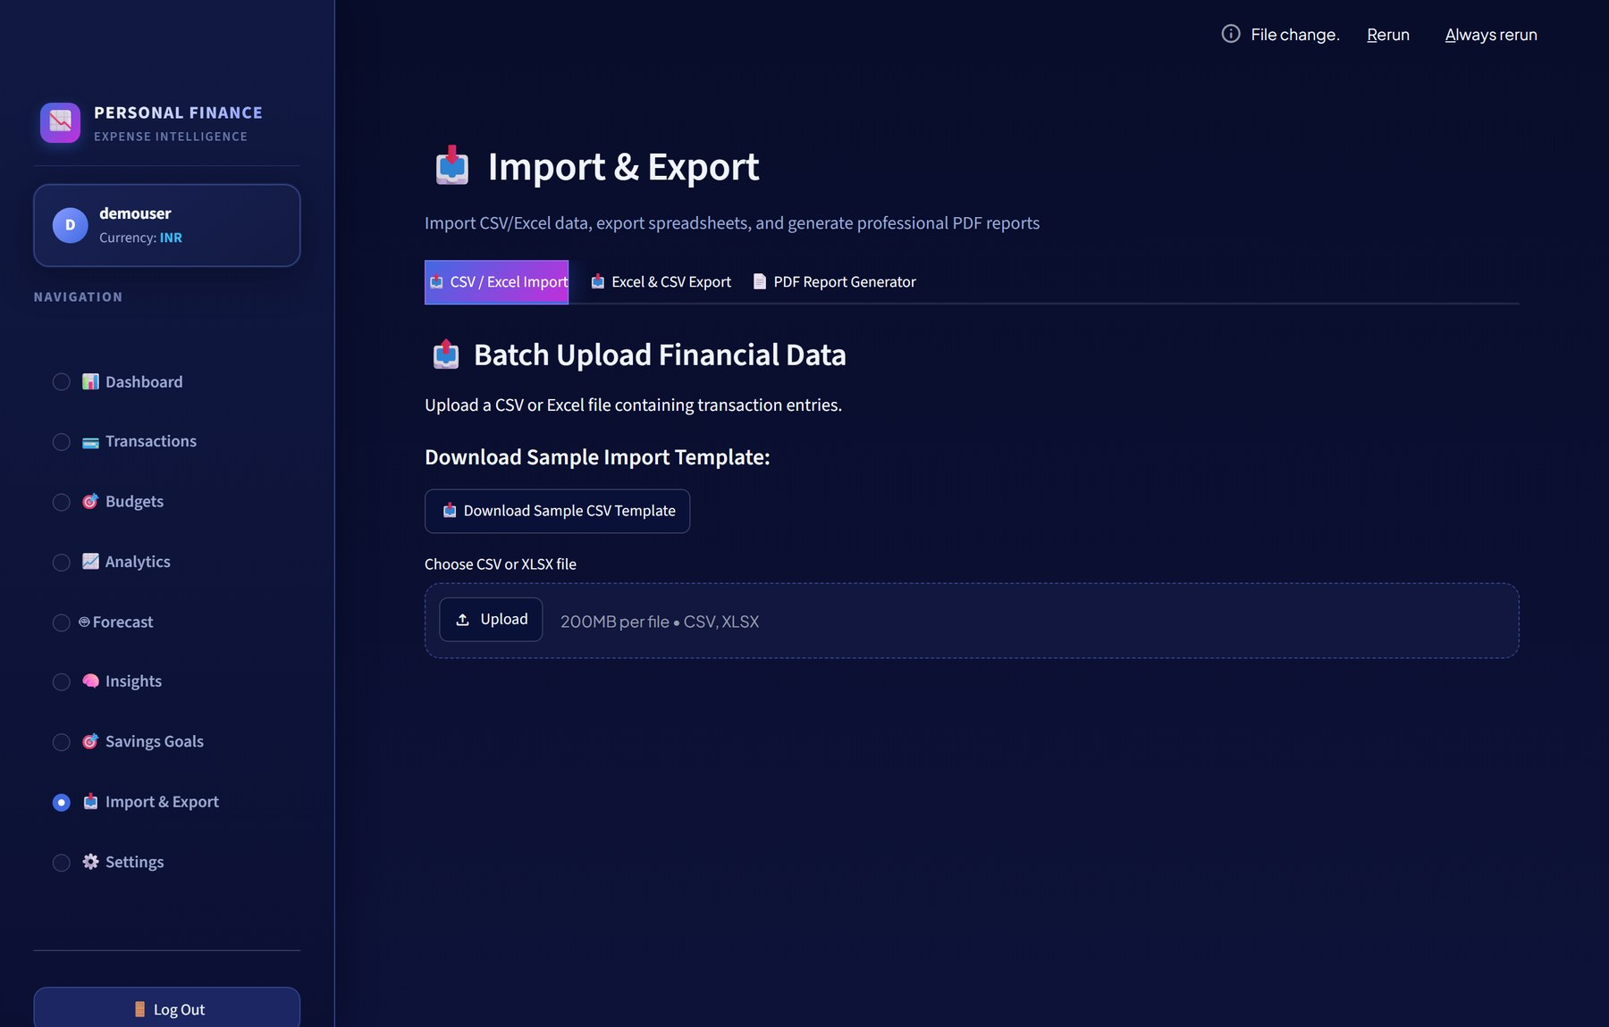
Wealth Milestones & Data Portability
11
Emergency Fund: 65.0% (₹6,500 of ₹10,000)
Japan Vacation: 51.4% (₹1,800 of ₹3,500)
New Macbook Pro: 100%, completed
Deposit popover logs funds per goal
Drag-and-drop CSV/XLSX, up to 200MB
Schema validation and sample CSV template
Multi-sheet Excel (OpenPyXL) and CSV export
Branded multi-page PDF (FPDF2) with audit log
Personal Expense Tracker | Finance & Intelligence Platform
Notes:
Expense tracking without goals is only half the picture, so each savings goal gets its own card with a progress bar and a deposit popover that updates progress immediately. Note the Japan Vacation goal has a target date of mid October, so it is a nice example of a goal that is behind pace. On the right, the import side validates dates, types and amounts before anything touches the database. The export tabs next to it produce the Excel workbook and the PDF report.

Slide 12

Summary: Strengths, Metrics & Roadmap
12
VERIFIED STRENGTHS
KEY METRICS
FUTURE ROADMAP
PLANNED
6/6 unit tests pass (1.7 s)
10
9
MFA and email verification
Open Banking API (Plaid)
Async ML retraining workers
Mobile-first interface
Email/SMS spending alerts
Auto Postgres-to-SQLite fallback
Modules
Pages
PBKDF2-SHA256, 100k iterations, salted
5
7
DB tables
Chart types
Local queries under 5 ms (3,700+ rows)
6/6
3,721
ML forecast with confidence range
Tests
Demo records
KNOWN LIMITATIONS
ML trains synchronously on page load (fast at current scale)
Session state is tab-scoped; hard refresh re-checks auth
No MFA or email verification yet
Personal Expense Tracker | Finance & Intelligence Platform
Notes:
Close by separating what is delivered from what is planned. Everything in the first two columns is implemented and tested; the roadmap column is clearly labelled planned. The limitations strip is there on purpose: synchronous training is fine at this data size but would need background workers at scale, and the lack of MFA is the most important security gap. Finish by offering the live demo, since the Instant Demo button makes it a ten-second setup.

