Slide 1
DIGITAL TWIN CHALLENGE 2026
ChipUP
A Digital Twin for Predictive Glucose Spike Monitoring
in Type 2 Diabetes
Chennai Institute of Technology
Reshmi K · Rosiny C A · Varsha S · Yokhithaa S

Slide 2
THE PROBLEM
Glucose spikes are treated after the fact
Type 2 Diabetes affects over 100 million people in India. One of its most dangerous everyday risks is the post-meal glucose spike — a rapid rise that silently damages the heart, kidneys, and eyes over time.
100M+
People living with Type 2 Diabetes in India
Today, patients and doctors usually find out about a spike only after it has already happened — via a CGM reading or a lab test. By then, the damage is already underway.
Reactive
is how care works today — react after the spike, not before it
Our goal: proactive
predict the spike 2 hours before it happens
ChipUP — Digital Twin Challenge 2026
2

Slide 3
THE CONCEPT
What is a patient Digital Twin?
A Digital Twin is a continuously updated virtual replica of a patient's physiology — built by fusing two very different kinds of data into one living model.
Static / Historical
Dynamic / Real-time
The patient's long-term clinical profile
The patient's live physiological trajectory
Demographics & BMI
Continuous glucose (CGM), 5-min
HbA1c & years since diagnosis
+
Heart rate & HRV
Medication (insulin, metformin)
Sleep stage
Comorbidities (BP, cardiovascular)
Step count / activity
Lipid panel & kidney markers
Updated continuously, not once
Fused into one continuously updated patient twin
ChipUP — Digital Twin Challenge 2026
3

Slide 4
OUR SOLUTION
ChipUP: predicting the spike, not just the sugar
We built a proof-of-concept Digital Twin focused on one specific, high-impact prediction task: will this patient's glucose spike in the next 2 hours?
1
2
3
4
Simulate the twin
Fuse the streams
Predict the event
Inform the doctor
Generate synthetic EHR + wearable data mimicking real patients
Merge rolling wearable windows with each patient's static profile
XGBoost model flags spike risk 2 hours ahead of onset
Risk score + explainability surfaced on a live dashboard
ChipUP — Digital Twin Challenge 2026
4

Slide 5
DATA STRATEGY
Navigating the sandbox rules
Real patient data is restricted by privacy laws like the DPDP Act and HIPAA. Every dataset in this project is synthetically generated — no real patient information is used anywhere.
For EHR data
For wearable data
Static clinical profile generation
Dynamic time-series generation
• Synthetic patient generation (Synthea-style)
• 5-minute interval CGM + HR + HRV + sleep
• 200 simulated patient profiles
• 7 days per patient (~403K readings)
• Realistic HbA1c, BMI, medication mix
• Spike frequency scaled to HbA1c severity
ChipUP — Digital Twin Challenge 2026
5

Slide 6
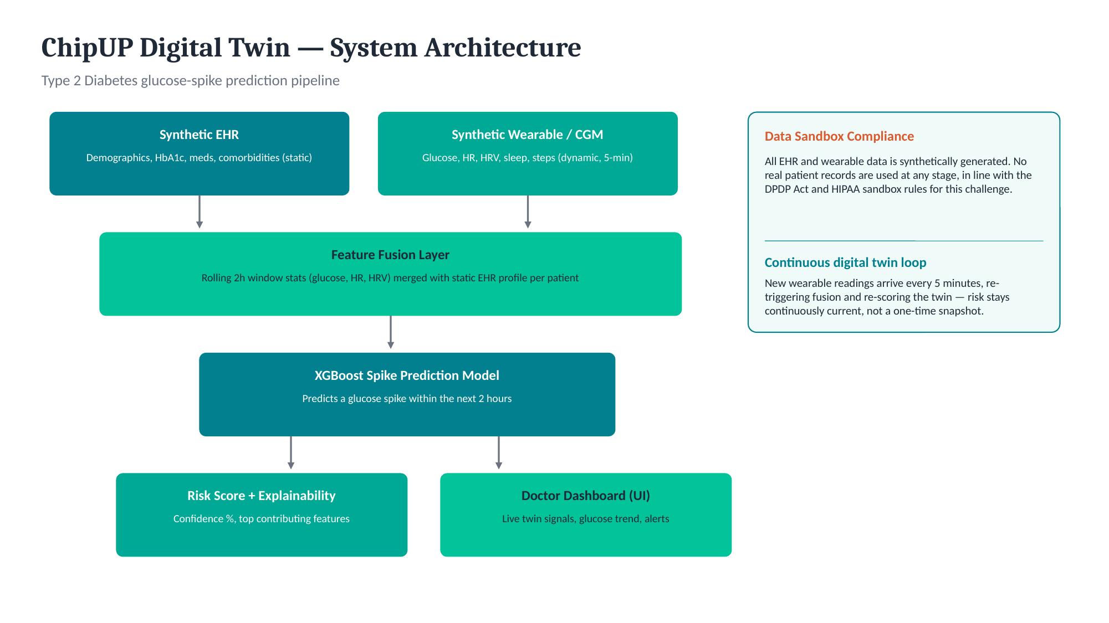
SYSTEM DESIGN
End-to-end architecture
ChipUP — Digital Twin Challenge 2026
6

Slide 7
TECHNICAL APPROACH
Why XGBoost for this prediction task
Fast iteration
Trains in seconds on CPU — critical for a hackathon timeline
Technical stack
Language
Python 3
Explainable
Feature importances build clinician trust, unlike a black box
Data generation
NumPy, Pandas
Imbalance-aware
Feature engineering
Rolling-window stats (Pandas)
scale_pos_weight handles the natural rarity of real spikes
Model
XGBoost (gradient-boosted trees)
Strong tabular fit
Evaluation
scikit-learn (ROC-AUC, PR-AUC)
Rolling-window features already encode short-term temporal signal
Dashboard mockup
HTML / CSS
ChipUP — Digital Twin Challenge 2026
7

Slide 8
RESULTS
Model performance on held-out patients
0.77
1,430
403K+
ROC-AUC on held-out patients
Labeled spike events across 200 patients
Wearable readings fused with EHR profiles
Top predictive features
Known limitation (by design)
Recent sleep quality
Precision on the rare spike class is currently low at the default threshold, due to natural class imbalance. Next steps: threshold tuning, cost-sensitive learning, and a larger synthetic cohort. We surface this openly rather than hide it.
Glucose trend (2h slope)
Glucose variability
Recent activity (steps)
Heart rate variability
ChipUP — Digital Twin Challenge 2026
8

Slide 9
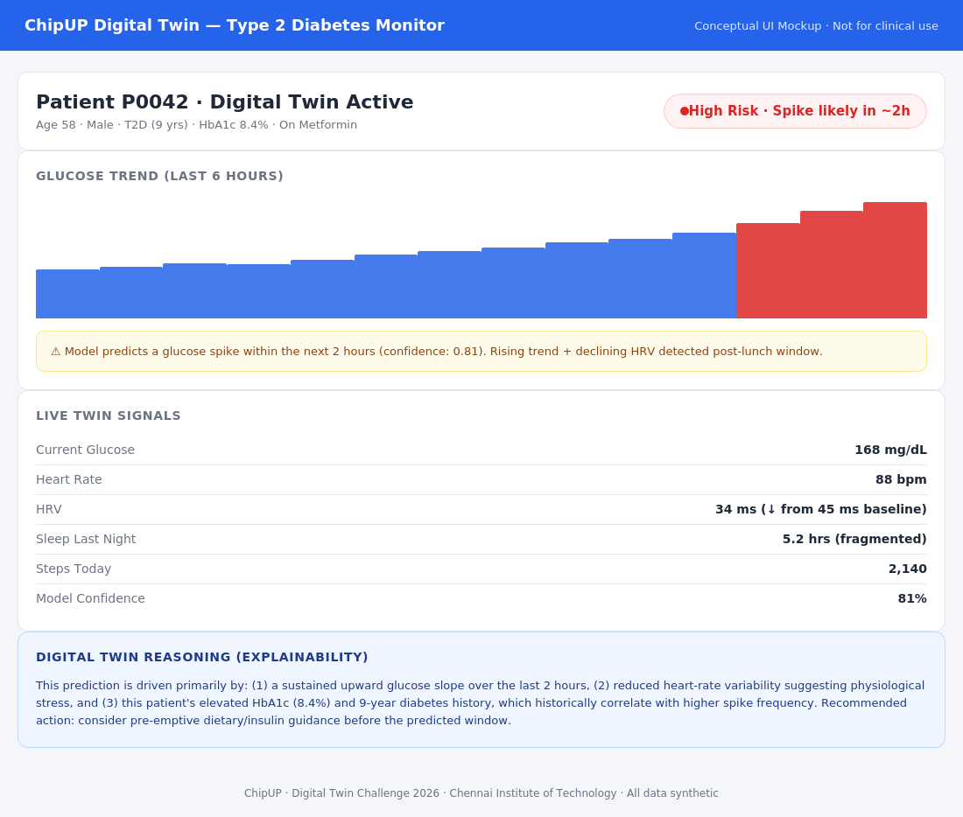
CONCEPTUAL UI
How a doctor interacts with the twin
ChipUP — Digital Twin Challenge 2026
9

Slide 10
IMPACT & ROADMAP
From PoC to real-world impact
Clinical impact
Near-term roadmap
Long-term vision
Pre-emptive dietary or insulin guidance
Validate on real, IRB-approved cohorts
Extend to hypertension, CV risk twins
Fewer emergency interventions
Threshold tuning for higher precision
Full-body multi-condition twin
Better long-term glycemic control
Expand to hypoglycemia prediction
Clinician co-design of the dashboard
Builds clinician trust via explainability
Multi-day trend forecasting
Integration with real EHR systems
ChipUP — Digital Twin Challenge 2026
10

Slide 11
Thank you
ChipUP — Digital Twin Challenge 2026
Chennai Institute of Technology · Reshmi K, Rosiny C A, Varsha S, Yokhithaa S

