Slide 1
Efect of exam weeks on vıewıng habbıts
Muhammed Reşid Sağlam 31320

Slide 2

My dataset
Youtube watch history
Via Google Takeout

Slide 3
My Hypothesıs
Amount of non-Shorts videos I watch decreases in exam weeks and weeks closer to exam weeks.

Slide 4
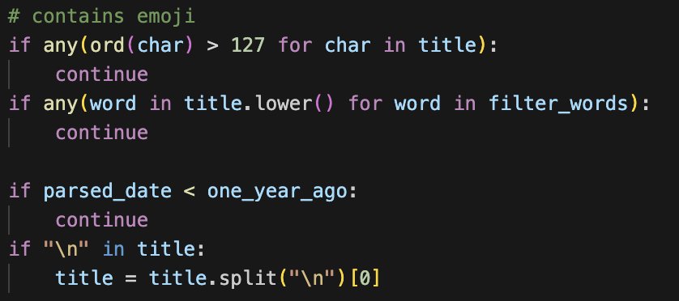
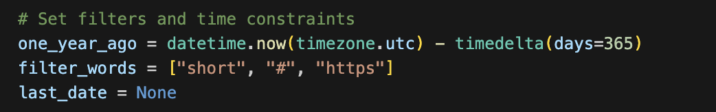
I started with cleaning out my dataset. I conducted my analysis on last year, excluding Shorts as much as I can, and omitting the videos I did not watch more than 1 minute.
For this I used filter words such as “#” “short” and “https” and emojis and removed the data containing these in the title.
Then continued with creating my dataframe with desired attributes.

Slide 5
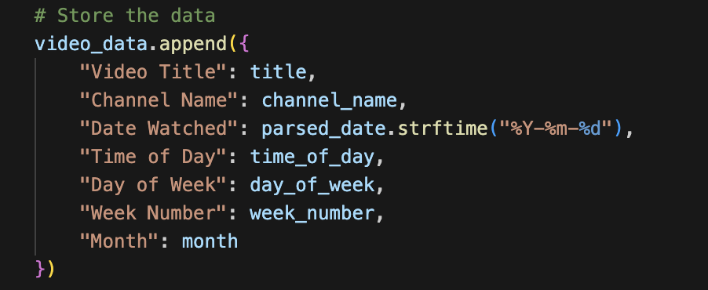
Here are the attributes I derived:
Title
Channel Name
Date Watched
Time of Day:
00.00 – 06.00: Night
06.00 – 12.00: Morning
12.00 – 18.00: Noon
18.00 – 00.00: Evening
Day of Week
Week Number
The furthest week present in the dataset is marked as 1
The most recent week present in the dataset is marked as 52
Month
Further attributes will be derived from these attributes

Slide 6
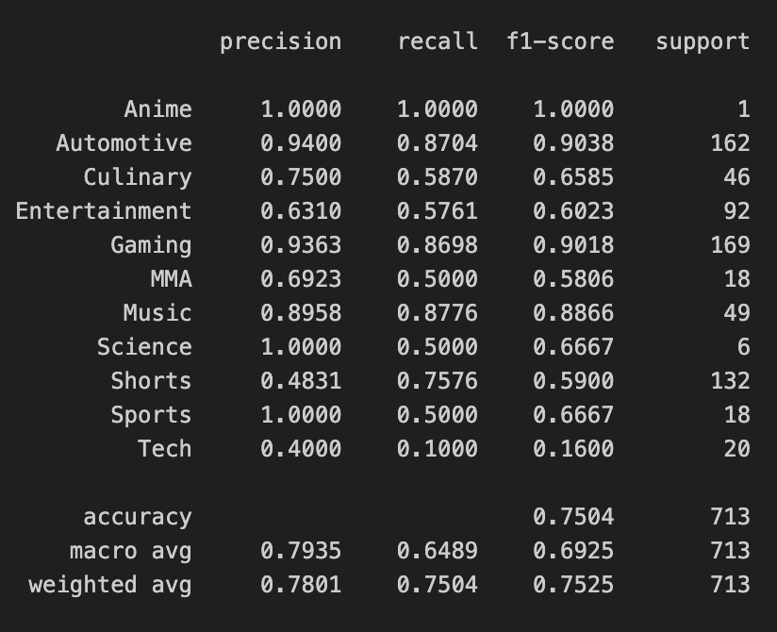
Later, I categorized close to half of the channel names myself, and provided the data sheet to an ML model to categorize the rest of the videos.
The accuracy of the model came out somewhat accaptable, especially for the categories that I manually categorized.

Slide 7
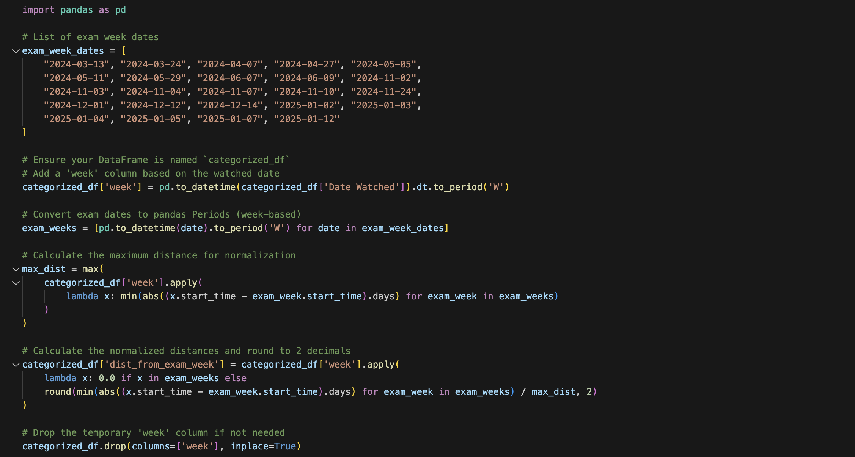
After filtering my data frame for Shorts again, I provided the dates on which I had exams, a brief mail search was sufficient.
Then created a new attribute namely “distance_from_exam_week” and calculated the value for each data, ranging from 0 (exam week) to 1 (furthest from any exam week)

Slide 8
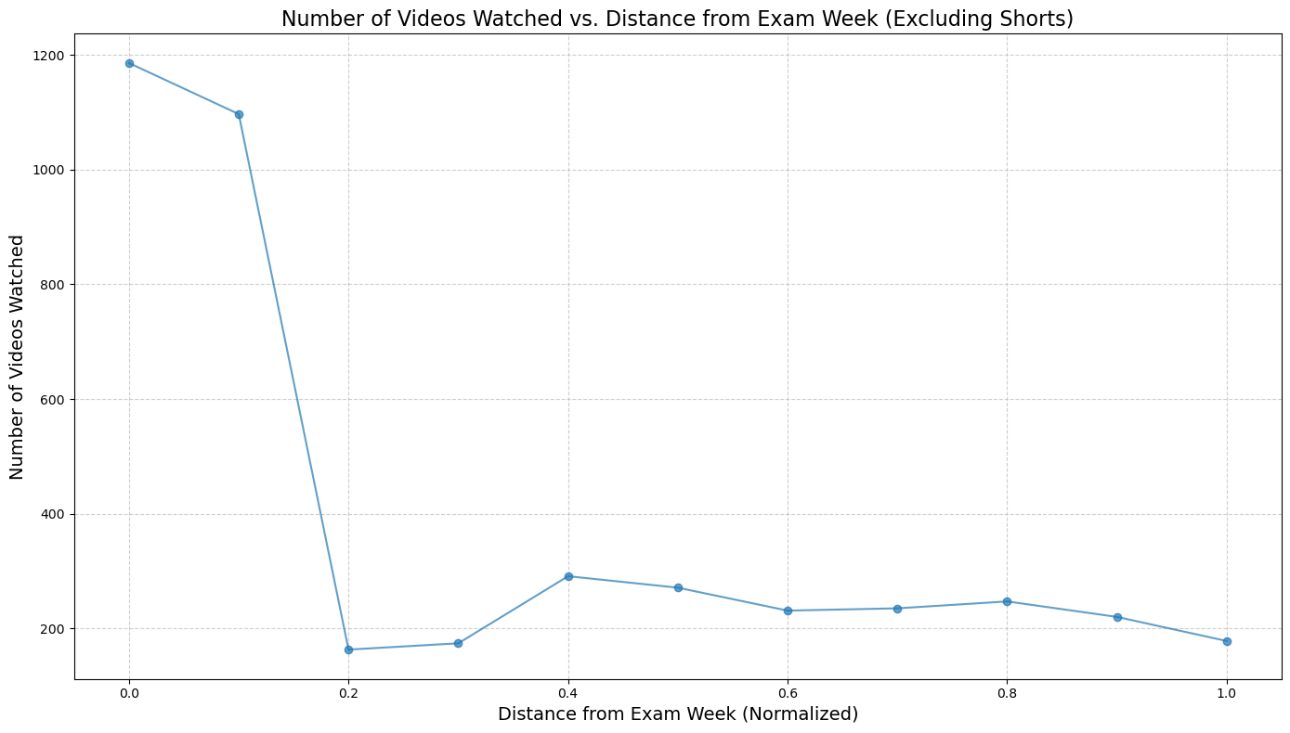
From there I used visualization methods for better undertanding
This chart represents number of videos watched with respect to distance from exam week.
The videos for distance 0.0 and 0.1 are in abundance, indicating period marked as “exam week” seems large, thus includes more videos than rest.
I chose to disregard 0.0 since exam weeks are long and would distrupt my analysis
There seems to be no significant trend among the rest

Slide 9
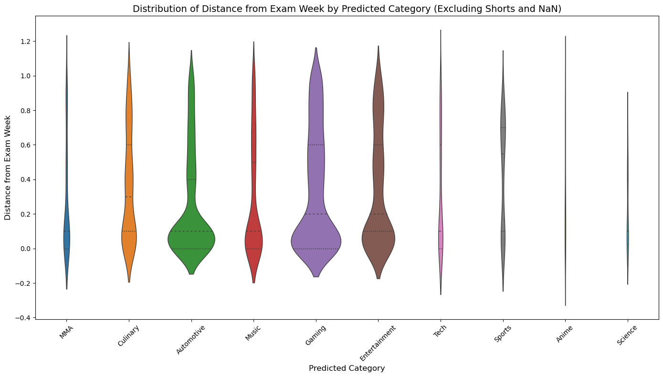
Then I decided a violin chart would be perfect to uncover some trends based on category and time away from an exam week
There seems to be difference in frequencies of categories but overall there still seems to be no significant trend.

Slide 10
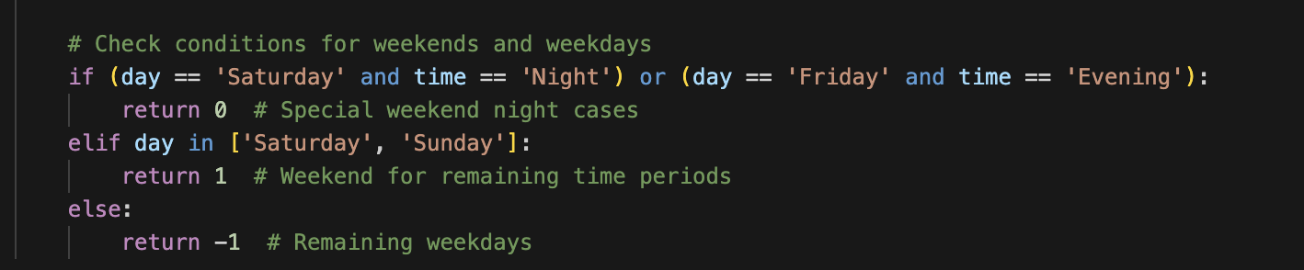
In case I needed a more comprehensive analysis, I introduced a new attribute, indicating whether I watched the video on a weekday or weekend.
I chose to not categorize Friday Evening and Saturday Night, since I don’t consider that time period to be any of them.

Slide 11
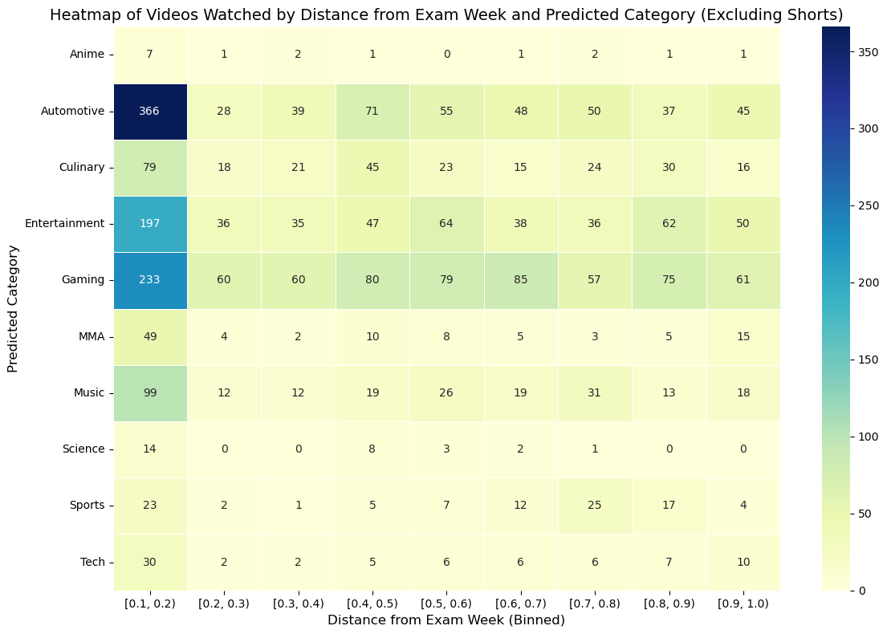
I created a heatmap to uncover any correlation
While some categories have their highs the further they are, majority are diverse and seem random.
There seems to be no apperant trend.

Slide 12
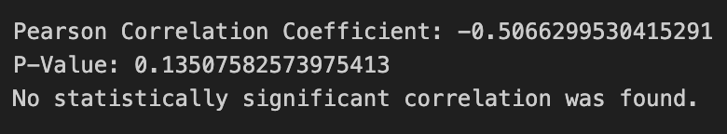
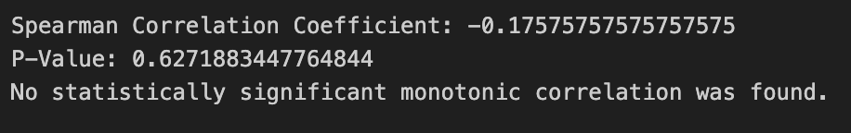
Then I resorted to Pearson and Spearman Correlation tests so I could be more decisive.
Both tests resulted in high p-values, indicating no significant trends, thus forcing me to fail to reject the null hypothesis

Slide 13
Addıtıonal analysıs
After my hypothesis test failed to reject null, I wanted to explore my data bit more
First I wanted to check for each category, what trend it seems to follow.
Then I wanted to check for trends based on whether the video was watched in weekend or weekday.

Slide 14
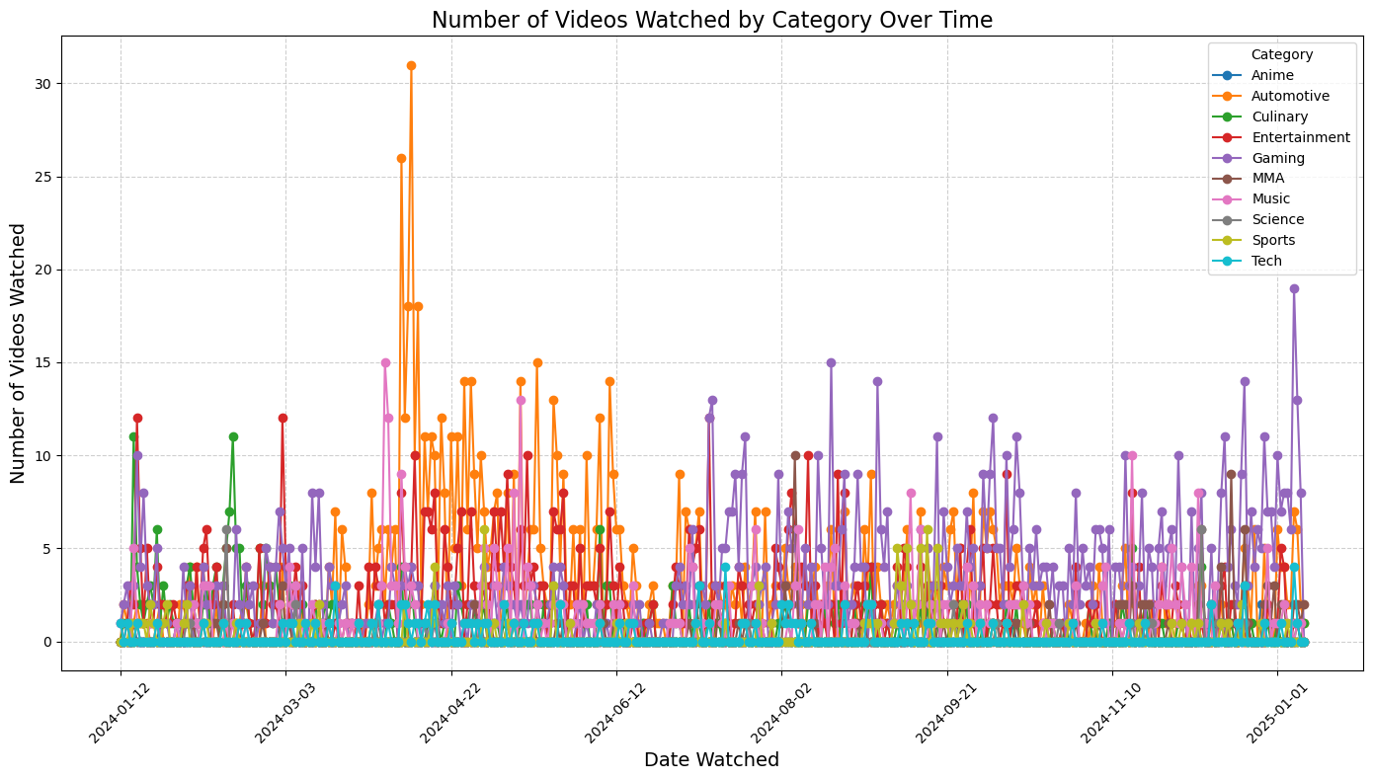
I created a line chart representing each categories watched video amount on each date.
Then created a quadratic regression model to uncover trends.

Slide 15
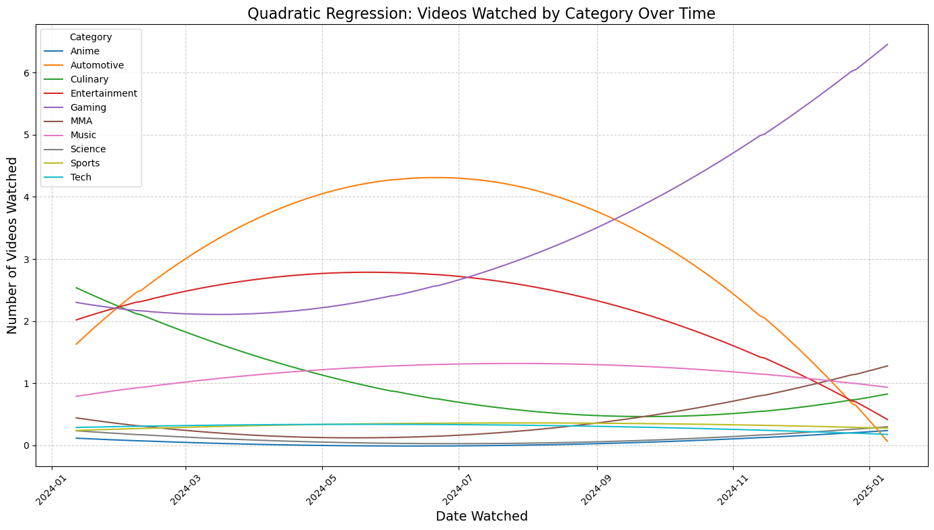
Automotive: Initially increased, peaked and then gradually decreased over time.
Gaming: Overall increase, some fluctuations, but upward trend dominates.
Music: Remained relatively stable, with slight increases at some points, no trend.
Culinary: Decreased, stable for a while, and slight increse.
Tech: Remained flat, no trend.
Entertainment: Increased at firs, remained stable and then decreased.
MMA: Slight increase at first, then remains stable.
Sports: Increased initially but steadily decreased.
Science: Stable throughout, no trend.
Anime: Stable throughout, no trend.

Slide 16
Summary
• Categories like Gaming and Automotive showed more pronounced trends.
• Entertainment and Sports exhibited a pattern of increase followed by decrease.
• Categories like Tech, Music, and Science remained steady without significant changes.

Slide 17
Weekend analysıs
I calculated the average number of videos I watched in weekdays, weekends, and the period transioning from weekday to weekend.
Then used a bar chart to visualize them

Slide 18
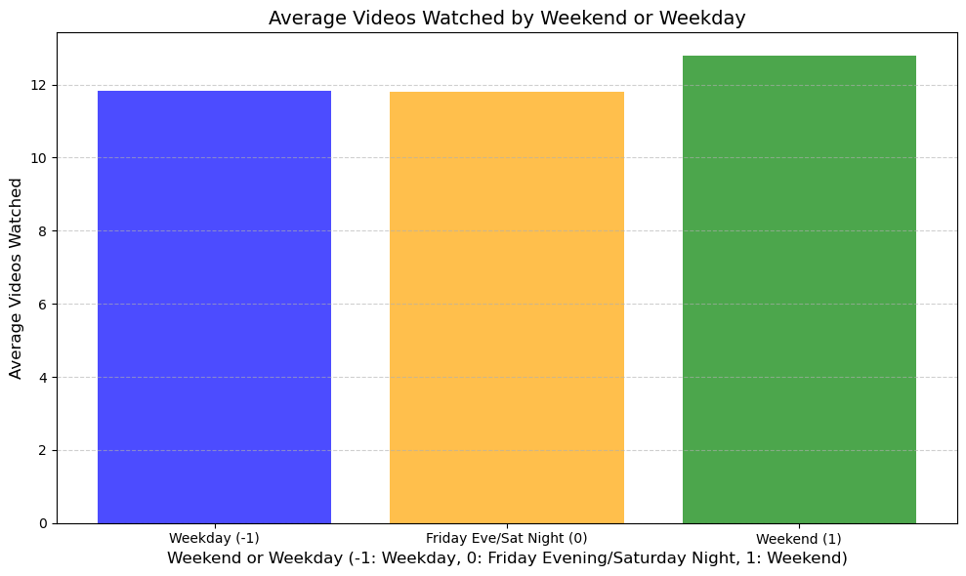
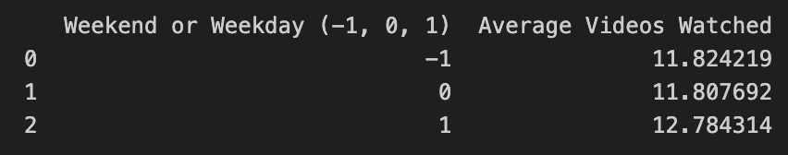
It appears on average I watch 1 more video in weekends than weekdays. No significant trend again.

Slide 19
conclusion
After my analysis and hypothesis testing, I failed to reject my null hypothesis, indicating there is no significant correlation with my viewing habbits and exam weeks.
Additional analysis also failed to discover any trend with number of videos I watch and whether the day is weekend or not.
I uncovered some trends for specific categories, but not all seem to represent the truth.
It appears my viewing habbits are currently randomized, indicating that I should make some changes on them, for the sake of my grades.

