Slide 1
Using 3D Maps in Excel 2016

Slide 2
Introduction: What is 3D Maps?
With 3D Maps, you can plot geographic and temporal data on a 3-D globe or custom map, show it over time, and create visual tours you can share with other people. You’ll want to use 3D Maps to:
Map data Plot more than a million rows of data visually on Bing maps in 3-D format from an Excel table or Data Model in Excel.
Discover insights Gain new understandings by viewing your data in geographic space and seeing time-stamped data change over time.
Share stories Capture screenshots and build cinematic, guided video tours you can share broadly, engaging audiences like never before. Or export tours to video and share them that way as well.

Slide 3
Agenda for Today…
3D Maps Vocabulary
Brief 3D Maps Setup(5 minutes)
Dataset Explanation
Demos, Demos, Demos…

Slide 4
3D Maps Vocabulary
Tour(s) - A tour can have a single scene, or multiple scenes that play sequentially to show different views of your data
Scene(s) –
Custom Region –
Tour Editor
Field List –
Layer Pane -

Slide 5
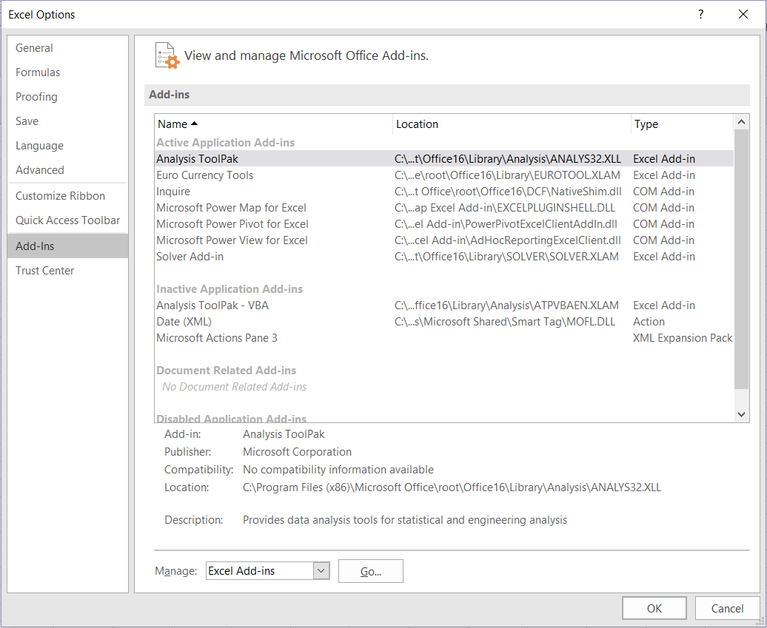

Slide 6
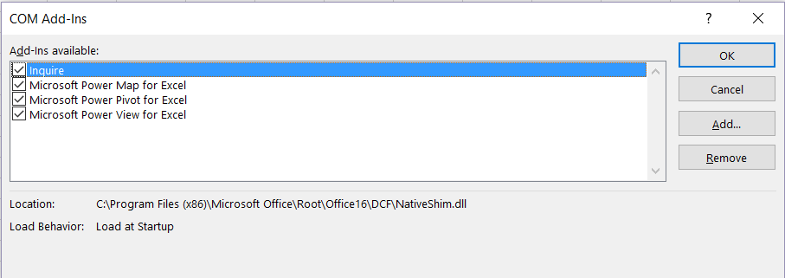

Slide 7
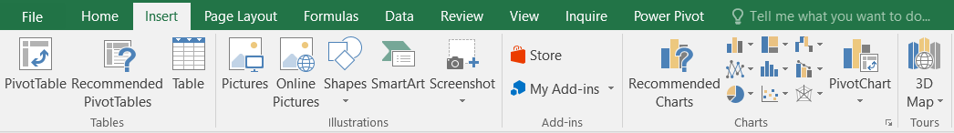

Slide 8


Slide 9
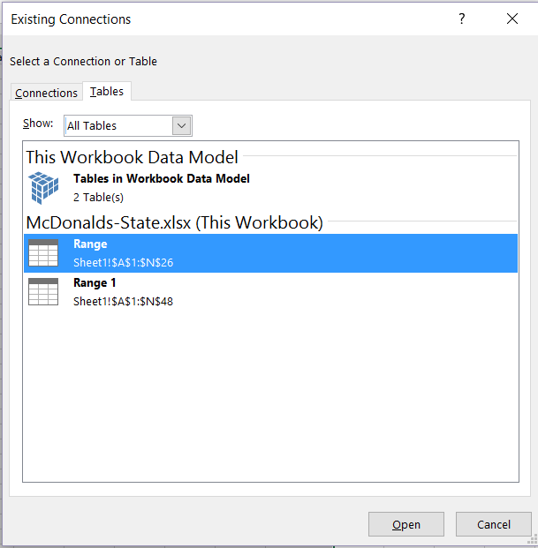

Slide 11




Datasets
www.steakandshake
www.mcdonalds.com
www.shakeshake.com
www.fiveguys.com
www.bk.com

Slide 12
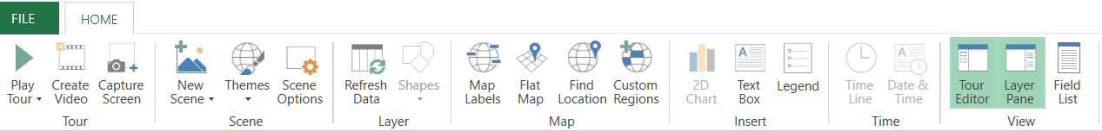

Slide 13
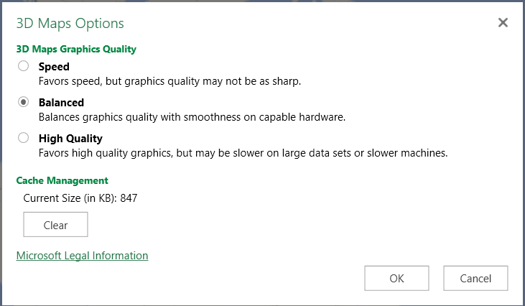

Slide 14


Slide 15
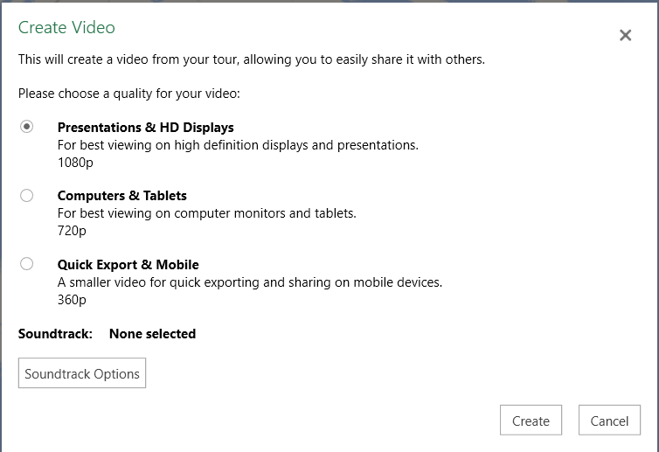

Slide 16
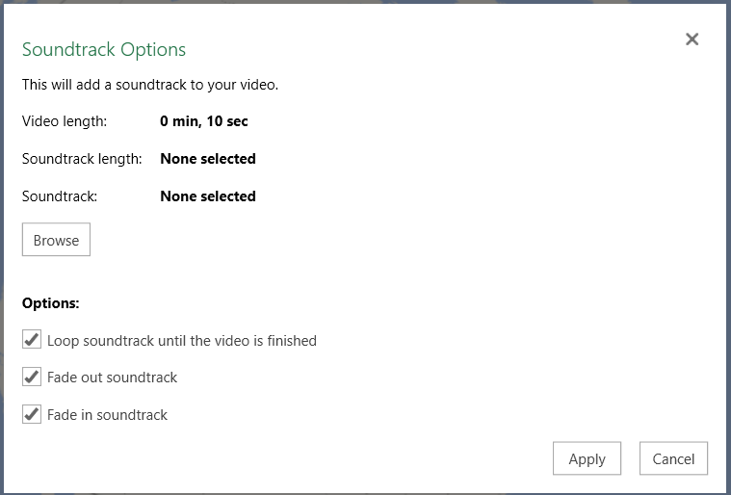

Slide 17
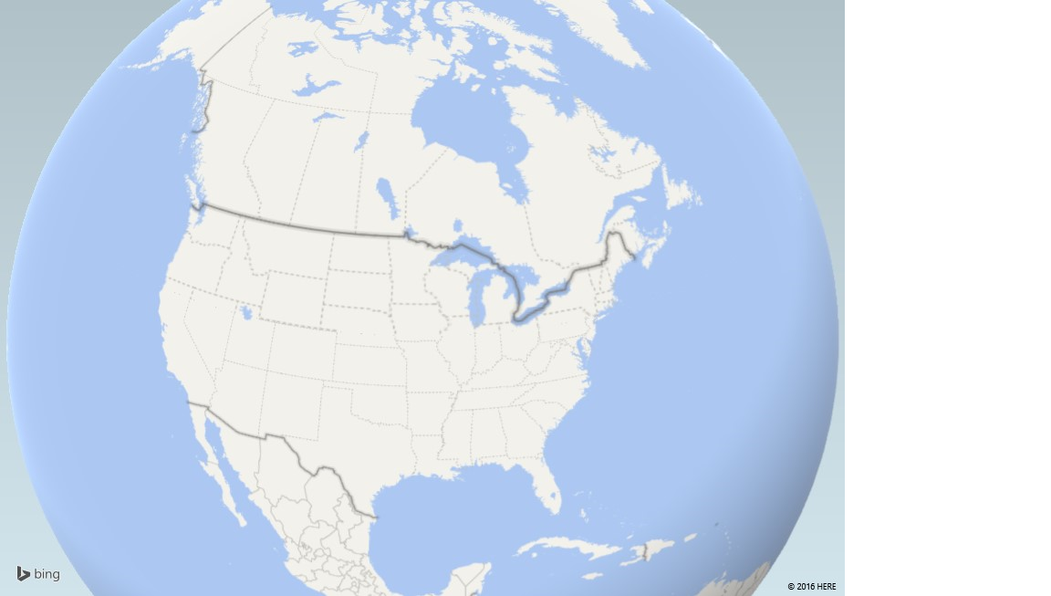

Slide 18
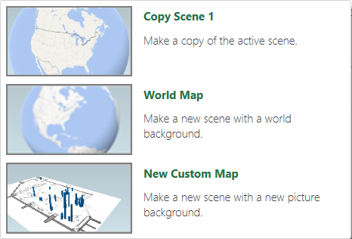

Slide 19
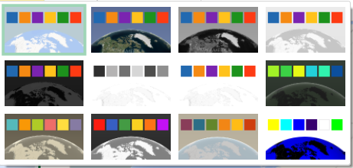

Slide 20
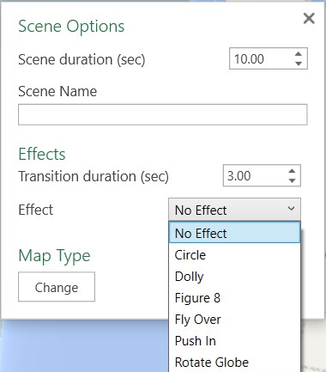

Slide 21
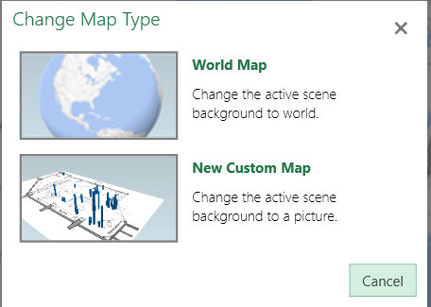

Slide 22
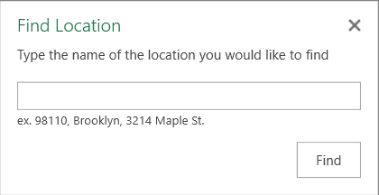

Slide 23
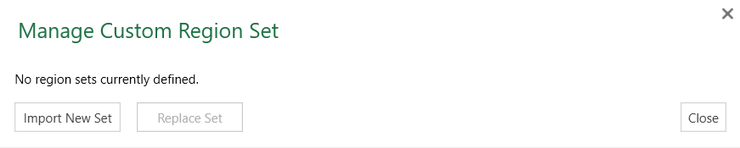

Slide 24
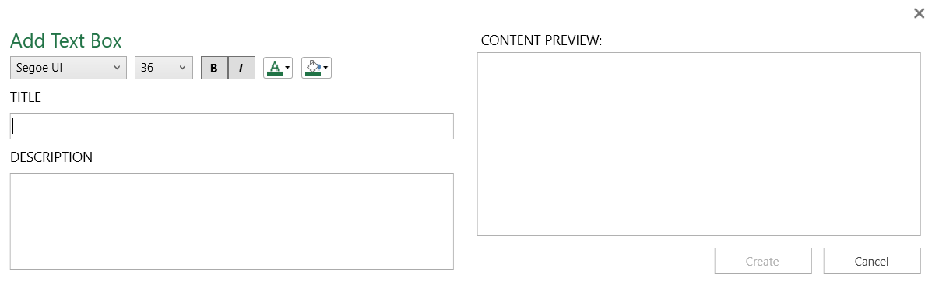

Slide 26
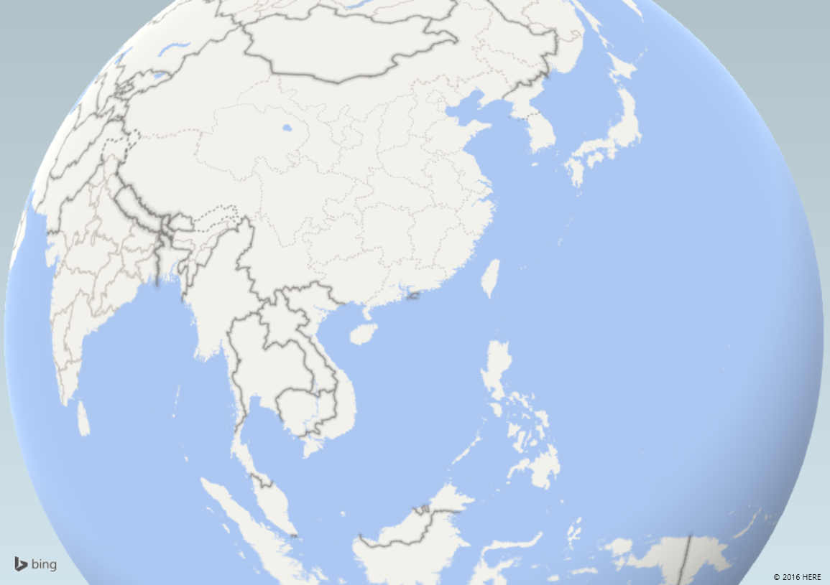

Slide 27
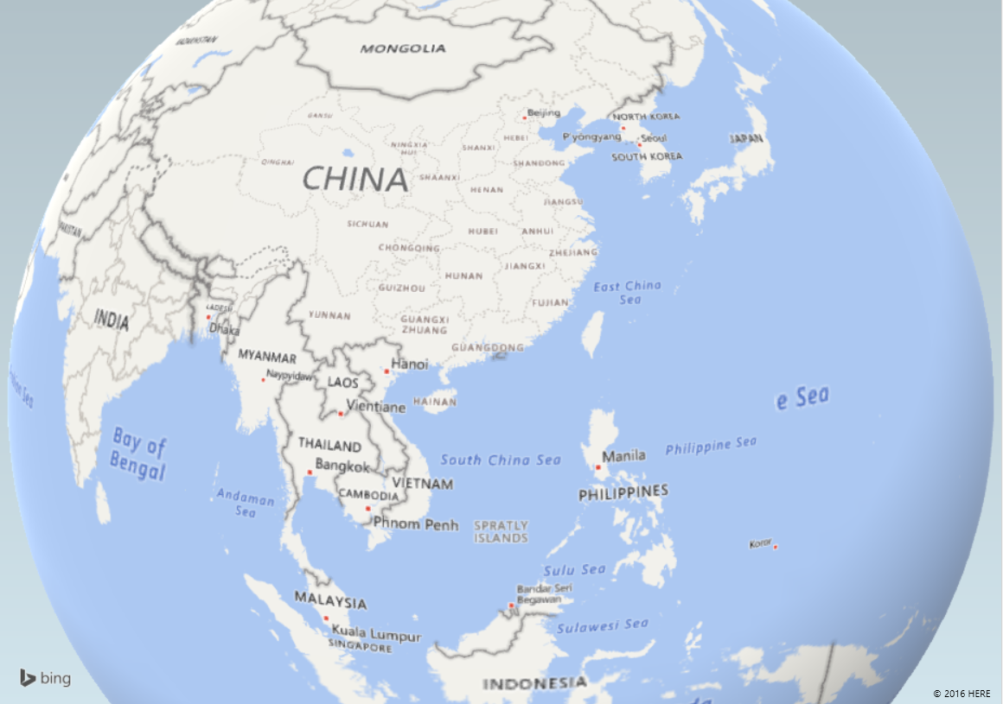

Slide 28
