Slide 1


RESILIENT
Resilient Energy System Infrastructure Layouts for Industry, E-Fuels and Network Transitions
Dr Lukas Franken, TU Berlin, Germany
CETPartnership Annual Conference · Innovations in Action · 20 October 2026
Notes:
15 minutes, then a joint 10-minute Q&A with LoCoMoSa. The tech host advances the slides, so say “next slide”.

Slide 2

Introducing our Project
Resilient
FUNDING
CETPartnership 2022 call
Energy
System
COORDINATOR
TU Berlin, ENSYS
Infrastructure
Layouts for
KICK-OFF
February 2024, Berlin
Industry,
E-Fuels and
FINAL WORKSHOP
20 November 2026, Berlin
Network
Transitions
CONSORTIUM
10 partners, 5 countries
Notes:
The acronym spells out the scope: infrastructure layouts for the whole energy system (industry, e-fuels, networks) that stay robust when the future turns out differently than planned. German partners are additionally funded by the BMWE.

Slide 3
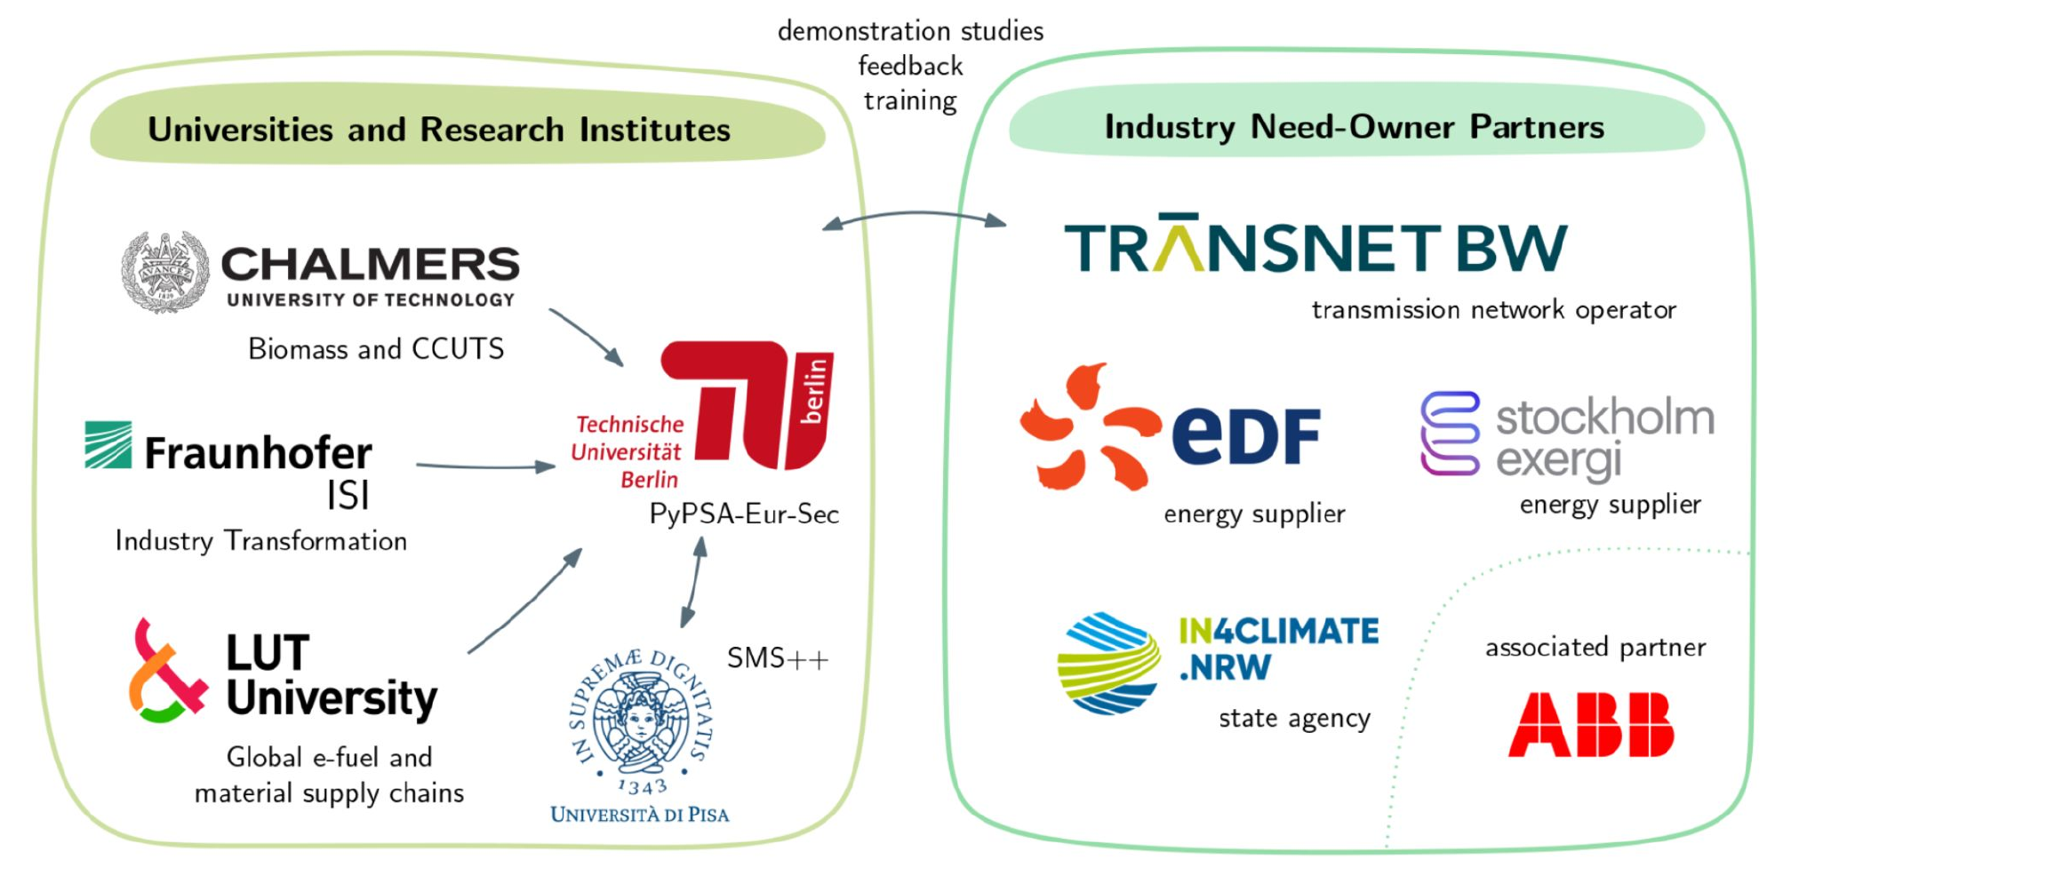
Our Consortium
10 partners
Germany · 4
Sweden · 2
Finland · 2
Italy · 1
France · 1
Notes:
Two halves. Research side: TU Berlin (lead, PyPSA-Eur), University of Pisa (SMS++ solver backend), Fraunhofer ISI (industry transformation, FORECAST), Chalmers (biomass and carbon capture), LUT (global e-fuel and material supply chains). Need-owners: TransnetBW (defines uncertainties, leads demonstration studies), EDF (national and European planning), Stockholm Exergi (bioenergy with carbon capture), IN4climate.NRW (industry and state carbon/hydrogen strategies), ABB Finland (associated, e-fuel data).

Slide 4

Our Research Focus
UNCERTAINTIES
OUTPUT
Fuel & technology costs
Resilient infrastructure layouts
Hydrogen availability
PyPSA-Eur
Grid & pipeline delays
+ stochastic optimisation & CVaR
Case studies
Industry restructuring
+ industry transformation
France
+ e-fuels, biomass & carbon capture
Germany
E-fuel & material imports
Renewables build-out
+ SMS++ decomposition
Sweden
Social acceptance
Finland
Notes:
We take the open sector-coupled model PyPSA-Eur and make it plan under uncertainty: stochastic optimisation with risk measures, a deeper representation of industry (Fraunhofer ISI’s FORECAST), e-fuel conversion, biomass and carbon capture infrastructure, plus decomposition methods (SMS++, University of Pisa) to keep the large stochastic problems solvable. Demonstrated in case studies for France, Germany, Sweden and Finland.

Slide 5
Key Innovations
Open-source planning of energy infrastructure under uncertainty
17
24
9
~220
research papers
scientific talks
workshops
people trained
WHO BENEFITS
Transmission system operators
Energy suppliers
Industry
State agencies & policy
Open-source modelling community
Notes:
Numbers as listed on the project website. Concrete outputs by the end: the extended open-source PyPSA-Eur releases, open datasets (e.g. hydrogen and derivative import options), public training material, and the national case studies. The next slide shows one representative result.

Slide 6
Key Innovations
OPEN-SOURCE CODE
124 pull requests merged into the PyPSA ecosystem
Stochastic optimisation & CVaR
Model dualisation
linopy v0.8
in PyPSA v1.0
PyPSA-Eur
73
PyPSA
42
Open high-voltage grid
Industrial process heat
linopy
5
from OpenStreetMap · Scientific Data 2025
endogenous in PyPSA-Eur
atlite
2
powerplantmatching
2
Notes:
Everything we build goes upstream into the open-source tools: 124 merged pull requests. Stochastic optimisation and CVaR risk measures shipped with PyPSA v1.0; linopy gained Model.dualize(); PyPSA-Eur now builds its grid from OpenStreetMap and optimises industrial process heat endogenously.

Slide 7
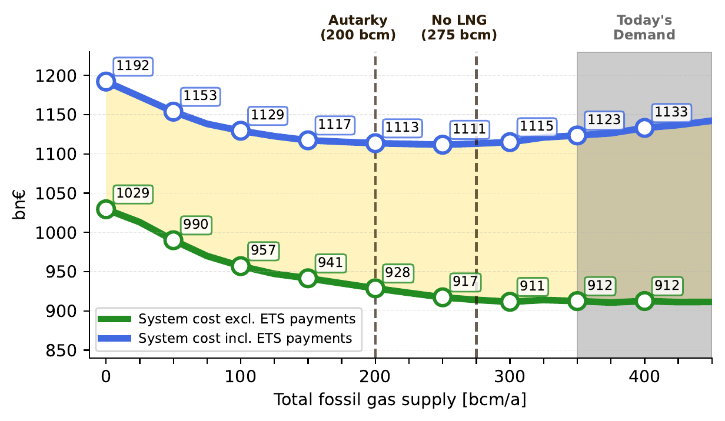
Expected Results: Pricing Energy Security
Quantifying the trade-off between energy security and energy costs
European system cost vs. fossil gas supply · 100 €/tCO₂ · Franken, Riepin & Brown (2026)
Notes:
Representative of what RESILIENT does: put a price on security. Tightening the cap on fossil gas barely moves system cost until well past the No-LNG and Autarky marks. Going LNG-free costs about 5 bn€ a year, halving gas use about 16 bn€, under 2 % of system cost. We come back to this curve in the paper section.

Slide 8
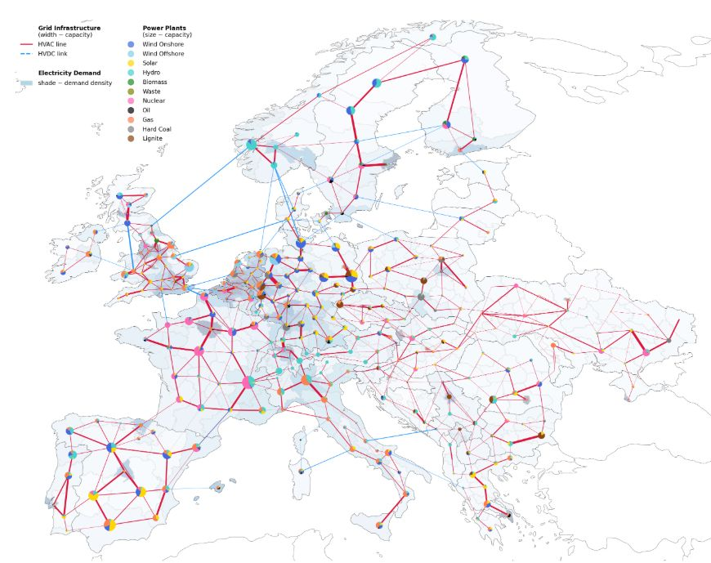
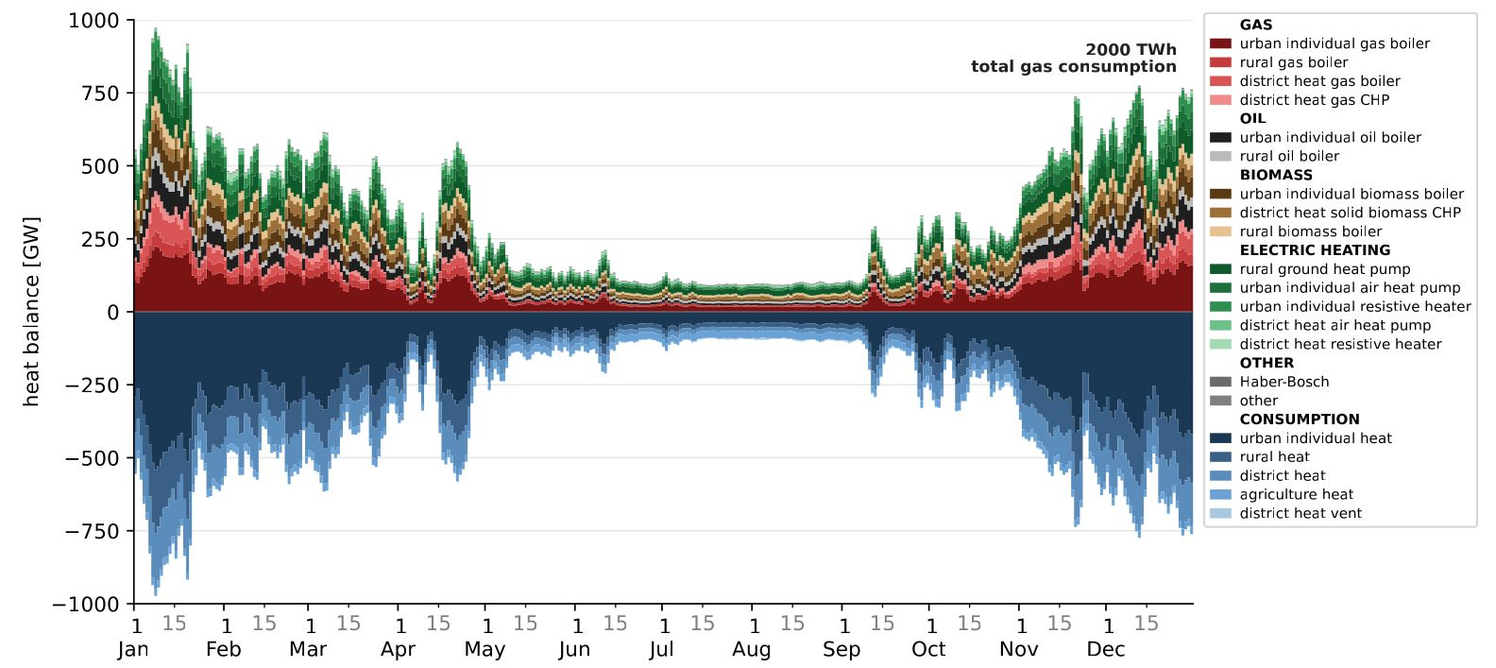
The PyPSA-Eur Model
50 nodes
3-hourly
power · heat · industry · transport · biomass · agriculture
Notes:
Sector-coupled model of the European energy system: 50 nodes, 3-hourly resolution, weather year 2024, covering power, heat, biomass, industry, transport and agriculture. Investment and dispatch are co-optimised, so gas allocation across sectors emerges from costs rather than being imposed. Right: a year of heat supply and demand in the 2,000 TWh gas scenario.

Slide 9
Accelerating fossil gas independence in Europe
WORKING PAPER · ARXIV, JULY 2026
Lukas Franken · Iegor Riepin · Tom Brown
Notes:
The question: what does it cost Europe to cut its gas imports, and does that actually protect consumers from gas price shocks?

Slide 10
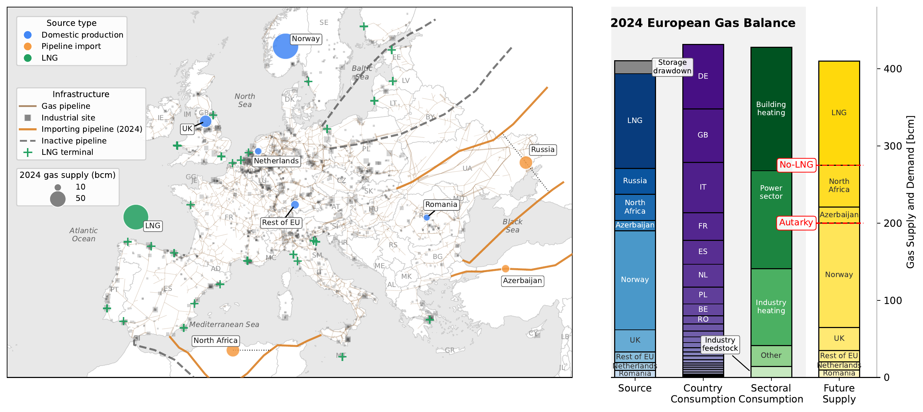
Europe’s Gas Today
Roughly a third each to power, buildings and industry; Europe’s own production covers ~200 bcm
Data: Eurostat (2024), OIES, Hotmaps, OpenStreetMap · Franken, Riepin & Brown (2026)
Notes:
Domestic production plus North African and Azerbaijani pipelines cover about 275 bcm; Europe’s own production alone about 200 bcm. Everything above that is LNG and remaining imports, tying consumer prices to global gas markets.

Slide 11
The Gas Abatement Curve
No-LNG: +5 bn€/a · Autarky: +16 bn€/a, under 2 % of system cost (excl. ETS payments)
Gas cap 450 → 0 bcm in 25 bcm steps · 100 €/tCO₂ · Franken, Riepin & Brown (2026)
Notes:
We tighten a cap on fossil gas supply from today’s ~450 bcm down to zero and let the model re-optimise everything. System cost barely moves deep into the phase-out. Between No-LNG and Autarky the difference is minimal; only beyond Autarky do costs climb, by up to ~100 bn€.

Slide 12
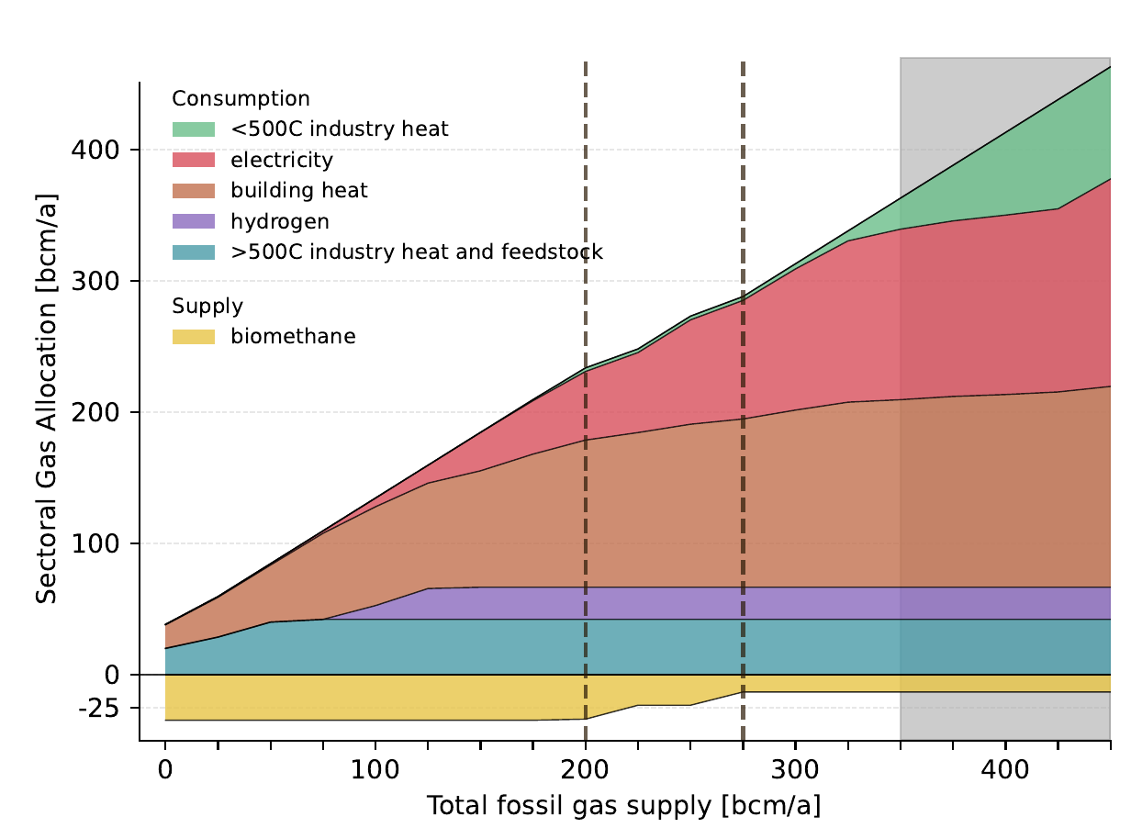
Where the Gas Goes
Low-temperature industry heat and power exit first; building heat holds on longest
Dashed lines: Autarky (200 bcm), No-LNG (275 bcm) · grey: today’s demand · Franken, Riepin & Brown (2026)
Notes:
At today’s 350–450 bcm, gas splits roughly into thirds between power, building heat and industry. As the cap tightens, gas leaves industry heat below 500 °C and bulk power first. Even below 50 bcm, about half of the remaining gas goes to residential heating, because heat-pump economics vary by region. Between 275 and 200 bcm the model builds over 30 bcm of biomethane.

Slide 13
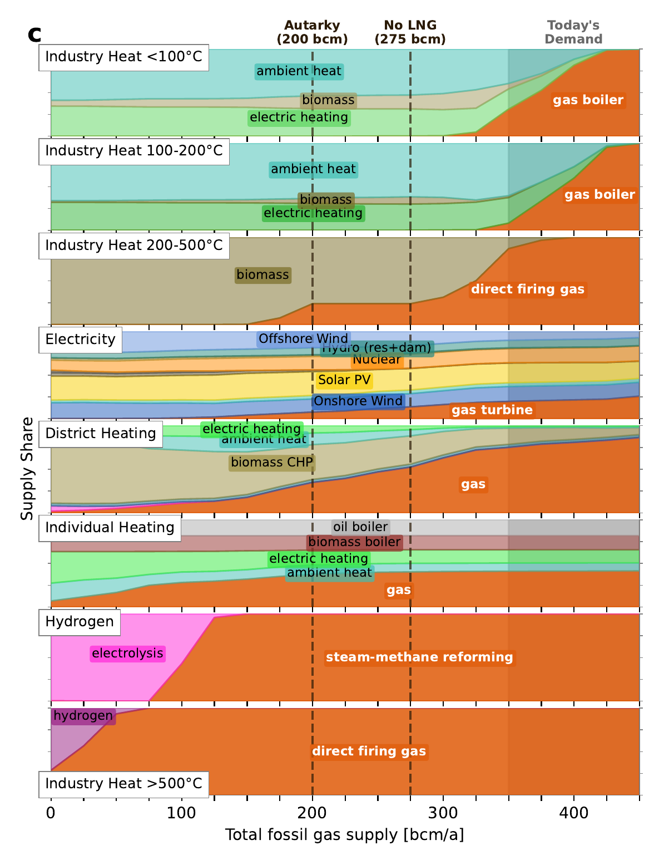
What Replaces Gas, Sector by Sector
Industry heat < 500 °C
heat pumps, electric heating, biomass
Power
wind, solar and batteries; gas leaves bulk generation at ~250 bcm
Building heat
gradual, with regional hold-outs
Industry > 500 °C
hydrogen, only after > 30 bcm of biomethane
Franken, Riepin & Brown (2026)
Notes:
The cost-optimal ordering: low-temperature industry heat goes first, then power, where wind and solar displace bulk generation and batteries take over daily balancing; gas stays only as backup for long low-renewable spells. Building heat phases out gradually. High-temperature industry switches to hydrogen only once the biomethane potential is exhausted.

Slide 14
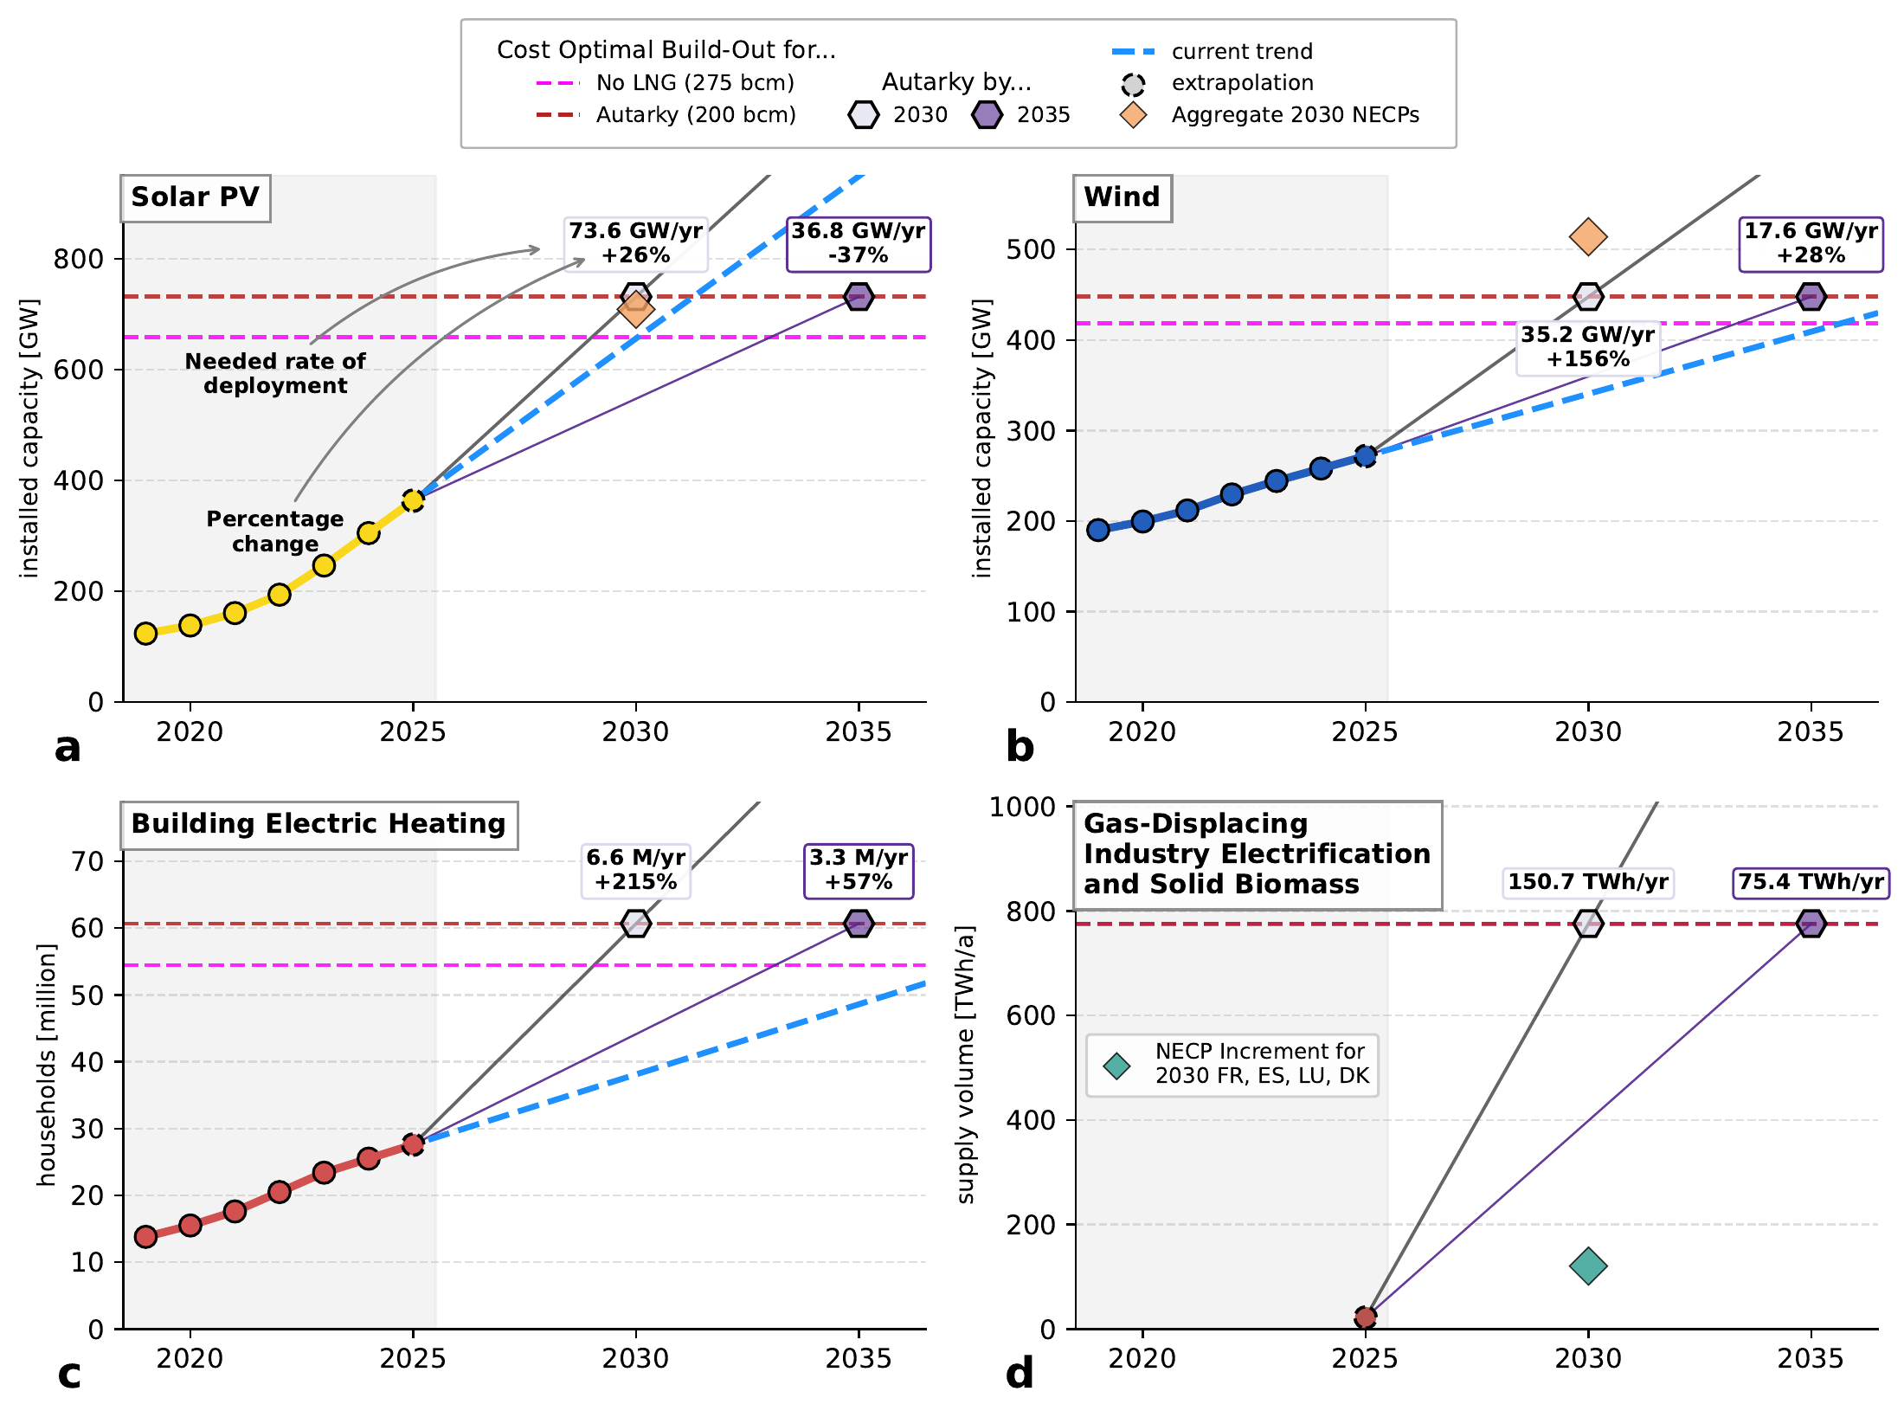
Are We on Track for Autarky?
Autarky needs twice the 2025 wind, solar and heat-pump fleets; power gets there first
NECP targets 2030: Ember (2024), DESNZ (2024) · Franken, Riepin & Brown (2026)
Notes:
On current trends, renewables reach autarky levels between 2030 and 2040, sooner if NECP targets are met. Building heat pumps lag to 2040–2050. Industry has no consistent trend yet; it needs about 75 TWh/a of electrification and biomass for a 2035 target. Without industry electrification, autarky costs about 10 bn€/a more and needs 5–6 million extra electrically heated homes.

Slide 15
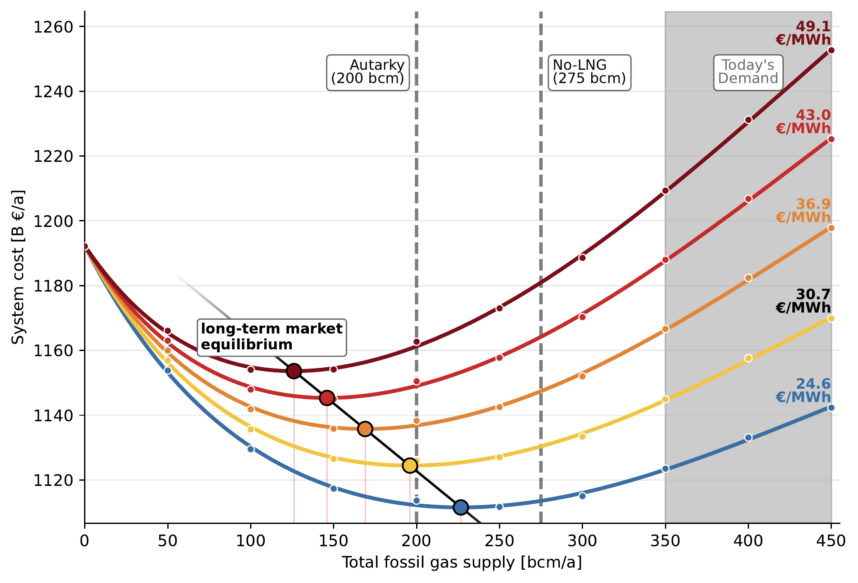
Where Gas Demand Settles
At gas prices of 30 €/MWh or more and 100 €/tCO₂, autarky is cost-optimal
Long-run price elasticity of gas demand ≈ −1.33 · Franken, Riepin & Brown (2026)
Notes:
For each external gas price, total system cost traces a parabola; its minimum is where demand would settle in a long-term equilibrium. Demand stays above 275 bcm, still needing LNG, only if prices return to pre-2020 levels of 15–25 €/MWh. Points right of the minimum are a system slow to adapt, i.e. lock-in.

Slide 16
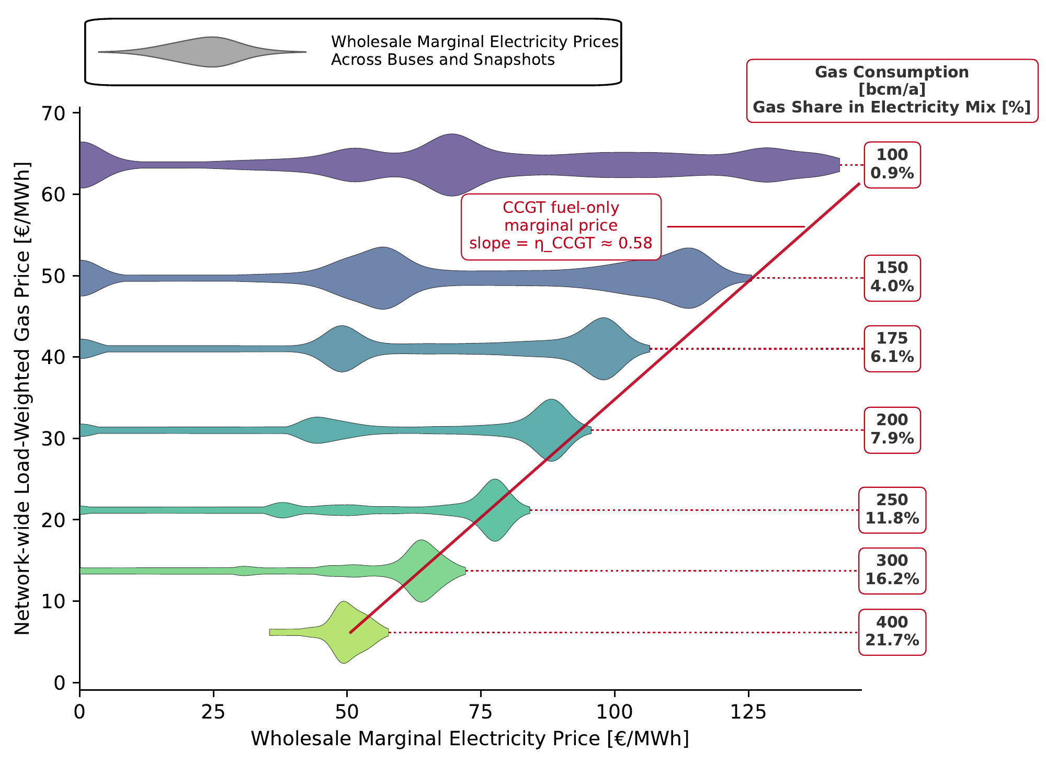
Gas Still Sets the Electricity Price
Even below 8 % of the power mix, gas anchors the price about half the time
Red line: CCGT fuel-only marginal cost, slope = efficiency 0.58 · Franken, Riepin & Brown (2026)
Notes:
Independence alone does not shield consumers. Two mechanisms: uniform-price auctions, and batteries, whose discharge price is set by the gas turbine they displace. The upper band of each distribution follows the CCGT fuel cost as the gas price rises with scarcity.

Slide 17
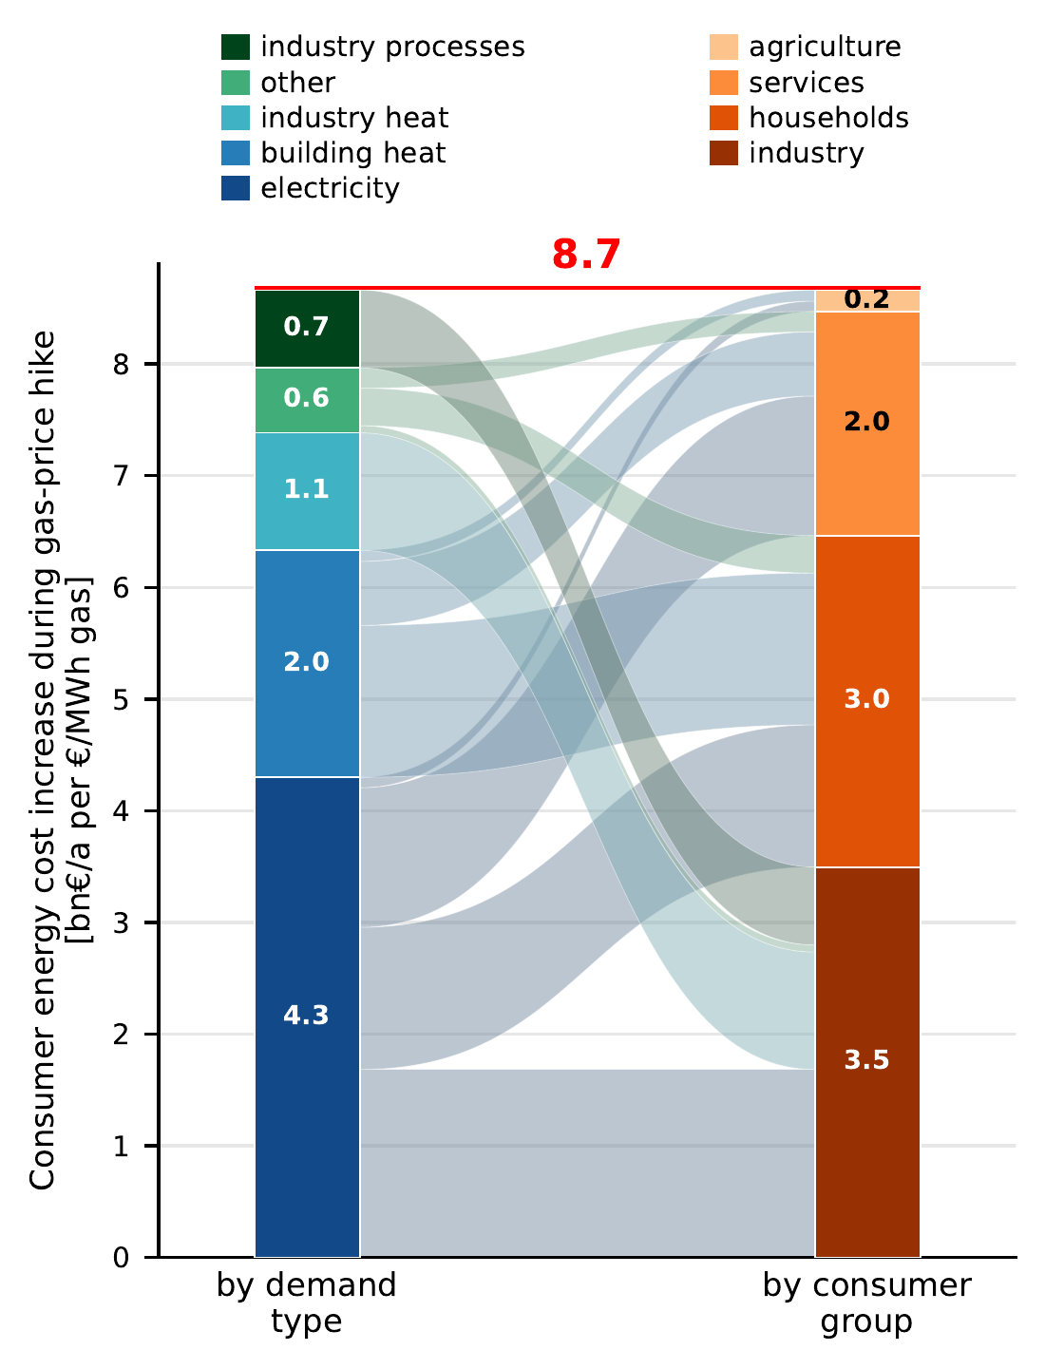
Gas Price Shocks Reach Every Consumer
+1 €/MWh on gas costs consumers +8.7 bn€ a year, about twice volume × price
System at 400 bcm/a, operation-only re-optimisation · Franken, Riepin & Brown (2026)
Notes:
A short-term shock: capacities fixed, only dispatch re-optimises. Electricity marginal prices pass the gas cost through to all other generators, so the bill roughly doubles relative to gas volume times price (~4 bn€). For comparison: the 16 bn€/a cost of autarky is what consumers pay today for a 2 €/MWh rise in import prices.

Slide 18
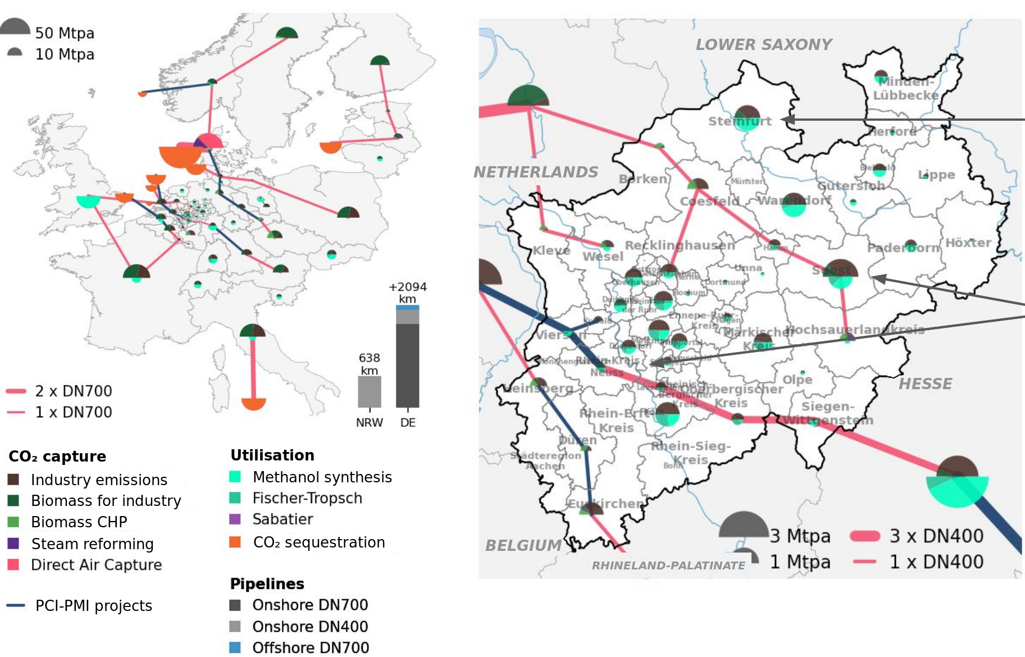
Other RESILIENT Work: NRW CO₂ Network in 2045
First step for NRW: one or two DN400 feeder pipelines, ~8.9 Mtpa each
Scenario 1.b: hard-to-abate industry, endogenous pipelines · Xiong, Al-Dabbas & Fleiter, CO₂ sprint, Gelsenkirchen, 30 June 2026
Notes:
Second RESILIENT application: CO₂ capture, transport, use and storage for industry in North Rhine-Westphalia, with Fraunhofer ISI and IN4climate.NRW. The model decides pipeline routes and sizes itself. Connect the largest emitters first: steel, then refineries and cement. Corridors west towards the Netherlands and Belgium are robust across all scenarios. Onshore storage would more than halve pipeline investment and save around 8 bn€ a year.

Slide 19
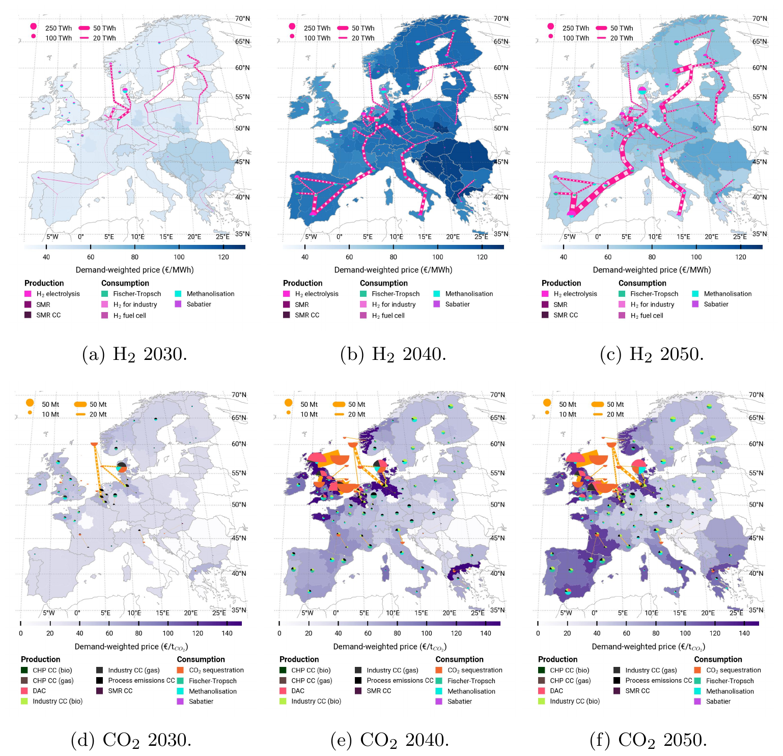
Other RESILIENT Work: PCI-PMI H₂ & CO₂ Backbone
From 2040, PCI-PMI pipelines cut system costs by more than 26 bn€ a year
PCI-PMI long-term scenario · Xiong, Brown & Riepin (2026), Environmental Research Letters
Notes:
Bobby Xiong’s paper on the EU’s Projects of Common and Mutual Interest for hydrogen and CO₂. Hydrogen pipelines bring cheap green hydrogen from the north and south-west to demand in central Europe; CO₂ pipelines link industrial emitters to offshore storage. Not essential in 2030, but from 2040 they save more than 26 bn€ a year. Delaying them beyond 2040 costs up to 24.2 bn€ a year, and they cut the need for direct air capture by 13 to 136 Mt a year.

Slide 20
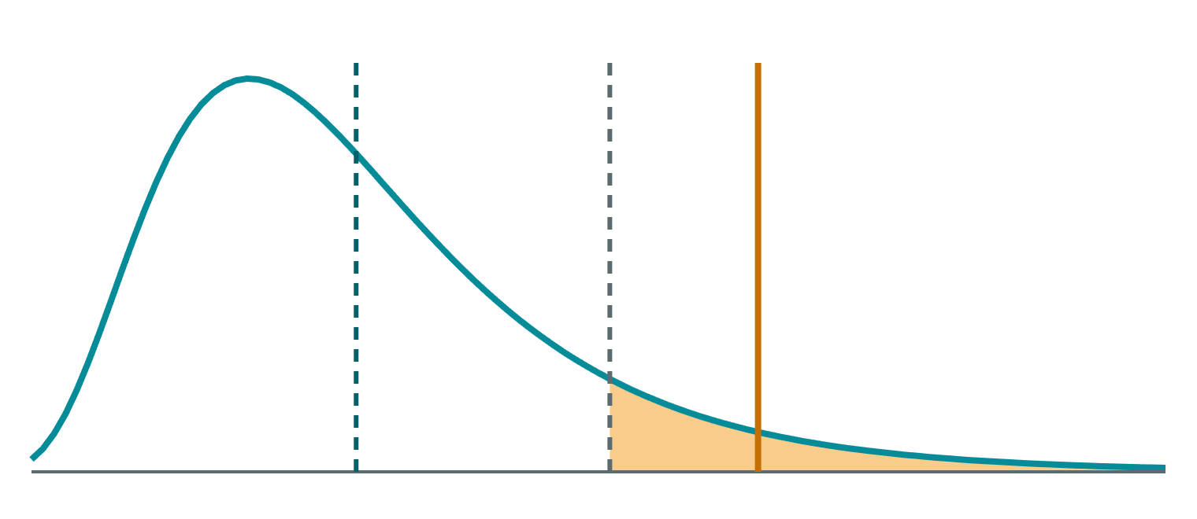

Other RESILIENT Work: Risk-Averse Planning with CVaR
Stochastic optimisation and CVaR in PyPSA v1.0, the optimisation core under PyPSA-Eur
Investment
E[OPEX]
VaRα
CVaRα
one plan, shared by all scenarios
Scenario 1
Scenario 2
Scenario N
worst 1 − α
p₁ · OPEX₁
p₂ · OPEX₂
p_N · OPEX_N
e.g. weather years, fuel prices, H₂ availability
operating cost across scenarios
min CAPEX + (1 − ω) · E[OPEX] + ω · CVaRα[OPEX]
n.set_risk_preference(alpha=0.95, omega=0.1)
PyPSA pull requests #1154 (stochastic optimisation) and #1345 (CVaR) · RESILIENT
Notes:
How risk enters the model. We optimise one investment plan against several scenarios at once, such as weather years, fuel prices or hydrogen availability, each with its own operation and probability. A risk-neutral planner minimises expected cost. CVaR adds the average cost of the worst 1 − alpha share of outcomes, weighted by omega: omega = 0 is risk-neutral, omega = 1 only cares about the tail. It is linear (an auxiliary excess variable per scenario), so it scales to PyPSA-Eur-sized problems. Two lines of code: set the scenarios, then set the risk preference.

Slide 21

Thank you!
Contact
Dr Lukas Franken
TU Berlin
lukas.franken@tu-berlin.de
resilient-project.github.io
Notes:
Hand over to the joint Q&A with LoCoMoSa.

