Slide 1



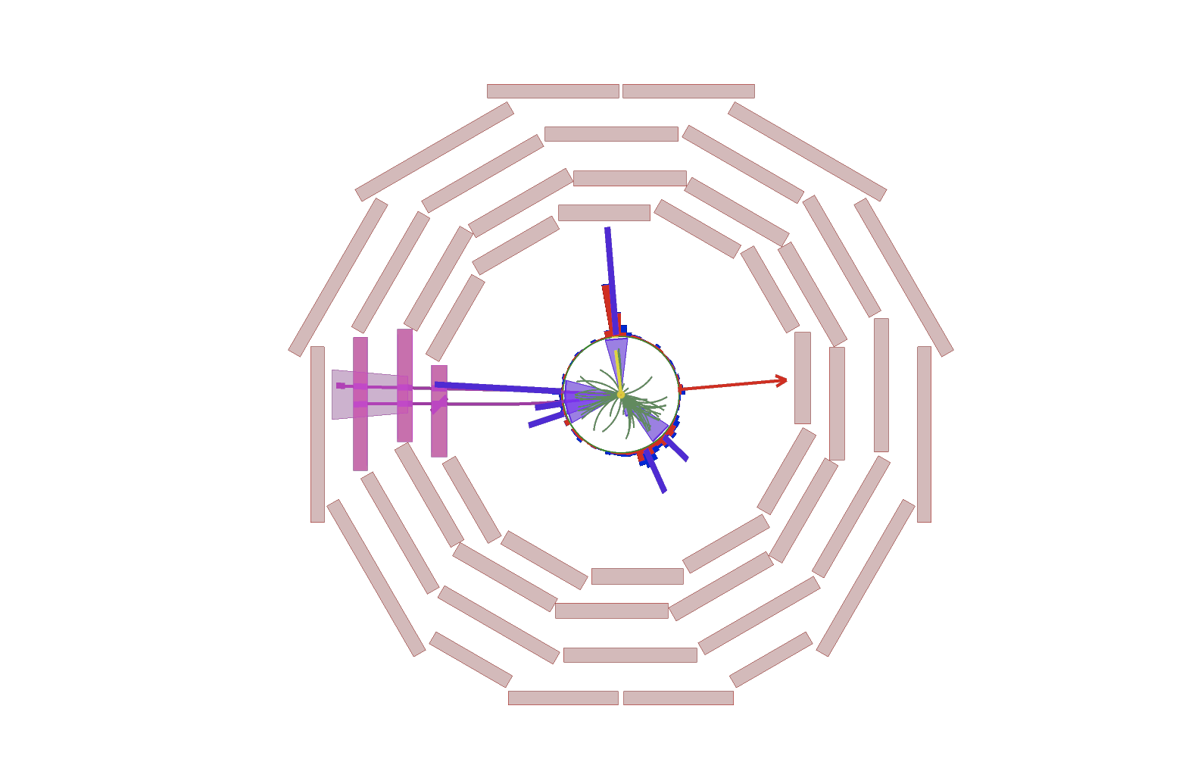
TopMixed Application for
high-dM regions(NPS-26-012)
Weekly All-hadronic Stop Meeting
‡Taiwoo Kim1, Sezen Sekmen1, Young Do Oh1, Chang-Seong Moon1,
Nathan Brandman-Hughes2, Richard Cavanaugh2
1 Kyungpook National University (KNU, Korea)
2 University of Illinois Chicago (UIC, USA)
Meyrin, Suisse
24th September 2026

Slide 2
Object definition
Object | Inputs | Jet selection | Candidate selection | Tag requirement
Boosted top Nbst | 1 AK8 | pT > 400 GeV |η| < 2 | mSD > 105 GeV | Top score > 0.5078
Mixed top Nmix | 2 or 3 AK4 + 1 AK8 | AK4: pT > 25 GeV, |η| < 2.5 AK8: pT > 200 GeV, |η| < 2.5 | No additional top mass or η window | TT / (TT + QCD) ≥ 0.9027690887451172
Resolved top Nres | 3 distinct AK4 | Each AK4: pT > 25 GeV, |η| < 2.5 | 100 ≤ m(3 AK4) ≤ 250 GeV |η(3 AK4)| < 2 | TT / (TT + QCD) ≥ 0.9433798789978027
W Nw | 1 AK8 | pT > 200 GeV |η| < 2 | 60 < mSD < 105 GeV | W score > 0.9385
AK4, AK8 and SubJet are separate jet collections.
1 2026. 9. 24. Taiwoo KIM – Weekly Stop Meeting
Notes:
Definitions from TROTASR/utils/shape_kinematics.py:73-78, trota_candidates.py:20-61,218-272, trota_inference.py:16-17,103-133 and event_selections.py:68-125. Cuts and working points are the current implementation for 2024 and 2025. Mixed/Resolved discriminant is TT/(TT+QCD), not raw TT probability. Mixed builder requires positive candidate pT but adds no top mass or eta window. Boosted/W pT uses the calibrated view. Stored TROTA nominal plots on slides 4-5 use the earlier integrated TROTA momentum convention; the new central CMS-p4 and JES/JER re-inference campaign is separate and ongoing. Region cleaning uses GCR medium photons or DY medium leptons, with AK4-reference deltaR>0.2 and AK8-reference deltaR>0.4. No such extra reference cleaning occurs in the SR/LLCR/QCDCR topology stage.

Slide 3
Object hierarchy
Boosted Top
Keep all passing AK8 jets.
Reserve their overlapping AK4 jets.
AK4–AK8 overlap
AK8 has two valid SubJets
Mixed Top
Highest score first. Reject shared AK8
or AK4 overlap with selected tops.
ΔR(AK4, SubJet 1) < 0.4
or ΔR(AK4, SubJet 2) < 0.4
Resolved Top
Highest score first. Reject AK4 overlap
with selected tops.
Otherwise
ΔR(AK4, AK8 axis) < 0.8
W
Reject shared AK8 or AK4 overlap
with selected tops. Keep independent W.
AK4 jets satisfying this rule
enter the overlap veto.
Only the overlapping candidate is rejected. Independent Mixed and W can coexist.
2 2026. 9. 24. Taiwoo KIM – Weekly Stop Meeting
Notes:
Source: TROTASR/utils/event_selections.py:24-56,68-138,181-204 and constituents.py:94-172. This is candidate arbitration, not mutually exclusive event branches. Continue to each stage even if the preceding stage selects no candidate. Mixed and Resolved sort by descending discriminant, then ascending candidateIndex. AK8 footprints are retained AK4 jets matched to its two distinct valid SubJets by deltaR<0.4, or to its axis by deltaR<0.8 when fewer than two valid SubJets exist. SubJet IDs and AK4 IDs belong to separate collections. Geometric matching does not mean AK8 reconstruction from AK4, and is not PF constituent-ID matching. A selected Mixed reserves its explicit AK4 plus all AK4 in its AK8 footprint. Different AK8 jets can conflict through a shared matched AK4. Current code has no Boosted-Boosted or W-W pairwise removal. Other region selections remain in addition to the stated topology count requirements.

Slide 4
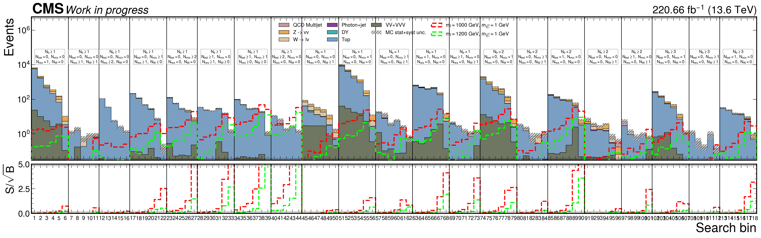
New high-dM SR
21 classes, 118 high-dM bins.
Category order: Nb, Nbst, Nmix, Nres, Nw.
3 2026. 9. 24. Taiwoo KIM – Weekly Stop Meeting
Notes:
Source figure: /Users/taiwoomac/Documents/All Hadronic Stop Analysis/TROTASR/stats/nominal_20260924_sr118/plots/predictions/highdm118_sr_2024_2025.png. SHA256 fe93991bbd8eafe4d327c4f0e8943d24be7195927c1c9d92a5a9492aa29d0e5d. Manifest: same directory plot_manifest.json. Combined 2024+2025, 220.66/fb at 13.6 TeV. Nominal prefit predictions, blinded SR. Immutable source highSR162 projects to 21 classes/118 bins. Original category merges [4,5], [7,8], [9,10,11,12], [19,24], [23,28] follow combined-year nominal full-category B<2, not per-bin or per-year B<2. Then displayed classes 2,15,20 (source categories 2,21,26) combine 500-800 and >=800 GeV into >=500 GeV. CR and low-dM binning remain unchanged. Dedicated Mixed SF inputs are not provided and none are fabricated. The original S/sqrt(B) axis stops at 5, so larger values are clipped in that panel.

Slide 5
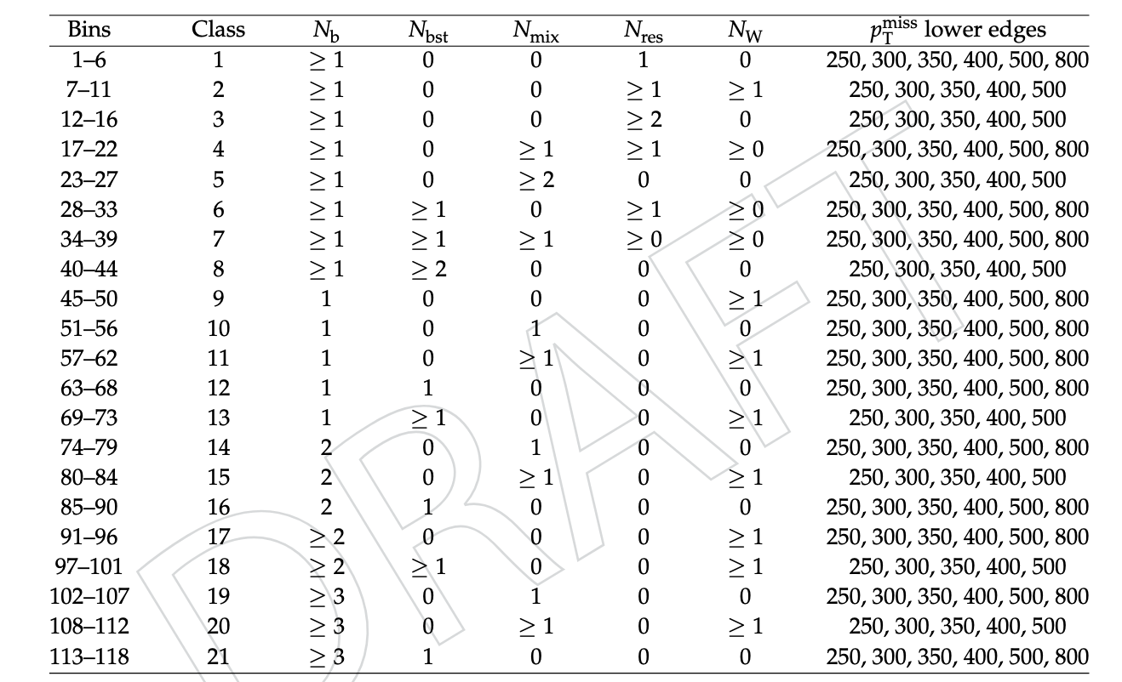
Category Table
4 2026. 9. 24. Taiwoo KIM – Weekly Stop Meeting
Notes:
Previous Run-3 baseline: /Users/taiwoomac/Documents/All Hadronic Stop Analysis/autonomous_allhad/reports/lowdm_cr_nisr_merged_20260921/limits, lowdm_cr_nisr_merged_20260921. Source policy: autonomous_allhad/configs/adopted_statistics_2024_2025.json. Nmix is absent. HighSR73 + lowSR30, pooled low-dM CRs, 338 analysis bins, 94 free rate parameters, autoMCStats 10 1 1. Existing adopted systematics and correlated signal xsec lnN. Limit coverage: T2tt 203/205, T2bW 350/354, T2tb 356/365, total 909/924 with 15 failed points. Previous PNG SHA256 0ca524ae8c59055c22878c68555c41707d7428c135d935ceb5817debfaf93ff4. These are the actual archived calculations, not a new fit or a SUS-19-010 substitute. Both panels retain the older Run-2 black overlay as context, but the requested comparison is between the two red Run-3 expected contours. The right-hand SR118 nominal calculation has different binning and an incomplete systematic set. This comparison therefore does not isolate the effect of adding TopMixed alone.
Sources: /Users/taiwoomac/Documents/All Hadronic Stop Analysis/TROTASR/stats/nominal_20260924_sr118/plots/contours/plot_manifest.json and the three embedded original contour PNGs. T2tt 201/205, T2bW 339/354, T2tb 353/365 valid results. Total 893/924 with 31 failed points. Existing plot mass display excludes 20 low-mass points each for T2bW and T2tb, displaying 319 and 333 valid points respectively. Red curves show current nominal expected median and expected bands. Black curves show the pinned SUS-19-010 observed/expected reference in the existing renderer. This is not a controlled with/without TopMixed sensitivity comparison. Do not attribute all differences to TopMixed. These stored-TROTA nominal results do not include the newly requested full CMS-p4 central plus JES/JER re-inference campaign. No old highSR162/121 fit results substitute for SR118.
contours/expected_limit_t2tt_2024_2025_highdm118_lowdm30_xsec_topology_thermal_relic.png SHA256 63362d9bc8ed52d29934f7fbc63fa1e978bfd3761e8f3ba482f218aa802fe35c
contours/expected_limit_t2bw_2024_2025_highdm118_lowdm30_xsec_topology_thermal_relic.png SHA256 99c3530b9dd0388d460b390b2f37c0c16fb0b3955d2efac2700e9bb23b67f294
contours/expected_limit_t2tb_2024_2025_highdm118_lowdm30_xsec_topology_thermal_relic.png SHA256 3b1cebb3680f70bebc98517c4a267bf51dd879f77d1417e1fedbdfa7dce2095c

Slide 6
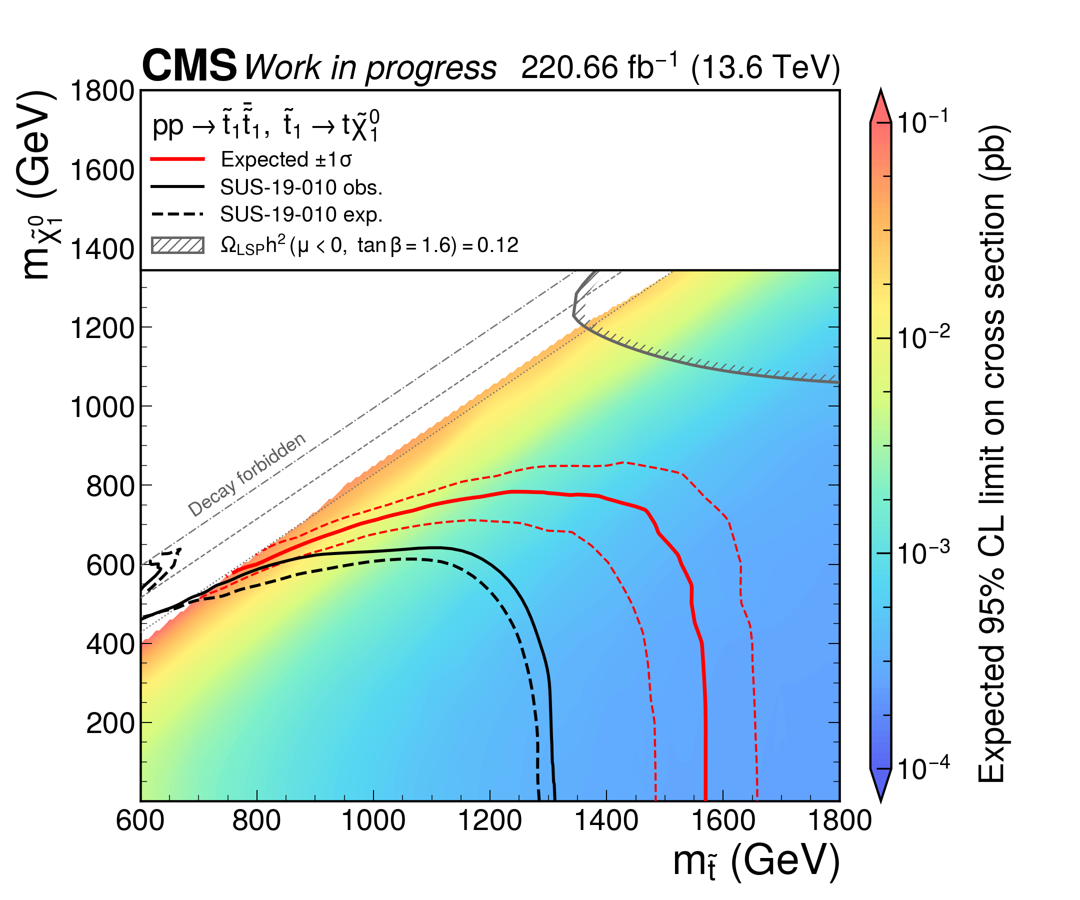
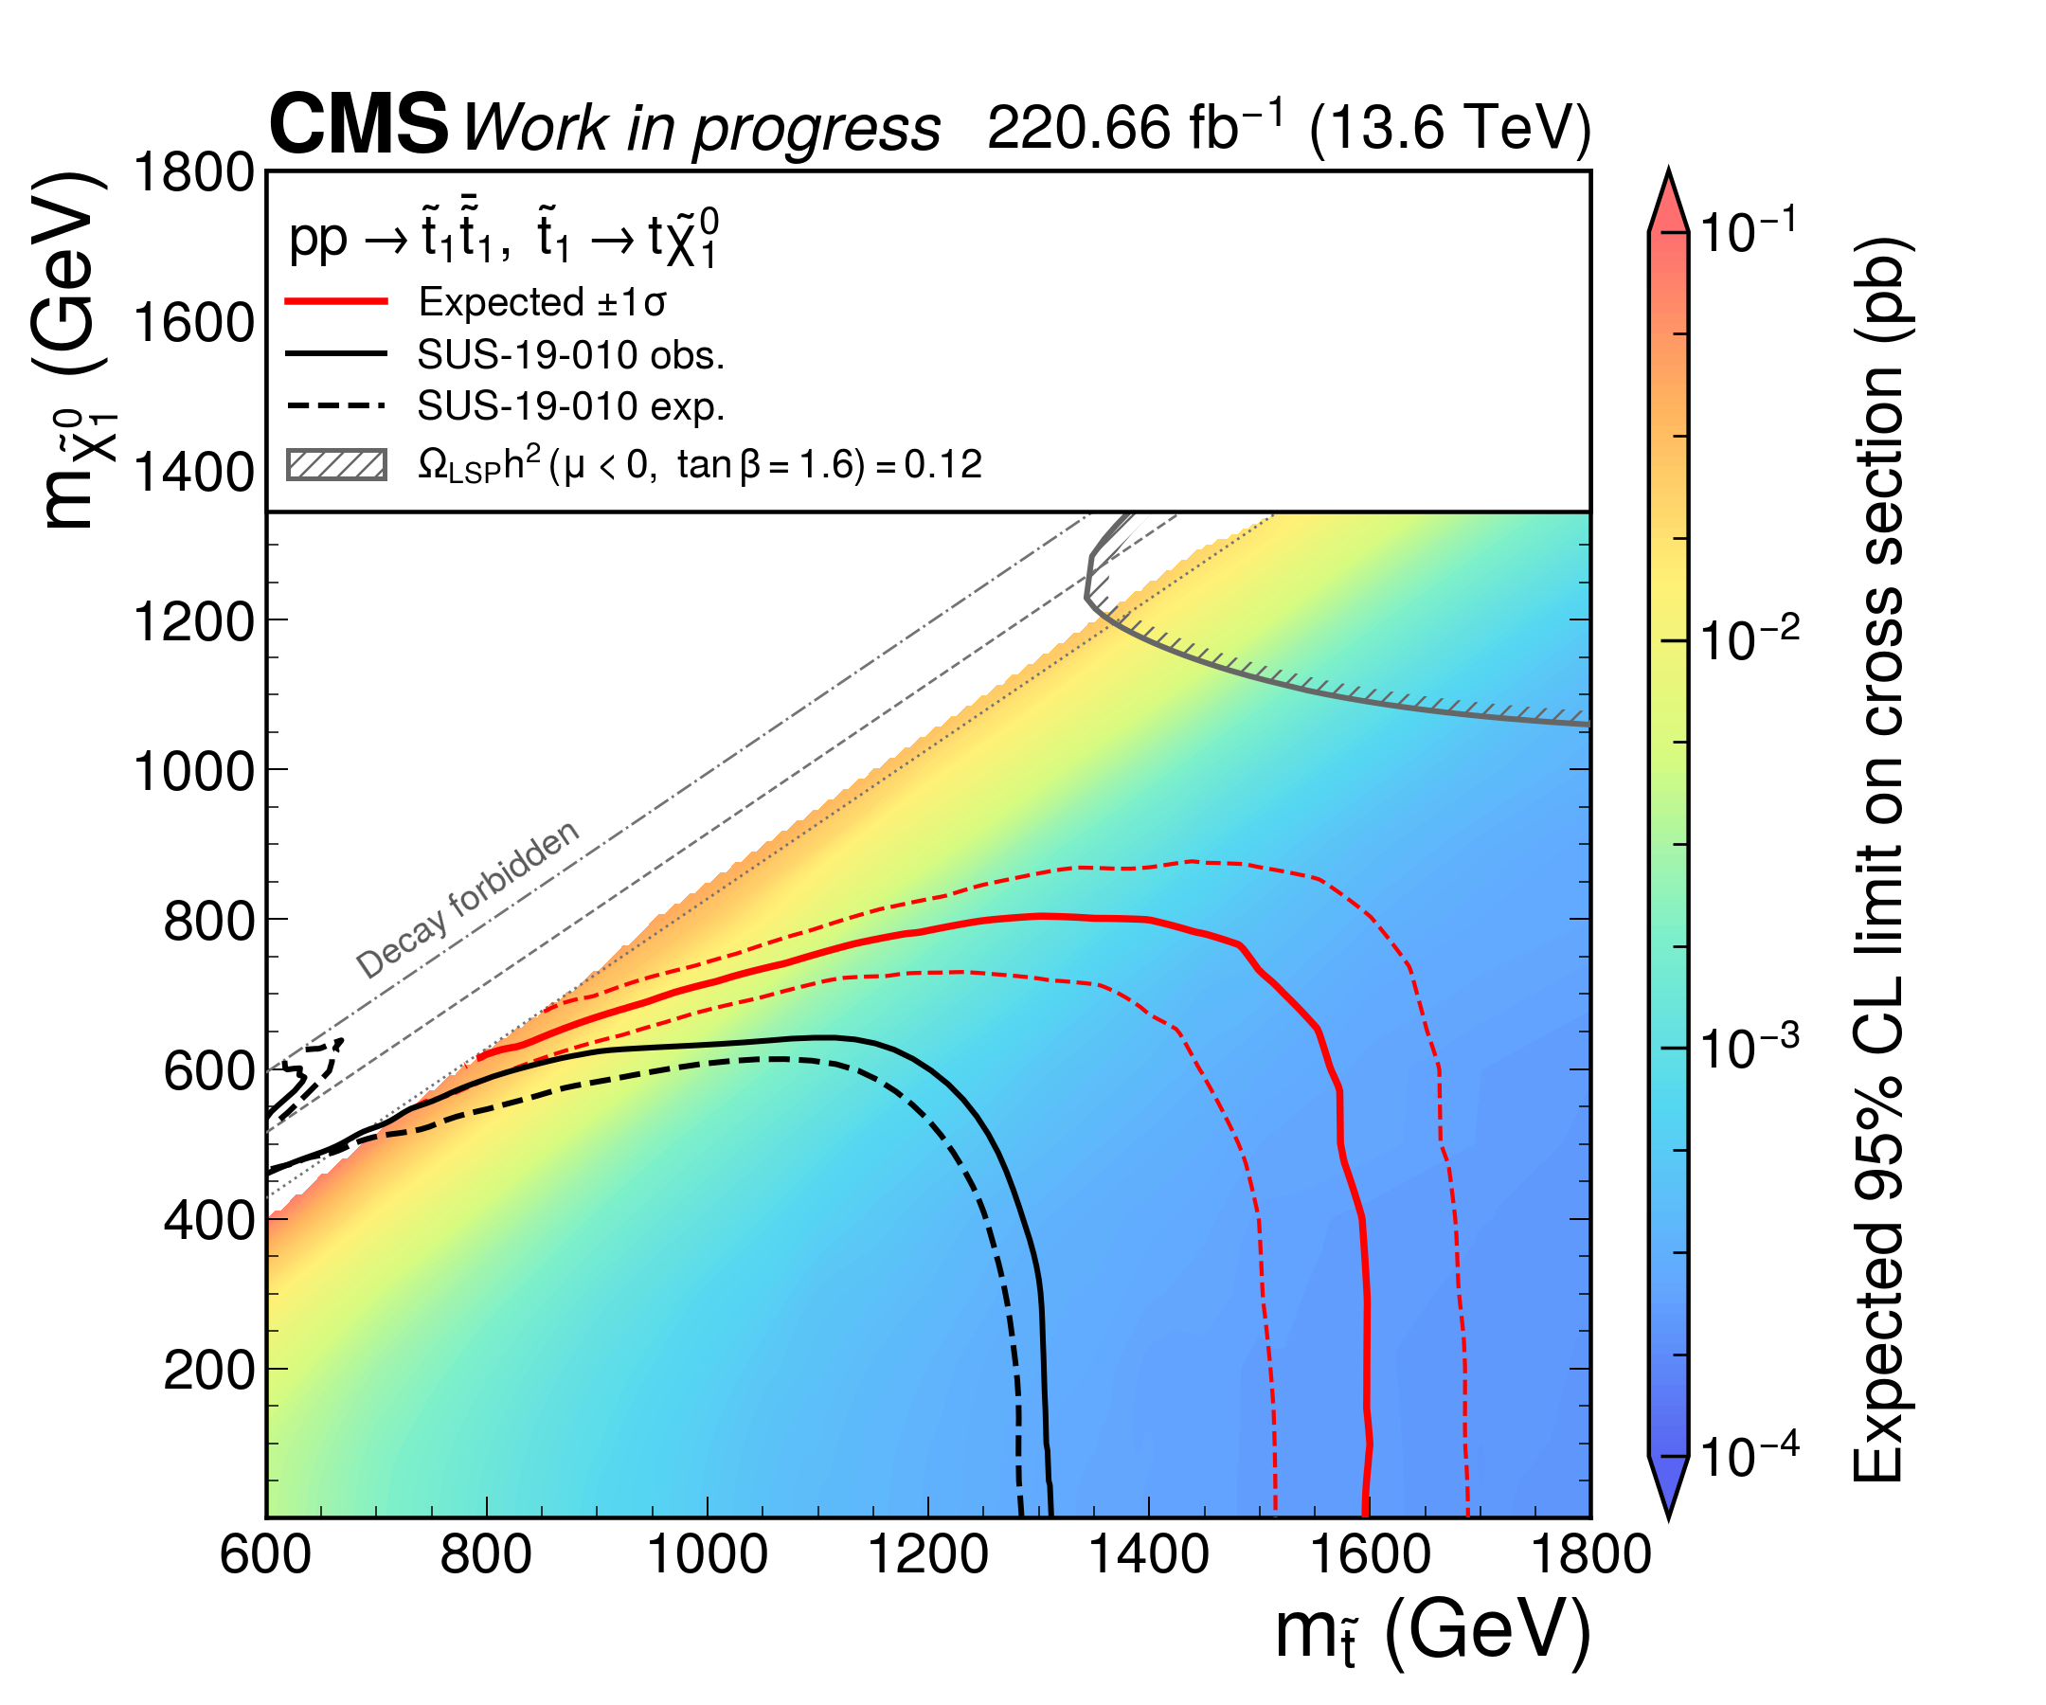
Limit comparison: T2tt
Without Nmix
With Nmix
5 2026. 9. 24. Taiwoo KIM – Weekly Stop Meeting
Notes:
Previous Run-3 baseline: /Users/taiwoomac/Documents/All Hadronic Stop Analysis/autonomous_allhad/reports/lowdm_cr_nisr_merged_20260921/limits, lowdm_cr_nisr_merged_20260921. Source policy: autonomous_allhad/configs/adopted_statistics_2024_2025.json. Nmix is absent. HighSR73 + lowSR30, pooled low-dM CRs, 338 analysis bins, 94 free rate parameters, autoMCStats 10 1 1. Existing adopted systematics and correlated signal xsec lnN. Limit coverage: T2tt 203/205, T2bW 350/354, T2tb 356/365, total 909/924 with 15 failed points. Previous PNG SHA256 35d67948398f77dd8bcdc3a19d7f1e97c079f2a007d2673cfb330e46e699572c. These are the actual archived calculations, not a new fit or a SUS-19-010 substitute. Both panels retain the older Run-2 black overlay as context, but the requested comparison is between the two red Run-3 expected contours. The right-hand SR118 nominal calculation has different binning and an incomplete systematic set. This comparison therefore does not isolate the effect of adding TopMixed alone.
Sources: /Users/taiwoomac/Documents/All Hadronic Stop Analysis/TROTASR/stats/nominal_20260924_sr118/plots/contours/plot_manifest.json and the three embedded original contour PNGs. T2tt 201/205, T2bW 339/354, T2tb 353/365 valid results. Total 893/924 with 31 failed points. Existing plot mass display excludes 20 low-mass points each for T2bW and T2tb, displaying 319 and 333 valid points respectively. Red curves show current nominal expected median and expected bands. Black curves show the pinned SUS-19-010 observed/expected reference in the existing renderer. This is not a controlled with/without TopMixed sensitivity comparison. Do not attribute all differences to TopMixed. These stored-TROTA nominal results do not include the newly requested full CMS-p4 central plus JES/JER re-inference campaign. No old highSR162/121 fit results substitute for SR118.
contours/expected_limit_t2tt_2024_2025_highdm118_lowdm30_xsec_topology_thermal_relic.png SHA256 63362d9bc8ed52d29934f7fbc63fa1e978bfd3761e8f3ba482f218aa802fe35c
contours/expected_limit_t2bw_2024_2025_highdm118_lowdm30_xsec_topology_thermal_relic.png SHA256 99c3530b9dd0388d460b390b2f37c0c16fb0b3955d2efac2700e9bb23b67f294
contours/expected_limit_t2tb_2024_2025_highdm118_lowdm30_xsec_topology_thermal_relic.png SHA256 3b1cebb3680f70bebc98517c4a267bf51dd879f77d1417e1fedbdfa7dce2095c

Slide 7
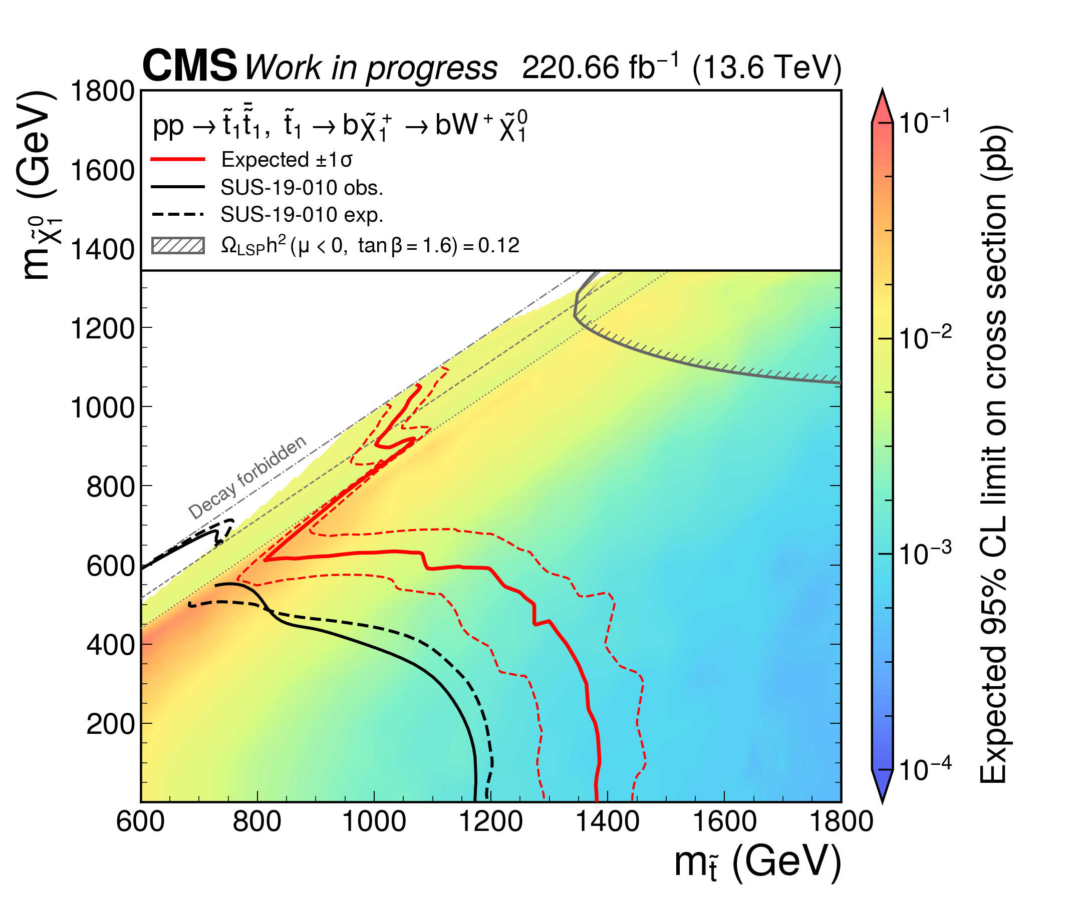
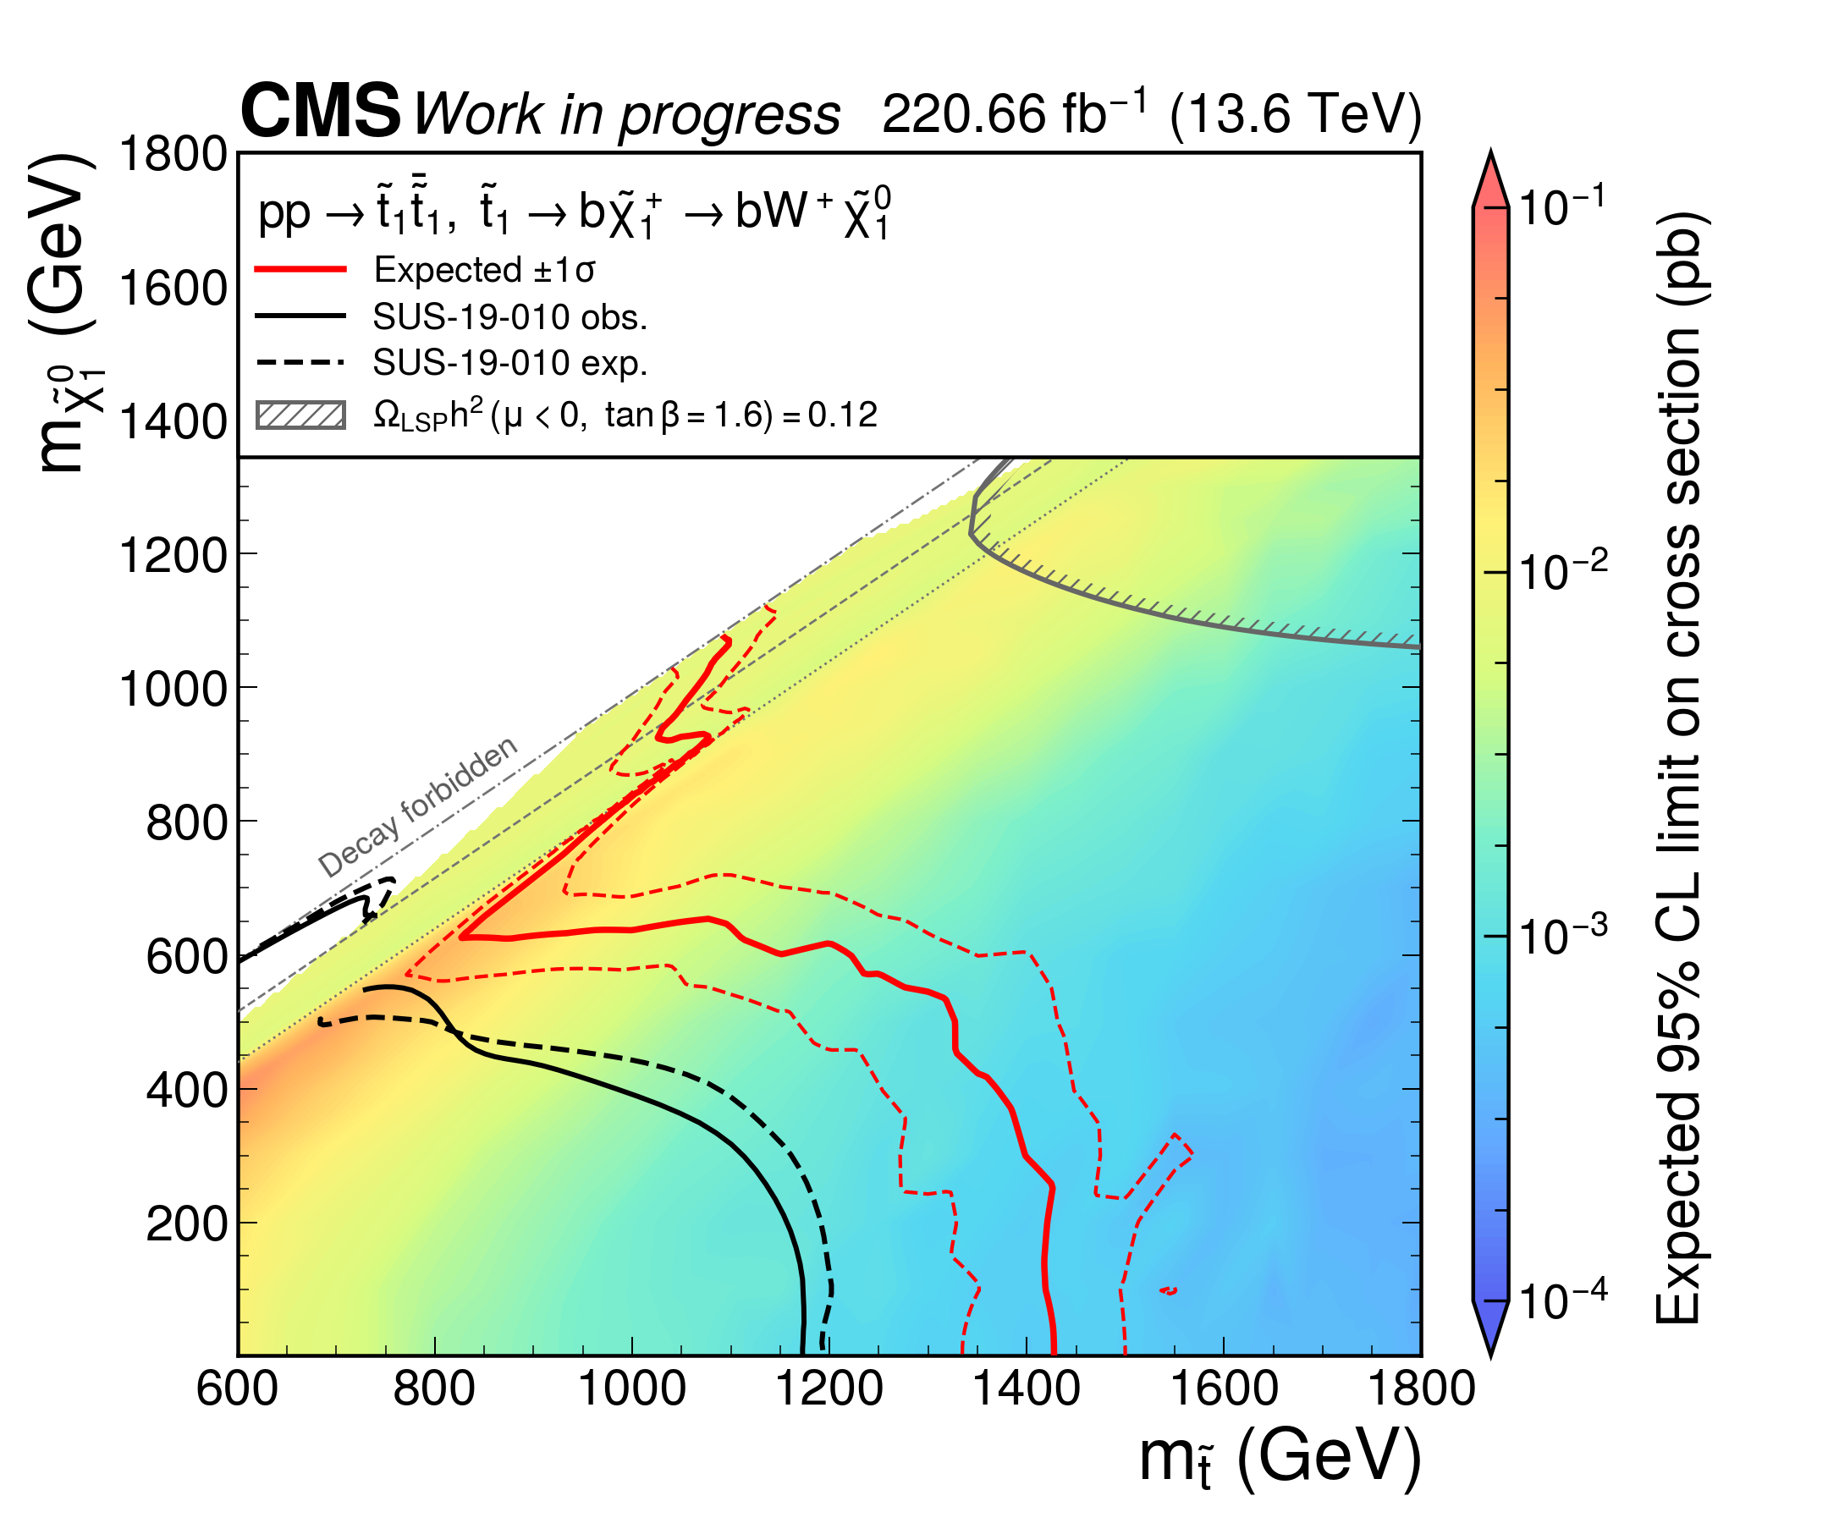
Limit comparison: T2bW
Without Nmix
With Nmix
6 2026. 9. 24. Taiwoo KIM – Weekly Stop Meeting
Notes:
Previous Run-3 baseline: /Users/taiwoomac/Documents/All Hadronic Stop Analysis/autonomous_allhad/reports/lowdm_cr_nisr_merged_20260921/limits, lowdm_cr_nisr_merged_20260921. Source policy: autonomous_allhad/configs/adopted_statistics_2024_2025.json. Nmix is absent. HighSR73 + lowSR30, pooled low-dM CRs, 338 analysis bins, 94 free rate parameters, autoMCStats 10 1 1. Existing adopted systematics and correlated signal xsec lnN. Limit coverage: T2tt 203/205, T2bW 350/354, T2tb 356/365, total 909/924 with 15 failed points. Previous PNG SHA256 3535088bddcbec57e9314c11583beb0965b3b92feb405067c8ca1a65e1c02dfc. These are the actual archived calculations, not a new fit or a SUS-19-010 substitute. Both panels retain the older Run-2 black overlay as context, but the requested comparison is between the two red Run-3 expected contours. The right-hand SR118 nominal calculation has different binning and an incomplete systematic set. This comparison therefore does not isolate the effect of adding TopMixed alone.
Sources: /Users/taiwoomac/Documents/All Hadronic Stop Analysis/TROTASR/stats/nominal_20260924_sr118/plots/contours/plot_manifest.json and the three embedded original contour PNGs. T2tt 201/205, T2bW 339/354, T2tb 353/365 valid results. Total 893/924 with 31 failed points. Existing plot mass display excludes 20 low-mass points each for T2bW and T2tb, displaying 319 and 333 valid points respectively. Red curves show current nominal expected median and expected bands. Black curves show the pinned SUS-19-010 observed/expected reference in the existing renderer. This is not a controlled with/without TopMixed sensitivity comparison. Do not attribute all differences to TopMixed. These stored-TROTA nominal results do not include the newly requested full CMS-p4 central plus JES/JER re-inference campaign. No old highSR162/121 fit results substitute for SR118.
contours/expected_limit_t2tt_2024_2025_highdm118_lowdm30_xsec_topology_thermal_relic.png SHA256 63362d9bc8ed52d29934f7fbc63fa1e978bfd3761e8f3ba482f218aa802fe35c
contours/expected_limit_t2bw_2024_2025_highdm118_lowdm30_xsec_topology_thermal_relic.png SHA256 99c3530b9dd0388d460b390b2f37c0c16fb0b3955d2efac2700e9bb23b67f294
contours/expected_limit_t2tb_2024_2025_highdm118_lowdm30_xsec_topology_thermal_relic.png SHA256 3b1cebb3680f70bebc98517c4a267bf51dd879f77d1417e1fedbdfa7dce2095c

Slide 8
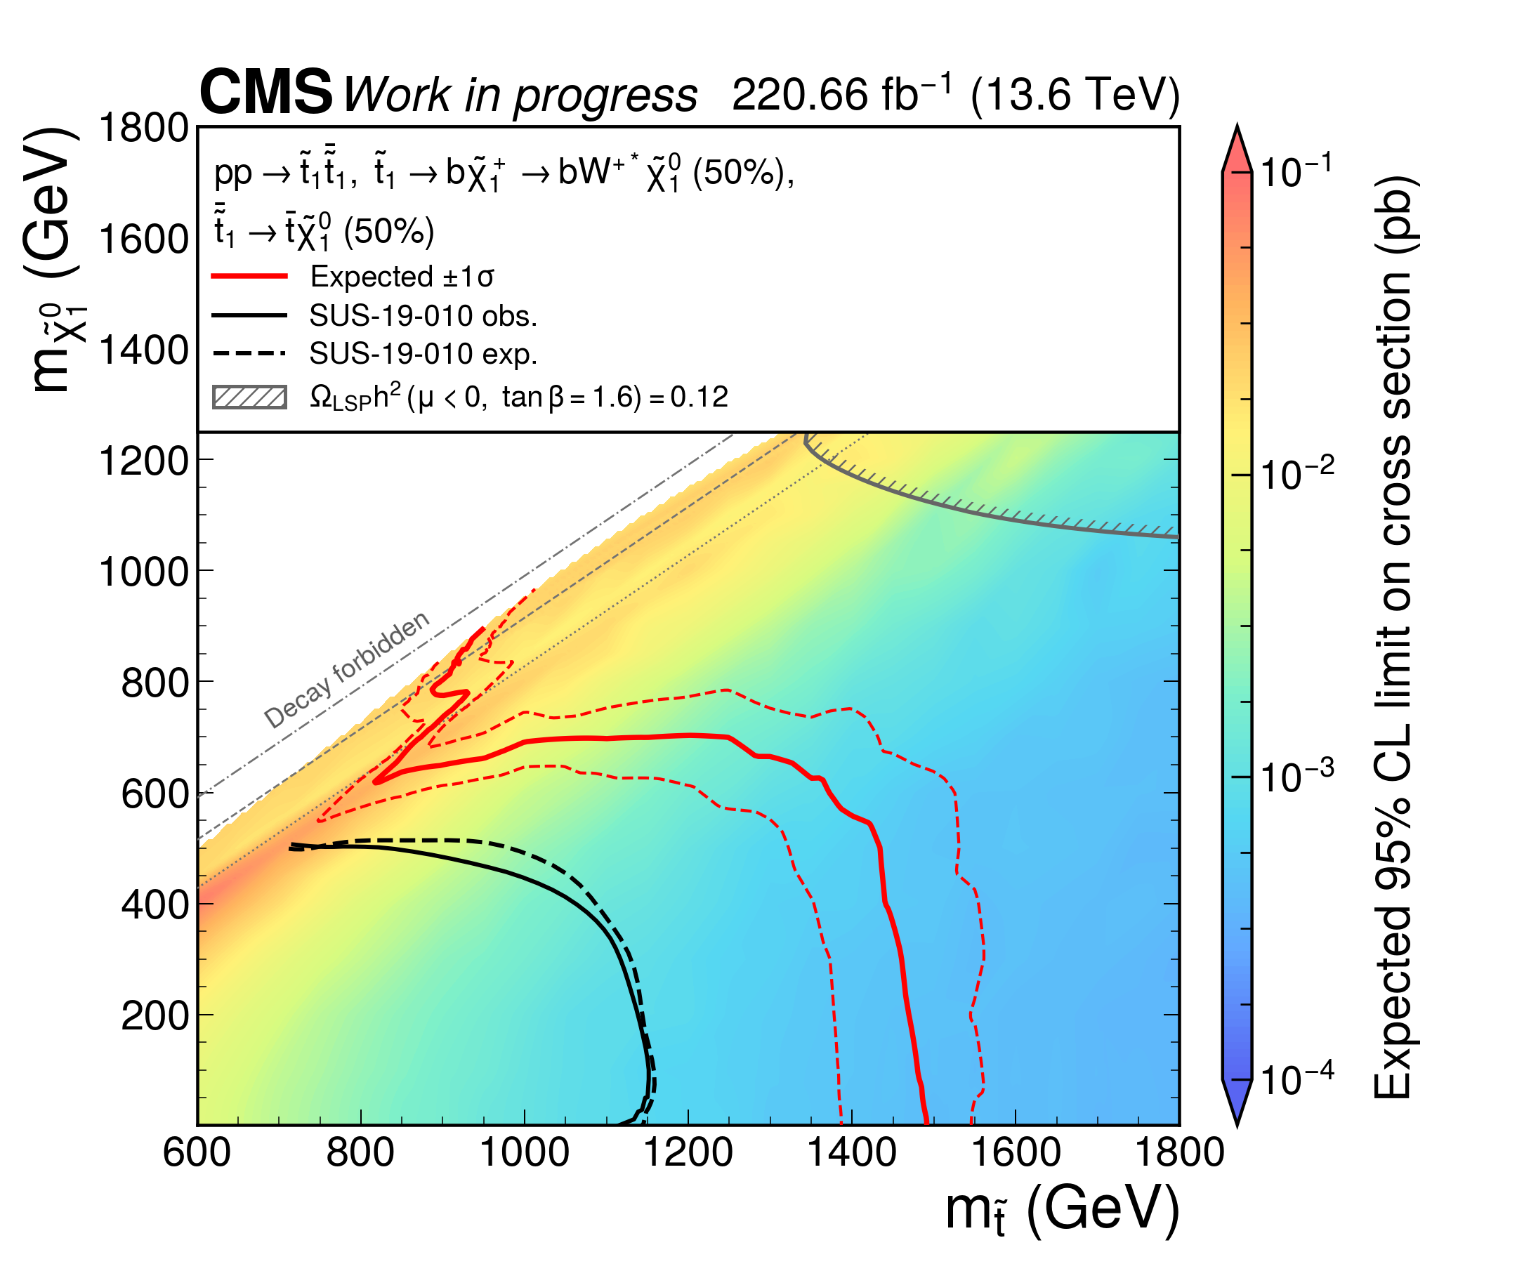

Limit comparison: T2tb
Without Nmix
With Nmix
7 2026. 9. 24. Taiwoo KIM – Weekly Stop Meeting
Notes:
Previous Run-3 baseline: /Users/taiwoomac/Documents/All Hadronic Stop Analysis/autonomous_allhad/reports/lowdm_cr_nisr_merged_20260921/limits, lowdm_cr_nisr_merged_20260921. Source policy: autonomous_allhad/configs/adopted_statistics_2024_2025.json. Nmix is absent. HighSR73 + lowSR30, pooled low-dM CRs, 338 analysis bins, 94 free rate parameters, autoMCStats 10 1 1. Existing adopted systematics and correlated signal xsec lnN. Limit coverage: T2tt 203/205, T2bW 350/354, T2tb 356/365, total 909/924 with 15 failed points. Previous PNG SHA256 0ca524ae8c59055c22878c68555c41707d7428c135d935ceb5817debfaf93ff4. These are the actual archived calculations, not a new fit or a SUS-19-010 substitute. Both panels retain the older Run-2 black overlay as context, but the requested comparison is between the two red Run-3 expected contours. The right-hand SR118 nominal calculation has different binning and an incomplete systematic set. This comparison therefore does not isolate the effect of adding TopMixed alone.
Sources: /Users/taiwoomac/Documents/All Hadronic Stop Analysis/TROTASR/stats/nominal_20260924_sr118/plots/contours/plot_manifest.json and the three embedded original contour PNGs. T2tt 201/205, T2bW 339/354, T2tb 353/365 valid results. Total 893/924 with 31 failed points. Existing plot mass display excludes 20 low-mass points each for T2bW and T2tb, displaying 319 and 333 valid points respectively. Red curves show current nominal expected median and expected bands. Black curves show the pinned SUS-19-010 observed/expected reference in the existing renderer. This is not a controlled with/without TopMixed sensitivity comparison. Do not attribute all differences to TopMixed. These stored-TROTA nominal results do not include the newly requested full CMS-p4 central plus JES/JER re-inference campaign. No old highSR162/121 fit results substitute for SR118.
contours/expected_limit_t2tt_2024_2025_highdm118_lowdm30_xsec_topology_thermal_relic.png SHA256 63362d9bc8ed52d29934f7fbc63fa1e978bfd3761e8f3ba482f218aa802fe35c
contours/expected_limit_t2bw_2024_2025_highdm118_lowdm30_xsec_topology_thermal_relic.png SHA256 99c3530b9dd0388d460b390b2f37c0c16fb0b3955d2efac2700e9bb23b67f294
contours/expected_limit_t2tb_2024_2025_highdm118_lowdm30_xsec_topology_thermal_relic.png SHA256 3b1cebb3680f70bebc98517c4a267bf51dd879f77d1417e1fedbdfa7dce2095c

Slide 9
Merci !
All-hadronic stop search
“Anything your heart desires will come to you.”
When you wish upon a star – Pinocchio

