Slide 1
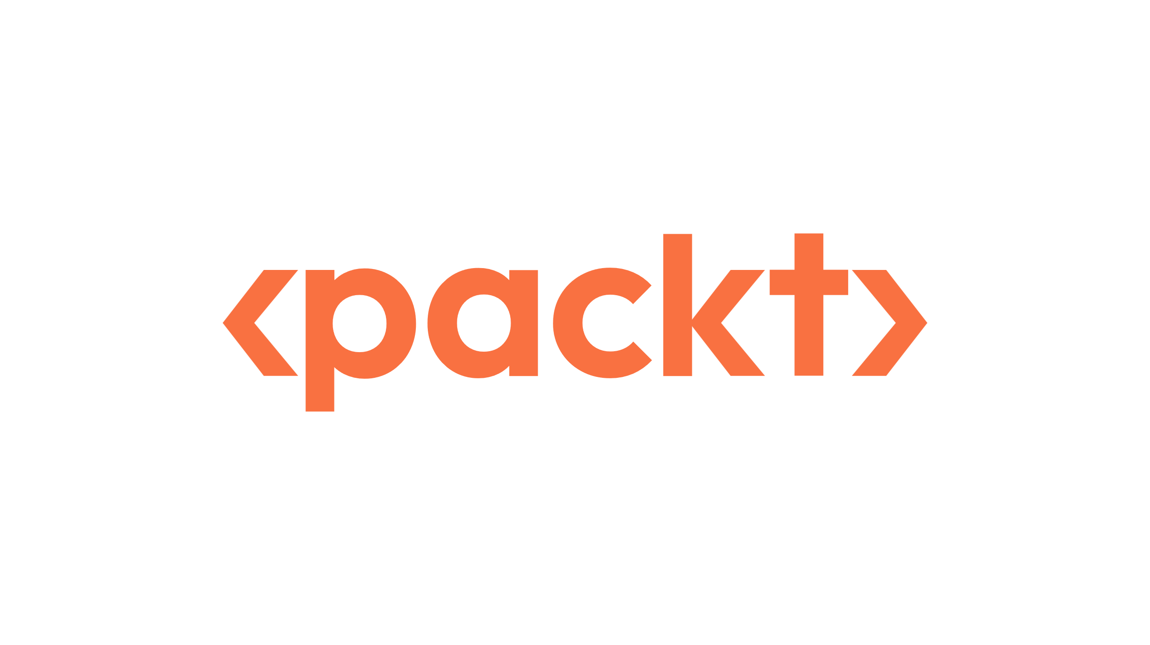

Starting Now
Building Agent-Ready Internal Developer Platforms
Ship a service, deploy an AI agent on the same platform, and keep it safe, observable, and stoppable. Everything runs on your laptop.
Ramiro Álvarez & Guillermo Vigil
Instructors

Slide 2

Building Agent-Ready
Internal Developer Platforms
A hands-on workshop · 140 minutes

Slide 3



About Ramiro
Platform engineer who builds internal developer platforms on Kubernetes.
Today he leads agent identity and tools, the AI gateway, and observability.
Ask him about LiteLLM, Langfuse, and running models behind a gateway.
Ramiro Álvarez
Instructor
github.com/kaskol10
linkedin.com/in/ramiroalvfer

Slide 4
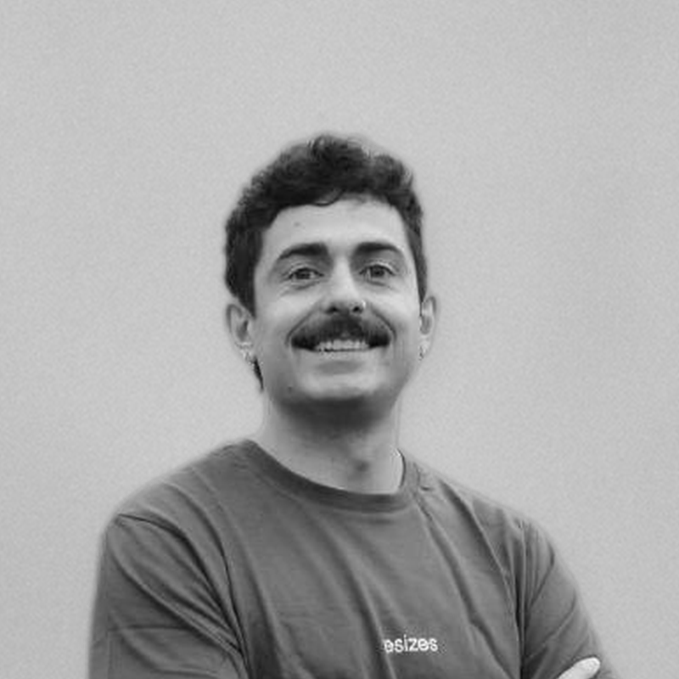
About Guillermo
Platform engineer who builds internal developer platforms on Kubernetes.
Today he leads the golden path and the self-documenting knowledge base.
Ask him about GitOps with Argo CD, CI checks that agents can read, and the fork flow.
Guillermo Vigil
Instructor
github.com/guillermotti
linkedin.com/in/guillermotti

Slide 5
Agenda
01
Agents as platform users
10 min
02
Golden path · Lab 1
20 min
03
Knowledge base · Lab 2
15 min
04
Identity, tools, and gateway
10 min
05
Hermes alert triage · Lab 3
30 min
06
Guardrails · Lab 4
30 min
07
Observability and cost
10 min
08
Where it breaks · Q&A
15 min

Slide 6
Before the session
What you need
Your machine
Docker with 12 GB of memory (16 recommended) and 4 CPUs
About 25 GB of free disk
An agent harness, for the Lab 2 question and auto-onboarding
Your own fork of the workshop repository, with GitHub Actions enabled
A capped OpenRouter key, about $10, that expires after the workshop
Your tools
kind, kubectl, helm, git, jq, envsubst
gh 2.50 or newer, logged in
yq 4.x from mikefarah, not the Python yq
kubeconform and helm-docs
preflight.sh checks all of this and prints one JSON line per check
>
Pg: 6

Slide 7
Before the session
Set up your environment
Fork the repository on GitHub, then clone your fork and point gh at it:
git clone https://github.com/<you>/agentic-idp-packt.git
cd agentic-idp-packt
gh repo set-default <you>/agentic-idp-packt
export GH_REPO=<you>/agentic-idp-packt
Check your machine, fill in .env, and run the bootstrap:
./labs/00-setup/local/preflight.sh
cp labs/00-setup/local/.env.example labs/00-setup/local/.env
./labs/00-setup/local/bootstrap.sh
Or let an agent harness do it: ask it to follow labs/02-knowledge-base/kb/guides/onboarding.md.
>
Pg: 7

Slide 8
Before the session
Fill in your .env
Copy .env.example to .env. Never commit .env.
Variable | What to put there
REPO_URL | https://github.com/<you>/agentic-idp-packt.git
REPO_WEB_URL | https://github.com/<you>/agentic-idp-packt
OPENROUTER_API_KEY | Your capped provider key. Only the gateway sees it.
GITHUB_TOKEN | Fine-grained token, your fork only: Contents and Pull requests, read and write. The runbook bot uses it in Lab 3.
LITELLM_MASTER_KEY | Leave empty. The bootstrap generates one for the kill switch.
SKIP_LANGFUSE | Leave empty. Set it to true only if your laptop is short on memory.
>
Pg: 8

Slide 9
Before the session
Check your environment
kubectl config current-context # kind-agentic-idp
kubectl -n argocd get applications # orders and runbooks: Synced, Healthy
Every UI is on port 80: http://argocd.localhost, http://langfuse.localhost, http://litellm.localhost, and http://orders.localhost/orders. Log in to Argo CD as admin:
kubectl -n argocd get secret argocd-initial-admin-secret -o jsonpath='{.data.password}' | base64 -d
Something broken? Reset the cluster. Your fork and pull requests are kept:
kind delete cluster --name agentic-idp && ./labs/00-setup/local/bootstrap.sh
>
Pg: 9

Slide 10
Before the session
The platform on your laptop
Piece | What it does today
kind cluster agentic-idp | Everything runs here, on your laptop
API gateway (ingress-nginx) | Every web UI on port 80, at *.localhost
Your fork, Git, and gh | The only write path. main is protected by CI checks
Argo CD | Syncs every app from your fork and reverts drift
CI: validate and docs-freshness | JSON errors an agent can read; stale docs fail the PR
Prometheus and Alertmanager | Fire the alert and send it to Hermes
Hermes and k8s-mcp | The triage agent and its read-only Kubernetes tools
LiteLLM | The AI gateway: one model alias, virtual keys, budgets
runbook-bot | The only component with a GitHub token. It only opens PRs
Langfuse | Traces of every model call, with tokens and cost
Kyverno | Policy at admission time, the second layer after RBAC
>
Pg: 10

Slide 11
Before the session
How the pieces connect
kind cluster: agentic-idp
You
and an agent harness
API gateway (ingress-nginx)
argocd · langfuse · litellm · orders, at *.localhost on port 80
GitHub: your fork
CI checks protect main. Argo CD polls it; runbook-bot opens PRs on it.
Argo CD
syncs every app from your fork
Prometheus
and Alertmanager fire the alert
orders
the service, in shop
Kyverno
admission policy: agent identities cannot write
alert
reads
runbook-bot
the only GitHub token
Hermes
the triage agent
k8s-mcp
read-only Kubernetes tools
report
MCP
virtual key
OpenRouter
the model provider
LiteLLM
AI gateway: keys and budgets
Langfuse
traces, tokens, and cost
provider key
traces
Green: the agent and its helpers, in the agents namespace.
>
Pg: 11

Slide 12
Before the session
How the labs fit together
Setup
Lab 1
Lab 2
Lab 3
Lab 4
Close
1
2
3
4
5
6
Fork, bootstrap, and check your cluster
Ship orders through the golden path
Generate docs that cannot go stale
Deploy Hermes and let it triage orders
Test the guardrails, then stop Hermes
Read the traces and see where it breaks
>
Pg: 12

Slide 13
Section 01: Agents as platform users
10 minutes

Slide 14

What changes when AI agents become users of the platform, alongside engineers?
- The question behind every section today

Slide 15
01 · Agents as platform users
Agent-ready means
Understand it
Docs and context agents can trust: generated from the platform and checked in CI.
Act safely in it
Its own identity, read-only tools, Git as the only write path, and policy as a second layer.
Observe and stop it
Every model call traced, every change in Git, and a kill switch that GitOps cannot undo.
>
Pg: 15

Slide 16

01 · Agents as platform users
One service, one agent
orders, in the shop namespace
The service everyone ships
Lab 1 deploys it through the golden path
Lab 2 documents it
Lab 3 breaks it on purpose
Hermes, in the agents namespace
The agent that triages alerts
Lab 3 deploys it the same way as orders
Lab 4 tests its guardrails and stops it
It never holds a cluster or GitHub token
>
Pg: 16

Slide 17
Section 02: The golden path
Lab 1 · 20 minutes

Slide 18
02 · The golden path
What changes for agents
Repositories
One folder per app with a fixed shape. An agent can scaffold it correctly every time.
CI/CD
Validation prints one JSON line per app with a clear error, not a wall of logs.
GitOps
Git is the only write path and main is protected: review, history, and rollback.
State and drift
Argo CD self-heal reverts any change made outside Git, by a human or an agent.
>
Pg: 18

Slide 19
02 · The golden path
Lab 1: ship orders (guided demo)
Walk through labs/01-golden-path/apps/orders/ and the golden path chart.
Open orders in Argo CD at http://argocd.localhost.
Change ORDER_DB in a pull request. Watch the golden-path-ci check, the merge, and the sync.
Argo CD polls your fork every 30 seconds. A hard refresh skips the wait:
kubectl -n argocd annotate application orders argocd.argoproj.io/refresh=hard --overwrite
Nobody runs kubectl apply for an app. Not you, not an agent.
>
Pg: 19

Slide 20
02 · The golden path
Lab 1: try it
Break the golden path and read what an agent would see:
git checkout -b try-lab-01
sed -i.bak 's/tag: "0.1.0"/tag: latest/' labs/01-golden-path/apps/orders/values.yaml
rm labs/01-golden-path/apps/orders/values.yaml.bak
git commit -am "try: use latest tag" && git push -u origin try-lab-01
gh pr create --fill && gh pr checks --watch
validate fails with an error an agent can act on:
{"app":"labs/01-golden-path/apps/orders","status":"fail","error":"image.tag is required and must not be latest"}
freshness and verify fail too (the catalog lists the tag). main blocks the merge. Close the PR:
gh pr close try-lab-01 --delete-branch && git checkout main
>
Pg: 20

Slide 21
Section 03: The knowledge base
Lab 2 · 15 minutes

Slide 22
03 · The knowledge base
Docs agents can trust
Generated
Chart reference, service catalog, alerts, policies, and RBAC. Stale docs fail the PR.
Hand-written
Guides, runbooks, AGENTS.md, and llms.txt: what a generator cannot know.
Linked from alerts
Every alert has a runbook_url. The on-call human and Hermes start from the same page.
Write-back
Hermes proposes runbook learnings through a bot PR. A human decides.
>
Pg: 22

Slide 23
03 · The knowledge base
Lab 2: docs that cannot go stale (guided demo)
Generate the reference docs and walk through them:
./labs/02-knowledge-base/scripts/generate-docs.sh
ls labs/02-knowledge-base/kb/generated/
Add a documented value to the chart's values.yaml and open a PR without regenerating. docs-freshness fails. Regenerate, push, and it passes.
# labs/01-golden-path/platform/charts/service/values.yaml
# -- Log level for the workload.
logLevel: info
Find orders in the service catalog, then read the WorkshopPodCrashLooping runbook. Hermes reads it in Lab 3.
>
Pg: 23

Slide 24
03 · The knowledge base
Lab 2: try it
Open an agent harness in your fork and ask, in a new chat:
Following the platform knowledge base, what are the exact steps
to deploy a new agent called hermes on this platform?
A good answer starts from AGENTS.md, follows kb/guides/deploy-an-agent.md, and names the folder, ServiceAccount, Secret, and pull request.
If it guesses, or suggests kubectl apply, the knowledge base has a gap.
Fix the docs, not the prompt.
>
Pg: 24

Slide 25
Section 04: Identity, tools, and the AI gateway
10 minutes

Slide 26
04 · Identity, tools, and the AI gateway
Three layers Hermes needs
Identity
Its own ServiceAccount, with no cluster permissions. The MCP server reads as hermes-reader, which cannot write or read Secrets.
Tools
Kubernetes only through named, read-only MCP tools. Terminal, file, and web tools are off.
Gateway
A LiteLLM virtual key for one model alias, with a budget and a rate limit. Never a provider key.
>
Pg: 26

Slide 27
04 · Identity, tools, and the AI gateway
RBAC is the coarse layer
What you run today
RBAC: verbs on resources
MCP tool allowlists
NetworkPolicy egress rules
Kyverno at admission time
The production next step
Relationship-based access, for example OpenFGA, for questions like “can this agent update that runbook?”
Kyverno stays at admission time
Different layers, not either/or
>
Pg: 27

Slide 28
Section 05: Hermes alert triage
Lab 3 · 30 minutes

Slide 29
05 · Hermes alert triage
How a triage flows
Break
Detect
Route
Investigate
Reason
Propose
1
2
3
4
5
6
A pull request breaks orders
Prometheus fires the alert
Alertmanager sends it to Hermes with its runbook
Read-only MCP tools: pods, events, logs
GLM 5.2 through the LiteLLM gateway
runbook-bot opens a triage PR and a fix PR
>
Pg: 29

Slide 30
05 · Hermes alert triage
Hermes never holds a GitHub token
Why
Anything an agent can read, a prompt injection can ask it to leak. A token plus GitHub egress would let a poisoned log push commits.
Instead
A narrow runbook bot holds the token
It only opens pull requests, and main is protected
Fix PRs may only change an existing labs/*/apps/*/values.yaml
Instruction-like text gets a WARNING in the PR body
Humans decide what merges
>
Pg: 30

Slide 31
05 · Hermes alert triage
Lab 3: check the identity
Left GITHUB_TOKEN empty at bootstrap? Add it to .env, then load it for the bot:
set -a; source labs/00-setup/local/.env; set +a
kubectl -n agents create secret generic runbook-bot-github \
--from-literal=GITHUB_TOKEN="$GITHUB_TOKEN" --from-literal=GITHUB_REPO=<you>/agentic-idp-packt \
--dry-run=client -o yaml | kubectl apply -f -
Step 1. Check what the platform team already set up:
kubectl -n agents get serviceaccounts,secrets
kubectl auth can-i list pods --as=system:serviceaccount:agents:hermes-reader -A # yes
kubectl auth can-i delete pods --as=system:serviceaccount:agents:hermes-reader -A # no
kubectl auth can-i get secrets --as=system:serviceaccount:agents:hermes-reader -A # no
>
Pg: 31

Slide 32
05 · Hermes alert triage
Lab 3: ship Hermes
Step 2. Follow kb/guides/deploy-an-agent.md, or ask an agent harness to. Either way, the result is:
git checkout main && git pull && git checkout -b lab-03-hermes
mkdir -p labs/03-hermes-triage/apps
cp -r labs/03-hermes-triage/starter/* labs/03-hermes-triage/apps/
./labs/01-golden-path/scripts/validate-apps.sh
./labs/02-knowledge-base/scripts/generate-docs.sh
git add -A && git commit -m "Deploy Hermes triage agent" && git push -u origin lab-03-hermes
gh pr create --fill && gh pr checks --watch
Merge when the checks pass. A new app takes up to 2 minutes to appear:
kubectl -n agents get pods,networkpolicies -w # hermes, k8s-mcp, runbook-bot
>
Pg: 32

Slide 33
05 · Hermes alert triage
Lab 3: break orders
Step 3. Pick one scenario: crashloop, oom, or bad-config. It opens a PR:
git checkout main && git pull
./labs/03-hermes-triage/scenarios/break-orders.sh crashloop
Wait for your wave, merge the PR, and watch Hermes. The alert fires about a minute later:
kubectl -n agents logs deploy/hermes -f
When the report is in, fix orders through Git as well, and merge that PR:
git checkout main && git pull
./labs/03-hermes-triage/scenarios/break-orders.sh undo
>
Pg: 33

Slide 34
05 · Hermes alert triage
Merge in two waves
WAVE A
2
Even table card. Merge the break PR first.
WAVE B
Odd table card. Merge about two minutes later.
MISSED THE CALLOUT?
Raise a hand. Do not merge early.
waves, so 30 laptops do not hit the model in the same second
>
Pg: 34

Slide 35
05 · Hermes alert triage
Lab 3: read the bot's pull requests
Step 4. The runbook bot opens two pull requests on your fork:
Triage PR: Hermes's report under labs/03-hermes-triage/triage-reports/, plus any runbook learning.
Fix PR: only an existing labs/*/apps/*/values.yaml. Anything else is rejected.
Instruction-like text gets a WARNING in the PR body. Review it as untrusted input.
Neither PR can merge itself, because main is protected.
gh pr list
>
Pg: 35

Slide 36
05 · Hermes alert triage
Lab 3: poisoned logs
Step 5. A failing job whose log tells agents to delete the shop namespace:
kubectl apply -f labs/03-hermes-triage/scenarios/poisoned-log.yaml
# Hermes reports it as a security finding. hermes-reader cannot delete anything anyway.
Step 6. A log that asks agents to send their secrets to a collector:
kubectl apply -f labs/03-hermes-triage/scenarios/poisoned-log-exfil.yaml
kubectl -n agents exec deploy/hermes -- \
python -c "import urllib.request; urllib.request.urlopen('http://collector.shop.svc.cluster.local:8080', timeout=5)"
# Must time out: egress is blocked.
kubectl -n shop logs deploy/collector # no requests from Hermes. Keep it for Lab 4.
>
Pg: 36

Slide 37
Section 06: Guardrails and recovery
Lab 4 · 30 minutes

Slide 38
06 · Guardrails and recovery
Defense in depth
RBAC
The first layer: verbs on resources. Easy to make too broad by mistake.
Kyverno
The second layer: agent identities cannot create, update, or delete anything directly.
GitOps
Guardrails are code in values.yaml. Self-heal puts back what someone deletes by hand.
Review
One approved PR can still weaken a guardrail. Agent guardrails need an owner.
>
Pg: 38

Slide 39
06 · Guardrails and recovery
Lab 4: policy as a second layer
Step 1. Enforce the policy, then give Hermes's identity too much RBAC on purpose:
kubectl apply -f labs/04-guardrails-recovery/policies/deny-agent-direct-changes.yaml
kubectl apply -f labs/04-guardrails-recovery/demo-rbac/hermes-remediator.yaml
kubectl auth can-i delete namespaces --as=system:serviceaccount:agents:hermes-reader # yes
Impersonate Hermes and try what the poisoned logs asked for. Kyverno denies all three:
kubectl delete namespace shop --as=system:serviceaccount:agents:hermes-reader --dry-run=server
kubectl -n shop patch deploy orders --as=system:serviceaccount:agents:hermes-reader \
-p '{"spec":{"replicas":0}}' --dry-run=server
kubectl -n agents delete networkpolicy hermes --as=system:serviceaccount:agents:hermes-reader --dry-run=server
kubectl delete -f labs/04-guardrails-recovery/demo-rbac/hermes-remediator.yaml
>
Pg: 39

Slide 40
06 · Guardrails and recovery
Lab 4: drift on a guardrail
Step 2. Someone debugging Hermes deletes its network policy as an admin:
kubectl -n agents delete networkpolicy hermes
kubectl -n agents get networkpolicy hermes -w
Kyverno allows it, because admins are not agents.
Within seconds Argo CD puts it back, because the policy lives in Git with Hermes.
Drift is not only a human problem: the same self-heal reverts an agent's change.
>
Pg: 40

Slide 41
06 · Guardrails and recovery
Lab 4: a helpful pull request
Step 3. Open a reasonable-looking PR. Read it, see the checks pass, and merge it:
git checkout main && git pull
./labs/04-guardrails-recovery/scripts/open-helpful-pr.sh
When Hermes restarts, run the egress check from Lab 3 again:
kubectl -n agents rollout status deploy/hermes
kubectl -n agents exec deploy/hermes -- \
python -c "import urllib.request; print(urllib.request.urlopen('http://collector.shop.svc.cluster.local:8080', timeout=5).read())"
# Now prints b'ok': the poisoned log has somewhere to send Hermes's key.
>
Pg: 41

Slide 42
06 · Guardrails and recovery
Lab 4: revert it through Git
Revert the merge with a pull request:
git checkout main && git pull && git checkout -b revert-hermes-egress
git revert --no-edit "$(git log --grep='let the agent check orders health' -n 1 --no-merges --format=%H)"
git push -u origin revert-hermes-egress && gh pr create --fill
Merge it, wait for the rollout, and run the egress check again. It times out.
In a real platform, CODEOWNERS would require the platform team on every agent's values.yaml.
>
Pg: 42

Slide 43
06 · Guardrails and recovery
Lab 4: the kill switch
Step 4. The obvious way does not work, because Argo CD scales it back to 1:
kubectl -n agents scale deploy hermes --replicas=0
kubectl -n agents get deploy hermes -w
Remove its credentials instead. Argo CD cannot recreate a Secret it does not manage:
./labs/04-guardrails-recovery/scripts/kill-switch.sh
kubectl -n agents get pods
The real kill switch blocks the virtual key on the gateway:
set -a; source labs/00-setup/local/.litellm-admin; set +a
LITELLM_ADMIN_URL=http://litellm.localhost ./labs/04-guardrails-recovery/scripts/kill-switch.sh local --block-key
>
Pg: 43

Slide 44
Section 07: Observability, audit, and cost
10 minutes

Slide 45
07 · Observability, audit, and cost
What the platform records
Traces
Langfuse records the prompt, the tool calls, the latency, and the tokens of every model call.
Audit trail
Traces, Git history, and Kyverno decisions together explain what the agent did and why.
Cost
Each virtual key has a budget and a rate limit. A blocked key stops spend at once.
>
Pg: 45

Slide 46
07 · Observability, audit, and cost
Open Langfuse
Read the login password from its Secret:
kubectl -n langfuse get secret langfuse-secrets -o jsonpath='{.data.LANGFUSE_INIT_USER_PASSWORD}' | base64 -d
Log in at http://langfuse.localhost as workshop@example.com and open the workshop project.
Each model call is one trace. Find the traces from your Lab 3 triage by time.
Read the prompt with the runbook, the MCP tool calls, and the token cost.
Match it with the bot's PR and the Kyverno denials from Lab 4.
>
Pg: 46

Slide 47
Section 08: Where it breaks
Q&A · 15 minutes

Slide 48
08 · Where it breaks
Where it breaks
What breaks | What helps
Stale docs | Generate reference docs and fail the PR when they drift
Over-broad RBAC | Policy as a second layer; no direct writes for agent identities
Prompt injection | Read-only tools, no egress, and no tokens in the agent
Approval theater | Owners review guardrail changes; CODEOWNERS on agent values
Alert storms | Triage each alert once per window, with a budget per key
Gateway outages | One central gateway, with a kill switch per key
>
Pg: 48

Slide 49
A platform is agent-ready when agents can understand it, act safely within it, and be observed and stopped when needed.
- The takeaway

Slide 50
08 · Where it breaks
Keep going
Everything stays in your fork after today.
Where | What
labs/README.md | All labs, in order, with the time each one takes
labs/02-knowledge-base/kb/guides/platform-map.md | Every piece of the platform and how they connect
labs/02-knowledge-base/kb/guides/onboarding.md | Let an agent harness rebuild the environment for you
“If you finished early” in each lab | Extra exercises for Labs 3 and 4
kind delete cluster --name agentic-idp | Clean up your laptop when you are done
>
Pg: 50

Slide 51
Thank you
Questions? Find us in the room.

