Slide 1

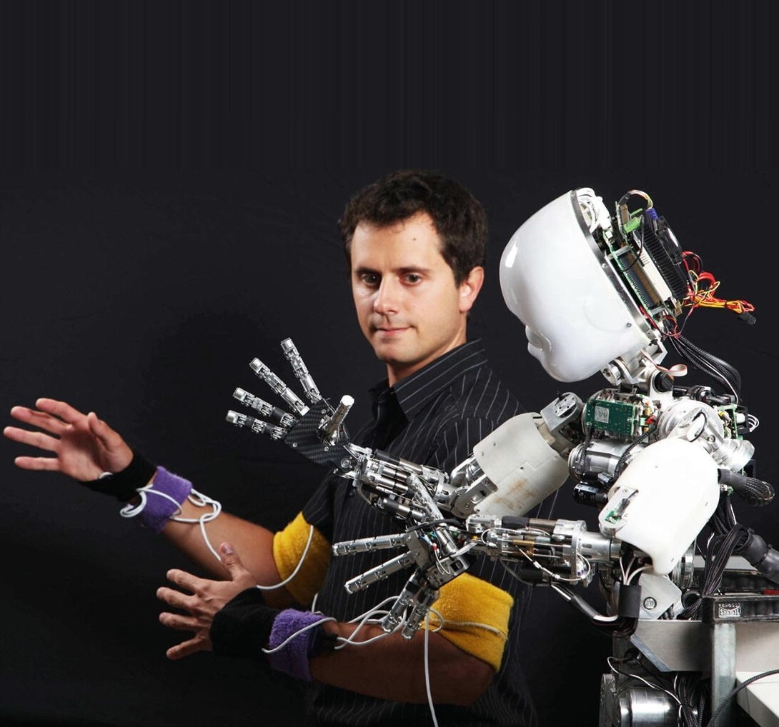
Proposal Thesis
Rosa Maessen

Slide 2
Proposals
Exerting skill using collaborative tasks
Focus on the effect of learning due to collaborative task
Focus on skill change robot to robot learning
Combining IL and RL

Slide 3
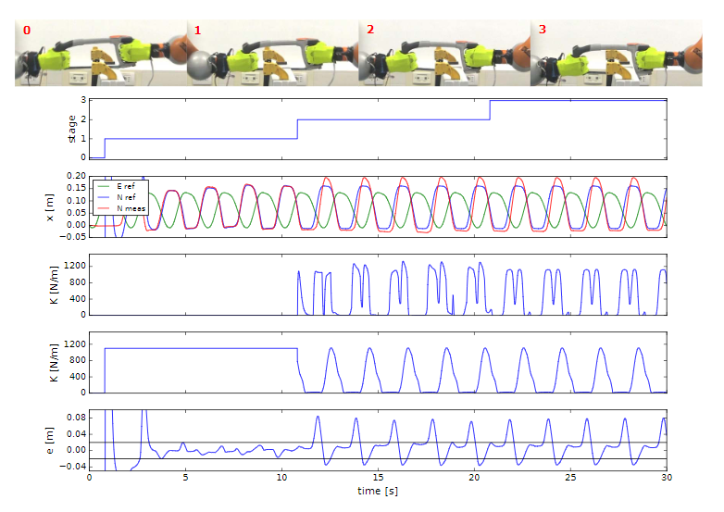
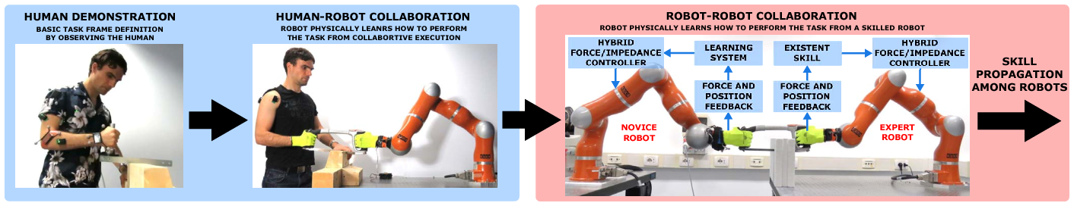
Option 1: Collaborative Task
Peternel, L., & Ajoudani, A. (2017, November). Robots learning from robots: A proof of concept study for co-manipulation tasks. In 2017 IEEE-RAS 17th International Conference on Humanoid Robotics (Humanoids) (pp. 484-490). IEEE.

Slide 4
Option 1: Collaborative Task
Proposal 1
Robot to Robot to Robot …
Hypothesis that behavior changes
Proposal 2
Use collaborative task to exert the skill of a human

Slide 5
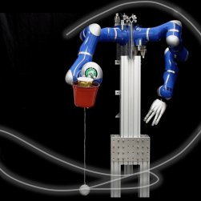
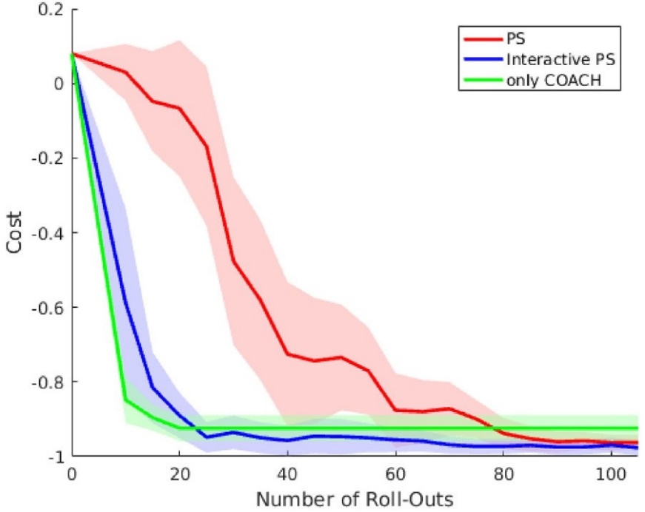
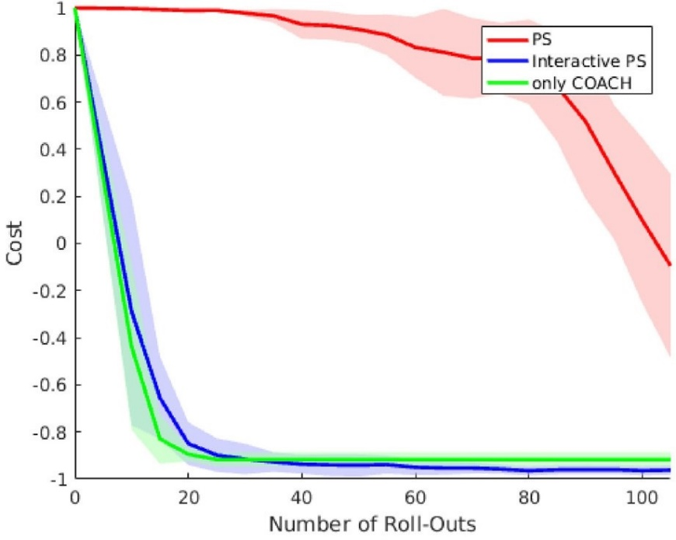
Option 2: Combing RL and IL
with initial Policy
without initial Policy
Carlos Celemin et al. “Reinforcement learning of motor skills using policy search and human corrective advice”. In: The International Journal of Robotics Research 38.14 (2019), pp. 1560–1580.

