Slide 1

Notes:
for whom is this the first meetup?

Slide 2
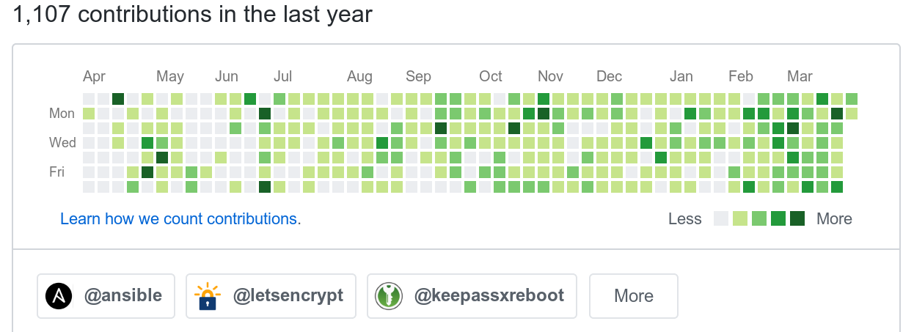
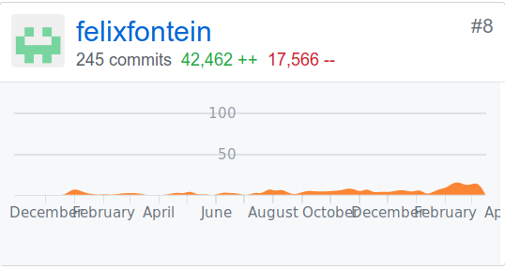
Felix Fontein
Notes:
Letsencrypt now acme modules, docker openssl
Redhat introduces a supershipit for him
Top 10 independent contributors the last 12 months
Prooved to be there if he should have screwed

Slide 3
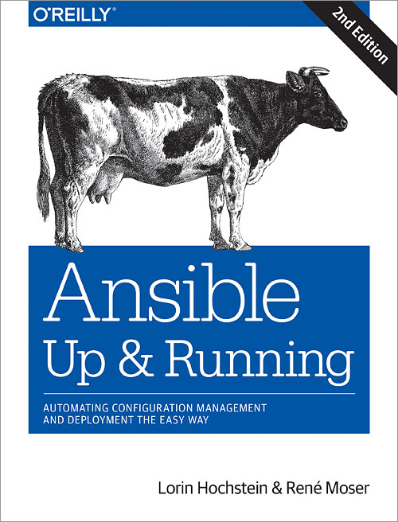
Ansible Inventory Plugins
René Moser
Systems Architect
Twitter: @resmo79
Blog: www.renemoser.net

Slide 4



Slide 5
Agenda
02.04.2019
Brief Intro
Hands on
Questions

Slide 6

Plugins
Notes:
Plugin architecture
Extendable
Can be transformed to solve in your use case
Fexible

Slide 7
Plugins
Action
Cache
Callback
Connection
Inventory
Lookup
Shell
Strategy
Tasks
Vars
Filters
Notes:
10 Typoes of plugins

Slide 8

History
Notes:
Python scripts with no helpers
No integration for configs --> bash wrappers
Custom caching
New style plugins, configure you inventory by yaml

Slide 9
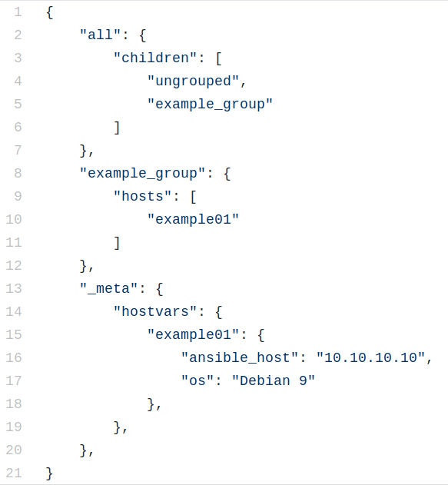
Inventory JSON
Notes:
Example schema what a script and plugin produces

Slide 10

Inventory
Notes:
Defines How and often how many
Static files as INI files but
Cloud world things come and go
Time based, load based, autoscale
Stable source is the cloud API

Slide 11
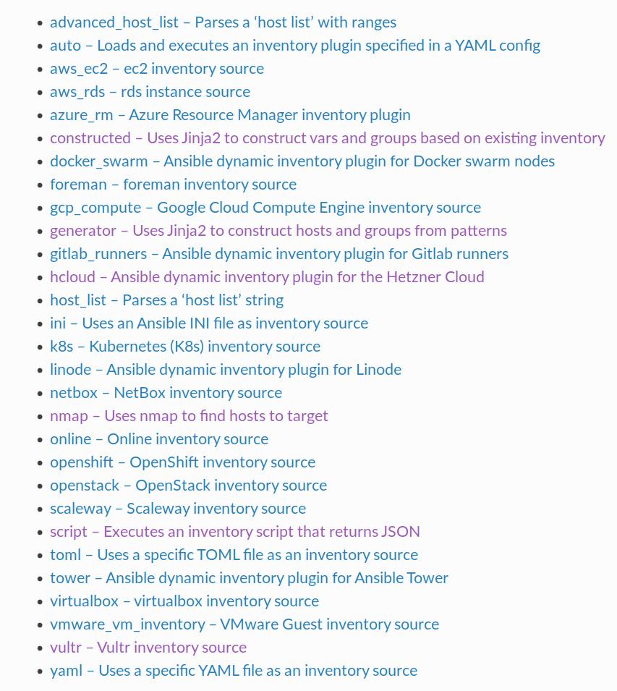
Inventory Plugins
Notes:
List of inventory plugins in 2.8
Many api related but there are also some exotic ones
Nmap, generator,

Slide 12
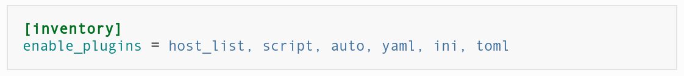
ansible.cfg
Notes:
Whitelisted per default are the following
Optimize this list by removing the plugins unused

Slide 13
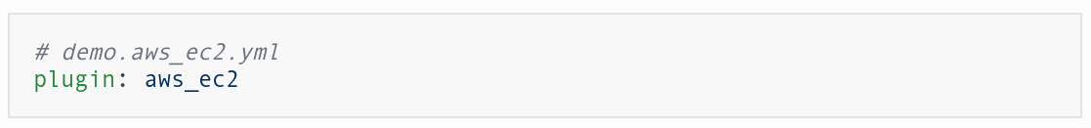
demo.aws_ec2.yml
Notes:
Shows a minimal config, file name is important

Slide 14
Graph it !
Notes:
Quick overview what is where

Slide 15

Demo!
...and thanks for not having slept during the intro...

