Slide 1
Federated Learning
Through Distributed Computing
Resmy Vijaykumar (WQD190042)
Liu Hong Yang (WQD190005)
Mohamed Fathi (WQD180081)
Sritharan Sivaguru (WQD180086)
Abu Zafar Mohammad Saleh (WQD180084)

Slide 2
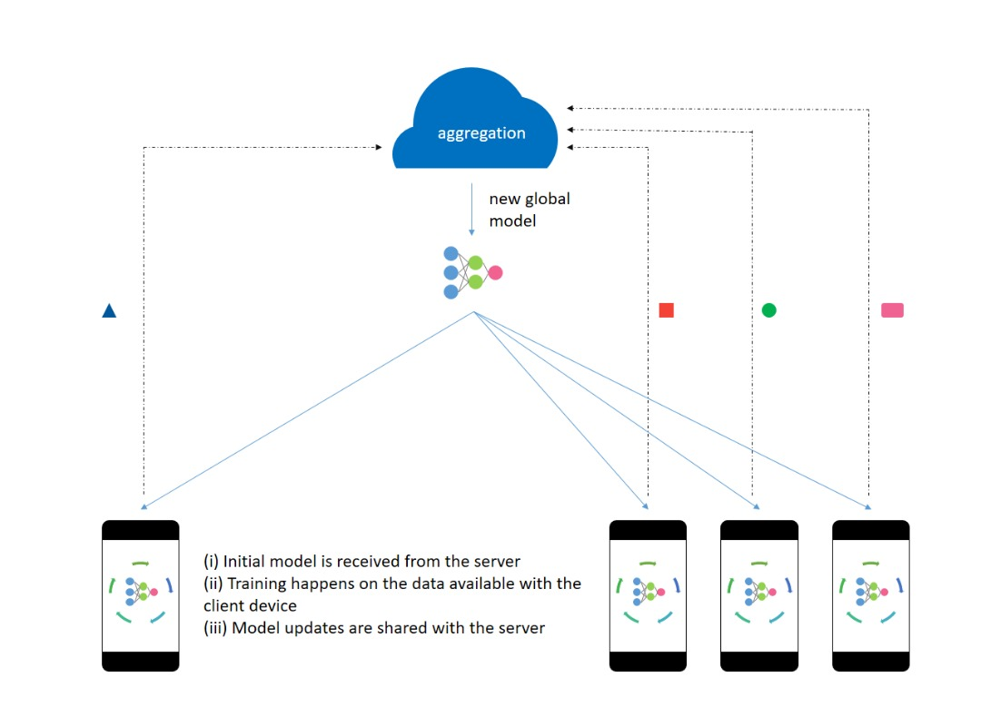
Sample 4
Introduction
Federated learning is a collaborative machine learning technique which trains a model using data present on local devices without sending the data to a centralized server.
How Federated Learning Works
Server in the cloud
New global model
Initial model is received from the server
Training happens with the data available on the local device
Model updates are shared with the server.
The models are aggregated and a new model is sent back to the local device.
Data
Data
Data
Data

Slide 3
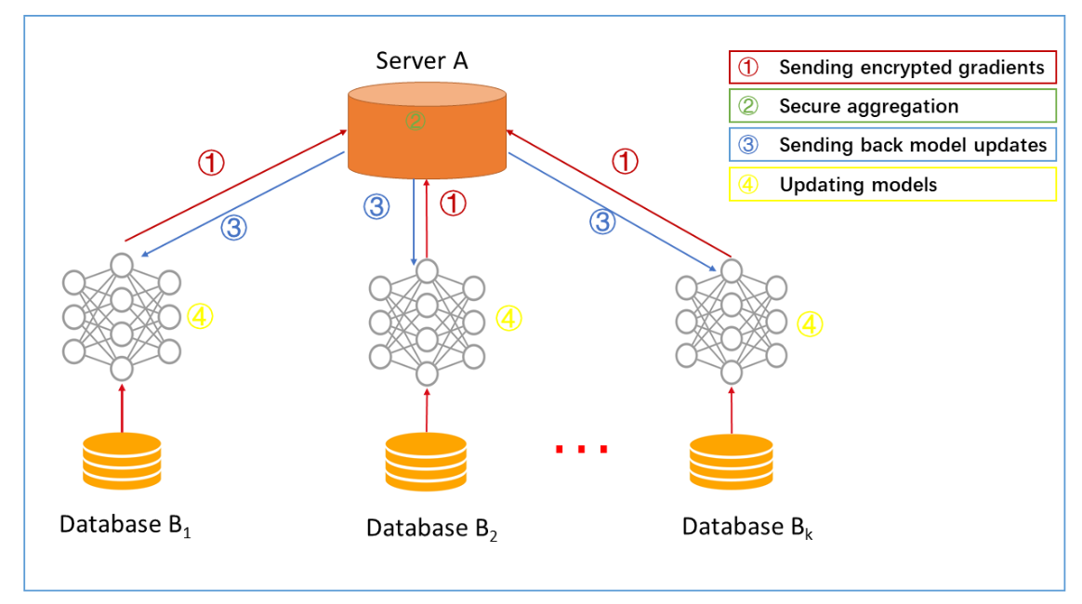
Sample 4
Scenario
For our demo we will be training our worker nodes to detect spam in text messages.
Gateway
Worker 1
Worker 2
Worker (n)
The architecture of a federated learning system for spam detection

Slide 4
Demo
Please stand by…

Slide 5
Q&A

