Slide 1
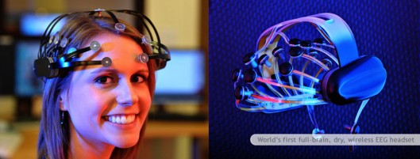
NeuroPass: Secure Neural Password using EEG sensor
Abhejit Rajagopal
Anthony Nguyen
EE113D

Slide 2
Introduction and Motivation
What is an EEG signal?
Why should you care?
Electroencephalogram
First demonstrated by Vladimir Pravdich-Neminsky in 1912 on a household canine
Voltage measurement of ionic current flows within neurons of the brain
Ensemble of neural oscillations
Little concrete analysis of such measurable electronic potentials
Computational framework needed to interpret signals since single neurons cannot be held responsible
Can help understand how the brain’s signaling system works

Slide 3
Information coding on neural channels
Brain’s signaling system
What are we proposing?
The brain is able to communicate with many muscles and cells throughout body over a network
Signaling system, measured via electronic potential, is a key metric
EEG in particular can help brain mapping
Examine extent of coded neural information
Propose: Detect salient, or even non-obvious higher-dimensional, signal features
Can both understand how brain’s signaling system works and create something useful/futuristic!

Slide 4
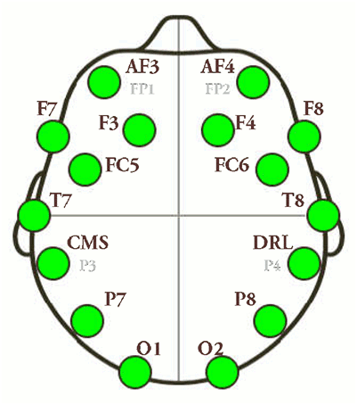
NeuroPass: EEG password
Our project’s goal is to generate a stream of coded information from neural (EEG) signals
Information can be decoded from 14 available channels
Can re-encoded in the form of a password
Emotiv EEG headset

Slide 5
Detection on a Noisy Channel
Challenge: analyzing arbitrary biological data to make dependable decisions from fundamentally noisy information
So what do one of these things look like?

Slide 6
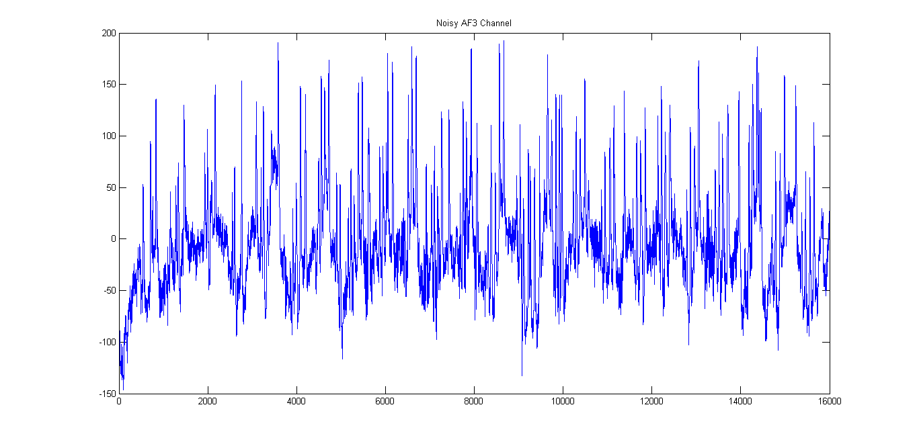
Detection on a Noisy Channel
Challenge: analyzing arbitrary biological data to make dependable decisions from fundamentally noisy information

Slide 7
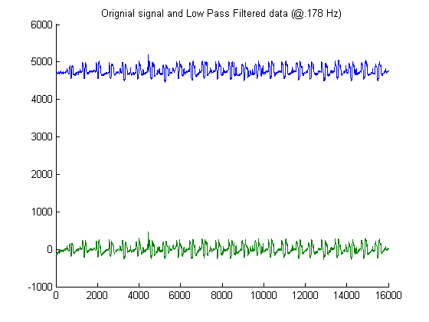
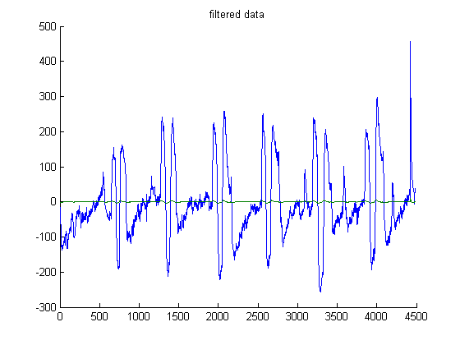
Noisy detection methods developed
Figure 2a:
DC offset removal
Figure 2b:
Digital filtering
Figure 3: Local Minima + Threshold
Figure 4: Masking

Slide 8
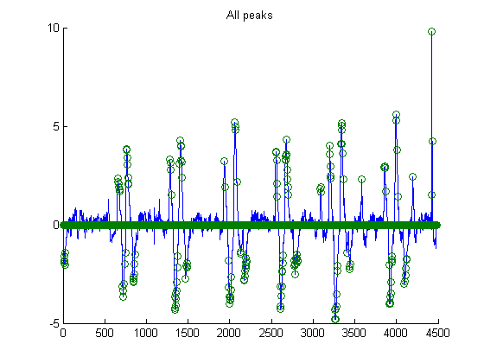
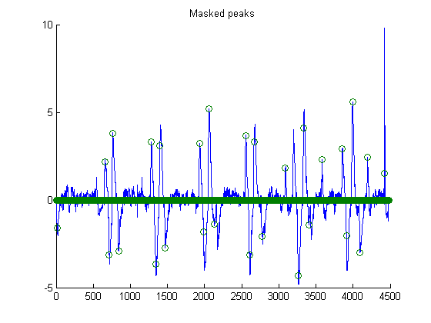
Noisy detection methods developed
Figure 2a: DC offset removal
Figure 2b: Digital filtering
Figure 3:
Local Max/Min & Threshold
Figure 4:
Masking

Slide 9
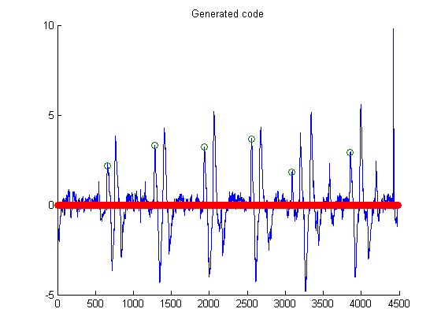
Code Generation
Figure 5:
Generated Code
>> code
code =
656 2
1282 2
1933 2
2552 2
3089 2
3854 2

Slide 10
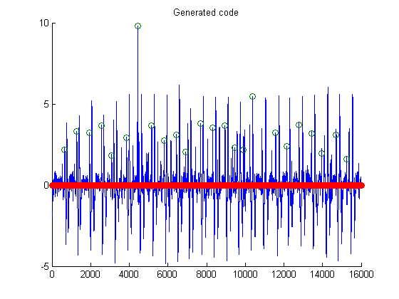
Code Generation
>> code
656 2
1282 2
1933 2
2552 2
3089 2
3854 2
4425 2
5160 2
5797 2
6438 2
6916 2
7679 2
8308 2
8957 2
9468 2
9912 2
10382 2
11576 2
12137 2
12783 2
13425 2
13952 2
14703 2
15234 2
Figure 6:
Generated Code

