Slide 1
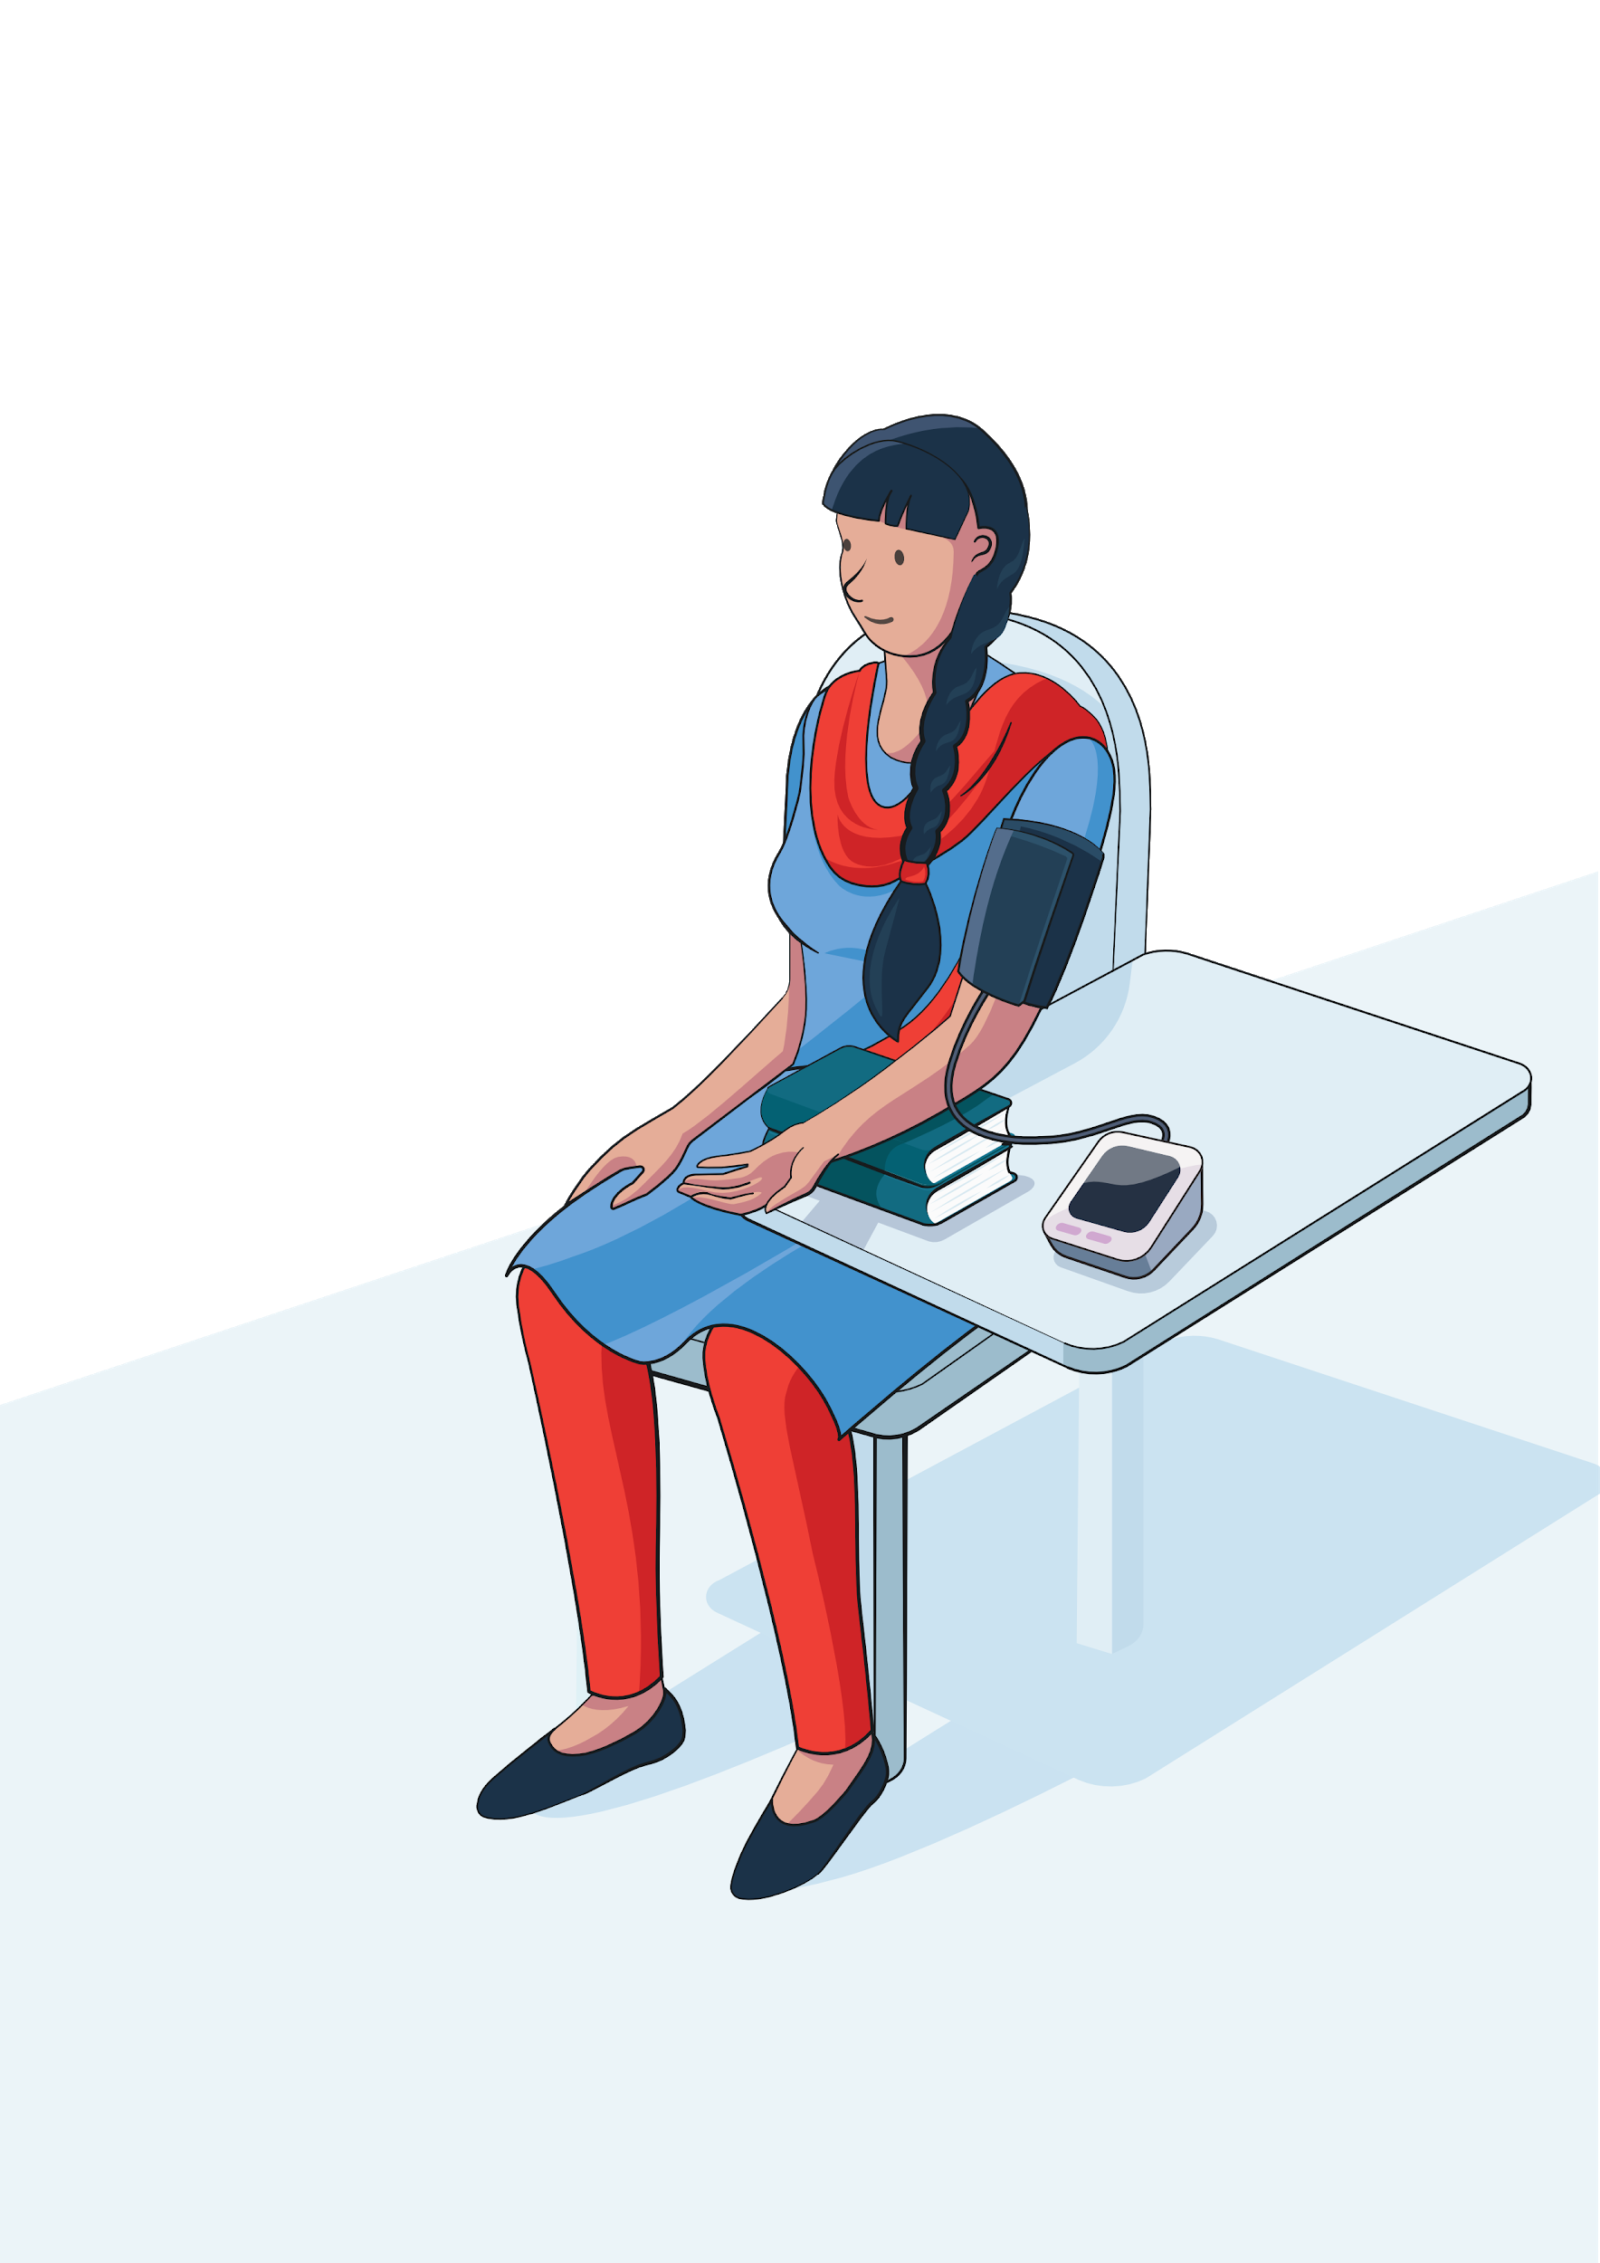

BP Measurement Checklist
Measure blood pressure of all adults ≥ 18 years
No talking during and between measurements
Back supported
Cuff at heart level
Use correct cuff size and positioning.
Arm supported
Small
Medium
Large
Ideal cuff bladder length is at least 80% of the patient's arm circumference.
Cuff width should cover at least 40% of the patient’s upper arm.
Ensure cuff is on bare arm or over thin layer of clothing. Avoid bunching of clothes under cuff.
Empty bladder before each reading.
Record exact reading from digital device. Don’t round.
Legs uncrossed and feet supported
Avoid exercise, tea/coffee, smoking in the last 30 minutes. Patient should rest comfortably and quietly for 5 minutes before the reading.

