Slide 1
Filo consolidated consensus as a cloud service
Bashir Hayat

Slide 2
Them
Distribute System (Cloud Servers)
Fulfill multi-tenant (User) Requirements
Performance Guarantees, prevent aggressive tenants (Disrupting others)
Overprovisioning and under Utilizating resources

Slide 3
Solution
Filo
Provide Consensus as multi-tenant cloud with through put guarantees and efficient utilization of cloud resources.

Slide 4
How
Distributed Controller
Piggyback consensus
protocol for
resource allocation
Filo
Consolidate tenants considering constraints and use placement Algorithm
SLA
Through put and fault tolerance
Tenants
REQ

Slide 5
History
Consensus:
Distributed Consensus is difficult where several processes agree on a common value.
Used by many system to elect Leaders.
Difficult to implement correctly due to this difficulty system like, ISIS, Chubby, Apache Zookeeper, Open Replica offer as Black Box Service.

Slide 6
History
Why Consensus in Cloud:
Heat of many Distributed application that are or will become cloud residents.
Offering consensus as simple to use cloud service will relieve users from hurdles of developing and maintaining it.

Slide 7
History
Why Consolidate Consensus:
Key success of cloud provider is to reduce footprint , means reduce cost for provider and users.
Sharing computing, storage and network resources to decrease the number of servers.

Slide 8
Goal
Consolidate consensus instances of many tenants (users) and deploy them on shared servers.
Sharing:
Underutilized resources can be (Temporarily) re allocated to other tenants who demands higher performance at runtime and price can be accordingly adjusted.

Slide 9
Filo
Offer Consensus as cloud service.
Design Simple API
Efficiently and fairly utilized shared servers.
Ensure performance isolation among tenants
Considering Throughput SLA guarantees and meets these requirements

Slide 10
Filo API
Intuitive:
User specify their SLAs in application level request rates
Choose from the range of reliability options by specifying the number of replicas and the durability mode of their data(Storing data in memory or stable storage)

Slide 11
Filo
Placement:
Filo co-locate replicas of various tenants on shared servers (Consolidation).
Novel placement Algorithm that packs replicas while representing SLAs and the constraints imposed by the properties of the consensus protocols.
Filo translate high level SLA specified by user to low level resources cost. (CPU, Storage etc)

Slide 12
Filo
Performance isolation:
Consolidating replicas on shared servers raises an immediate concern with performance isolation.
Filo guarantees performance isolation by rate limiting requests using multi resource token bucket.
Filo dynamically calculates and tunes budget of these token buckets

Slide 13
Misestimates
Anecdotal evidence suggest that tenants may miss estimate their SLA requirements.
Filo monitors resource utilization at run time and fairly re distribute free resources among the tenants using distributed controller.
Centralized controller are popular but due to overhead.

Slide 14
Consensus
Consensus enables a set of Processes (replicas) to reach agreement on some value.
Consecutive execution of consensus produce a log of ordered entries.
Filo provide consensus as a service by assigning to each tenant a set of replicas.
To handle fault tolerant, replicas of a tenant must be placed on distinct servers.

Slide 15
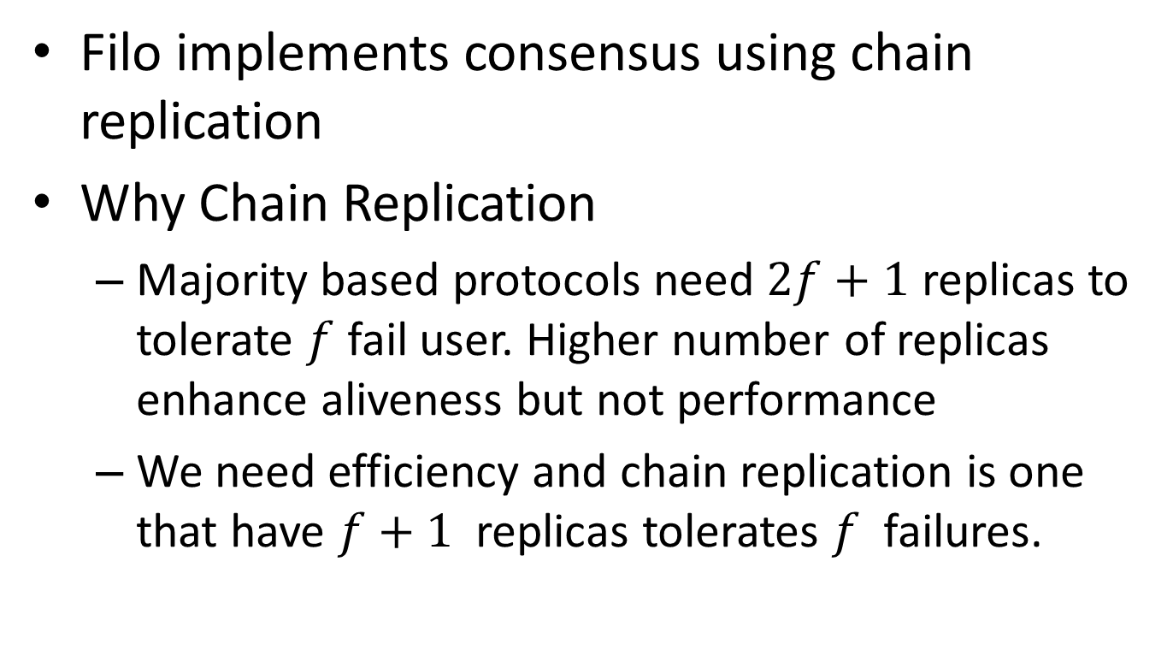
Consensus
Filo implements consensus using chain replication
Why Chain Replication
Majority based protocols need $2f+1$ replicas to tolerate $f$ fail user. Higher number of replicas enhance aliveness but not performance
We need efficiency and chain replication is one that have $f+1$ replicas tolerates $f$ failures.

Slide 16
Admission Controller
Admission controller analyzes admission request and finds servers to place replicas.
new applicant starts by submitting an admission request to the admission controller.
Attributes of admission request(durability mode, replication degree, request size, throughput SLA)

Slide 17
Admission Controller
Placement algorithm runs till all applicants are admitted to the system or denied
As discuss previous desired SLA is translated to CPU, network, and storage usage and saved as demand profile.
Using these profile at each iteration the algorithm decide, which applicant, which replica of selected applicant and which server to consider next.

Slide 18
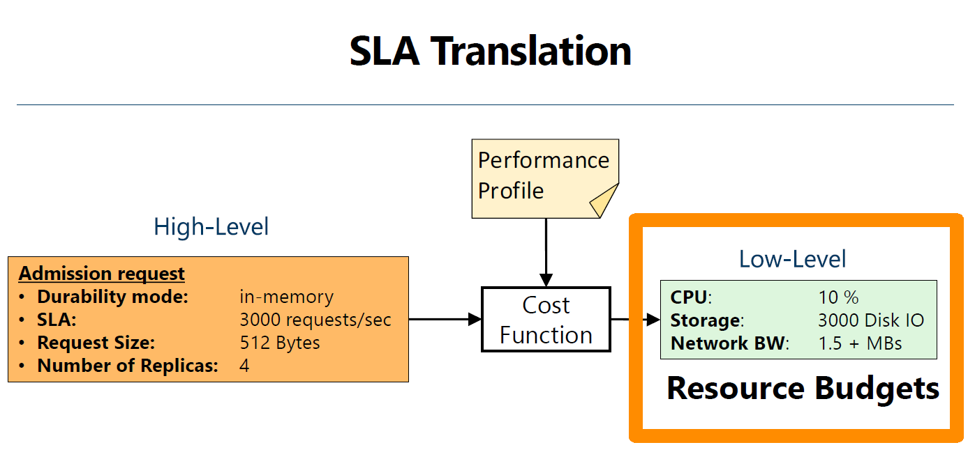

Slide 19
Placement
Based on three 3 policies:
Use greedy approach and based on three policies
POa: to maximize resource usage, prioritize the applicant with the highest dominant share
POb: for the selected applicant, prioritize the replica with the highest dominant share
Poc: to place the selected replica, prioritize the server with more free resources

Slide 20
Resource controller
Tenants miss estimated their SLA at admission phase, need resource more or less during runtime.
Filo monitor usage at run time and temporarily re distribute resources to address miss estimations.
Filo assign either Idle, or unallocated resources to the demanding tenants.

Slide 21
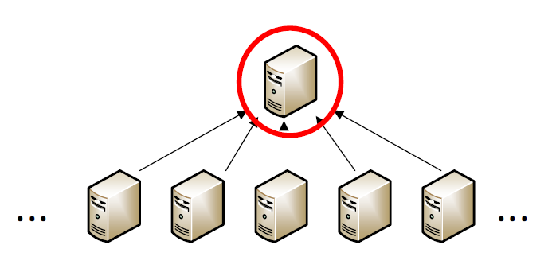
Centralized Resource Controller
Centrally controlling and re assigning resources is computationally intensive moreover its overhead increase with the size of the system.
Collect all information
Centrally

Slide 22
Distributed Resource Controller
Suggest distributed Algorithm because of servers do not need global visibility over all the other servers to dynamically adjust allocation as each tenants replicas are placed on a small set of servers.
Servers that manages the same consensus group need to coordinate with each other.

Slide 23
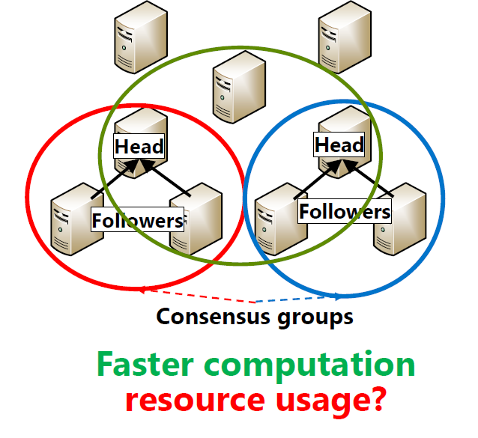
Distributed Resource Controller
Server coordinate locally, and do not need centralized Oracle.

Slide 24
Head DRF
Composed on two phase, allocation phase utilities are calculated by the head of servers only using a local execution of C-DRF.
And disseminated to the followers for voting.
At voting phase followers cast their votes by prioritizing the allocations that maximize their local resource utilization.

Slide 25
ALL DRF
Allocating phase execute all servers in parallel.
Each server execute C-DRF locally and sends its utilities to the relevant head servers.
Voting phase executed by the head servers only, the head server chooses the minimum of the utilities proposed by all the servers in Estimation.

Slide 26
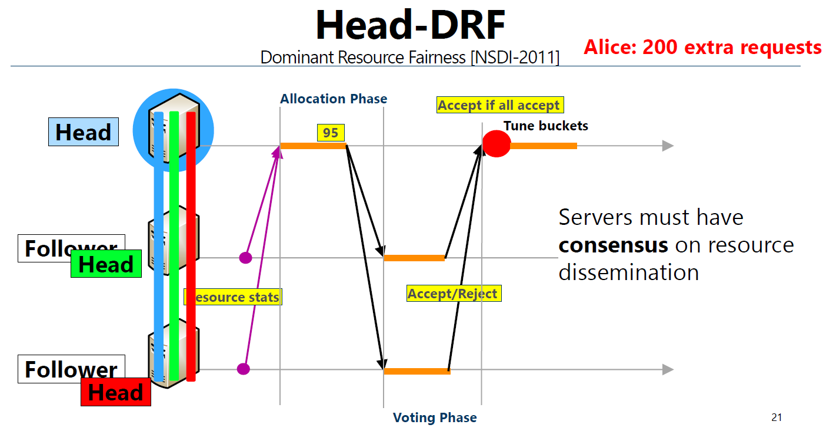

Slide 27
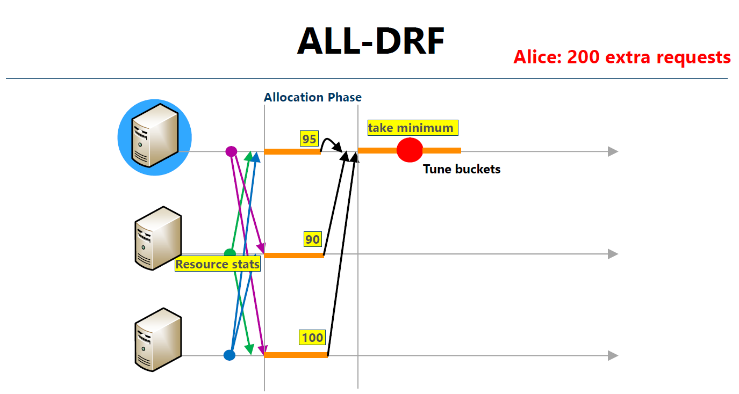

Slide 28
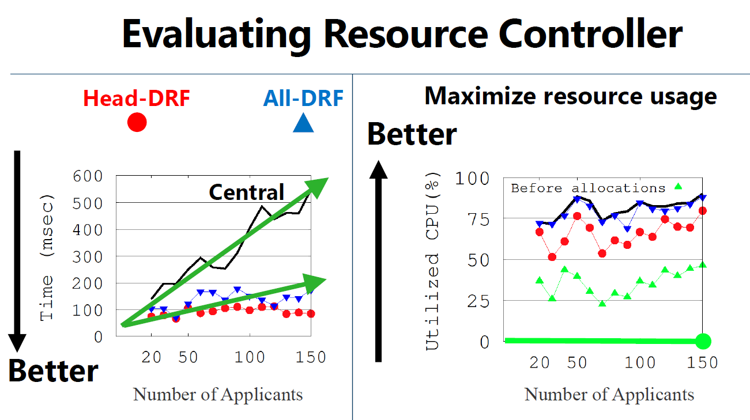

Slide 29
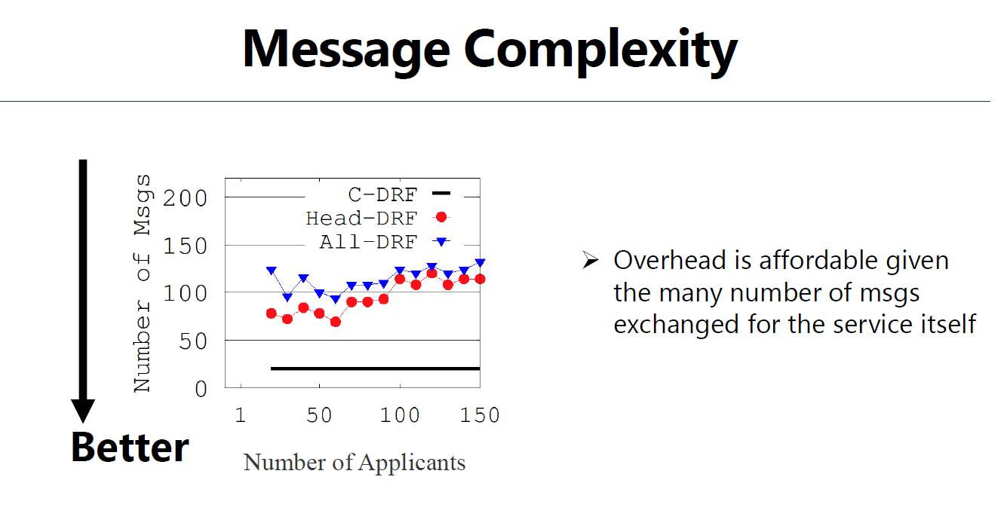

Slide 30
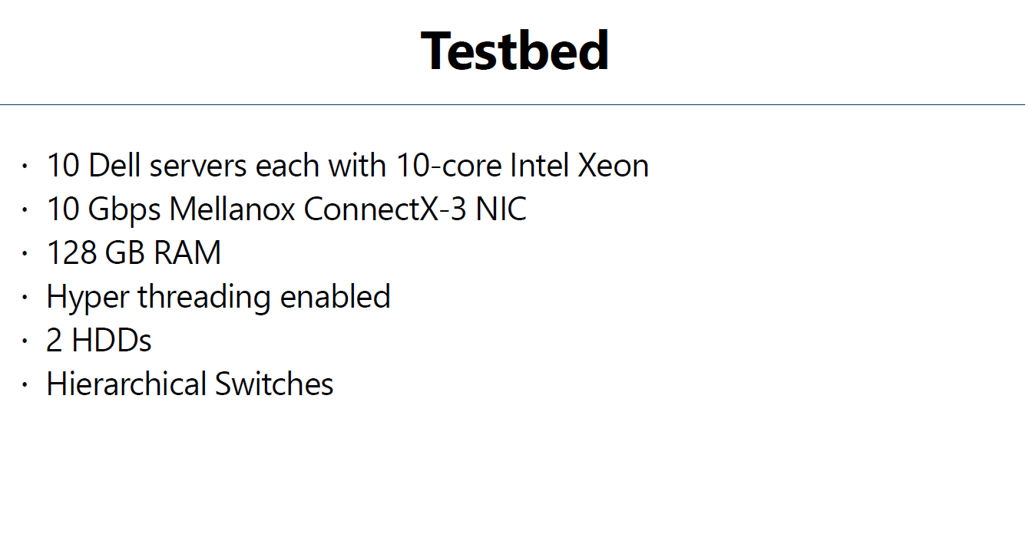

Slide 31
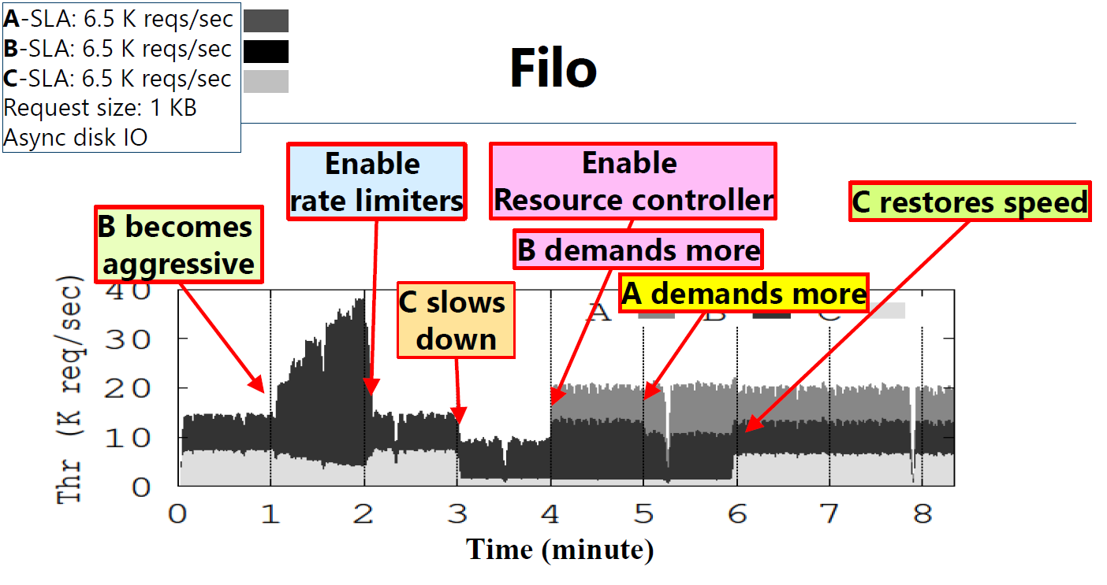

Slide 32
Conclusion
Filo: first system to provide multi tenant consolidated consensus as a cloud service.
Argued providing performance guarantees and isolation is particularly important in cloud where tenants share and compete over resources.
Placement algorithm for admitting tenants and two distributed algorithm for efficient and fair allocation of free resource at runtime.

