Slide 1
Cheap and Available State Machine Replication
Rong Shi and Yang Wang

Slide 2
Data
Durability and Availability
Power loss, Disk Corruption, S/W bugs
Big Data
Replication
f,2f+1,
3f+1
S-Rep= M-Rep=H-cost
On-demand instantiation+Lazy
Activate min rep, and backup later
Separate exe and agree node

Slide 3
Theme
Considering higher reliability, reduce the asynchronous state machine replication protocols.
Incorporate on demand instantiation, that activate a subset of replicas first and activates backup ones when active one fail.

Slide 4
Cont…
Apply lazy recovery, allowing system to proceed while recovering backup node in the back ground.
Identified that, when agreement nodes and execution nodes are logically separated, they each present unique property that enables lazy recovery.

Slide 5
Introduction
Replication is widely used in today’s storage systems to protect data against failures.
Strong replication protocol have move replica needed, eg. f machine fail have f+1 replica.
Paxos have 2f+1 replicas to tolerate f machine crashes.

Slide 6
Cont…
More replica– hight cost– need more storage—more bandwidth– more processors to process data.
To identify that for SMR protocol, lazy recovery is possible only when agreement and execution are separated.

Slide 7
Instant activation for agreement
What is the next request to execute.
Memory less—property– agreement node does not need– previous– next one– that suggests – active agreement node fails– blank agreement node can join.

Slide 8
Separating critical and flexible tasks for execution.
Execution node must execute request in order– later request may depend on information in early request.
Critical latency task require fewer replicas than flexible background task that can be delayed. Eg in Paxos, client need one reply to proceed.

Slide 9
On demand instantiation and lazy recovery.
On demand instantiation to reduce replication cost, and lazy recovery for availability.
When an active replica fails the system keeps processing request while recovering a backup replica in the background. Such combination achieve both.
Lazy recovery– ensure –system function correctly- partial state.

Slide 10
observation
When agreement and execution are separated, they each present a unique property that enables lazy recovery.

Slide 11
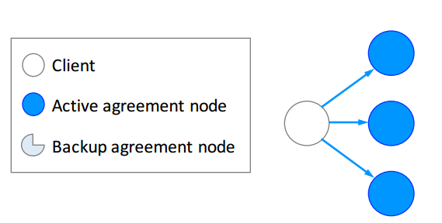
Instant activation for agreement node
An agreement protocol needs to decide the next request to execute, this task is memory less property.
A node does not need to know prior requests when agreeing on the next one

Slide 12
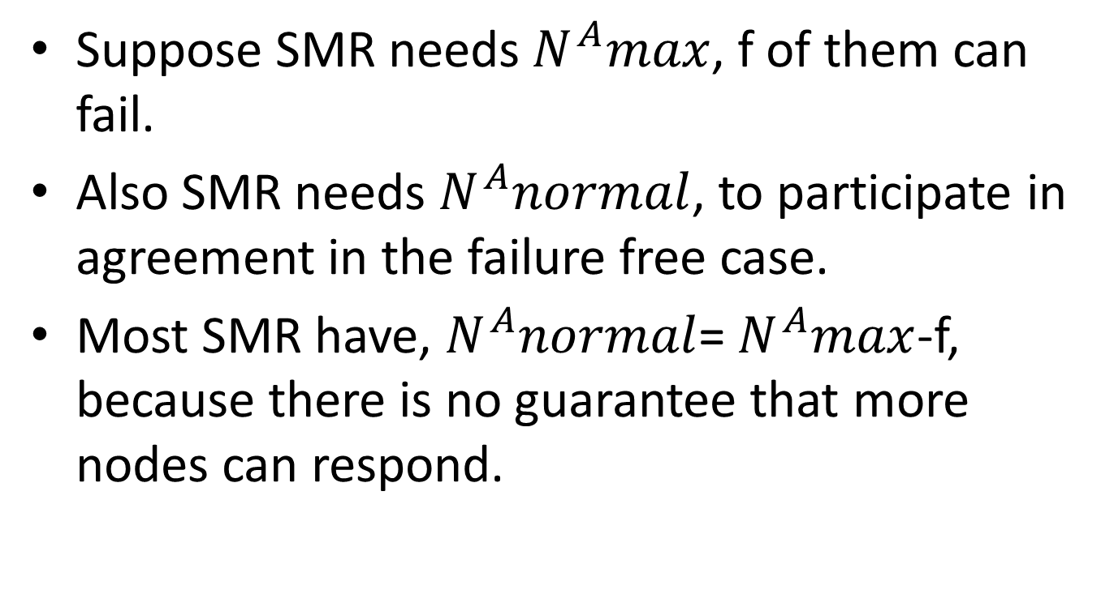
Instant activation for agreement node
Suppose SMR needs $N^{A}max$, f of them can fail.
Also SMR needs $N^{A}normal$, to participate in agreement in the failure free case.
Most SMR have, $N^{A}normal$= $N^{A}max$-f, because there is no guarantee that more nodes can respond.

Slide 13
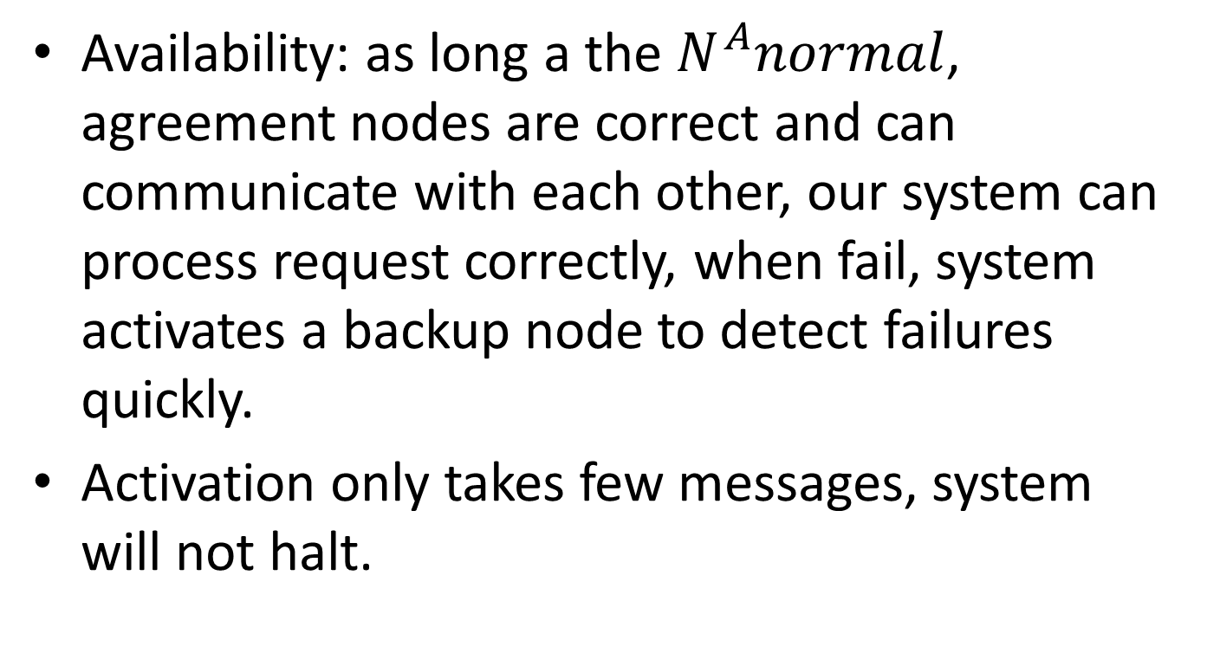
Instant activation for agreement node
Availability: as long a the $N^{A}normal$, agreement nodes are correct and can communicate with each other, our system can process request correctly, when fail, system activates a backup node to detect failures quickly.
Activation only takes few messages, system will not halt.

Slide 14
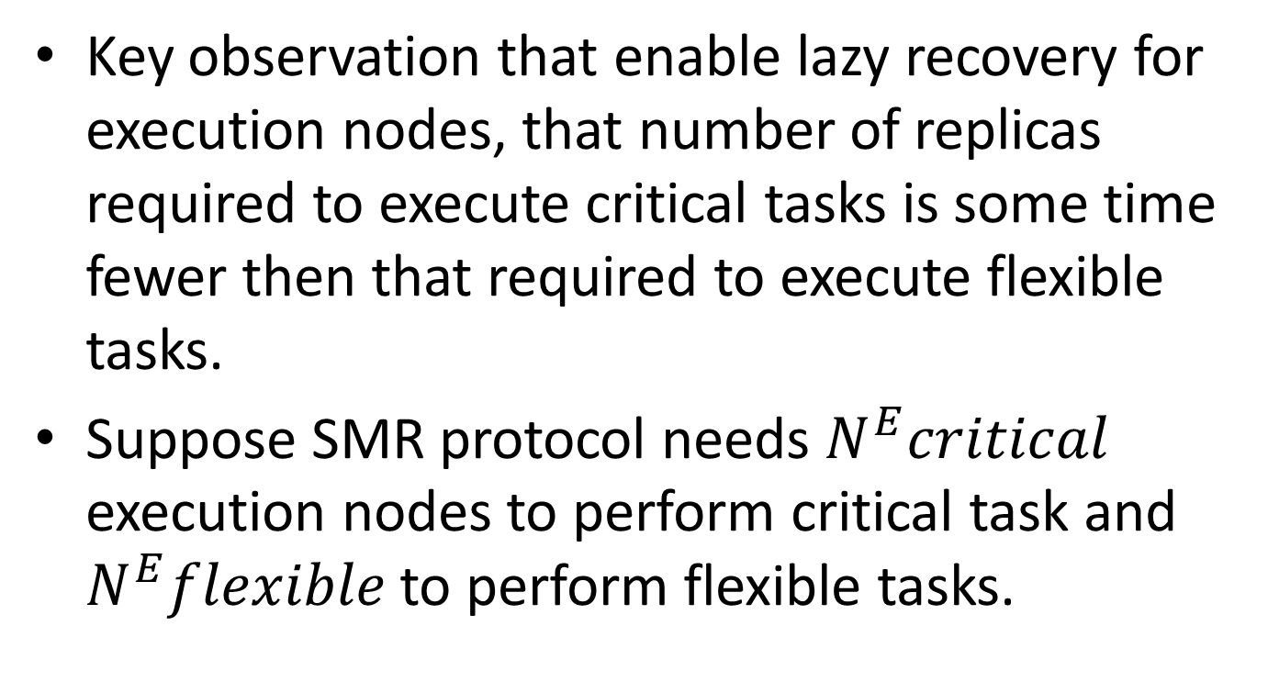
Separating critical and flexible tasks for execution
Key observation that enable lazy recovery for execution nodes, that number of replicas required to execute critical tasks is some time fewer then that required to execute flexible tasks.
Suppose SMR protocol needs $N^{E}critical$ execution nodes to perform critical task and $N^{E}flexible$ to perform flexible tasks.

Slide 15
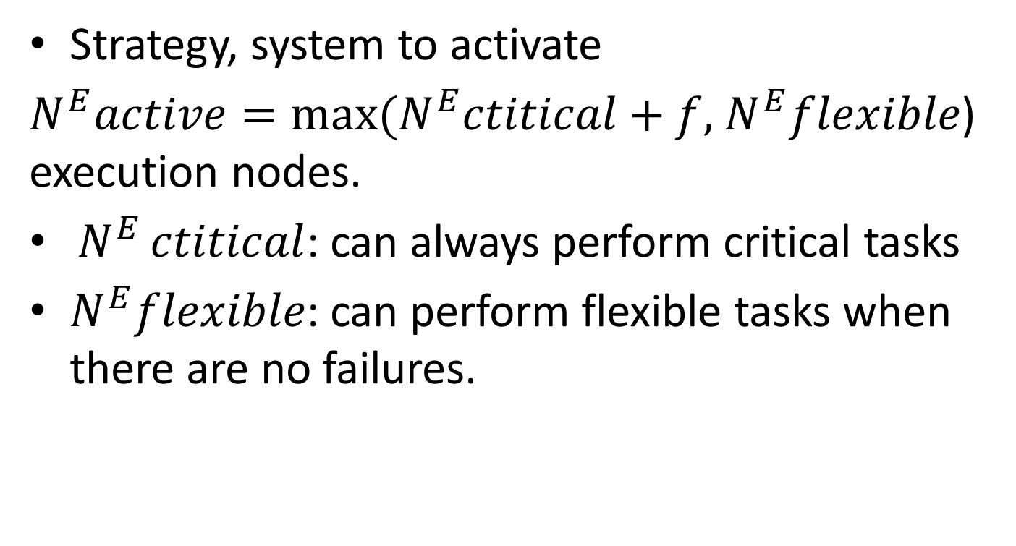
Strategy, system to activate
${N^{E}active=max⁡(N}^{E}ctitical+f,$ $N^{E}flexible$) execution nodes.
${⁡N}^{E}ctitical$: can always perform critical tasks
$N^{E}flexible$: can perform flexible tasks when there are no failures.

Slide 16
Summary
Activate a subset of agreement and execution nodes
When an agreement node fails, ask a blank one to join agreement immediately
When an execution node fails, keep processing requests with remaining execution nodes
Recover nodes later in the background

Slide 17
Adaptive recovery
Recovery can be performed timely manner because of two reasons:
data durability is determined by how frequently machines fail and how fast they can recover. Increase recovery time– data lose.
Flexible tasks, can not perform until recovery is complete. System blocked.

Slide 18
Adaptive recovery
An adaptive approach to meet the deadline specified by the administrator.

Slide 19
Agreement node recovery
A backup agreement node needs to fetch missing log entries from the leader. In this case the leader will perform the above tracking and adaptive control mechanism.

Slide 20
Execution Node Recovery
A backup execution node needs to fetch both the latest snapshot from an active execution node and the log entries afterwards from the leader. In that case both active execution node and the leader need to perform the above tracking and adaptive control mechanism.

Slide 21
Evaluation setup
Approach apply to Paxos, popular replication protocol.
Build thriftyPaxos.
Dell R220 with 8 cores, 16GB RAM, two Hard Drives.
Evaluate Replicated H2( database system), and RemoteHashMap ( benchmark application built by them).

Slide 22
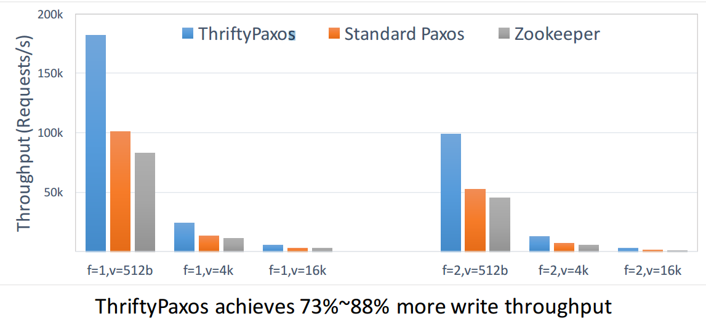
ThriftyPaxos achieves higher throughput

Slide 23
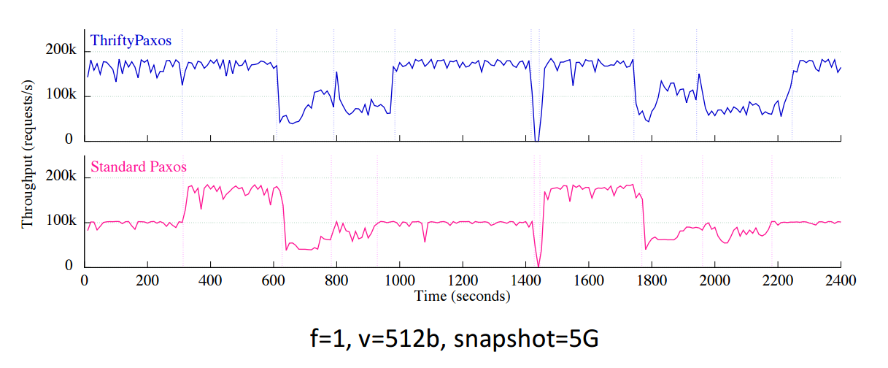
Maintaining availability during failure recovery

Slide 24
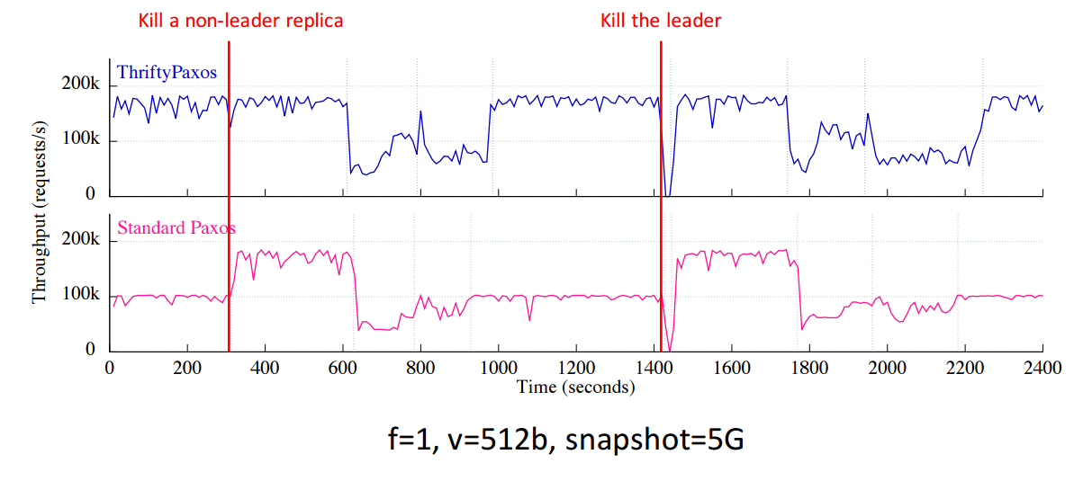
Maintaining availability during failure recovery

Slide 25
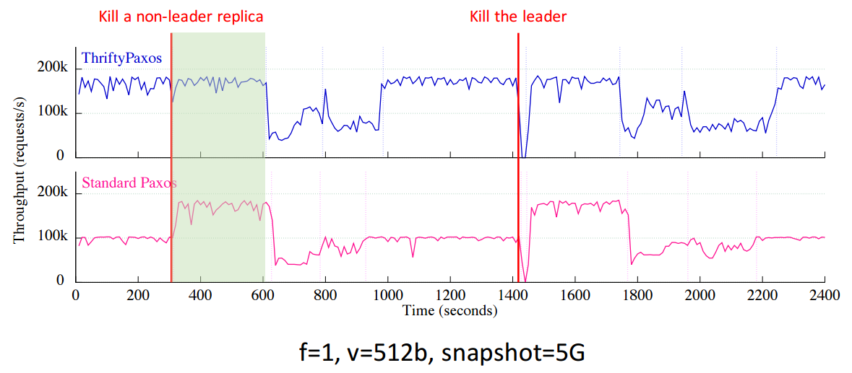
Maintaining availability during failure recovery

Slide 26
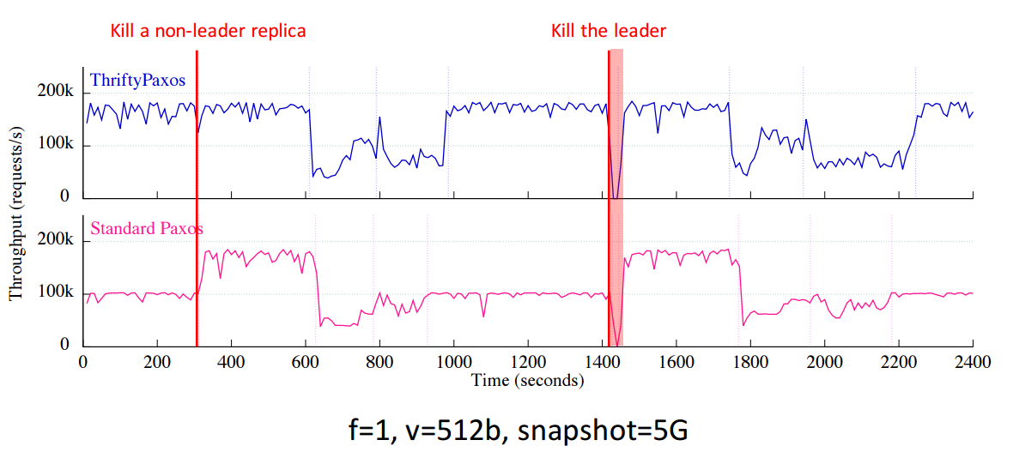
Maintaining availability during failure recovery

Slide 27
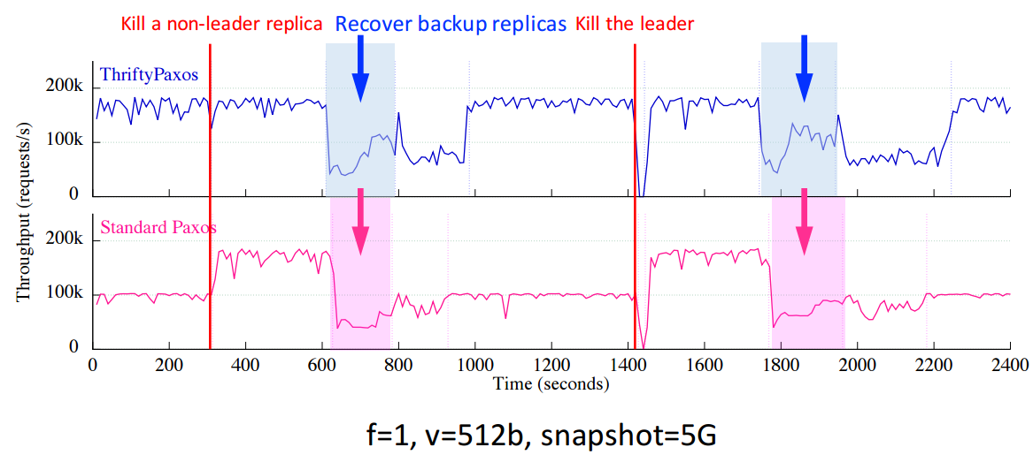
Maintaining availability during failure recovery

Slide 28
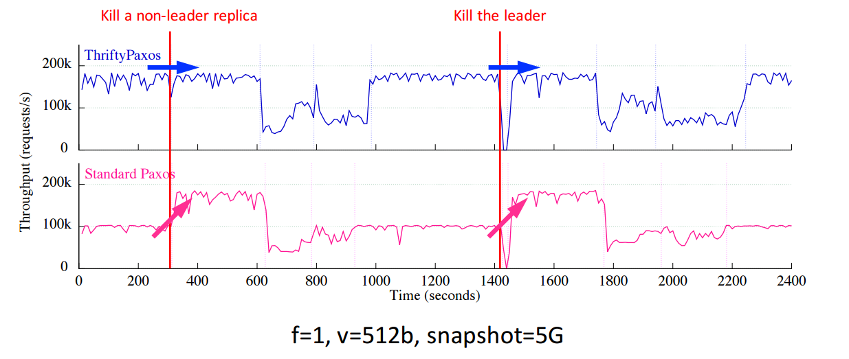
Maintaining availability during failure recovery

Slide 29
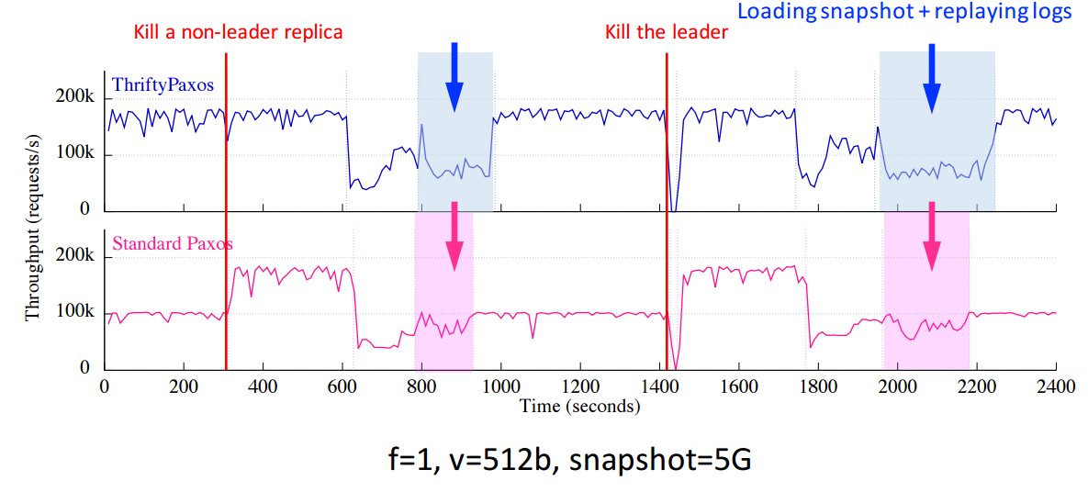
Maintaining availability during failure recovery

Slide 30
Conclusion
Strong replication does not have to be expensive
No need to invent new protocols
Examine conditions for correctness and availability in existing protocols
Combine on-demand instantiation and lazy recovery

Slide 31


