Slide 1
Realizing the Fault-Tolerance Promise of Cloud Storage Using Locks with Intent
Srinath Setty, Chunzhi Su, Jacob R. Lorch, Lidong Zhou, Hao Chen, Parveen Patel and Jinglei Ren
USENIX OSDI’ 16
Presented by: TSogbayr Jargalsaikhan (TSogo)

Slide 2
SUMMARY
Abstract
Cloud computing using com
Problem
need to make cloud computing code robust against failures of the machines running code, and to reason about concurrent access to cloud storage by multiple machines
concurrency faults (data races) in cloud computing
Solution
- locks with intent, which implement in client library called Olive
Keywords
concurrency, web, race detection, asynchrony, non-determinism

Slide 3

Introduction
Amazon AWS, Google Cloud and Microsoft Azure are becoming
popular choice for deploying applications

Slide 4
Introduction
New architecture for cloud compute and storage components of an application are separated:
applications store data on cloud storage
perform computation on a set of client virtual machines

Slide 5
Introduction
This architecture for applications poses an interesting new problems:
client running an application can fail
application processes on those clients can crash
network connecting those clients to the underlying storage can drop or reorder messages
This problem is made even more challenging by the fact that cloud storage services tend to offer limited, low level APIs.

Slide 6
Introduction
This architecture for applications poses an interesting new problems:
client running an application can fail
application processes on those clients can crash
network connecting those clients to the underlying storage can drop or reorder messages
This problem is made even more challenging by the fact that cloud storage services tend to offer limited, low level APIs.

Slide 7
Introduction
New abstraction called locks with intent.
A lock with intent lets a client lock an object in cloud storage as long as it first provides intent describing what it plans to do while holding the lock.
Once locked, the intent gains exclusive access to the object, just a traditional lock in a shared memory.

Slide 8
Introduction
For lock and unlock, they developed client library Olive.
Olive can work with any such storage service unchanged by using shim that translate the service’s API to model’s API

Slide 9
Building cloud applications: challenges
Cloud applications typically run on multiple client VMs and store state on cloud: the client VMs are used only for computation and are effectively stateless.
Different cloud storage services offer different, constantly-evolving APIs.

Slide 10
A Common storage model
common storage model
an API that has enough features to support Olive but is simple enough to be implemented by any cloud storage service.
This model is that of storage system providing schema-less tables. Each table row, also called an object, consists of a key and a set of attribute/value pairs.
A table may be divided into partitions to satisfy a system-imposed limit on maximum partition size.

Slide 11
A Common storage model: API
The model’s API includes operations to
CRUD
Create
Read
Update
Delete
Scan
takes table and predicate as parameters, and returns a stream providing all rows in that table satisfying that predicate.

Slide 12
A Common storage model: API
The model’s API includes operations to
UpdateIfUnchanged
is like UPDATE, except it does nothing if the object to be updated has been updated or deleted since certain previous operation on that object.
AtomicBatchUpdate
lets the applications perform multiple update and insert operatioins atomically.

Slide 13
A Common storage model: Invisible Entries
It always possible to put invisible entries in a scope
They should be used sparingly since they reduce performance and capacity. They reduce performance when an access to a real entry necessitates one or more accesses to invisible entries.
They reduce capacity by using space that could otherwise be used for application data.

Slide 14
A Common storage model: Lock
The primitives provided by the storage interface can be used to implement other useful client functionality.
It gets the lock if and only if that update succeeds. To release the lock, the client resets the locked bit via another update.

Slide 15
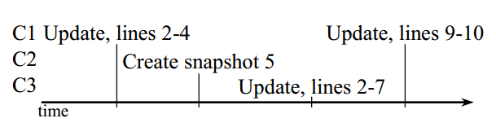
Cloud computing - Concurrency fault
Execution race example:

Slide 16
Locks with intent
Olive introduces lock with intent, which ensure exactly-once execution (despite failures) and mutual exclusion (for concurrent operations)
Olive does not and scalability characteristics of existing storage services.

Slide 17
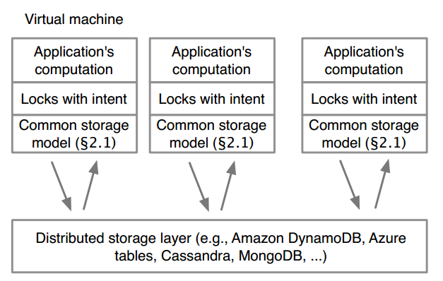
Olive’s high level architecture:

Slide 18
Locks with intent: Intents
an intent is a request for certain code snippet to be executed exactly once.
Exactly-once execution of an intent is challenging because:
the initiating client may fail partway through executing it
other clients attempting to recover from the initiator’s failure may lead to multiple, possibly concurrent, client executing intent.

Slide 19
Locks with intent: Intents: DAAL
Most cloud storage services do not support atomic actions across tables.
Olive introduces novel logging scheme called DAAL (Distributed Atomic Affinity Logging).
With DAAL, executionLog consists of 2 parts:
regular table that stores result of completed read operations
set of invisible entries that stores log entries corresponding to writes.

Slide 20
Locks with intent: Intents: DAAL
Most cloud storage services do not support atomic actions across tables.
Olive introduces novel logging scheme called DAAL (Distributed Atomic Affinity Logging).
With DAAL, executionLog consists of 2 parts:
regular table that stores result of completed read operations
set of invisible entries that stores log entries corresponding to writes.

Slide 21
Applications and Experience
Locks with intent make it easy to reason about desirable correctness and fault-tolerance properties of software.
Olive’s 4 main libraries:
STable library
Live table re-partitioning
Secondary indices
Transactions

Slide 22
Snapshots: STable library
A snapshot is a “point in time image” of a virtual guest operating system (VM). That snapshot contains an image of the VMs disk, RAM, and devices at the time the snapshot was taken
source: http://www.virtualizationadmin.com/faq/snapshot.html
for snapshots of tables.
the fundamental reason the bug arises is the difficulty of reasoning about the many possible interleavings of concurrent clients.

Slide 23
Live table re-partitioning
Exports a facility for live re-partitioning of tables. This functionality is crucial if a table may grow to the point where it exceeds system-imposed size limit.
Secondary indices
library that supports constructing, maintaining, and using secondary indices.
Olive provides a natural solution to eventually consistent secondary indices.

Slide 24
Transactions
library that augments the cloud storage API with the ability to form transactions out of an arbitrary collection of operations.
based on optimistic concurrency control, which has three phases:
shadow execution
verification
update in place

Slide 25
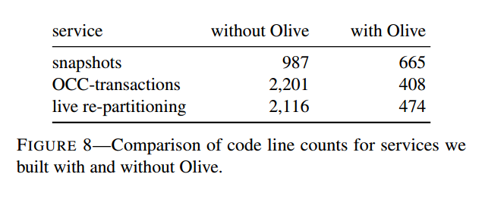
Evaluation: Comparison of Olive

Slide 26
Olive: Implementation
Approximately:
2000 lines of C# codes
Setup and Method:
G3 VM instance
8 core Intel Xeon E5 v3 family with 112 GB RAM
Windows Server 2012 R2
Finally Olive-based snapshotting service uses a NoSQL

Slide 27
Issues and discussions:
Olive related issues:
comparison of transactions (only support for exactly-once)
liveness of intents (some intent contain bugs leading to infinity loops, crashes, or deadlocks)
garbage collection of intent logs
security and privacy
cloud support (natively add to cloud support)

Slide 28
Conclusion:
Cloud applications atop distributed reliable cloud storage services represent a new model of building fault-tolerant distributed systems, where all coordination at the application layer goes through cloud storage, without the need to re-implement consensus protocols.

Slide 29
Thank you for your attention.
any questions?

