Slide 1
Unsafe Time Handling in Smartphones
Abhilash Jindal, Prahlad Joshi,
Y.Charlie Hu, Samuel Midkiff
Purdue University
USENIX ATC’ 16
TSogbayr Jargalsaikhan (TSogo)

Slide 2
SUMMARY
Abstract
This paper presents the first study of new class of software bugs on smartphones called sleep-included time bugs (SITB).
Problem
Battery problem
Time usage
Sleep-included time (bugs 4cases)
Solution
KLOCK tool
Keywords
Smartphone, SITB, software bugs, kernel

Slide 3
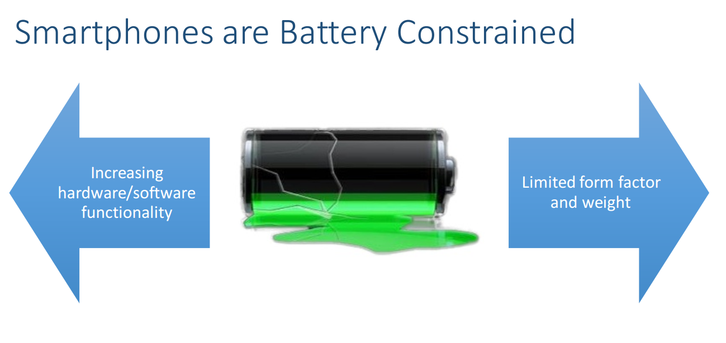
Introduction

Slide 4
Introduction
Smartphone problems
Power requirement
Power supply
Battery life

Slide 5
Background
Desktop/Server: CPU Default ON
CPU turned off when idle for long time
Smartphones: CPU Default OFF
Smartphone OSes aggressively turn off Screen/CPU after brief user inactivity
Helps increasing standby time period

Slide 6
Timekeeping in Linux
The Linux timekeeping subsystem is responsible for maintaining and providing current time to the rest of the kernel.
CLOCK_REALTIME
CLOCK_BOOTTIME
CLOCK_MONOTONIC
CLOCK_MONOTONIC_RAW

Slide 7
PROBLEM?

Slide 8
Sleep-Induced Time bugs
SITB happens when the smartphone CPU/SOC is suspended in the middle of a time manipulation
Alters intended program behavior
Hard to reproduce • Will only happen when CPU sleeps when the code execution is between time manipulation

Slide 9
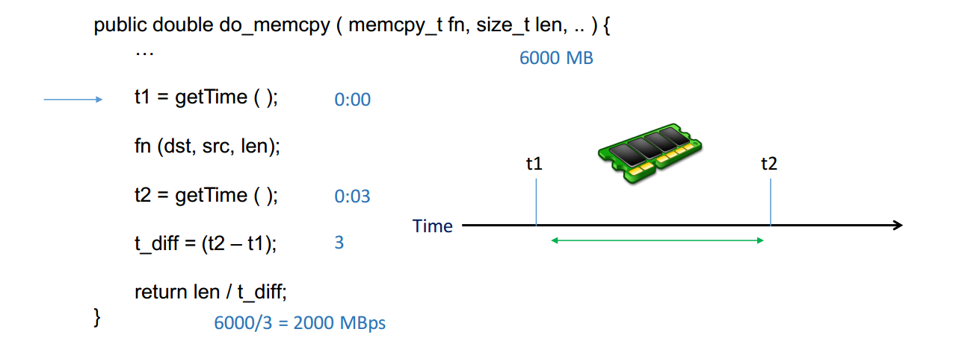
Sleep-Induced Time bugs (Ex:)

Slide 10
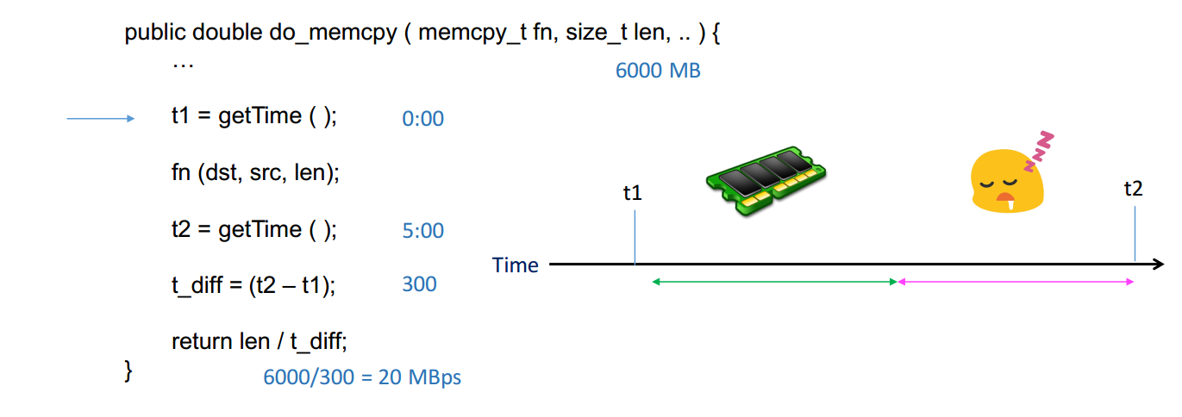
Sleep-Induced Time bugs (Ex:)

Slide 11
Time usage in Android
Collected list of time related APIs exposed at each software layer and grepped them
 | Kernel | Android Framework | 978 Apps
Time usages | 1072 | 1737 | 7798
Usages belong to four categories
Timed Callback
Time setting
Time arithmetic
Logging

Slide 12
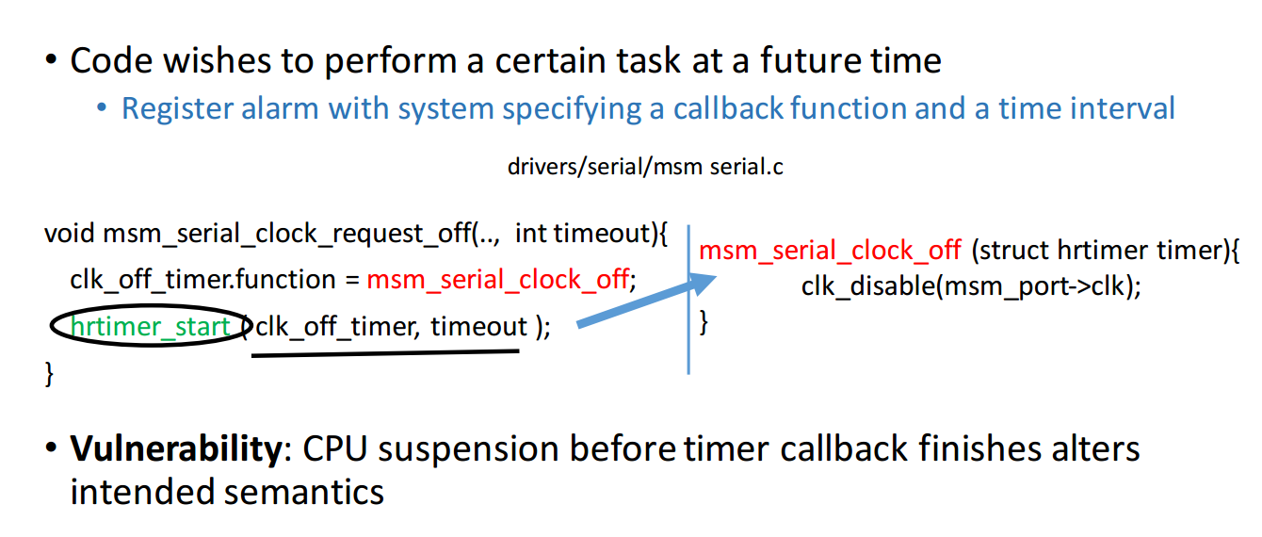
Case 1: Timed Callback

Slide 13
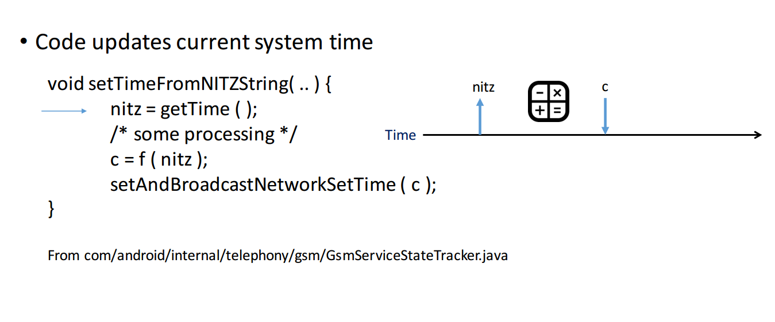
Case 2: Time Settings

Slide 14
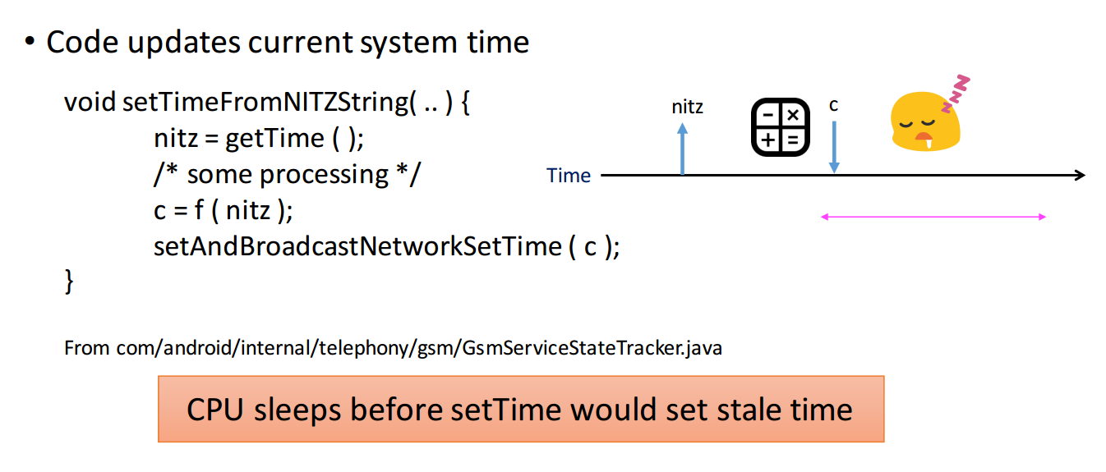
Case 2: Time Settings vulnerability

Slide 15
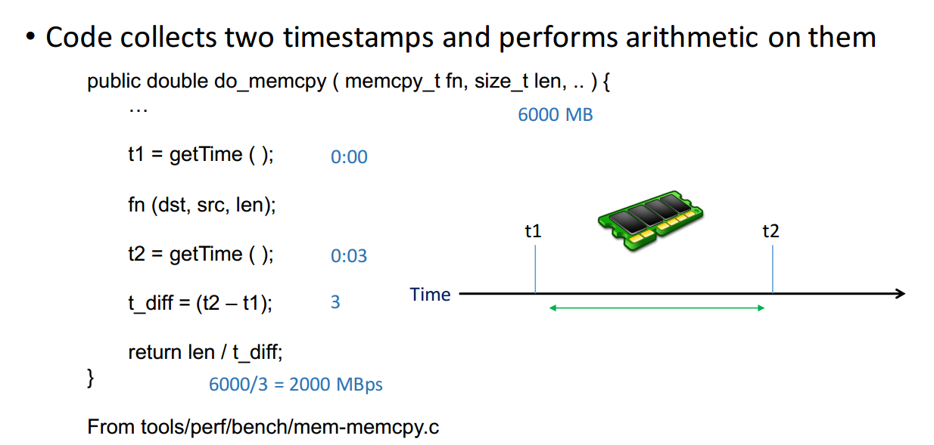
Case 3: Time arithmetic

Slide 16
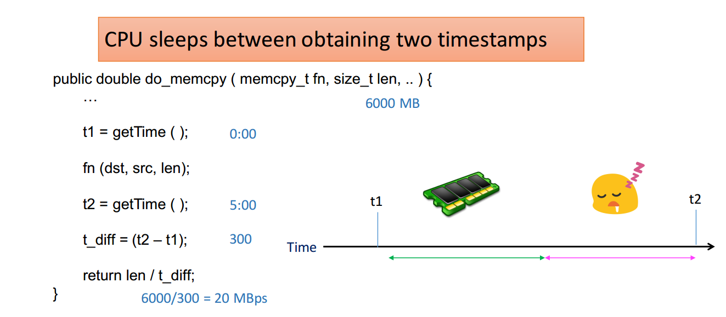
Case 3: Time arithmetic vulnerability

Slide 17
Case 4: Time logging
Code obtains current time and logs it in conjunction with some event
Usually for postmortem debugging
Vulnerability: CPU suspension in between event and its timestamping will result in an incorrect timestamp being logged for the event.

Slide 18
SOLUTION?

Slide 19
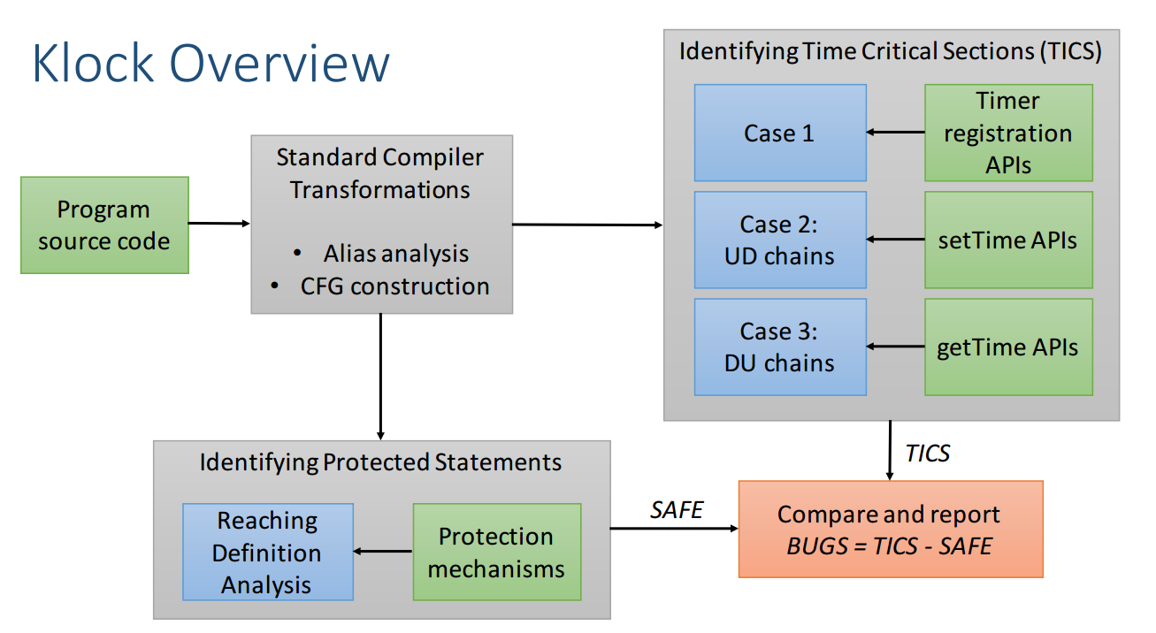
Klock tool

Slide 20
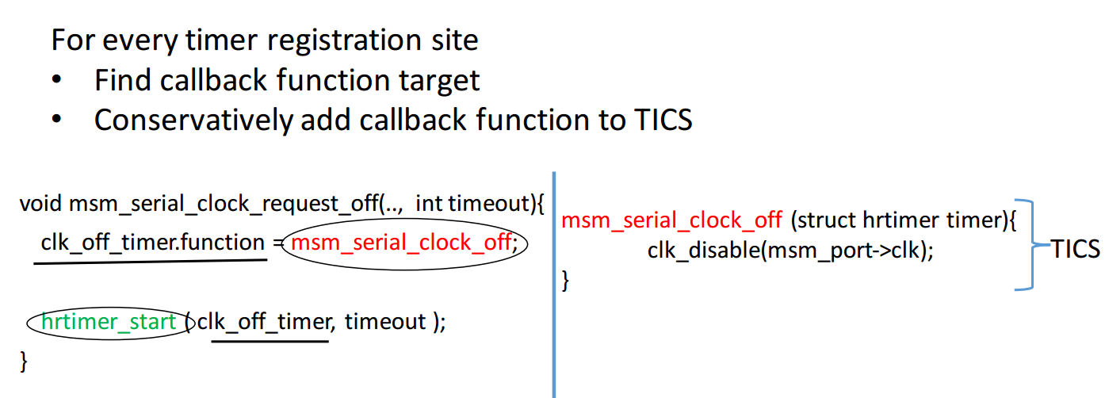
Identifying Time Critical Section Case 1: Timed Callback

Slide 21
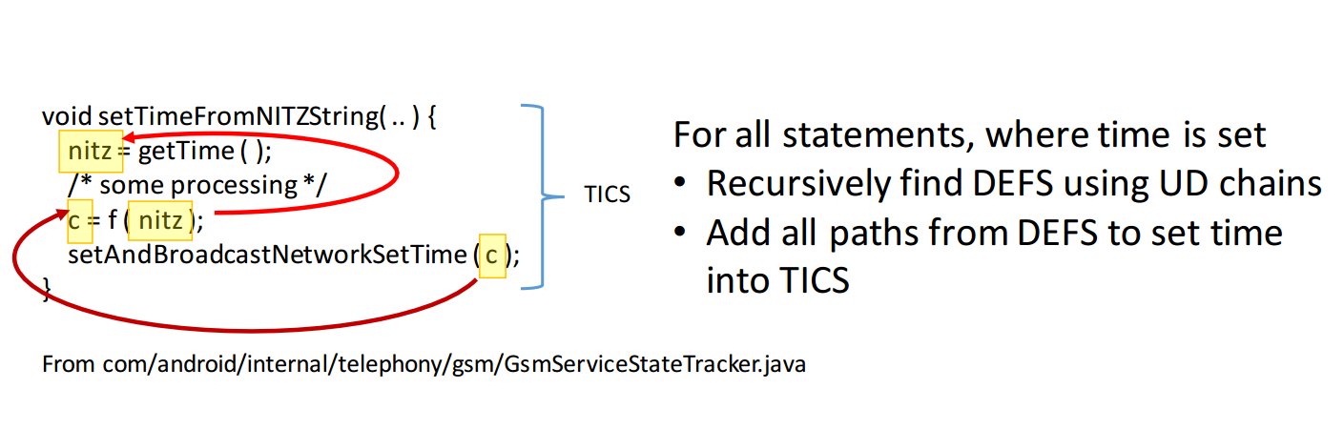
Identifying Time Critical Section Case 2: Time Settings

Slide 22
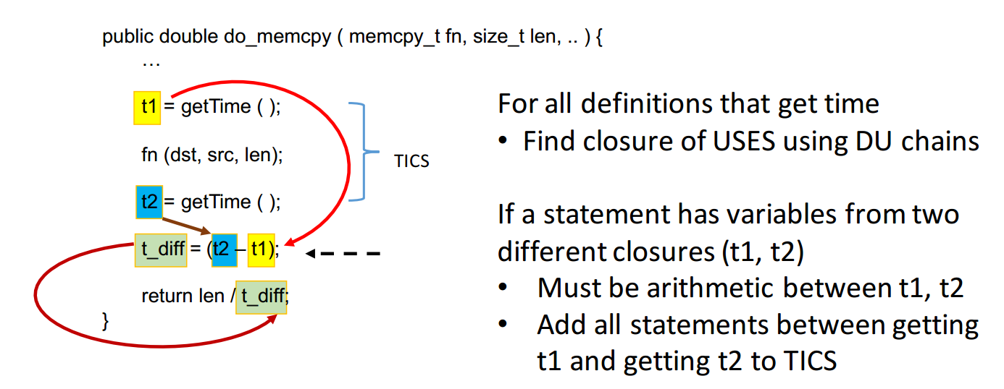
Identifying Time Critical Section Case 3: Time Arithmetic

Slide 23
Implementation
Built on LLVM compiler infrastructure
1 custom pass to build call graph
4 custom passes for identifying protected statements and identifying TICS (case 1,2, 3)
5 KLOC
Available at http://github.com/klock-android

Slide 24
Evaluation
Klock on 5 different kernel versions Nexus 1, Nexus 7, Nexus 10, Nexus S and x86 (with wakelocks enabled)
Found 63 bugs
4 timed callback bugs, 0 time setting bugs, 59 time arithmetic bugs
14 have been fixed, 7 files have been removed in newer kernel versions
Out of 42 remaining, 7 developers replied so far confirming the bugs

Slide 25
Bugs (63) breakdown
Correctness related bugs (18)
6 drivers incorrectly measure pulse width hence reading wrong received data
5 radio drivers incorrectly measure clock rate necessary to decode the incoming data
7 other miscellaneous bugs
Performance related bugs (15)
8 drivers spin for an extended period of time leaving device unusable
4 code locations call sleep for a long time
3 drivers keep their devices on longer than necessary wasting energy
Benchmark bugs (30)

Slide 26
Bugs (63) breakdown
106 False positives
Suspension does not affect program semantics
driver generates a random number using timer arithmetic
System calls
System calls (eg sys_settime) are just wrappers of actual time setting APIs and do not have suspension prevention mechanism

Slide 27
Conclusion
Sleep Induced Time Bugs
Time manipulation form Time Critical Sections
CPU suspension during Time Critical Sections lead to the bugs
Time is widely manipulated in Android Ecosystem
Timed callback, Time setting, Time arithmetic and Logging
Klock tool (detects SITB)
Static checker built using reaching definition analysis, UD/DU chains
Found 63 bugs in the kernel
http://github.com/klock-android

