Slide 1
Omid, Reloaded: Scalable and Highly-Available Transaction Processing
Ohad Shacham, Francisco Perez-Sorrosal, Edward Bortnikov,
Eshcar Hillel
Dong-su Lee
2017-05-08

Slide 2
Summary
Topic
large-scale distributed transaction processing
Problem
stages process data items in parallel, subject to data races
to limited scalability in the number of clients,
Solution
Omid; transaction processing service;
ACID transaction processing system for key-value stores

Slide 3
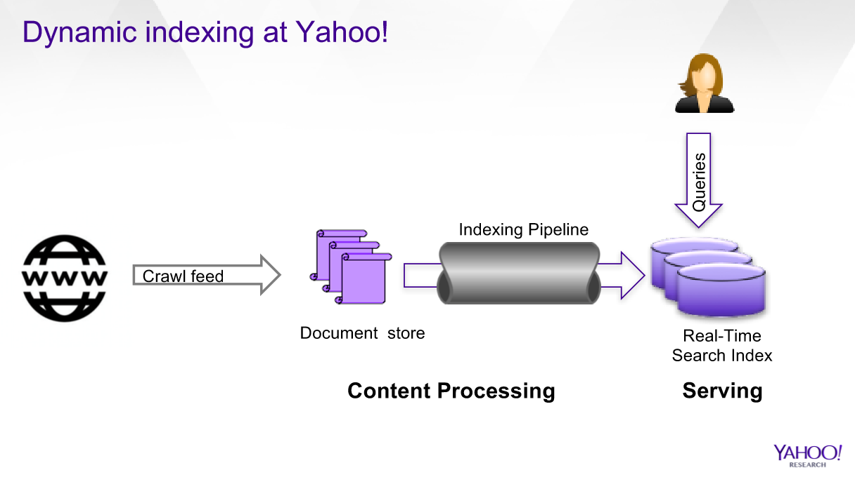
Introduction

Slide 4
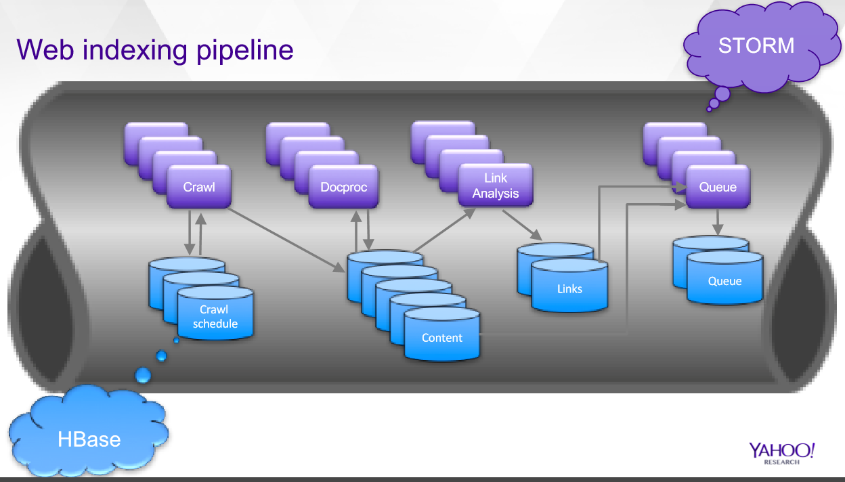
Introduction

Slide 5
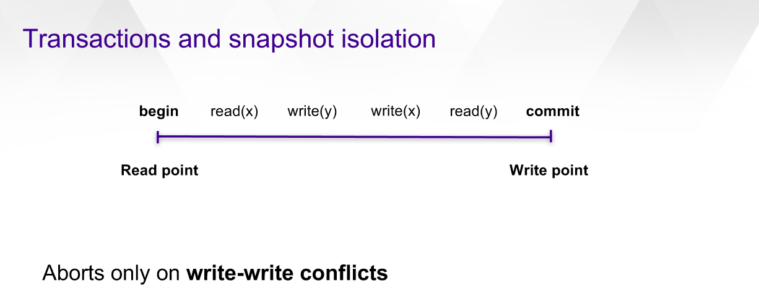
Introduction

Slide 6
Contribution
Scalability
providing snapshot isolation (SI)
using TM & scale-out of metadata (HBase)
High availability
TM is implemented as a primary-backup process pair

Slide 7
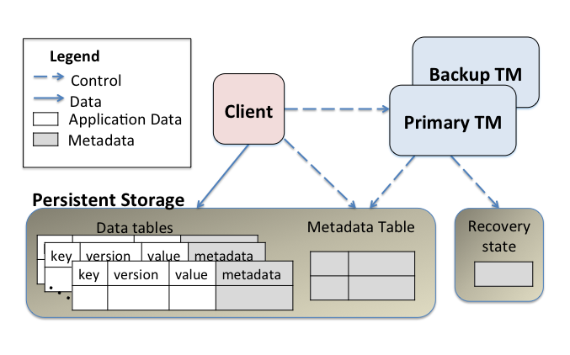
Omid architecture

Slide 8
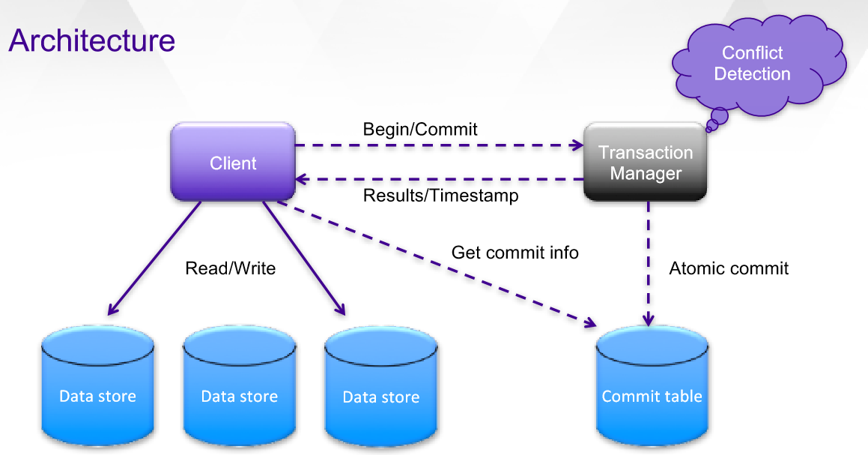
Omid architecture

Slide 9
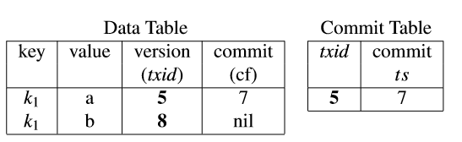
Data and metadata
Commit Table
to track transaction states
tentative

Slide 10
Service Semantics
ACID properties:
atomicity (all-or-nothing execution),
consistency (preserving each object’s semantics),
isolation (in that concurrent transactions do not see each
other’s partial updates),
durability (whereby updates survive crashes)
multi-versioning
Omid leverages; for consistent snapshots for SI

Slide 11
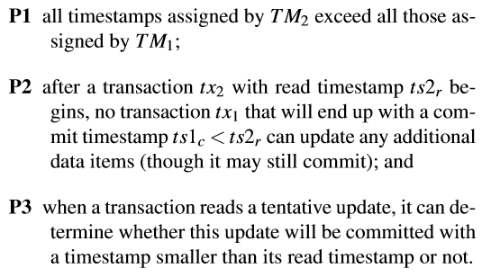
HA algoritm
Upon failover from TM1 (the old primary) to TM2 (the new one), following properties :

Slide 12


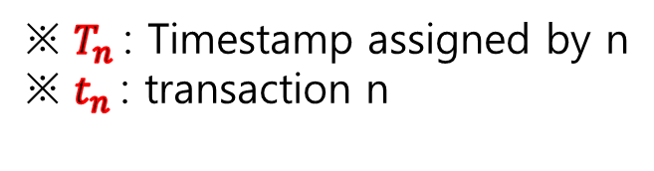

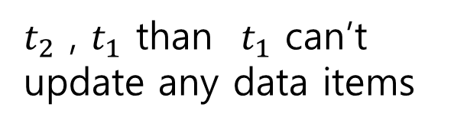




HA algorithm
P1
P3
$$T_{New}$$
$$U_{x}∈tative update$$
determine T
$$T_{Old}$$
$$T_{U}$$
$$T_{a}$$
P2
$$T_{2}$$
$t_{2}$ , $t_{1}$ than $t_{1}$ can’t update any data items
$$T_{1}$$
※ $T_{n}$: Timestamp assigned by n
※ $t_{n}$: transaction n

Slide 13
HA algorithm
P1 - commit timestamps continue to be totally ordered by commit time
P2 - ensures that a transaction encounters every update that must be included in its snapshot,
P3 - stipulates that the transaction can determine whether to return any read value.

Slide 14
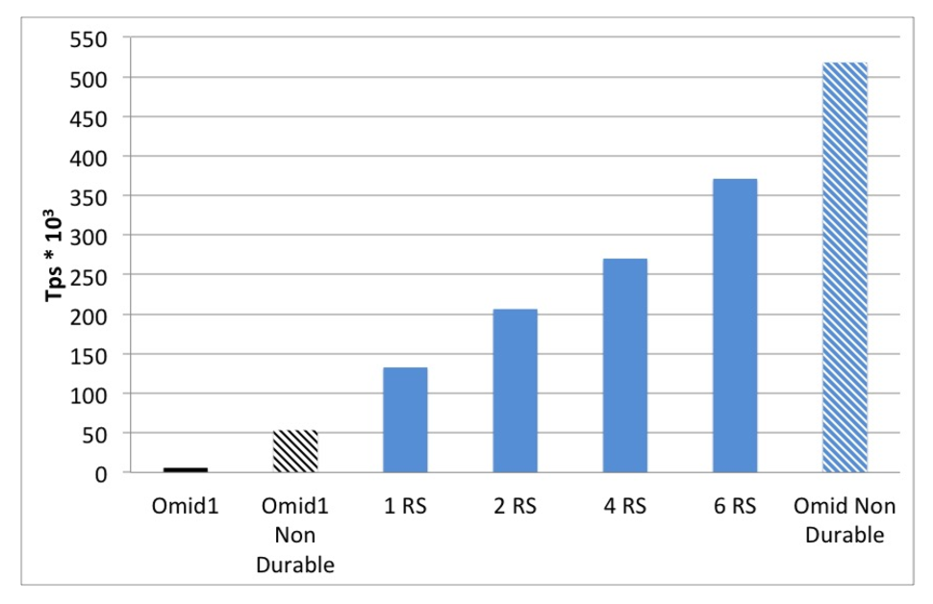
Evaluation
Scalability
※ HBase region servers

Slide 15
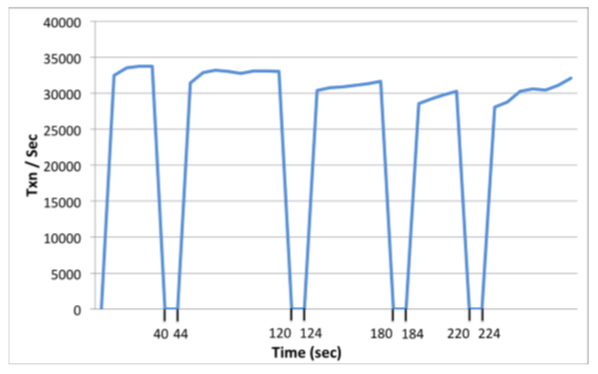
Evaluation
High availability

Slide 16
conclusion
Omid1 : did not employ a CT, but TM send clients information about all pending transactions
to limit scalability in the number of clients
Transaction : important use case in stream proc.
Omid : transaction processing service
Provide ACID properties :
Atomicity, Consistency, Isolation, durability

