Slide 1
Caching Doesn’t Improve Mobile Web Performance (Much)
Jamshed Vesuna, Colin Scott, Michael Buettner,
Michael Piatek, Arvind Krishnamurthy and
Scott Shenker
USENIC ATC ‘16
presented by: TSogbayr Jargalsaikhan (TSogo)

Slide 2
Summary
topic
Understand the effects of caching on mobile web performance
problem
recent paper reported that increasing the cache hit ratio for an HTTP proxy from 22% to 32% improved
solution
argue and prove that

Slide 3
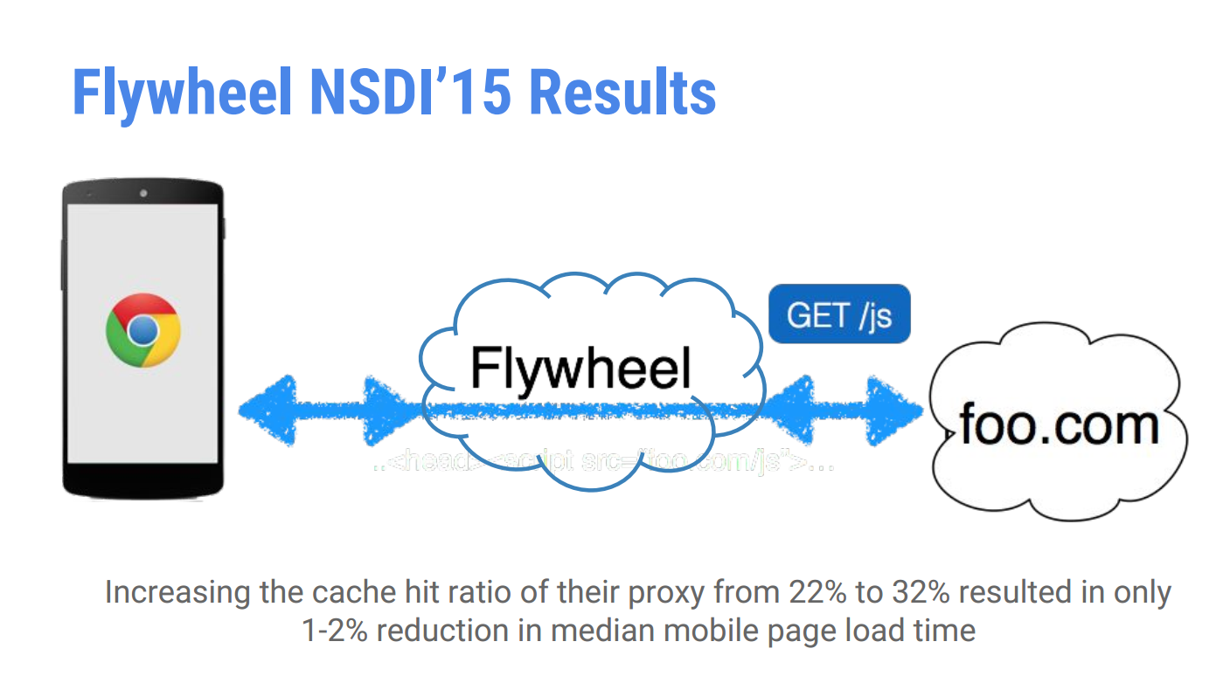
Flywheel NSDI’15 results

Slide 4
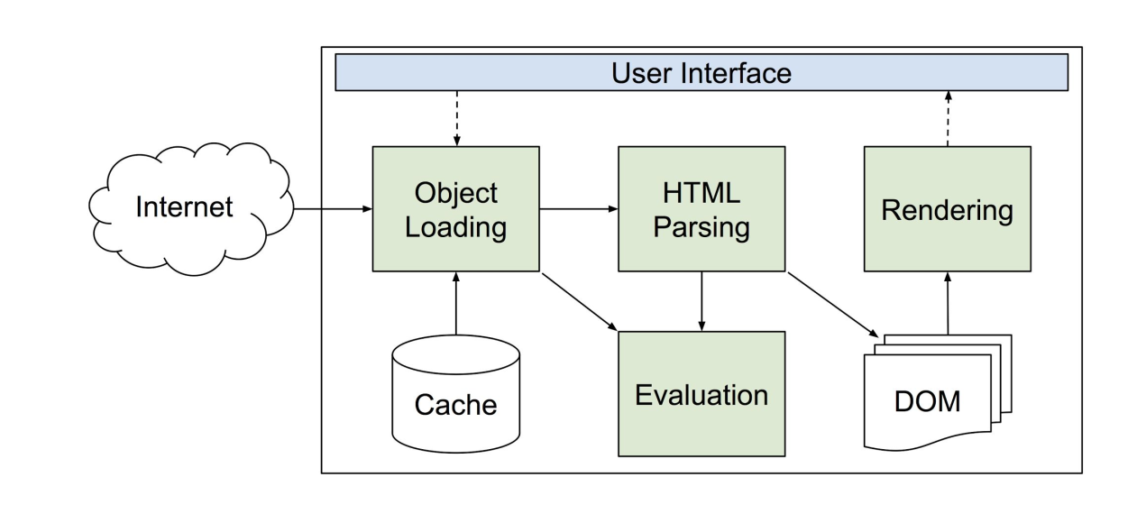
Background - Loading web pages

Slide 5
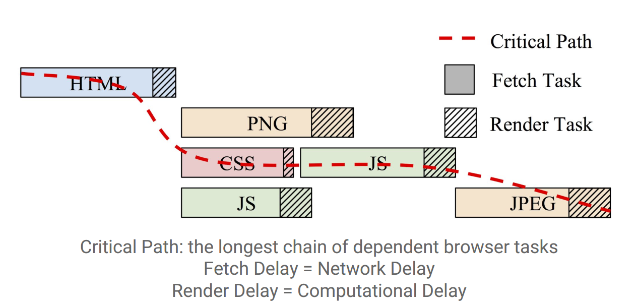
Background - Critical Path

Slide 6
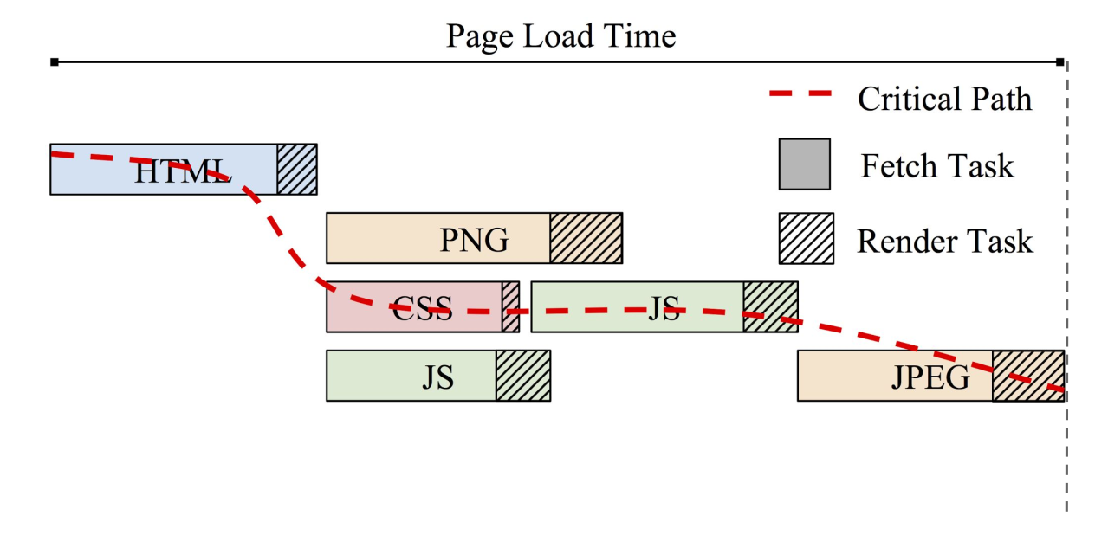
Background - Page Load Time (PLT)

Slide 7
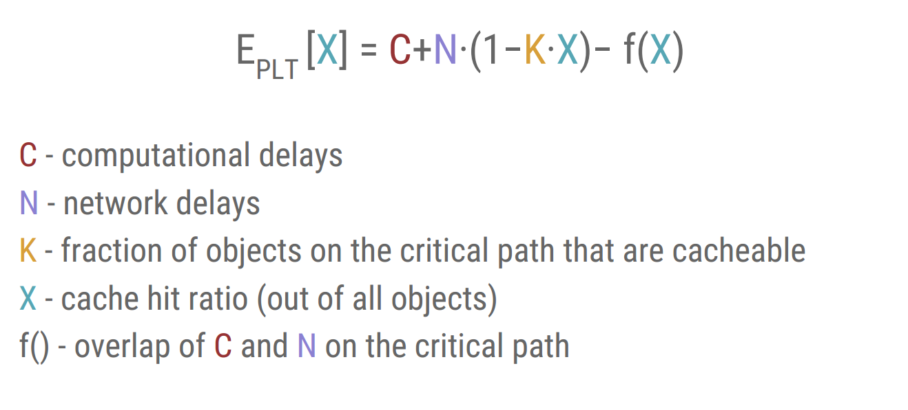
Performance Model - Estimating PLT

Slide 8
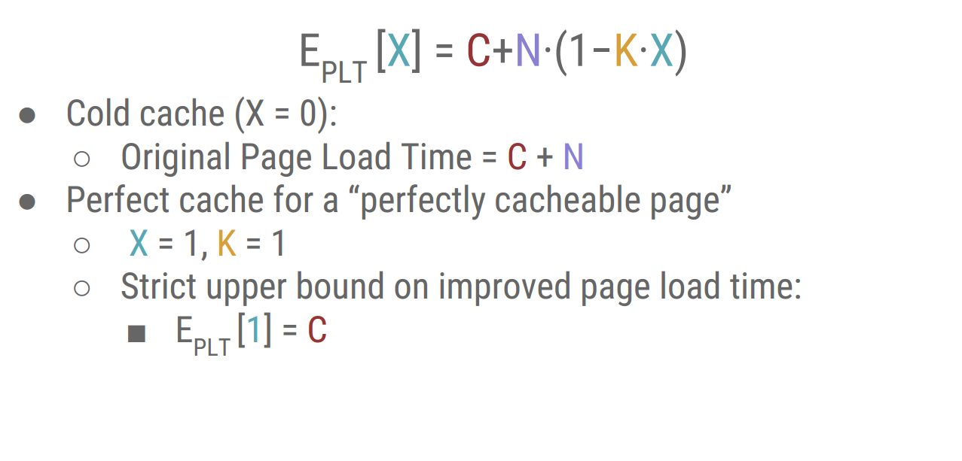
Performance Model - Building an Intuition

Slide 9
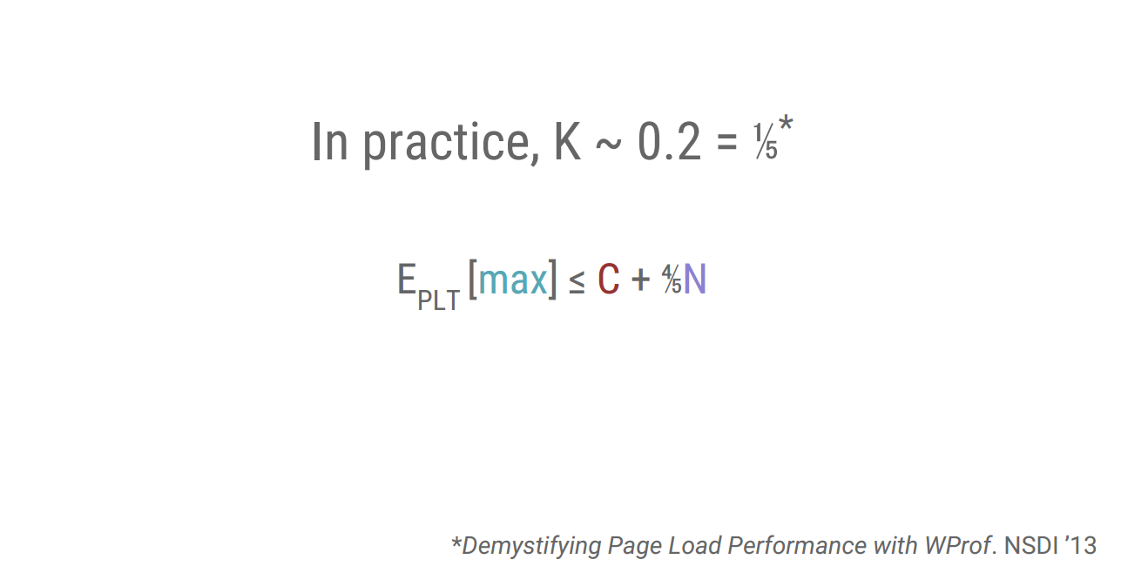
Performance Model - Fitting K

Slide 10
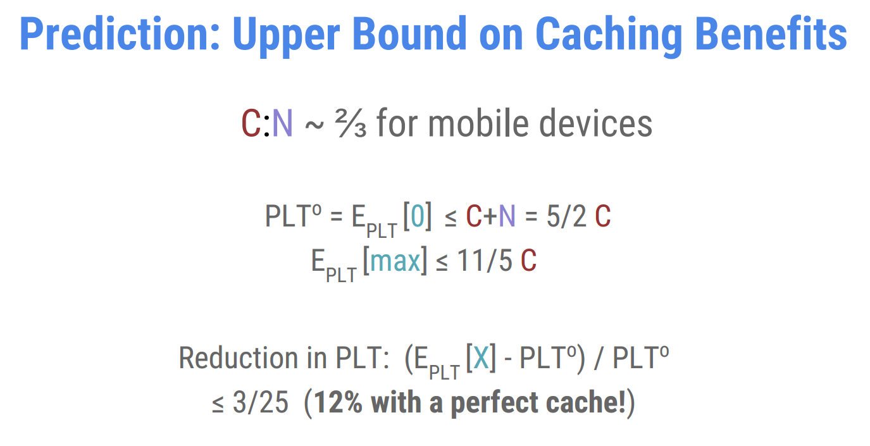

Slide 11
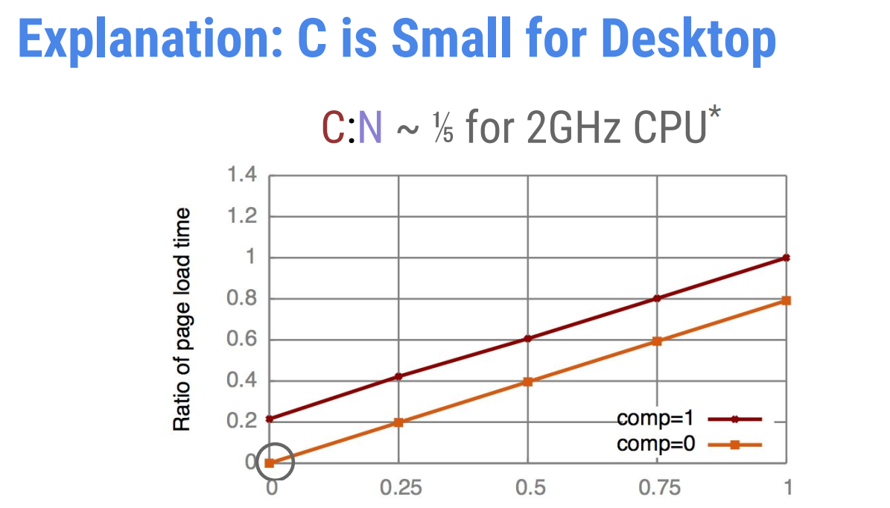
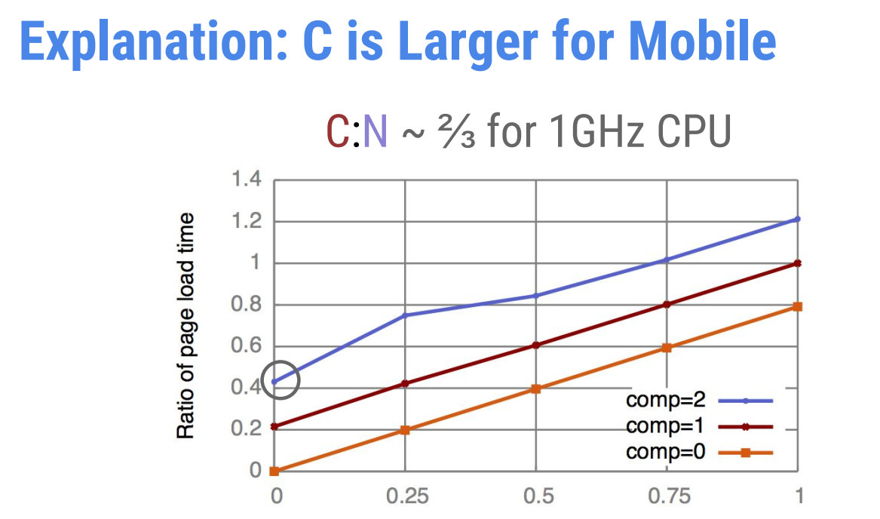

Slide 12
Experimental Apparatus
makes use of:
Telemetry
Web Page Replay
both are part of Chromium, OS components of Google Chrome.

Slide 13
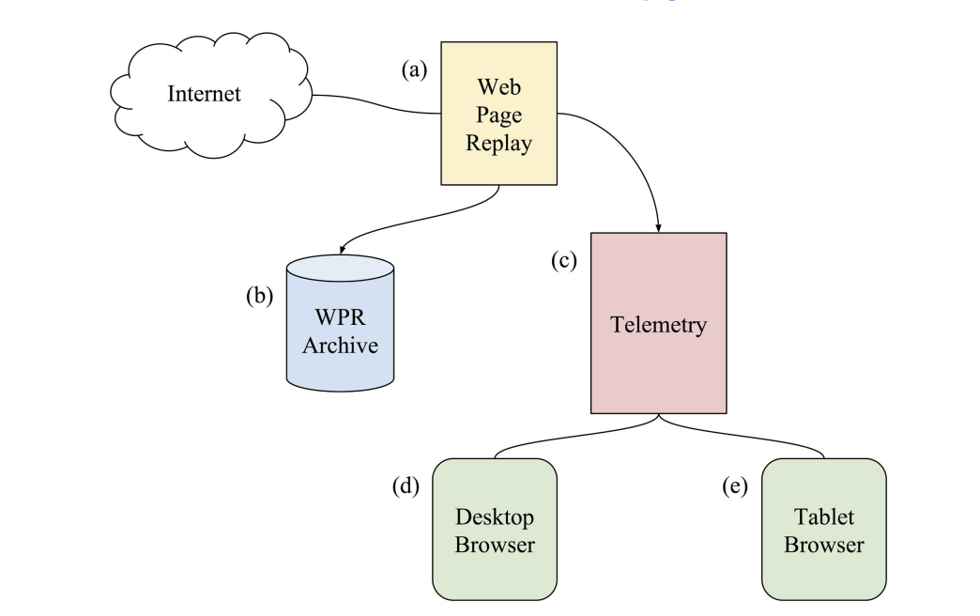
Experimental Apparatus Workflow

Slide 14
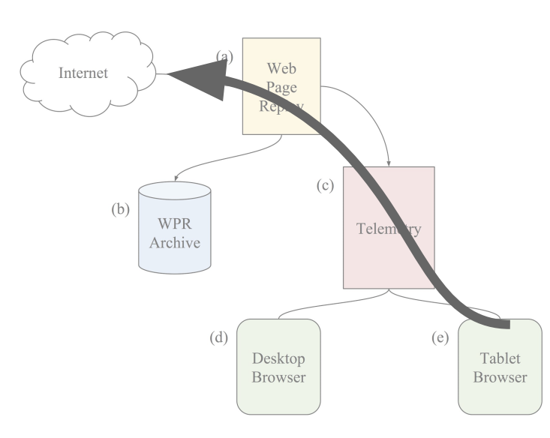
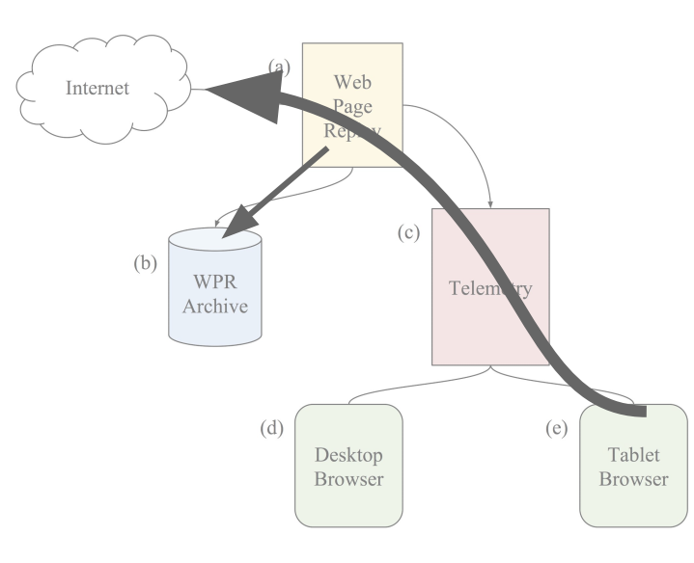
Measurement Methodology
Record the original page

Slide 15
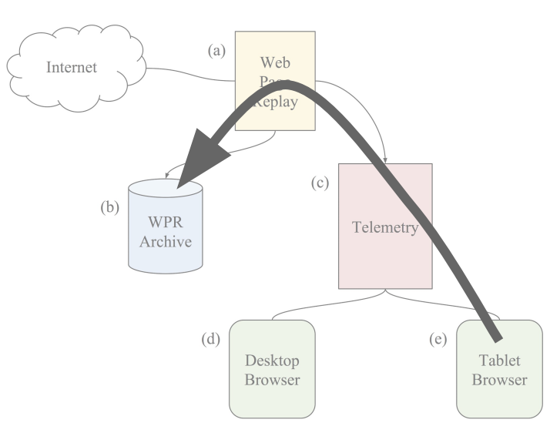
Measurement Methodology
Record the original page
Then, replay with:
With a “perfect cache”
or a “partial cache”

Slide 16
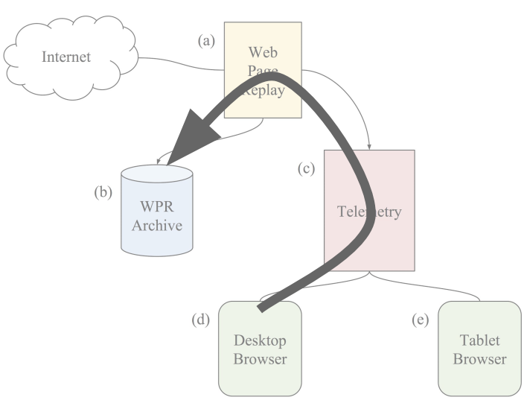
Measurement Methodology
Record the original page
Then, replay with:
With a “perfect cache”
or a “partial cache”
Repeat

Slide 17
Specifications:
Each web page was originally fetched over UC Berkeley’s LAN
down: 250Mbps, up: 230Mbps
Mobile Device: Galaxy Tab 4
1.2GHz quad-core processor
1.5GB on board RAM
Android 4.4, KitKat
Desktop results: virtual machine
3.2GHz quad-core processor
6GB RAM

Slide 18
Workload Characteristics:
Data Set:
random subset for 400 of Alexa top 2000 URLs and loaded their root URL (‘/’)
Fraction of Cacheable bytes:
over 90% of web pages have more than 90% of their total bytes marked as cacheable
Total Bytes:
while 95% of web pages are under 6.8MB, the media web page size is less then 1.2MB
Initial Network Delays:
the median delay between sending/receiving the first response byte was 50ms, with mean of 151.17ms and standard deviation of 403.77ms

Slide 19
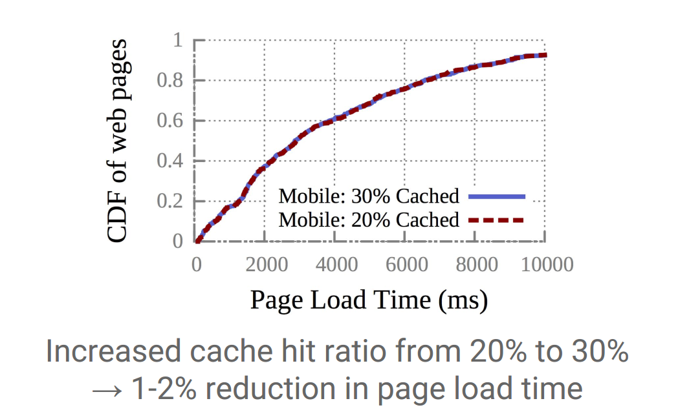
Performance Result:
caching doesn’t significantly reduce mobile PLT

Slide 20
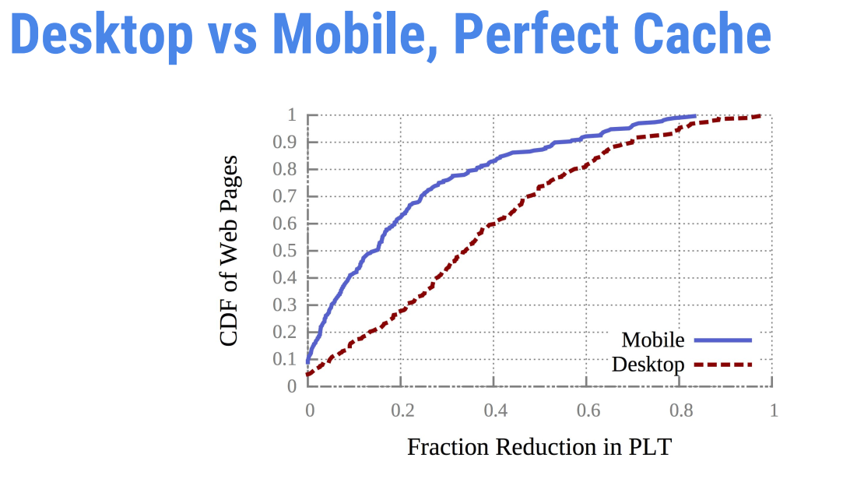
Performance Result:
caching doesn’t significantly reduce mobile PLT

Slide 21
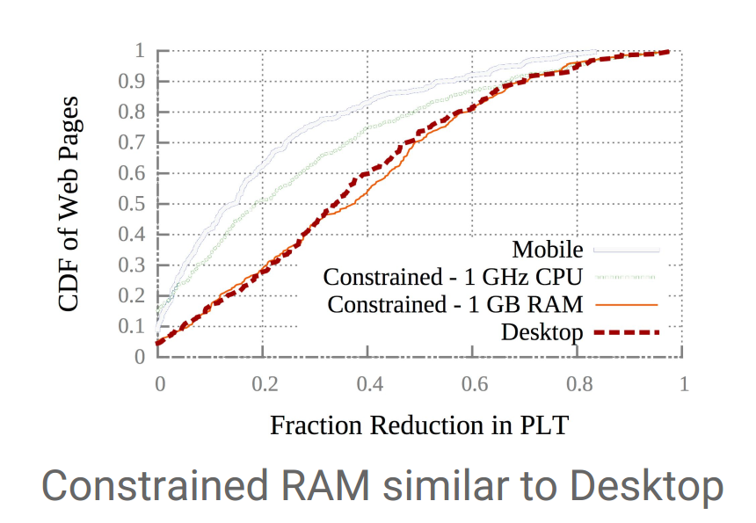
Performance Result:
Limited RAM doesn’t affect computational delays:

Slide 22
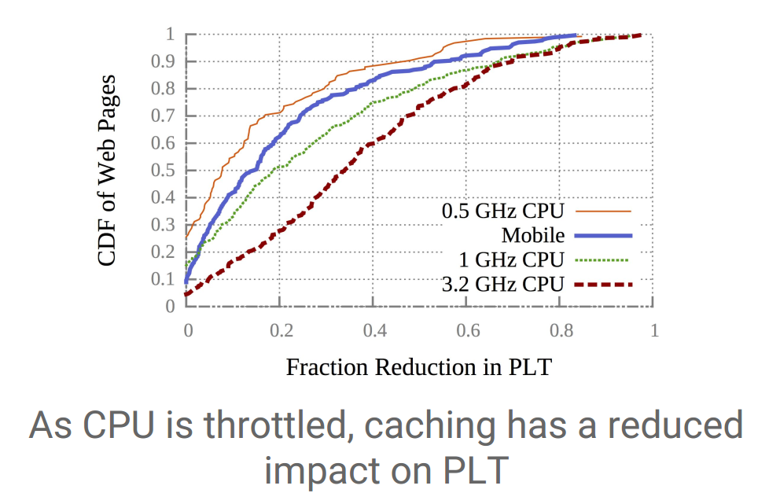
Performance Result:
Slow CPU Speeds increase computational delays:

Slide 23
What we learnt:
Slower CPUs increase computational delays (C)
For desktop, network delay (N) dominates (C)
For mobile, network delay (N) is comparable to (C) (3:2)
Caching only reduces (N)
Mobile devices benefit less from web caching

Slide 24
Conclusion:
Content providers:
Stop paying for CDN’s (for mobile users)
Analyze what’s on the critical path:
Cache critical path items
Make use of SPDY* or HTTP/2 prioritization levels
*SPDY - Open-specification networking protocol that was developed primarily at Google for transporting web content.

Slide 25

Thank you for you attention.
Any questions?

