Slide 1
Algorithms and Data Structures for Efficient Free Space Reclamation in WAFL
Ram Kesavan, Rohit Singh, Travis Grusecki and Yuvraj Patel
FAST17
Dong-su Lee
2017-05-28

Slide 2
Summary
Topic
Free Space Reclamation in WAFL
Problem
high performance requirements
Solution
Free Space Reclamation;
Summary map; BFLog

Slide 3
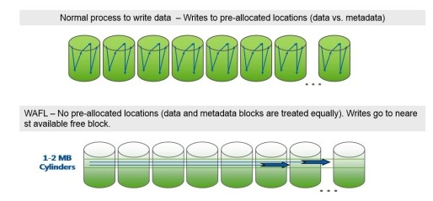
Write Anywhere File Layout (WAFL)
transactional file system
uses the copy-on-write mechanism
fast write performance and efficient snapshot creation

Slide 4
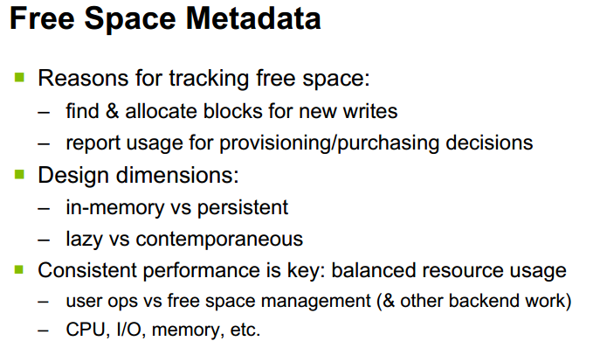

Slide 5
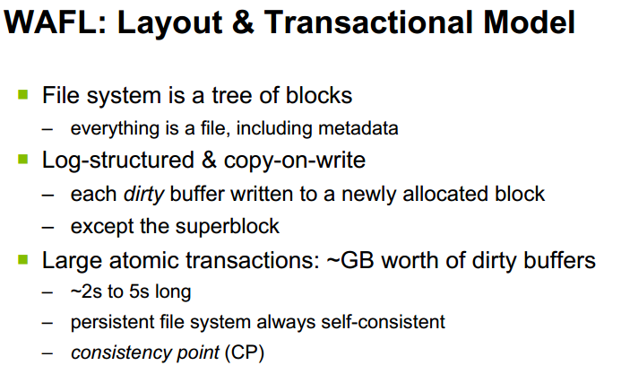

Slide 6
The Batched Free Log
Tlog
the nodes of a binary tree, where each node contains block references.
problem of Tlog
no easy way to tell how many nodes would be updated due to an insertion.
Batched Free Log
It accumulates delete-logged blocks and, after some threshold, it sorts and frees them.

Slide 7
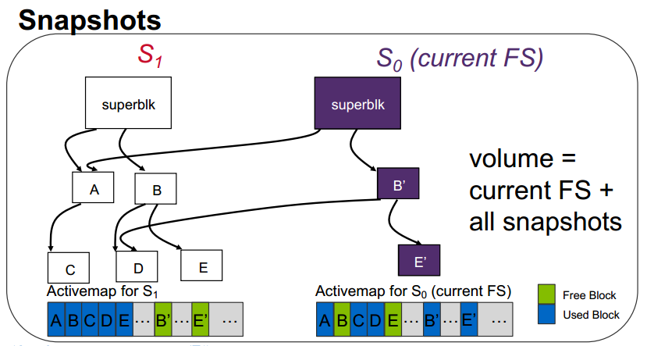
f

Slide 8
Summary Map
Definition
a bitmap file; Bit-OR of snapshots’ activemaps
Block is free iff every activemap says it is free in the activemap and ①in all the snapmaps.
Fast reclamation of space without impacting other operations

Slide 9



Snapshot Creation
snap create scan
create
$$S_{i}$$
S$can$
Update summary
Not update
Bit of$S_{i}$

Slide 10









Snapshot Deletion
Deletion by Subtraction (dbys)
$$Scan$$
$$S_{i}$$
$$S_{j}$$
$$Clear$$
$S_{i}$’s snapmaps
$S_{i}$’s snapmaps
Bit of$S_{i}$
 | Bit of$S_{j}$
$$S_{i} Not neighbor in S_{j}$$

Slide 11
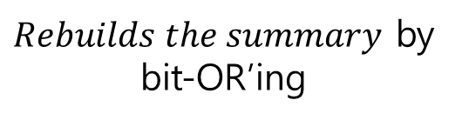
Snapshot Deletion
Deletion by Addition (dbya)
$$Scan$$
$Rebuilds the summary$ by bit-OR’ing
snapmaps of all remaining snapshots
A | B | C
A | B | C
A | B | C

Slide 12
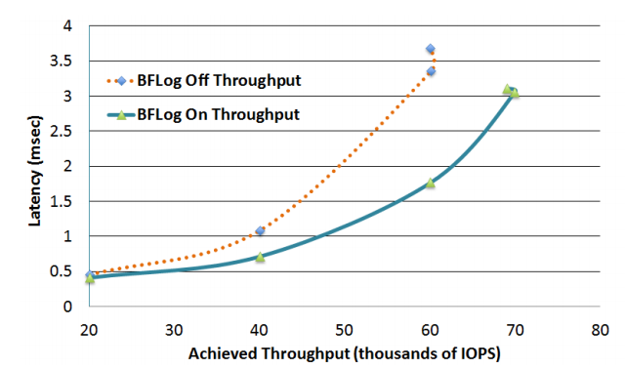
Evaluation
※ IOPS- Input/output operations per second
BFLog vs Tlog
17% higher write throughput at 34%-48% lower latency

Slide 13
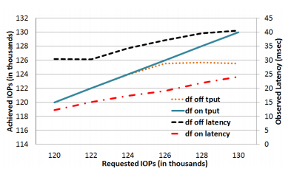
Evaluation
Bunched delayed frees: 60% lower latency at any load & higher saturation point

Slide 14
conclusion
WAFL has evolved over 2+ decades
deployments, media/hardware trends, applications/workloads
Free space reclamation has also evolved
handle the changing requirements
interaction with dozens of features
Consistent & predictable performance
with low latency and high throughput

