Slide 1
Light-Weight Contexts:An OS Abstraction for Safety And Performance
Anjo Vahldiek-Oberwagner, Eslam Elnikety
Deepak Garg, Bobby Bhattacharjee
Ju-Hyeok Park

Slide 2
summary
Topic
new OS abstraction—light-weight contexts (lwCs)
Problem
There is a high cost when switching between processes.
Solution
provide the units of protection, privilege, and execution state within a process.
Significance
process can return to a prior recorded state (Rollback).
lwCs within the process may have different views of memory.
switching lwCs is quicker than switching kernel threads within the same process.

Slide 3
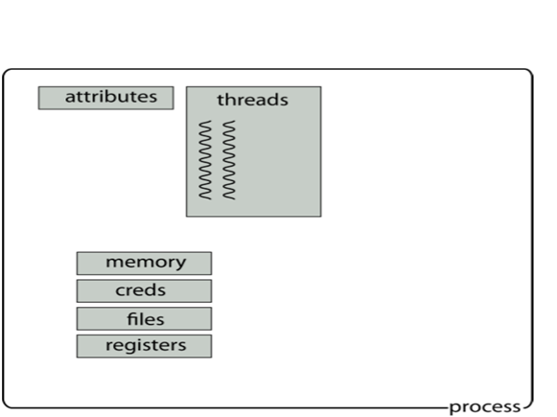
background
Process have attributes, thread, and memory, creds, and files, register.

Slide 4
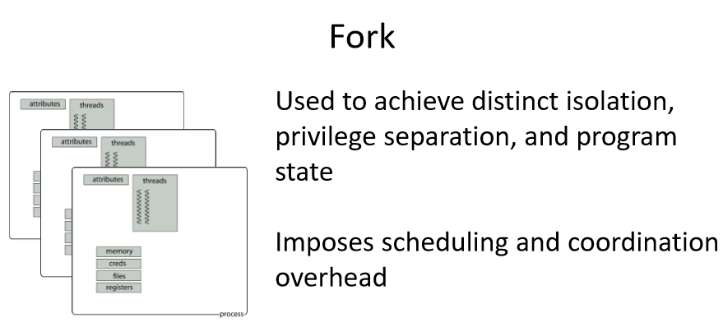
background

Slide 5
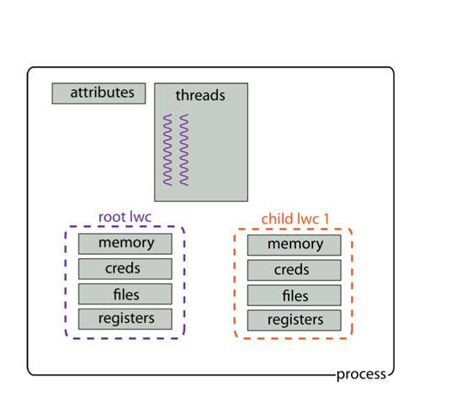
Light-Weight Context

Slide 6
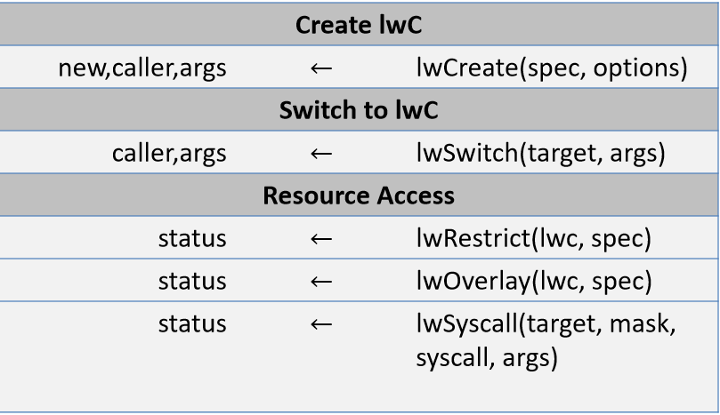
API Summary

Slide 7
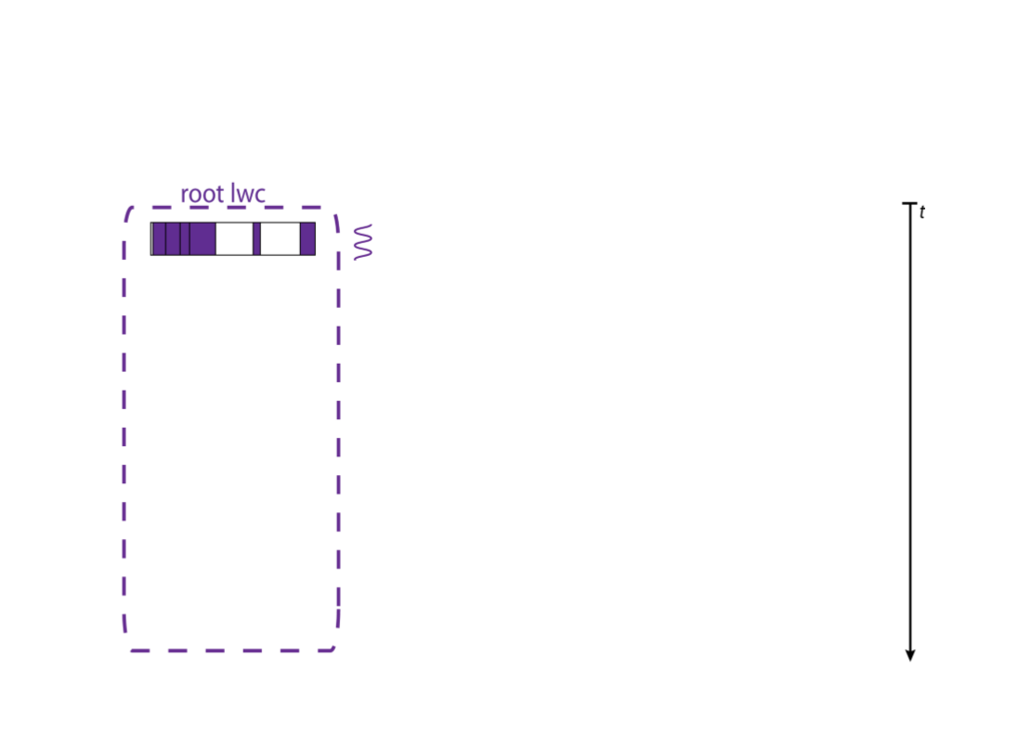
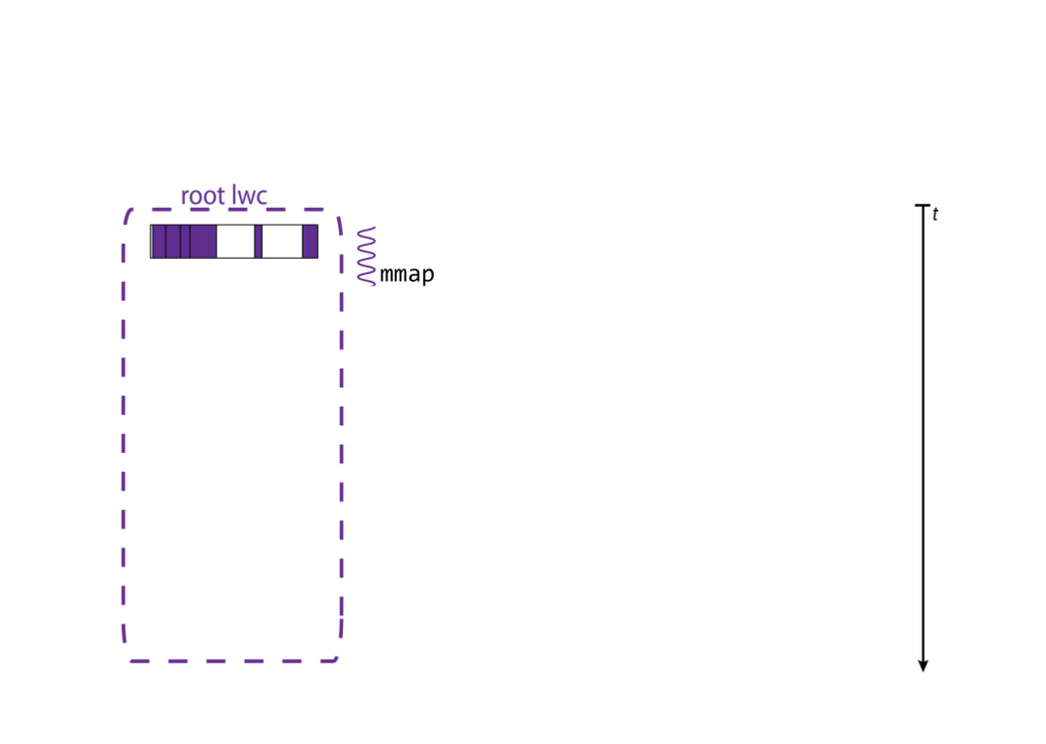
Lwc create

Slide 8
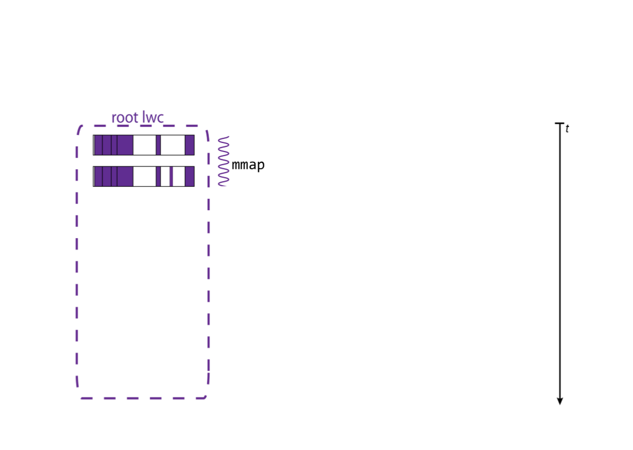
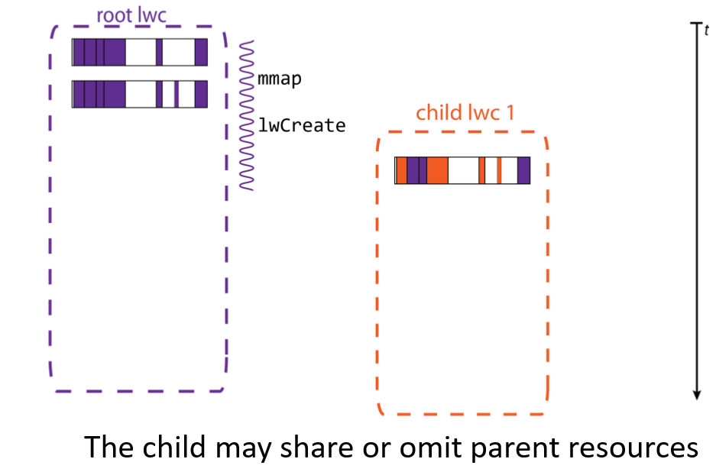
Lwc create

Slide 9
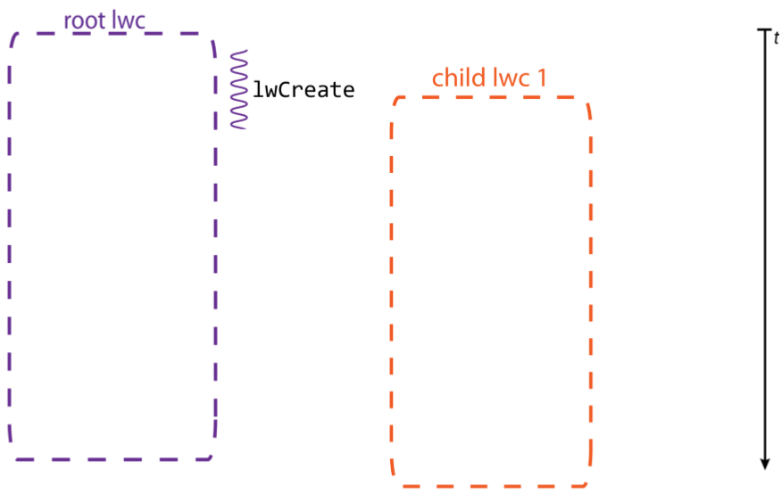
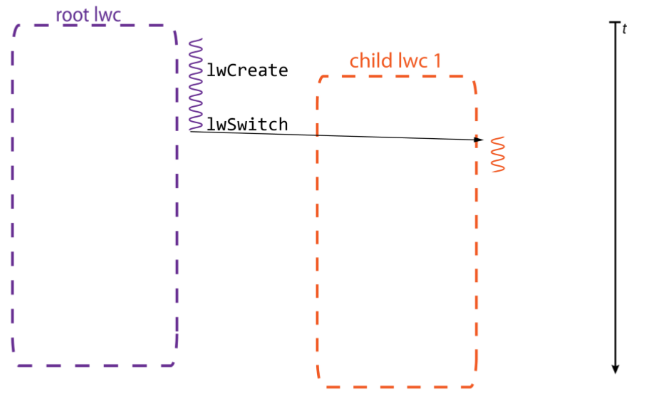
Lwc Switch

Slide 10
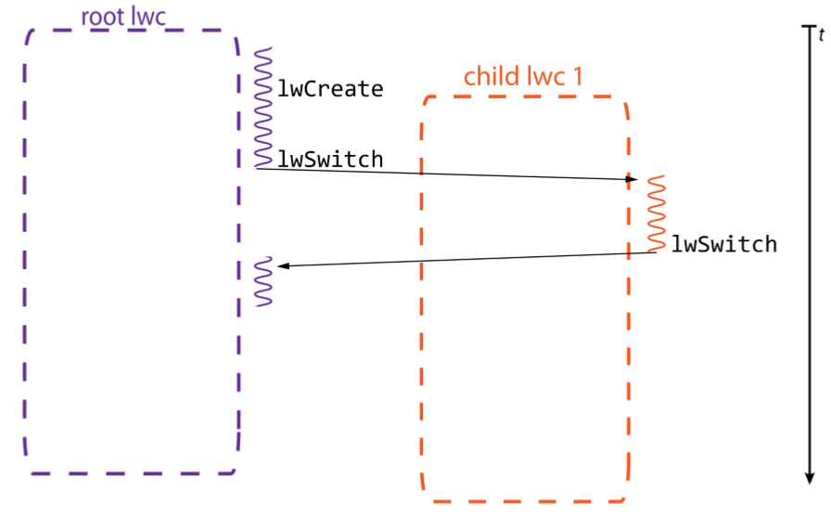
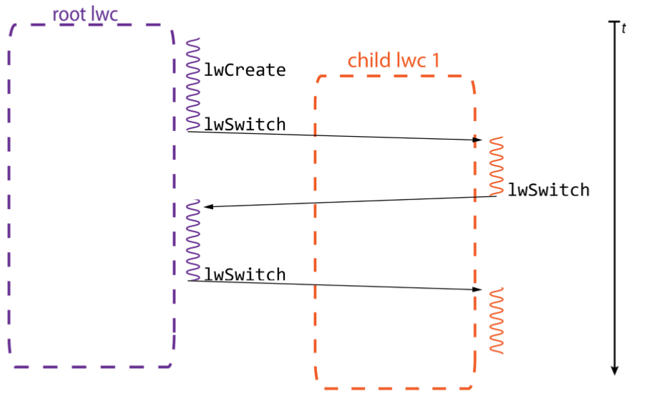
Lwc Switch

Slide 11
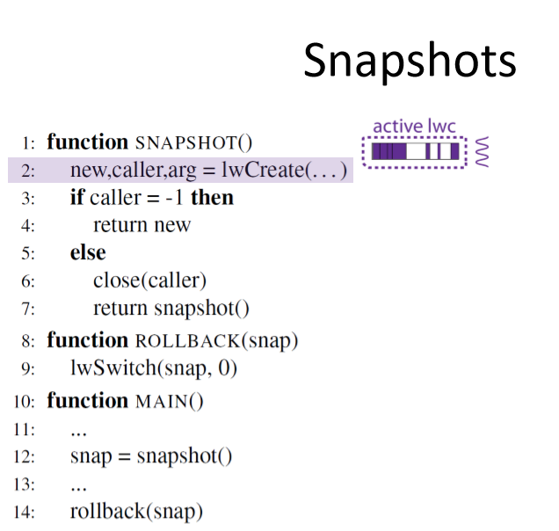
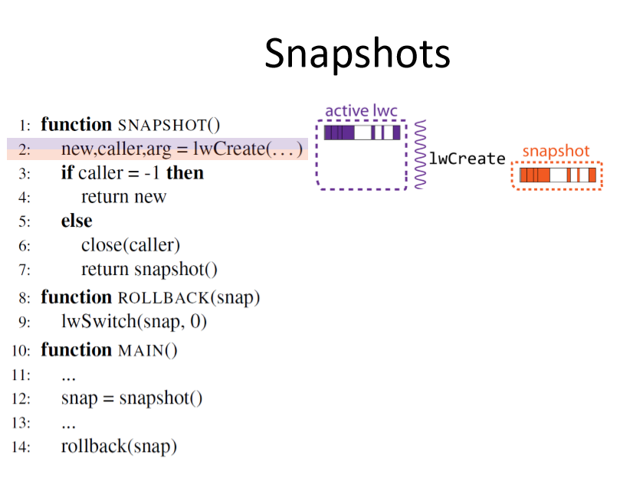
Snapshots

Slide 12
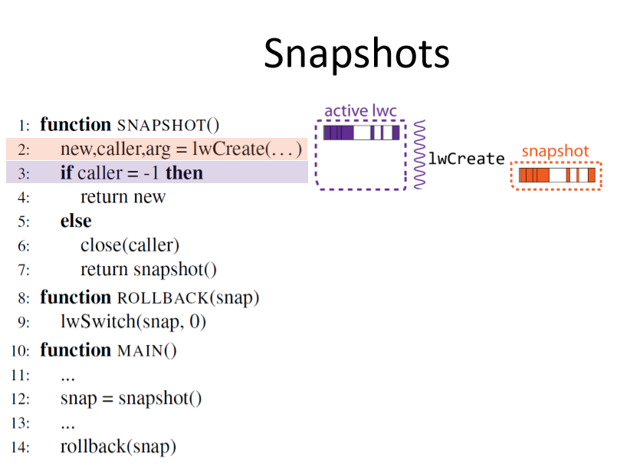
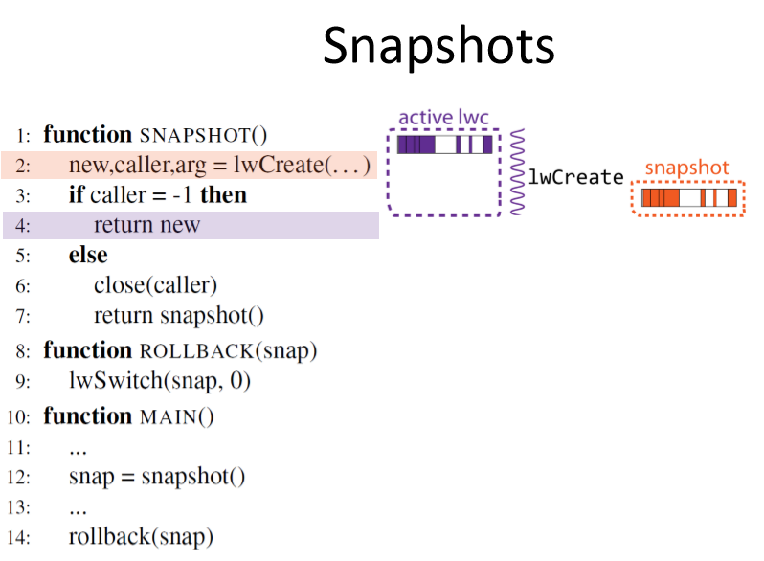
Snapshots

Slide 13
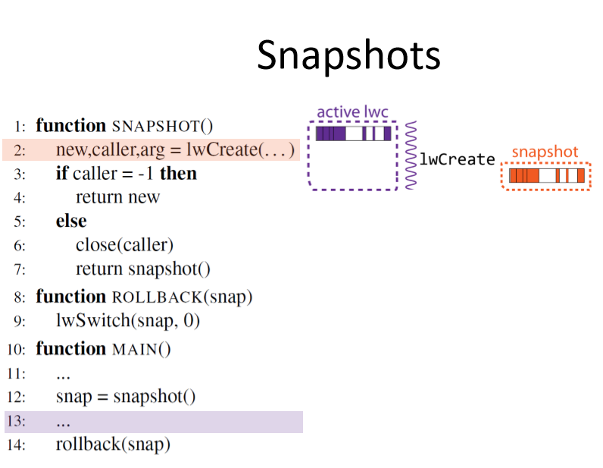
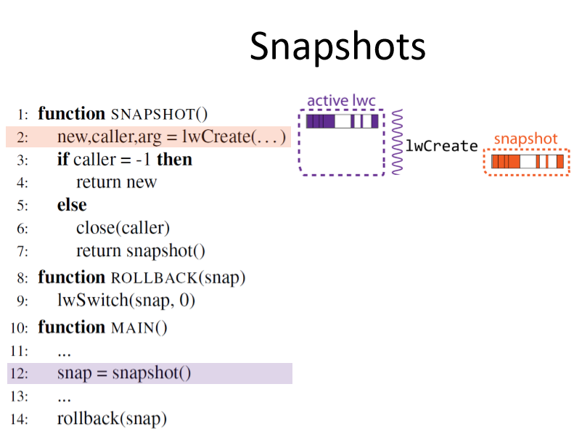
Snapshots

Slide 14
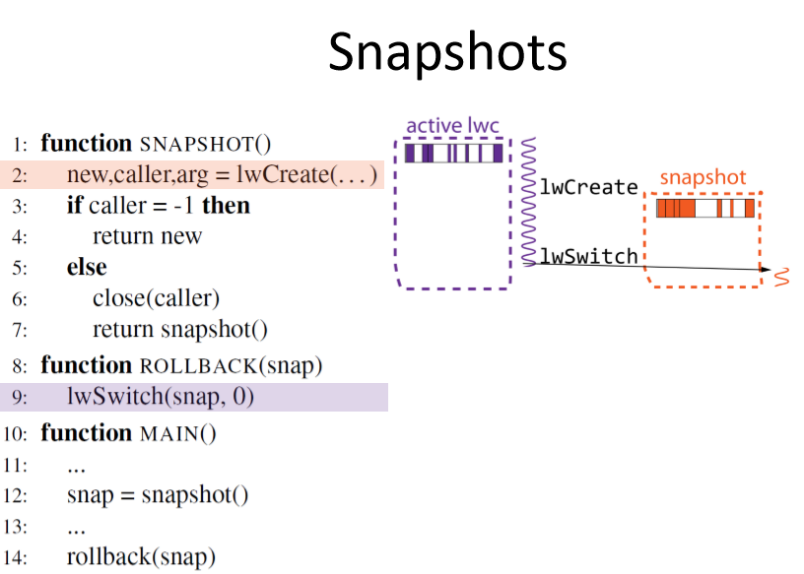
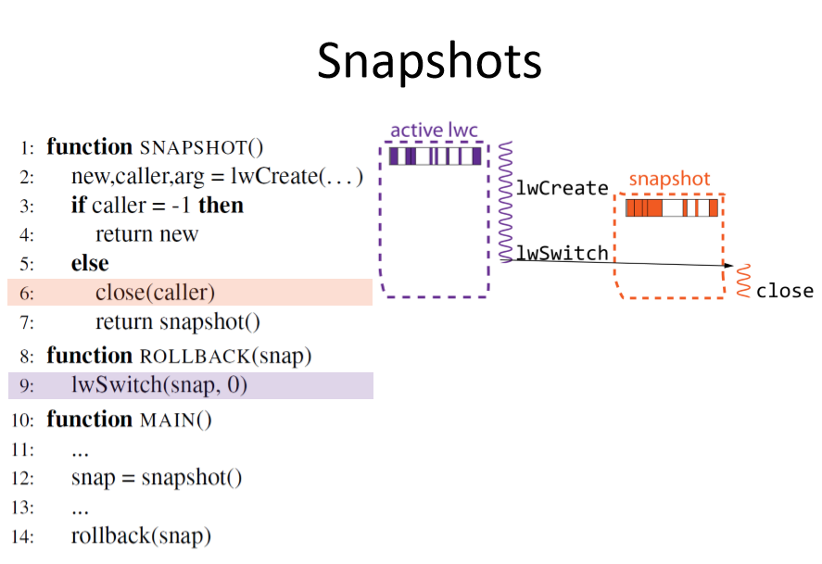
Snapshots

Slide 15
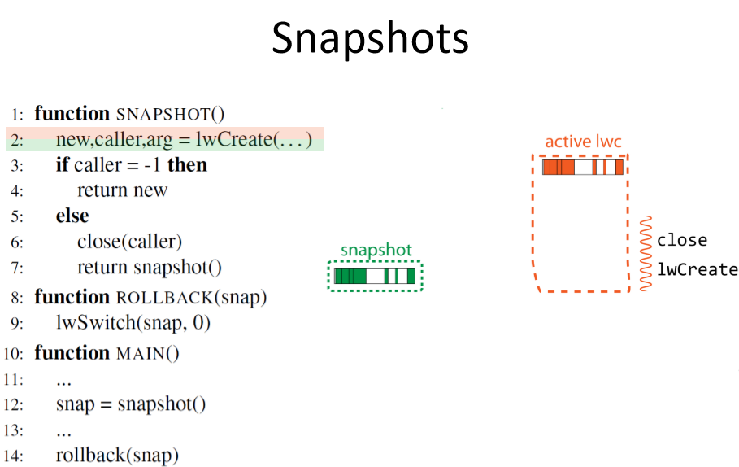
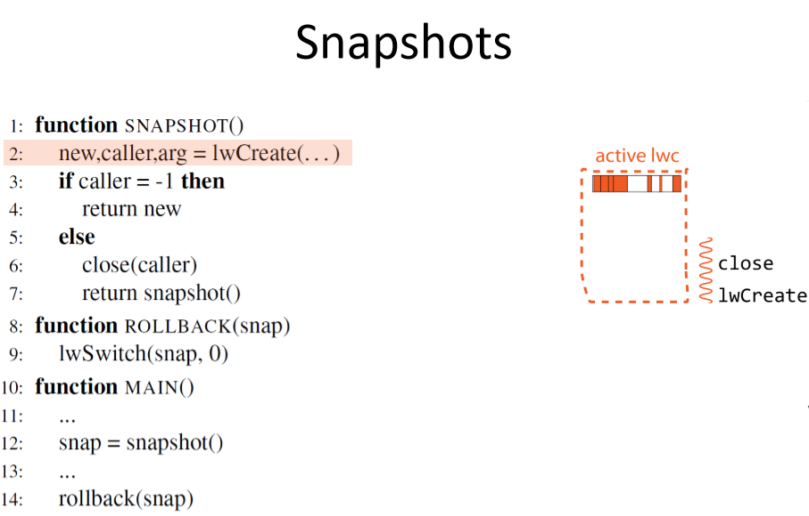
Snapshots

Slide 16
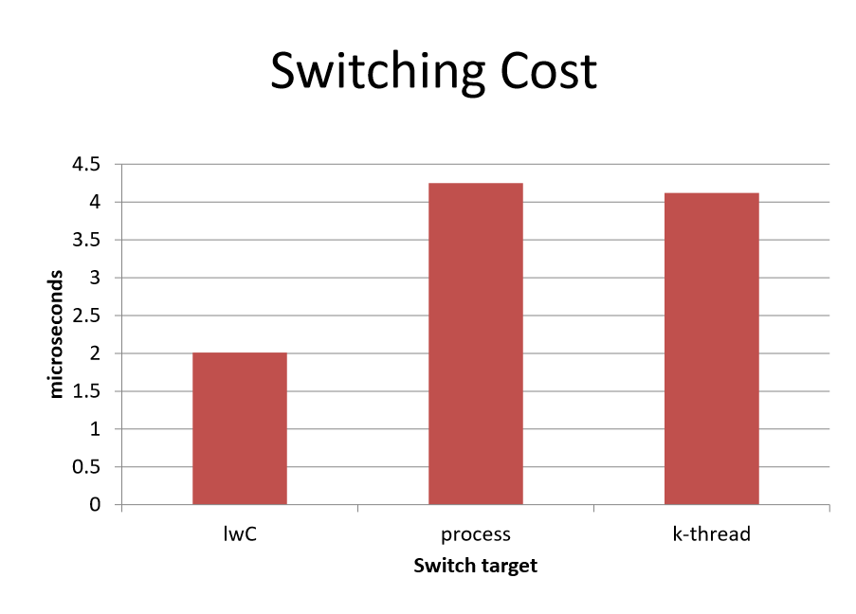
evaluation

Slide 17
conclusion
evaluated light-weight contexts (lwCs), a new first-class OS abstraction that provides units of isolation, privilege, and execution state independent of processes and threads.
The evaluation results show similar or better performance than the original configuration.

