Slide 1
Testing Error Handling Code in Device Drivers Using Characteristic Fault Injection
Jia- Ju Bai, Yu-Ping Wang , Jie Yin, and Sho-Min Hu
Present by
Tserennadmid Batgerel

Slide 2








DRIVER INTRODUCTION
2
Role
Manage hardware devices
Support high-level programs
Run in kernel mode
Applications Operating System
Process management
Network control
……
Device drivers
Hardware devices

Slide 3
DRIVER ERROR HANDLING
3
Occasional errors
Kernel exceptions (-ENOMEM, -EFAULT, ……)
Hardware malfunctions (-EIO, -EBUSY, ……)
 ……
Challenges for error handling
Complex program logic and context
Many different kinds of errors
Infrequent to trigger
 ……
Error handling code in drivers is necessary but hard to
correctly implement

Slide 4
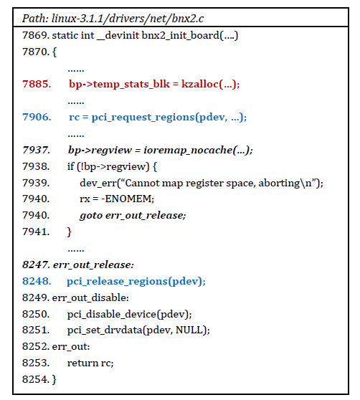

MOTIVATION
4
Error handling code is incorrect in some drivers
Memory is allocated
Error handling
is triggered
Memory is NOT
freed!

Slide 5
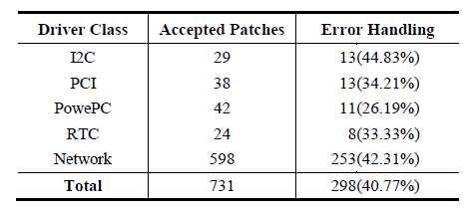
MOTIVATION
5
Patch study
July 2015
Findings
40% of accepted patches are related to error handling code
Many error handling patches are used to fix common bugs
Error handling code in current drivers is not reliable enough

Slide 6
GOAL
6
Testing error handling code in device drivers
Bug-detection capability
Error-handling-code coverage
Automation and efficiency
Scalability and generality

Slide 7







BASIC TECHNIQUE
7
Software fault injection (SFI)
Good coverage for error handling code
Exact runtime information for bug detection
Support most drivers
Typical SFI System
Data Analyzer
Controller
Fault Library
Workload Library
Fault Injector
Workload Generator
Runtime Monitor
Target Driver

Slide 8
PREVIOUS SFI APPROACHES
8
Some famous approaches
Linux Fault Injection Capabilities Infrastructure
ADFI (ISSTA ’15), KEDR (ICST ’11), LFI (DSN ’09)…
Limitations
Low fault representativeness
Numerous redundant test cases
Several kinds of faults
Much manual effort
Our solution is to introduce driver characteristics into SFI

Slide 9
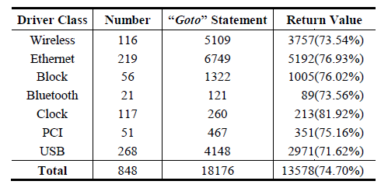
CHARACTERISTIC 1
9
Function return value trigger
The error handling code is often triggered by a bad function return value
Driver study
75% of "goto" statements are in if branches of bad function return values

Slide 10
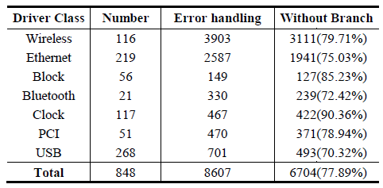
CHARACTERISTIC 2
10
Few branches
There are few if branches in error handling code
Driver study
78% of error handling code is out of the if branches
Reason: fail-stop model

Slide 11
CHARACTERISTIC 3
11
Check decision
To check whether an occasional error occurs, an if
check is often used in the source code
The checked data can be function return values (C1) or common variables

Slide 12
CHARACTERISTIC USAGE
12
Function return value trigger (C1)
Injecting faults into function return values can cover most error handling code
Few branches (C2)
Injecting single fault in each test case can cover most error handling code
Check decision (C3)
The function whose return value is checked in the code should be fault-injected

Slide 13


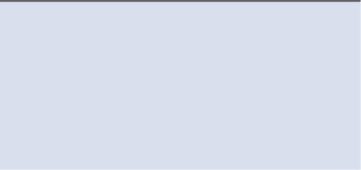
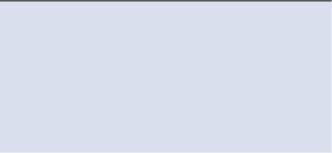
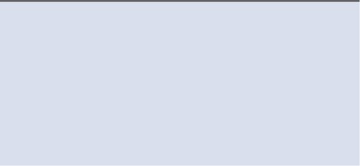
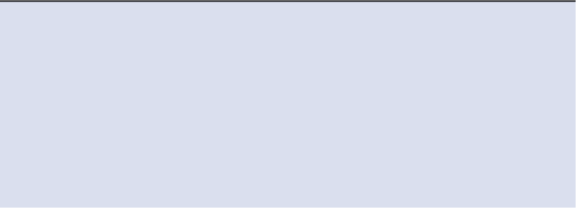








EH-TEST
13
Architecture
Fault extractor
Fault injector
Probe inserter
OS source code
Target Driver
+
Other Drivers
+
Interface Functions
EH-Test
Fault Extractor
Fault Injector
Probe Inserter
Runtime Monitor
Pair Checkers
Target Functions
Test Cases
Bug Reports
Pair checkers
Two phases
Test case generation
Runtime testing

Slide 14













PHASE 1: TEST CASE GENERATION
14
Task 1: Extracting target functions
Input: OS + driver source code
Output: target functions
Method: pattern-based extraction strategy
OS source code
Target Driver
+
Other Drivers
+
Interface Functions
EH-Test
Fault Extractor
Fault Injector
Probe Inserter
Runtime Monitor
Pair Checkers
Functions
Test Cases
Bug Reports

Slide 15
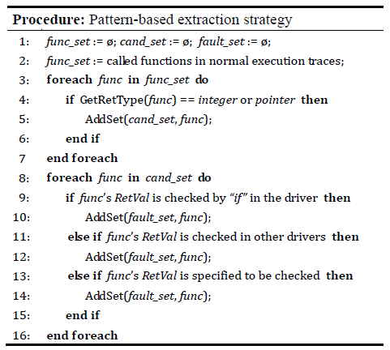
PATTERN-BASED EXTRACTION
15
Based on C1 and C3
Three code patterns
Automated and accurate extraction
Collect traces: Simple extraction:
(candidate functions)
Pattern 1:
Pattern 2:
Pattern 3:

Slide 16





PHASE 1: TEST CASE GENERATION
16
Task 2: Injecting faults into target functions
Input: driver code + target functions
Output: processed driver LLVM bytecode
Method: single fault injection, code instrumentation
OS source code
Target Driver
+
Other Drivers
+
Interface Functions
EH-Test
Fault Extractor
Fault Injector
Probe Inserter
Runtime Monitor
Pair Checkers
Functions
Test Cases
Bug Reports

Slide 17


PHASE 1: TEST CASE GENERATION
17
Task 3: Inserting probes for runtime monitoring
Input: processed driver LLVM bytecode
Output: driver test cases (loadable drivers)
Method: code instrumentation
OS source code
Target Driver
+
Other Drivers
+
Interface Functions
EH-Test
Fault Extractor
Fault Injector
Probe Inserter
Runtime Monitor
Pair Checkers
Functions
Test Cases
Bug Reports

Slide 18







PHASE 2: RUNTIME TESTING
18
Runtime monitoring
Record runtime information
Maintain a resource-usage list
Measuring code coverage
OS source code
Target Driver
+
Other Drivers
+
Interface Functions
EH-Test
Fault Extractor
Fault Injector
Probe Inserter
Runtime Monitor
Pair Checkers
Functions
Test Cases
Bug Reports

Slide 19

PHASE 2: RUNTIME TESTING
19
Bug reporting
Driver crashes
Driver hangs
Resource-release omissions
OS source code
Target Driver
+
Other Drivers
+
Interface Functions
EH-Test
Fault Extractor
Fault Injector
Probe Inserter
Runtime Monitor
Pair Checkers
Functions
Test Cases
Bug Reports

Slide 20
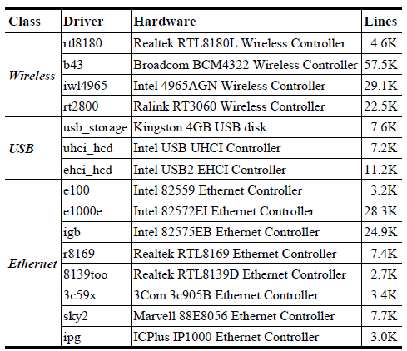
EVALUATION
20
15 common Linux drivers (3.1.1 and 3.17.2)
4 wireless drivers
3 USB drivers
8 Ethernet drivers

Slide 21
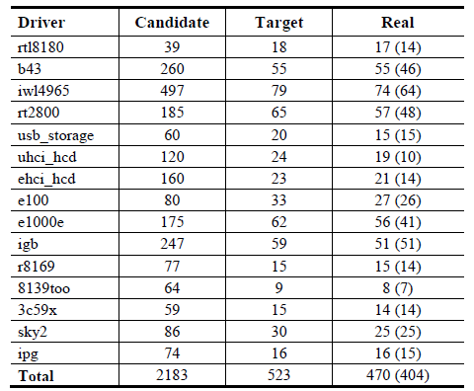
EVALUATION
21
Target function extraction
76% of candidate functions are filtered out
10% false positive rate
86% of target functions are called in initialization

Slide 22
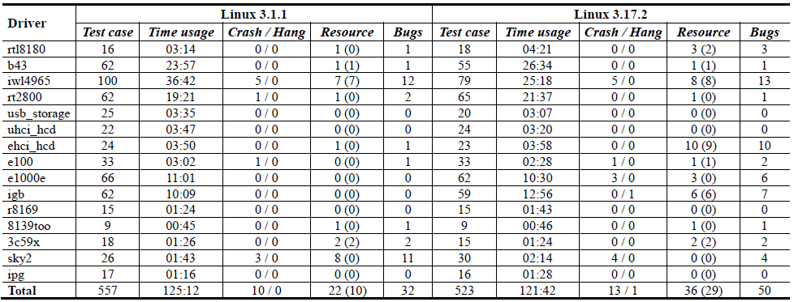
EVALUATION
22
Bug detection
32 real bugs in 3.1.1, 50 real bugs in 3.17.2
9 bugs in 3.1.1 have been fixed in 3.17.2
17 patches are sent, and 15 of them are applied
Many resource-release omissions

Slide 23
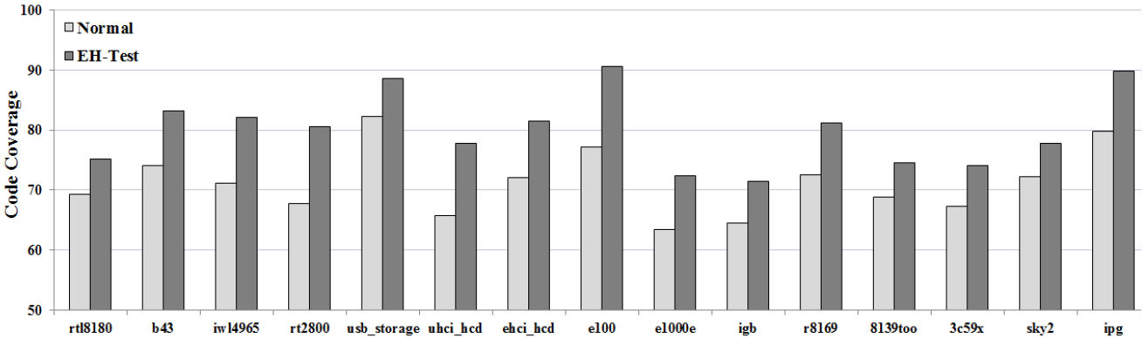
EVALUATION
23
Code coverage
Improve 8.8% in driver initialization
Not all error handling code can be covered

Slide 24
ADFI VS EH-TEST
24
ADFI [ISSTA ’15]
SFI testing for drivers
Injecting faults into target function return values
Detect crashes, hangs and memory leaks
Differences
Target functions are manually selected
Injecting multiple faults into each test case
Bug detection
Find the same number of bugs in e100 and r8169
10 bugs in ehci_hcd found by EH-Test are omitted

Slide 25
LIMITATIONS
25
Some error handling code is uncovered
Single fault injection
Only injecting faults into function return values
Only default configuration is covered

Slide 26
CONCLUSION
26
Driver code study and 3 useful characteristics
Automated and accurate method: pattern-based extraction strategy
Efficient SFI approach: EH-Test
50 real bugs in 15 Linux drivers
Future work: cover more error handling code
and configurations

Slide 27
27
Thank you
Q & A

