Slide 1
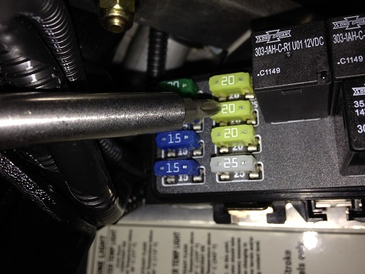
2013 Arctic Cat M-1100
The 20 Ampere
fuse is where we
took power

Slide 2
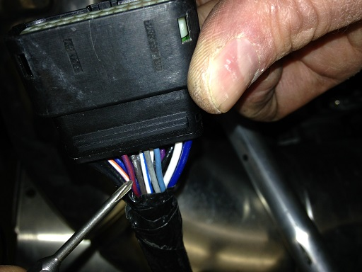
2013 Arctic Cat M-1100
M1100 tether wires
From large ECM plug
Red/Violet and Red/Green
Go to Kill Switch. We cut
Red/Green from Pin17 of
The plug.

Slide 3
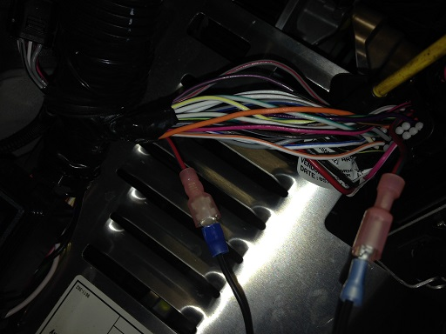
2013 Arctic Cat M-1100
Here are the male/female
Blade connectors we used
For the tether connection.

Slide 4
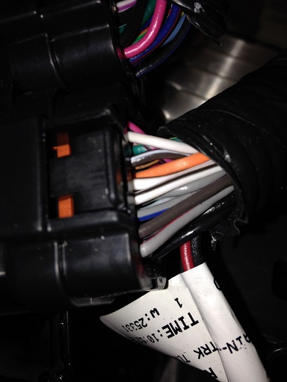
2013 Arctic Cat M-1100
Grey/Red wire on the corner of the large ECM plug is the coil wire.

