Slide 1
EXPLORATORY FOLLOW-UP · NO NEW DATA PULLED
Does spatial resolution explain the MERRA-2 vs. MODSCAG fSCA disagreement?
Question: how much of the pooled bias pattern reflects MERRA's coarse 0.625°×0.5° grid vs. some other systematic cause?
Constraint: reuse existing outputs only — no daily reprocessing, no redownload, no change to the aggregation rule (MODIS is always aggregated up to MERRA; MERRA is never resampled down).
Terrain heterogeneity proxy: binned the checked-in USGS 3DEP DEM (800×600 px) into the 72 MERRA cells and computed within-cell elevation std. dev. — cells straddling steep terrain are the ones a coarse grid represents worst.
Bias signal: recombined the already-computed monthly sufficient statistics (climatology_month rows in pixel_stats.csv) per cell into one pooled WY2010–2023 bias/NMB per cell, same 5% low-snow mask as the public bias/MAE figure.
Two comparisons: (1) correlate terrain heterogeneity against the spatial bias pattern; (2) compare spatial variance (cell-to-cell) against temporal variance (year-to-year) as a rough magnitude check on which axis dominates.
Inputs (all pre-existing)
tests/fixtures/domain_dem_3dep.tif
real 3DEP DEM, checked in
results/water_year_2010_2023_pixel_stats.csv
per-cell climatology sufficient stats
results/water_year_2010_2023_overall_stats.csv
per-year domain sufficient stats
New, exploratory-only artifact:
scripts/resolution_attribution.py → results/derived_resolution_attribution.{csv,png}
Not part of the scientific-contract pipeline or public product; error sign, masks, and grid rules unchanged from README.md.

Slide 2
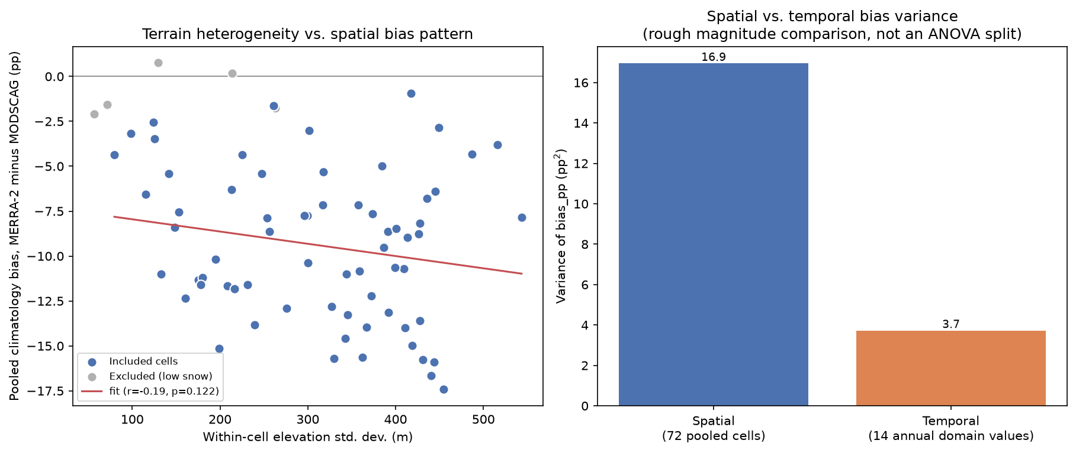
FINDINGS
Result: bias pattern is mostly not explained by terrain heterogeneity
Correlation: r = -0.19 (p = 0.12, R² ≈ 0.04) between within-cell elevation std. dev. and pooled bias across 67 of 72 cells (5 masked for low snow) — essentially no relationship, and the weak trend runs opposite to a resolution-mismatch story.
Variance split: spatial variance across cells (≈16.9 pp²) is ~4.5× the interannual variance at the domain level (≈3.7 pp²) — the disagreement is mostly a stable spatial pattern, not a year-to-year one.
Interpretation: since that spatial pattern doesn't track terrain heterogeneity, resolution/aggregation mismatch looks like a minor contributor. Worth investigating next: land cover, radiation/snow-physics differences, or a location-dependent MERRA bias unrelated to subgrid relief.
Correlational, not a controlled regridding experiment — MERRA is never resampled to MODIS resolution in this repository. See results/derived_resolution_attribution.csv for full per-cell values.

