Slide 1
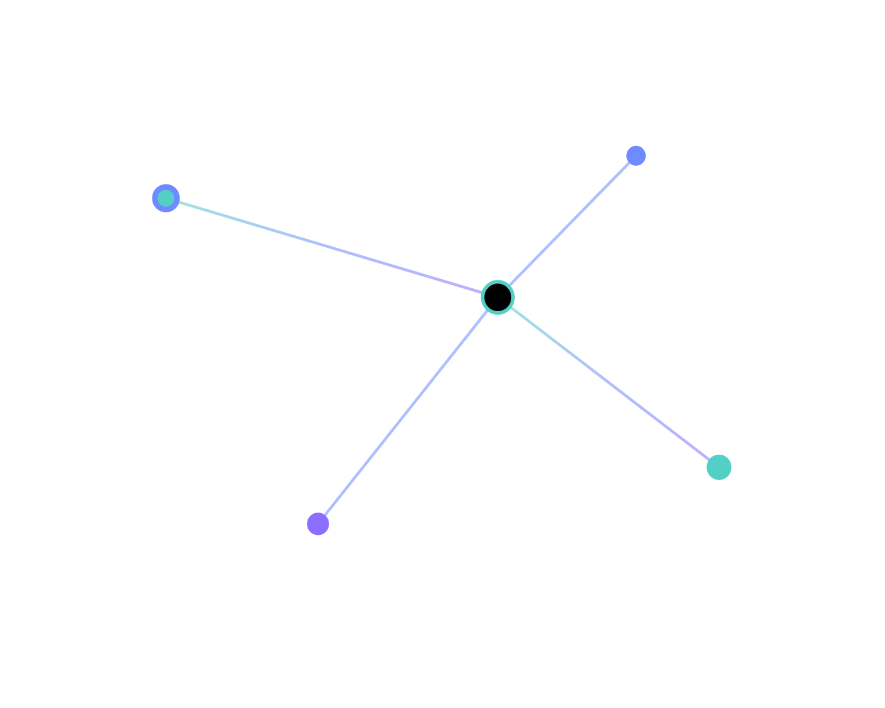
AI INFRASTRUCTURE · ARCHITECTURE REVIEW
The fabric beneath intelligent systems.
A calm, end-to-end review of the QuietFabric platform: topology, performance, reliability, and the proposal for the next phase.
fabric.route / gpu-east-03
p95 18ms
FY26 · Q2
Platform Eng
Confidential
quarterly review
prepared by
internal

Slide 2






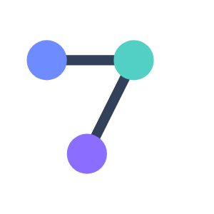
AGENDA
Five things we'll cover
01 · Context
02 · Performance
Where the platform stands today
Latency, throughput, utilization
03 · Architecture
04 · Reliability
Routes, fabric, model serving
SLOs, error budget, failure modes
05 · Roadmap
Q & A
Capacity plan, cost, recommendation
Discussion & decisions
QuietFabric
AI Infrastructure Architecture Review
02 / 23

Slide 3
01
Context
Where the platform stands today — scope, scale, and the systems beneath modern intelligence.
QuietFabric
03 / 23

Slide 4
EXECUTIVE SUMMARY
all routes healthy
The platform is reliable, and approaching capacity
99.95 %
38 ms
71 %
$1.2 M
route availability
TTFT p50
GPU utilization
quarterly spend
▲ within SLO
▲ 6% vs last q
▼ headroom shrinking
▲ 14% vs last q
Reliability is solid
— we held SLO across three regions with no Sev-1 incidents this quarter.
Capacity is the risk
— utilization is trending toward saturation; we propose a Phase-1 pool expansion.
QuietFabric
Executive summary
04 / 23

Slide 5
SYSTEM AT A GLANCE
One inference route, four stages
edge-ingress
fabric-router
gpu-pool
token-stream
kr · 2.1ms
400G · ecn
b200 ×8
sse · live
scale
workload
uptime
3 regions · 6 pools
dual-encoder + VLM
142d 06h
48 GPUs serving production traffic
1.2k rps peak, streaming tokens
since last route reschedule
QuietFabric
System at a glance
05 / 23

Slide 6



CURRENT ARCHITECTURE
The serving stack, top to bottom
Edge & ingress
TLS termination · regional routing
2.1ms p50
Fabric & network
cilium · sr-iov · multus · 400G
ecn
GPU pools
nvidia b200 ×8 · rail-optimized
8/8 scheduled
Model serving
paged kv-cache · fp8 · continuous batching
126 tok/s
Storage & vectors
object-native training plane · vector ingest
jp · kr
QuietFabric
Current architecture
06 / 23

Slide 7
02
Performance
How the fabric behaves under load — latency, throughput, and where headroom is going.
QuietFabric
07 / 23

Slide 8
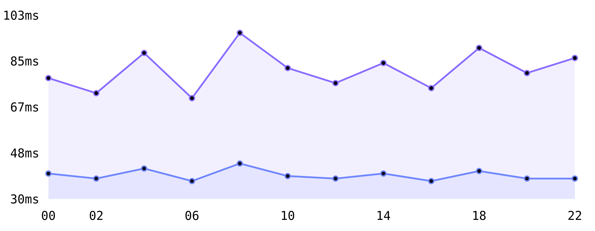
PERFORMANCE · LATENCY
TTFT p50
TTFT p95
Time-to-first-token, last 12 hours
QuietFabric
Performance · latency
08 / 23
p50 holds at 38ms — comfortably inside the 60ms target.
p95 spikes during bursts — driven by kv-cache pressure, not the network.

Slide 9
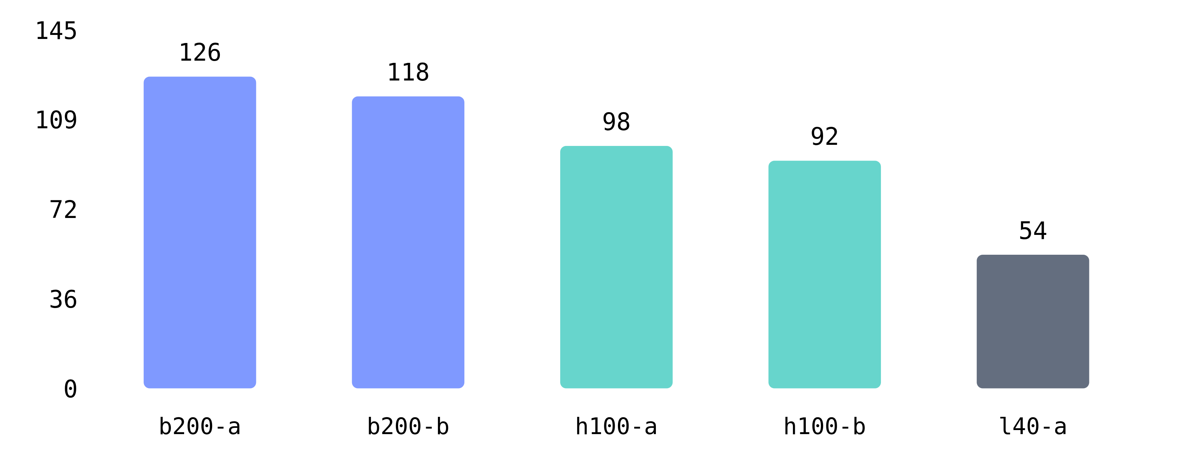
PERFORMANCE · THROUGHPUT
Sustained throughput by GPU pool
QuietFabric
Performance · throughput
09 / 23
B200 pools lead
at 126 tok/s — the L40 pool is a long tail we should retire or repurpose.

Slide 10
PERFORMANCE · CAPACITY
Utilization is climbing across every dimension
71 %
74 %
62 %
24 q
GPU utilization
kv-cache occupancy
fabric bandwidth
peak queue depth
capacity watch
At current growth, kv-cache occupancy crosses 85% in ~7 weeks — the trigger for Phase-1 expansion.
QuietFabric
Performance · capacity
10 / 23

Slide 11
03
Architecture
The route, the fabric, and the serving stack — and why each decision was made.
QuietFabric
11 / 23

Slide 12
ARCHITECTURE · ROUTE
Live inference route, with latency budgets
edge-ingress
fabric-router
gpu-pool
token-stream
budget 3ms · act 2.1ms
budget 1ms · ecn
schedule · b200 ×8
first token 38ms
38 ms
126 tok/s
142 d
end-to-end TTFT p50
streaming throughput
route stability
QuietFabric
Architecture · route
12 / 23

Slide 13
ARCHITECTURE · FABRIC
The network is part of the execution graph
COMPONENT
CONFIGURATION
fabric@control-plane: ~
Cluster fabric
cilium · sr-iov · multus
$ fabric route inspect inference-edge # resolving topology across 3 namespaces… ingress.kr healthy p50 2.1ms router.fabric healthy credit-fc nominal pool.gpu-b200 healthy 8/8 scheduled
Bandwidth
400 Gbps · rail-optimized
Congestion
ecn · credit-flow
Overlay
headscale · 4 namespaces
Region
gcp asia-northeast3
QuietFabric
Architecture · fabric
13 / 23

Slide 14
ARCHITECTURE · TRADE-OFFS
Every choice bought something, and cost something
what we gained
what it cost
Rail-optimized placement cut
all-reduce tail latency
.
Less scheduler freedom under
fragmentation
.
Indirection added on the
hot path
.
Paged kv-cache raised
effective batch size
.
Occasional
throughput dips
during bursts.
ECN keeps queues
shallow under load
.
QuietFabric
Architecture · trade-offs
14 / 23

Slide 15
04
Reliability
SLOs, the error budget, and the way this system actually fails — quietly, at the edges.
QuietFabric
15 / 23

Slide 16
RELIABILITY · SLOS
within budget
We held every SLO this quarter
99.95 %
38 ms
63 %
availability · target 99.9%
TTFT p50 · target <60ms
error budget remaining
▲ met
▲ met
▲ healthy
SLO
TARGET
ACTUAL
STATUS
Route availability
99.9%
99.95%
met
TTFT p95
< 120ms
96ms
met
Token stream uptime
99.5%
99.7%
met
QuietFabric
Reliability · SLOs
16 / 23

Slide 17
RELIABILITY · FAILURE MODES
The risk isn't a crash — it's silent backpressure
Silent backpressure
— pool saturates, queue climbs, latency degrades while liveness still reads healthy.
mitigation
Alert on the slope, not the threshold.
kv-cache exhaustion
— occupancy crosses 85%, evictions cascade onto the hot path.
By the time a threshold trips, the route has been degrading for minutes. We now page on rate-of-change of queue depth and TTFT.
Rail fragmentation
— scheduler can't co-locate tensor-parallel ranks, collectives slow.
QuietFabric
Reliability · failure modes
17 / 23

Slide 18
05
Roadmap & proposal
The capacity plan, the cost model, and the decision we're asking for.
QuietFabric
18 / 23

Slide 19
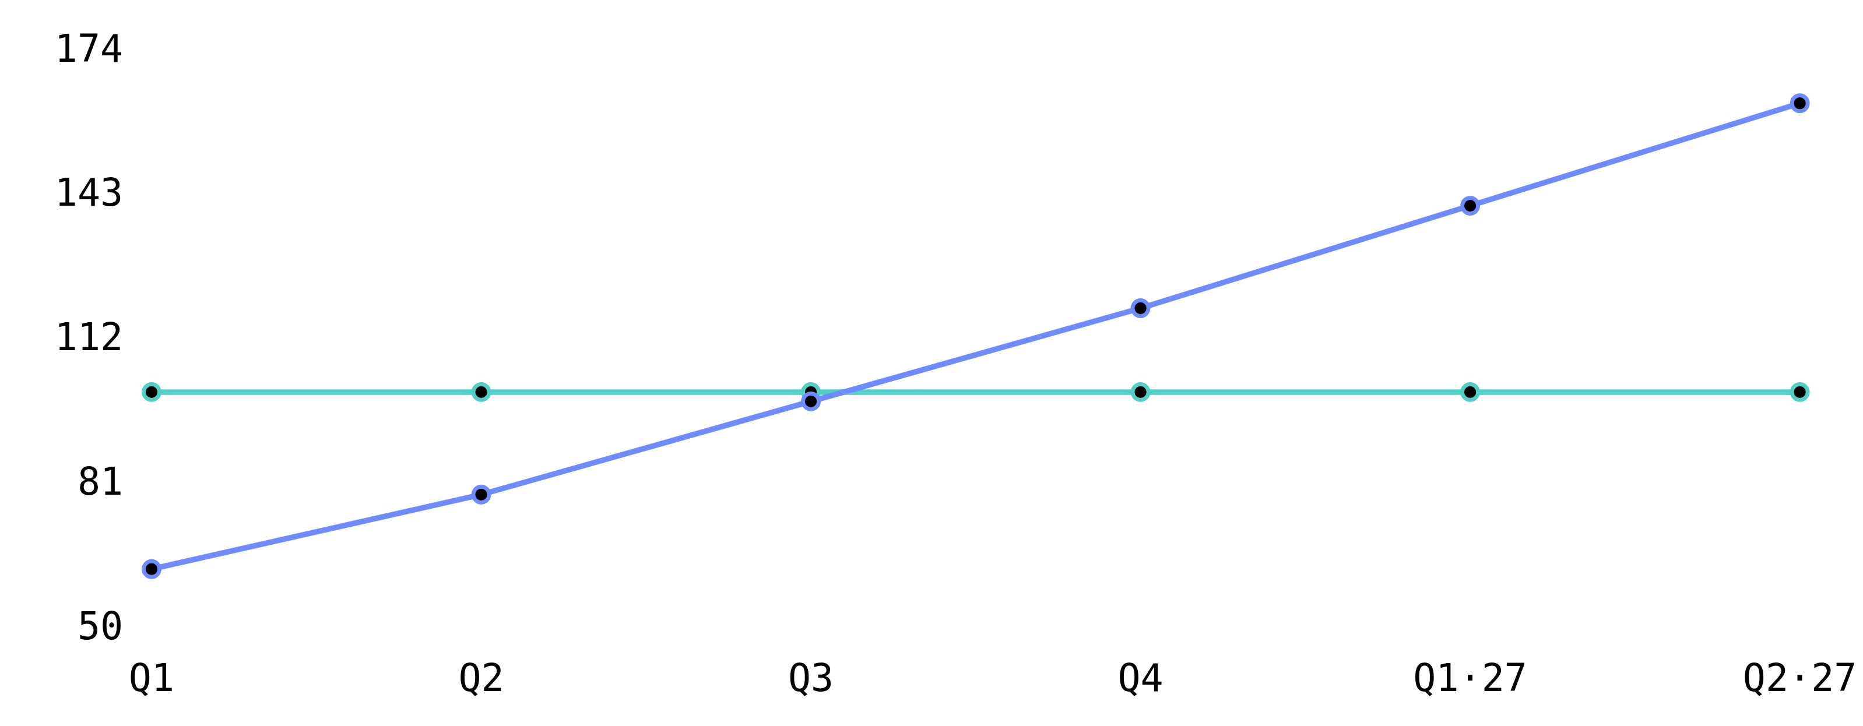
ROADMAP · CAPACITY
capacity
projected demand
Demand crosses capacity in Q3 without action
QuietFabric
Roadmap · capacity
19 / 23
Phase-1 expansion
(+2 B200 pools) restores headroom through FY26 and is the recommendation that follows.

Slide 20
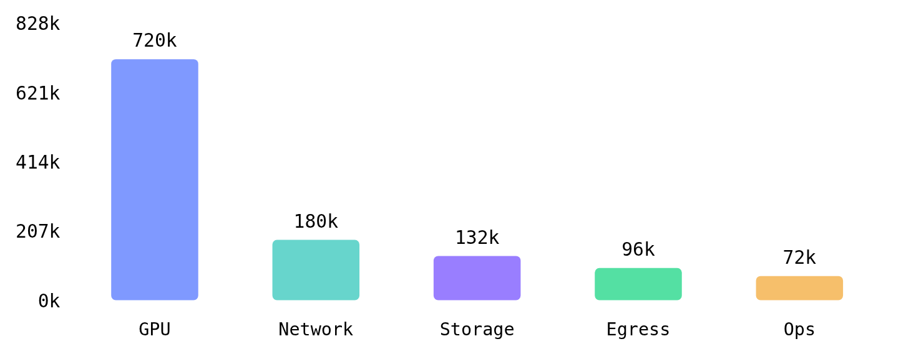
ROADMAP · COST
Where the quarterly spend goes
COMPONENT
QUARTER
SHARE
GPU compute
$720k
60%
Network & fabric
$180k
15%
Storage
$132k
11%
Egress
$96k
8%
Ops
$72k
6%
QuietFabric
Roadmap · cost
20 / 23

Slide 21
ROADMAP · DECISION
ADR-014
Recommendation: approve Phase-1 expansion
decision
impact
Add 2 B200 pools in asia-northeast3, retire the L40 pool, and move kv-cache to fp8 fleet-wide.
+58 %
+$240 k
capacity headroom
net quarterly cost
rationale
Restores headroom through FY26.
Retiring L40 offsets ~30% of the new cost.
6 wk
low
to deploy
rollout risk
QuietFabric
Roadmap · decision
21 / 23

Slide 22
ROADMAP · NEXT STEPS
What happens after this review
next steps
open risks
This week
— approve ADR-014, reserve capacity.
B200 lead times could slip the timeline.
fp8 kv-cache needs a quality regression gate.
L40 retirement must not strand any tenant.
Weeks 1–4
— provision pools, validate rail placement.
Weeks 5–6
— canary, then promote fp8 kv-cache.
QuietFabric
Roadmap · next steps
22 / 23

Slide 23
in closing
Invisible systems. Visible intelligence.
The platform is reliable today. Approve Phase-1 and it stays that way through FY26 — quietly, beneath everything we ship.
QuietFabric
platform-eng@quietfabric · #infra-review
23 / 23

