Slide 1
RestauWants
Track, review, wishlist, and share restaurants with friends.

Slide 2
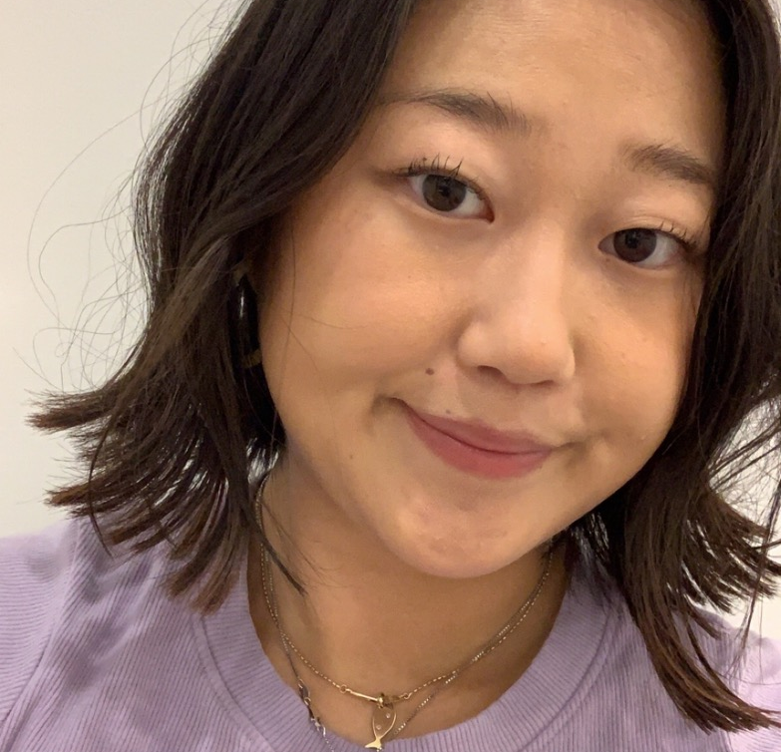
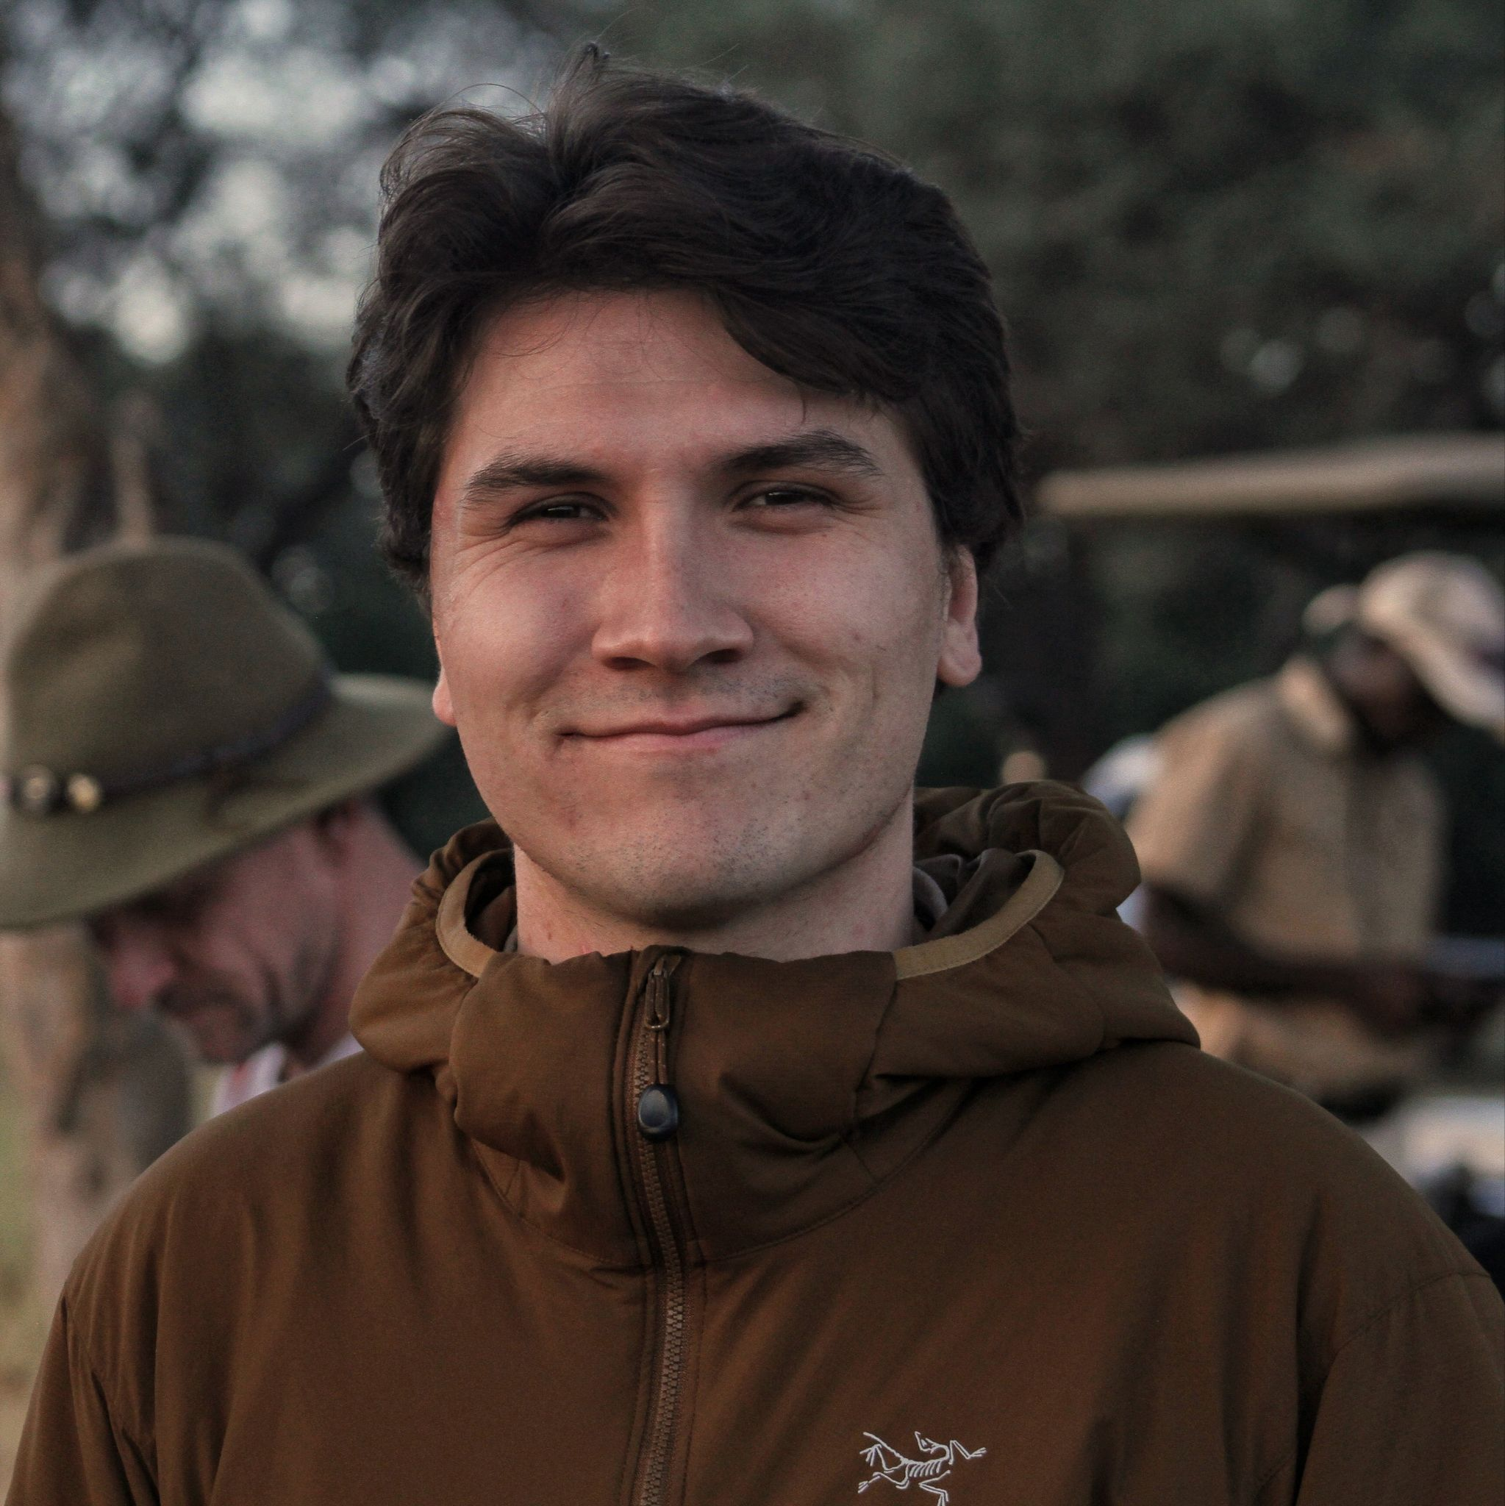
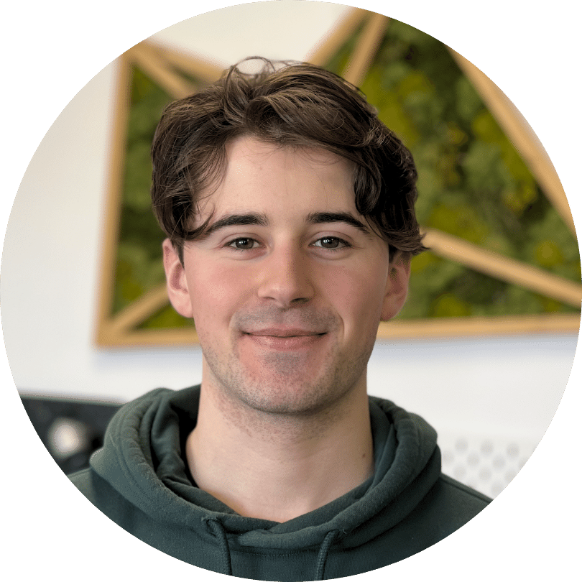
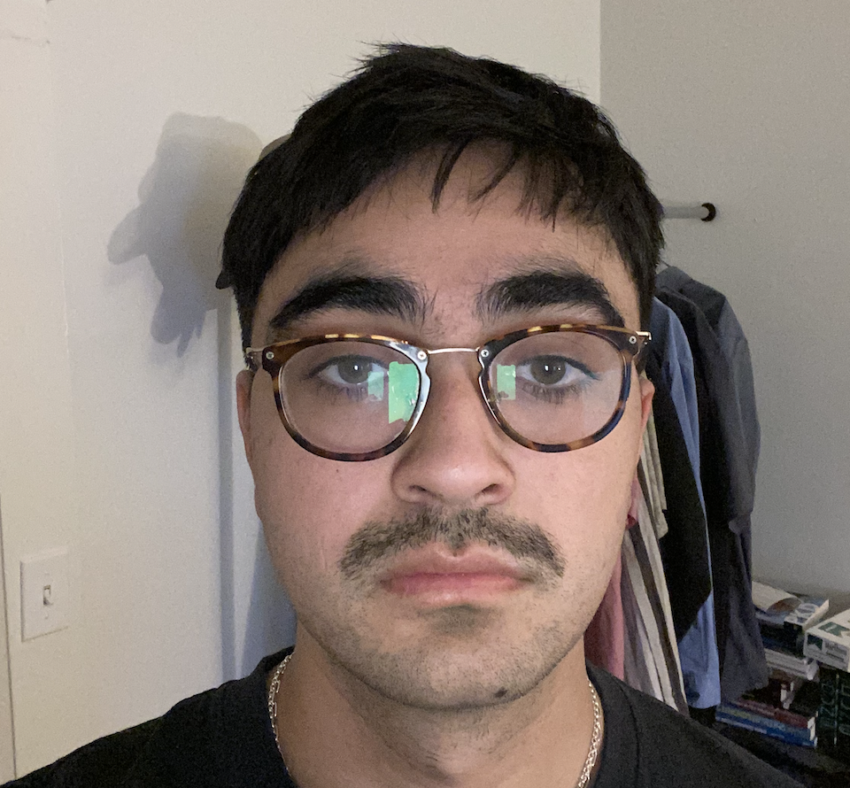
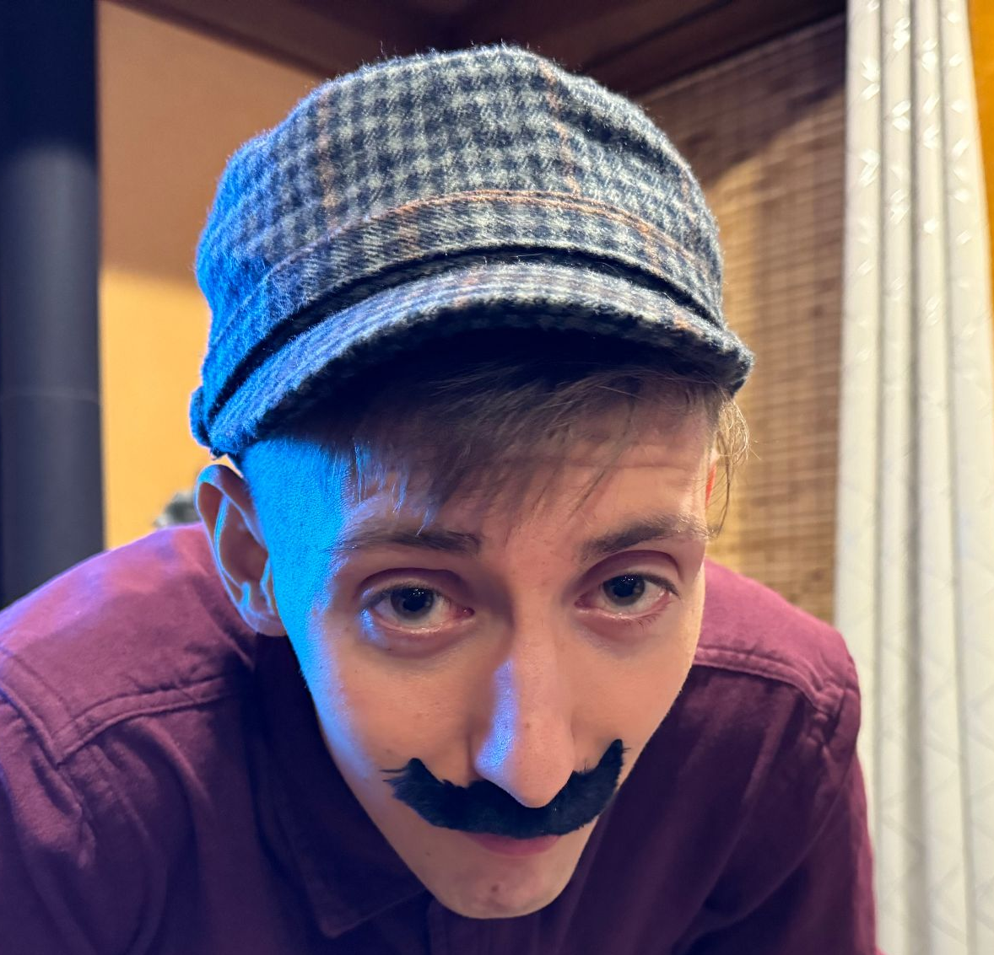

TEAM
Rebecca
Jeon
Cam
Rohwer
Callum Curtis
Devin
Frioud
Norman Anderson
Nick
Badyal

Slide 3
OUR IDEA
PROBLEM
SOLUTION
Lack of trust in restaurant reviews from strangers
Difficult to gather and maintain restaurant recommendations
Privacy concerns with publishing public reviews
Application for users to…
  Write reviews on restaurants and specific items at restaurants
  Share their reviews privately with a select group of close contacts
  Gain inspiration from their friends’ reviews
  Build a personalized database of restaurants they enjoy or want to visit

Slide 4
YOUR FEEDBACK
DIFFERENTIATOR
ENGAGEMENT
TRUST
PERSONA
Why us over Yelp or Google maps?
Why will users keep coming back?
How do we deliver trust?
Who are we designing this app for?

Slide 5
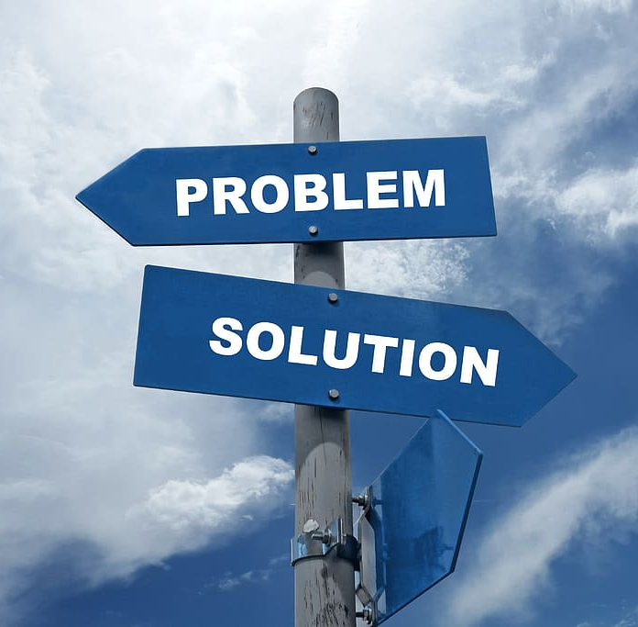
RESEARCH
Learning more about our target user to follow up on feedback.

Slide 6
20
Potential users were interviewed by members of the team.

Slide 7
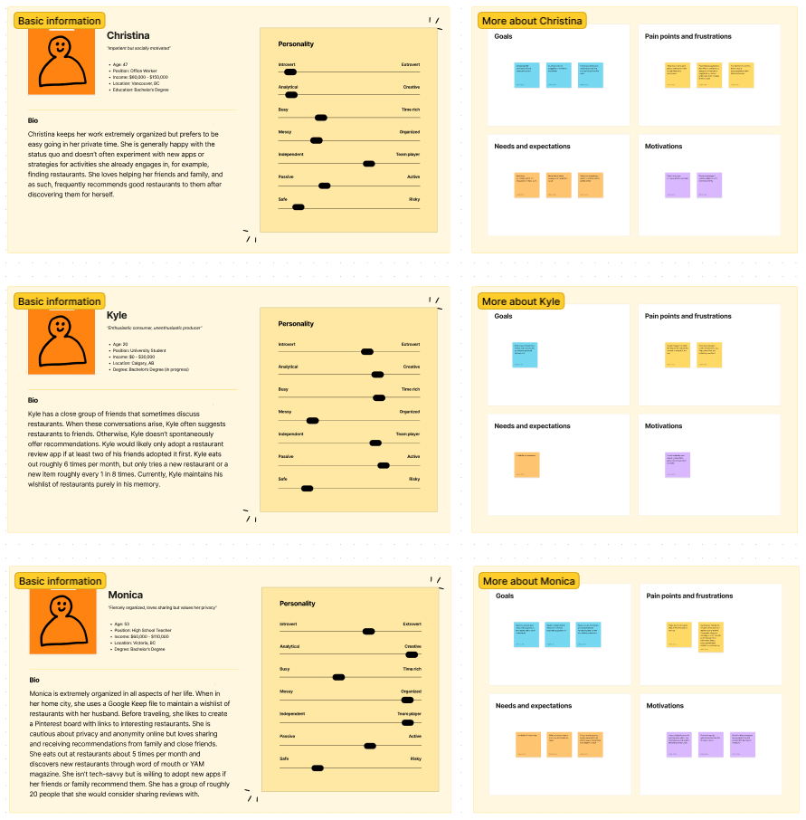
3
User personas were created.

Slide 8

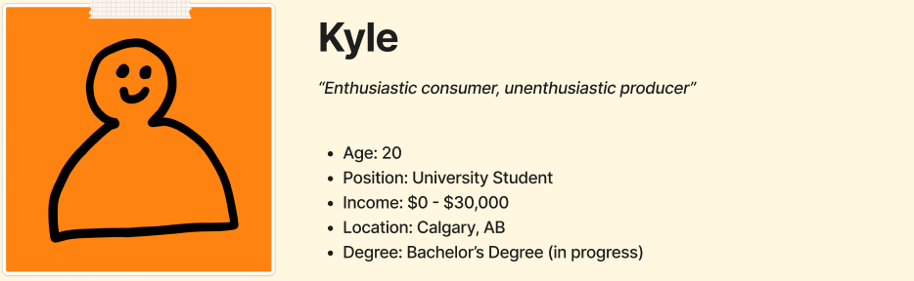
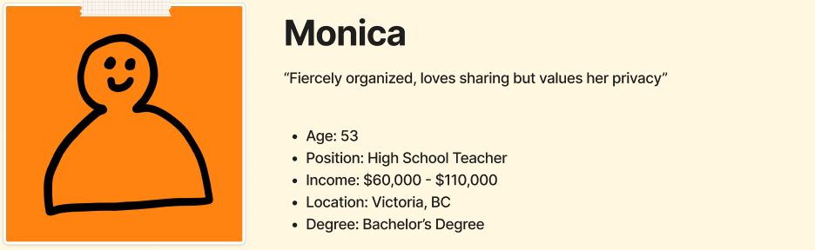
3
User personas were created.

Slide 9
1
Target persona was selected.

Slide 10
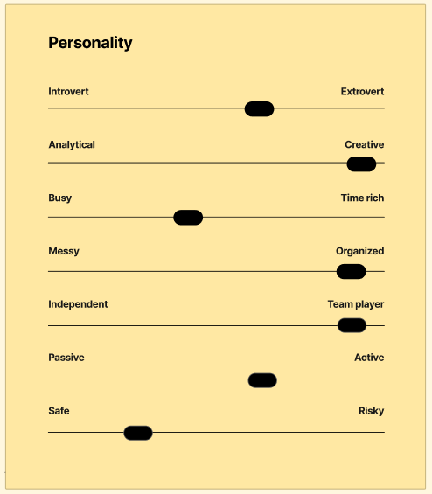
1
Target persona was selected.

Slide 11
WHY THIS PERSONA?
GAINS
PAINS
Experiences social fulfillment in providing recommendations to contacts (extroverted)
Receiving trusted suggestions makes a big difference (safe)
Finds joy in building a personalized collection of restaurant reviews (organized, creative)
Would not consider sharing their opinion on other platforms due to privacy concerns (safe)
Currently spends effort corroborating online reviews (safe)
Doesn’t receive many recommendations from contacts as they are busy with their own careers and families (older)

Slide 12
WHAT DO THEY CARE ABOUT?
PRIVACY
ORGANIZATION
SHARING
EASE OF USE
“[I don’t write reviews because of] privacy, Big Brother and all of that.”
“I create a pinterest board [of restaurants] before traveling somewhere.”
“I would use it [to look at reviews from contacts] for sure.”
“I don’t write reviews because I’m too lazy.”

Slide 13
FEATURES
ID | PRIORITY | FEATURE
REQ-1 | Must-Have | Create, Edit, Delete Review
REQ-2 | Must-Have | Share With and View Reviews From Contacts
REQ-3 | Must-Have | View Your Historical Reviews
REQ-4 | Must-Have | Maintain a Wishlist of Restaurants
REQ-5 | Must-Have | Add Contacts
REQ-6 | Should-Have | Auto Filling of Restaurant Details in Reviews
REQ-7 | Should-Have | Link to Restaurant Websites from Reviews
REQ-8 | Should-Have | Support for Photos in Reviews
REQ-9 | Should-Have | Filters and Search Criteria Within Wishlist
REQ-10 | Should-Have | Search and View Details by Restaurant
REQ-11 | Should-Have | Organizational Features for Wishlist
REQ-12 | Could-Have | Map View
REQ-13 | Could-Have | Comments on Reviews
REQ-14 | Could-Have | Notifications of Activity by Contacts

Slide 14
ROADMAP
ID | PRIORITY | FEATURE
REQ-1 | Must-Have | Create, Edit, Delete Review
REQ-2 | Must-Have | Share With and View Reviews From Contacts
REQ-3 | Must-Have | View Your Historical Reviews
REQ-4 | Must-Have | Maintain a Wishlist of Restaurants
REQ-5 | Must-Have | Add Contacts
REQ-6 | Should-Have | Auto Filling of Restaurant Details in Reviews
REQ-7 | Should-Have | Link to Restaurant Websites from Reviews
REQ-8 | Should-Have | Support for Photos in Reviews
REQ-9 | Should-Have | Filters and Search Criteria Within Wishlist
REQ-10 | Should-Have | Search and View Details by Restaurant
REQ-11 | Should-Have | Organizational Features for Wishlist
REQ-12 | Could-Have | Map View
REQ-13 | Could-Have | Comments on Reviews
REQ-14 | Could-Have | Notifications of Activity by Contacts
MILESTONE | FEATURES
M1 | REQ-1 to REQ-3
M2 | REQ-4 to REQ-8
M3 | REQ-9 to REQ-11
Stretch | REQ-12 to REQ-14

Slide 15
CIRCLING BACK TO YOUR FEEDBACK…
DIFFERENTIATOR
ENGAGEMENT
TRUST
PERSONA
Privacy, trust, collection building.
Social fulfillment, contact activity.
Reviews only from known contacts.
“Fiercely organized, loves sharing but values her privacy”

Slide 16
DEMO
GitHub: https://github.com/restauwants/restauwants
App: https://restauwants-nextjs.vercel.app/

Slide 17
REFLECTION
GLAD…
SAD…
MAD…
We invested in user research and established a clear persona
Used a tech-stack template to quickly get to writing business logic
Created UI mockups before assigning features to team members
Devin worked on a proof of concept for restaurant data retrieval
We didn’t conduct user research sooner to make more time for programming
Midterms and assignments from other courses took time away in the last week
We don’t have a better process for experimenting with schema updates to the database

Slide 18
REFLECTION
See our issues in GitHub for everything we worked on and who did what!
https://github.com/restauwants/restauwants/issues

Slide 19
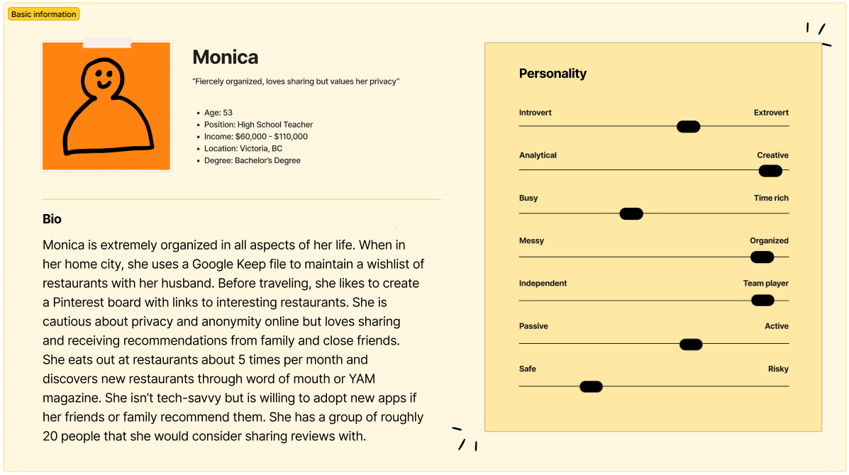
THANKS!

