Slide 1
RestauWants
Track, review, wishlist, and share restaurants with friends.

Slide 2
Planning Slide
Intro
Demo
Mentor Feedback
User Research
RoadMap
Competition
Progress
30 sec
Devin
30 sec
Callum
5 min
Callum
30 seconds
Rebecca
2.5 min
Nick
30 sec
Cam
~30 sec? (Norman?)

Slide 3
Quick Recap
Problem
Solution
Lack of Trust in Public Opinion
Maintaining Restaurant Recommendations
Privacy Concerns with Sharing Reviews
Sharing private Reviews
Trustworthy Recommendations
Keeping a Wishlist

Slide 4


Progress Update
You can now add your friends.

Slide 5

Progress Update
You can now add your friends.
Save your favourite restaurants for later.

Slide 6

Progress Update
You can now add your friends.
Save your favourite restaurants for later.
Restaurant names autofill in search.

Slide 7
Progress Update
You can now add your friends.
Save your favourite restaurants for later.
Restaurant names autofill in search.
Your reviews are editable.

Slide 8
Demo

Slide 9
Your Feedback
Monetization
How to make revenues?
Engagement
Competitors
How is it sticky?
What is our unique selling point?

Slide 10
Our New Solution
Homemade meals
Expanding scope to recipes
Untapped social market
Another means of connection

Slide 11
24 Interviews
Conducted by our team to validate our new idea

Slide 12
The Results
Is there truly a want?
Can we monetize it?
What is the barrier?
Short answer, yes
Real world examples
Lots of interest and excitement
Have two potential users already
Not the social media side
New potential revenue streams:
Influencers selling courses/meal plans/recipes
AI generated recipes
Social pressure is huge
“If my friends use it I’d try”
Inputs must be streamlined
If the want to post is there it will be posted

Slide 13
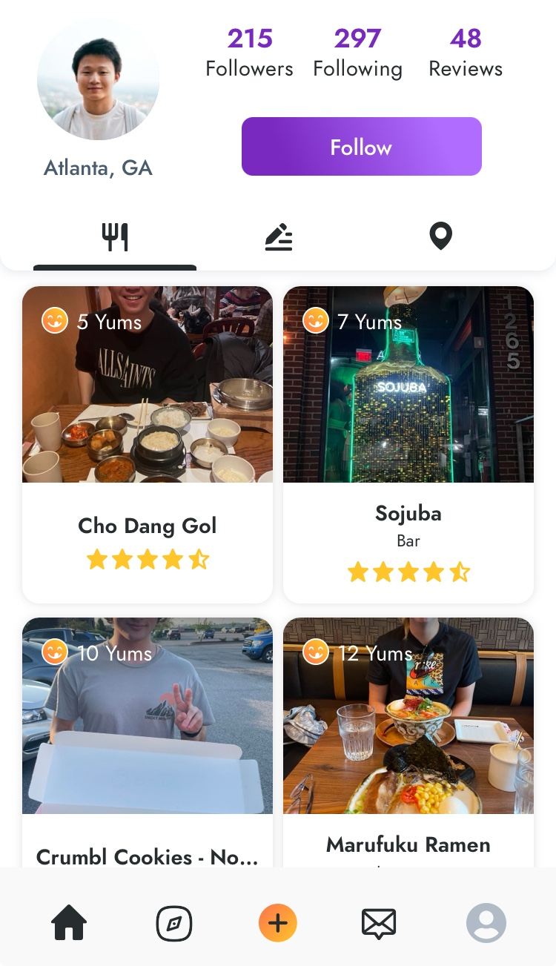
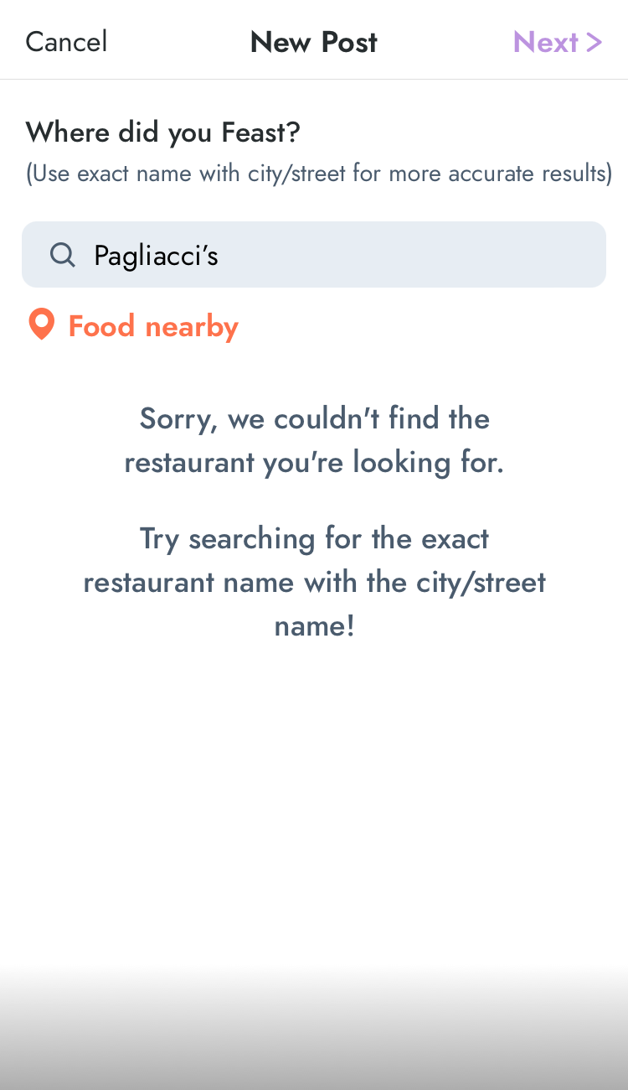
Our Competitors: Feast
Notes:
Feast looks great - it has ratings like our app. But it’s got a fatal flaw - namely it isn’t possible for me to add any posts on my account.

Slide 14
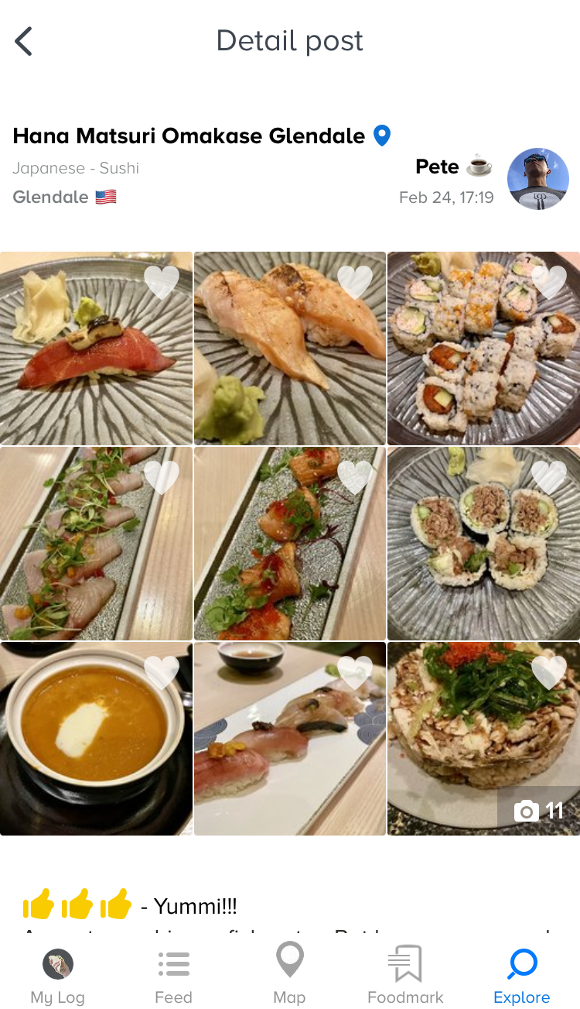
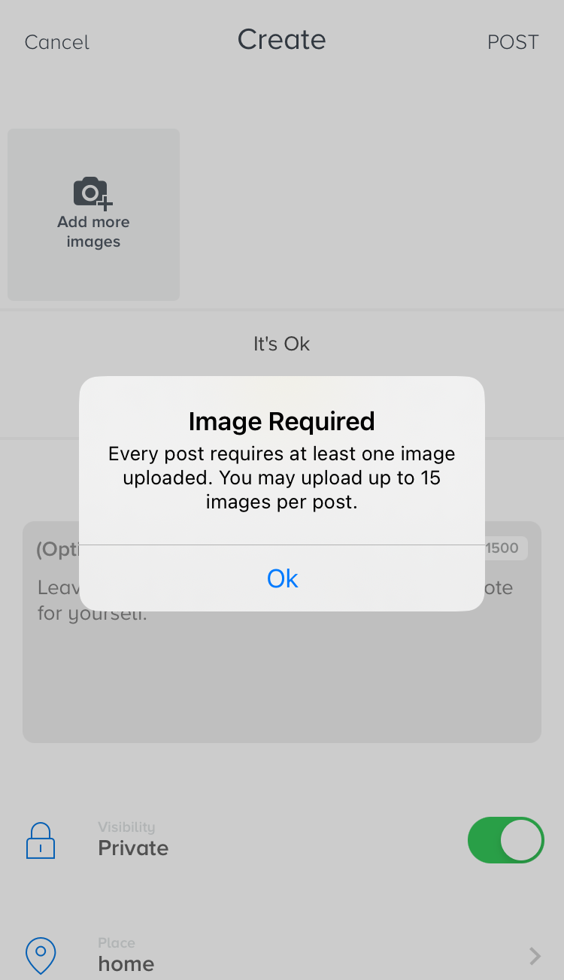
Our Competitors: Yummi
Notes:
Yummi has a lot of users (although some have abandoned the app) – however their app is focused on something different than ours - as you can see you MUST upload an image, but adding any text is optional. This is a service meant for sharing what your food looked like, but nothing beyond that

Slide 15
Roadmap
ID | PRIORITY | FEATURE
REQ-1 | Must-Have | Create, Edit, Delete Review
REQ-2 | Must-Have | Share With and View Reviews From Contacts
REQ-3 | Must-Have | View Your Historical Reviews
REQ-4 | Must-Have | Maintain a Wishlist of Restaurants
REQ-5 | Must-Have | Add Contacts
REQ-6 | Should-Have | Auto Filling of Restaurant Details in Reviews
REQ-7 | Should-Have | Link to Restaurant Websites from Reviews
REQ-8 | Should-Have | Support for Photos in Reviews
REQ-9 | Should-Have | Filters and Search Criteria Within Wishlist
REQ-10 | Should-Have | Search and View Details by Restaurant
REQ-11 | Should-Have | Organizational Features for Wishlist
REQ-12 | Could-Have | Map View
REQ-13 | Could-Have | Comments on Reviews
REQ-14 | Could-Have | Notifications of Activity by Contacts
MILESTONE | FEATURES
M1 | REQ-1 to REQ-3
M2 | REQ-4 to REQ-6
M3 | REQ-8 to REQ-11
Stretch | REQ-12 to REQ-14

Slide 16






The Restauwants Team
Rebecca Jeon
Cam
Rohwer
Callum
Curtis
Devin
Frioud
Norman
Anderson
Nick
Badyal
Uniting food lovers, one plate at a time!
CREDITS: This presentation template was created by Slidesgo, and includes icons by Flaticon and infographics & images by Freepik

Slide 17
Thanks!

Slide 18
Cost Reduction in Manufacturing Industry Project Proposal
Here is where your presentation begins

Slide 19
Contents of this template
You can delete this slide when you’re done editing the presentation
Fonts | To view this template correctly in PowerPoint, download and install the fonts we used
Used and alternative resources | An assortment of graphic resources that are suitable for use in this presentation
Thanks slide | You must keep it so that proper credits for our design are given
Colors | All the colors used in this presentation
Icons and infographic resources | These can be used in the template, and their size and color can be edited
Editable presentation theme | You can edit the master slides easily. For more info, click here
For more info:
Slidesgo | Blog | FAQs
You can visit our sister projects:
Freepik | Flaticon | Storyset | Wepik | Videvo

Slide 20
Table of contents
01
04
02
05
03
06
Objectives
Solutions
Resources
Communication plan
Budget
Conclusion

Slide 21

How to create a project proposal
Creating a project proposal can be done in five steps:
Define the project objectives and timeline
Identify resources needed to complete the project
Develop a budget for the project and estimate any potential risks associated with it
Write down your proposed solution and provide supporting documents or evidence that prove its feasibility if necessary
Develop a communication plan to ensure key stakeholders are kept informed of progress throughout the entire process

Slide 22
01
Objectives of the project

Slide 23
Objectives
Our aim
The goal
An aim in a corporate context is a goal or desired result that the organization seeks to achieve. The aim should be clear and achievable, and often serves as the basis for further planning actions inside the organization
Goals inside a company are usually specific and measurable, with clearly defined deadlines and outcomes. The company’s goals help focus the actions of the organization and ensure resources are used effectively

Slide 24
Resources
Human
resources
Financial resources
Physical resources
The project team is responsible for the successful execution of the project. Our team is composed of experienced professionals with the necessary skills and expertise to complete the project on time and
within budget
Our project budget is $100,000. This budget includes all expenses associated with the project, including salaries and equipment. We have allocated these resources to ensure that we are able to complete the project within budget
Our project requires a number of specialized pieces of equipment. We will be using [insert equipment and their functions]. All equipment is in good working condition and has been tested and calibrated prior to use

Slide 25
Budget
Sources of funding
Personnel costs
Funding for a company can come from personal savings or investments, bank loans and other loan options, venture capital and angel investors, grants, competitions or programs, crowdfunding…
Personnel costs refer to the expenses incurred in hiring, training and retaining staff for a company. This can include salaries, bonuses, benefits and other payroll-related costs
Equipment and materials
Travel and miscellaneous
Equipment and materials costs refer to all the expenses related to the purchasing, maintenance and upkeep of any physical items used in production or other business processes inside the company
Travel and miscellaneous costs refer to expenses related to any travel-related activities, such as conferences, trainings or business trips. It may also include office supplies, communications services, licenses and other miscellaneous expenses

Slide 26
Solutions
Solution 1
Solution 2
Solution 3
Implementing a new CRM (Customer Relationship Management) system to improve customer data management and
sales tracking
Outsourcing specific business functions (such as accounting or IT) to a third-party provider to reduce costs and increase time efficiency
Launching an e-commerce platform to expand the reach of the business and increase online sales
Solution 4
Solution 5
Solution 6
Developing a new product or service to diversify the business and increase revenue streams
Implementing a cost-saving initiative, such as energy-efficient practices or process automation, to reduce expenses
Establishing strategic partnerships with other businesses to gain access to new markets or
innovative technologies

Slide 27
$500,000
200 units
25%
Net profit of the project
Break-even point
Market share in the industry

Slide 28
10 million
First-year revenue of the project

Slide 29
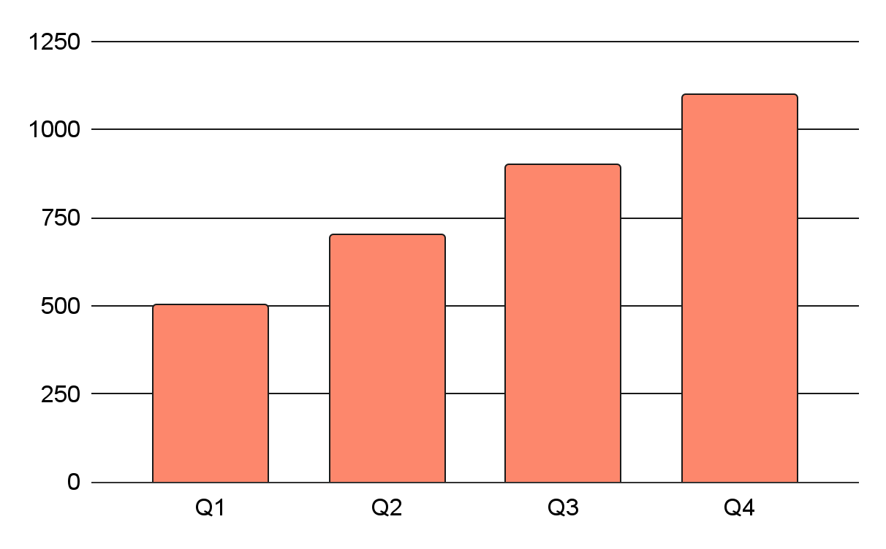
Project data
Benefits of using graphs
Graphs in project proposals offer visual organization, enabling clear presentation of information in a structured format. They enhance the visual appeal, facilitate data comparison and improve overall clarity and professionalism of your project proposal
Follow the link in the graph to modify its data and then paste the new one here. For more info, click here

Slide 30
Project activities
Activity | Start date | End date | Resource | Cost | Revenue
Market research | 1/1/20XX | 1/15/20XX | Market research firm | $20,000
Product development | 1/16/20XX | 6/30/20XX | R&D team | $200,000
Beta testing | 7/1/20XX | 8/15/20XX | Beta testers | $10,000
Marketing campaign | 1/1/20XX | 1/15/20XX | Advertising agency | $100,000
Product launch | 1/16/20XX | 6/30/20XX | Sales team | $50,000 | $500,000
Post-launch support | 7/1/20XX | 8/15/20XX | Support team | $50,000 | $800,000

Slide 31

What to show in a mockup
Product/website description: A brief overview of the product/website, including its key features, dimensions, and materials used
Features and benefits: A detailed explanation of the product's/website's features and how they will benefit the user
Technical specifications: A list of the product's/website's technical specifications, such as dimensions, weight, power requirements, connectivity options and hosting platform

Slide 32
Project timeline
01
02
03
04
Conduct market research and analyze the target audience to identify opportunities
Create the product or service by defining features, design, and functionality
Test the product with a group of users to receive feedback and improve the product
Execute a marketing campaign to promote the product to the target audience
05
06
07
08
Release the product or service to the market with a comprehensive launch plan
Provide customer support to ensure customer satisfaction
Explore opportunities for growth and expansion of the product or service
Continuously improve the product based on customer feedback and market trends

Slide 33
Project roadmap
Initiative | Objective | Jan | Feb | Mar | Apr | May | Jun | Jul | Aug | Sep | Oct | Nov | Dec
Market research | Increase brand awareness by 30% within the first year
Product development | Achieve a customer satisfaction rate of 90%
Marketing campaign | Increase revenue by 20% within the first year
Product launch | Achieve a customer satisfaction rate of 90% within the first year
Expansion | Reduce costs by 15% within the first year by expanding the product
Partnership | Reach profitability within 18 months of launch

Slide 34




Photo showcase
A photo showcase can be a useful addition to a business project proposal as it can help to visually communicate the concept or idea being proposed

Slide 35
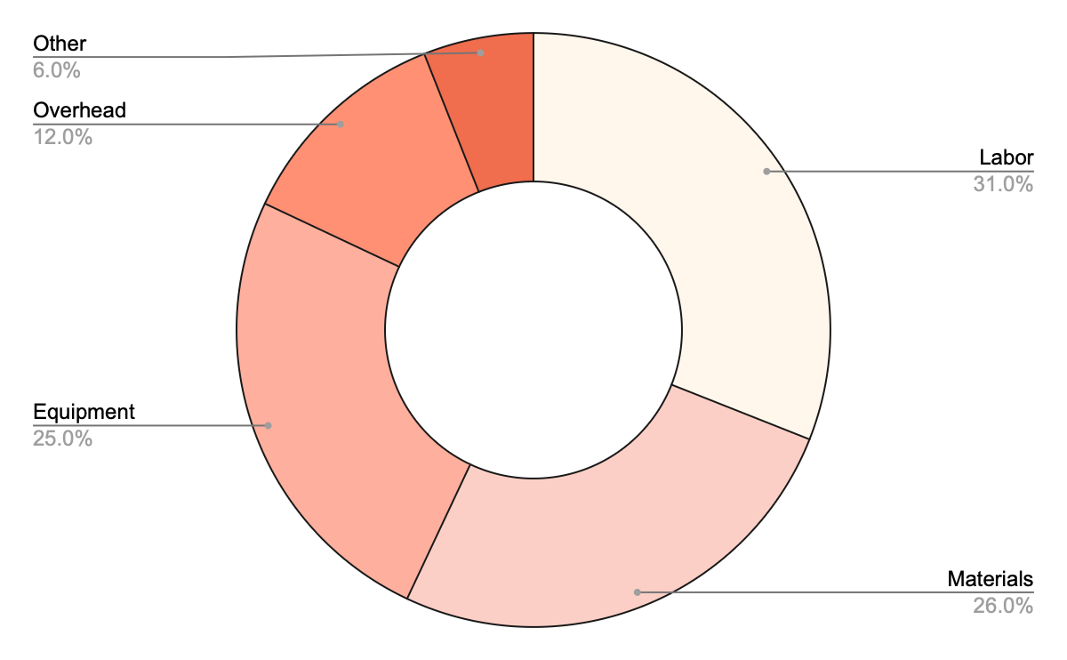
Project expenses
Labor
Materials
Equipment
Overhead
Other
Follow the link in the graph to modify its data and then paste the new one here. For more info, click here

Slide 36
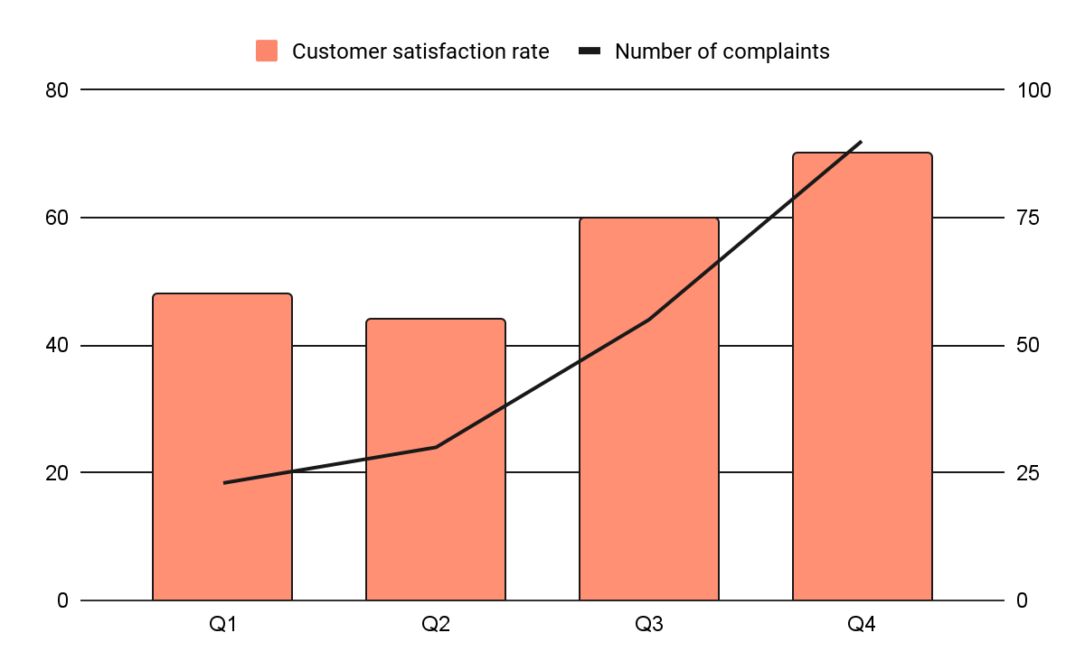
KPI dashboard
Resource | Utilization rate | Cost per unit
Labor | 85% | $50
Equipment | 70% | $100
Materials | 95% | $20
Rent | 90% | $1,000
Energy | 80% | $80
Software licenses | 80% | $200
Advertising | 60% | $500
120 u/day
2h
Output per worker
Time to complete a task
Follow the link in the graph to modify its data and then paste the new one here. For more info, click here

Slide 37
Thanks!
Do you have any questions?
youremail@freepik.com
+34 654 321 432
yourwebsite.com
Please keep this slide for attribution

Slide 38
Alternative resources
Here’s an assortment of alternative resources whose style fits that of this template:
Illustrations:
Flat design minimal interior design id card template
Modern geometric banner

Slide 39
Resources
Did you like the resources used in this template? Get them on these websites:
Illustrations:
Flat design minimalist business card
Hand drawn modern business card template I
Hand drawn modern business card template II
Hand drawn modern business card template III
Hand drawn modern business card template IV
Flat design minimalist business card
Photos:
Man in safety equipment at his workplace
Young woman working in a warehouse I
Young woman working in a warehouse II
Man in safety equipment working
People in safety equipment at their
Medium shot plus-size people working in construction

Slide 40
Instructions for use
If you have a free account, in order to use this template, you must credit Slidesgo by keeping the Thanks slide. Please refer to the next slide to read the instructions for premium users.
As a Free user, you are allowed to:
Modify this template.
Use it for both personal and commercial projects.
You are not allowed to:
Sublicense, sell or rent any of Slidesgo Content (or a modified version of Slidesgo Content).
Distribute Slidesgo Content unless it has been expressly authorized by Slidesgo.
Include Slidesgo Content in an online or offline database or file.
Offer Slidesgo templates (or modified versions of Slidesgo templates) for download.
Acquire the copyright of Slidesgo Content.
For more information about editing slides, please read our FAQs or visit our blog:
https://slidesgo.com/faqs and https://slidesgo.com/slidesgo-school

Slide 41
Instructions for use (premium users)
As a Premium user, you can use this template without attributing Slidesgo or keeping the "Thanks" slide.
You are allowed to:
Modify this template.
Use it for both personal and commercial purposes.
Hide or delete the “Thanks” slide and the mention to Slidesgo in the credits.
Share this template in an editable format with people who are not part of your team.
You are not allowed to:
Sublicense, sell or rent this Slidesgo Template (or a modified version of this Slidesgo Template).
Distribute this Slidesgo Template (or a modified version of this Slidesgo Template) or include it in a database or in any other product or service that offers downloadable images, icons or presentations that may be subject to distribution or resale.
Use any of the elements that are part of this Slidesgo Template in an isolated and separated way from this Template.
Register any of the elements that are part of this template as a trademark or logo, or register it as a work in an intellectual property registry or similar.
For more information about editing slides, please read our FAQs or visit our blog:
https://slidesgo.com/faqs and https://slidesgo.com/slidesgo-school

Slide 42
Fonts & colors used
This presentation has been made using the following fonts:
Sora
(https://fonts.google.com/specimen/Sora)
Kantumruy Pro
(https://fonts.google.com/specimen/Kantumruy+Pro)
#191919
#fff7eb
#f06d4e
#fd876c
#fca692
#fcccc2

Slide 43





Storyset
Create your Story with our illustrated concepts. Choose the style you like the most, edit its colors, pick the background and layers you want to show and bring them to life with the animator panel! It will boost your presentation. Check out how it works.
Pana
Amico
Bro
Rafiki
Cuate

Slide 44
Use our editable graphic resources...
You can easily resize these resources without losing quality. To change the color, just ungroup the resource and click on the object you want to change. Then, click on the paint bucket and select the color you want. Group the resource again when you’re done. You can also look for more infographics on Slidesgo.

Slide 47
JANUARY
FEBRUARY
MARCH
APRIL
MAY
JUNE
PHASE 1
Task 1
Task 2
PHASE 2
Task 1
Task 2
JANUARY
FEBRUARY
MARCH
APRIL
PHASE 1
Task 1
Task 2

Slide 50
...and our sets of editable icons
You can resize these icons without losing quality.
You can change the stroke and fill color; just select the icon and click on the paint bucket/pen.
In Google Slides, you can also use Flaticon’s extension, allowing you to customize and add even more icons.

Slide 51
Educational Icons
Medical Icons

Slide 52
Business Icons
Teamwork Icons

Slide 53
Help & Support Icons
Avatar Icons

Slide 54
Creative Process Icons
Performing Arts Icons

Slide 55
Nature Icons

Slide 56
SEO & Marketing Icons

Slide 57


