Slide 1
NLTK Sentiment Analysis
Submitted to: Dr. Varun
Submitted by:
Akshay Garg-102116048
Divya Arora-102116033
Nikhil-102116061
Pushkar-102116043

Slide 2
Nltk:
NLTK stands for Natural Language Toolkit, and it is a Python library that provides tools and resources for working with human language data. It offers a wide range of functionalities for text processing, including tokenization, stemming, tagging, parsing, and semantic reasoning.
Overall, NLTK is a powerful and widely-used tool for natural language processing tasks, and it is a valuable resource for researchers, developers, and data scientists working with text data.

Slide 3
Sentiment Analysis :
Computer science's Sentiment Analysis has significant connections with Computational Linguistics and Machine Learning. The most popular text categorization tool, sentiment analysis determines if an incoming message's underlying sentiment is positive, negative, or neutral . It is the process of computationally recognizing and classifying opinions stated in a text.
Natural Language Processing and Sometimes referred to as opinion mining

Slide 4
NLTK Sentiment Analysis
Sentiment analysis involves analyzing text to determine the emotional tone of the communication. It involves the use of natural language processing (NLP) techniques to extract and classify opinions, attitudes, and emotions expressed in text. It is used in social media monitoring to track public opinion about a brand, product, or service. Sentiment analysis is also used in market research to gain insights into consumer behavior and preferences. Overall, sentiment analysis is a valuable tool for businesses and organizations to gain insights into customer behavior and preferences, improve customer satisfaction, and make informed decisions.

Slide 5
Examples of sentiment analysis:
“I really like the new design of your website!” → Positive
“I’m not sure if I like the new design” → Neutral
“The new design is awful!” → Negative

Slide 6
Given a movie review or a tweet, it can be automatically classified in categories. These categories can be positive, negative , neutral sentiments. Sentiment Analysis for Brand Monitoring Sentiment Analysis for Customer Service Sentiment Analysis for Market Research and Analysis

Slide 7
Sample Positive text Ankush laughed out loud. He was amused. I feel great after meeting you. Sample Negative Text Ram was angry at Rohan. This building looks horrible. She was attracted towards garden.

Slide 8
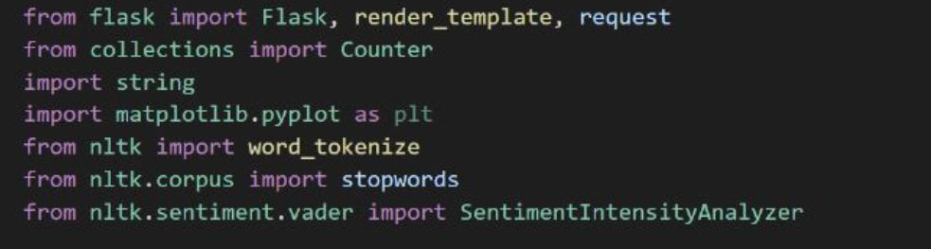
These are all the libraries used inside our web application:

Slide 9
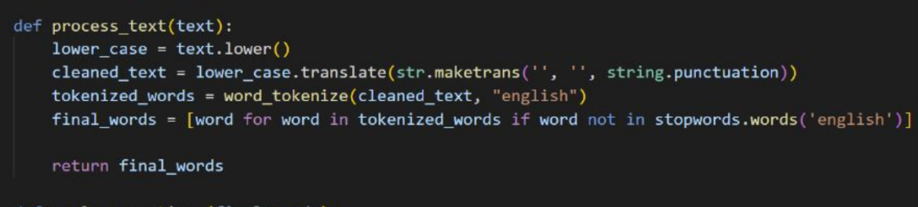
With the aforementioned function, which has all of the standard punctuation symbols inside of it, this text is changed to lower case and all punctuation is deleted. The text parameter of the process text function is a string that denotes some input text. This function's goal is to clean up and pre-process the input text in order to generate a list of "final words" that can be used in subsequent research.

Slide 10
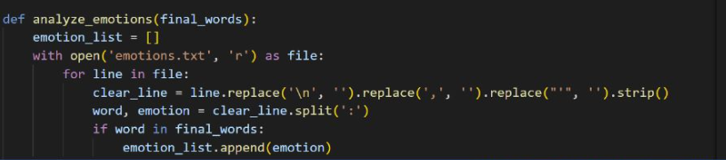
An input list of "final words" is used by the analyze emotions function to analyze the text's emotions. The function reads a text file called "emotions.txt" that lists words and the emotions that go with each one. It then checks to see if each word in the input list is also listed in the emotion file. A list of emotions (emotion list) is updated if a word with an associated emotion is discovered in the emotion file. The function's final output is an object called Counter that tracks the frequency of each emotion in the emotion list.

Slide 11
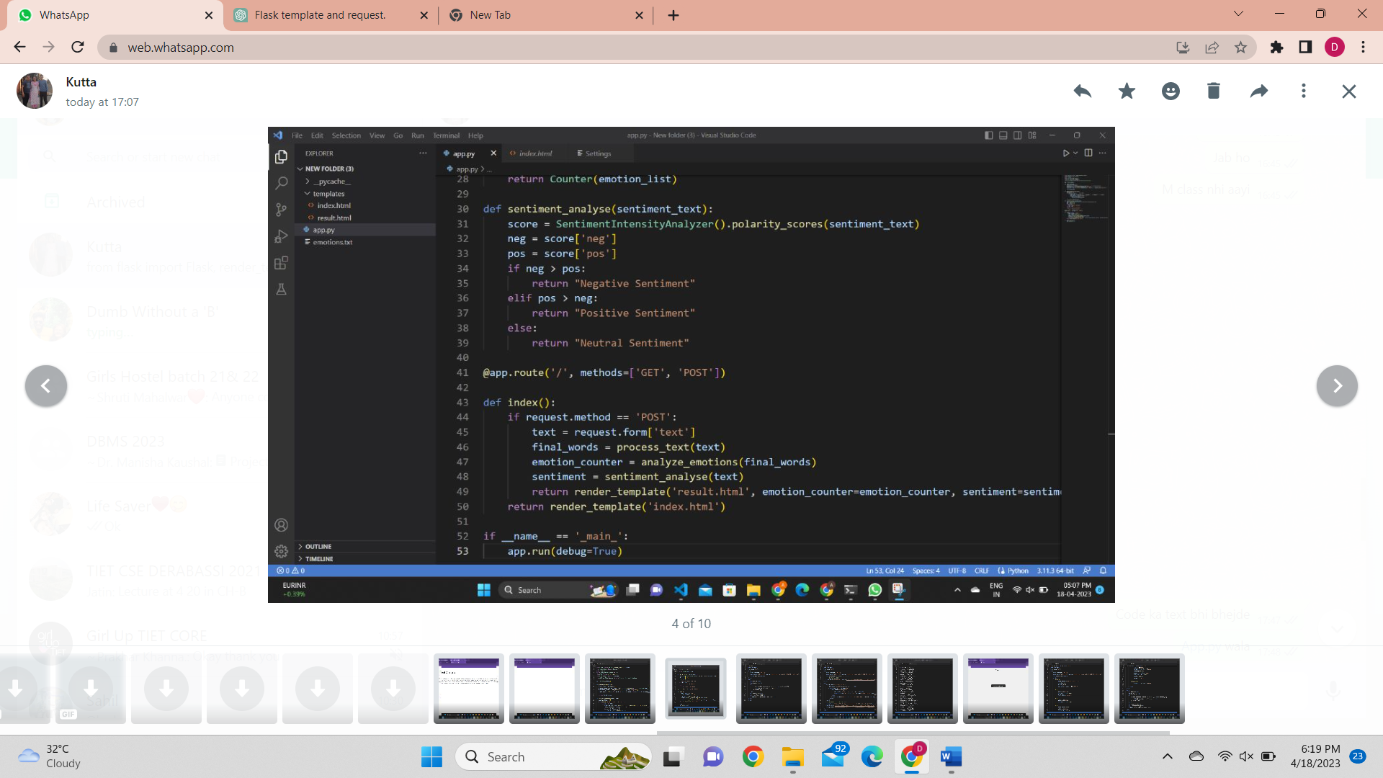
The sentiment_analyse function takes a string of text as input (sentiment_text) and uses the SentimentIntensityAnalyzer class from the nltk.sentiment.vader module to perform sentiment analysis on the text. This function returns a string indicating the overall sentiment of the input text as "Positive Sentiment", "Negative Sentiment", or "Neutral Sentiment".

Slide 12
Thank you

