Slide 1

SRI VENKATAESHWARA COLLEGE OF ENGINEERING AND TECHNOLOGY (AUTONOMOUS)
R.V.S Nagar, Chittoor – 517 127. (A.P)
Department of CSE(AI&ML)
Project Title:
STARTUP FUNDING PREDICTION AND INVESTMENT ANALYTICS
TEAM MEMBERS:
R.MAHENDRA BABU(22781A33A7)
P.REDDY HARISH(22781A33A6)
S.BHAVYA SREE(22781A33C2)
K.MANOHAR(23785A3308)
Guide:
K.ANJANEYULU

Slide 2
AGENDA
INTRODUCTION
ABSTRACT
LITERATURE SURVEY
EXISTING SYSTEM
DRAWBACKS IN EXISTING SYSTEM
PROPOSED SYSTEM
MODULE & MODULE DESCRIPTION
FUTURE SCOPE
CONCLUSION

Slide 3
1. INTRODUCTION
The startup ecosystem has become a major driver of economic growth, innovation, and employment generation. With thousands of startups emerging every year, investors face significant challenges in identifying ventures that have high growth potential. Startup funding decisions are often influenced by intuition, past experience, or limited analysis rather than data-driven insights.
Many startups fail due to improper funding strategies, wrong timing, or lack of investor confidence. At the same time, investors risk financial losses when funding decisions are made without reliable prediction models. Therefore, there is a growing need for an intelligent system that can analyze historical startup data, identify key success factors, and predict funding outcomes accurately. This project aims to address these challenges using machine learning and data analytics.

Slide 4
2. ABSTRACT
This project proposes a machine learning–based system for predicting startup funding success and analyzing investment patterns. By leveraging historical startup data such as industry sector, funding rounds, location, founding year, business model, and founder background, the system predicts the likelihood of funding and estimated investment amount.
The application performs data cleaning, feature engineering, model training, and evaluation to generate meaningful insights. The system provides investors with analytical dashboards and prediction results, enabling data-driven investment decisions and reduced financial risk. This solution enhances transparency, accuracy, and efficiency in startup investment analytics.

Slide 5
3.LITERATURE SURVEY:-
Author / Year | Method Used | Key Focus | Limitations Identified
Mollick (2014) | Statistical Analysis | Funding success factors | No predictive modeling
Kakati & Roy (2019) | Logistic Regression | Startup success prediction | Limited dataset
Shrestha et al. (2020) | Decision Tree, Random Forest | Funding outcome prediction | Handling noisy data
Hastie et al. (2009) | Machine Learning Models | Predictive analytics | Complex interpretation
Scikit-learn Docs | ML Implementation | Model evaluation & tuning | Tool-dependent

Slide 6
HARDWARE AND SOFTWARE REQUIREMENTS
Hardware Requirements:-
Processor: Intel Core i5 / AMD Ryzen 5 or higher
RAM: Minimum 8 GB
Storage: 20 GB free disk space
Software Requirements:-
Operating System: Windows 10/11 or Linux
Programming Language: Python 3.8+
Libraries: NumPy, Pandas, Matplotlib, Seaborn, Scikit-learn
Development Environment: VS Code / Jupyter Notebook

Slide 7
4. Existing System
The existing startup funding analysis systems rely mainly on static reports, manual evaluation, and retrospective analysis. These systems provide historical insights but do not offer predictive capabilities. Investment decisions are often subjective and depend on human judgment rather than data-driven models.
Additionally, existing systems lack automation, scalability, and real-time prediction features, making them inefficient for handling large and dynamic startup datasets.

Slide 8
5. EXISTING SYSTEM DRAWBACKS:
1.No accurate funding prediction mechanism
2.Dependency on manual analysis and intuition
3.Inability to handle large and complex datasets
4.Time-consuming decision-making process
5.High risk of biased investment decisions

Slide 9
5. PROPOSED SYSTEM
The proposed system introduces a predictive analytics framework using machine learning algorithms to forecast startup funding outcomes. The system analyzes historical startup data and extracts meaningful patterns to determine funding probability and potential investment size.
By automating preprocessing, feature engineering, model training, and prediction, the system provides reliable insights to investors and stakeholders. It minimizes human bias, improves decision accuracy, and supports scalable investment analysis.

Slide 10
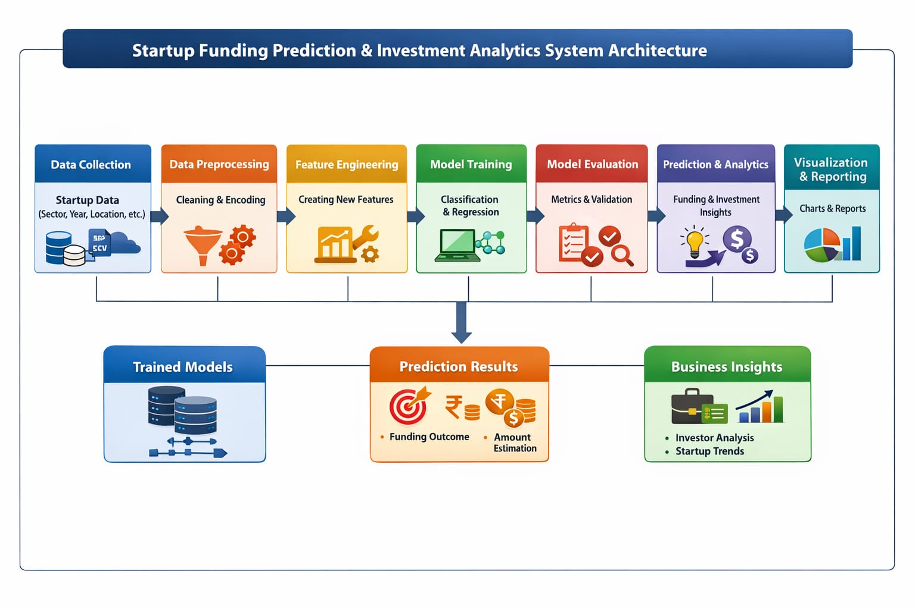
ARCHITECTURE OF THE SYSTEM

Slide 11
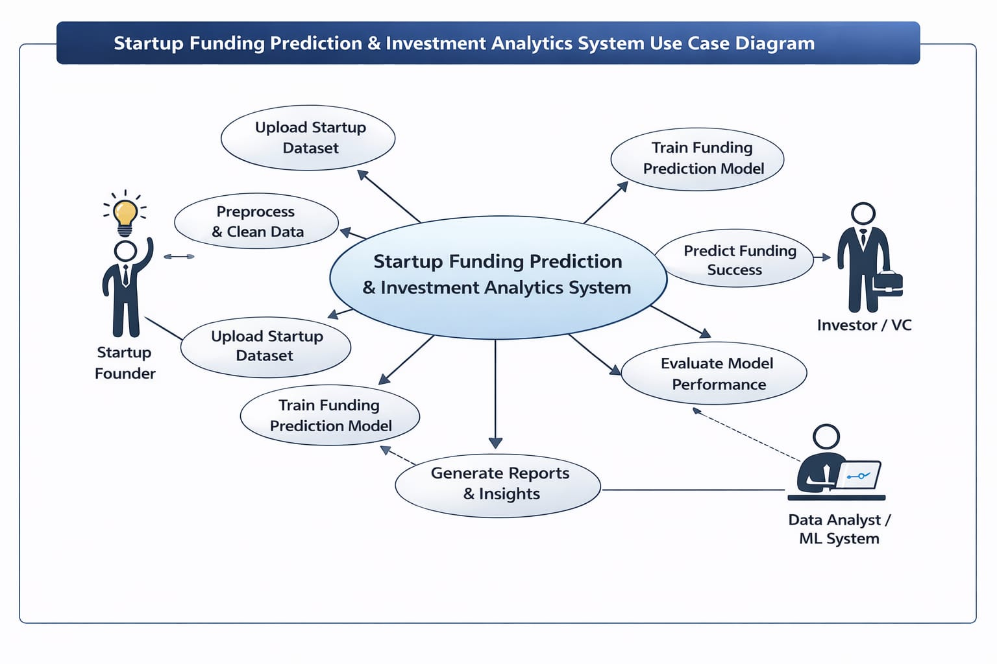

Slide 12
7. MODULE DESCRIPTION :
Data Collection Module:-
Collects startup funding datasets from CSV files or databases containing structured startup attributes.
Data Preprocessing Module:-
Handles missing values, duplicates, outliers, and inconsistent data formats to ensure dataset quality.
Feature Engineering Module:-
Transforms categorical variables, scales numerical features, and selects important predictors for model training.
Model Training Module:-
Implements machine learning models such as Logistic Regression, Random Forest, and XGBoost to predict funding outcomes.
Prediction & Analytics Module:-
Predicts funding success and investment range while generating insights for investors.
Visualization Module:-
Displays trends, funding distribution, and investor insights using graphs and charts.

Slide 13
METHODOLOGY & ALGORITHM :
Methodology:-
Problem identification and requirement analysis
Data collection and cleaning
Feature selection and transformation
Model training and evaluation
Prediction and result analysis
Algorithms Used:-
Logistic Regression
Random Forest
Decision Tree
These algorithms are suitable for classification and regression tasks related to startup funding prediction.

Slide 14
ALGORITHM:
Input Dataset:-
Collect historical startup funding data containing attributes such as sector, location, founding year, funding rounds, and founder background.
Data Preprocessing:-
Remove duplicate records, handle missing values, encode categorical features, and normalize numerical data.
Feature Engineering:-
Extract meaningful features such as startup age, sector-wise funding trends, and funding stage indicators
Dataset Splitting:-
Split the dataset into training and testing sets for model validation.
Model Training:-
Train supervised machine learning algorithms such as Logistic Regression, Decision Tree, Random Forest, and Gradient Boosting.
Model Selection:-
Evaluate models using accuracy and error metrics and select the best-performing model.
Prediction:-
Predict startup funding success and estimate the potential investment amount for new startup data
Result Analysis:-
Display prediction results and analytical insights to support data-driven investment decisions.

Slide 15
IMPLEMENTATION & EXECUTION :
1.The system is implemented using Python and machine learning libraries.
2. The dataset is first cleaned and preprocessed. Feature engineering techniques are applied to improve model performance.
3.Trained models predict the funding outcome and estimated funding amount.
4. The best-performing model is selected based on accuracy and evaluation metrics

Slide 16
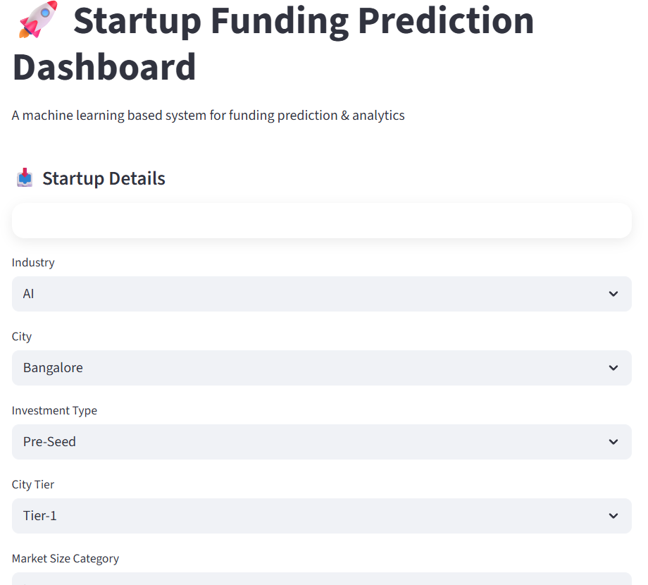
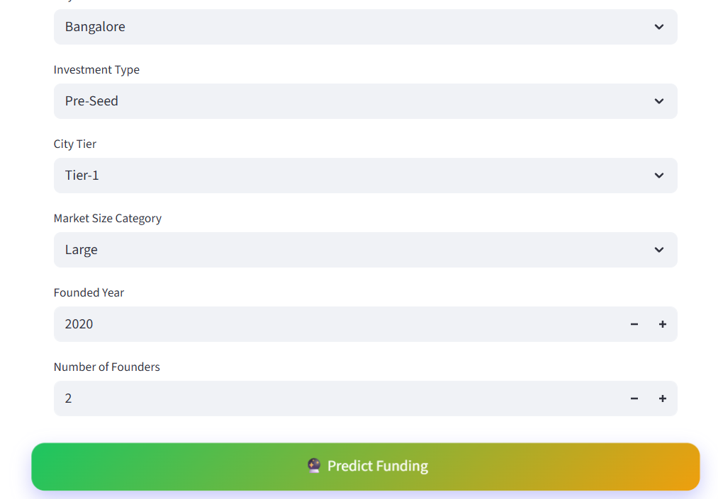
OUTPUT SCREENSHOTS

Slide 17
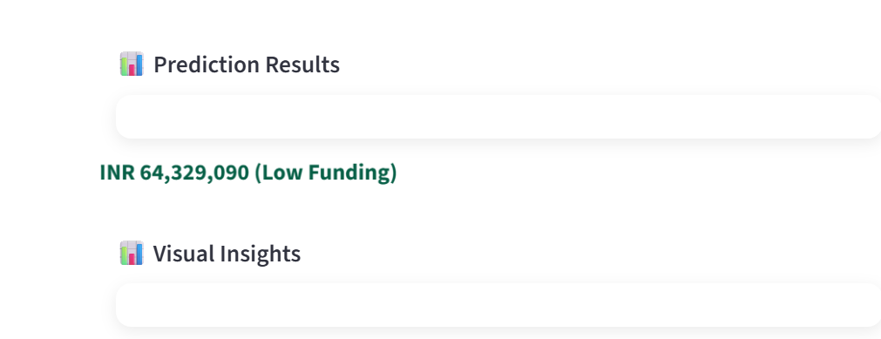
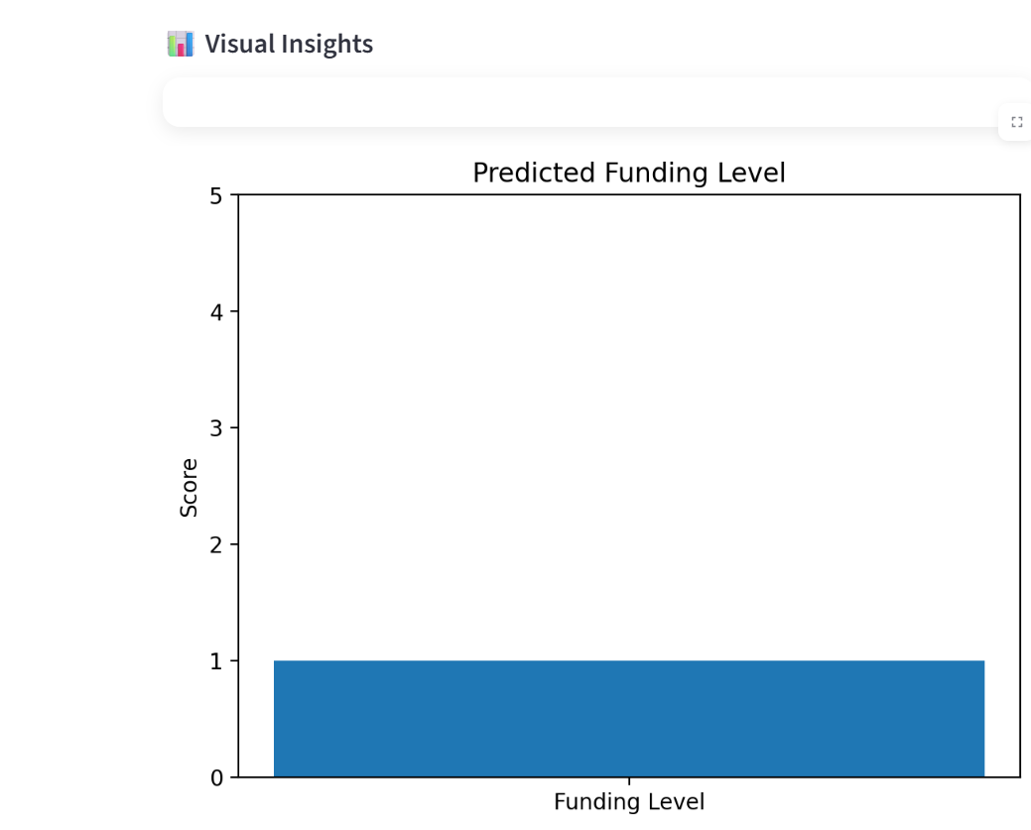

Slide 18
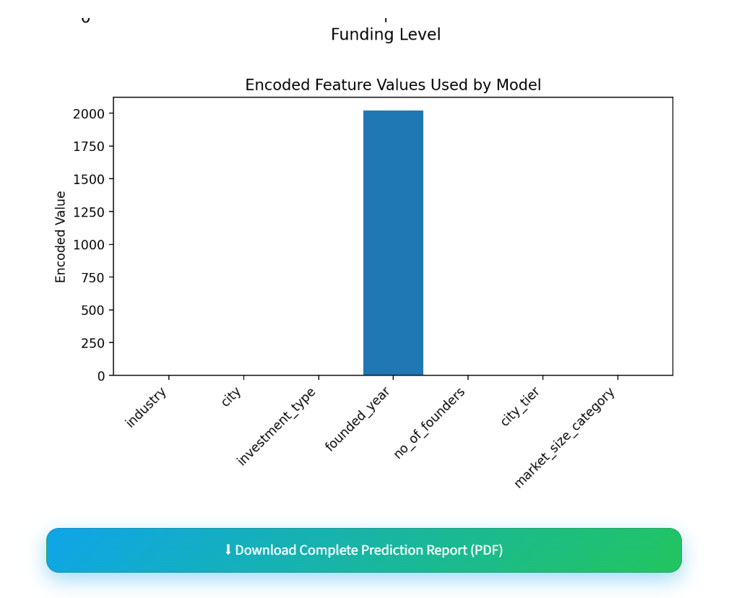

Slide 19
8. FUTURE SCOPE
1.Integration with real-time startup databases
2.Use of deep learning models for advanced prediction
3.Investor recommendation system
4.Web-based interactive dashboard
5.Inclusion of macroeconomic indicators

Slide 20
9. CONCLUSION
This project successfully demonstrates the application of machine learning in startup funding prediction and investment analytics. By converting historical startup data into actionable insights, the system helps investors make informed decisions and reduces investment risk. The proposed solution enhances transparency, efficiency, and accuracy in the startup investment ecosystem.

Slide 21
References:-
T. M. Kakati and J. Roy, “Predicting startup success using machine learning techniques,” International Journal of Business Analytics, vol. 6, no. 3, pp. 45–58, 2019.
C. Mollick, “The dynamics of crowdfunding: An exploratory study,” Journal of Business Venturing, vol. 29, no. 1, pp. 1–16, 2014.
S. Shrestha and P. Shrestha, “Startup funding prediction using supervised machine learning,” IEEE International Conference on Data Science, 2020, pp. 312–318.
I. H. Witten, E. Frank, and M. A. Hall,
Data Mining: Practical Machine Learning Tools and Techniques, 3rd ed., Morgan Kaufmann, 2011.
T. Hastie, R. Tibshirani, and J. Friedman,
The Elements of Statistical Learning, Springer, 2009.
Scikit-Learn Documentation.
Available: https://scikit-learn.org
Kaggle Datasets – Startup Funding & Investment Data.
Available: https://www.kaggle.com
J. Han, M. Kamber, and J. Pei,
Data Mining: Concepts and Techniques, 3rd ed., Elsevier, 2012.
Python Software Foundation,
Python Language Reference, Available: https://www.python.org

Slide 22
Thank You

