Slide 1

Spacecraft Dynamics Lecture - UUM571 - Project Part 1
Name and Surname: Resul Dagdanov
Student ID: 511211135
- Istanbul Technical University - ITU Aeronautical and Astronautical Engineering
Name: Resul Dagdanov ID: 511211135
Slide No. 1

Slide 2
Project Part 1 Overview
Travel to planet Mars from planet Earth.
Wait on Mars parking orbit until return window is opened.
Stages:
1) Launch Platform Coordinates Selection
2) Determine Appropriate Launch Date & Time
3) Rocket Launch to Earth Parking Orbit (500km)
4) Conduct Hyperbolic Escape Trajectory Maneuver
5) Apply Hohmann Transfer to Mars
6) Travel to Mars Parking Orbit with Hyperbolic Maneuver
7) Wait Until Return Window is Opened
Name: Resul Dagdanov ID: 511211135
Slide No. 2

Slide 3
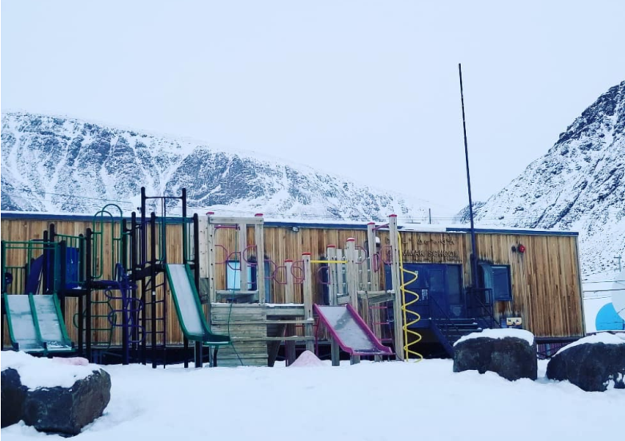
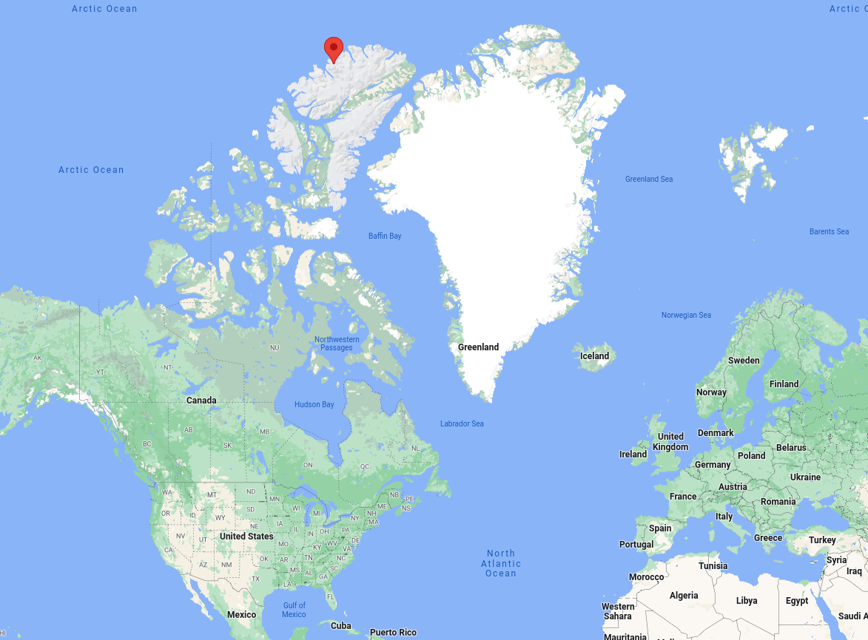
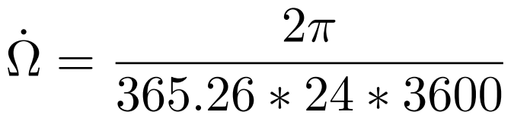
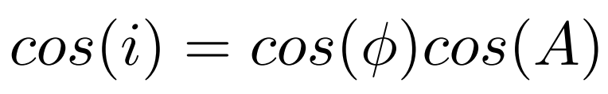
Launch Location Selection
Sun-synchronous Earth circular parking orbit is chosen.
Does not have to be eligible/realistic location.
Azimuth Angle: A = 279.3489 degrees
Orbital Inclination: i = 97.401 degrees
average rate of change of the the right ascension:
Latitude Angle: L = 82.499 degrees
Name: Resul Dagdanov ID: 511211135
Slide No. 3

Slide 4
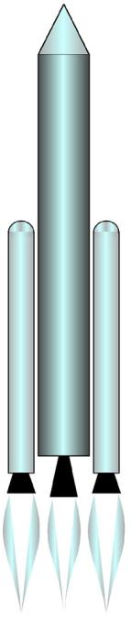
Launch Vehicle Design
Design Properties:
Launch vehicle rocket will burnout at an altitude of 500 km.
Only one stage rocket is designed.
Parameters:
Rocket thrust (constant): T = 10^6 N
Diameter: d = 3.7 m
Drag coefficient: Cd = 0.5
Frontal area of the launch vehicle: A = 10.75 m^2
Flight path angle: gamma = 90 degrees
Earth parking orbit spacecraft mass: m_pl = 6666 kg
Launch vehicle propellant mass: m_p = 54321 kg
Rocket empty mass: m_e = 12345 kg
Total Launch Vehicle tandem-stacket mass: m = 73332 kg
Name: Resul Dagdanov ID: 511211135
Slide No. 4

Slide 5
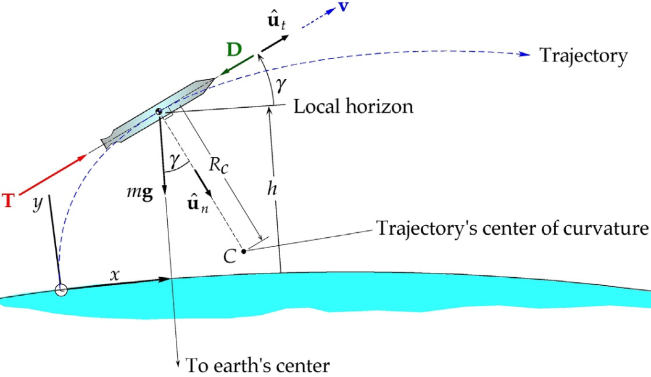
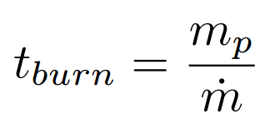
Rocket Performance
Changing gravitational acceleration w.r.t. altitude
Fuel flow rate is considered constant: m_d = 165.8728 kg/s
Experimentally selected specific impulse: I = 614.548 s
Assumed that flight path angle is constant
Total fuel burning time until reached to
Earth parking orbit: t = 327.48588 s
5 minutes and 28 seconds
Spacecraft speed after burnout: v = 4.95288 km/s
Name: Resul Dagdanov ID: 511211135
Slide No. 5

Slide 6
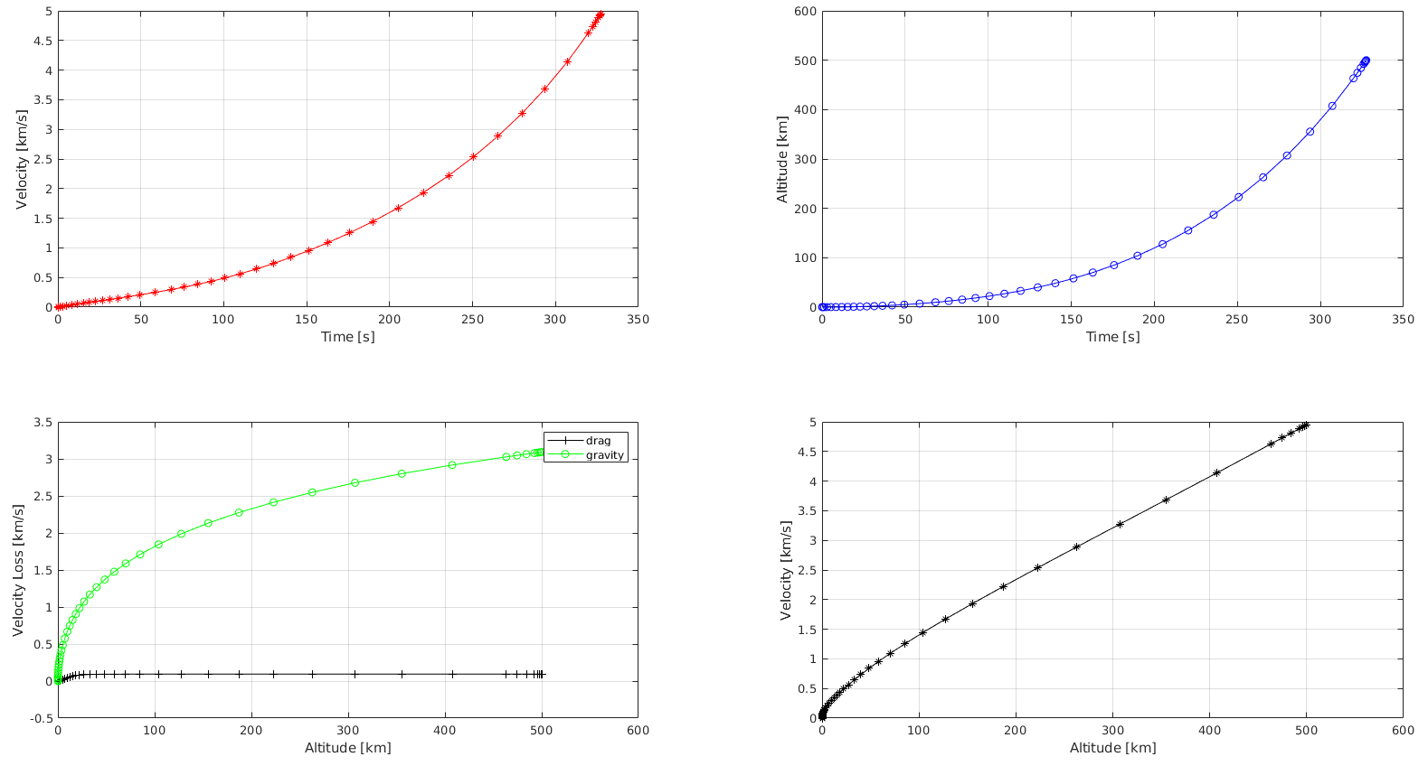
Rocket Performance
Velocity at Earth circular parking orbit: v = 7.61258 km/s
Spacecraft velocity after rocket burnout: v = 4.95288 km/s
Delta V = 2.6597 km/s
Name: Resul Dagdanov ID: 511211135
Slide No. 6

Slide 7
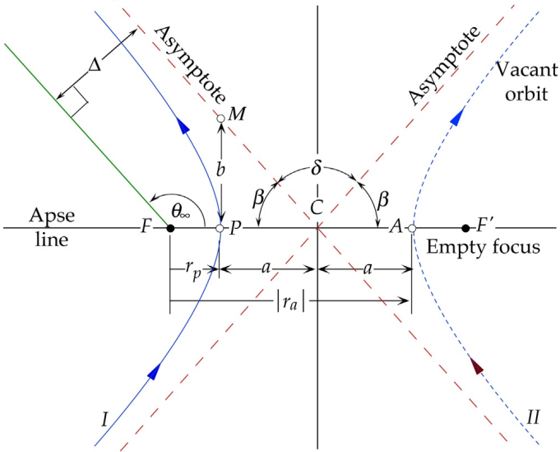
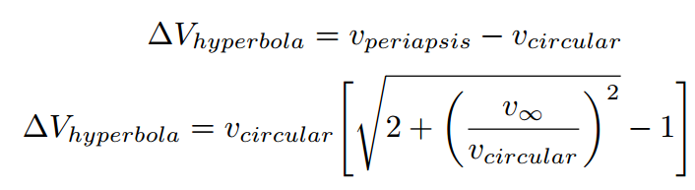
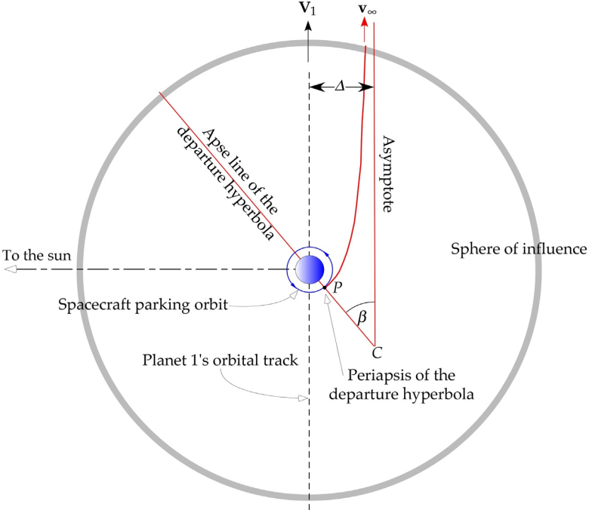
Escape Earth SOI
Specific impulse of spacecraft to make an interplanetary delta-v maneuver: I = 321 s.
Hyperbolic excess speed of the Earth departure hyperbola: V∞ = 2.94346 km/s
Delta V = 3.54840 km/s
Perigee of a departure hyperbola with respect to the Earth velocity vector:
beta = 29.54795 degrees
Using an orbit equation for reaching Earth SOI radius:
theta = 148.87471 degrees
Total duration of the spacecraft while in hyperbolic trajectory: t = 273086.80638 s
3 days, 3 hours, 51 minutes, and 27 seconds
Name: Resul Dagdanov ID: 511211135
Slide No. 7

Slide 8
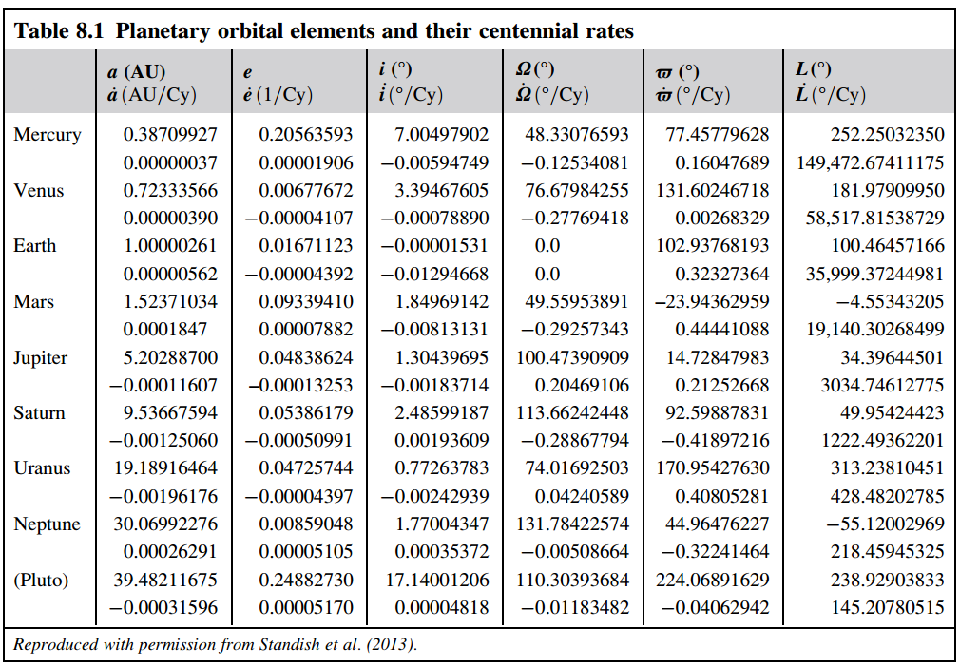
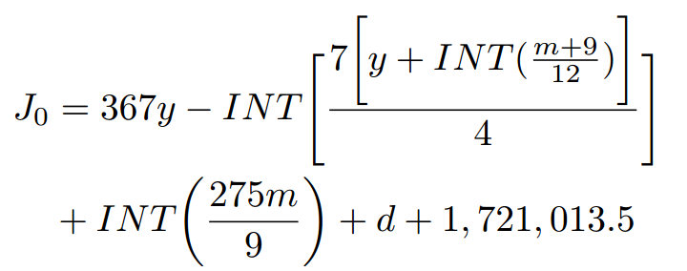


Planetary Ephemeris
After adding additional 3 days, 3 hours, 56 minutes, and 55 seconds to the launch date and time,
the Hohmann transfer maneuver will be initialized:
Year : 2023
Month : May
Day : 10
Hour : 3 p.m.
Minute : 8
Second : 6
Julian day number:
Using Kepler’s equation to calculate eccentric anomaly E.
Mean anomaly: Planetary True Anomaly:
Name: Resul Dagdanov ID: 511211135
Slide No. 8

Slide 9
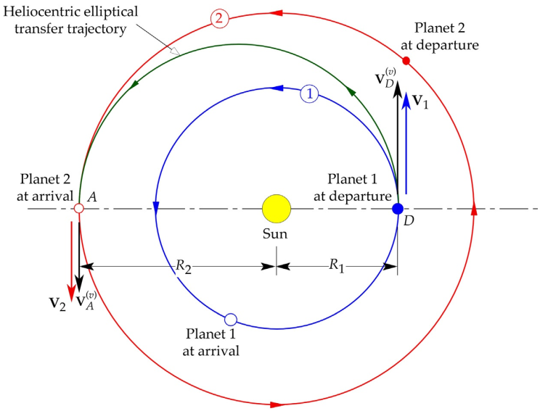
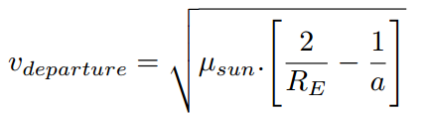
Hohmann Transfer
Assumptions:
inclination of planetary orbital trajectories of the planets Earth and Mars are assumed to be 0 degrees; so the
Earth and Mars have the co-planar orbits.
solar orbits of the planets Earth and Mars in heliocentric orbital plane are assumed to be circular orbits; so the
eccentricity of these orbits are equal to 0.
Solar effects and space perturbations are neglected.
True anomaly difference between planets is 44.32 degrees.
The duration of Hohmann transfer:
t = 22362713.30644 s
258 days, 19 hours, 51 minutes, and 53 seconds
Spacecraft’s heliocentric velocity: V = 32.72794 km/s
Name: Resul Dagdanov ID: 511211135
Slide No. 9

Slide 10
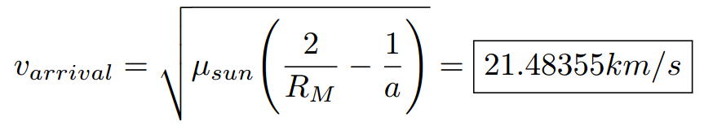
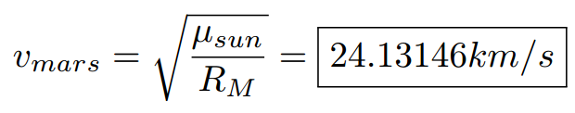
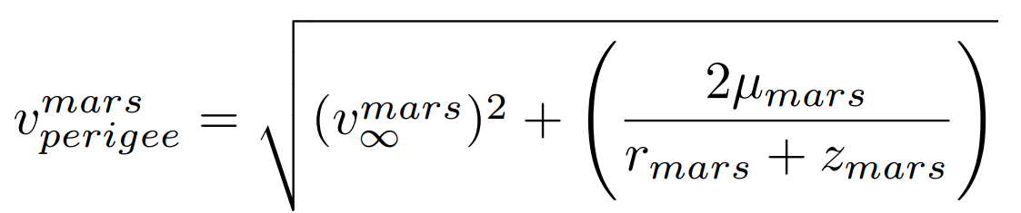

Mars Arrival
The spacecraft will enter to the Mars SOI in 2024 year, January, 24th, 10 a.m., 59 min, and 59 sec.
The speed of the spacecraft after Hohmann transfer at Mars SOI location:
The speed at Mars capture orbit (at Mars SOI radius):
The spacecraft velocity relative to Mars at periapse of approach hyperbola:
Delta-V for stay in mars circular orbit:
Name: Resul Dagdanov ID: 511211135
Slide No. 10

Slide 11
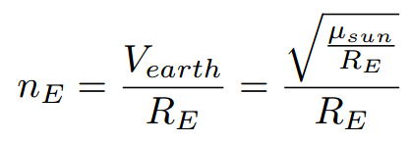


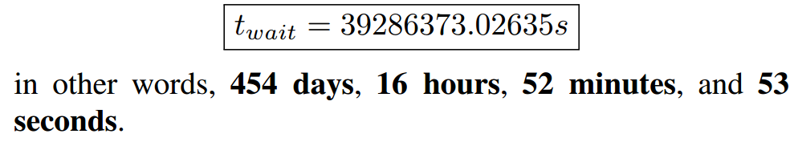
Wait for Next Window
The spacecraft will enter to the Mars SOI in 2024 year, January, 24th, 10 a.m., 59 min, and 59 sec.
Earth and Mars planets mean angular velocity (circular orbit assumption):
Initial phase angle between Earth and Mars:
Final phase angle between Earth and Mars:
Waiting time:
Name: Resul Dagdanov ID: 511211135
Slide No. 11

Slide 12
Conclusion
Codes and simulation are conducted in MATLAB.
Detailed report is submitted to the Ninova system with all codes and simulations, including LaTEX file.
Only one reference is used throughout the study:
“H. Curtis, Orbital mechanics for engineering students. ButterworthHeinemann, 2013”
Report is 6 pages in IEEE format written in LaTEX.
To-Do:
Detailed readme to be added to the simulation codes.
Simulation graphics will be added in the next part of the project.
Align with others to make sure that ephemeris and delta-v calculations are correct.
Name: Resul Dagdanov ID: 511211135
Slide No. 12

