Slide 1

Spacecraft Dynamics Lecture - UUM571 - Project Part 2
Name and Surname: Resul Dagdanov
Student ID: 511211135
- Istanbul Technical University - ITU Aeronautical and Astronautical Engineering
Name: Resul Dagdanov ID: 511211135
Slide No. 1

Slide 2
Project Part 2 Overview
Detecting Mars eclipse.
Kalman filter for estimating sensor measurements
Stages:
1) General information about Kalman Filter
2) Detect Mars eclipse or shadow in parking orbit
3) Construction of the EKF algorithm
4) Apply two experimental cases with/out Rate-Gyro
5) Calculate RMS Errors
Name: Resul Dagdanov ID: 511211135
Slide No. 2

Slide 3
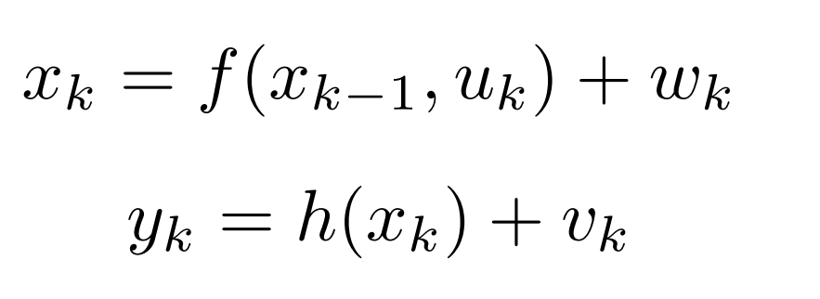


Extended Kalman Filter Introduction
Applied for both non-linear and linear systems.
F: state transition matrix
H: observation matrix
Q: process noise covariance
R: measurement noise covariance
x: initial state estimate
P: initial covariance estimate
z: measurement vector
Name: Resul Dagdanov ID: 511211135
Slide No. 3

Slide 4
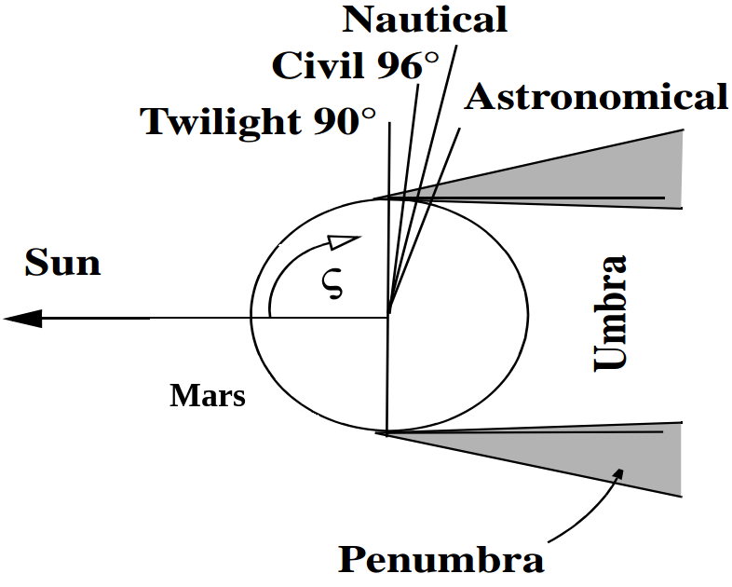



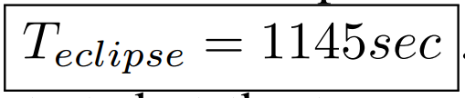
Detect Mars Eclipse
From Project Part 1, the spacecraft will be on a 300
km parking orbit of Mars on the date 2024 year, January
month, 24th day, hour 10 a.m., 59 minutes, and 59
Seconds.
Julian Date
Longitude and Mean Anomaly of Mars
Name: Resul Dagdanov ID: 511211135
Slide No. 4

Slide 5
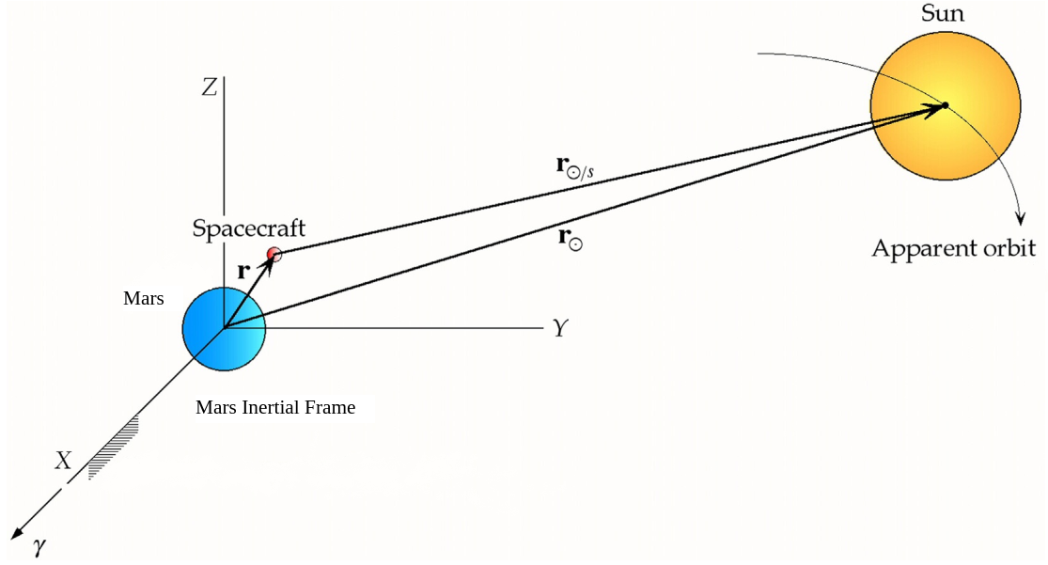

Sun Position Vector
Name: Resul Dagdanov ID: 511211135
Slide No. 5

Slide 6
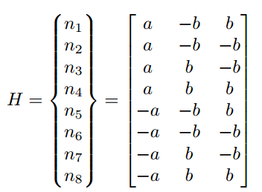




EKF Approach
Zero mean gaussian noise for both dynamic and measurement functions
Name: Resul Dagdanov ID: 511211135
Slide No. 6

Slide 7
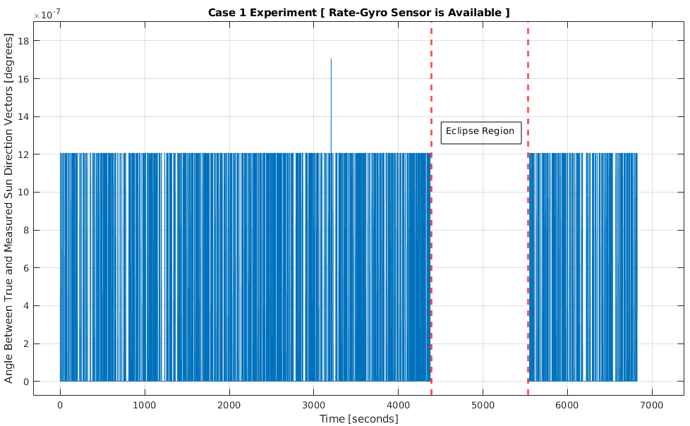
Experiments Case 1
Name: Resul Dagdanov ID: 511211135
Slide No. 7

Slide 8
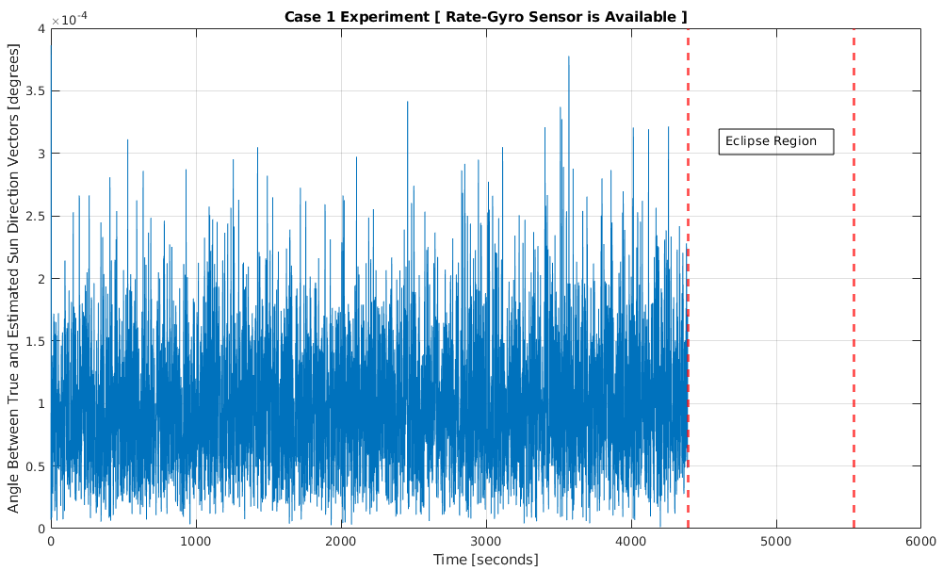
Experiments Case 1
Name: Resul Dagdanov ID: 511211135
Slide No. 7

Slide 9
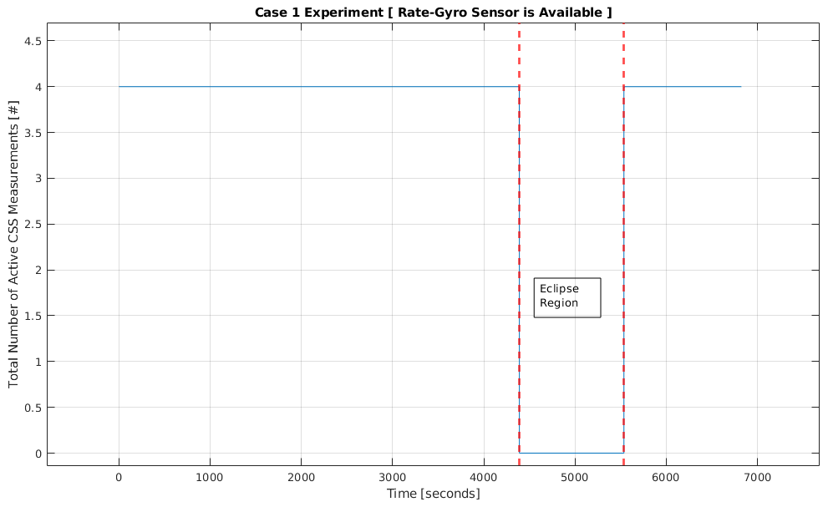
Experiments Case 1
Name: Resul Dagdanov ID: 511211135
Slide No. 7

Slide 10
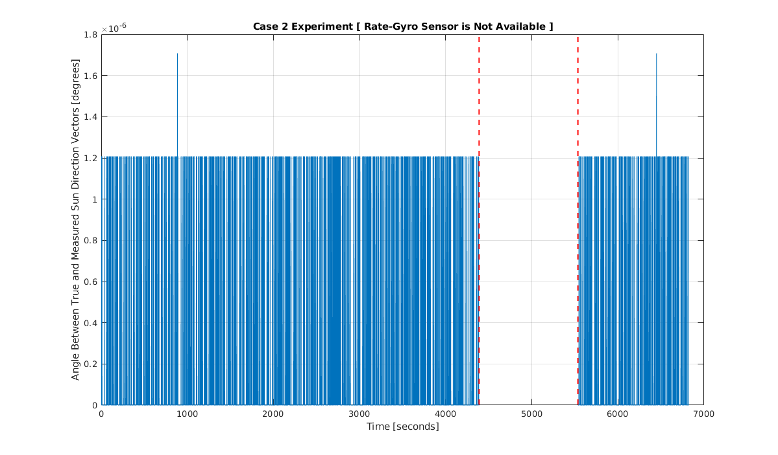
Experiments Case 2
Name: Resul Dagdanov ID: 511211135
Slide No. 7

Slide 11
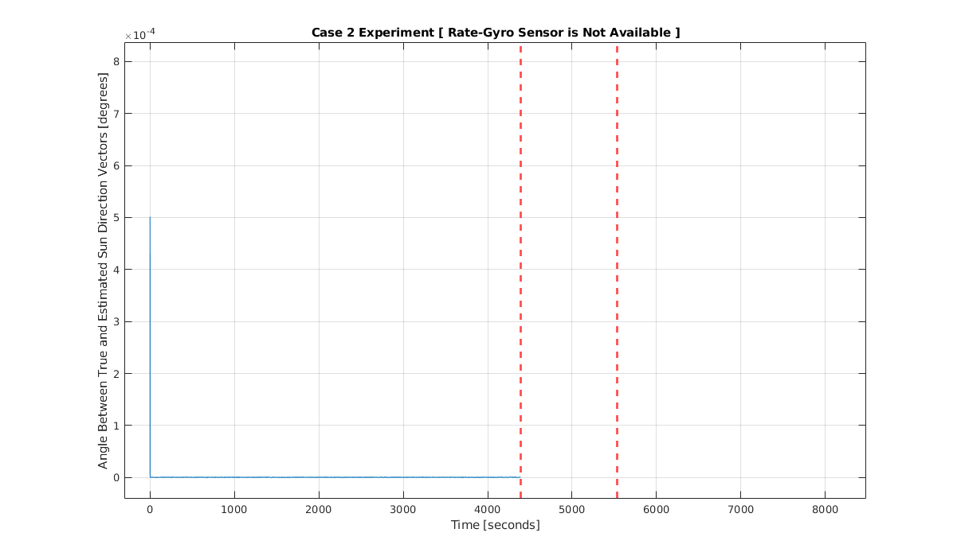
Experiments Case 2
Name: Resul Dagdanov ID: 511211135
Slide No. 7

Slide 12
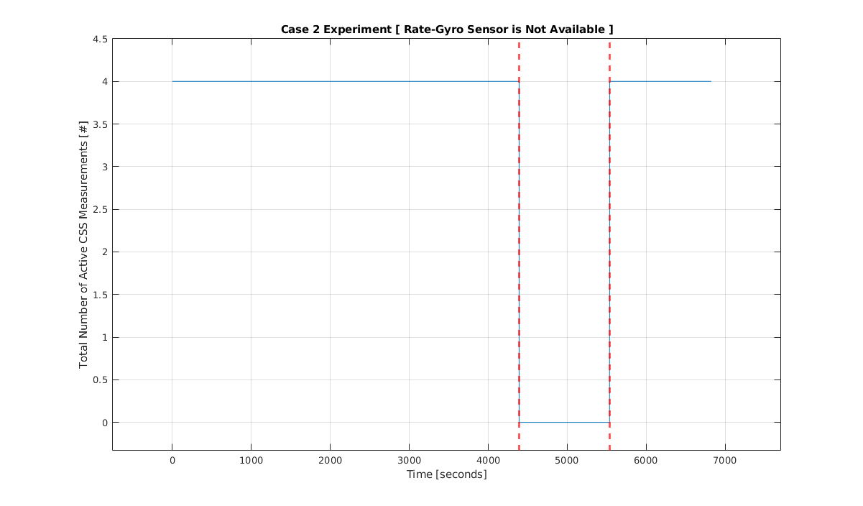
Experiments Case 2
Name: Resul Dagdanov ID: 511211135
Slide No. 7

Slide 13
RMS Errors in Sun Direction Estimation
Case 1: (Rate-Gyro available)
RMS Error Angle Between True and Estimated: 217.2029 km
Case 2: (Rate-Gyro not available)
RMS Error Angle Between True and Estimated: 16.1830 km
Name: Resul Dagdanov ID: 511211135
Slide No. 7

Slide 14
Conclusion
Codes and simulation are conducted in MATLAB.
Detailed report is submitted to the Ninova system with all codes and simulations, including LaTEX file.
Name: Resul Dagdanov ID: 511211135
Slide No. 12

