Slide 1

DATA ANALYSIS · SQUAD BUILDER
FIFA World Cup 2026
Three Squads: Worst Value, Best Budget & Dream Squad
Built from real, verified Transfermarkt market values vs. average match rating
47
Players in the 'Worst Value' pool
389
Players in the 'Best Budget' pool
824
Total players analyzed (≥2 matches)
Source: player_ratings.csv · match_statistics.csv · Transfermarkt (verified)
Prepared by Resul Işık

Slide 2
In This Deck
01
Tournament Snapshot
02
Possession & Goal Rate
Goals, cards, correlations, top players
Does more possession really mean more goals?
03
Methodology
04
Three Squads
How the three squads were built
Worst Value, Best Budget & Dream Squad
05
Value Extremes
06
Comparison & Takeaways
Highest/lowest market value & price/performance
Side-by-side and key conclusions

Slide 3
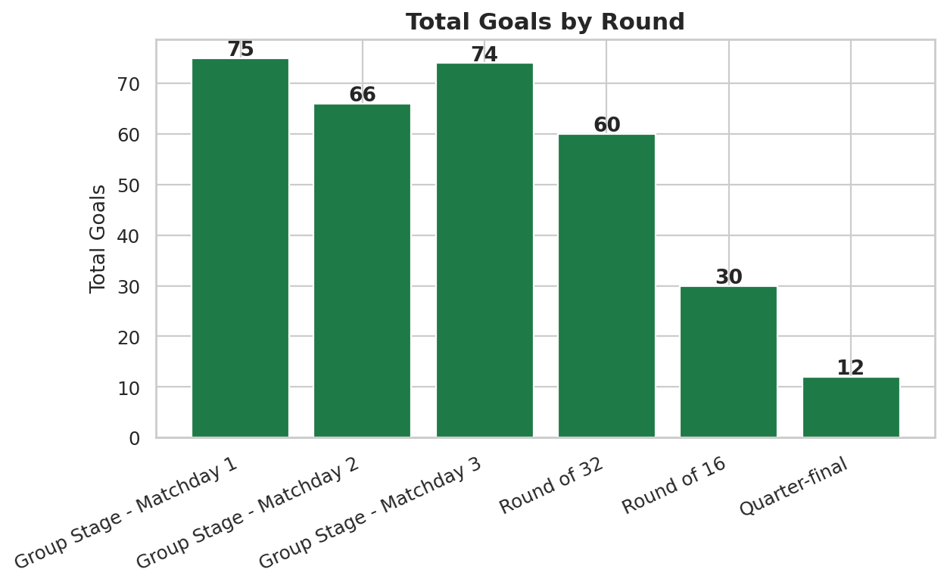
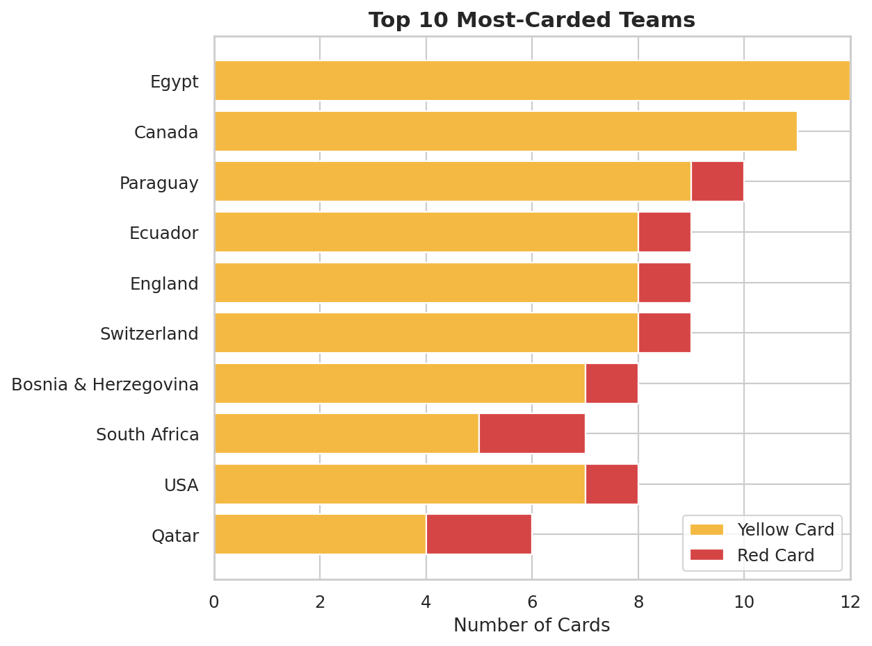
Tournament Snapshot: Goals & Discipline
317 goals in 100 matches (3.17/match) · 100 matches through the Quarter-final
Goals stayed high through every round of the tournament.
Colombia, Morocco and Tunisia top the disciplinary table.

Slide 4
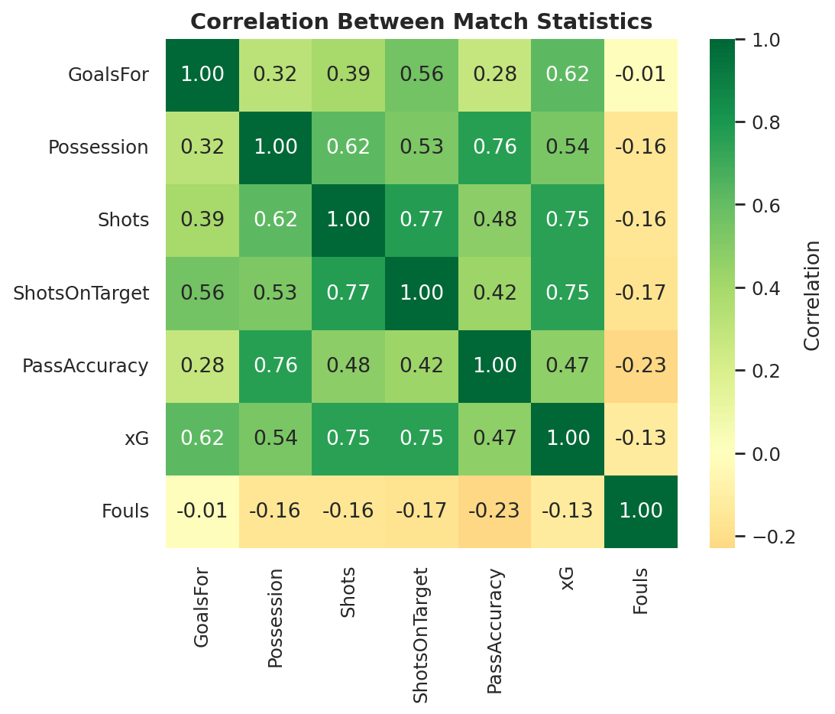
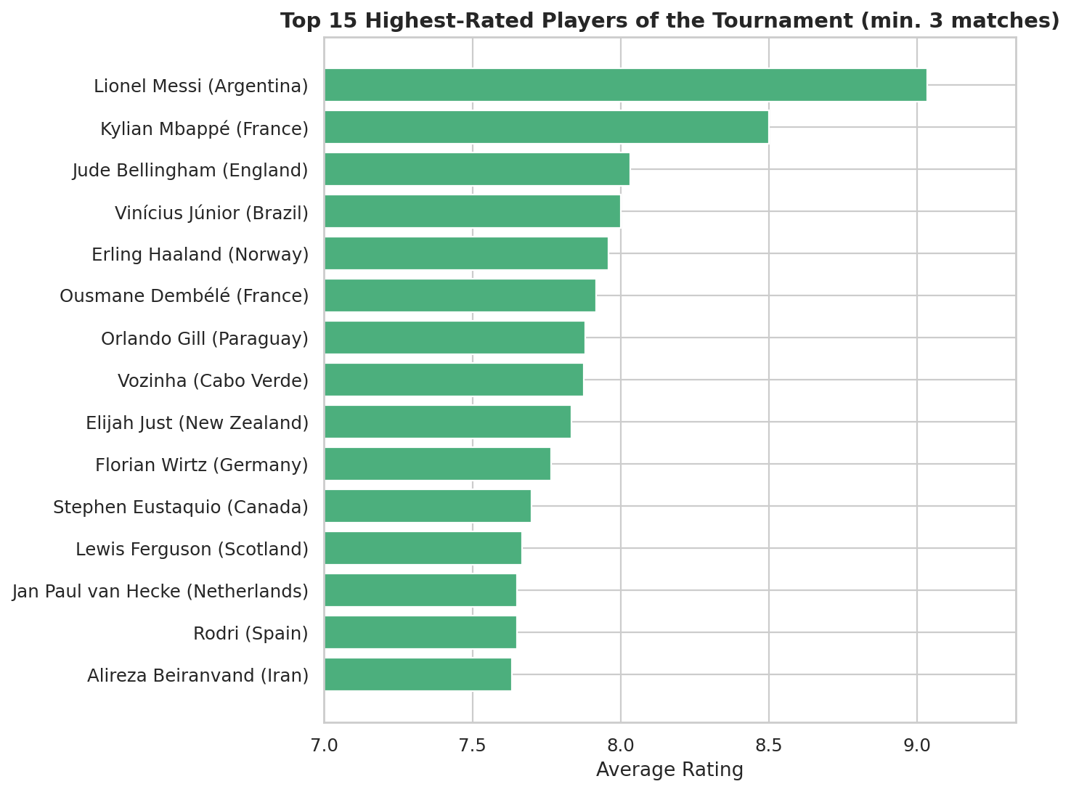
Tournament Snapshot: What Drives Goals & Who Stood Out
Correlation matrix of match stats · top 15 rated players (min. 3 matches)
xG (r≈0.62) explains goals far better than possession (r≈0.32).
Messi, Mbappé and Haaland lead the individual ratings.

Slide 5
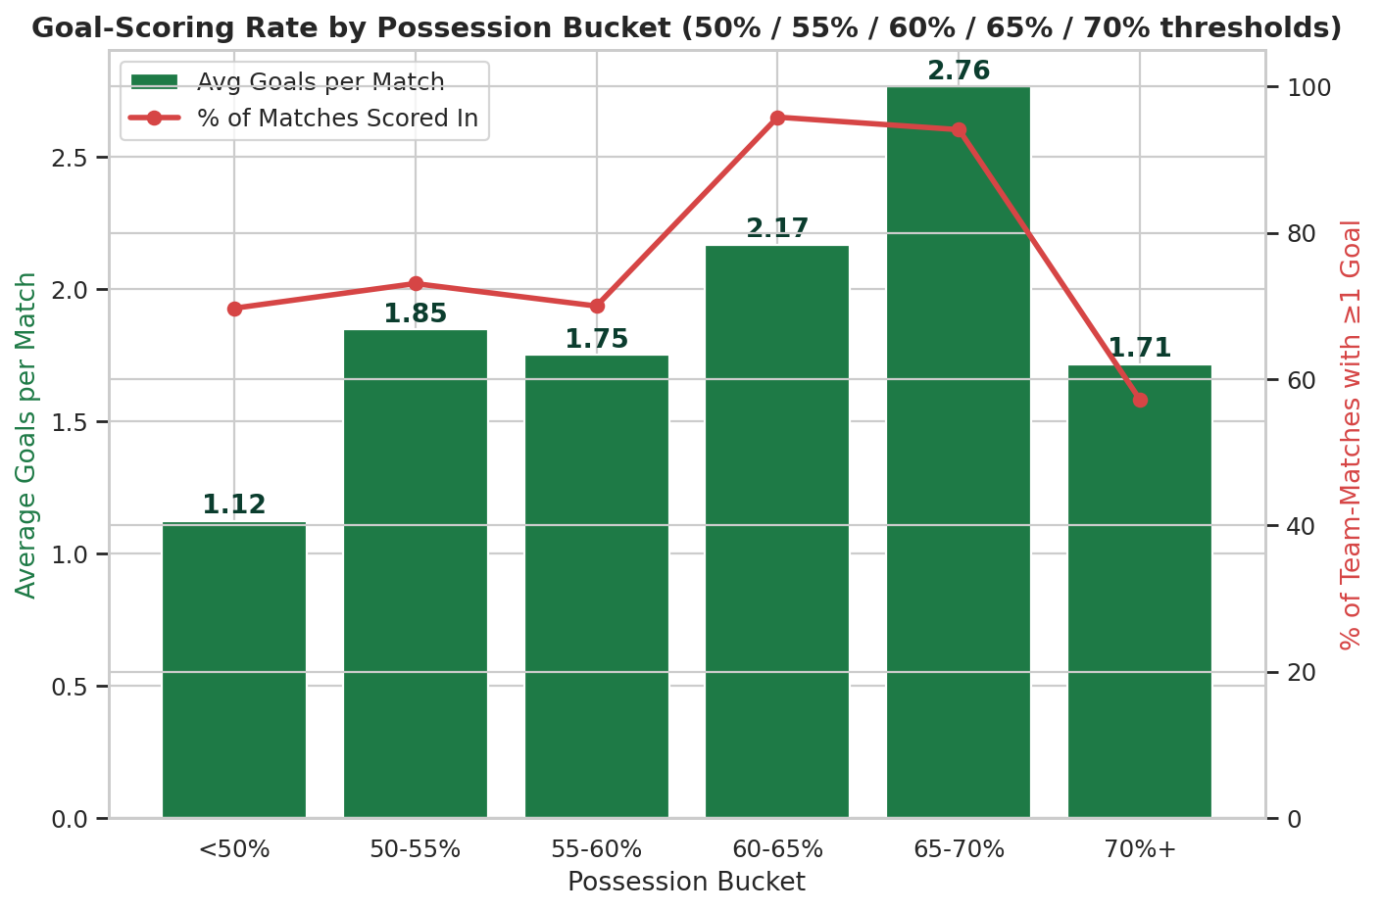
Goal-Scoring Rate by Possession Bucket
How does scoring change as possession crosses the 50% / 55% / 60% / 65% / 70% thresholds?
Reading the chart
Bars = average goals per match in that possession bucket.
Line = % of team-matches with at least 1 goal.
Both peak at 65-70% possession, then drop at 70%+.
Goals rise steadily with possession up to 65-70% (2.76 goals/match), but the 70%+ bucket falls back to just 1.71 goals and a 57% scoring rate — the lowest of any bucket, suggesting a point of diminishing returns.

Slide 6
Methodology
Same regression baseline used across all three squads for a fair comparison
1
Base pool: every player with ≥ 2 matches played (824 players), using real Transfermarkt market value.
2
A regression AvgRating ~ log10(MarketValue) is fit once on the full pool.
3
Each player's ValueResidual = actual rating − predicted rating for their price. Positive = outperforming price, negative = underperforming.
4
The three squads below simply apply different filters to this same residual before picking the best (or worst) player per position (4-3-3).

Slide 7
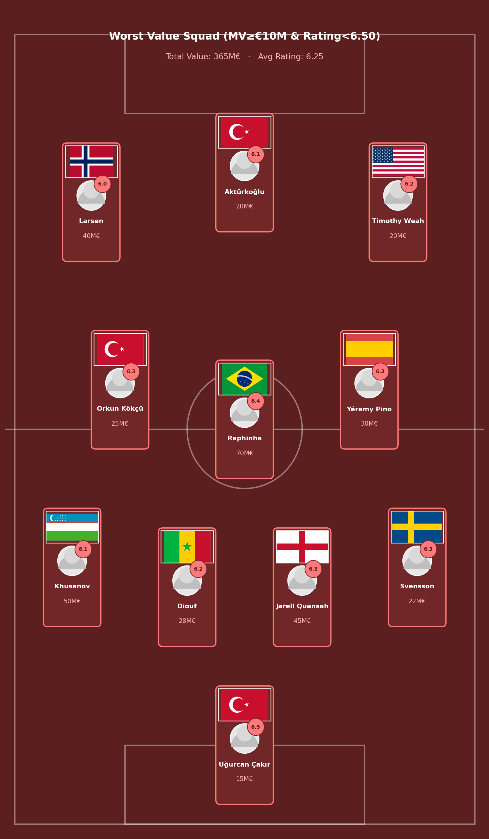
Worst Value Squad
Filter: Market Value ≥ €10M AND Average Rating < 6.50
Total value: €365M · Average rating: 6.25
Worst per position
Khusanov (D) 6.13 / 50M€
Diouf (D) 6.20 / 28M€
Kökçü (M) 6.27 / 25M€
Strand Larsen (F) 5.95 / 40M€
No goalkeeper met both conditions simultaneously — the GK slot uses the worst-value keeper priced ≥€10M instead (Uğurcan Çakır, rating exactly 6.50).

Slide 8
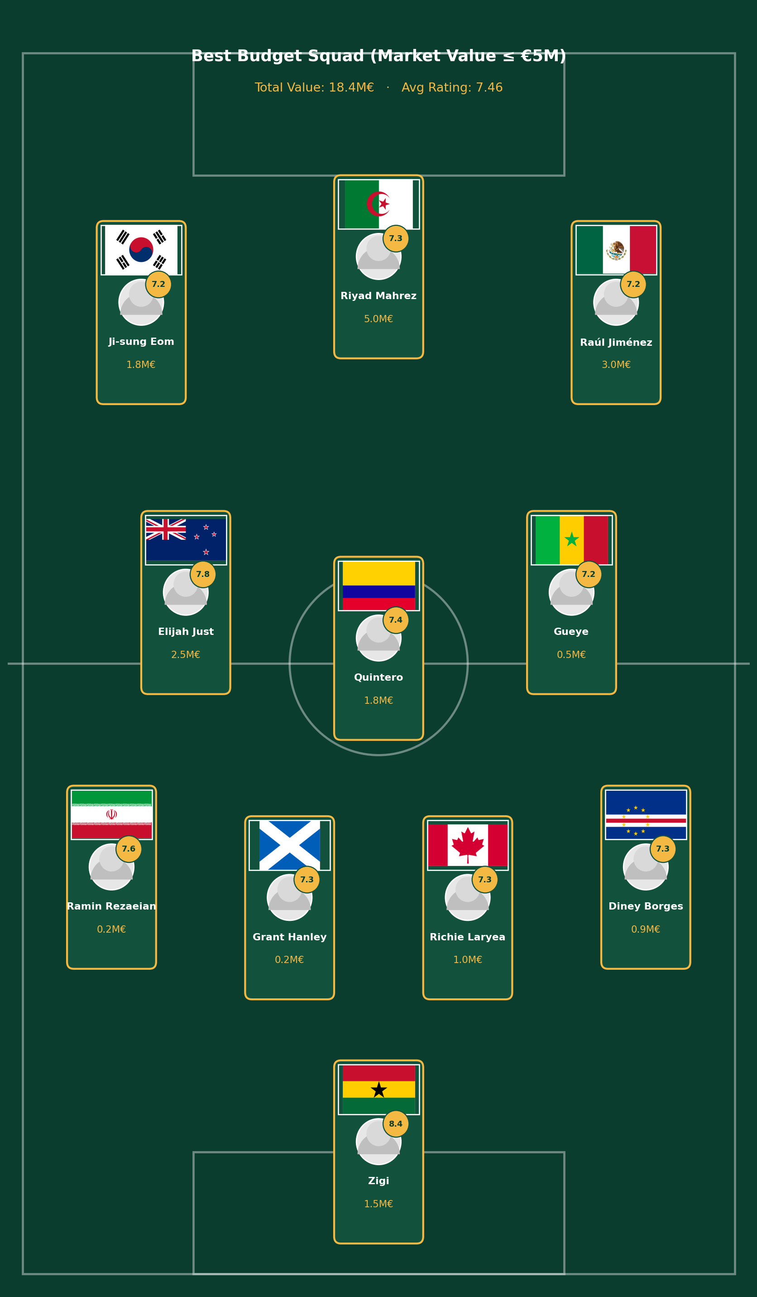
Best Budget Squad
Filter: Market Value ≤ €5M (any rating)
Total value: €18.45M · Average rating: 7.46
Best per position
Ati Zigi (G) 8.45 / 1.5M€
Rezaeian (D) 7.57 / 0.25M€
Elijah Just (M) 7.83 / 2.5M€
Mahrez (F) 7.28 / 5M€
Every player here costs 5M€ or less, yet the average rating (7.46) beats most €100M+ real squads.

Slide 9
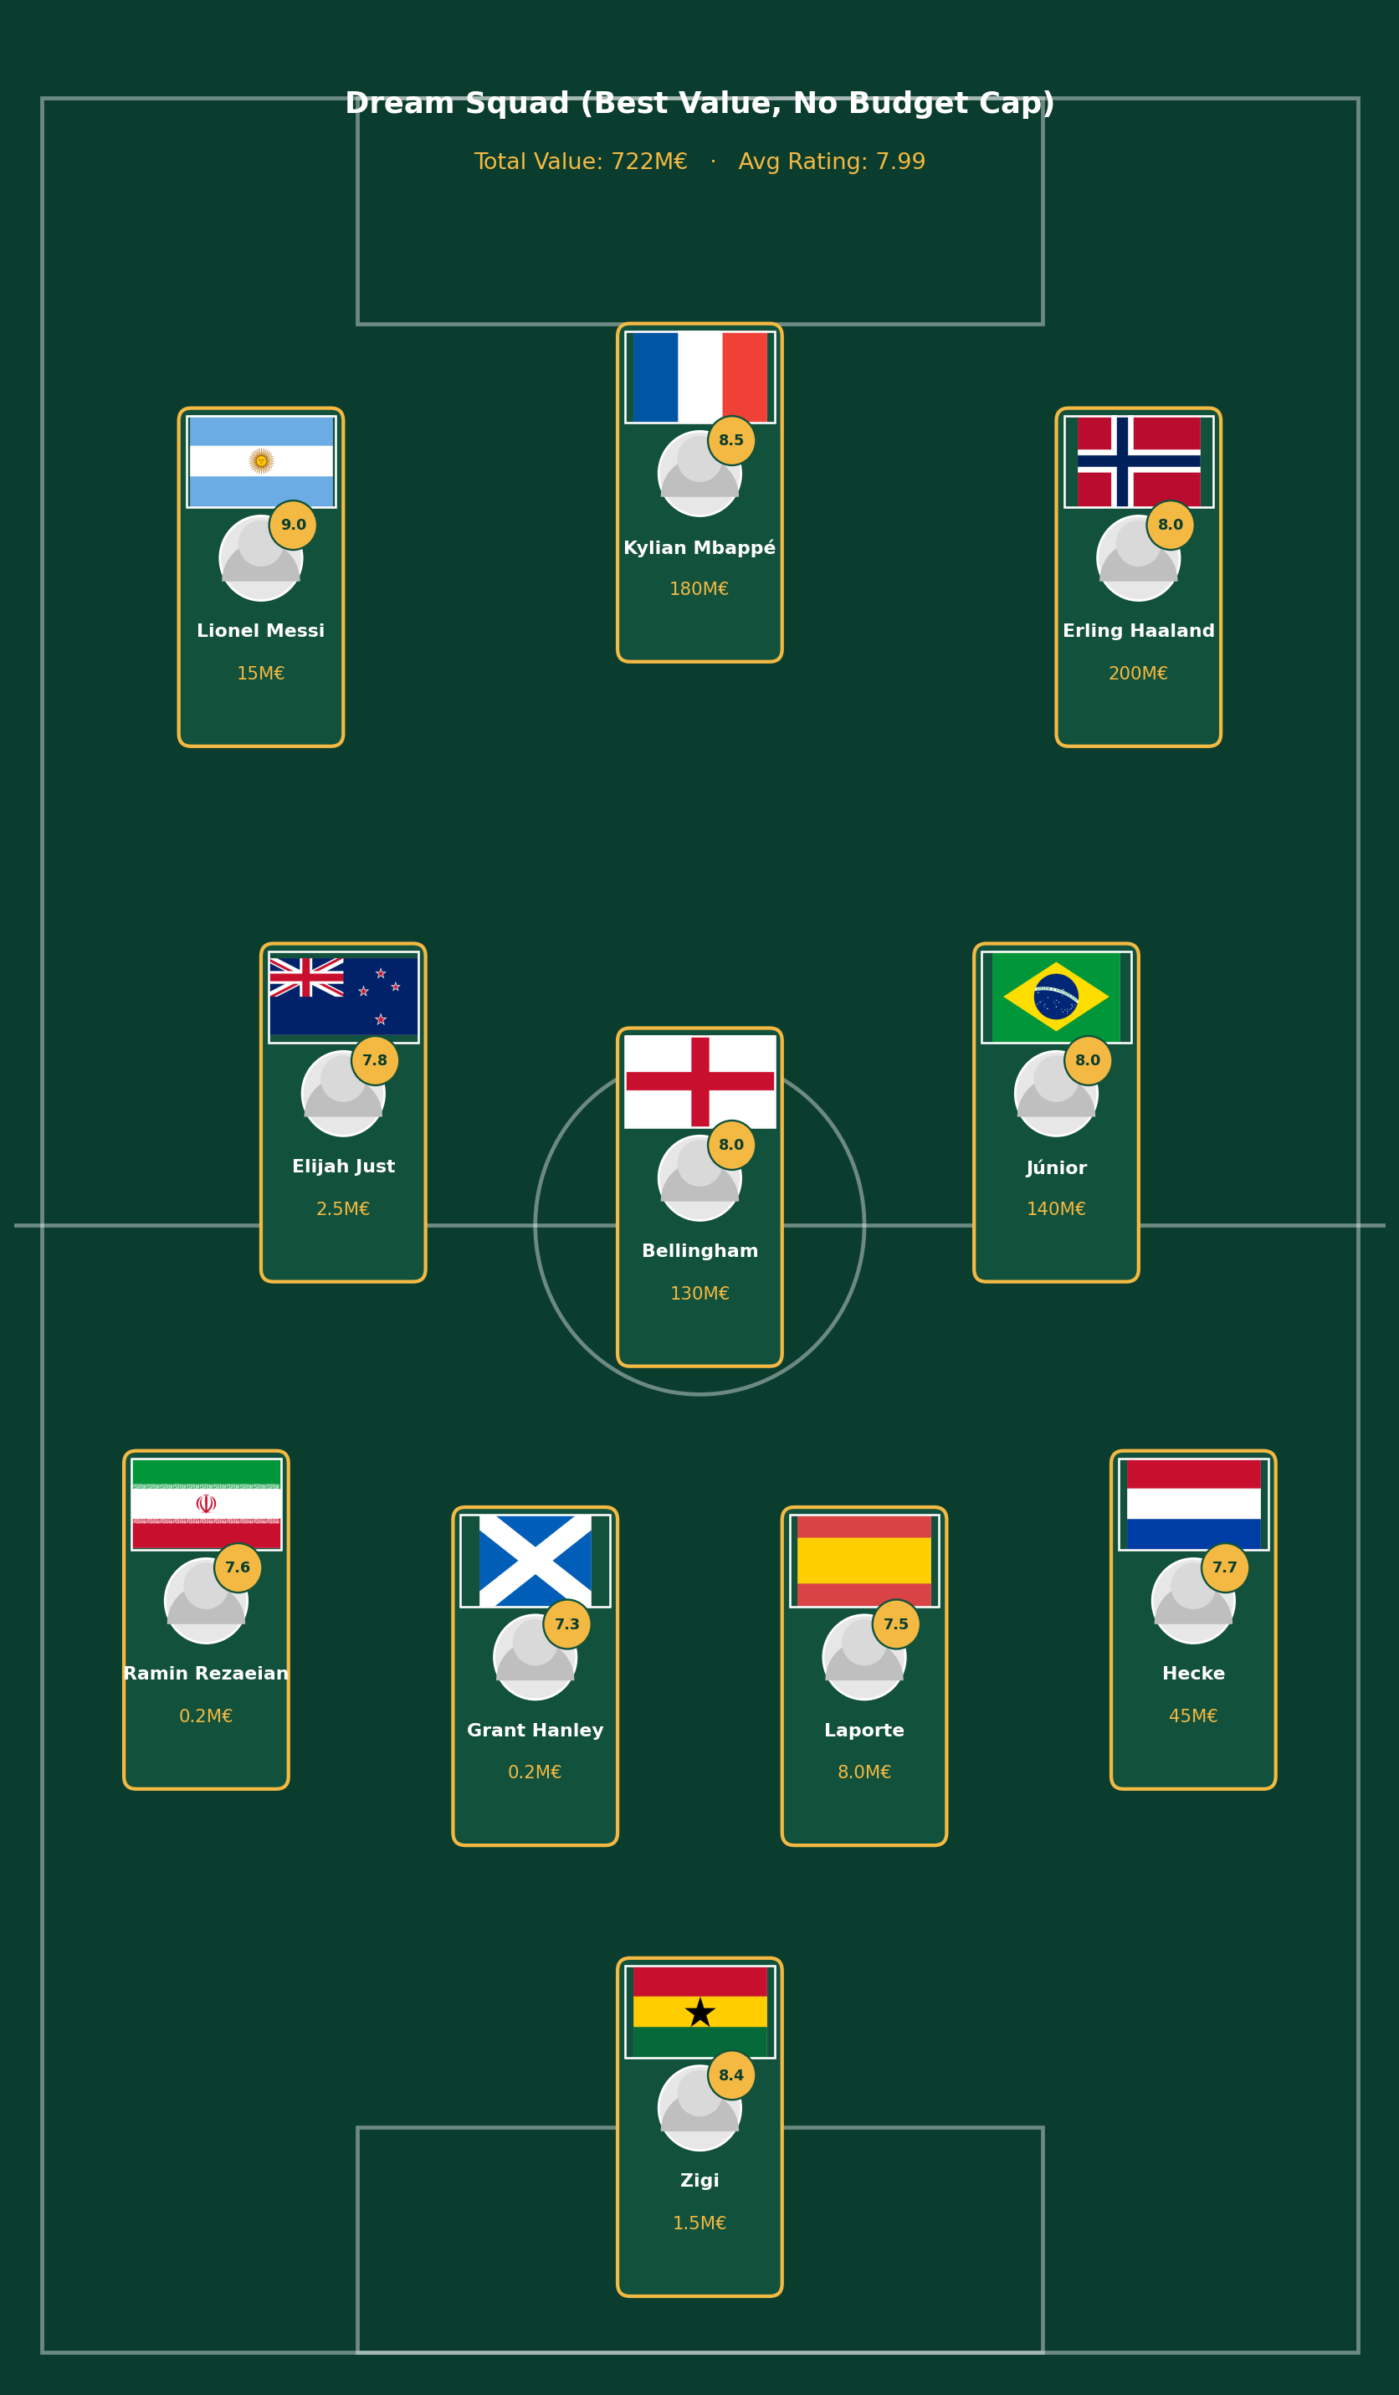
Dream Squad
No budget cap — best value among players rated ≥7.0
Total value: €722M · Average rating: 7.99
Front three
Messi 9.03 / 15M€
Mbappé 8.50 / 180M€
Haaland 7.96 / 200M€
Cheaper than France's real €1,523M squad — the best-rated semifinalist — with a higher average individual rating.

Slide 10
Side-by-Side Comparison
Squad | Total Value | Avg Rating | Value / €1M
Worst Value Squad | €365M | 6.25 | 0.017
Best Budget Squad | €18.45M | 7.46 | 0.404
Dream Squad | €722M | 7.99 | 0.011
Real France (best-rated) | €1,523M | 7.18 | 0.005
The Best Budget Squad delivers 37x more "rating per €1M" than the Dream Squad, and 24x more than the Worst Value squad.
France has the highest average player rating (7.18) among the 4 semifinalists (France, Argentina, Spain, England) - yet its real squad value (€1,523M) is more than double the Dream Squad's €722M, for a lower average rating.

Slide 11
Market Value & Price/Performance Extremes
Two different questions: who has the biggest budget, and who gets the most out of it
💰 Raw Squad Market Value
⚖️ Price/Performance (Value Residual)
TOP 3
TOP 3
1. France
€1,523M
1. Argentina
+7.95
2. England
€1,358.2M
2. Mexico
+6.23
3. Spain
€1,222.8M
3. France
+6.06
BOTTOM 3
BOTTOM 3
1. Qatar
€19.9M
1. Uruguay
−5.64
2. Jordan
€20.3M
2. Senegal
−5.49
3. Iraq
€21.2M
3. Türkiye
−5.46

Slide 12




Key Takeaways
€18.45M can buy elite performance
Price guarantees nothing
The Best Budget Squad averages 7.46 — higher than most €500M+ real squads.
The Worst Value Squad cost €365M and still averaged only 6.25.
The Dream Squad beats a real €1.5B squad
Market value explains performance, but loosely
€722M with a 7.99 average — higher rated than France's real €1,523M squad (7.18), for less than half the price.
The gap between the best and worst squads shows scouting/fit matters as much as price.

Slide 13


Thank You
Questions welcome
Prepared by Resul Işık
Let's connect
github.com/resulisik
linkedin.com/in/resul-isik

