Slide 1

Learning and Deducing Temporal Orders
Dr. Resul Tugay
University of Edinburgh
VLDB 23

Slide 2
Motivation
Data Keeps changing
9590 Households move, 1496 people marry, 810 people divorce each day in the UK
Outdated data damages revenues of companies
Data-driven decisions based on outdated data can be worse than making decisions with no data
Why do these problems happen ?
Missing Timestamps
Timestamps may simply not be recorded
*E.g., in a health database, 16/26 relations are not timestamped
Imprecise Timestamps
Timestamps may be too coarse, “12-8-2021” vs “12-8- 2021 20:41”
**E.g., 90% of appointment records have imprecise timestamps
Incorrect Timestamps
Update time vs logged time
*https://pubmed.ncbi.nlm.nih.gov/30488750/
**https://ieeexplore.ieee.org/document/6597227
Notes:
As reported by Royal Mail, on average, “9590 households move, 1496 people marry, 810 people divorce, 2011 people retire and 1500 people die” each day in the UK
When the data at a search engine is out of date, a restaurant search may return a business that had closed three years ago.

Slide 3
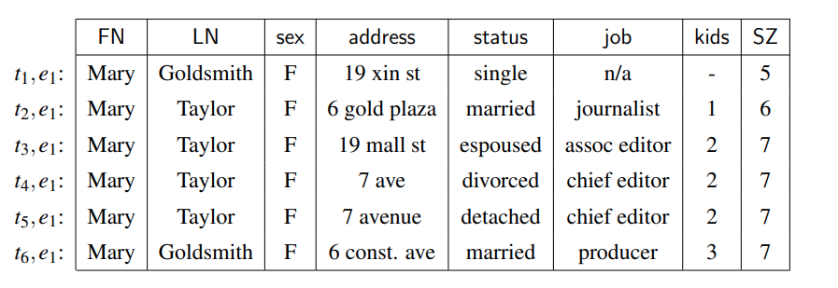
What Do We Do?
We study how to determine temporal orders on attribute values in a set of tuples that pertain to the same entity, in the absence of complete timestamps
Consider an example
How can we determine the temporal orders on the attribute values in the absence of complete timestamps?
2016
2019
Notes:
Some attribute values of these tuples have become stale since Mary’s data changes over the

Slide 4
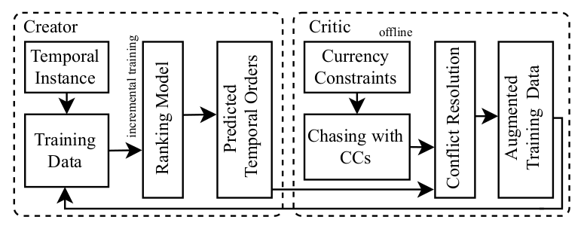
Proposed Method
Our framework is called GATE(Get the lATEst) and consist of Creator and Critic
We propose a combination of Deep Learning(DL) and rule-based deduction
Creator employs a DL model to learn temporal orders with the help of other attribute values
We use Learning To Rank (LTR) approach to separate latest values from non-latest ones
Critic validates the learned temporal orders by the Creator and deduces more ranked pairs and provide additional training data

Slide 5
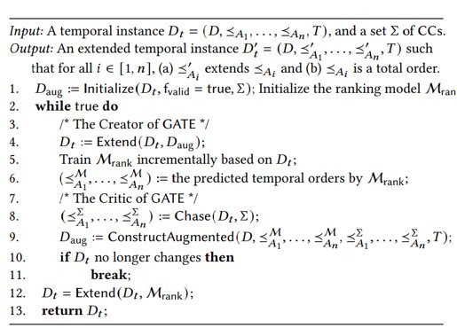
GATE Workflow
Input : Partial order, initial timestamped dataset
Output: Total order where we have ranking
Creator
DL model is used to train the data
DL model predicts temporal orders
Critic
Takes the output of creator which is temporal orders
Uses chase algorithm to create more data by currency constraint
Provide these data to the creator for the next round
Notes:
Why do we use chase algorithm ? :it has Church-Rosser property, no matter which CC we start, the result does not change

Slide 6
Reasons that we combined
Why have we combined deep learning with logic rules ?
It hard to justify temporal orders by a ranking model
They cannot find complicated structure. For instance, address of a person might change when he/she gets married
Number of rules is limited, and it is hard to find every rule
If we have semantically same but syntactically different attribute values, then logic rules cannot generalize ('wedded' vs 'married')
Ranking Model not explicitly consider some temporal properties, i.e., transitivity, this motivates us to use logic rules

Slide 7
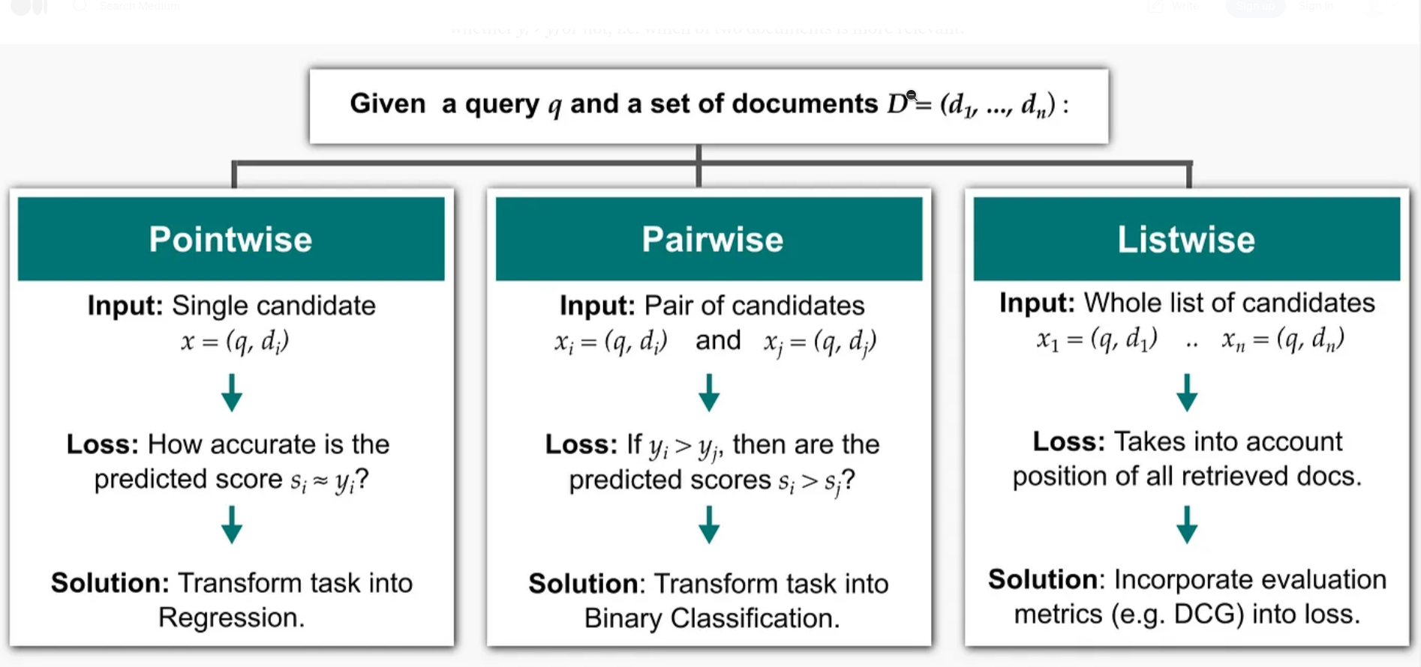
Approaches for Ranking Model(LTR)
Three different approaches for LTR: Pointwise, pairwise and listwise
* https://towardsdatascience.com/learning-to-rank-a-complete-guide-to-ranking-using-machine-learning-4c9688d370d4
Notes:
Why we haven't used other methods ? Because pointwise makes the problem extra harder, i.e. ordinal regression plus they can not separate latest from non-latest
Also listwise is not suitable for our purpose they can not separate latest from non-latest. They can only order the attribute values.
Pointwise and listwise: Presentation 3, slide 4, presentation 2, slide 6
.

Slide 8
Our Ranking Model: Pairwise
Why have we chosen pairwise method and not others ?
Because we want to separate latest values from non-latest values
Pointwise (ordinal regression problem) is harder
Listwise does not separate latest from non-latest
We want total order, but global ranking function should know more than one latest value
For instance, ranking function should know both 'passed away' and 'dead' when they appear in different entities
status
working
Passed away
operating
status
working
dead
operating

Slide 9
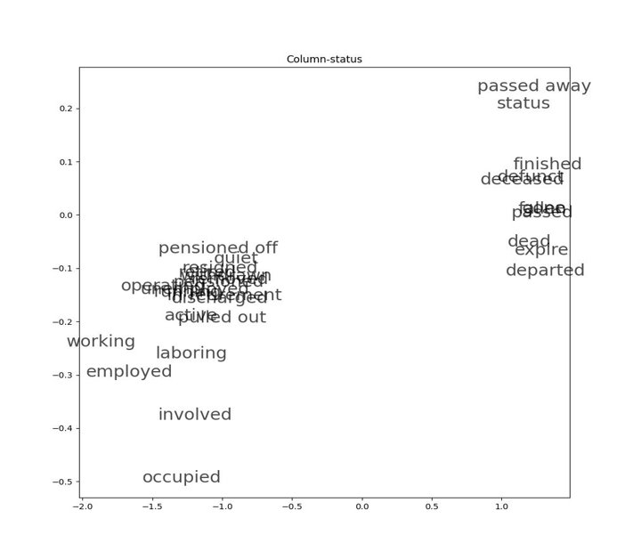
High Level Example
status
working
Passed away
operating
e1
status
working
dead
operating
e2
status
pensioned off
employed
involved
e3
D(status, pensioned off) < D(status, involved)
D(status, pensioned off) < D(status, employed)

Slide 10
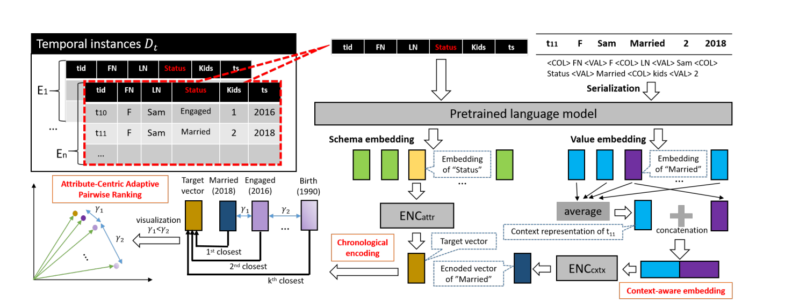
Creator

Slide 11
Embeddings
We first get the embeddings of attribute values; 𝜙𝑡₁ [𝐴] , 𝜙𝑡₂ [𝐴]
Consider that t₁[A] is the latest value and t₂[A] is the non-latest value of attribute A
We first get embedding of t₁[A] and t₂[A]
t₁[status] = 'engaged' and t₂[status] = 'married'
tid | FN | LN | Status | kids
t1 | John | Doe | engaged | 0
t2 | John | Doe | married | 1
𝜙𝑡₁ [𝐴]
engaged
Pretrained Model (BERT)
-0.3 | 0.9 | ... | ... | 0.8
married
0.6 | 0.05 | ... | ... | 0.7
𝜙𝑡₂ [𝐴]

Slide 12
Context-Aware Embeddings
After getting the embeddings (emb(𝑡[𝐴])) of attribute values; 𝜙𝑡₁ [𝐴] , 𝜙𝑡₂ [𝐴]
We get context-aware embedding for each tuple
We do this by using serialization of the tuple
serialize(𝑡) = ⟨COL⟩𝐴₁ ⟨VAL⟩𝑡 [𝐴₁] . . . ⟨COL⟩𝐴_{𝑛} ⟨VAL⟩𝑡[𝐴_{𝑛}]
Then we get embedding (emb(𝑡)) of serialize(𝑡) for each tuple, then concatenate
𝐸𝑡[𝐴] = [emb(𝑡[𝐴]); emb(𝑡)]
tid | FN | LN | Status | kids
t1 | John | Doe | engaged | 0
t2 | John | Doe | married | 1

Slide 13
Challenges
Why do we use other attributes?
Attribute correlation: An attribute value can change back and forth (married -> divorced -> married again), it is hard to determine the up-to-date value on a single attribute only
Why not just using Language Models?
Limitation of embedding models: LMs are not trained to organize data chronologically, simple embedding of words do not reflect orders
What should we consider the order ?
Existing ranking methods do not consider real-life characteristics of timeliness. For instance, the margin between the value 'birth' and 'engaged' should be larger than the values 'engaged' and 'married'

Slide 14
Loss Function
𝐸𝑡₁[𝐴] = [emb(𝑡₁[𝐴]); emb(𝑡₁)]
Loss = Σ(t₁,t₂) { max{ -tanh( <𝜙𝑡₂ [𝐴] , 𝜙𝑡 [𝐴]>)
+ 𝛾𝑡₁,𝑡₂ +
tanh(<𝜙𝑡1 [𝐴] , 𝜙𝑡 [𝐴]>), 0 }
}
⟨·, ·⟩ is the inner product and 𝛾𝑡₁,𝑡₂ is the adaptive margin between the two tuples
The loss will be 0 if latest value is very close then inner product will be large positive, so tanh will be 1, but because of the negative sign, it will be -1. Second part will also be -1, because of the max function loss will be 0
Otherwise, loss will be 3 + cos(𝜙𝑡₁ [𝐴] , 𝜙𝑡₂ [𝐴] )

Slide 15
Framework Overview
Creator
Initialize data with available timestamps
Train Ranking model with available data
Predict new temporal orders which their confidence score is higher than threshold
conf(𝑡 ₁ ⪯𝐴 𝑡 ₂ ) = 𝜎 (dist (𝜙𝑡₂ [𝐴] , 𝜙𝐴 ) − dist (𝜙𝑡₁ [𝐴] , 𝜙𝐴 ))
Critic
Then Critic takes the new predicted temporal orders along with currency constraints to deduce more ranked pairs by Chase algorithm
Provide new training data for the creator
If there is a conflict with predicted temporal orders from creator and the currency constraints, then ask this to the creator and resolve the issue.
When there is no more training data, terminate

Slide 16
Critic
Deduce new temporal orders by chase algorithm
Input: Temporal orders D_{t} and CCs
Outputs: Ranked pairs, t₁,t₂ (fixes)
Ground Truth ₹ by CCs
CC1: t₁[status] = 'single' and t₂[status] = 'married' -> t1 <_{status} t2
CC2: t₁<_{status} t₂ -> t₁ <_{address} t₂
Then we add t₁,t₂ to the U_{address}
For each temporal order by ML; we evaluate them by lazy evocation, valuations
We do no need to enumerate each temporal order
Notes:
Chase algorithm was proposed in Codd's paper to check whether non-binary decomposition is lossless. As an alternative to successive combining method.

Slide 17
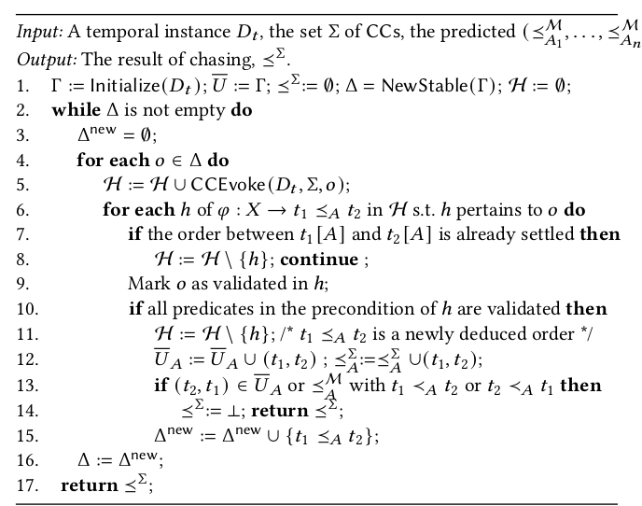
Chase Algorithm
New temporal order o
Lazy Evocation, find all valuations for the given order ( t₁ <_{status} t₂ -> t₁ < t₂ and t₁ <_{status} t₂ -> t₁ <_{address} t₂ )
Validate the temporal order
Newly deduced order
Check conflict
Notes:
Chase algorithm was proposed in Codd's paper to check whether non-binary decomposition is lossless. As an alternative to successive combining method.

Slide 18
Critic Example
Assume that we have followings
U_{status} ((1,2))
CC1: t₁[status] = 'single' and t₂[status] = 'married' -> t₁ <_{status} t₂
CC2: t₁[status] = 'married' and t₂[status] = 'divorced' -> t₁ <_{status} t₂
CC3: t₁ <_{status} t₂ -> t₁ <_{address} t₂
CC4: t₁<_{A} t₂ and t₂ <_{A} t₃ -> t₁ <_{A} t₃ -> Transitive CC
Chase algorithm, runs through all CCs and deduce new orders
For instance, by CC3, we add (1,2) to U_{address}
By CC4 (1,4) U_{status}
Then these newly deduced pairs is fed back to Creator as an augmented data
Notes:
Chase algorithm was proposed in Codd's paper to check whether non-binary decomposition is lossless. As an alternative to successive combining method.

Slide 19


Evaluation Metrics
We have used following evaluation metrics:
Precision : the ratio of temporal orders determined correctly to all ranked pairs predicated true
Recall: the ratio of temporal orders predicted correctly to all true orders
MRR(𝑒) : the mean reciprocal rank over a set of 𝑛 ranking:
where 𝑛 is the number of attributes, rank_{i} is the rank of latest attribute of entity 𝑒
MAP@K(𝑒): Mean average precision at K
Average precision of top-K values

Slide 20
Evaluation Metrics - Tradeoffs
F-measure: Suitable for pairwise ranking, but not for the list
MRR : This method puts a high focus on the first relevant element of the list. It is best suited for targeted searches such as users asking for the “best item for me”. The MRR metric does not evaluate the rest of the list of recommended items. It focuses on a single item from the list.
MAP : Handles the ranking of lists recommended items naturally. This metrics shines for binary (relevant/non-relevant) ratings. However, it is not fit for fine-grained numerical ratings

Slide 21
Experimental Results Datasets
We used three real-life dataset and one synthetic dataset
Career: Football players, from FIFA-15 TO FIFA-22, We also scraped data
NBA: Basketball players
COM: Self-employed entrepreneurs in Shenzen
Synthetic: Just like the example shown with 12.3K tuples for 1K entities
All datasets have ground-truths
Timestamps are different in terms of granularity
We selected 5% of data as initial timestamps
Code is open sourced at https://github.com/resultugay/GATE.

Slide 22
Experimental Results Baselines
We have baselines as follows:
Creator: Creator only deduce temporal orders by DL
Critic: Critic only, deduce temporal orders by CCs
Creator_{itr} : Iteratively update data with predicted but unjustified temporal orders by critic (no confidence)
Creator_{NC}: DL without contextual information
Creator_{NE}: DL without chronological encoding
Creator_{NA} : cross entropy loss instead of adaptive margin-based loss
Gate_{NC} : GATE that adopts the brute-force method for the chase (for efficiency test)
UncertainRule and Improve2C: Rule Based
RANK_{Bert} and Ditto_{Rank}: ML based

Slide 23
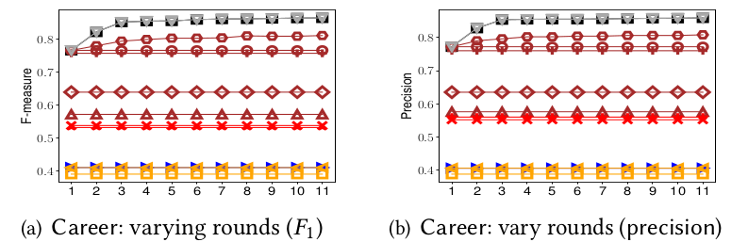
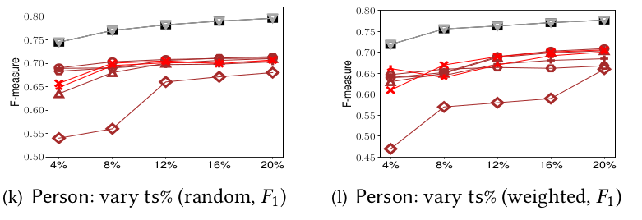
Experimental Results Accuracy
Notes:
As you can see when we have varying rounds, the F-measure of baselines do not change, but we have increasing F-measure for the GATE due to incremental training
Also when the K is 1, we have less score but when we consider more candidates, MAP also increases.

Slide 24
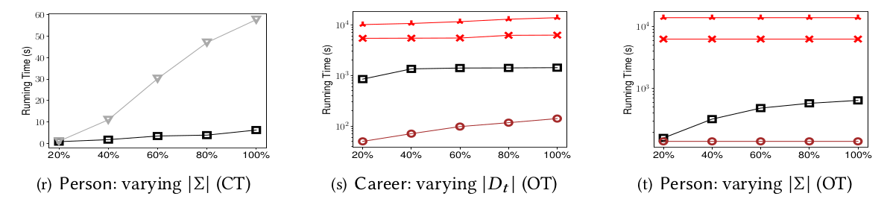
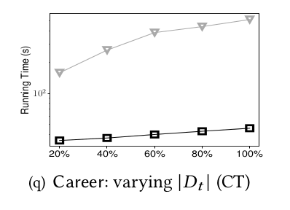
Experimental Results Varying parameters
Notes:
We also run experiments for different initial timestamps. The more timestamp that we have in the beginning, we have slightly better results.
For the varying entites for the chase algorithm, the more we use the better F1 we get.
We have also tested efficiency, order extension to total order. OT is the time for extending stable ordes to total orders by DL.
CT is chase time, GAte and GATENC(brute force chase). It is around 4 times slower.
We also test number of currency constraints, as we have more CCs, we have slower GATE due to more training data deduced by Critic.

Slide 25
Conclusion and Future Works
We have proposed a novel architecture for data currency
This is the first effort for combining DL and Rule-based methods
Novel ranking algorithm considers chronological orders
Critic justifies and deduces more orders
In future, when there is a missing data, how can we use our framework to fill
Also, how can we impose the DL part (creator) into rule-based methods as predicates just like in Conditional Functional Dependencies to catch conflicts and missing values

Slide 26
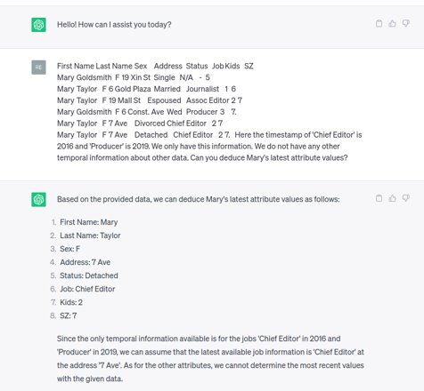
And The ChatGPT
Since the only temporal information available is for the jobs 'Chief Editor' in 2016 and 'Producer' in 2019, we can assume that the latest available job information is 'Chief Editor' at the address '7 Ave'. As for the other attributes, we cannot determine the most recent values with the given data.

