Slide 1

Linking Entities Across Relations and Graphs
Wenfei Fan^{1,2}, Liang Geng³, Ruochun Jin¹, Ping Lu², Resul Tugay¹, Wenyuan Yu³
University of Edinburgh^{1,}
Shenzhen Institute of Computing Sciences²
Alibaba Group³
Notes:
Hello everybody, my name is Resul Tugay, I am a third-year PhD student at University of Edinburgh. today l am going to present our paper called ‘linking entities across relations and graphs’. This paper is a joint work with people from Shenzhen instute of computing Science and Alibaba group

Slide 2
Outline
Motivation and Problem Statement
Entity Linking
Graph Matching
Methods
Proposed Method
General Schema
Parametric Simulation
Experimental Results
Conclusion and Future Work
Notes:
So, this is the outline, l will start with motivation and problem statement and then l will talk about methods used in the literature and then l will continue with our proposed method to solve the problem. Then l will show some experimental results and lastly the conclusion and future work.

Slide 3
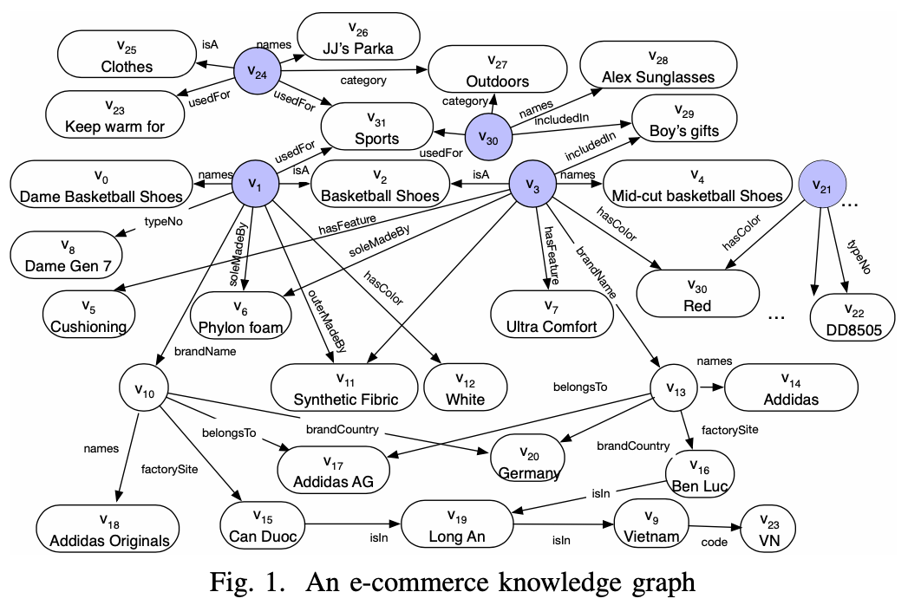
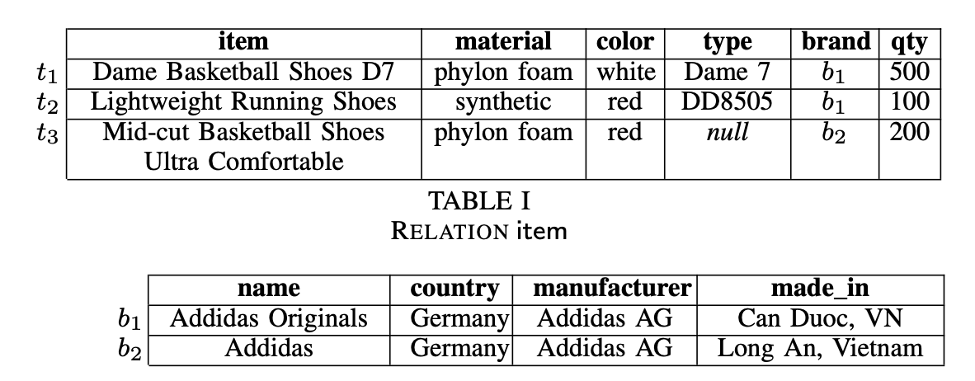
Motivation
3/17
Graph
Relational Data
Notes:
knowledge graphs or graph representation of data are getting popular these days.
Although most business data resides in relational databases, it is increasingly common to find graph-structured data, e.g., transaction graphs, knowledge bases and social networks.
It is often necessary to correlate the data from different sources
for extracting, integrating or any other purposes such as recommendation. Here you can see some of the data resides in relation data such as item and its features. However, on the right hand, we have graph data which holds some other data.

Slide 4
Problem Statement Entity Linking
4/17
France
Paris Hilton
Paris
isin
Consider a tuple that has ‘City name, population, etc’ attributes, e.g. (Paris, 2.1M, etc), the idea is to determine that "Paris" refers to the city of Paris and not to Paris Hilton.
City name | Population | Country
Paris | 2.1M | France
president
Was_born
pop
E. Macron
New_york
2.1M
Notes:
Consider a tuple that has ‘City name, population, etc’ attributes, e.g. (Paris, 2.1M, etc), the idea is to determine that "Paris" refers to the city of Paris and not to Paris Hilton.
So, the problem statement is given two entities appearing in two different sources, the task is to understand or match whether these entities refer the same entity in the real world or not ?
We are trying to link entities between a
relational database $D$ and a graph $G.$

Slide 5

Problem Statement Graph Matching
5/17
Considering the nature of the problem and the inputs, This problem can be considered as graph matching problem when we convert relational data into a graph.
Now the question becomes is it possible to determine whether a vertex $u$ in $G1$ and a vertex $v$ in $G2$ refer to the same real-world entity?
Can we use some scores to link entities ? For instance, vertex label closeness. E.g., basketball shoes and shoes.
Notes:
Now, we have relational and graph data, if we convert relation data into a graph, then entity linking becomes graph matching. Graph matching is the problem of finding a similarity between graphs.
Also, when linking entities can we use some scores or some sort of thresholds to link entities? For instance, basketball shoes and shoes are not same but if we look at their embedding similarities, it will be high. So how much high should we use to consider that given entities are match or not.

Slide 6
Literature Review
6/17
Entity Resolution/ Entity Linking is a long-standing challenge. There are couple of methods and types;
ML/DL Based
Traditional Similarity Checking
Heterogenous/ homogenous
Graph Simulation / Matching Algorithms
Notes:
Entity Resolution is a general name of entity linking or entity deduplication etc. and it’s a long-standing problem in the literature. There are many methods and types. For instance, the first and traditional one is to check string similarity of entities. Or Some of them are purely based on binary classification that is given two entities ML model considers this problem as binary classification and classify whether match or not.
Or One can consider this problem as graph matching as we do.

Slide 7
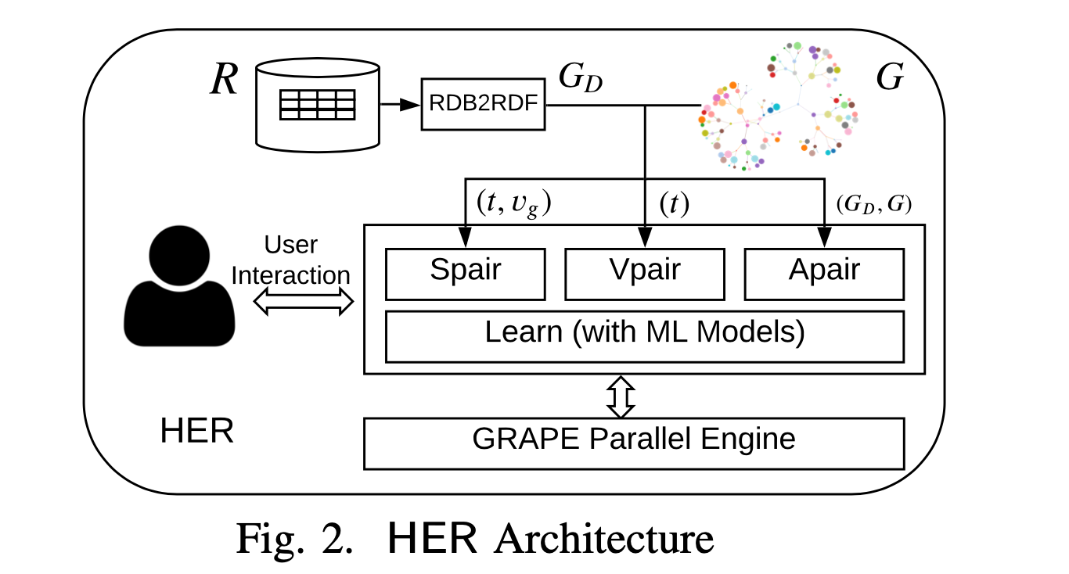
Proposed Method General Schema
7/17
There are couple of steps that we have done in order to link entities.
https://github.com/alibaba/GraphScope
Notes:
So this is the general schema of our framework. We have a relation data on the left hand side and graph that is shown here on the right hand side. First of all we convert relational data to graph data which l will talk about it later. . And we have 3 different modes to link entities.
Spair, this mode takes two vertices and decides whether they are match or not recursively.
Vpair, this mode takes one vertex from relation data, tries to find all matching from graph data
Apair, this mode finds all matching between relational data and graph data.
Here l say relational data, but its actually graph representation of relational data.

Slide 8
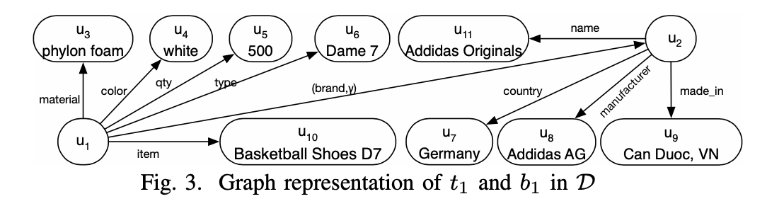

Proposed Method RDB2RDF
8/17
Converting relational data $D$ into graph $GD$. We have used RDB2RDF method to convert relational data into graph. This conversion is just a direct mapping of cells. Column names are edge labels and cell values are vertex labels.
Notes:
Here we use a RDB2RDF method, this is a standart from W3C. It basically takes each cell value in the relational data as vertex label and column names as edge label and creates the graph.

Slide 9

Proposed Method Parametric Simulation
9/17
After having two graphs, we have three modes to link entities.
Spair: This mode checks whether given tuple $t$ and vertex $v$ make a match ?
Vpair: This mode is for all vertices in $G$ that match a given tuple $t ∈ D$.
Apair: This mode is to find all matches across $D$ and $G$
Underlying algorithm is parametric simulation.
parametric simulation is inductively defined to match ($ut, vg$) and their descendants. It maps paths in $GD$ to paths in $G.$ It is also parameterized by scores.
Notes:
The proposed method is parametric simulation, it is a graph matching algorithm.
I already talked about these modes, spair vpair and apair and scores. The reason that we have these scores, and recursive inspecting is, it may not suffice to inspect only local features of vertices . Hence parametric simulation recursively checks the pairwise semantic closeness of descendants of vertices, with the help of machine learning (ML) to accommodate topological matching.

Slide 10
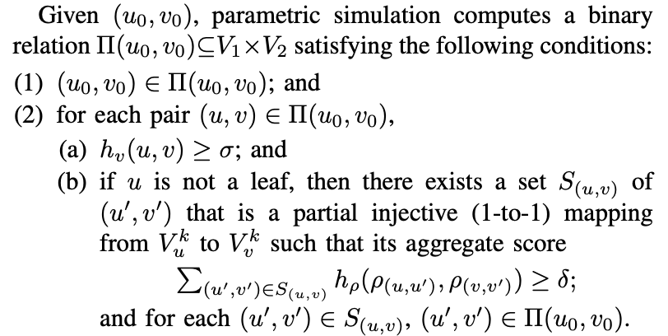

Proposed Method Parametric Simulation
10/17
Here, we are trying to understand whether $u0$, and $v0$
Makes a match ?
First, we are checking their word embeddings’ (BERT)
Similarities. If this similarity is above the threshold, then
We are checking their descendants and paths.
Notes:
Here is the algorithm. Parametric simulation computes matching or binary relation as in other graph matching algorithms. For each pair, we check their similarities and also their descendants similarities. If one of these is a leaf then we are not executing the parametric simulation, if not, we call this function and compute aggregated score. This score is different than vertex label score. Here we are checking edge labels are matching or not. Because the graph and relational data might have different topology.

Slide 11
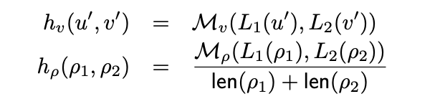

Proposed Method Parametric Simulation
11/17
To determine whether a vertex $u0$ in $G1$ matches a vertex $v0$ in $G2$, parametric simulation inductively considers the “closeness” of descendants of $u0$ and descendants of $v0$. For this, we have parameter $τ$ and $δ$.
Michael
Alex
Alex
Son
son
Grandson
daughter
Tom
Tom
Matilda
Notes:
Lets call, graph representation of relational data as G1, to identify a vertex u from G1 and vertex v from G2, we take word embeddings of these vertex labels in the MV function and computer cosine similarity.
To identify $u0$ and $v0$ in practice, it often suffices to inspect a small number of their important properties. For this, we have another parameter $k$ that is number of important descendants. This parameter is important since there might be exponentially many paths especially when $G1$ and $G2$ is dense. We are finding the important descendants with LSTM. Here given a vertex, LSTM generates a descendants up to bound top-k descendant. After having lots of paths from the given vertex, we use resource allocation algorithm to choose top-k ones.

Slide 12

Proposed Method Parametric Simulation
12/17
Even though, we have a dynamic programming approach to solve the problem with parametric simulation, the complexity of the algorithm is O(($VD$ + $ED$)($V$+$E$). Given large $GD$ and $G$ quadratic-time could still be expensive.
We parallelize the parametric simulation.
We use GraphScope* framework from Alibaba Inc.
It is under BSP model, exchanges messages between the machines.
* https://github.com/alibaba/GraphScope

Slide 13
Experimental Results Baselines
13/17
We have used following as baselines;
MAGNN: A GNN - based model that learns vertex embeddings for similarity, with both vertex attributes and meta-paths.
Bsim: Based on vertex labels and topological matching.
JedAI: A rule-based ER toolkit implemented in Java.
MAG: A state-of-the-art ML-based system for ER on relations.
DEEP: A deep-learning-based ER Python package under Magellan
Note: Our codes will be released at the time of publication
Notes:
We have compared our method with 5 baselines.

Slide 14
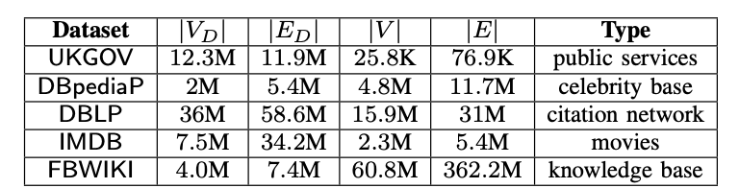
Experimental Results Datasets
14/17
Notes:
These are the datasets that we have used.

Slide 15
Experimental Results Accuracy
15/17
HER beats all of the baselines in terms of speed and accuracy; this shows that parametric simulation is more accurate than using ML methods and rule based methods.
Varying sigma
Varying k
* https://github.com/alibaba/GraphScope
Notes:
When the sigma is too low, it considers lots of vertices match however they are not, hence it increases false positives and reduces precision. But the fmeasure increases.
Also when top-k descendants. Up to some point, accuracy does not change, but when we have 10 or more important descendant, then it becomes enough to match vertices.

Slide 16
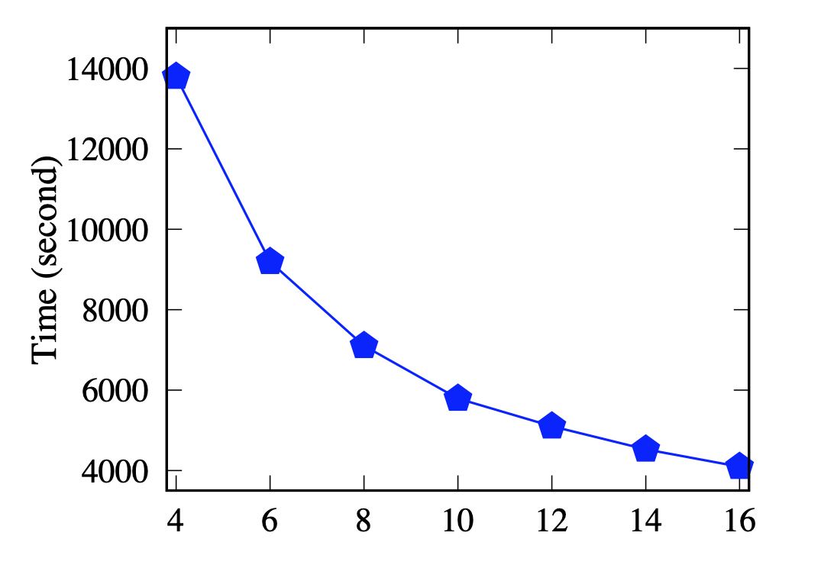
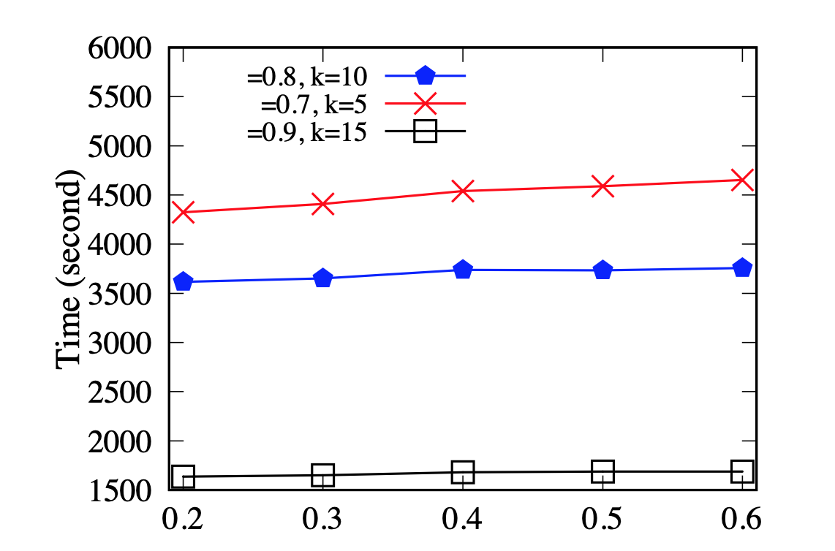
Experimental Results Speed
16/17
Varying n
Varying delta
FBWIKI
* https://github.com/alibaba/GraphScope
Notes:
Here, we show what happens when we increase the number of machines in the parallel version of parametric simulation algorithm, when we increase the machine number from 4 to 16, the time taken decreases by 14k seconds to 4 or 5k seconds for the fbwiki data.
Also delta parameter, the path control, its obvious that when we increase the delta that means we need to check more paths between vertices, it takes more time but not significantly. This shows that, no matter you increase too much this parameter, you get matching.

Slide 17
Conclusion and Future Work
17/17
Our framework is more accurate than ML-based and rule-based methods.
It also performs the best in efficiency. When running in the VPair mode with a single machine, it is a lot times faster than the baselines on average.
Our framework is parallelizable.
New notion of parametric simulation which can be also used as graph pattern matching.
We are planning to use different data formats to link entities such as JSON. Also we are planning to use improve RDB2RDF method that is how can we map relational data into graph preserving the semantic structure.

