Slide 1
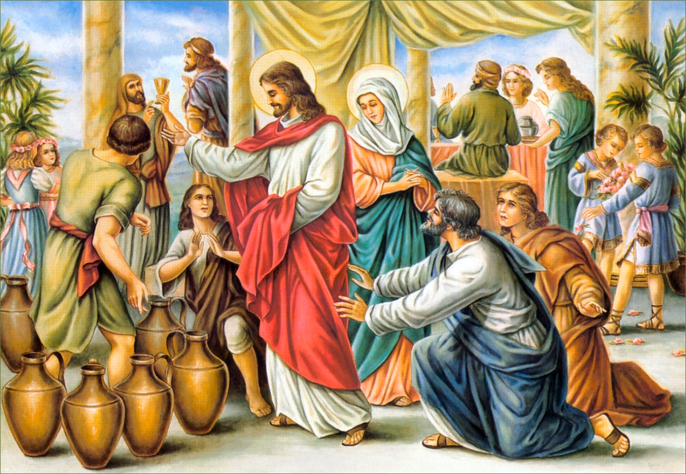
2nd Sunday in Ordinary Time

Slide 2
We are gathering together
unto Him.
We are gathering together
unto Him.
Unto him shall the gathering
of the people be,
We are gathering together unto Him.

Slide 3
We are praising together
unto Him.
We are praising together
unto Him.
Unto him shall the praising
of the people be,
We are praising together unto Him.

Slide 4
2nd Sunday in Ordinary Time

Slide 5
Lord have mercy Lord have mercy
Christ have mercy Christ have mercy
Lord have mercy Lord have mercy

Slide 6
Glory to God in the highest and on earth peace to people of goodwill

Slide 7
We praise you, we bless you,
We adore you, we glorify you,
We give you thanks for your great glory.
Lord, God heavenly king,
O God, almighty Father

Slide 8
Glory to God in the highest and on earth peace to people of goodwill

Slide 9
Lord, Jesus Christ, only begotten son
Lord, God, Lamb of God, son of the
Father
You take away the sins of the world have mercy on us
You take away the sins of the world receive our prayers
You are seated at the right hand of the Father, have mercy on us

Slide 10
Glory to God in the highest and on earth peace to people of goodwill

Slide 11
For you only are the Holy One,
You are the Lord, You only are the most high, Jesus Christ
With the Holy Spirit in the glory of
God the Father.
Glory to God in the highest and on earth peace to people of goodwill
Amen, amen, amen.

Slide 12
2nd Sunday in Ordinary Time

Slide 13
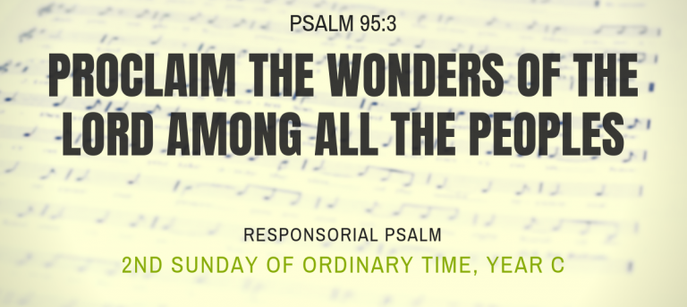

Slide 14
2nd Sunday in Ordinary Time

Slide 15
Alleluia, alleluia, alleluia!
Blessed is the King who comes in the name of the Lord! Peace in heaven and glory in the highest.
Alleluia, alleluia, alleluia!

Slide 16
2nd Sunday in Ordinary Time

Slide 17
Nicene Creed
I believe in one God,
the Father almighty,
maker of heaven and earth,
of all things visible and invisible.
I believe in one Lord Jesus Christ,
the Only Begotten Son of God,
born of the Father before all ages.
God from God, Light from Light,
true God from true God,
begotten, not made, consubstantial with the Father;
through him all things were made.
For us men and for our salvation
he came down from heaven,

Slide 18
(At the word that follow up to and including “…. became man”, all bow)
and by the Holy Spirit was incarnate of the Virgin Mary,
and became man.
For our sake he was crucified under Pontius Pilate,
he suffered death and was buried,
and rose again on the third day
in accordance with the Scriptures.
He ascended into heaven
and is seated at the right hand of the Father.
He will come again in glory
to judge the living and the dead
and his kingdom will have no end.

Slide 19
I believe in the Holy Spirit, the Lord, the giver of life,
who proceeds from the Father and the Son,
who with the Father and the Son is adored and glorified,
who has spoken through the prophets.
I believe in one, holy, catholic and apostolic Church.
I confess one Baptism for the forgiveness of sins
and I look forward to the resurrection of the dead
and the life of the world to come.
Amen.

Slide 20
Lord, bless our families

Slide 21
2nd Sunday in Ordinary Time

Slide 22
All for You, Lord, all for You;
Everything I give to You.
All for you, Lord, all for You;
Make it all your own.

Slide 23
Take my hands and feet, Lord,
take them all for You,
They are instruments, Lord,
put them to your use,
To spread your love and give the good news:
All for You, my God.

Slide 24
All for You, Lord, all for You;
Everything I give to You.
All for you, Lord, all for You;
Make it all your own.

Slide 25
2nd Sunday in Ordinary Time

Slide 26
Holy, holy, holy Lord God of hosts
Heaven and earth are
full of your glory.
Hosanna in the highest
Blessed is He who comes
In the name of the Lord
Hosanna in the highest

Slide 27
2nd Sunday in Ordinary Time

Slide 28
Memorial Acclamations
We proclaim your Death, O Lord,
and profess your Resurrection,
until you come again.
When we eat this Bread and drink this Cup,
we proclaim your Death, O Lord,
until you come again.
Save us, Saviour of the world,
For by your Cross and Resurrection
You have set us free.

Slide 29
2nd Sunday in Ordinary Time

Slide 30
Lamb of God, you take away the sins of the world,
Have mercy on us, have mercy on us
Lamb of God, you take away the sins of the world,
Have mercy on us, have mercy on us
Lamb of God, you take away the sins of the world,
Grant us peace, grant us peace

Slide 31
2nd Sunday in Ordinary Time

Slide 32
Jesus has the table spread,
where the saints of God are fed;
He invites His chosen people:
come and dine.
With His manna He doth feed
and supply our every need.
Oh, ‘tis sweet to sup with Jesus
all the time.

Slide 33
Come and dine,” the Master calleth, “Come and dine”.
You may feast at Jesus’ table
all the time.
He who fed the multitude,
turned the water into wine,
To the hungry calleth now:
“Come and dine”.

Slide 34
The disciples came to land,
thus obeying Christ’s command,
For the Master called unto them, “Come and dine.”
There they found their hearts’ desire:
Bread and fish upon the fire.
Thus He satisfied the hungry
in His time.

Slide 35
Come and dine,” the Master calleth, “Come and dine”.
You may feast at Jesus’ table
all the time.
He who fed the multitude,
turned the water into wine,
To the hungry calleth now:
“Come and dine”.

Slide 36
Soon the Lamb will take His bride
to be ever at his side,
All the hosts of heaven will assembled be.
Oh, ‘twill be a glorious sight,
all the saints in spotless white,
And with Jesus they will feast eternally.

Slide 37
Come and dine,” the Master calleth, “Come and dine”.
You may feast at Jesus’ table
all the time.
He who fed the multitude,
turned the water into wine,
To the hungry calleth now:
“Come and dine”.

Slide 38
Come to Me all who thirst
And are weary
Come, be quenched at the
Fountain of freshness
My streams of living water
will flow forth
From My heart in abundance

Slide 39
If you but knew what a gift
God is offering, and who it is that,
Asked you for water,
You’d be the one who would
Ask Him to give you
That living water for eternal life

Slide 40
He who drinks of the water
That I give him,
Ne’er again will he seek
Other water
My gift will stay within him
Like a fountain
That renews him in spirit

Slide 41
If you but knew what a gift
God is offering, and who it is that,
Asked you for water,
You’d be the one who would
Ask Him to give you
That living water for eternal life

Slide 42
On the cross when the
Son of God lay hanging
He was pierced by the
Lance of a soldier
And from the very heart
Of the Savior
Lo! There came blood and water

Slide 43
If you but knew what a gift
God is offering, and who it is that,
Asked you for water,
You’d be the one who would
Ask Him to give you
That living water for eternal life

Slide 44
PRAYER FOR VOCATIONS
LORD of the Harvest,
BLESS young people with the gift of courage to respond to your call.
Open their hearts to great ideals, to great things.
INSPIRE all of your disciples to mutual love and giving—
for vocations blossom in the
good soil of faithful people.
INSTILL those in religious life, parish
ministries, and families with the confidence
and grace to invite others to embrace
the bold and noble path of a life
consecrated to you.

Slide 45
UNITE us to Jesus through prayer and sacrament,
so that we may cooperate
with you in building your reign of mercy
and truth, of justice and peace.
Amen.
— Pope Francis
Adapted from the Message on the 51st World Day
of Prayer for Vocations (2014).

Slide 46
2nd Sunday in Ordinary Time

Slide 47
We are happy Christians
all united in the Lord;
we belong to one family.
Jesus Christ has chosen us to carry on His life over every land and sea.
From the North and from the South and from the East and West
He has called us all together

Slide 48
And we are delighted
that we are united into God’s own family;
Yes, we are delighted
that we are united into God’s own family

