Slide 1
NSLOOKUP Talk.Title
What can you find in DNS debug logs?

Slide 2
Me in brief
12 years in IA
Mostly in DoD
I have letters after my title

Slide 3
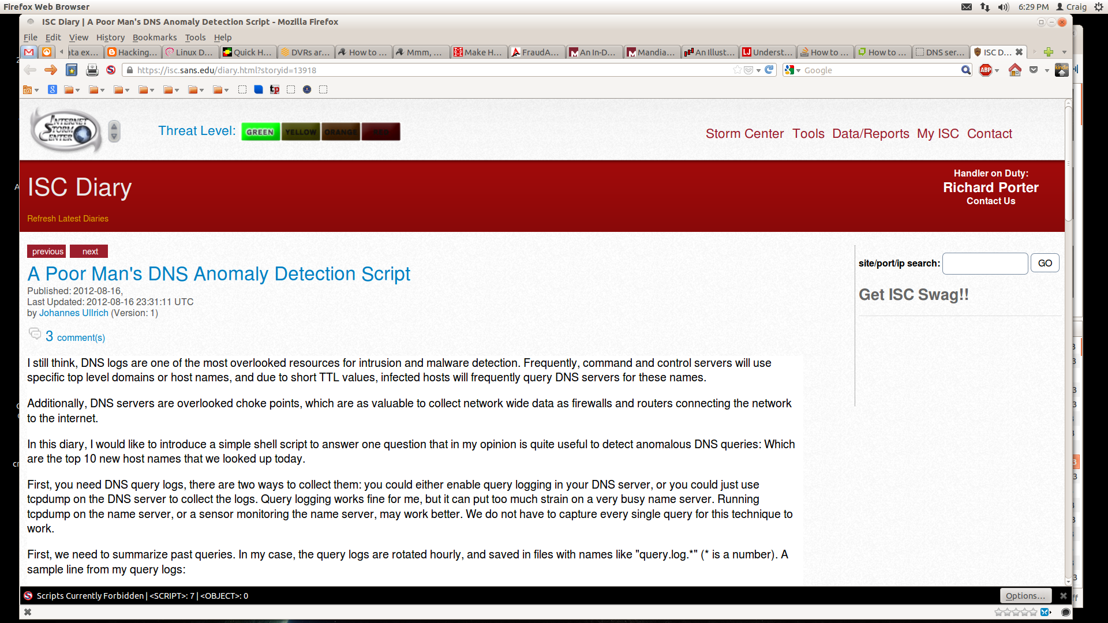

Slide 4
How can I use DNS logs to find IOCs and/or possible attacks?

Slide 5
1. Looked for top new host names seen each day/week.
Notes:
Because infected hosts need to communicate with C&C. Changing domains require with short TTL mean frequent lookups.
Look for unusual TLD that only one host is looking up

Slide 6
Aurora attack on Google: Key to analysis was DNS logs
Attackers used a hard coded DNS server while doing reconnaissance.
Notes:
Analysis of the DNS traffic allowed security team to determine the scope of the attack.

Slide 7
1. Looked for top new host names seen each day/week.
2. New traffic to newly registered sites
Notes:
This is a warning sign.

Slide 8
1. Looked for top new host names seen each day/week.
2. New traffic to newly registered sites
3. Host that has a large increase in daily queries is suspicious
Notes:
This increase can be normal (some type of cron job), odd but legit (forgotten periodic update) or malicious.

Slide 9
- Used to allow DNS responses from a different server
than where the query was sent (per RFC 1035)
- RFC 2181 changed that. Expect responses
from the same location query sent.

Slide 10
1. Looked for top new host names seen each day/week.
2. New traffic to newly registered sites
3. Host that has a large increase in daily queries is suspicious
4. Look for responses from servers that you didn't send queries.
5. Duplicate responses, one from correct server another from a rogue
Notes:
This increase can be normal (some type of cron job), odd but legit (forgotten periodic update) or malicious.

Slide 11
Who is using your DNS server?
Notes:
Are your filters set correctly? Misconfigured machines, badly configured perimeter defense.

Slide 12
1. Looked for top new host names seen each day/week.
2. New traffic to newly registered sites
3. Host that has a large increase in daily queries is suspicious
4. Look for responses from servers that you didn't send queries.
5. Duplicate responses, one from correct server another from a rogue
6. Unauthorized machines using your internal DNS
Notes:
DNS replies with RFC 1918 addresses that are external to your network or that you aren't using
Queries from ip addresses that are not part of your subnets.

Slide 13
Blacklists and 'Greylists'
Notes:
You may be blocking bad domains at the edge, or someone may be blocking them for you. Another method of detecting machines attempting to connect.
Blacklists for those places you definitely don't want connections.
NOTE: If you have a hit on a blacklisted domain, you should have a note for WHY that domain is blacklisted. Especially if you subscribe to a blacklist.
Greylist – domains that may not necessarily be bad, but you may want to keep an eye on people or machines that make too many connections to these domains.

Slide 14
1. Look for top new host names seen each day/week.
2. New traffic to newly registered sites
3. Host that has a large increase in daily queries is suspicious
4. Look for responses from servers that you didn't send queries.
5. Duplicate responses, one from correct server another from a rogue
6. Unauthorized machines using your internal DNS
7. Blacklists and 'Greylists'
Notes:
DNS replies with RFC 1918 addresses that are external to your network or that you aren't using
Queries from ip addresses that are not part of your subnets.

Slide 15
DNS Cache Poisoning
Notes:
.

Slide 16
1. Look for top new host names seen each day/week.
2. New traffic to newly registered sites
3. Host that has a large increase in daily queries is suspicious
4. Look for responses from servers that you didn't send queries.
5. Duplicate responses, one from correct server another from a rogue
6. Unauthorized machines using your internal DNS
7. Blacklists and 'Greylists'
8. Large number of queries for non-existent domains & large number of NXDOMAIN answers
Notes:
DNS replies with RFC 1918 addresses that are external to your network or that you aren't using
Queries from ip addresses that are not part of your subnets.

Slide 17
Data Exfiltration via DNS

Slide 18
Use DNS to beacon/call home

Slide 19
9. Look for long, randomized hostname queries sent to the same or small subset of domains.
10. Look for TXT requests and of course TXT responses that contain large amounts of gibberish.
11. Watch for “beaconing” behavior—the same hostnames (that aren’t in the Alexa list) being pinged regularly.
12. Look for domains in oddball TLDs and subdomain resellers
13. Look for patterns of recursive DNS usage during odd hours.
Notes:
1) Look for long, randomized hostname queries sent to the same or small subset of domains. This one is a no-brainer, and you can start by just looking for extremely long hostnames being resolved.
2) Look for TXT requests and of course TXT responses that contain large amounts of gibberish.
3) Watch for “beaconing” behavior—the same hostnames (that aren’t in the Alexa list) being pinged regularly.
4) Look for domains in oddball TLDs and subdomain resellers—especially ones known to harbor many malicious registrations like .su, .ru, and .tk.—particularly if you don’t do business in those countries normally.
5) Look for patterns of recursive DNS usage during odd hours. Most machines don’t need to look up new domain names when people aren’t surfing or doing other “randomizing” types of activities that humans do, so lots of non-cached hostnames shouldn’t be hit late at night.
6) Examine the history and hosting of the nameservers being used by domains queried and the reputation those nameservers have. If they are located in unusual countries, are being supported by fast flux, are brand new domains, or are in hosting facilities with abuse problems, the traffic needs more scrutiny.

Slide 20
Passive DNS collection for example:
Records what domain names were assigned to what
IP addresses at the time those
domain names were requested

Slide 21
9. Look for long, randomized hostname queries sent to the same or small subset of domains.
10. Look for TXT requests and of course TXT responses that contain large amounts of gibberish.
11. Watch for “beaconing” behavior—the same hostnames (that aren’t in the Alexa list) being pinged regularly
12. Look for domains in oddball TLDs and subdomain resellers
13. Look for patterns of recursive DNS usage during odd hours
14. FQDNs with odd IP addresses (111.111.111.111)
15. FQDNs changing assigned IP address frequently
Notes:
This can be an indicator of compromise, as malware authors will often park their callback or second stage domains at odd types of IP addresses.

Slide 22
DNS reputation services

Slide 23
Script
https://github.com/reswob10/ScourDNS
Notes:
Gstatic and ilk, filter out?

Slide 24
Reference Links
See Word Document

