Slide 1
Ethereum Gas Price Prediction
Machine Learning: Interim Project Presentation
T-27: Aryan GD Singh (2019459), Saatvik Bhatnagar (2019097), Pragya Singh (2017305), Rupanshoo Saxena (2019096)

Slide 2
Motivation
What is Ether (ETH)?
ETH is a cryptocurrency. It is digital money that is global and decentralized, secured by cryptography.
What is Ethereum?
Ethereum is a technology that allows transaction of the cryptocurrency Ether for a small fee.

Slide 3
2. Introduction
Why this project? In Ethereum, the user should purchase a number of gases for reaching a transaction consensus. Gas Limit restricts the execution time and the memory cost of the transaction. Generally, the higher the gas price, lesser is the time spent on reaching consensus of the transaction. In a block, transaction gas prices vary greatly, generating a gas price which is reasonable in terms of both the price and the time spent on reaching consensus is of utmost importance. Through this project, we aim to find the lowest reasonable gas price for a block using features influencing it.

Slide 4
3. Literature Review
The paper [1] uses a regressive approach to build the prediction model on the basis of various features of a transaction, this would form the basis of our model.
This paper uses a Machine Learning Regression-based gas price predicting approach (MLR), aiming to find the lowest transaction gas price in the next block for carrying out economical Ethereum transactions. Specifically, it identifies five influencing factors (i.e. difficulty, block gas limit, transaction gas limit, ether price, and miner reward) from the Ethereum transaction process and resorts to the classic machine learning regression to build the predicting model.
The paper [2] uses a model different from the widely used Geth algorithm, this provides us a different perspective on our model and provides other features for inclusion in our model.

Slide 5
3. Literature Review
3. The paper [4] uses multiple models - binomial classification algorithms and
regression models. Different models are used to see how different
assumptions can affect the model’s performance.
[ 1 ] : Fangxiao Liu, Xingya Wang*, Zixin Li, Jiehui Xu, Yubin Gao. (2019). Effective GasPrice Prediction for
Carrying Out Economical Ethereum Transaction.
[ 2 ] :Sam M. Werner, Paul J. Pritz, and Daniel Perez. (2020). Step on the Gas? A Better Approach for
Recommending the Ethereum Gas Price.
[ 4 ] : Matthew Chen, Neha Narwal, and Mila Schultz. Predicting Price Changes in Ethereum.

Slide 6
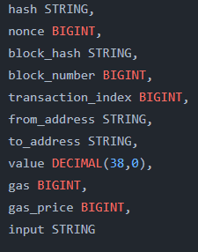
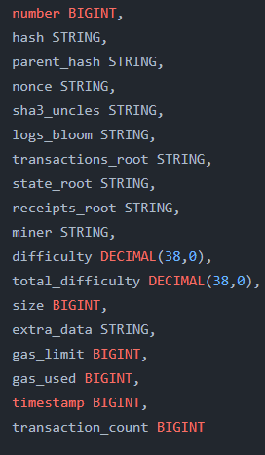
4. Dataset
The datasets used were taken from the Ethereum blockchain using GCP’s BigQuery API - Transactions and Blocks.
The two main entities which affect the gas price are blocks and transactions. We used the BigQuery API to join the blocks and transactions dataset and get the relevant features.
4.1 Description
A block contains various transaction and every transaction has a related gas price and gas used.
The BigQuery API had two tables with the following schemas:
Transaction schema 2. Block schema
It consists of 1.1 million transactions that took place from 00:00:02 UTC to 23:59:38 UTC, July 3, 2021. The total number of unique blocks processed during this time is 6357.
The dataset consists of 200,000 entries and 18 attributes.

Slide 7
4. Dataset
3. Final dataset
We combined both these datasets to obtain our required dataset. The SQL query used to obtain the same is:
SELECT
BLOCKS.number, BLOCKS.difficulty, BLOCKS.total_difficulty, BLOCKS.size, BLOCKS.gas_limit, BLOCKS.transaction_count, TRANSACTIONS.value, TRANSACTIONS.gas, TRANSACTIONS.gas_price
FROM
`bigquery-public-data.crypto_ethereum.blocks` AS BLOCKS
INNER JOIN
`bigquery-public-data.crypto_ethereum.transactions` AS TRANSACTIONS
ON
BLOCKS.number = TRANSACTIONS.block_number
WHERE
DATE(BLOCKS.timestamp) = '2021-07-03'

Slide 8
4. Dataset
The final dataset consists of 12 attributes:
number: the block number
difficulty: Integer of difficulty of the block
total difficulty: Integer of the total difficulty of the chain until this block.
size: the size of the block
value: amount of ETH to transfer from sender to recipient.
gas: to the unit that measures the amount of computational effort required to execute specific operations on the Ethereum network.
gas_price: the price we are paying for every unit of gas used in the transaction.
gas_limit: the max amount of gas units that can be consumed by the transaction.
transaction_count: the number of transactions in the block.
The attributes that affect gas price are:
tx_gas_limit: it affects whether a transaction would be mined or not
difficulty: it affects the ease of mining blocks, thus an increase in difficulty would lead to higher gas prices. It has a positive correlation with gas price

Slide 9
4. Dataset
4.2 Dropping Columns
The following columns were dropped from the transaction dataset while forming the final dataset since they were unrelated to the prediction of gas price:
hash, transaction index, sender and receiver addresses
block hash, block number, nonce, input.
The following columns were dropped from the block dataset while forming the final dataset since they were unrelated to the prediction of gas price:
number, hash, parent_hash, sha3_uncles, transaction_root, transaction_count
state_root, miner, recipients_root, nonce, extra_date, timestamp
The following columns were dropped from the Final dataset:
total_difficulty: the integer of total difficulty of the chain until this block. We later realized that this feature doesn’t play an important role in determining gas price.
value: while training the models, we noticed that there were big values in this attribute that didn’t really play a huge role in training.
gas_price: this was dropped because we are trying to predict min gas price we should pay so that it gets included in the block and this attribute denotes the transaction gasPrice which we won’t have access to.

Slide 10
4. Dataset
4.3 Feature Engineering
4.3.1 Handling NULL/Zero values
The entries which had their gas_price = 0 were removed from the table. Replacing it with mean values would not have been correct and would have hindered the predicting process.
4.3.2 Feature addition
Firstly, we grouped the data by number (block number). Next, for every block number, we find the minimum, mean and maximum gas prices and store these.
Next, for each block, we make 3 new features → past_min, past_mean, and past_max.
past_min: contains the mean of the minimum gas price for past 5 blocks.
past_mean: contains the mean of the mean gas price for past 5 blocks.
past_max: contains the mean of the maximum gas price for past 5 blocks.
For each transaction, past_min, past_mean and past_max were appended based on the block number.
4.3.3 Dataset Scaling
We standardized the input data using StandardScaler so that the model is not skewed due to absolute values.

Slide 11
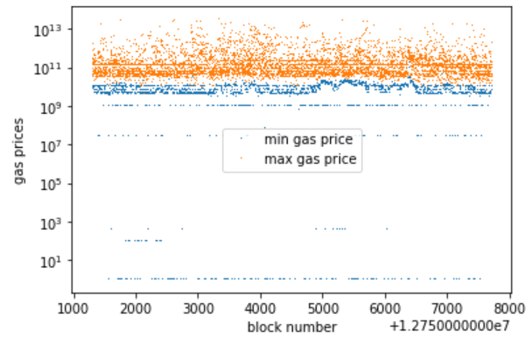
4. Dataset
4.4 Preparing Training and Testing Data
We split the dataset in a 7:3 ratio using Sklearn train_test_split.
4.5 Dataset Analysis
We conducted some operations on the data so as to get a better
understanding of the dataset.
In Fig. 4.5.1, we can see that there exists a gap between the minimum
and maximum gas price for a particular block, so we can infer that it
is possible to predict an apt gas price within this range that will lead
to our transaction being included in the block.
Fig 4.5.1

Slide 12
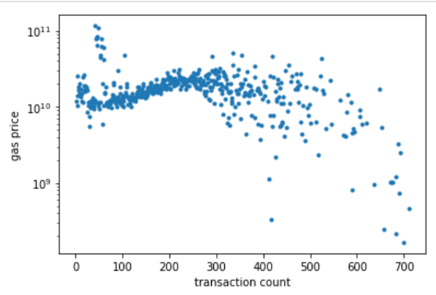
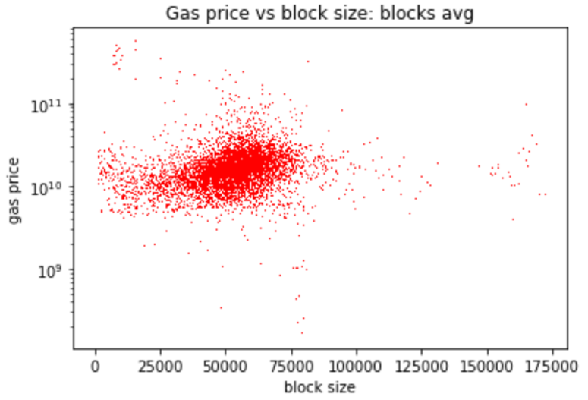
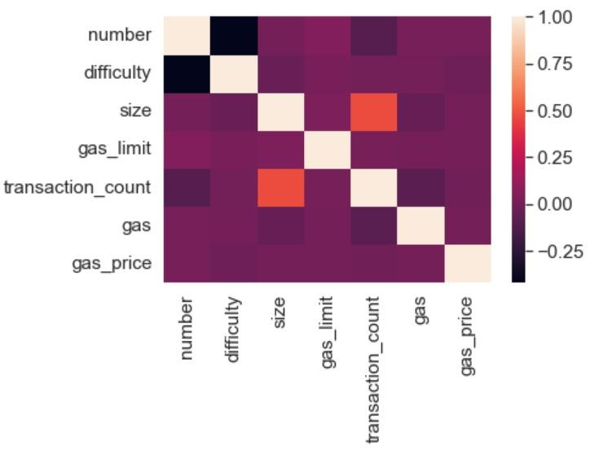
4. Dataset
In Fig. 4.5.2 and 4.5.3, we can see that there does not exist a strong relationship between the block size and transaction count to the gas price, so we need to find a more complex linear relationship using Regression techniques that can accurately predict the gas price.
Fig 4.5.4 shows the correlation of different attributes of the final dataset with each other, lighter to darker color shows higher to lower correlation.
Fig 4.5.2
Fig 4.5.3
Fig 4.5.4

Slide 13
5. Methodology
5.1 Models:
We trained our dataset on the following machine learning models:
5.1.1 Linear Regression (Simple, Ridge, Lasso Regression)
We used simple regression with default values, grid search using negative RMSE for both lasso and ridge regression.
5.1.2 Random Forest
Implemented default random forest model, grid search using negative RMSE.
5.1.3 ADABoost
We used the default ADAboost model.
5.1.4 Neural Network
We used a neural network with 4 layers, the first 3 have activation ReLu, and the last has a linear activation function, loss -> MSE and metric -> MSE.
5.1.5 XG Boost
We implemented XG Boost with grid search.

Slide 14
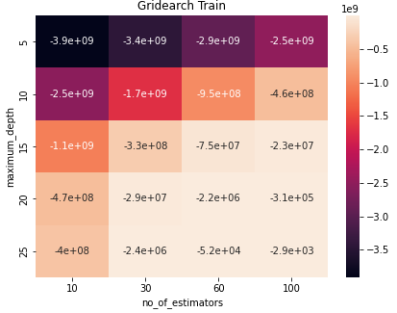

5. Methodology
For comparison among these models we are using the following criteria:
RMSE (Root Mean Square Error)
MAE (Mean Absolute Error)
R2 Score
Accuracy
Fig 5.1: XGBoost Grid Search on training data
Fig 5.2: XGBoost Grid Search on testing data

Slide 15
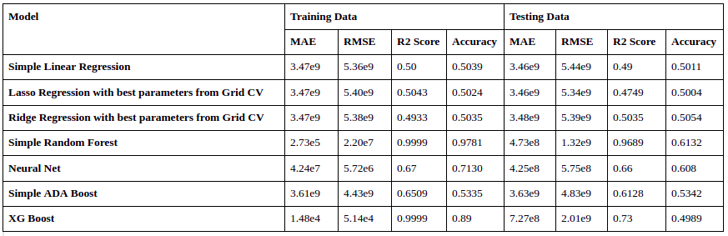
6. Analysis and Results:
6.1 Results

Slide 16
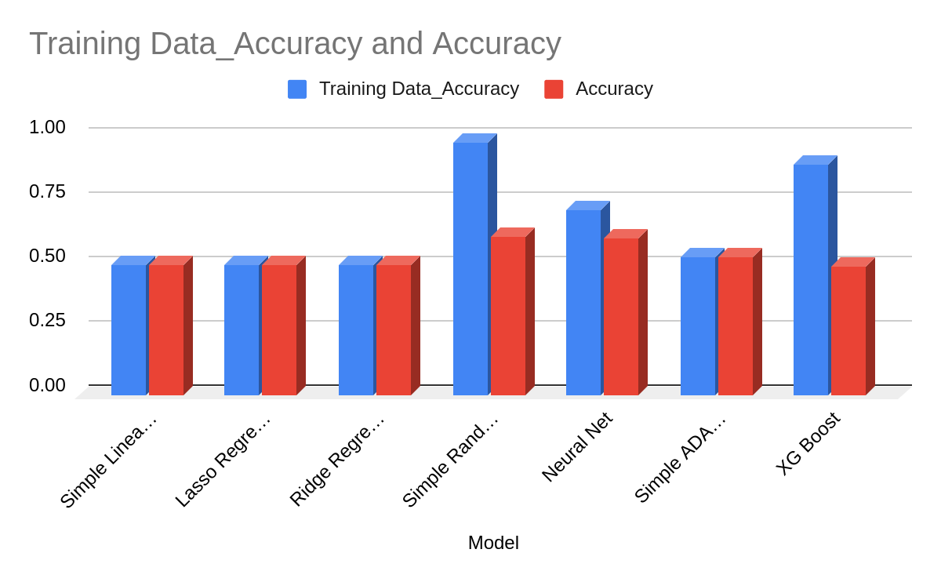
6. Analysis and Results:

Slide 17
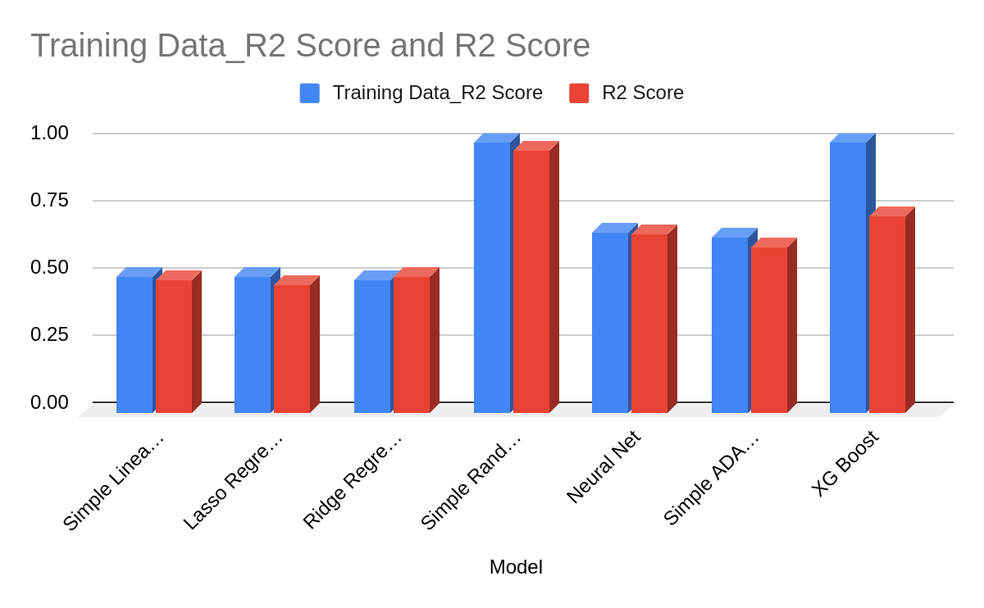
6. Analysis and Results:

Slide 18
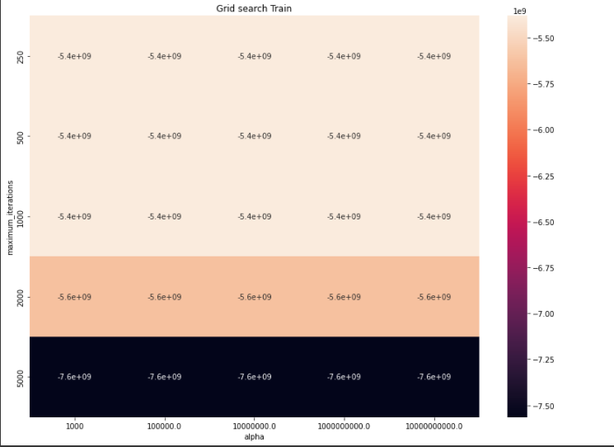
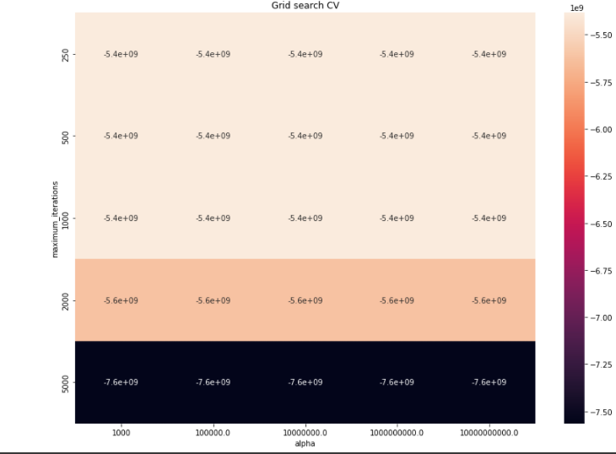
6. Analysis and Results:
6.1 Results
Fig 6.2.1: Heat map of negative root mean squared error on training data while using Grid Search CV with Lasso Regressor as the parameter
Fig 6.2.2: Heat map of Negative root mean squared error of testing data while cross-validation using grid search with Lasso Regressor as the parameter.

Slide 19
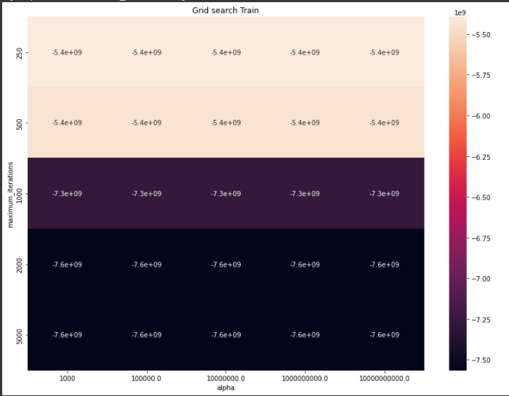
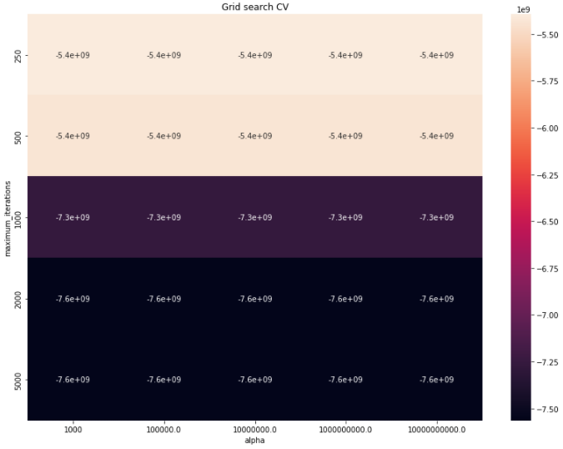
6. Analysis and Results:
Fig 6.2.3: Heat map of negative root mean squared error on training data while using Grid Search CV with Ridge Regressor as the parameter
Fig 6.2.4: Heat map of Negative root mean squared error of testing data while cross-validation using grid search with Ridge Regressor as the parameter.

Slide 20
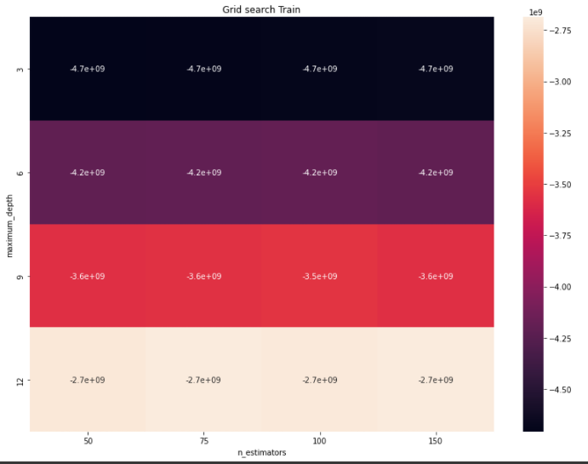
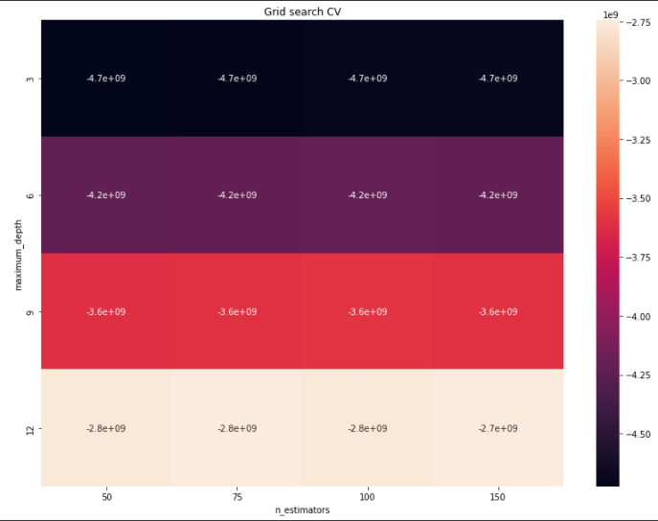
6. Analysis and Results:
Fig 6.2.5: Heat Map of Negative root mean squared error of training data while cross-validation using grid search with Random Forest
Fig 6.2.6: Heat Map of Negative root mean squared error of testing data while cross-validation using grid search with Random Forest

Slide 21
6. Analysis and Results:
In our analysis, we thoroughly examined and observed a few different Machine learning models (listed in section 5.1) to predict the gas price of ethereum. Linear Regression gave us low accuracy on training and testing data. The Random Forest and Neural network models perform the best with accuracy 0.6132 and 0.608 respectively.
Overall, Random Forest gave us the best accuracy.

Slide 22
7. Conclusion
We started by learning about Ethereum, how it functions, etc. We understood the importance of its application in today’s world and thus the need of predicting the lowest reasonable gas price for a block. Afterward, we critically analyzed our data, which initially consisted of 2 different datasets for transactions and blocks. We studied their features and combined the two datasets, dropped columns that didn’t affect the prediction process, dropped rows with incomplete data, and added more features that could help us make predictions. We trained some models like Linear Regression (Ridge and Lasso), Random Forest, Neural Network, ADA Boost, and XG Boost. From our results, Random Forest performed the best. Neural Network also performed well followed by ADABoost and Linear Regression.

Slide 23
References
[1] Fangxiao Liu, Xingya Wang*, Zixin Li, Jiehui Xu, Yubin Gao.(2019). Effective GasPrice Prediction for Carrying Out Economical Ethereum Transaction.
[2] Sam M. Werner, Paul J. Pritz, and Daniel Perez. (2020). Step on the Gas? A Better Approach for Recommending the Ethereum Gas Price.
[3] Vinicius C. Oliveira, Julis Almeida Valadares, Jose Edurado A. Sousa, Alex Borges Vieira, Heder Soares Bernardino, Saulo Moraes Villela.(2021).Analyzing Transaction Confirmation in Ethereum Using Machine Learning Techniques.
[4] Matthew Chen, Neha Narwal, and Mila Schultz.Predicting Price Changes in Ethereum.

Slide 24
Individual Contribution:
Motivation: Rupanshoo
Literature review: Pragya
Dataset fetching: Aryan
Data Preprocessing: Rupanshoo & Saatvik
Methodology: Aryan & Saatvik
Analysis, Results and Conclusion: Saatvik, Aryan and Rupanshoo

