Slide 1
COMP 1451
Introduction to Software Development 2
Session 2
Notes:
Objects First with Java
© David J. Barnes and Michael Kölling

Slide 2
Libraries
Using library classes to implement some more advanced functionality
email: pmills5@learn.bcit.ca
Notes:
Objects First with Java
© David J. Barnes and Michael Kölling
Objects First with Java
© David J. Barnes and Michael Kölling

Slide 3
Main concepts to be covered
Using library classes
Reading documentation
email: pmills5@learn.bcit.ca
Notes:
Objects First with Java
© David J. Barnes and Michael Kölling
Objects First with Java
© David J. Barnes and Michael Kölling

Slide 4
The Java class library
Thousands of classes.
Tens of thousands of methods.
Many useful classes that make life much easier.
Library classes are often inter-related.
Arranged into packages.
email: pmills5@learn.bcit.ca
Notes:
Objects First with Java
© David J. Barnes and Michael Kölling
Objects First with Java
© David J. Barnes and Michael Kölling

Slide 5
Working with the library
A competent Java programmer must be able to work with the libraries.
You should:
  know some important classes by name;
  know how to find out about other classes.
Remember:
  we only need to know the interface, not the implementation.
email: pmills5@learn.bcit.ca
Notes:
Objects First with Java
© David J. Barnes and Michael Kölling
Objects First with Java
© David J. Barnes and Michael Kölling

Slide 6
Reading class documentation
Documentation of the Java libraries in HTML format;
Readable in a web browser
Class API: Application Programmers’ Interface
Interface description for all library classes
email: pmills5@learn.bcit.ca
Notes:
Objects First with Java
© David J. Barnes and Michael Kölling
Objects First with Java
© David J. Barnes and Michael Kölling

Slide 7
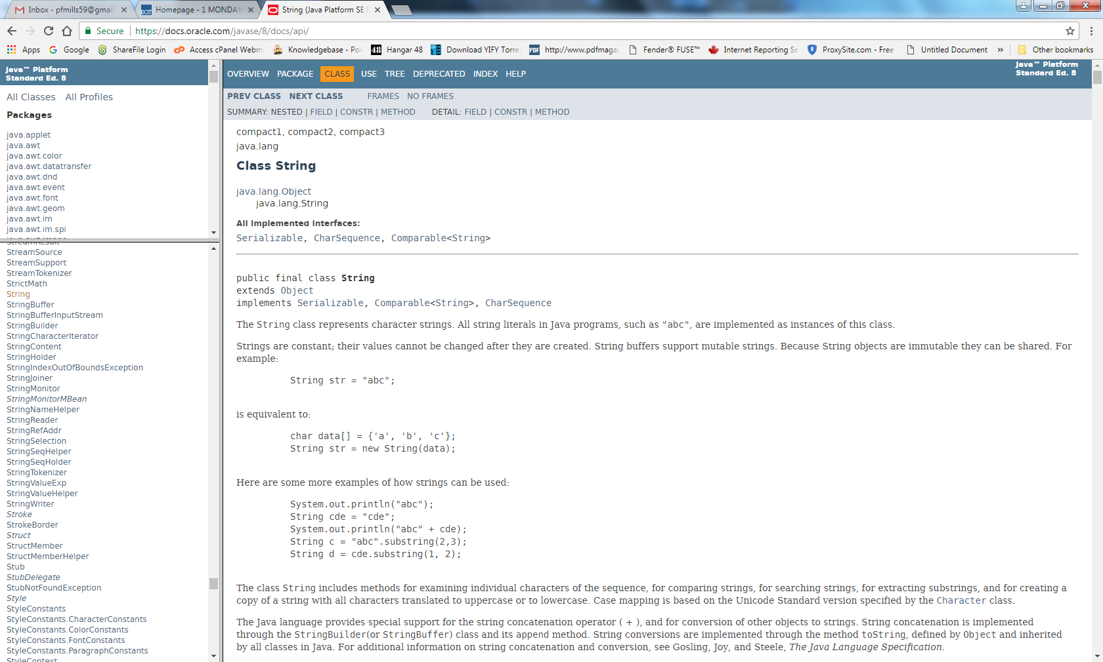
email: pmills5@learn.bcit.ca
Notes:
Objects First with Java
© David J. Barnes and Michael Kölling

Slide 8
Interface vs implementation
The documentation includes
the name of the class;
a general description of the class;
a list of constructors and methods
return values and parameters for constructors and methods
a description of the purpose of each constructor and method
the interface of the class
email: pmills5@learn.bcit.ca
Notes:
Objects First with Java
© David J. Barnes and Michael Kölling
Objects First with Java
© David J. Barnes and Michael Kölling

Slide 9
Interface vs implementation
The documentation does not include
private fields (most fields are private)
private methods
the bodies (source code) of methods
the implementation of the class
email: pmills5@learn.bcit.ca
Notes:
Objects First with Java
© David J. Barnes and Michael Kölling
Objects First with Java
© David J. Barnes and Michael Kölling

Slide 10
Documentation for startsWith
startsWith method
  public boolean startsWith(String prefix)
Tests if this string starts with the specified prefix.
Parameters:
  prefix - the prefix of a String.
Returns:
  true if the …; false otherwise
email: pmills5@learn.bcit.ca
Notes:
Objects First with Java
© David J. Barnes and Michael Kölling

Slide 11
Using library classes
Classes organized into packages.
Classes from the library must be imported using an import statement (except classes from the java.lang package).
They can then be used like classes from the current project.
email: pmills5@learn.bcit.ca
Notes:
Objects First with Java
© David J. Barnes and Michael Kölling
Objects First with Java
© David J. Barnes and Michael Kölling

Slide 12
More sophisticated behavior
Using library classes to implement some more advanced functionality
email: pmills5@learn.bcit.ca
Notes:
Objects First with Java
© David J. Barnes and Michael Kölling
Objects First with Java
© David J. Barnes and Michael Kölling

Slide 13
Main concepts to be covered
Further library classes
  Set
  Map
Writing documentation
  javadoc
email: pmills5@learn.bcit.ca
Notes:
Objects First with Java
© David J. Barnes and Michael Kölling
Objects First with Java
© David J. Barnes and Michael Kölling

Slide 14
Using sets
import java.util.HashSet;
...
HashSet<String> mySet = new HashSet<String>();
mySet.add("one");
mySet.add("two");
mySet.add("three");
for(String element : mySet) {
do something with element
}
Compare with code for an ArrayList!
email: pmills5@learn.bcit.ca
Notes:
Objects First with Java
© David J. Barnes and Michael Kölling
Objects First with Java
© David J. Barnes and Michael Kölling

Slide 15
Maps
Maps are collections that contain pairs of values.
Pairs consist of a key and a value.
Lookup works by supplying a key, and retrieving a value.
Example: a telephone book.
email: pmills5@learn.bcit.ca
Notes:
Objects First with Java
© David J. Barnes and Michael Kölling
Objects First with Java
© David J. Barnes and Michael Kölling

Slide 16
Using maps
A map with strings as keys and values
:HashMap
"Charles Nguyen"
"(531) 392 4587"
"Lisa Jones"
"(402) 536 4674"
"William H. Smith"
"(998) 488 0123"
email: pmills5@learn.bcit.ca
Notes:
Objects First with Java
© David J. Barnes and Michael Kölling
Objects First with Java
© David J. Barnes and Michael Kölling

Slide 17
Using maps
HashMap <String, String> phoneBook =
new HashMap<String, String>();
phoneBook.put("Charles Nguyen", "(531) 9392 4587");
phoneBook.put("Lisa Jones", "(402) 4536 4674");
phoneBook.put("William H. Smith", "(998) 5488 0123");
String phoneNumber = phoneBook.get("Lisa Jones");
System.out.println(phoneNumber);
email: pmills5@learn.bcit.ca
Notes:
Objects First with Java
© David J. Barnes and Michael Kölling
Objects First with Java
© David J. Barnes and Michael Kölling

Slide 18
public vs private
Public elements are accessible to objects of other classes:
  Fields, constructors and methods
Fields should not be public.
Private elements are accessible only to objects of the same class.
Only methods that are intended for other classes should be public.
email: pmills5@learn.bcit.ca
Notes:
Objects First with Java
© David J. Barnes and Michael Kölling
Objects First with Java
© David J. Barnes and Michael Kölling

Slide 19
Information hiding
Data belonging to one object is hidden from other objects.
Know what an object can do, not how it does it.
Information hiding increases the level of independence.
Independence of modules is important for large systems and maintenance.
email: pmills5@learn.bcit.ca
Notes:
Objects First with Java
© David J. Barnes and Michael Kölling
Objects First with Java
© David J. Barnes and Michael Kölling

Slide 20
Splitting Strings
public HashSet<String> getInput()
{
System.out.print("> ");
String inputLine =
reader.nextLine().trim().toLowerCase();
String[] wordArray = inputLine.split(" ");
HashSet<String> words = new HashSet<String>();
for(String word : wordArray) {
words.add(word);
}
return words;
}
email: pmills5@learn.bcit.ca
Notes:
Objects First with Java
© David J. Barnes and Michael Kölling
Objects First with Java
© David J. Barnes and Michael Kölling

